Slide 1
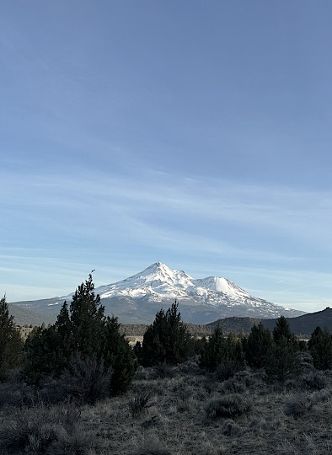
November 10, 2026
Siskiyou County Groundwater Sustainability Agency: SGMA Update

Slide 2
Agenda
GSP Periodic Evaluations (due January 2027)
Current Conditions
Data & Projects
Funding
Regulatory Processes: Scott River Adjudication, SWRCB, and Regional Board

Slide 3
GSP Periodic Evaluations

Slide 4
GSP PERIODIC EVALUATIONS
Periodic Evaluations Due January 2027
The GSA will submit Periodic Evaluations (PEs) for the Butte, Scott, and Shasta Valley GSPs to DWR in January 2027, covering WY2021–2025
SGMA requires a PE of each GSP every 5 years (23 CCR §356.4); these are the first PEs for the three Siskiyou County basins
Each PE reports on implementation progress: new data and information, groundwater conditions relative to Sustainable Management Criteria (SMCs), status of Projects and Management Actions (PMAs), and updates to the basin setting
PEs document how the GSA has responded to DWR’s GSP determinations and Recommended Corrective Actions
Schedule: draft PEs released for Advisory Committee and public review November→ comments incorporated → final PEs submitted through the SGMA Portal in late January 2027
Tulelake GSA: County Board of Supervisors sits as GSA for Tulelake Subbasin
  Consultants are working on a plan amendment and will have a draft to the GSA’s in early January

Slide 5
GSP PERIODIC EVALUATIONS
How the GSA Is “In Compliance” with SGMA
DWR Determinations
Annual Reports
Periodic Evaluations
All GSPs approved with some recommended corrective actions which are addressed in the Periodic Evaluation.
Annual Reports submitted to DWR by April 1 each year, WY2021 through WY2025
On track for January 2027 submittal; respond to DWR corrective actions
Monitoring Networks
Projects and Management Actions
Public Engagement
Groundwater level, interconnected surface water, and water quality monitoring expanded; data reported to the SGMA Portal (some modification to networks included in the Periodic Evaluation).
Recharge, well inventory, upland management studies and other PMAs being implemented
Regular Advisory Committee meetings in each basin.

Slide 6
Current Conditions: Scott Valley groundwater levels

Slide 7
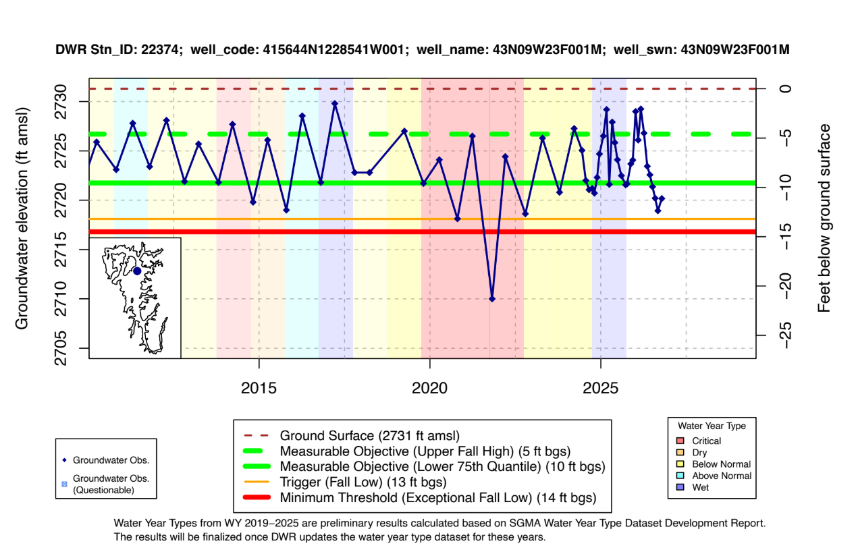
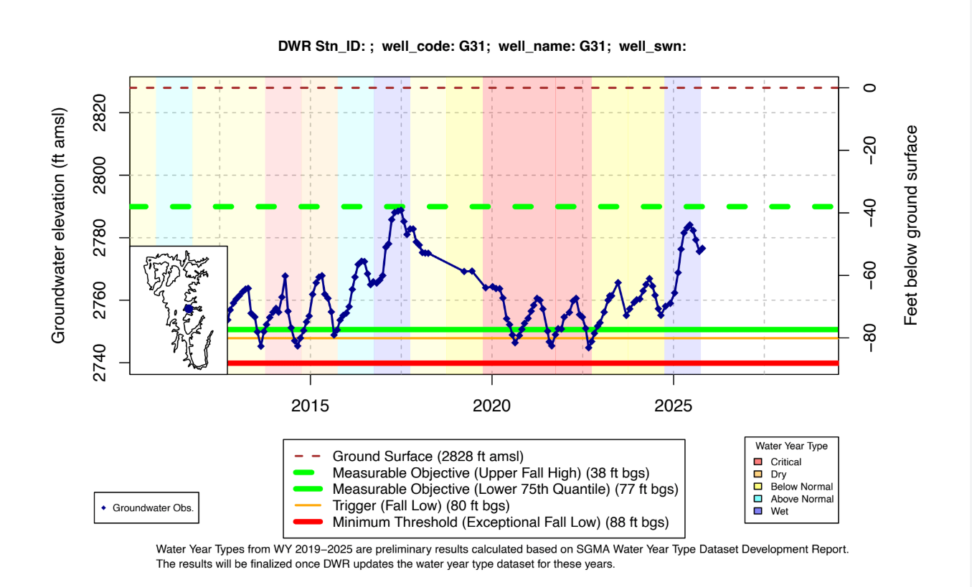
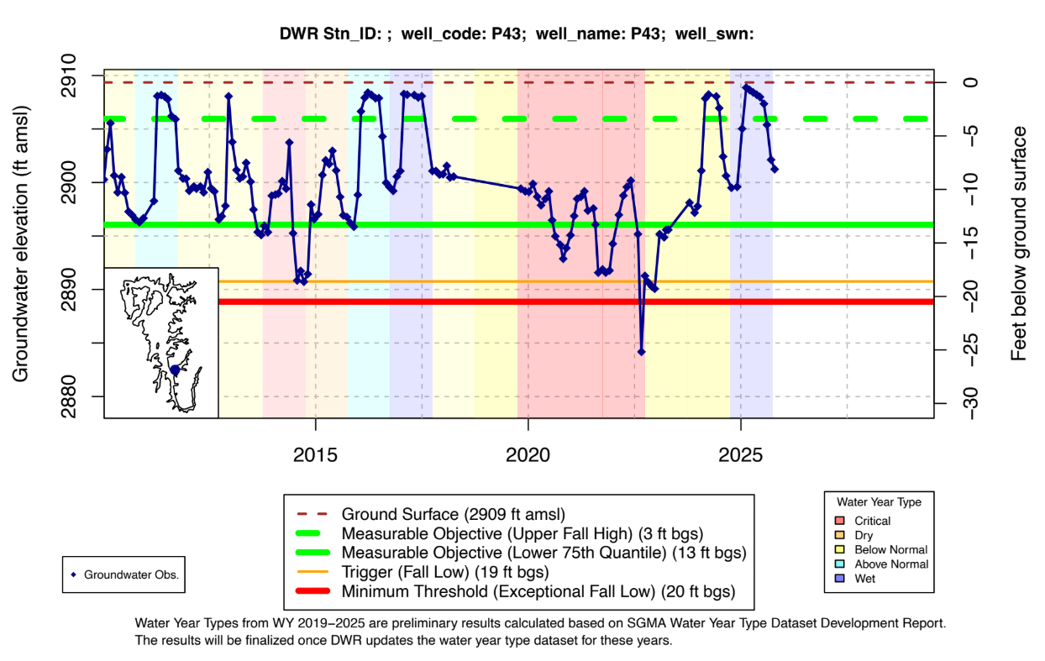
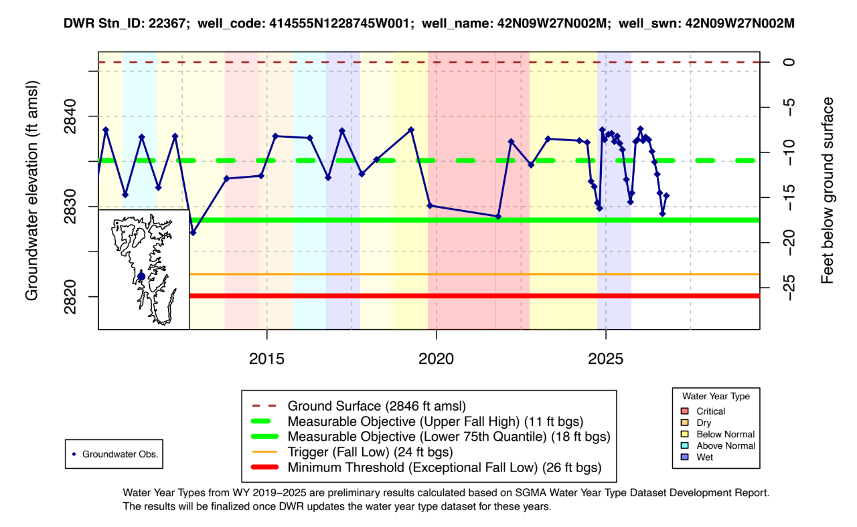

Slide 8
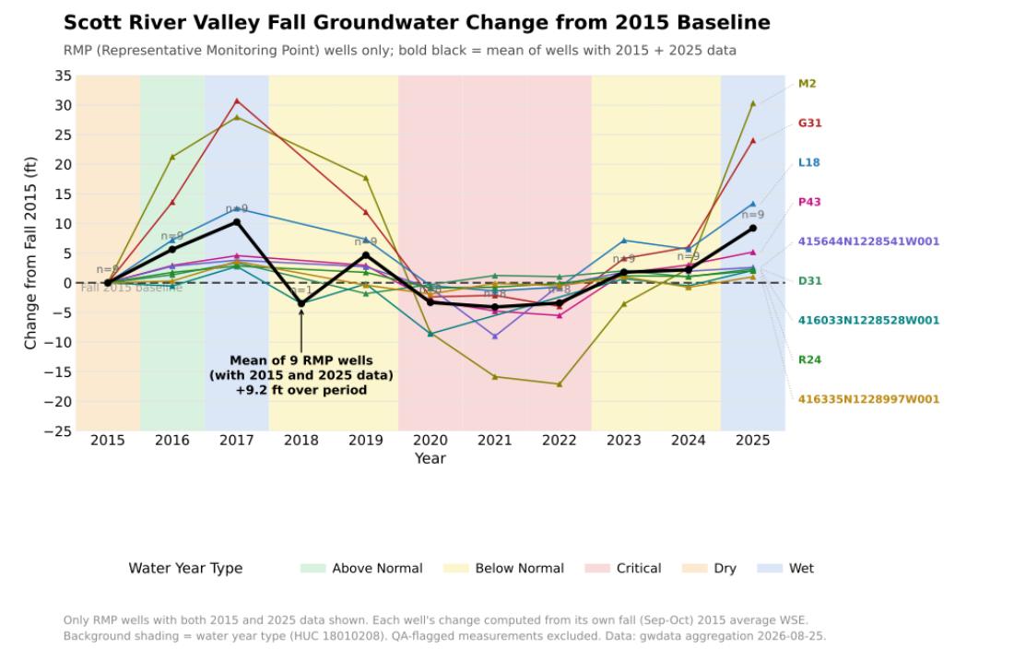

Slide 9
Current Conditions: Shasta Valley

Slide 10
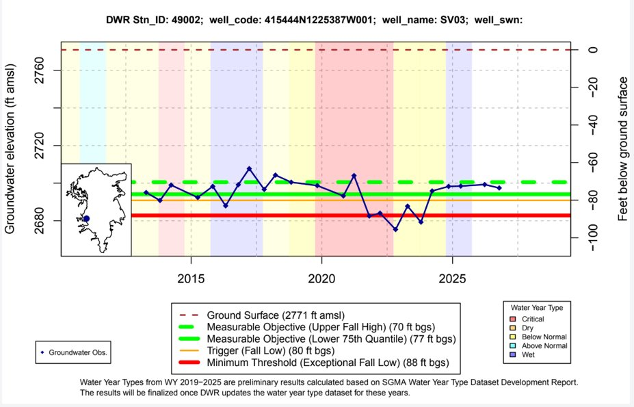
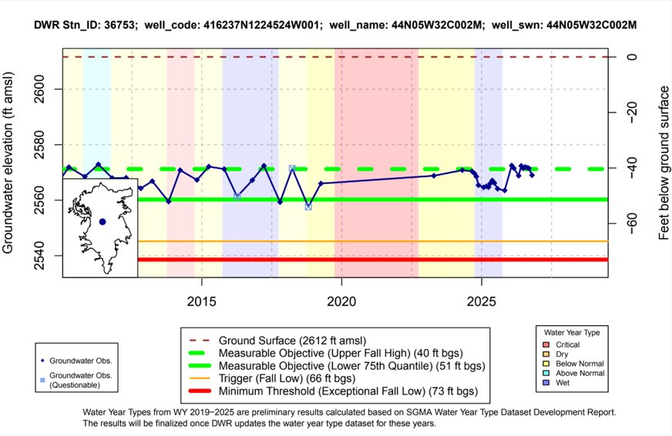
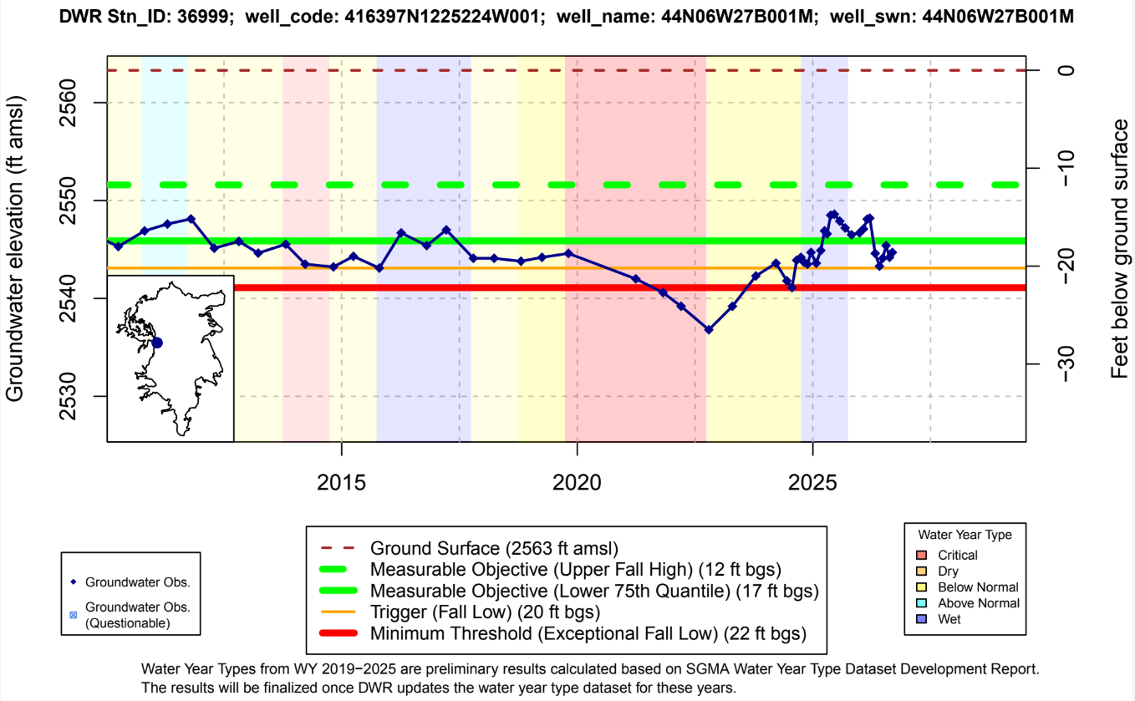
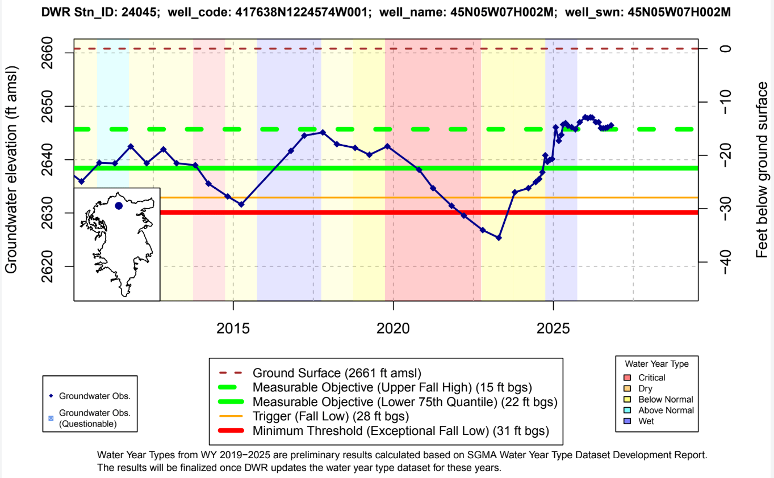

Slide 11
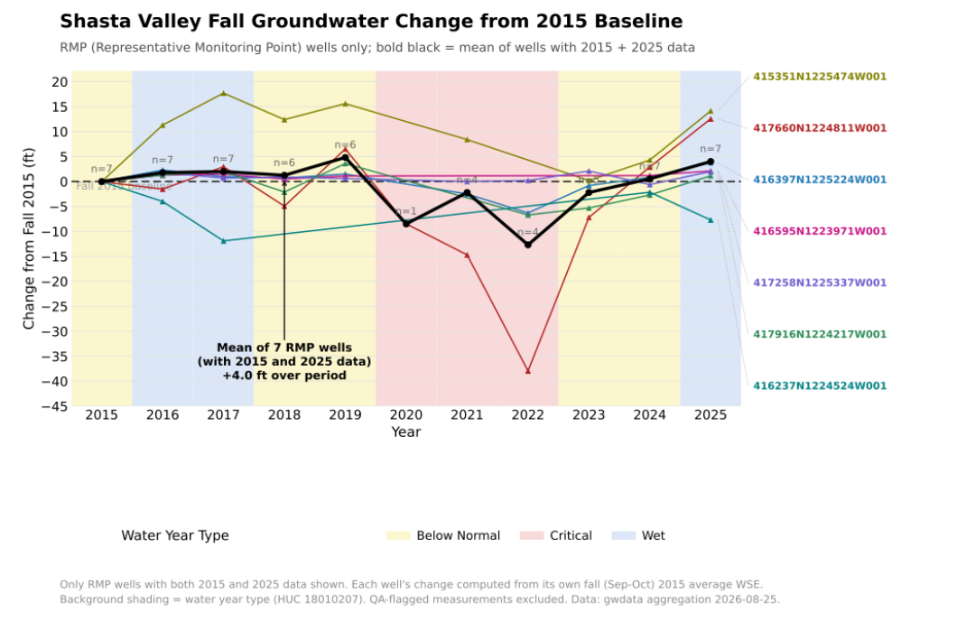

Slide 12
Current Conditions: Butte Valley groundwater levels

Slide 13
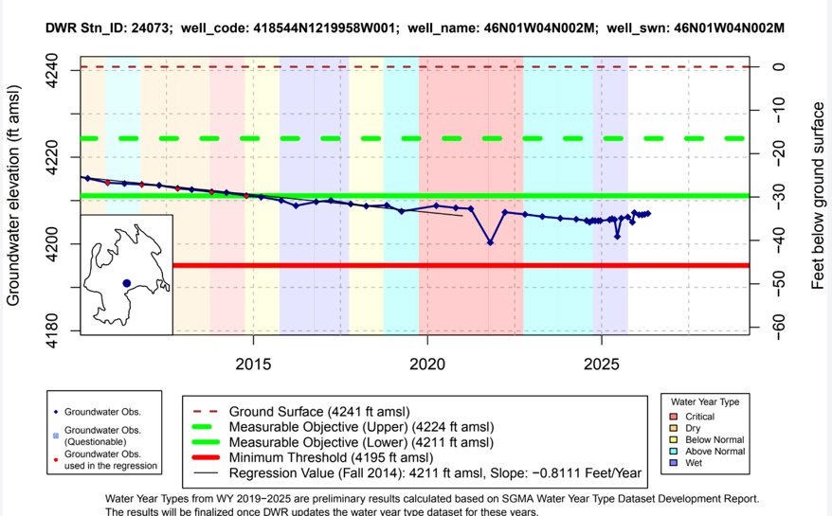
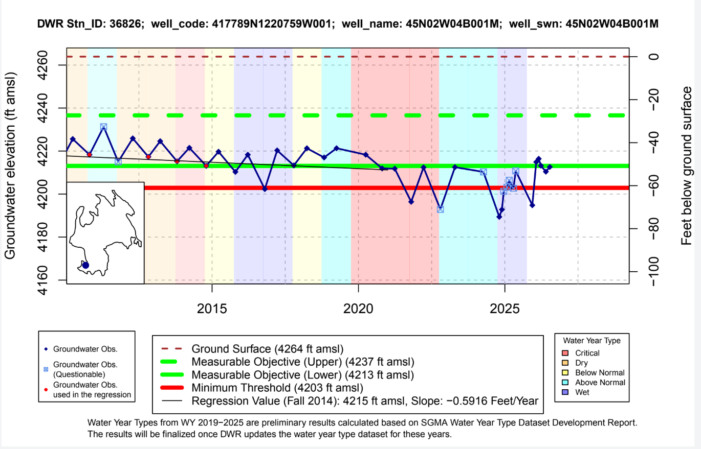
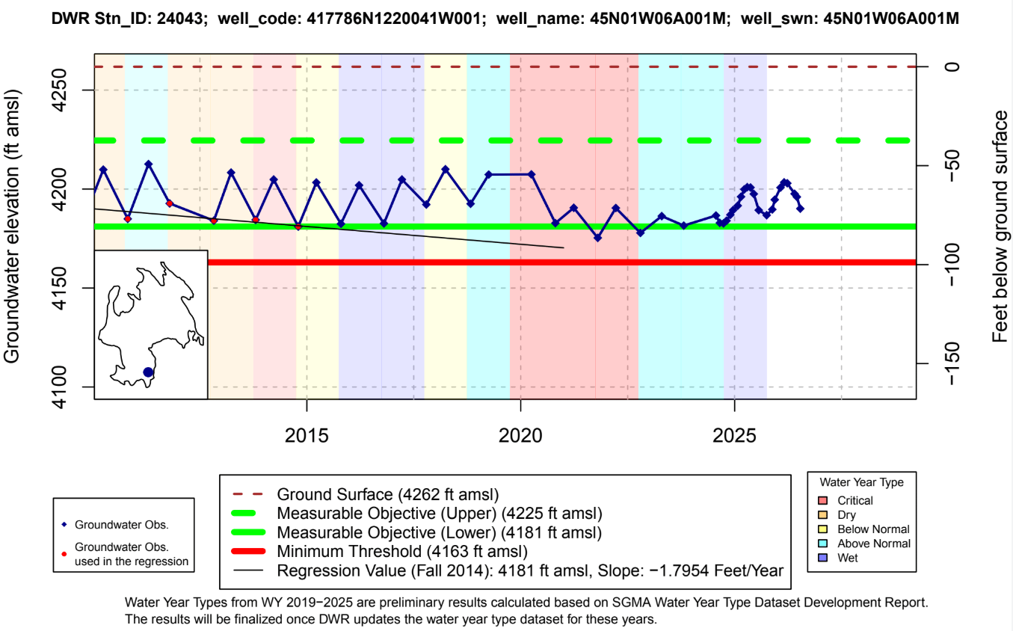
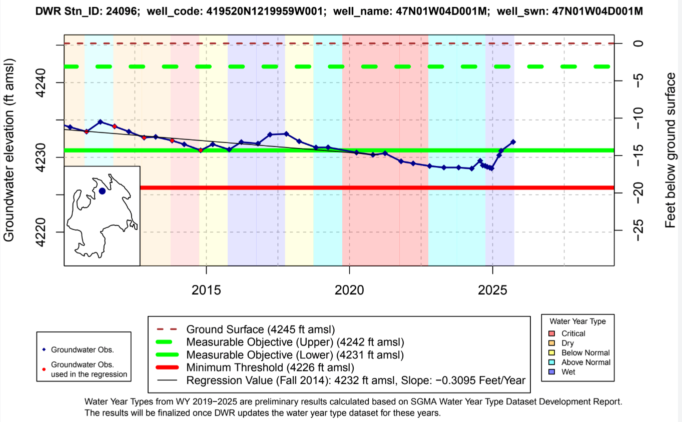

Slide 14
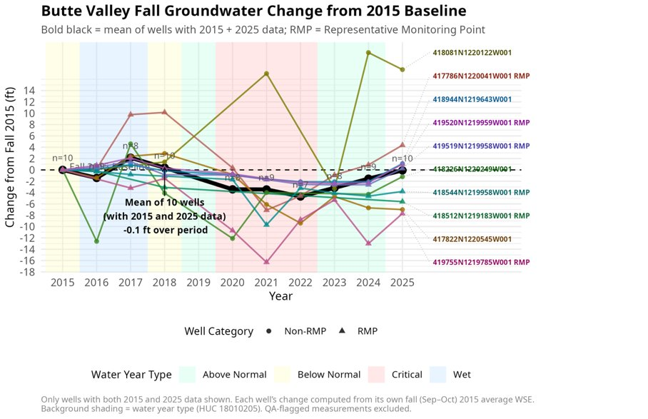

Slide 15
Data and Projects: Scott, Shasta and Butte Valley
New Data & Developments Since GSP Submittal
Status of Existing & Ongoing Projects and Management Actions

Slide 16




SCOTT VALLEY
Projects & Progress Since the 2022 Groundwater Plan
Storing water underground
Working with landowners
Protecting wells
Groundwater recharge project
Winter river water is spread on fields and through irrigation ditches to refill groundwater. A 5-year permit was secured in 2025.
Upland management study
Testing whether thinning juniper and brush could leave more water for streams.
Voluntary land repurposing
Farmers paid to rest fields: 781 acres in 2024 and 3,309 acres in 2025. Grant-funded, led by the Farm Bureau.
Irrigation efficiency
Field stations measure how much water crops actually use. First results in 2026.
Community input
Advisory Committee meets quarterly.
Well inventory
Mapping where wells are, how they were built and which are active. Complete fall 2026.
Well risk assessment
Identifies which wells could go dry in a drought.
New well permits
Reviewed with the County for effects on streams.
Better information behind decisions
Groundwater model
Updated every year to test “what if” scenarios.
More monitoring
Well levels, stream and ditch flows, and rain gauges.
Underground mapping
New airborne survey of the geology beneath the valley.

Slide 17
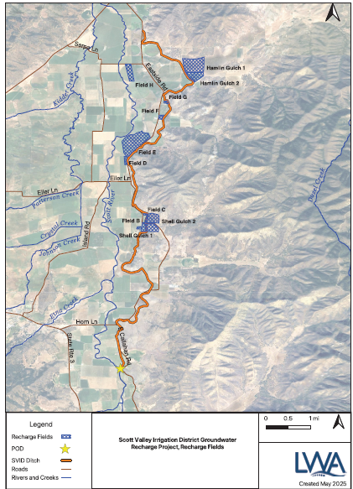
PROJECTS – SCOTT VALLEY
SVID Groundwater Recharge Project
Major Accomplishments
BY THE NUMBERS
Amount of water diverted from Scott River into SVID irrigation ditch.
5-year temporary permit secured
TP21482 issued by the State Water Board in December 2025, replacing the one-season permits SVID renewed annually from 2023 through 2025
DIVERTED BY SEASON (AF)
Recharge footprint expanded
From 3 fields (~15 acres) in 2023 to 10 sites (261 acres) in 2024, using on-farm recharge and infiltration along the unlined SVID ditch
2023
816
2024
2,539
2025
868
Groundwater response documented
Well SCT_786 next to Field B rose 17 ft during the 2024 season.
2026
2,053
Permit conditions and water quality
Diversions met Fort Jones (440 cfs) and 10%-of-flow bypass terms with no downstream injury claims; water quality sampled under a Regional Board low-threat waiver (2025)
Orange = first season under the 5-year permit.
Future Plans
Expansion into upland gulches based on model scenarios to optimize timing of recharge benefits to coincide with late summer and fall.

Slide 18
SHASTA VALLEY
Projects & Progress Since the 2022 Groundwater Plan
Storing water underground
Working with landowners
Protecting wells
Groundwater recharge pilot
Flooding pastures in the Grenada Irrigation District to raise groundwater and help keep household wells from going dry.
Upland management study
Testing whether thinning juniper and brush could leave more water for streams.
Voluntary land repurposing
Farmers paid to rest fields: 502 acres in 2024 and 1,660 acres in 2025. Grant-funded, led by the Farm Bureau.
Irrigation efficiency
Field stations measure how much water crops actually use. First results in 2026.
Community input
Advisory Committee meets quarterly.
Well inventory
Mapping where wells are, how they were built and which are active.
Well risk assessment
Identifies which wells could go dry in a drought.
New well permits
Reviewed with the County for effects on streams.
Better information behind decisions
Groundwater model
Updated every year; USED FOR SIMULATION OF MANAGEMENT SCENARIOS.
More monitoring
Well levels, water quality, streams and spring-fed habitats.
Underground mapping
Airborne survey refined the geology map (done 2025).

Slide 19
PROJECTS – SHASTA VALLEY
Shasta Valley Groundwater Recharge Project
Summary of Activities
BY THE NUMBERS
Neither permit was utilized to divert water from Shasta River to designated underground storage areas
Two 180-day temporary permits secured
TP21469 (WY25) and TP21484 (WY26) issued by the State Water Board to divert 5,000 and 3,426 af to underground storage, respectively
Emergency Exemption for CEQA
An emergency declaration exempted groundwater recharge projects from traditional CEQA pathways. This exemption was rescinded in 2026. Submission of application requires CEQA be completed
DIVERTED BY WATER YEAR (AF)
2025
0 / 5,000
2026
0 / 3,426
Additional Monitoring Equipment Installed
Installed a contactless stage sensor and flow measurements within GID’s lower ditch on the west side of I-5 to better understand recharge volumes
Challenges
Limited water availability
Terms of permits require 4 90th percentile events to pass before diversion can occur
Expensive permits with no guarantee of approval or ability to divert
2025-2026 Permit #T033516
90th percentile daily flows (cfs) Shasta R at USGS Yreka Gage. 12/1-3/31
Day | Dec | Jan | Feb | Mar | Day | Dec | Jan | Feb | Mar
1 | 300 | 387 | 591 | 651 | 17 | 456 | 706 | 650 | 496
2 | 337 | 371 | 554 | 630 | 18 | 432 | 774 | 660 | 485
3 | 401 | 382 | 547 | 587 | 19 | 367 | 625 | 623 | 495
4 | 369 | 451 | 640 | 540 | 20 | 409 | 772 | 602 | 477
5 | 403 | 446 | 591 | 594 | 21 | 473 | 692 | 637 | 432
6 | 331 | 435 | 595 | 545 | 22 | 438 | 698 | 586 | 466
7 | 324 | 398 | 655 | 514 | 23 | 384 | 585 | 584 | 491
8 | 311 | 448 | 699 | 515 | 24 | 378 | 523 | 599 | 539
9 | 335 | 451 | 615 | 562 | 25 | 379 | 522 | 577 | 571
10 | 354 | 433 | 625 | 510 | 26 | 382 | 563 | 586 | 508
11 | 368 | 457 | 657 | 514 | 27 | 427 | 560 | 558 | 496
12 | 383 | 424 | 629 | 516 | 28 | 462 | 543 | 587 | 481
13 | 368 | 435 | 593 | 474 | 29 | 477 | 547 | 570 | 484
14 | 384 | 526 | 614 | 471 | 30 | 478 | 572 |  | 465
15 | 383 | 568 | 553 | 459 | 31 | 474 | 547 |  | 506
16 | 432 | 694 | 588 | 456
Future Plans
Pursue additional funding to cover cost of supporting hydrologic analysis, environmental compliance, and permit fees
Explore alternatives to expensive 180-day temporary diversion permits
Improve understanding of hydrologic, biologic, and fluvial geomorphologic needs within the Shasta River

Slide 20
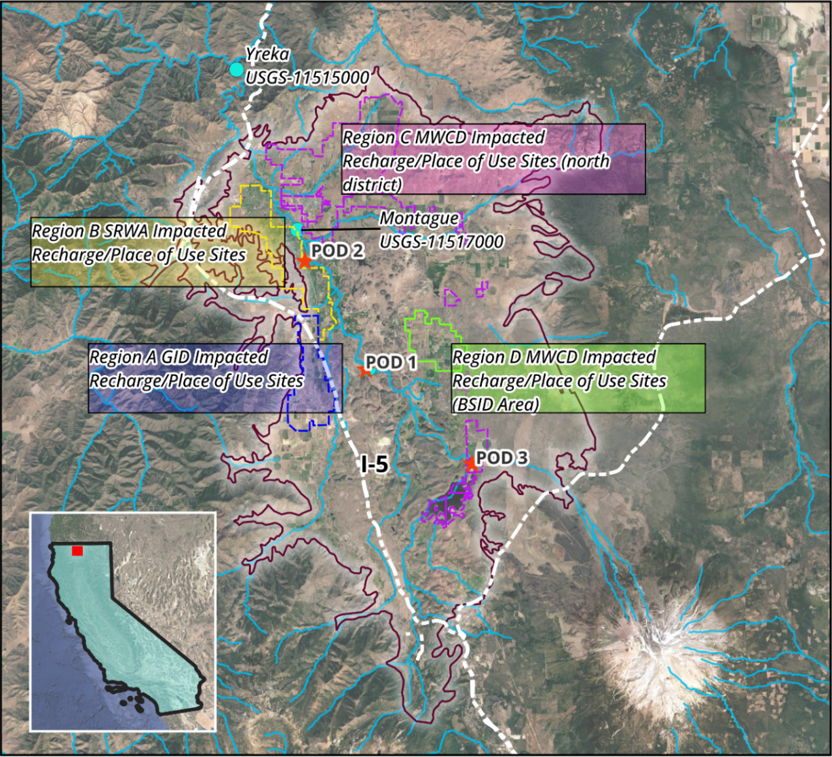
PROJECTS – SHASTA VALLEY
Shasta Valley Groundwater Recharge Project – Potential Recharge Regions

Slide 21
BUTTE VALLEY
Projects & Progress Since the 2022 Groundwater Plan
Planning for water use
Working with landowners
Protecting wells
Groundwater allocation options
Modeling “what if” options such as resting fields or reducing demand. Discussed with the Advisory Committee; no program adopted yet.
Meiss Lake investigation
New monitoring wells and a lake level gauge (started 2026) to learn how the lake and groundwater are connected.
Irrigation efficiency
6 alfalfa farms (about 720 acres) are switching to lower, more efficient sprinklers plus soil moisture sensors.
Community input
Advisory Committee meets quarterly, with targeted outreach on monitoring, fees, irrigation and wells.
Well inventory
Mapping where wells are, including household wells located through 911 addresses.
Well risk assessment
Identifies which wells could go dry in a drought.
Better information behind decisions
Groundwater model
Rebuilt with more detailed geology and better farm water-use estimates.
More monitoring
29 real-time wells, 7 stream gauges and water quality sampling.
Underground mapping
Airborne survey completed; the basin is still managed as one aquifer.

Slide 22
Butte Valley: Irrigation Efficiency Evaluation
12 Operations were scouted for participation, 6 operations will participate (all alfalfa)
Participants will receive new LESA emitter package, lower elevation of emitters (48” above ground), and soil moisture sensors (CropX multi-depth).
720 acres in total
Previous irrigation methods were Center Pivot MESA, or Mid Elevation Sprinkled Application
Subcontracted through InterMountain Ag
Improvements completed in Spring 2026

Slide 23
FUNDING
DWR SGM Implementation Grant Timeline
DWR Sustainable Groundwater Management (SGM) Implementation Grant funds annual reporting, PE preparation, model updates, monitoring expansion, fee studies and economic evaluation, recharge projects and upland management studies
Implementation progress tracked by grant component; work wraps up for Scott and Shasta in December 2026.
1
2
3
4
2024 – 2026
Implementation
Monitoring, modeling, well inventory, fee and economic studies, and PE preparation
December 2026
Grant work complete
Remaining grant-funded tasks completed for Butte (May 2026), Shasta and Scott Valleys (December 2026)
January 2027
Closeout
Final invoicing and grant completion report to DWR
Next grant???
· Grant-funded tasks wrap up as the PEs are submitted

Slide 24
FUNDING
Future Grant Funding
Program | Project / Scope | Status
WaterSMART Drought Response | Expand SVID managed aquifer recharge to upland gulch sites (Scott) | Submitted – pending
WCB Streamflow Enhancement | Scott Valley In-Lieu Recharge project | Not selected
WaterSMART Applied Science | Shasta Valley data collection, spring tracer study, and Big Springs submodel Building a Better Butte: Applied Science for Groundwater Sustainability Siskiyou Flood Control and Water Conservation District | Submitted – pending
Prop 4 SGM Implementation | Concept proposals expected early 2027 | Upcoming
Prop 4 Watershed Resilience | Watershed Resilience Program grants | Upcoming
DWR / NFWF / USFWS | DWR: 5-year recharge permit; NFWF and USFWS: Montague / Big Springs area | Upcoming
National Fisha and Wildlife Foundation | Funding awarded for SVID Recharge Project, through Farm Bureau | Active

Slide 25
FUNDING
Fee Studies and Economic Analysis
WHY IT MATTERS
Long-term funding for SGMA compliance after grant funding ends
Evaluates fee and rate options to pay for monitoring, reporting, PEs, and GSP implementation
Uses parcel-scale groundwater use estimates to allocate costs
Funded by the DWR SGM Implementation Grant
Status and Next Steps
Fee/rate options
Evaluation of fee and rate options
Groundwater use estimates
Parcel-scale groundwater use estimates complete
Economic analysis
Scott and Shasta Valley hydro-economic analysis expected December 2026
Butte Valley: hydro-economic analysis completed in March 2026
Basin cost estimates
Annual cost of GSP implementation by basin
Public process
Outreach, Prop 26 and Prop 218 considerations
Adjudication Discussion

Slide 26
State and Regional Regulatory Processes

Slide 27



Current Regulatory Environment in Scott and Shasta Valleys
State Water Resources Control Board
  SB88
  Emergency Drought Minimum Instream Flow Regulation / AB-263
  Local Cooperative Solutions
North Coast Regional Water Quality Control Board
  TMDL
  Waste Discharge Requirement Permit
Department of Water Resources
  Sustainable Groundwater Management Act – Groundwater Sustainability Plans
The GSA’s Longer-Term Path

Slide 28

STATE AND REGIONAL REGULATORY PROCESSES
Current Regulatory Environment in Scott and Shasta Valleys
DWR
SGMA
SWRCB
E-Regs/AB263
NCRWQCB
TMDL / WDR
All three regulatory programs:
Have the same goal to protect and expand spatial and temporal distribution of quality habitat for aquatic species
Require expensive monitoring and reporting to meet minimum regulatory compliance
Require project and management actions to satisfy regulatory requirements and achieve goals
GW Use
Surface Flow
Water Quality
Surface Flow
Water Use
Water
Users
Surface Flow

Slide 29
STATE AND REGIONAL REGULATORY PROCESSES
SWRCB Flow Setting and Regional Board WDR
Scott River Flow Setting
Shasta River Flow Setting
Accounting in GSP Implementation
Status of the SWRCB instream flow process for the Scott River
Status of the SWRCB instream flow process for the Shasta River
How flow requirements are reflected in ISW SMCs, PMAs, and the PEs
Regional Board WDR Comments
Upcoming Water Board Meeting December 2nd
Coordination
Summary of GSA / County comments on the North Coast Regional Board WDR
Key points for comments at the upcoming Water Board meeting
Aligning SGMA, flow requirements, and WDR monitoring to limit duplicate costs for water users

Slide 30
Thank You
Questions and discussion

Slide 31
EXTRA SLIDES

Slide 32
PERIODIC EVALUATION RESULTS · SCOTT VALLEY
Scott Valley: Conditions Over WY2021–2025
The evaluation period included two critical (WY2021–22), two below normal (WY2023–24), and one wet year (WY2025). GSP implementation is on track and the Basin is not in overdraft.
27.2 TAF/yr
Average simulated agricultural pumping, below the 42 TAF/yr sustainable yield in every year
Sustainability Indicator | Undesirable Result? | WY2021–2025 Summary
Groundwater levels | No | One RMP fell below its MT in fall 2021 only and recovered every year after; 14 of 15 measured RMPs met their MO in WY2025
Groundwater storage | No | Evaluated using groundwater levels as a proxy, so it follows the groundwater level results
Degraded water quality | No | No nitrate MT exceedances; specific conductance not reported by public water systems (data gap)
Land subsidence | No | No displacement above the ±0.1-ft InSAR noise threshold in any year
Interconnected surface water | No | Modeled depletion reversal averaged 16–18%, from ~1% (WY2021) to 37–40% (WY2023); ISW SMCs unchanged
−25 TAF
Net storage change over WY2021–2025 (SVIHM); year-to-year fluctuation with no long-term decline
16–18%
Average ISW depletion reversal at Fort Jones (6.15 cfs), above the 5% 2027 interim milestone
2 dry wells
Both reported in 2022, a critical year; none reported since conditions improved
UR = undesirable result; MT = minimum threshold; MO = measurable objective; RMP = representative monitoring point; SVIHM = Scott Valley Integrated Hydrologic Model.

Slide 33
PERIODIC EVALUATION RESULTS · SCOTT VALLEY
Scott Valley: PE Revisions and Implementation Progress
GSP Revisions - No Plan Amendment warranted
Groundwater levels and storage: a UR now requires MT exceedances at more than 25% of RMPs for two consecutive water years (previously any single RMP)
Water quality: removes the 2022 GSP concentration-trend criterion (RCAs 3a–3d)
Land subsidence: a UR requires more than 0.1 ft in one year and at least 0.5 ft over five years
Interconnected surface water: MT, MO, and interim milestones unchanged; UR stated against the existing MT (RCA 4a)
Water budget: SVIHM extended through WY2025 for a current water budget (RCA 1)
Monitoring networks: 12 RMPs replaced with telemetered wells; 2 removed
IMPLEMENTATION HIGHLIGHTS
38 wells with new continuous telemetry; 4 shallow transects across the Scott River
AEM survey and updated geologic model; SVIHM updated
Land Fallowing: 781 acres (2024) and 3,039 acres (2025) (CDFW grant, led by Farm Bureau)
SVID recharge: 2,539 AF (WY2024) and 868 AF (WY2025) diverted
Well inventory and updated well risk assessment complete
Well Permitting Guidelines adopted (May 2024)
Draft PE comments due December 7, 2026 · Final PE submitted to DWR in late January 2027

Slide 34
PERIODIC EVALUATION RESULTS · SCOTT VALLEY
Scott Valley: Projects, ISW Analysis, and DWR Corrective Actions
Projects and Management Actions
STATE WATER BOARD CONTEXT
Emergency Regulations: curtailments in WY2021–22; kept in effect by AB 263
Local Cooperative Solutions: ~30% pumping reduction by participating growers
Irrigation efficiency study
7 soil moisture/ET stations and 1 eddy covariance station installed in 2025 for a three-season study (Farm Bureau, SVRCD, GSA); Mobile Irrigation Lab evaluations begin WY2026
Upland management study
Model scenarios using large wildfires as a proxy for vegetation removal indicate upland management can increase water yield; study completes in WY2026
DWR CORRECTIVE ACTIONS
From the April 2023 approval; the PE responds to all five
Current water budget (1)
Groundwater level MTs and other indicators (2)
Water quality SMCs and coordination (3a–3d)
ISW SMCs, data gaps, and coordination (4a–4e)
Physical monitoring supporting SVIHM (5)
ISW depletion analysis
Stream depletion functions with telemetry and LiDAR: pumping depletions of ~20 cfs (Oct–Mar) to ~100 cfs (Apr–Sep), concentrated on two mainstem reaches (preliminary)

Slide 35
PERIODIC EVALUATION RESULTS · SHASTA VALLEY
Shasta Valley: Conditions Over WY2021–2025
The evaluation period included two critical (WY2021–22), two below normal (WY2023–24), and one wet year (WY2025). GSP implementation is on track and the Basin is not in overdraft.
+190 TAF
Gain in groundwater storage since WY2000 (SWGM)
Sustainability Indicator | Undesirable Result? | WY2021–2025 Summary
Groundwater levels | Yes: WY2022, WY2023 | Drought-year URs at two RMPs (near Gazelle and Grenada). All affected RMPs have recovered; 8 of 10 measured RMPs met their MO in WY2025
Groundwater storage | Yes: WY2022, WY2023 | Evaluated using groundwater levels as a proxy, so it follows the groundwater level results
Degraded water quality | No | Three nitrate MT exceedances at two public supply wells (WY2024–25), none meeting the UR definition
Land subsidence | No | No displacement above the ±0.1-ft InSAR noise threshold in any year
Interconnected surface water | No (interim SMCs) | 2022 GSP baseflow SMCs not evaluated (diversion data unavailable; SWGM method pending calibration). No MT exceedances at the four interim ISW RMPs
+8.5 TAF
Net storage change over WY2021–2025: −93 TAF in WY2021–22, +101 TAF in WY2023–25
24.4 TAF/yr
Updated sustainable yield estimated by the model.
17 dry wells
Reported in WY2021–2023, all in critical or below normal years; none with onset in WY2024–25
UR = undesirable result; MT = minimum threshold; MO = measurable objective; RMP = representative monitoring point.

Slide 36
PERIODIC EVALUATION RESULTS · SHASTA VALLEY
Shasta Valley: PE Revisions and Implementation Progress
GSP Revisions - No Plan Amendment warranted
Groundwater levels and storage: a UR now requires MT exceedances at more than 25% of RMPs for two consecutive water years; MTs and MOs at existing RMPs are unchanged
Water quality: removes the 2022 GSP concentration-trend criterion
Land subsidence: a UR requires more than 0.1 ft in one year and at least 0.5 ft over five years
Interconnected surface water: interim SMCs based on groundwater levels at four ISW RMPs replace the 2022 GSP baseflow SMCs, pending State Board permanent flows and DWR ISW guidance
Water budget: sustainable yield updated to 24.4 TAF/yr with the updated SWGM
Monitoring networks: two groundwater level RMPs replaced after loss of site access; three wells added to the ISW network
IMPLEMENTATION HIGHLIGHTS
17 wells with new continuous telemetry and 5 new stream gages
AEM survey and updated geologic model; SWGM updated with a new soil water budget component
Land Fallowing: 502 acres (2024) and 1,660 acres (2025) voluntarily fallowed (CDFW grant, led by Farm Bureau)
Recharge pilot permitted (Jan 2025, Jan 2026); no water diverted in WY2025 because flow conditions were not met
Well inventory and updated well risk assessment complete
Well Permitting Guidelines
Draft PE comments due December 7, 2026 · Final PE submitted to DWR in late January 2027

Slide 37
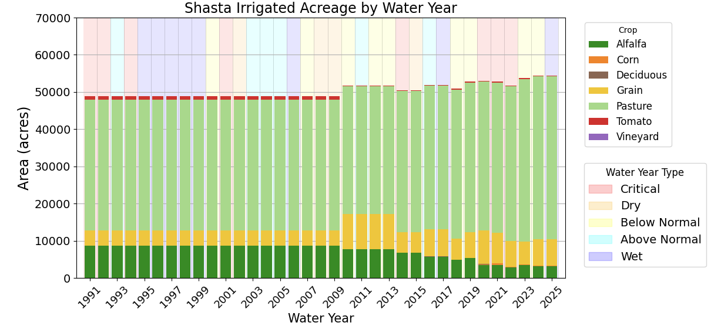
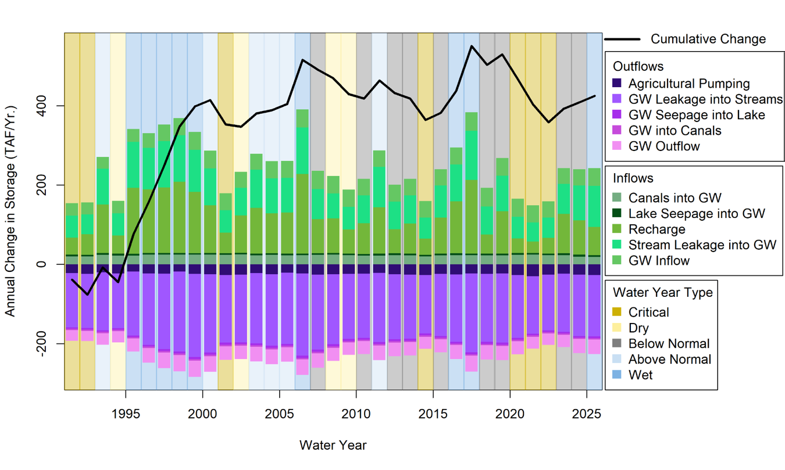
Shasta Watershed Landuse and Model Updates
No significant changes in overall land use or cropping patterns occurred during the evaluation cycle.
Flows into and out of groundwater modeled in SWGM along with the cumulative change in groundwater storage

Slide 38
PERIODIC EVALUATION RESULTS · BUTTE VALLEY
Butte Valley: Key Periodic Evaluation Results (WY 2021-2025)
SUSTAINABLE YIELD
58,477
acre-feet per year
Recalibrated with the updated model, based on crop water use and irrigated acreage
UPDATED GEOLOGY
AEM survey completed
Draft hydrogeologic conceptual model memo synthesizes well construction, AEM, geochemical, and isotope data (1952–2025)
MODEL UPDATE
Model recalibrated
Model expanded from 8 to 11 aquifer layers and recalibrated with AEM data
Watershed (PRMS) and soil water budget components updated
MONITORING
New data coverage
6 wells instrumented for continuous data (Apr–Jul 2025)
7 flow stations and 1 stage-only station
Meiss Lake: 8 shallow wells (spring 2026) and a dedicated lake stage gauge

Slide 39
PERIODIC EVALUATION RESULTS · BUTTE VALLEY
Butte Valley: Projects, SMC Refinements, and DWR Corrective Actions
Projects and Management Actions
SMC REFINEMENTS IN THE PE
Water quality UR: trend analysis removed
Land subsidence UR: updated for consistency with DWR BMP guidance
Irrigation efficiency pilot
6 alfalfa operations (720 acres) received low-elevation spray (LESA) emitter packages and multi-depth soil moisture sensors; completed spring 2026 (SGMA grant)
Well inventory
Completed spring 2026: well locations, construction details, and number of active wells; supports an updated well risk assessment
DWR CORRECTIVE ACTIONS
From the Feb 2025 approval; the PE responds to each
Allocation and demand management (1a–1b)
Aquifer characterization and data gaps (2a–2b)
Groundwater contour maps (3); GDEs (4)
Water quality SMCs and coordination (5a–5c)
Subsidence SMCs (6); ISW (7a–7e)
Water quality monitoring frequency (8)
Meiss Lake ISW/GDE investigation
Evaluates whether potential ISW and GDEs near Meiss Lake (CDFW Butte Valley Wildlife Area) are connected to groundwater; continuous monitoring through 2026

