Slide 1
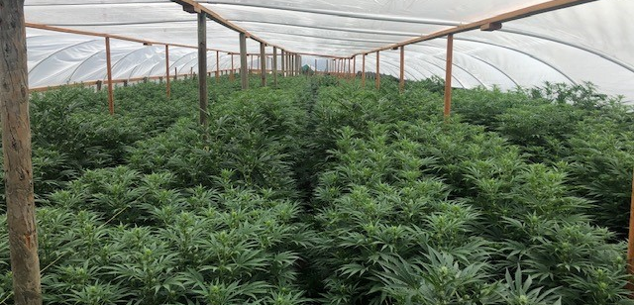
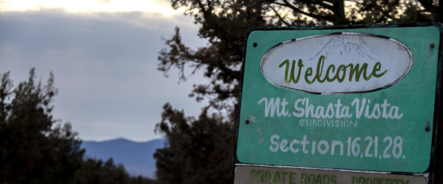
MT. SHASTA VISTA SUBDIVISION

Slide 2
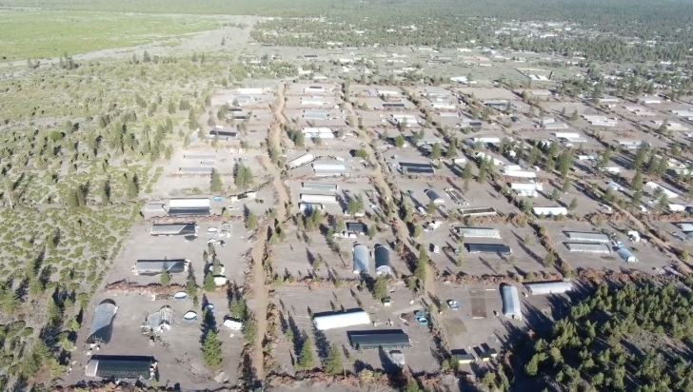

Slide 3
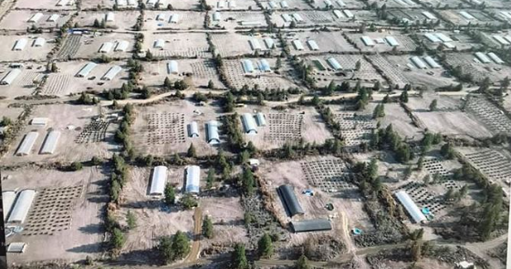

Slide 4
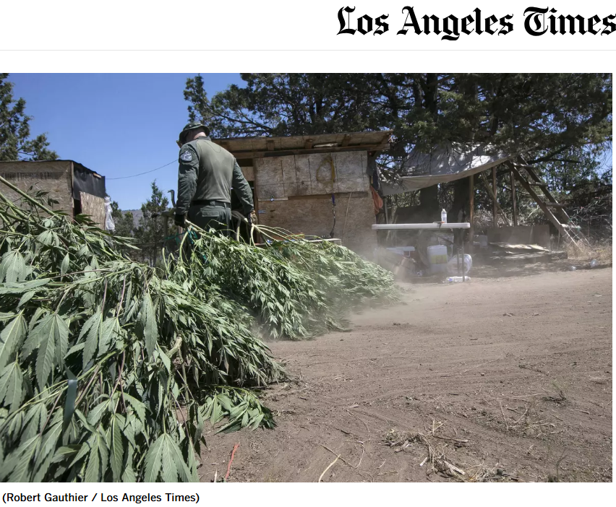
BRIEF HISTORY
2014: Satellite imagery of the largely vacant subdivision showed only a couple of small, isolated marijuana patches.
2015: A rapid influx of Hmong buyers began purchasing parcels in large numbers for low cash prices, setting up primitive infrastructure and hundreds of garden plots.
Late 2015–2016: By the end of 2016, roughly a third of the properties in the subdivision had ties to the migration, and over 500 distinct grow sites were documented.

Slide 5
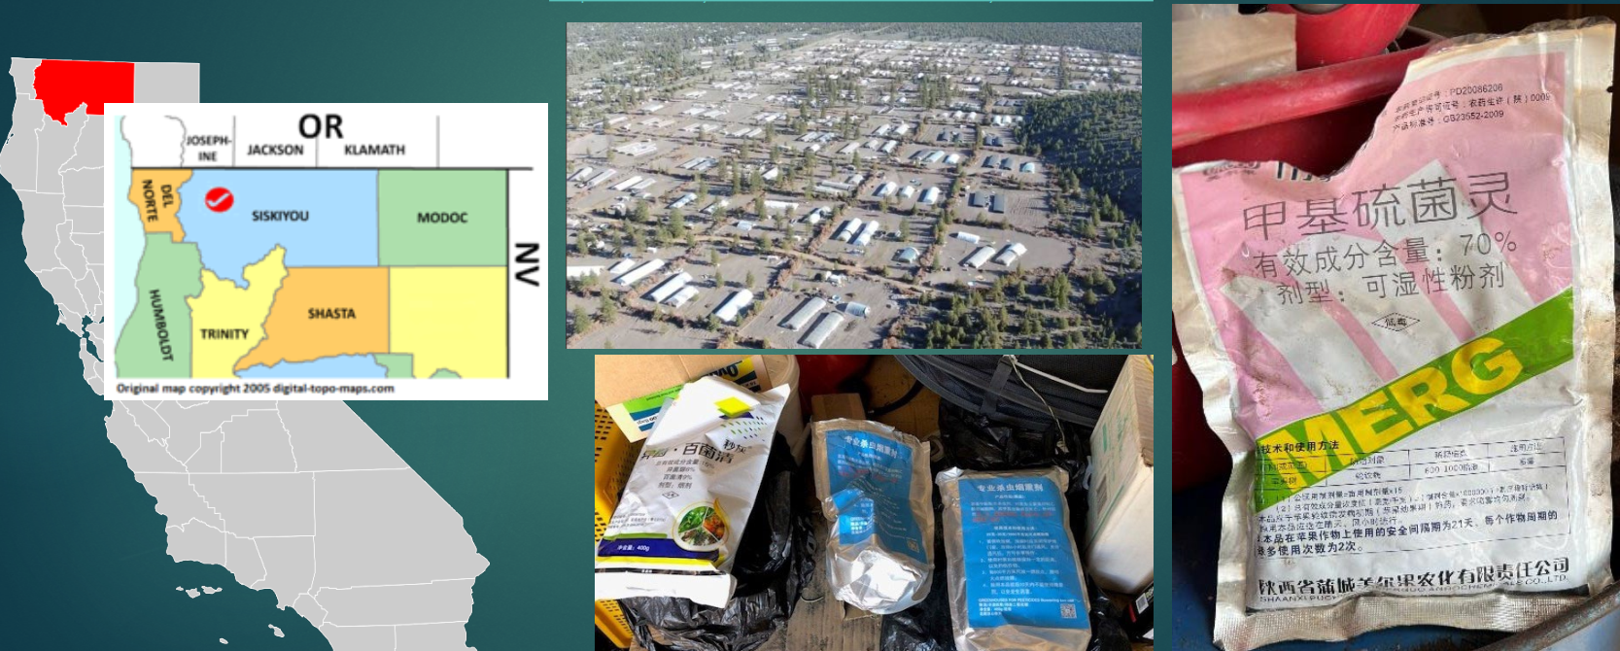
ILLEGAL PESTICIDES

Slide 6
LAW ENFORCEMENT EXPOSURE
On May 13, 2025, a search warrant was served at a property in Siskiyou County.
During the service of the search warrant, members of law enforcement entered a room, that actively had combustible pesticides burning, exposing all members of the team.
Exposed members had to go to the hospital. They were treated for extreme headaches, nose bleeds, nausea and fatigue. These symptoms lasted for days after the exposure.

Slide 7
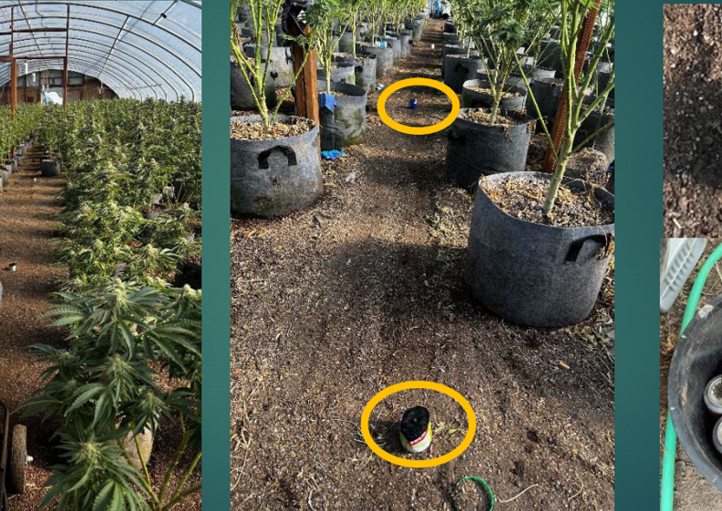
Combustible pesticides are placed in half-cut aluminum cans, with the wick located in the center. Cans are placed throughout an enclosed structure and lit.

Slide 8
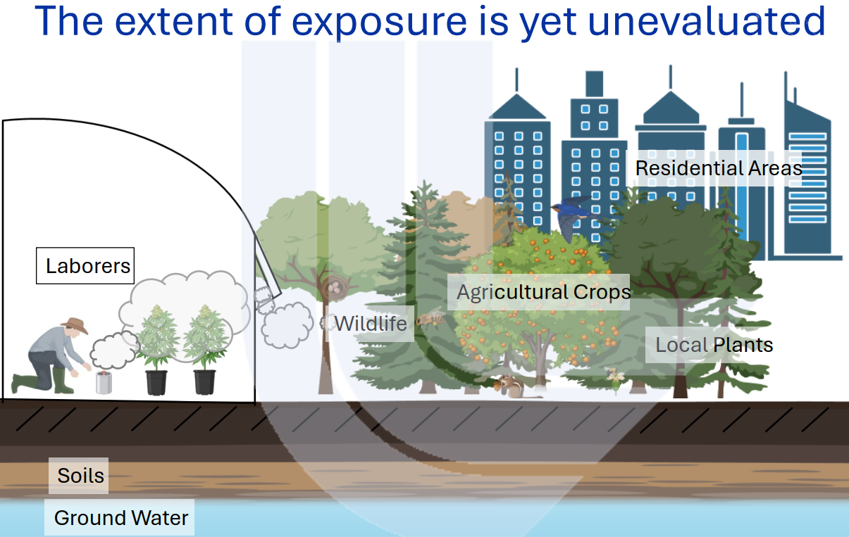

Slide 9
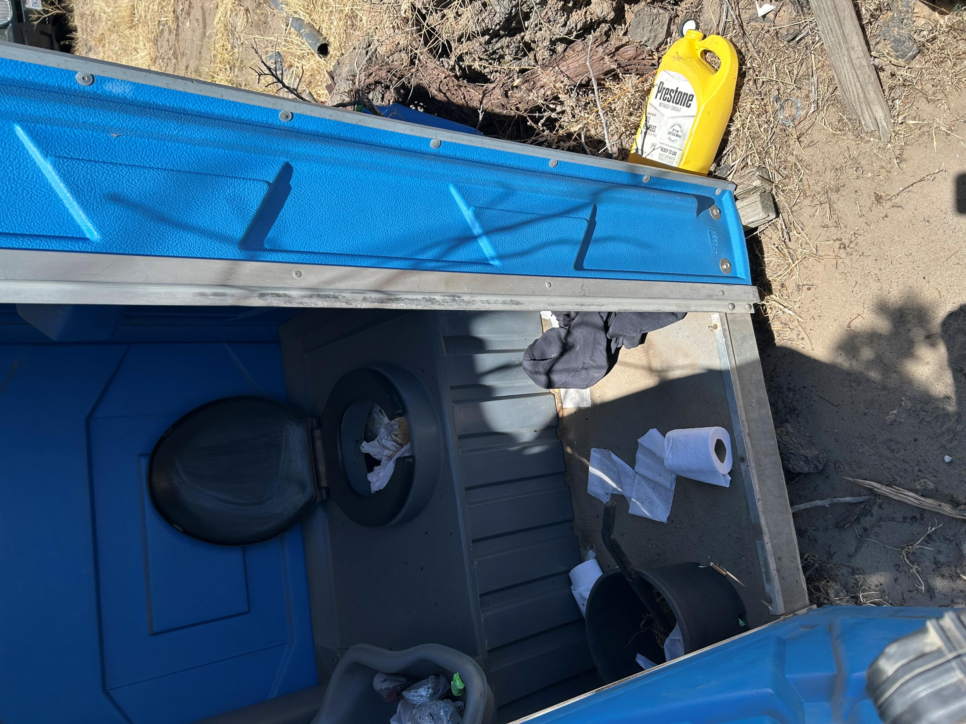
ENVIROMENTAL IMPACTS: Over 80% of the targeted illegal cultivation sites involved dangerous, foreign-labeled toxic pesticides and human carcinogens.

Slide 10
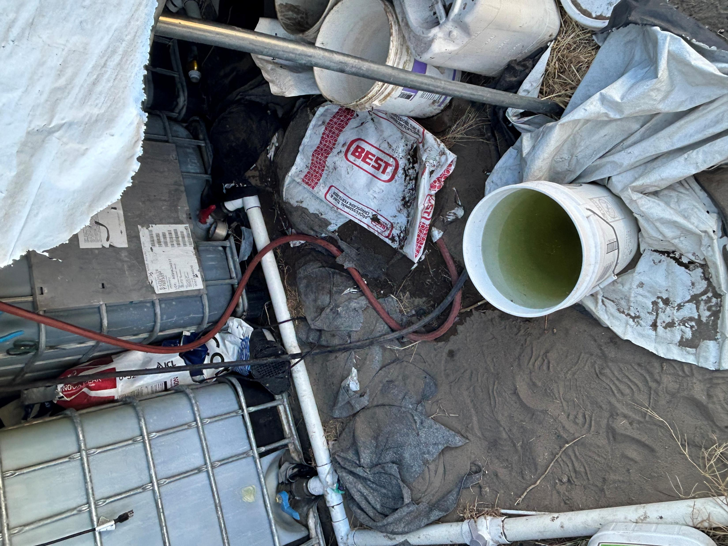
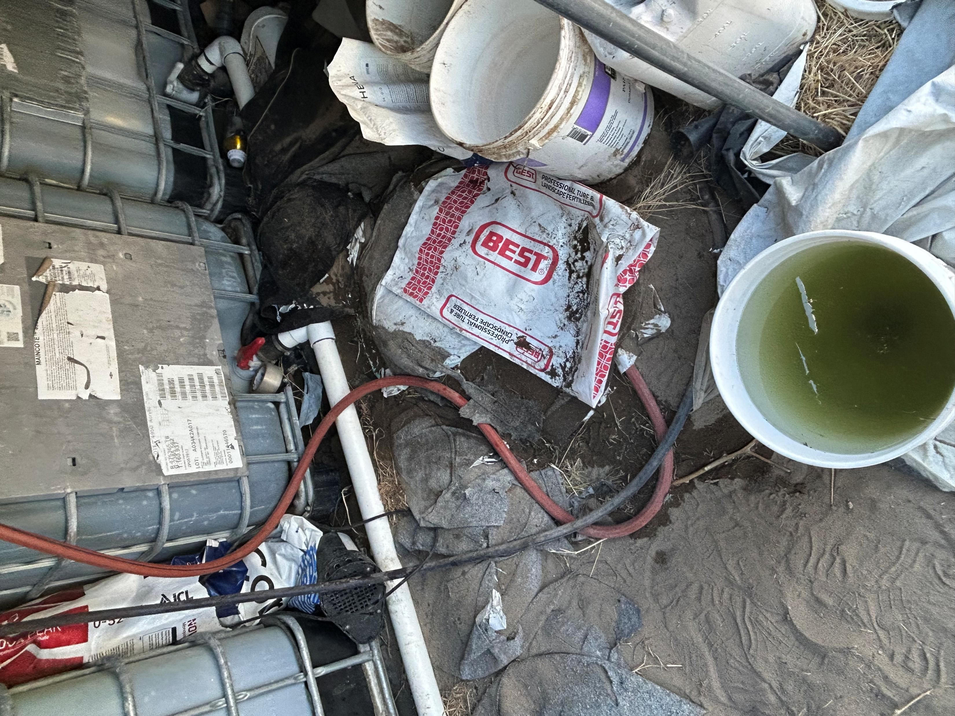
TYPICAL WATER SET UP WITH LEAKING PVC CONNECTIONS. THE GROUND IS LOOSE AND SANDY, LEADING TO EASY ABSORPTION

Slide 11
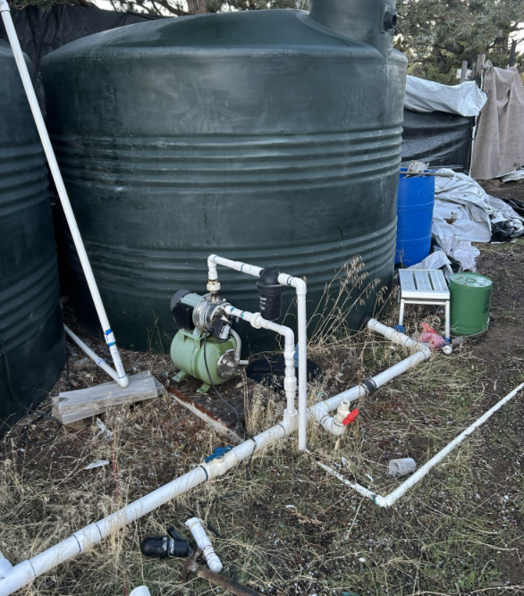
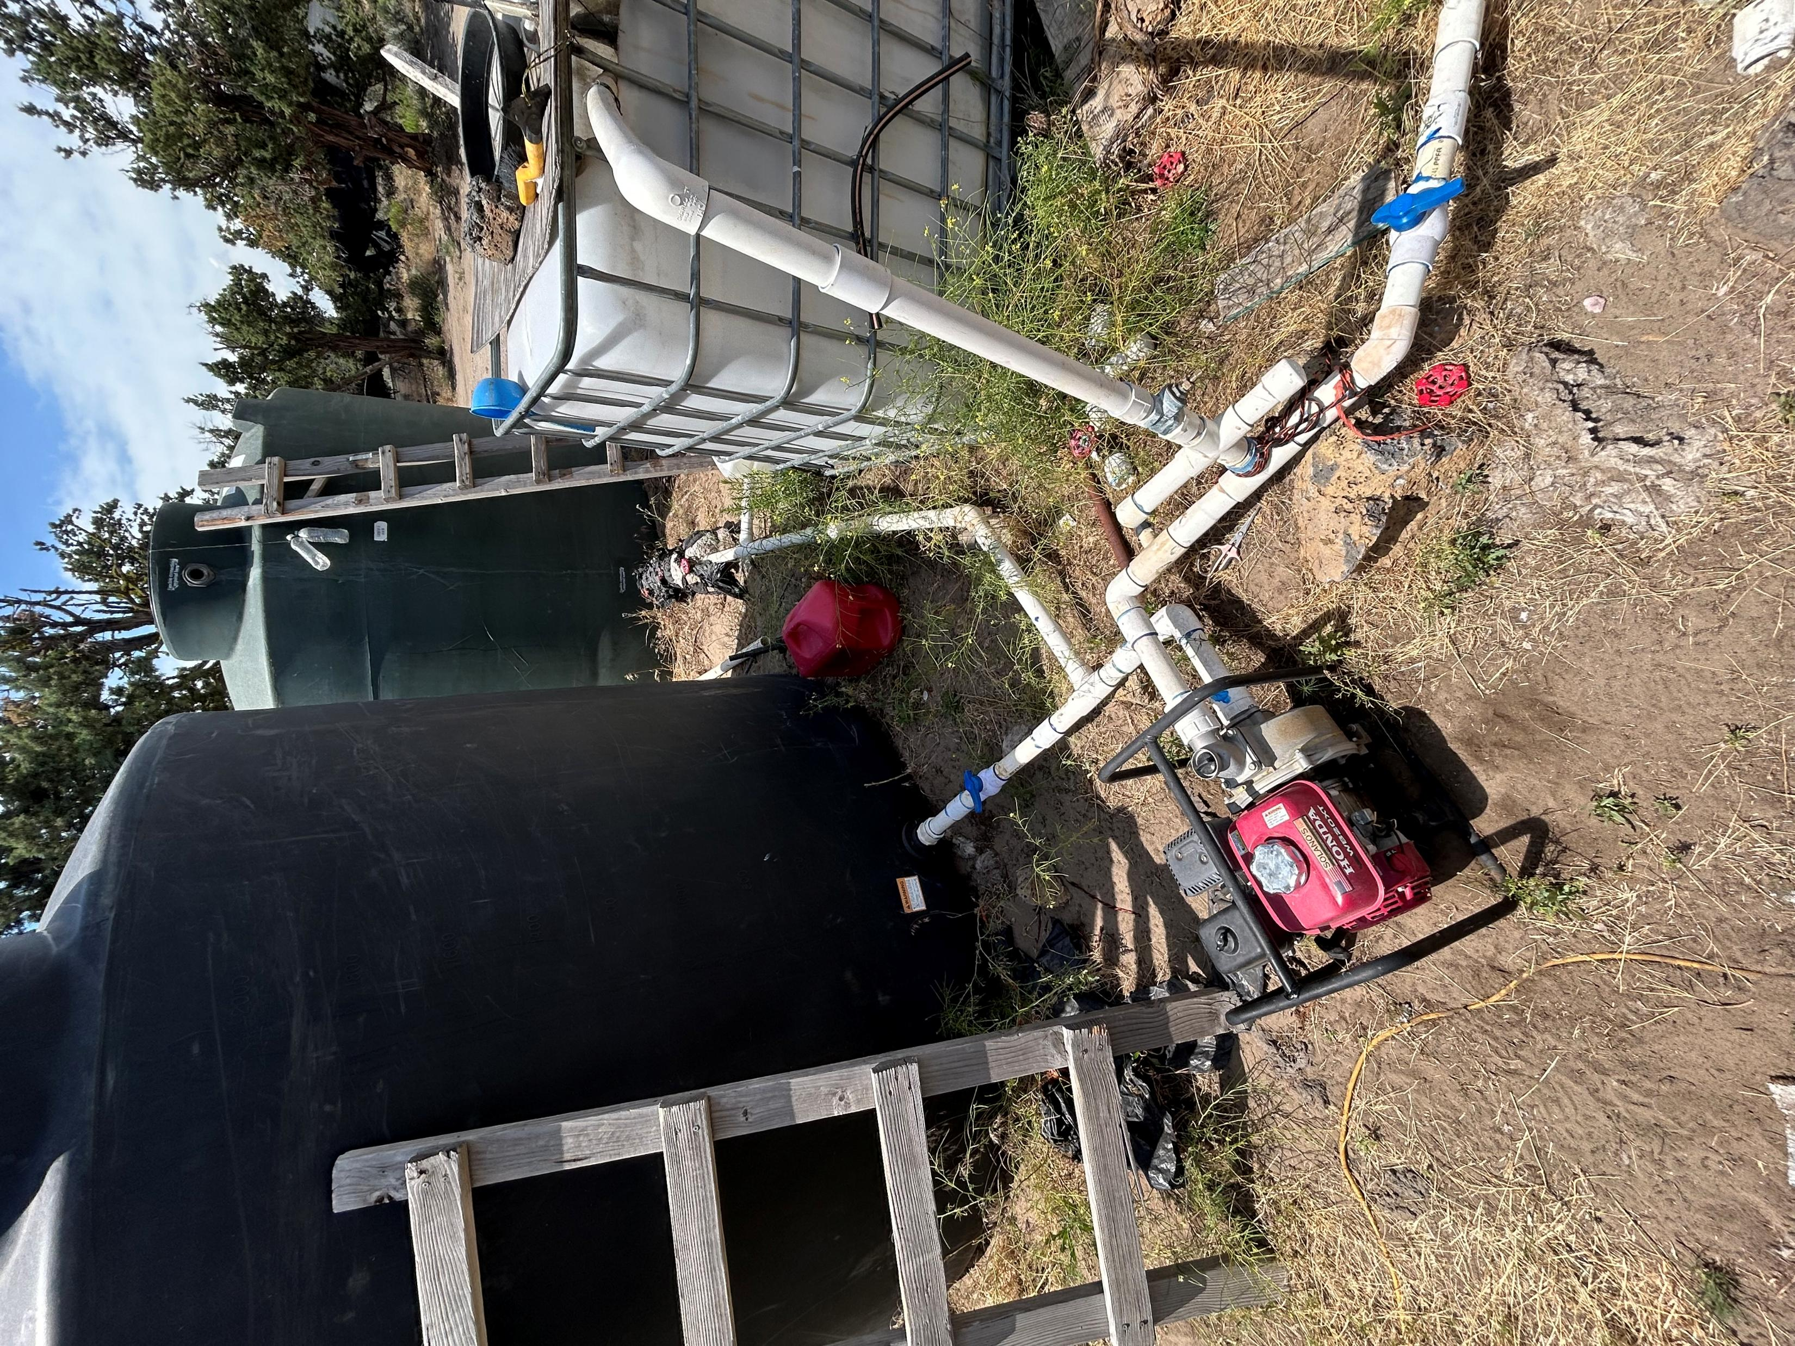

Slide 12
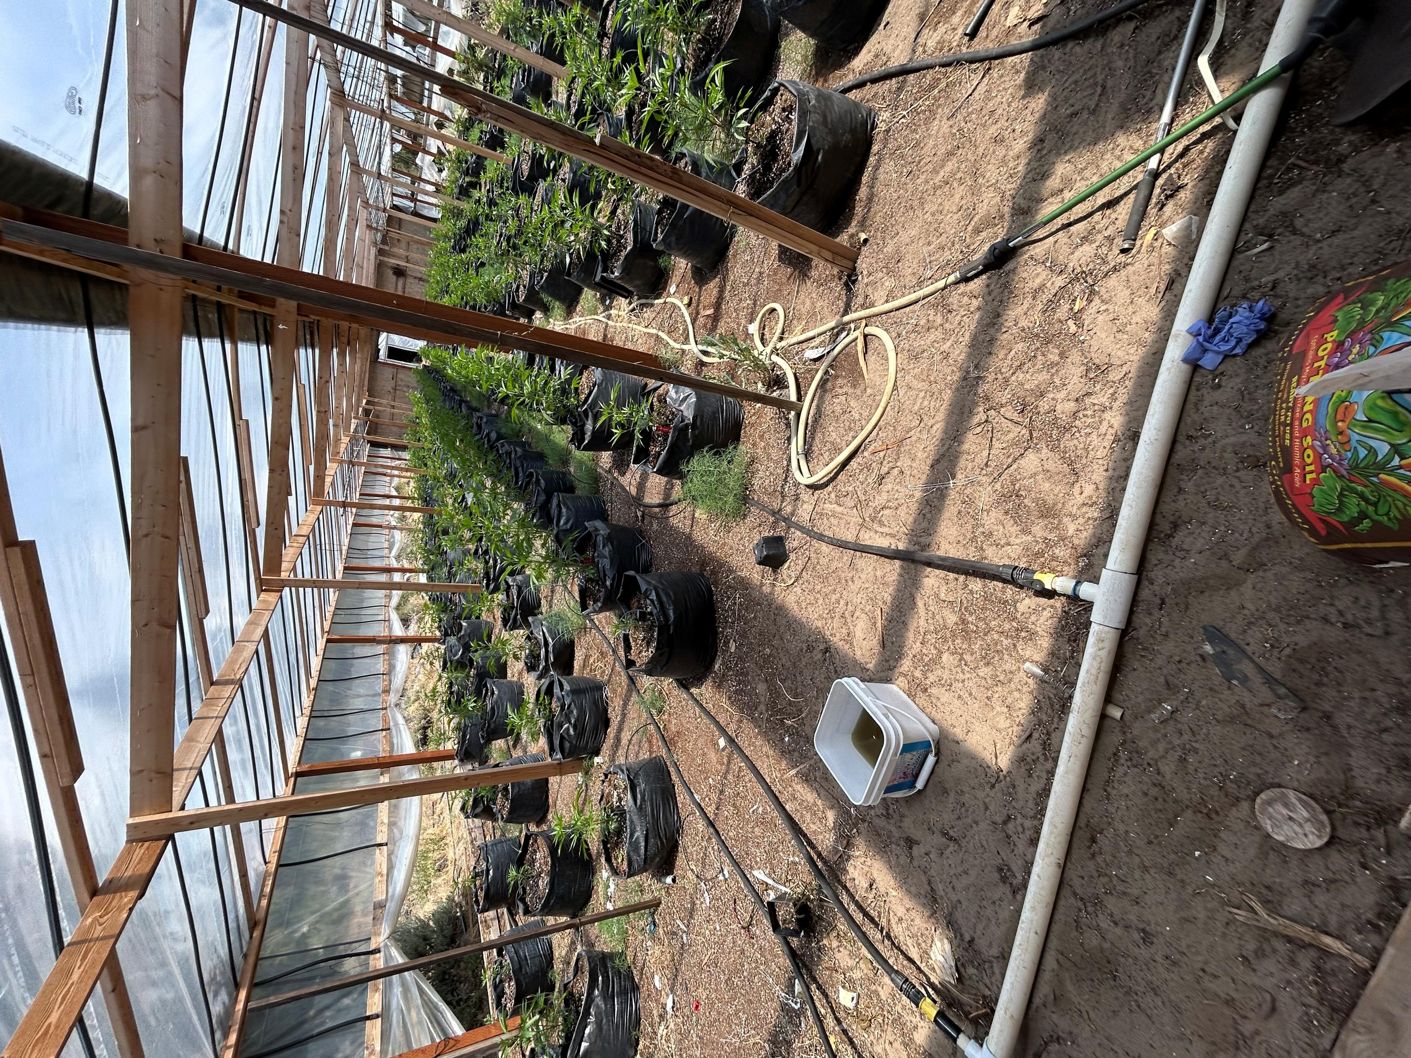
VARIOUS WATER LINES GOING TO THE GROW

Slide 13
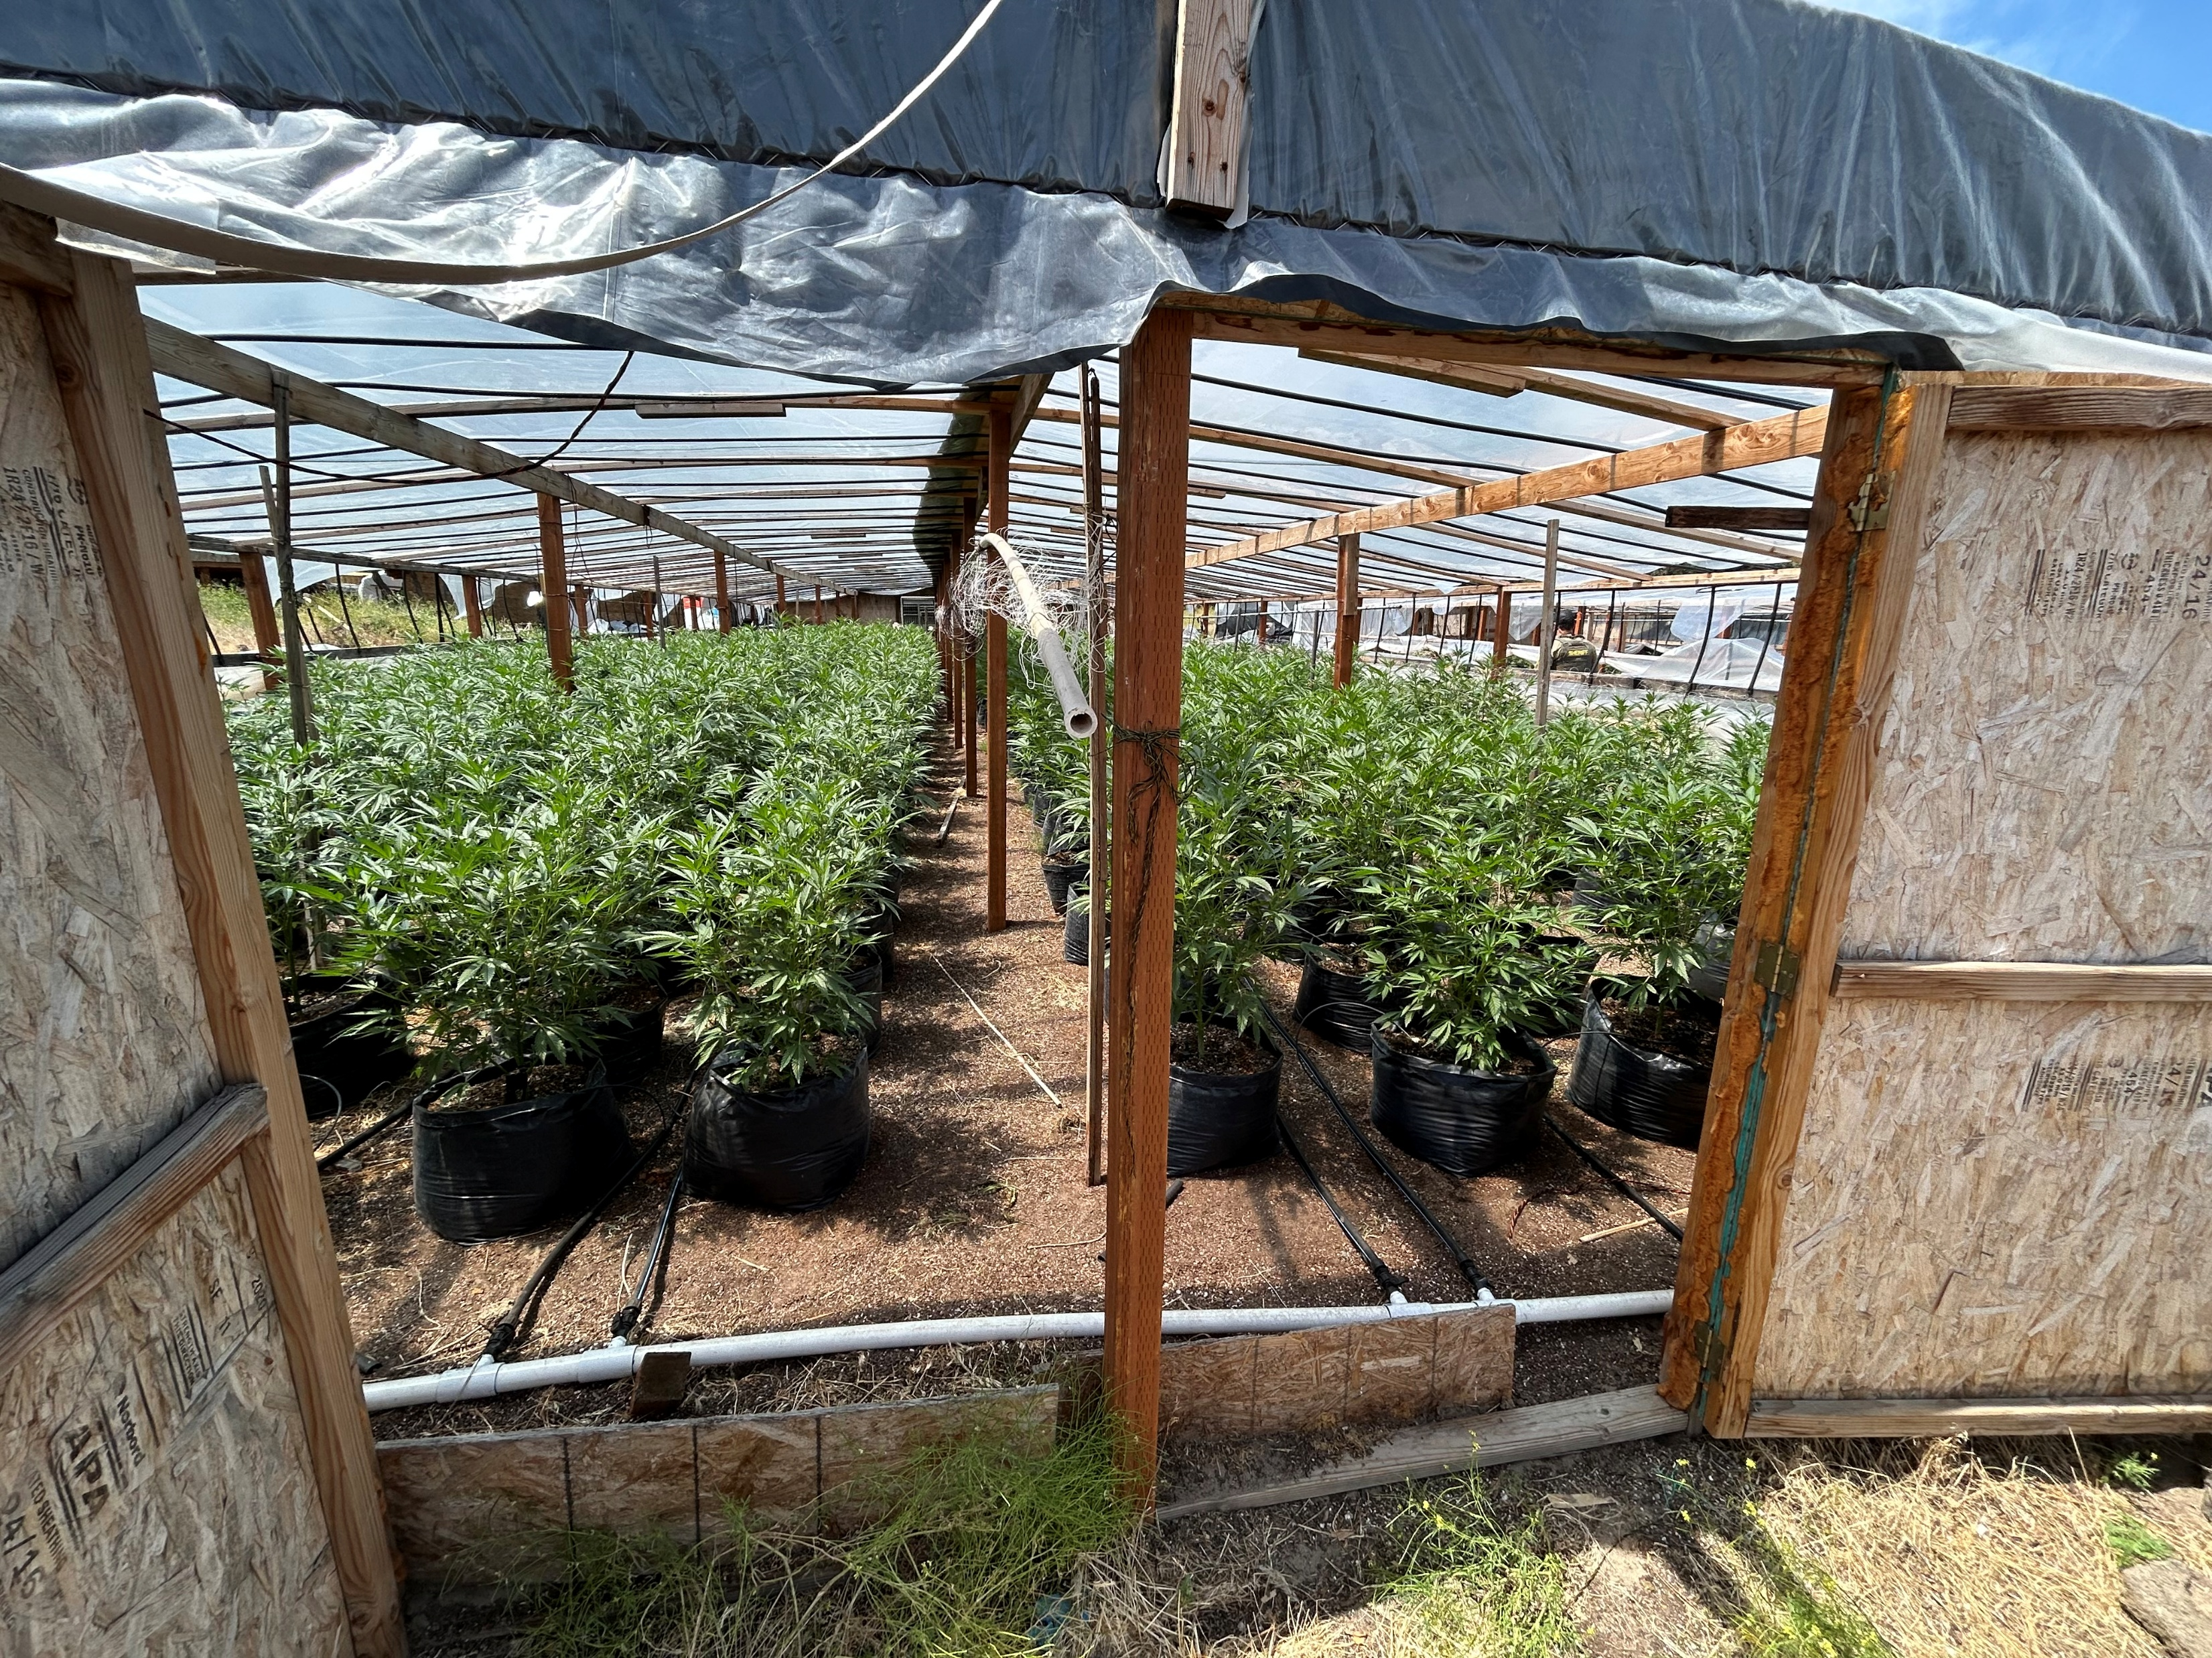
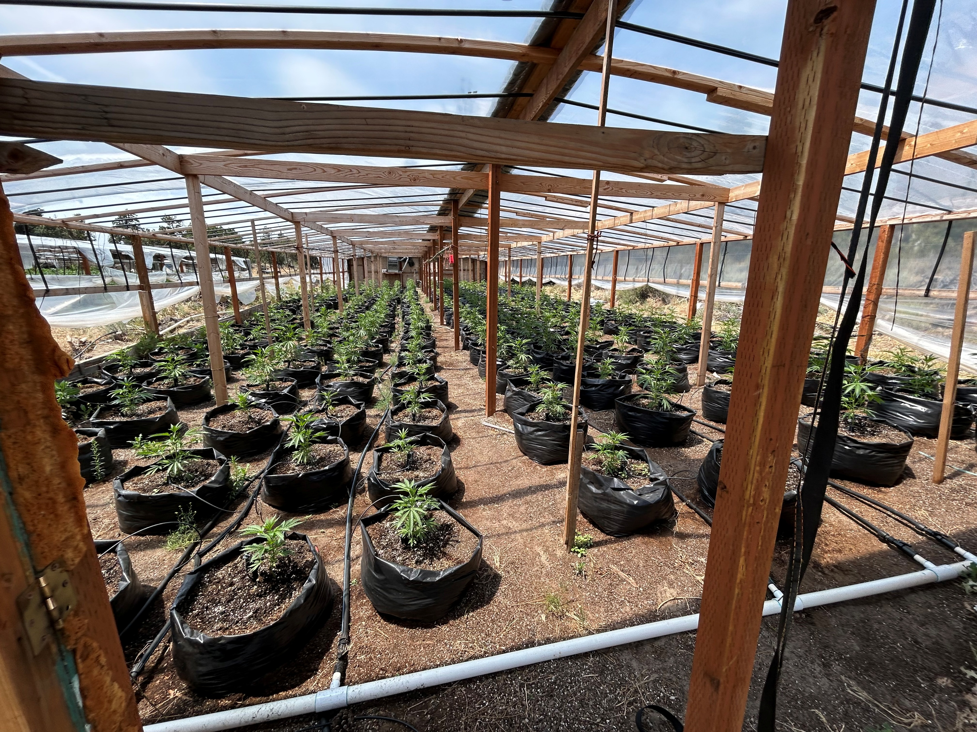
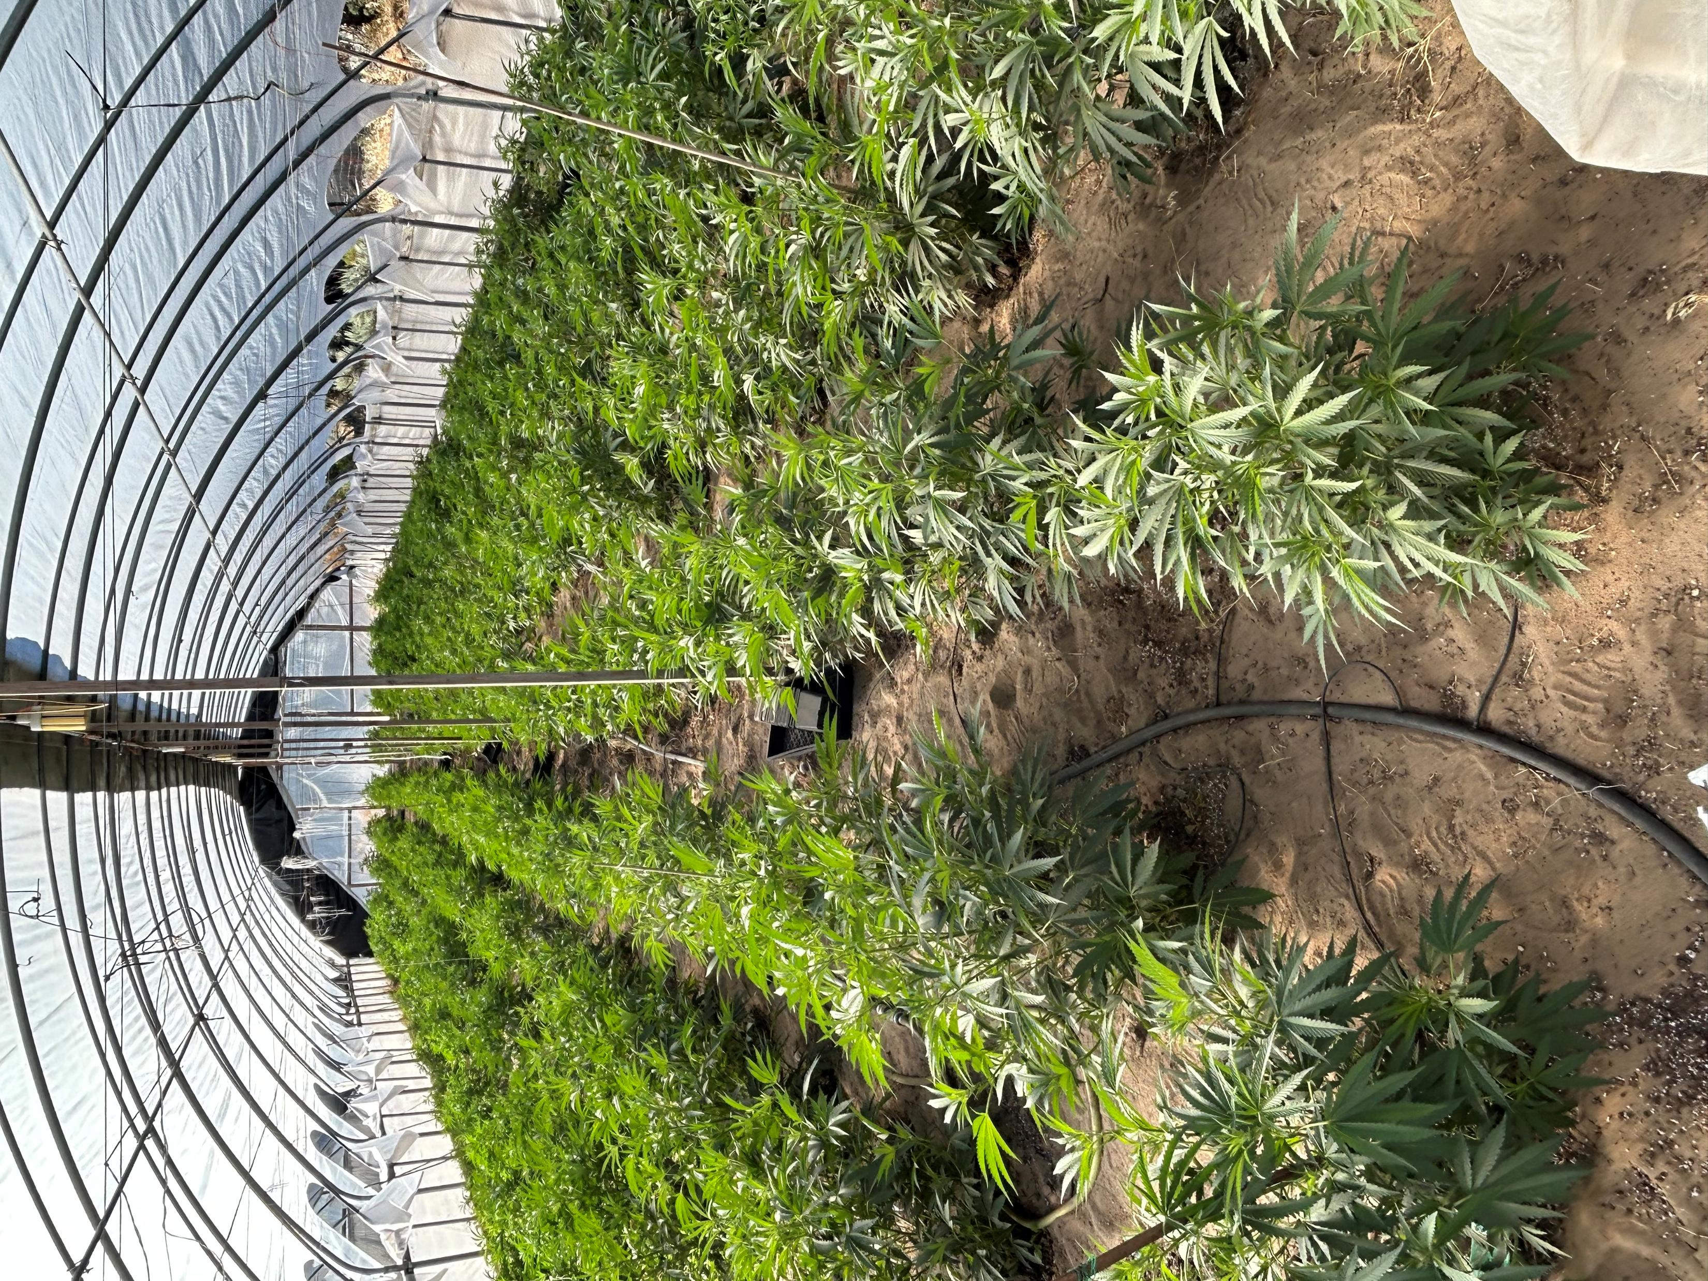

Slide 14
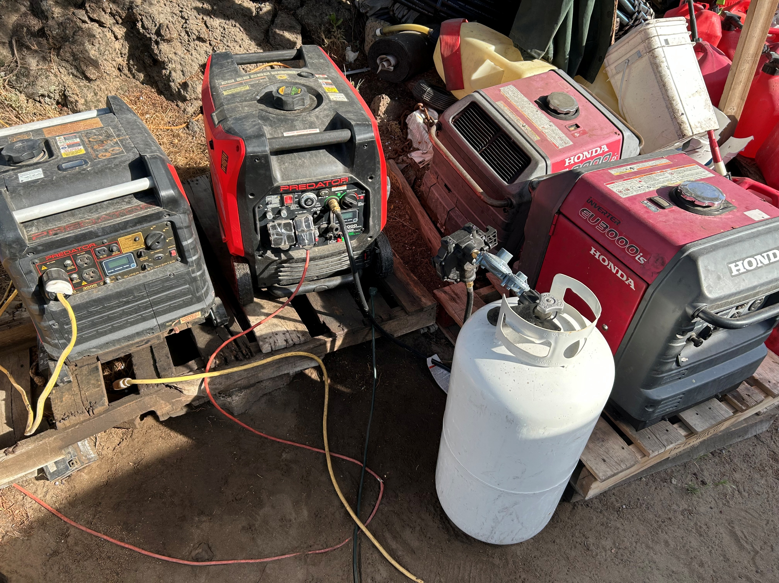
DISCOLORED SOIL IS EVIDENCE OF FUEL SPILLAGE

Slide 15
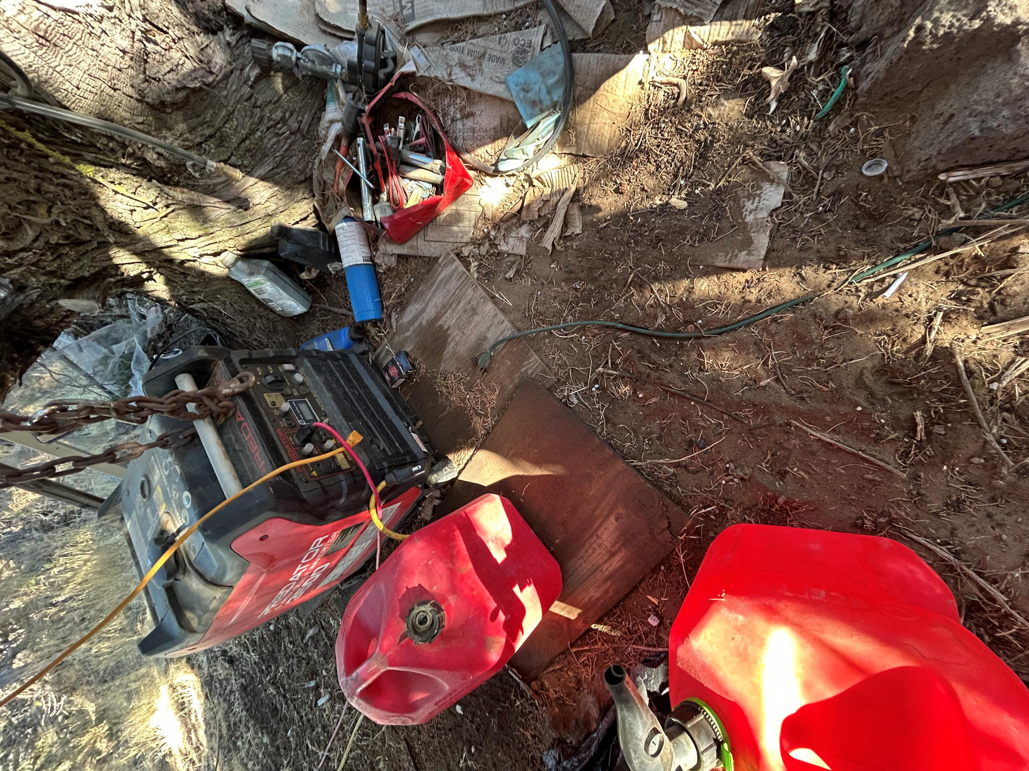
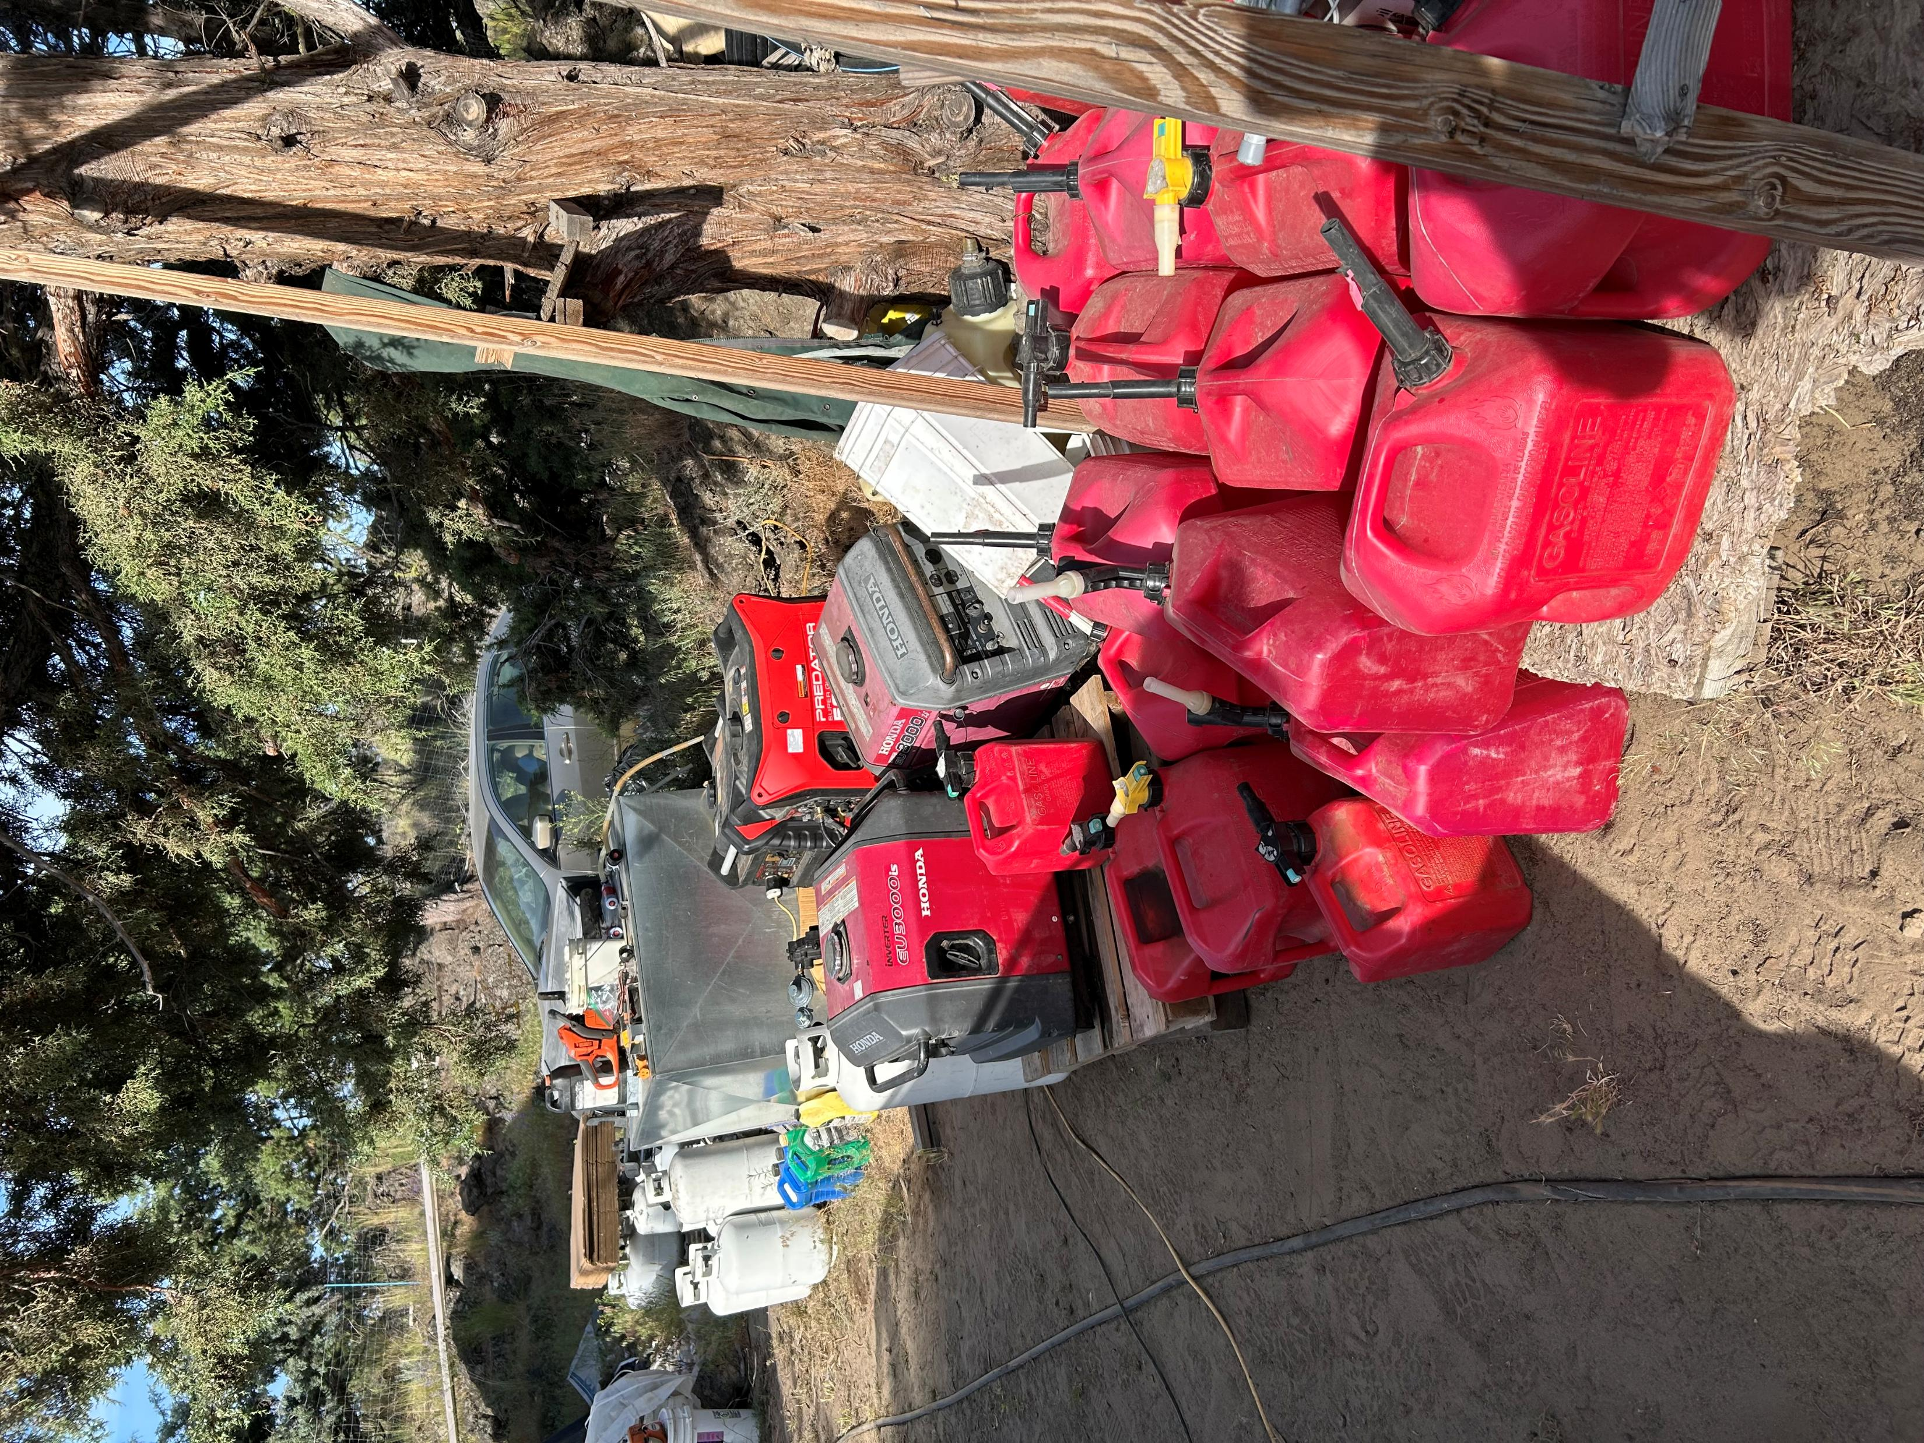

Slide 16
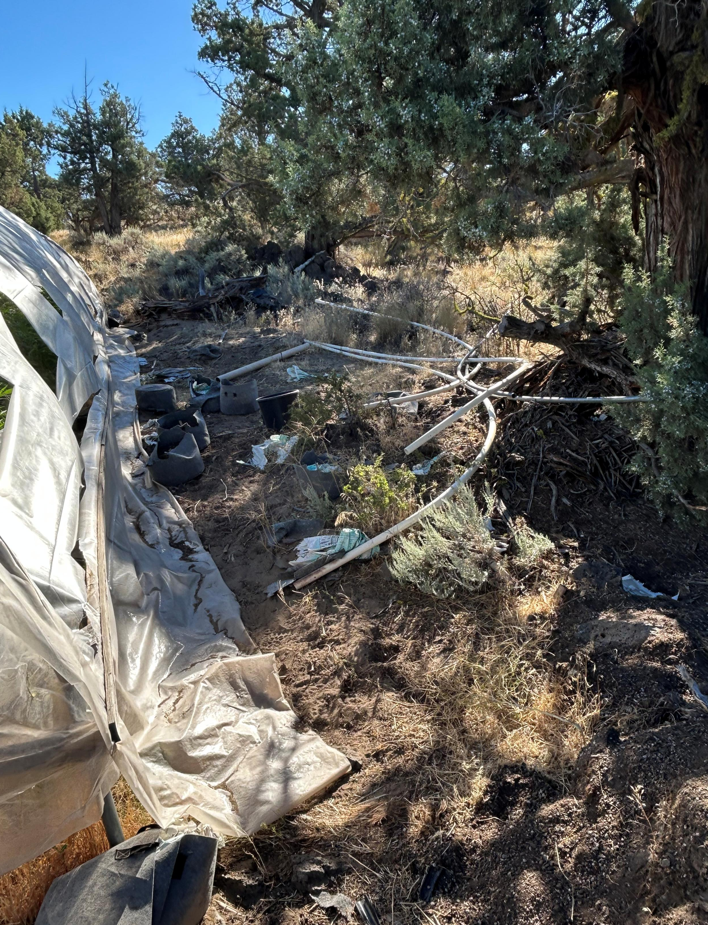
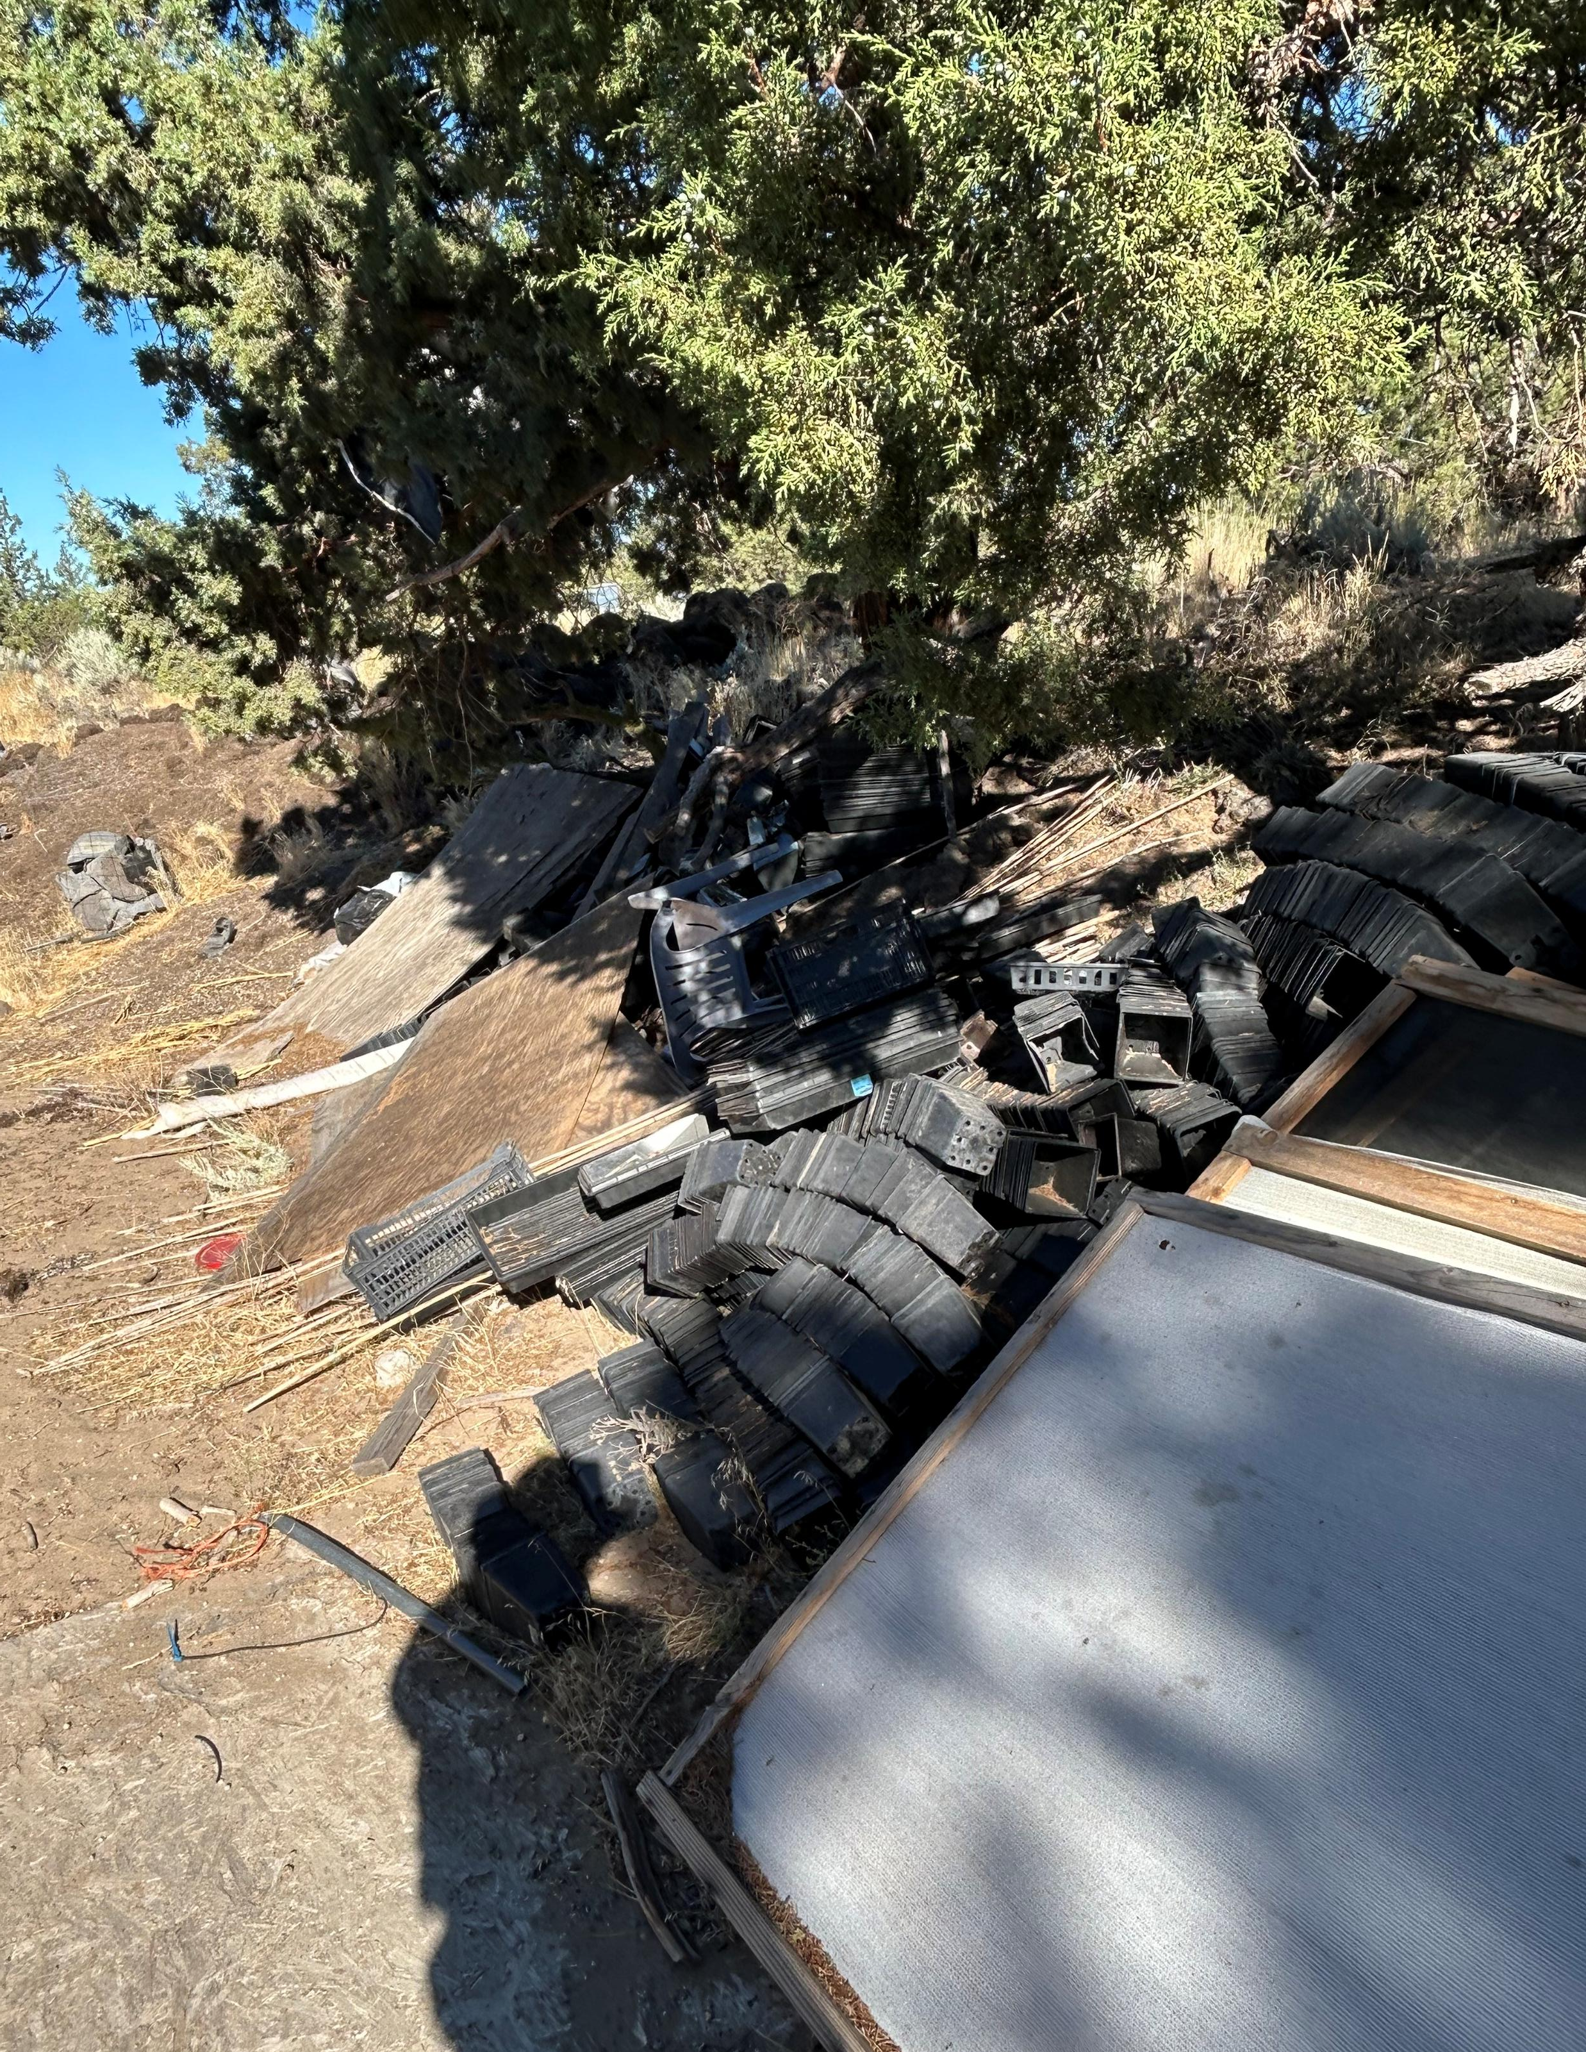
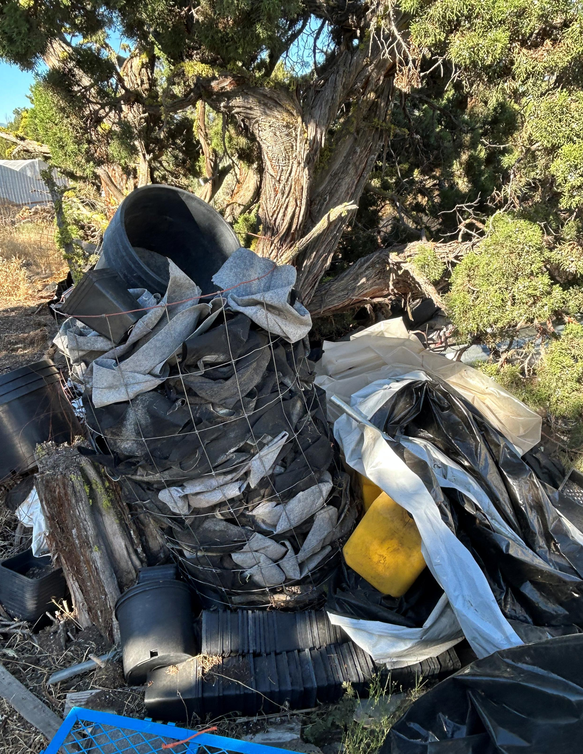
PREVIOUS GROW SITE TRASH

Slide 17
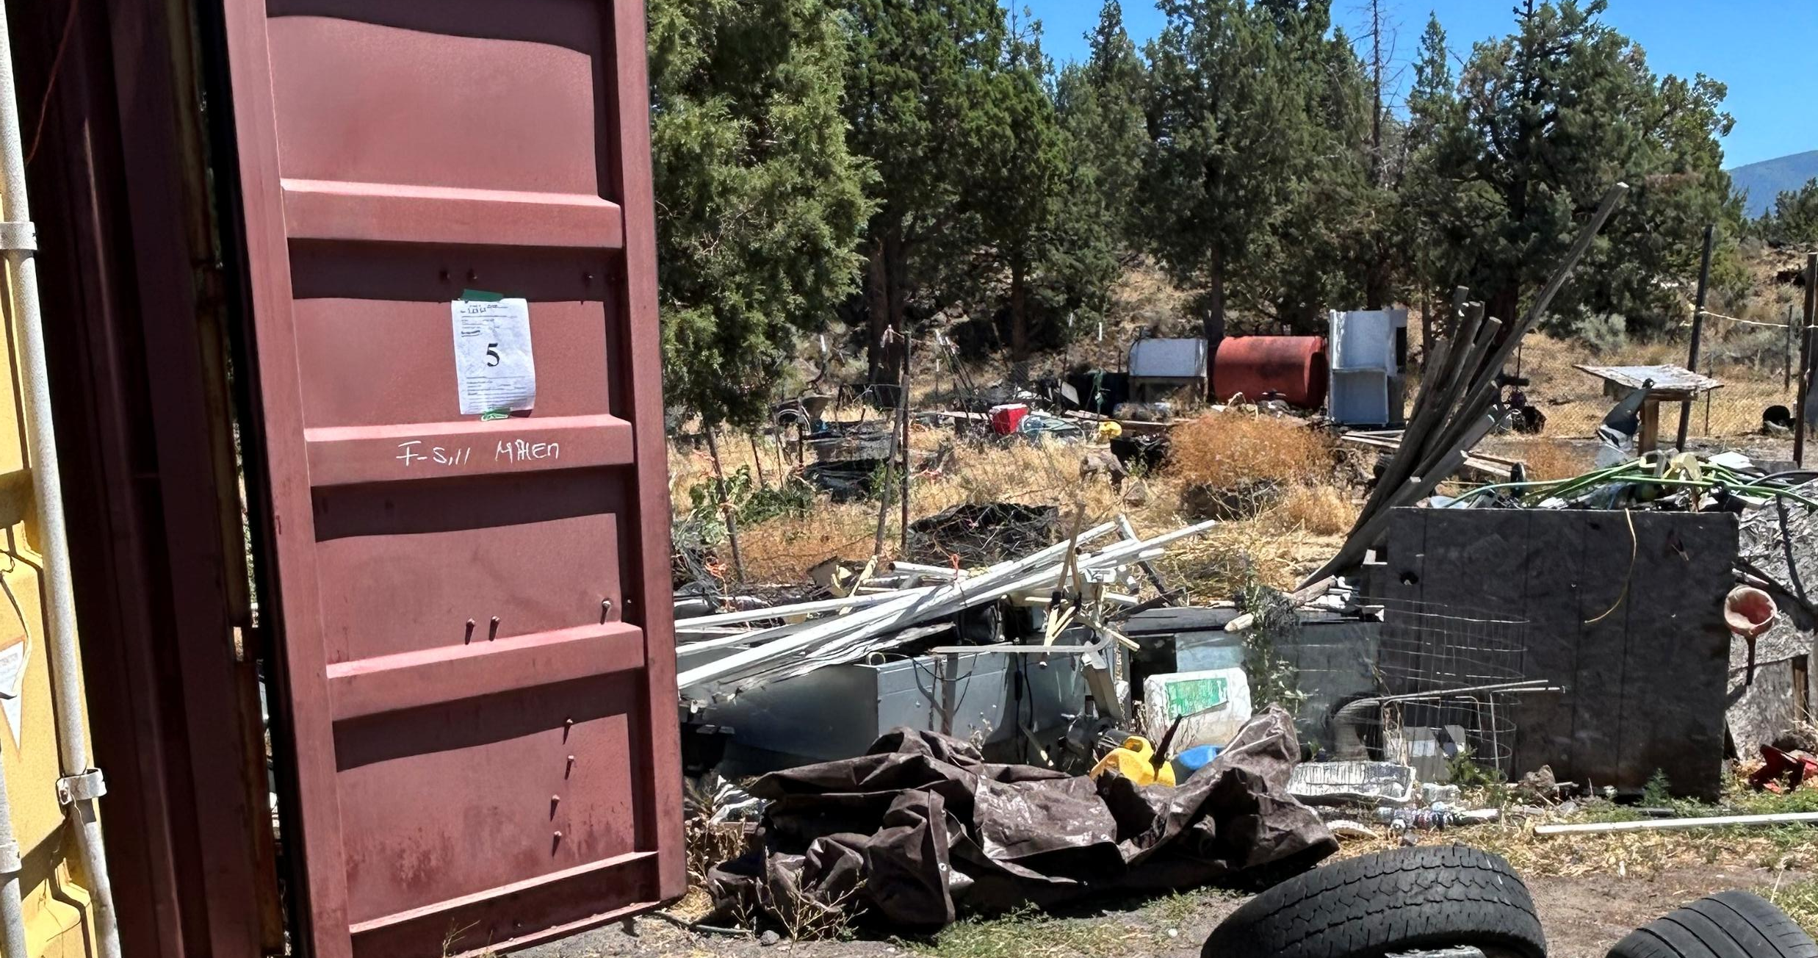

Slide 18
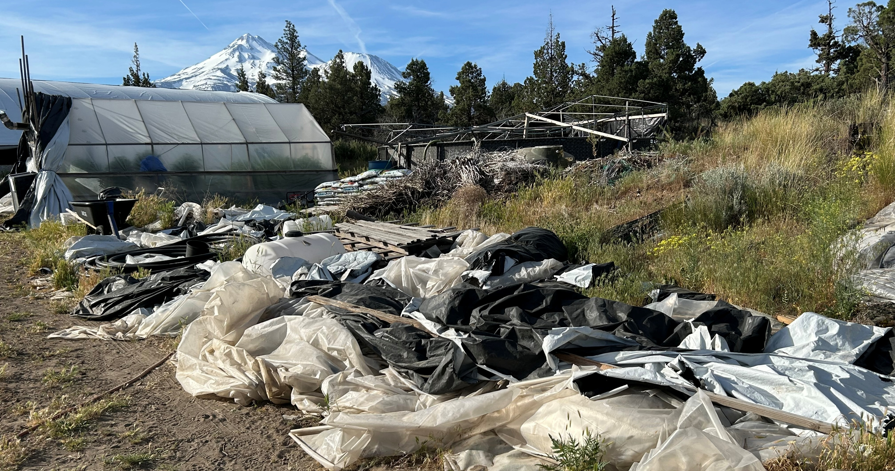

Slide 19
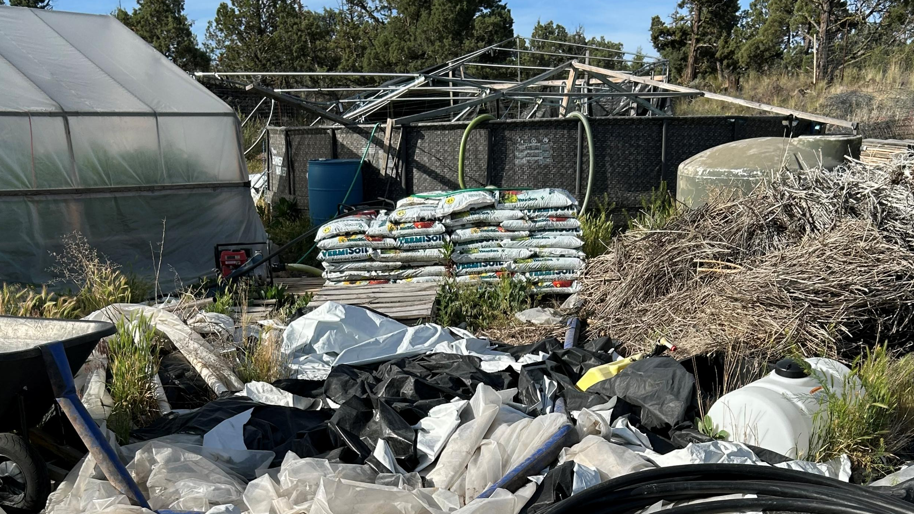

Slide 20
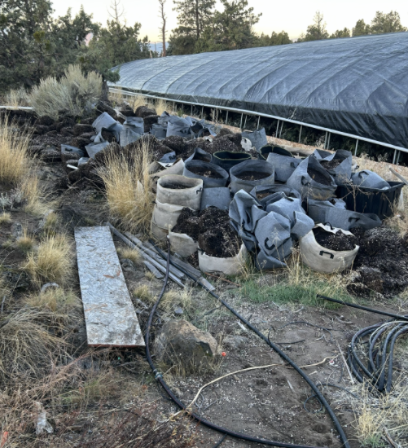
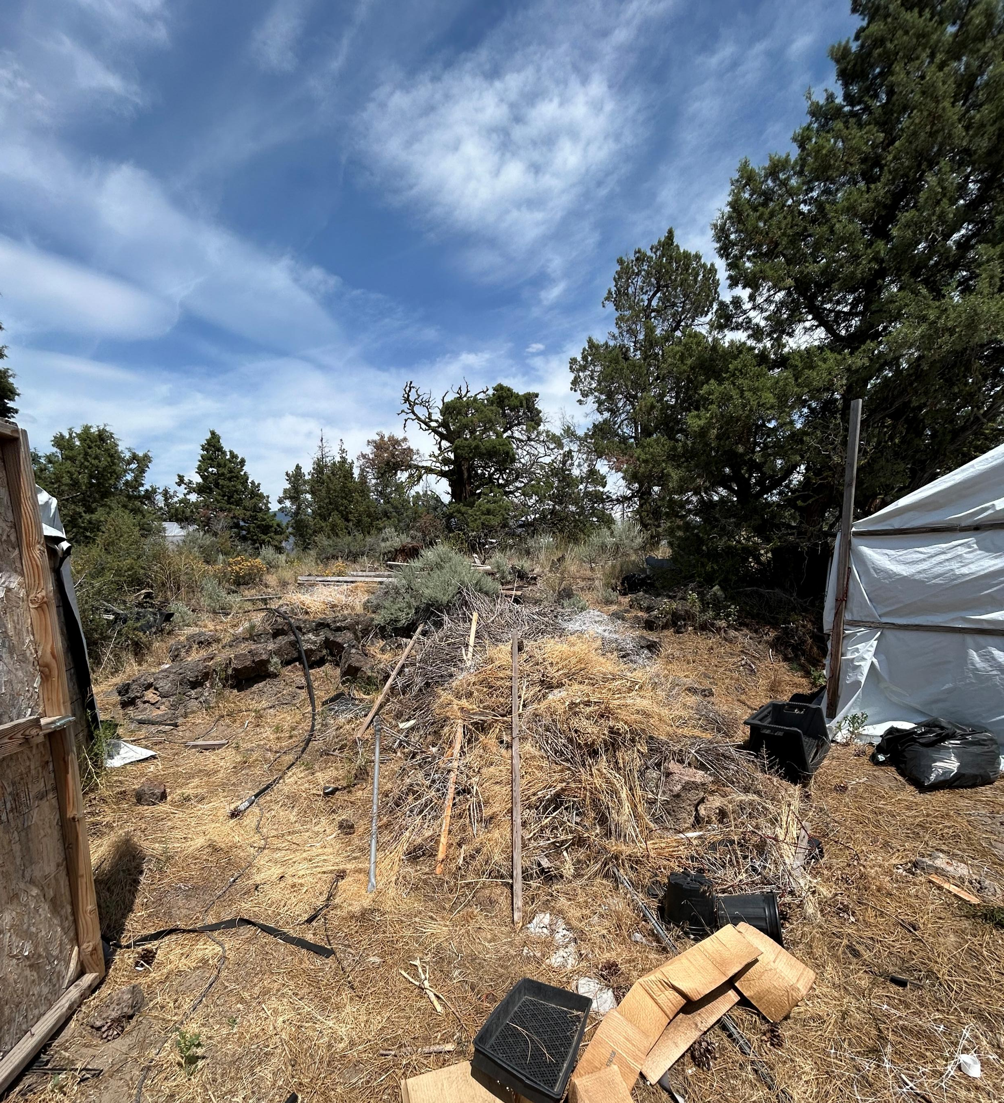

Slide 21
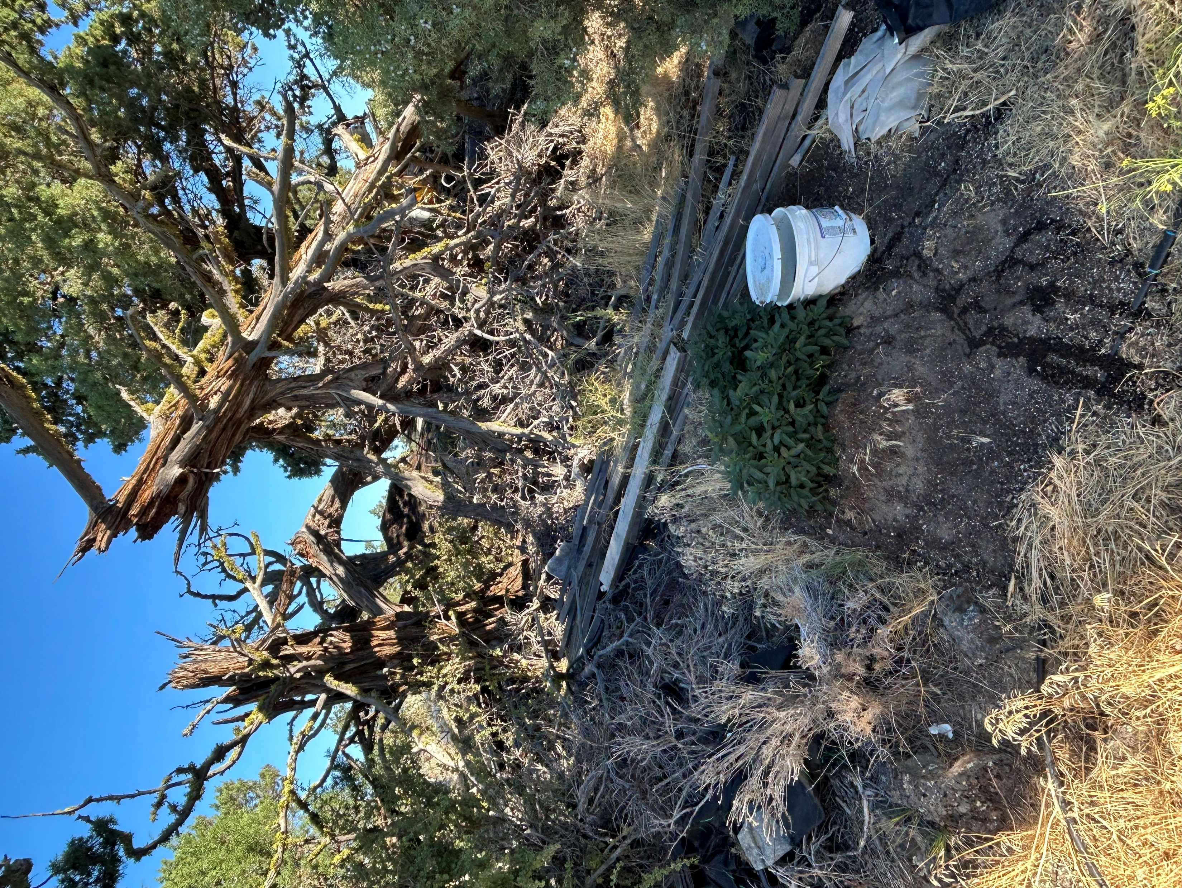
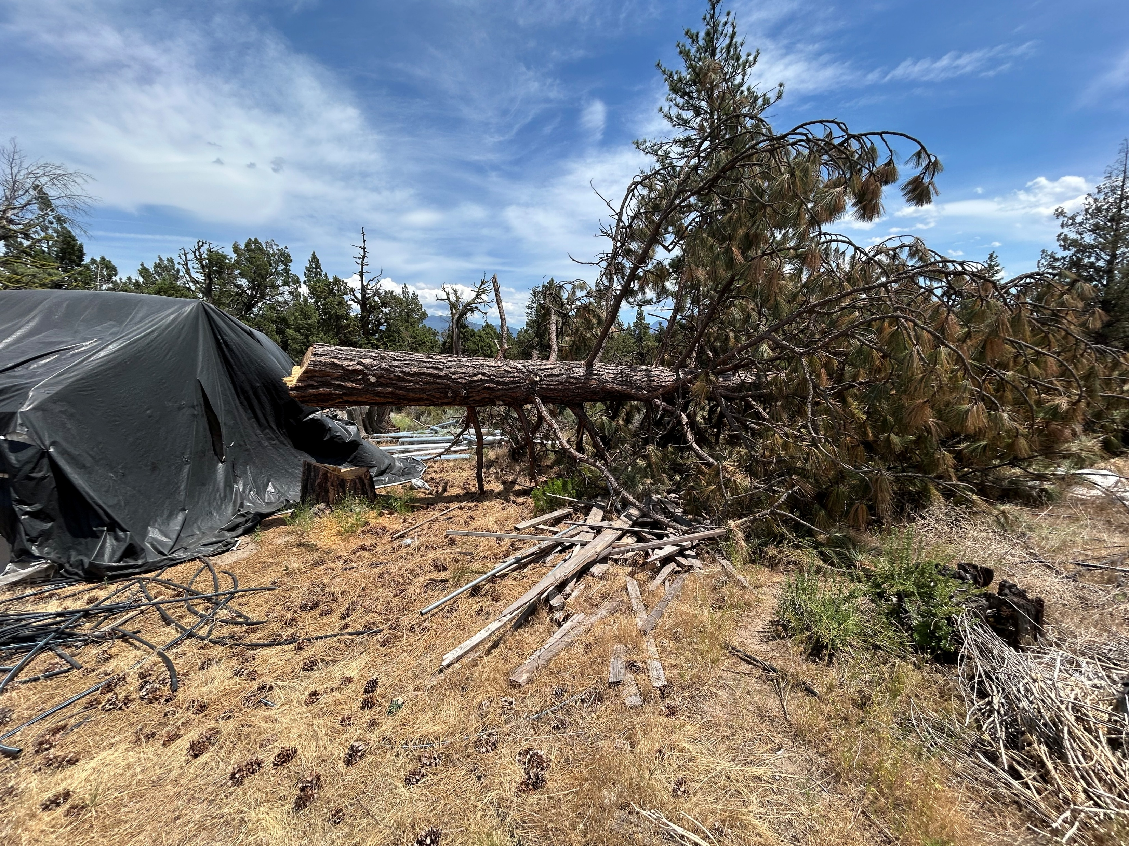
DESTRUCTION OF NATURE AND DISTURBED EARTH

Slide 22
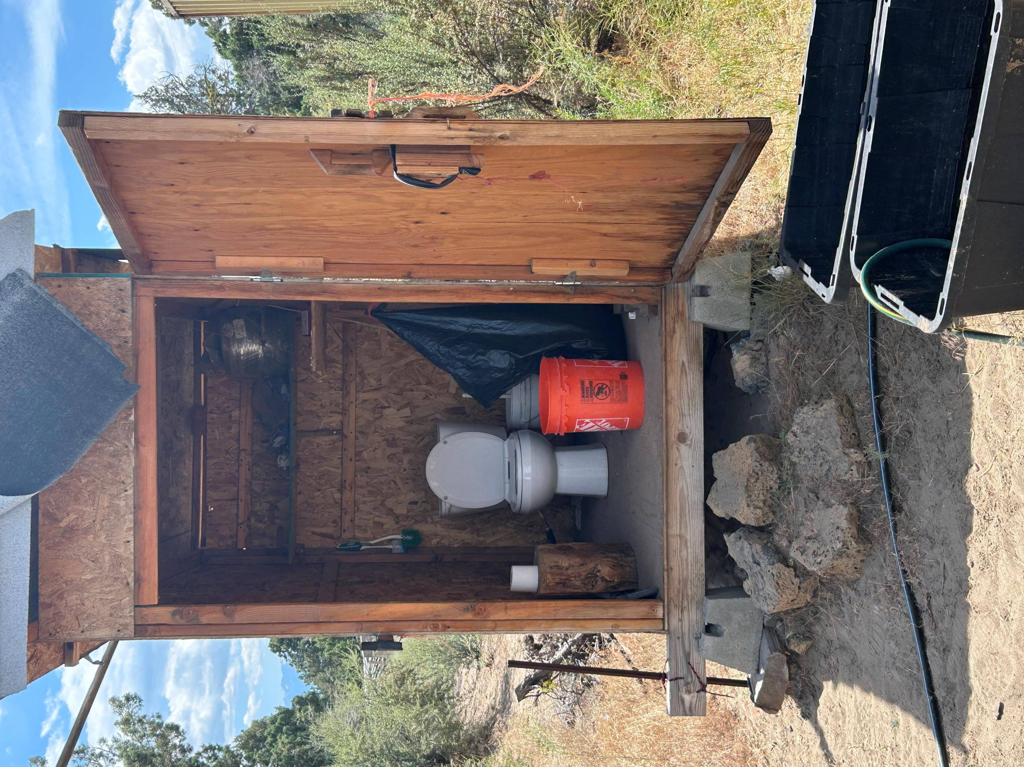
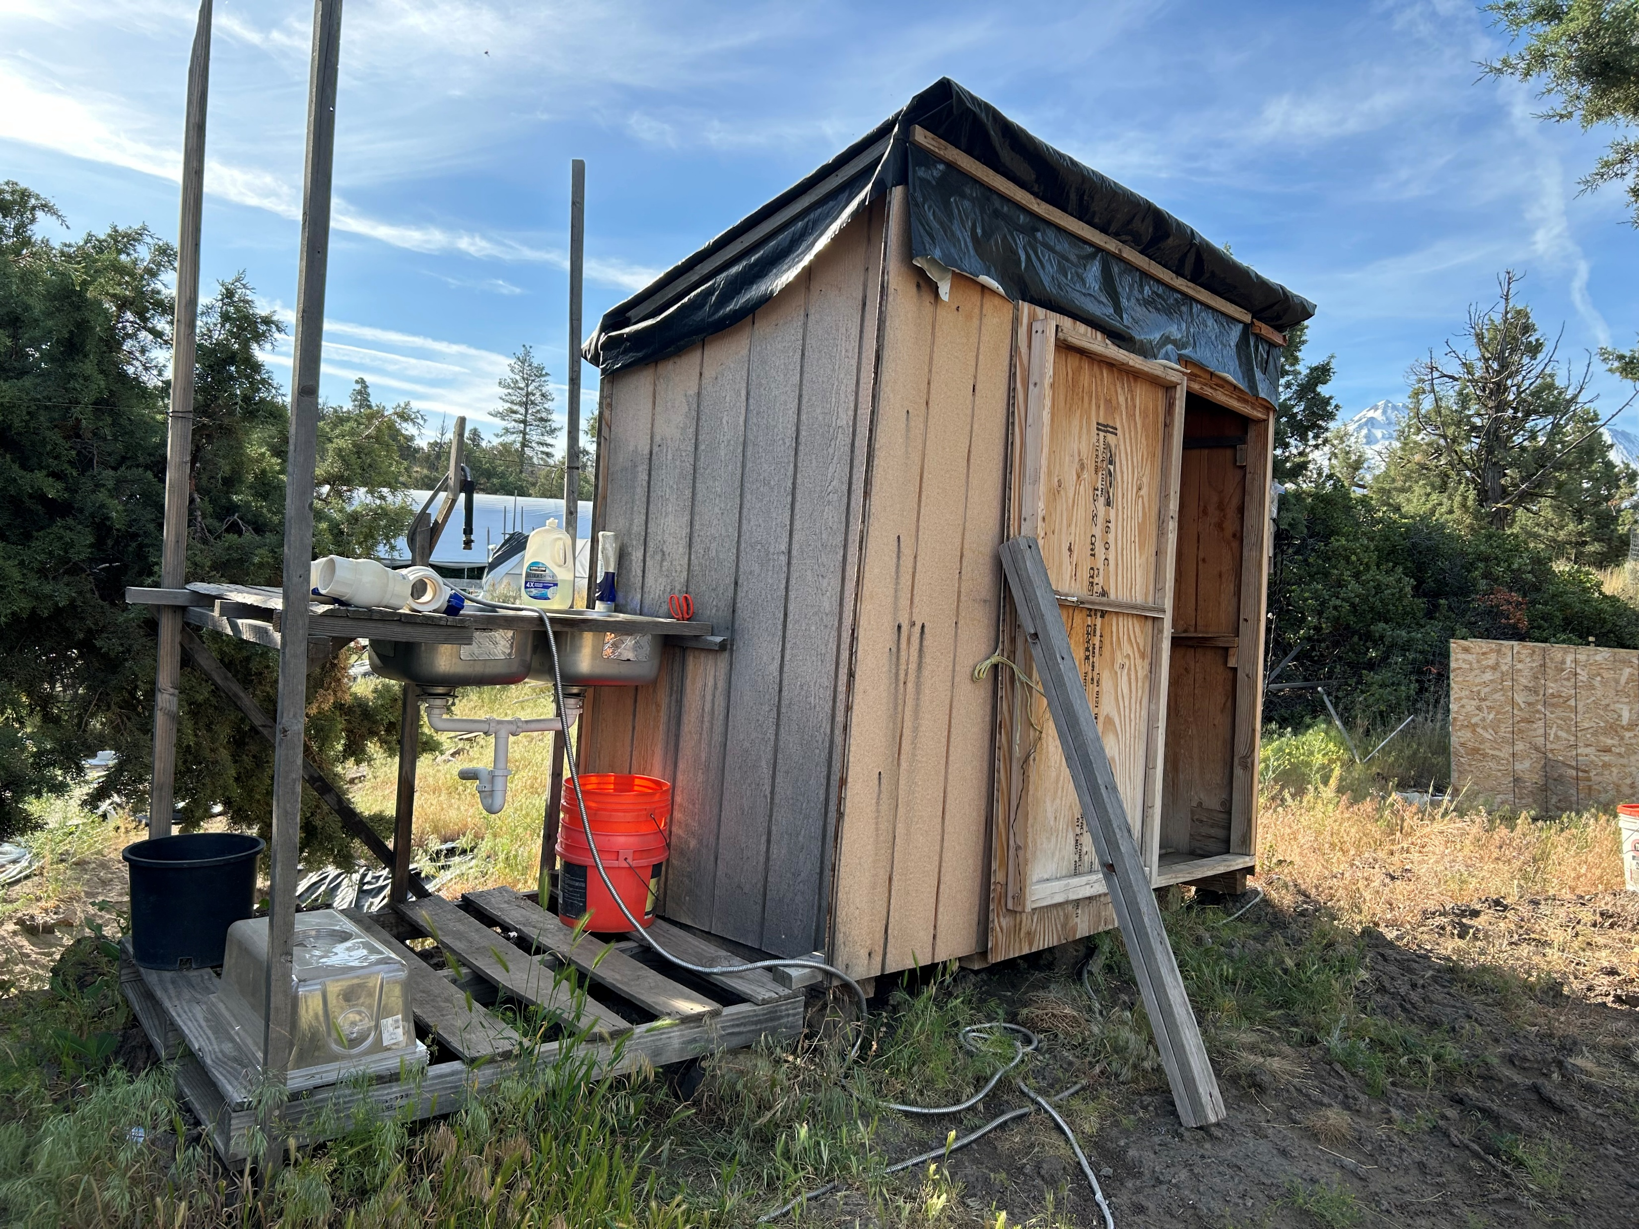
WATER AND SEWAGE FLOW OPENLY ONTO THE GROUND

Slide 23
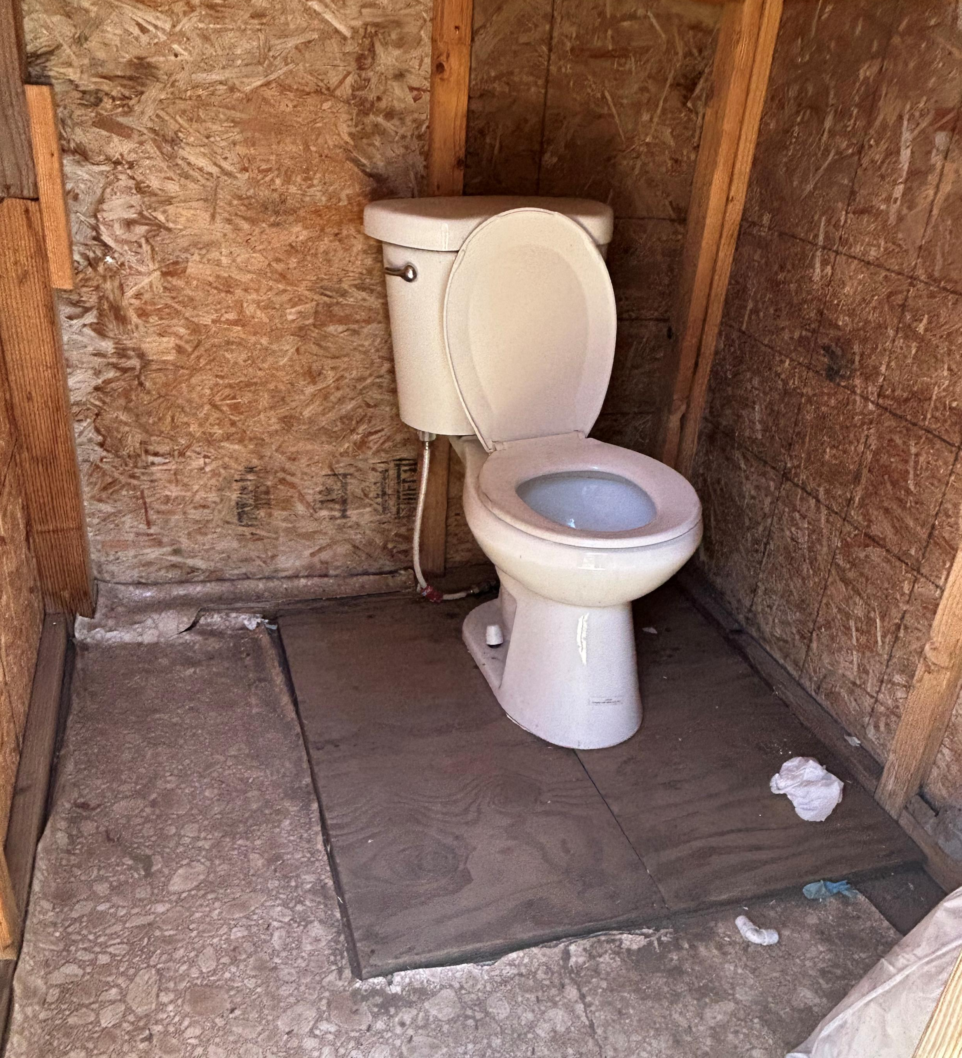
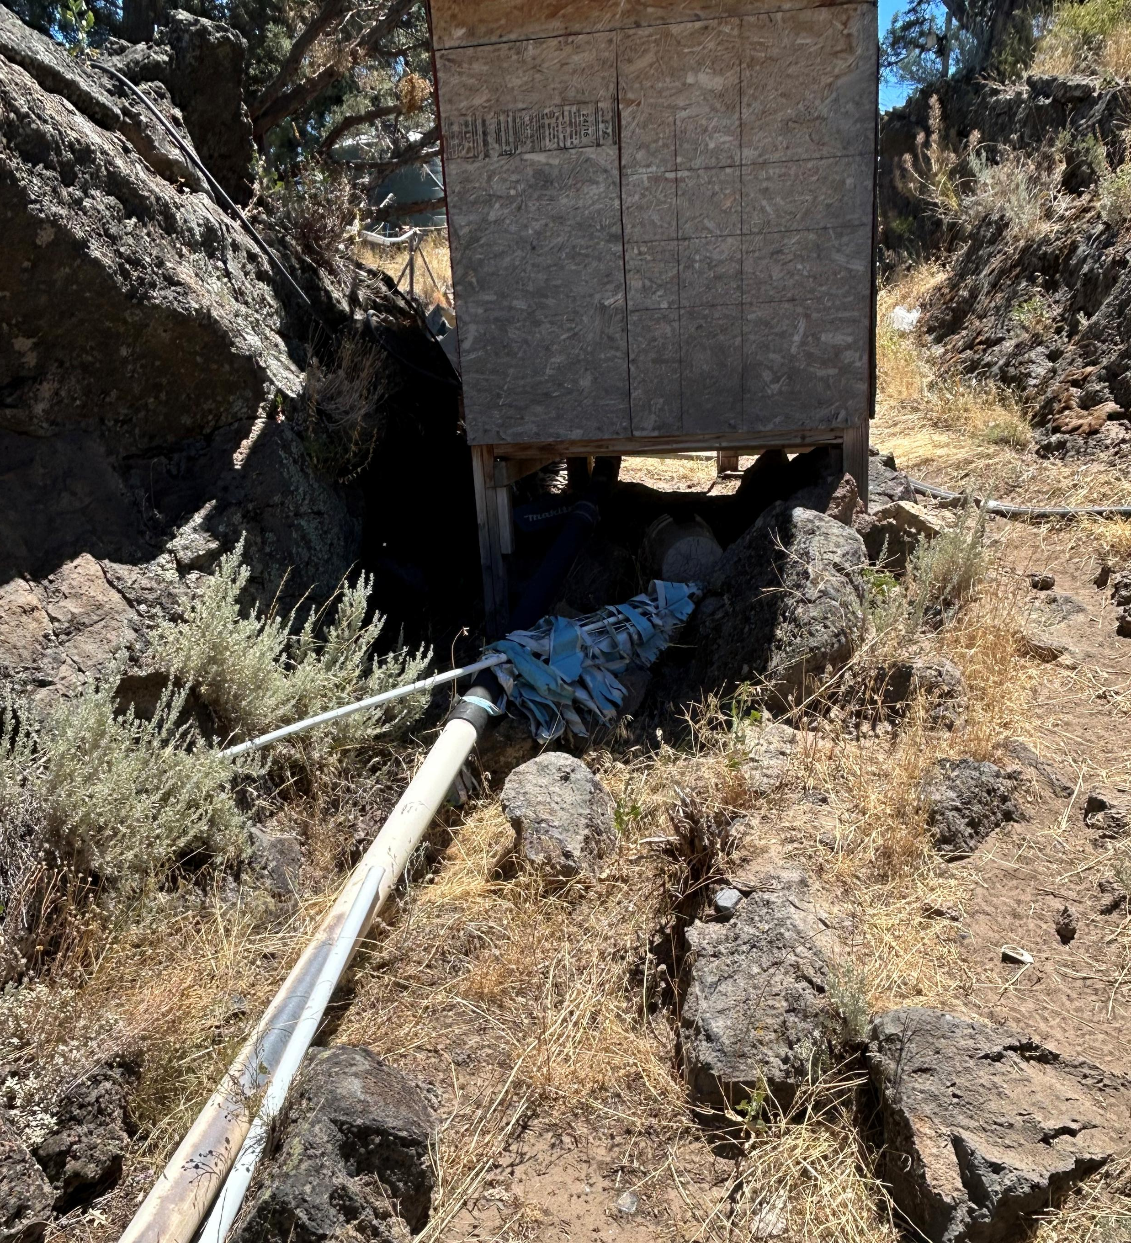

Slide 24
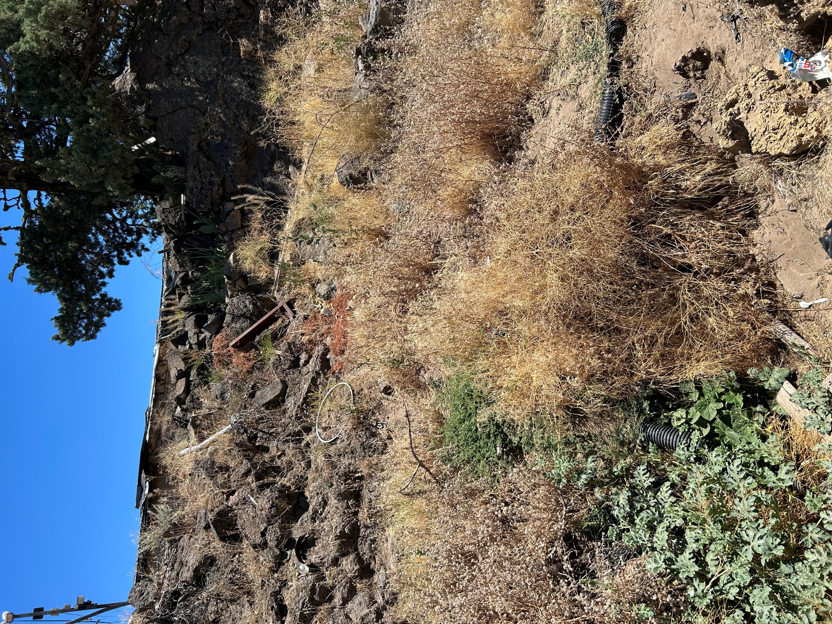
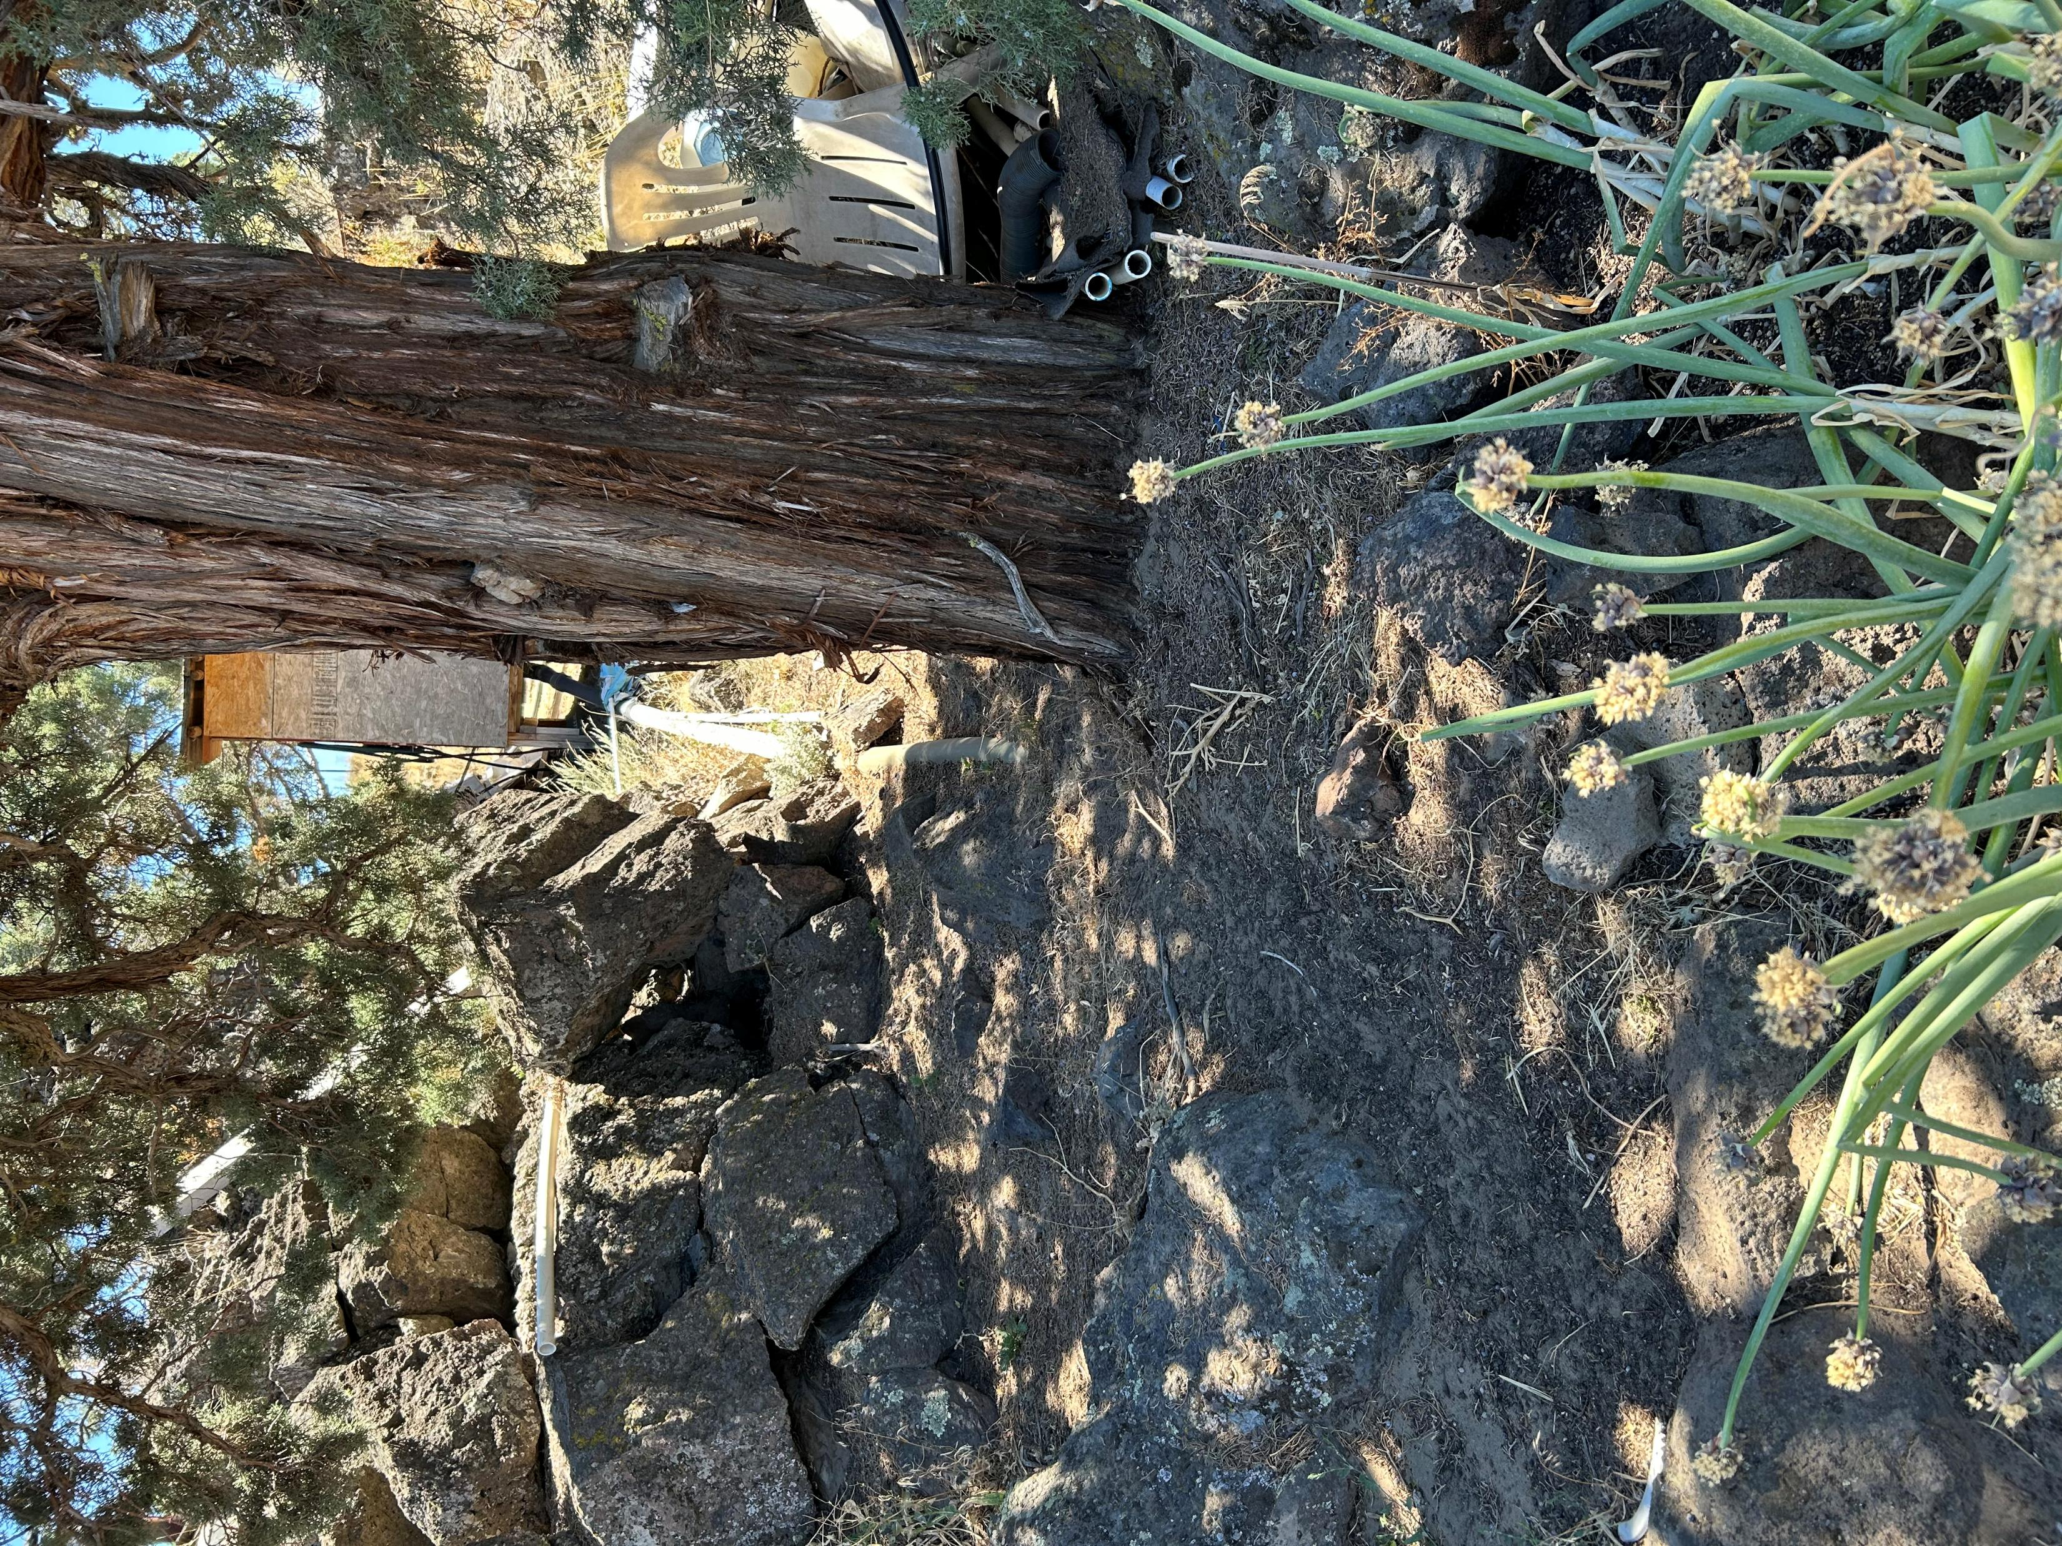
SEWER LINES RUNNING THROUGHOUT PROPERTY

