Slide 1
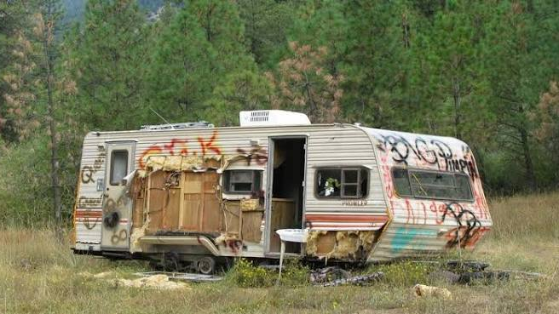
Code Enforcement Authority
Understanding Authority, Limitations and Enforcement Process
Siskiyou County Community Development Department
Board of Supervisors Meeting
August 11, 2026

Slide 2
Purpose
Review
Review Code Enforcement authority
Clarify
Clarify what the County can—and cannot—do
Explain
Explain enforcement tools
Review
Review common enforcement scenarios
Discuss
Discuss legal limitations

Slide 3
Where Does Our Authority Come From?
County Code
State Law
Citation procedures
Building regulations
Planning & zoning
Nuisance abatement
California Constitution
Government Code
Health & Safety Code
Penal Code
Code of Civil Procedure

Slide 4
Code Enforcement Philosophy
Complaint
Investigation
Voluntary Compliance
Administrative Action
Civil/Criminal Remedies
Abatement (when authorized)
Enforcement Priorities
  Health & Safety
  Severity
  Public Impact
  Staff Resources
  Persistent Violations

Slide 5
Available Enforcement Tools
Investigation
Notice of Violation (NOV)
Administrative Citations
Civil Action
Nuisance Abatement

Slide 6
Legal Safeguards
Complaint
Investigation
Notice
Opportunity to Correct
Citation (if necessary)
Appeal Rights
Court

Slide 7
Abandoned Vehicles
What Code Enforcement Does:
Property Owner Options:
Investigates potential County Code violations.
Opens a code enforcement case when warranted.
Seeks voluntary compliance first. Issues notices and citations when violations remain.
May pursue formal nuisance abatement through the legal process when authorized.
Remove the vehicle themselves.
Arrange for removal through a licensed tow company.
Correct the violation before further enforcement action.

Slide 8
Abandoned Vehicles
Private Property
County Property
County may remove
State Highway
CHP/Caltrans jurisdiction
Property owner remains responsible

Slide 9
What Code Enforcement Cannot Do:
Enter private property without authority
1
Ignore due process
2
Remove vehicles without legal basis
3
Compel action outside County Code
4

Slide 10
Key Takeaways
Authority is established by County Code and state law.
Enforcement is discretionary and risk-based.
Voluntary compliance is preferred whenever practical.
Due process protects property owners.
Some situations require lengthy legal processes before action can occur.
Staff acts only within the authority provided by law.

Slide 11
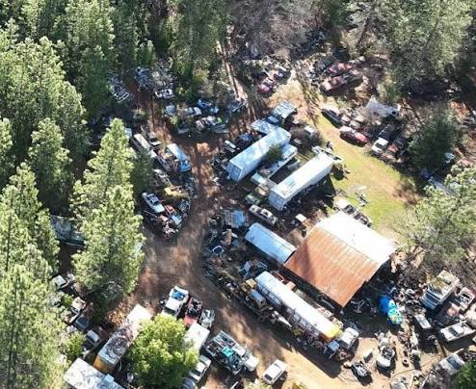
Questions?

