Slide 1
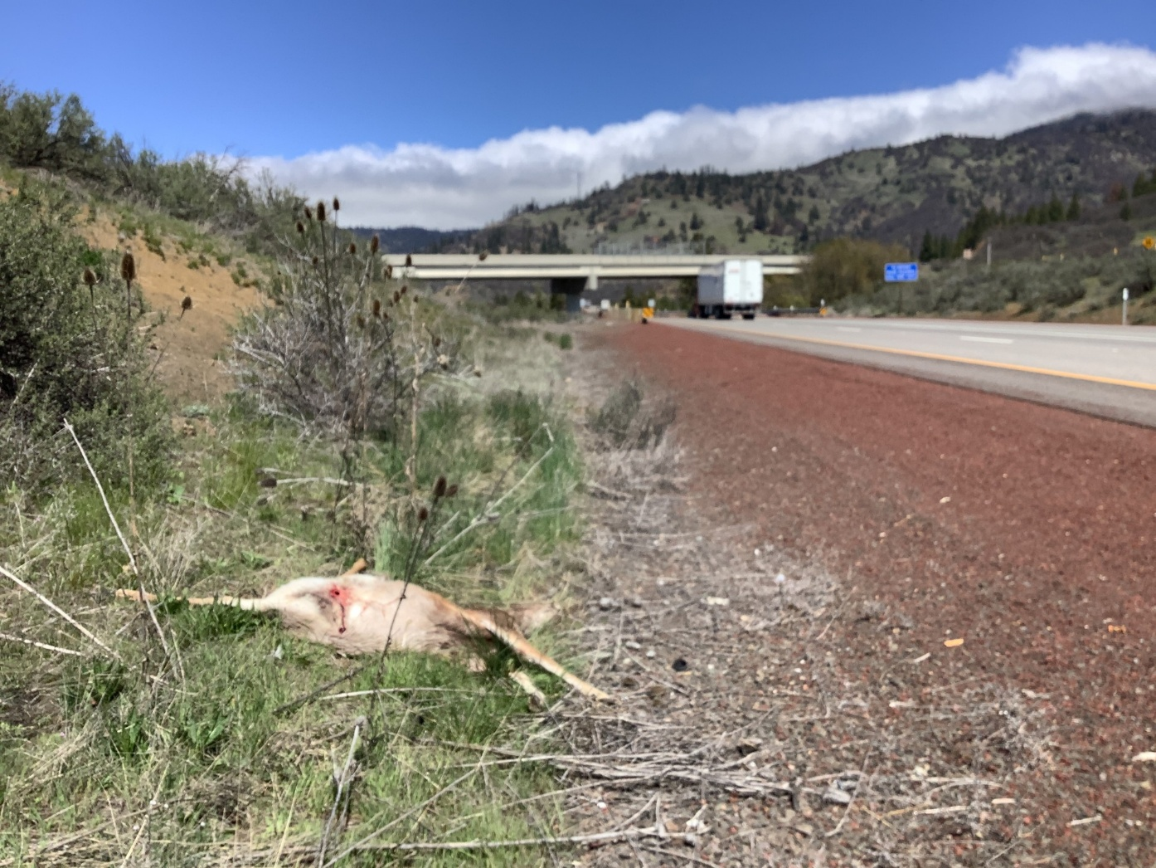
Interstate-5 Siskiyou Wildlife Crossing Planning Project
Fraser Shilling, Brock Ortega, Clara Woodie, Dudek
George Jennings, Ore-Cal RC&DC

Slide 2
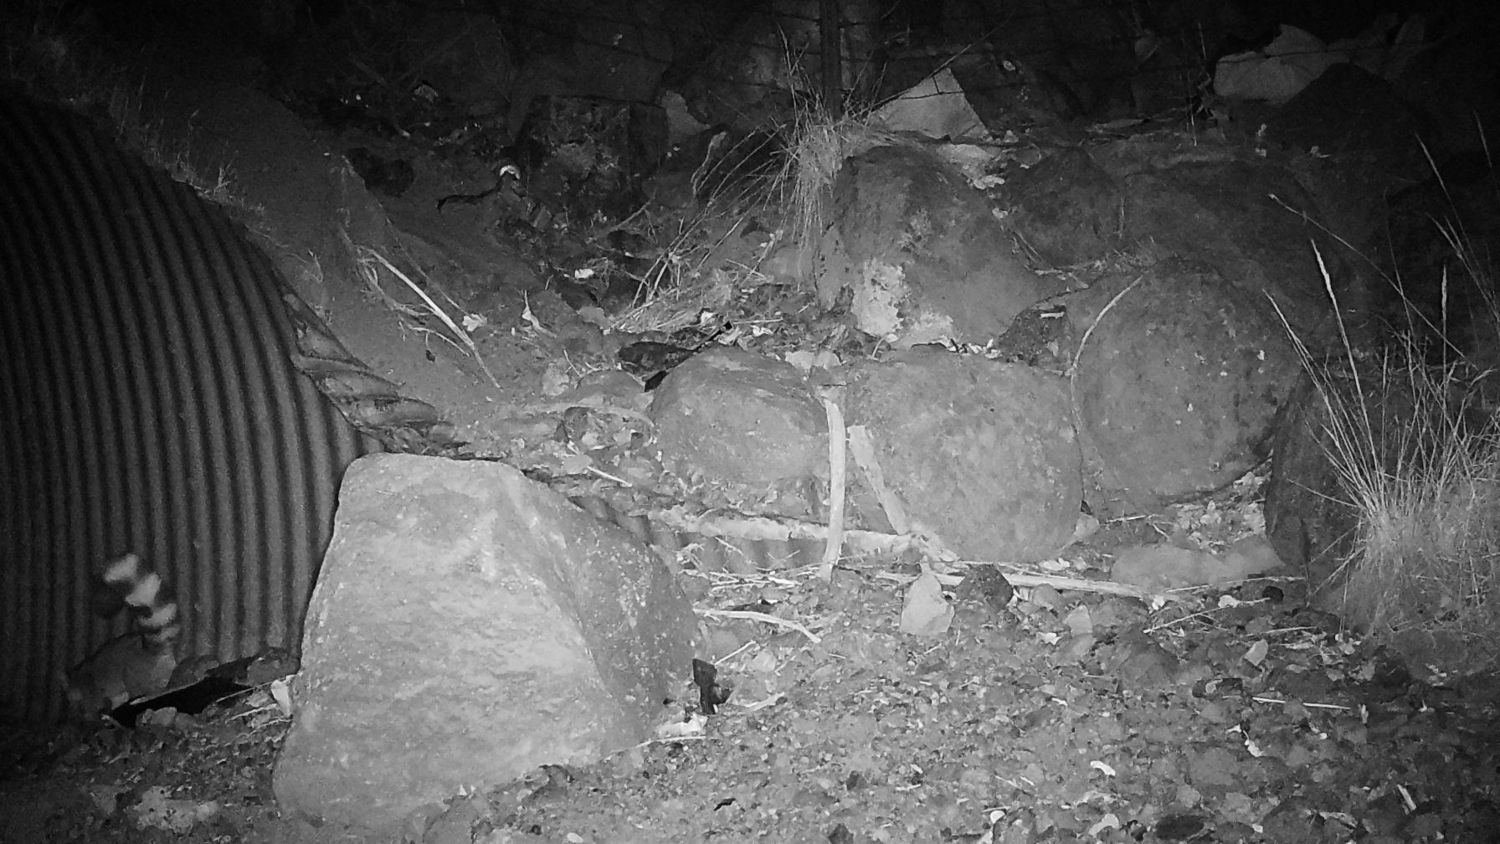
Wildlife Crossings
Existing crossings
Pipe culvert
Box culvert
Arch culvert
Bridge
Over-crossing
Associated structures (fencing, jump-outs)

Slide 3
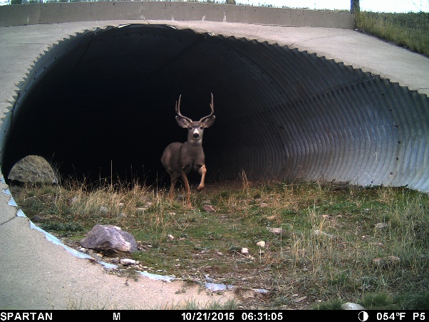
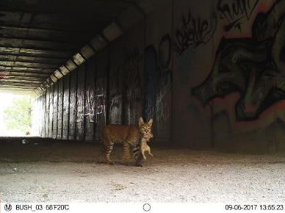
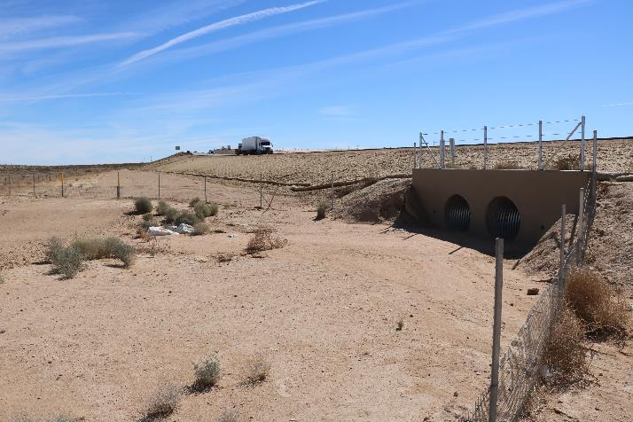
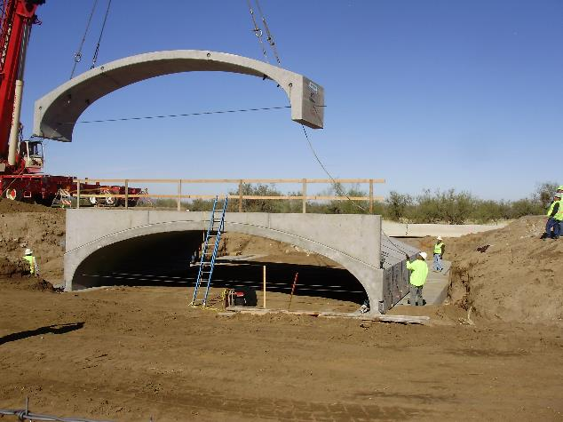
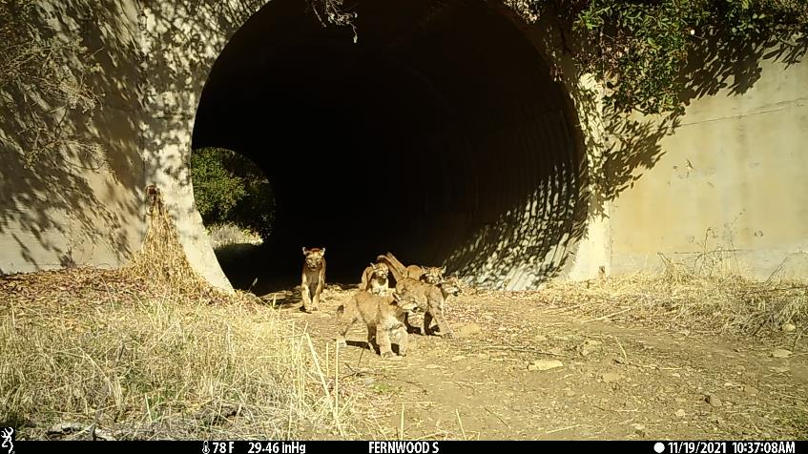
Culverts
Arch
Pipe
Box

Slide 4
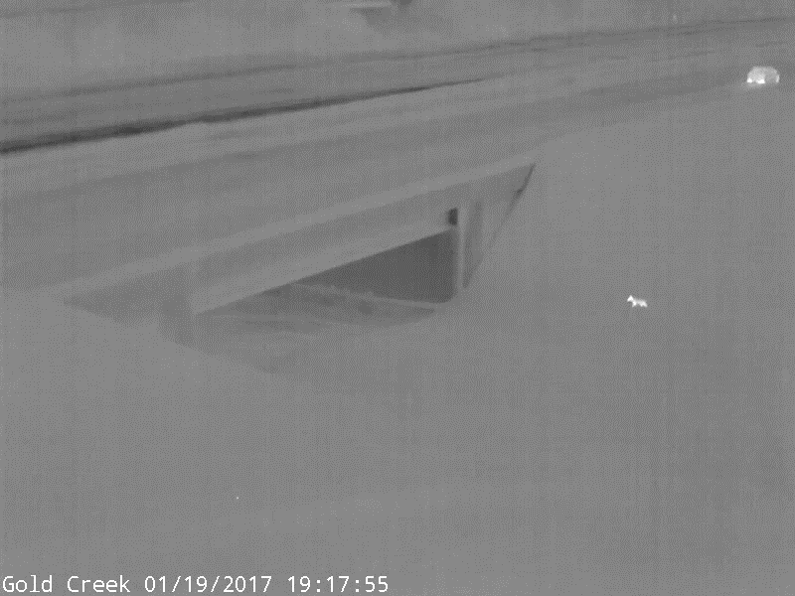
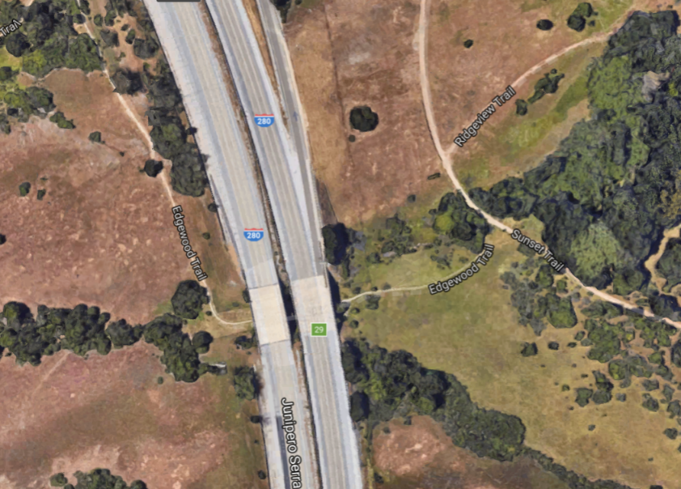
Bridges/under-crossings

Slide 5
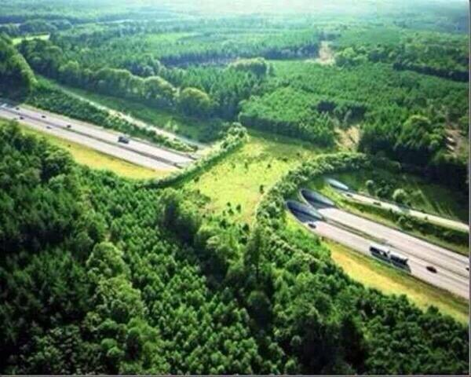
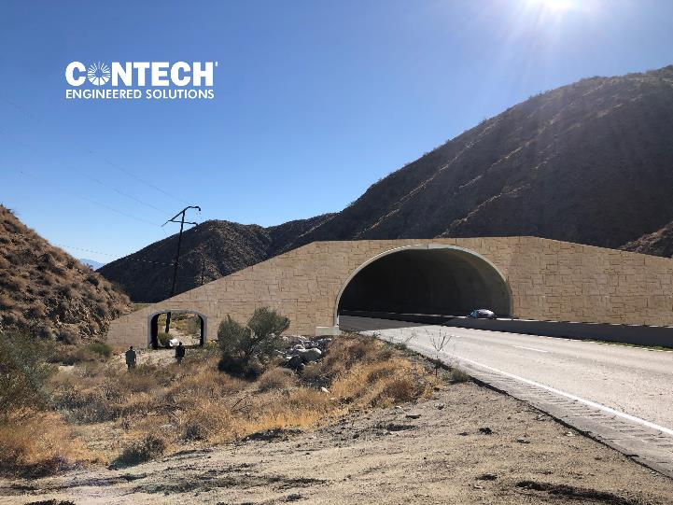
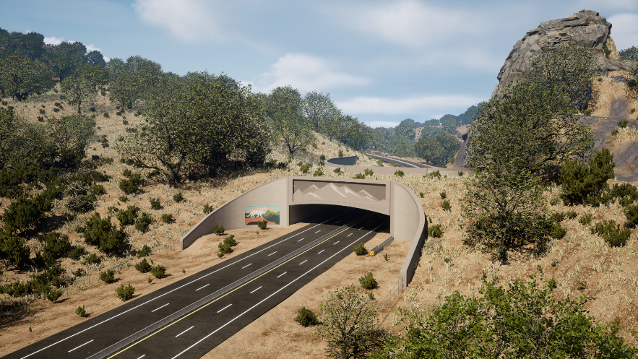
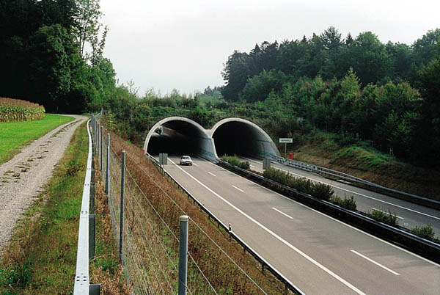
Bridges/over-crossings

Slide 6
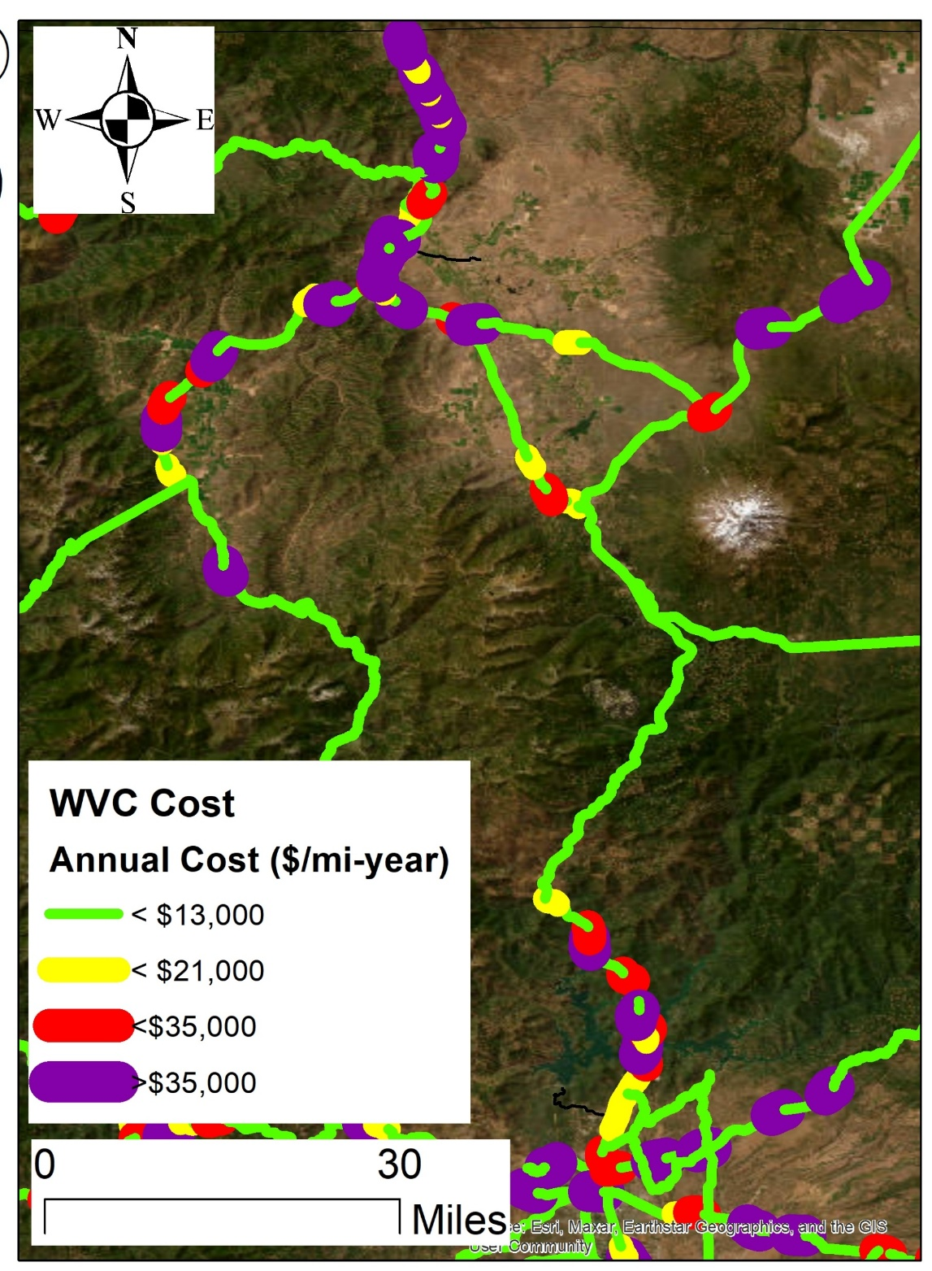
Primary Objectives
High cost of wildlife-vehicle collisions
Prioritize locations to maximize wildlife connectivity AND reduce wildlife-vehicle collisions
5

Slide 7
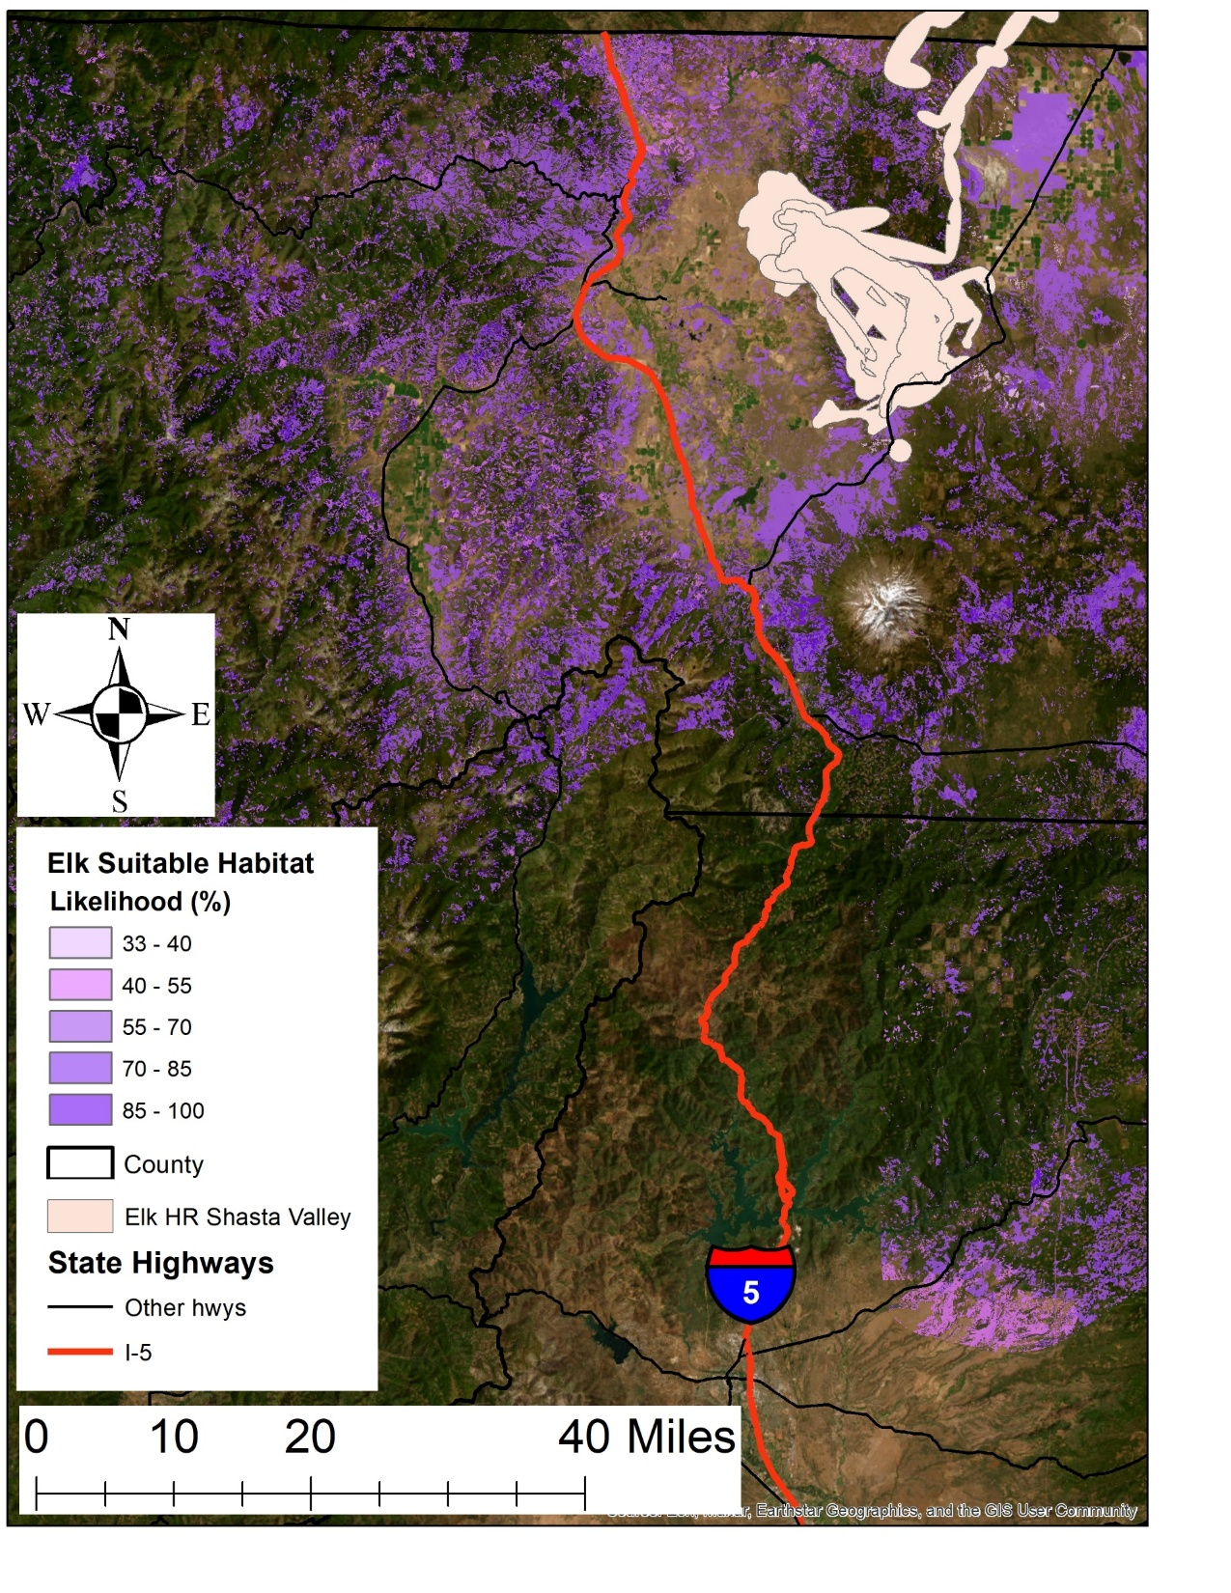
Overall Process
Start with ecology – where are the wildlife and where do they need to move
Engineering feasibility
Caltrans documentation (PID) and environmental clearance
Ends with 65% design

Slide 8
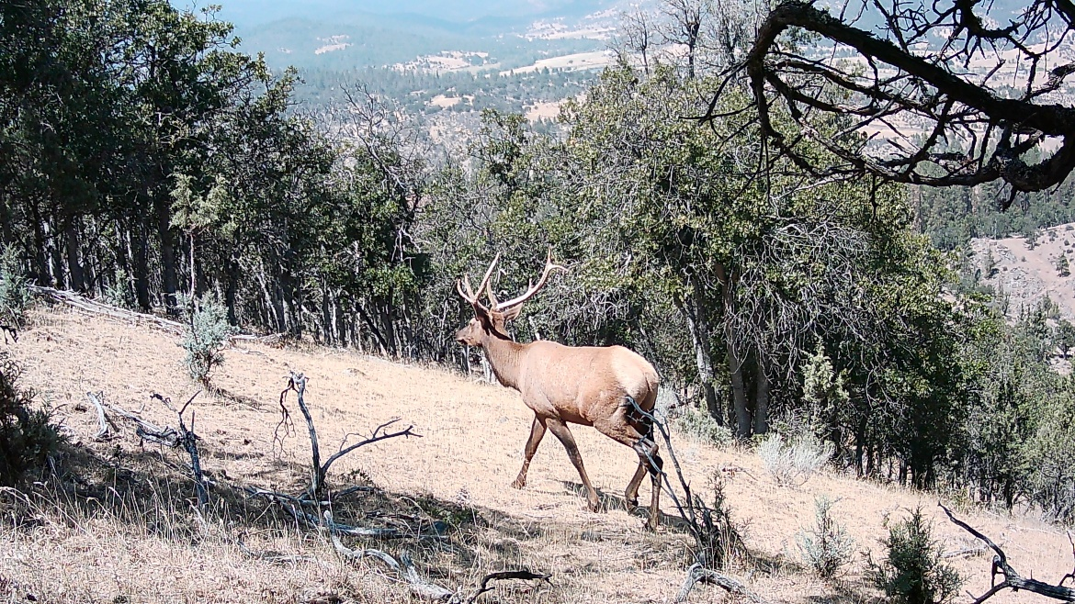
Collect Data
a) Wildlife vehicle collision/roadkill (carcass and crash)
b) Wildlife occurrences
c) Wildlife use of existing highway crossings (cameras, animal sign, DNA)
d) Wildlife habitat
e) Traffic disturbance
f) Slope
g) Ownership/conservation status
h) Nearby roads/development

Slide 9
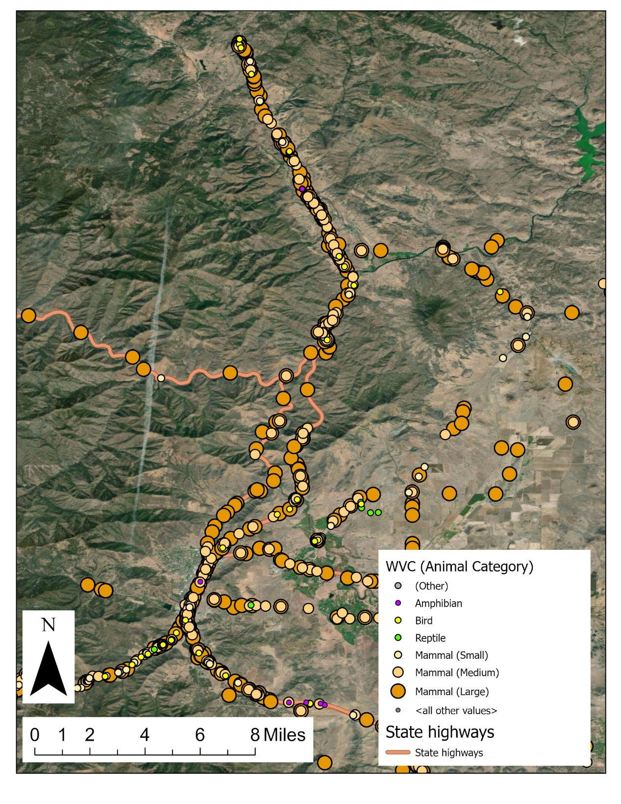
Roadkill/WVC

Slide 10
Suitable Habitat

Slide 11
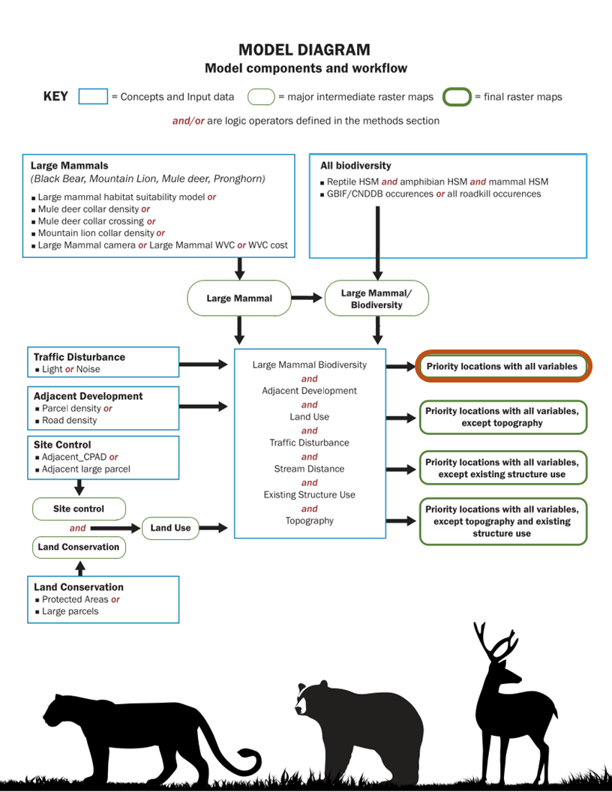
Location Prioritization Model

Slide 12
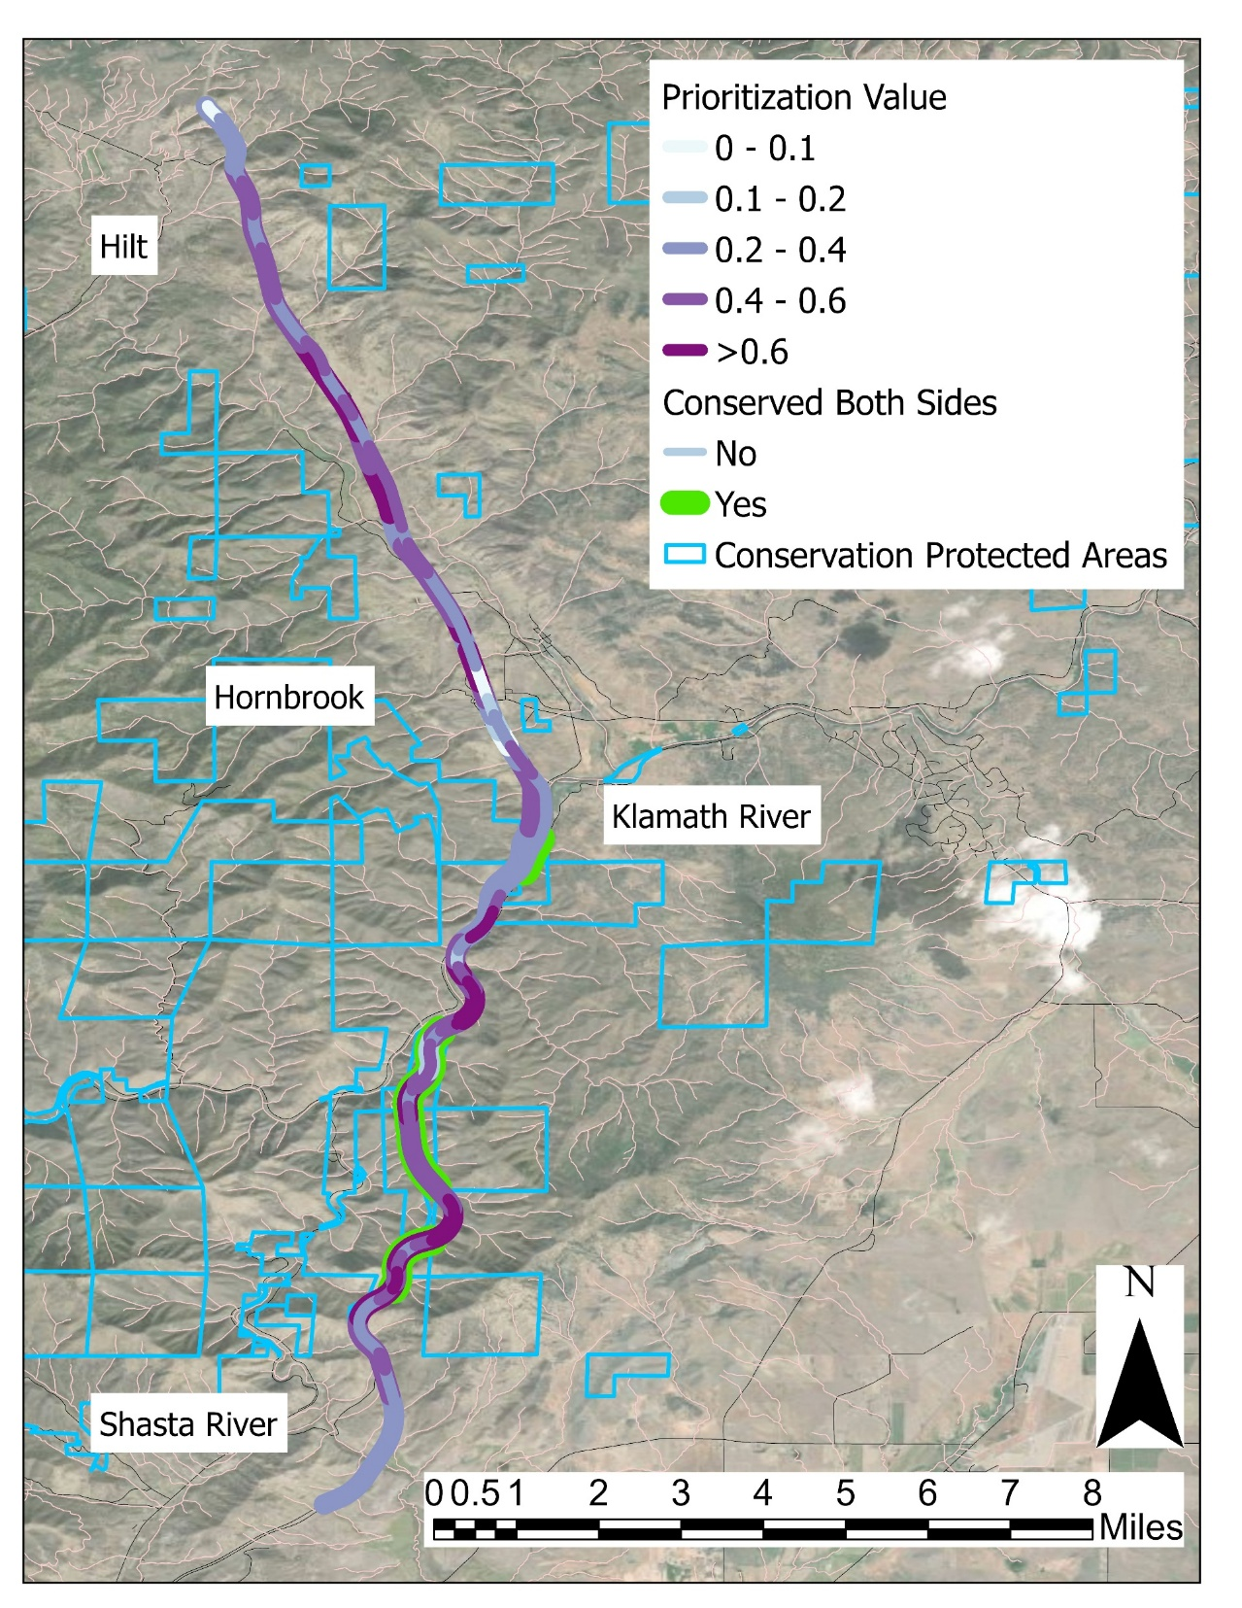
Priority Locations

Slide 13
Gap Analysis
Find the existing structures
Measure or calculate what species will use each one
For each species, identify the gaps along the highway where there is no existing structure
For each stretch (1 mile) of highway, determine how many species have a gap

Slide 14
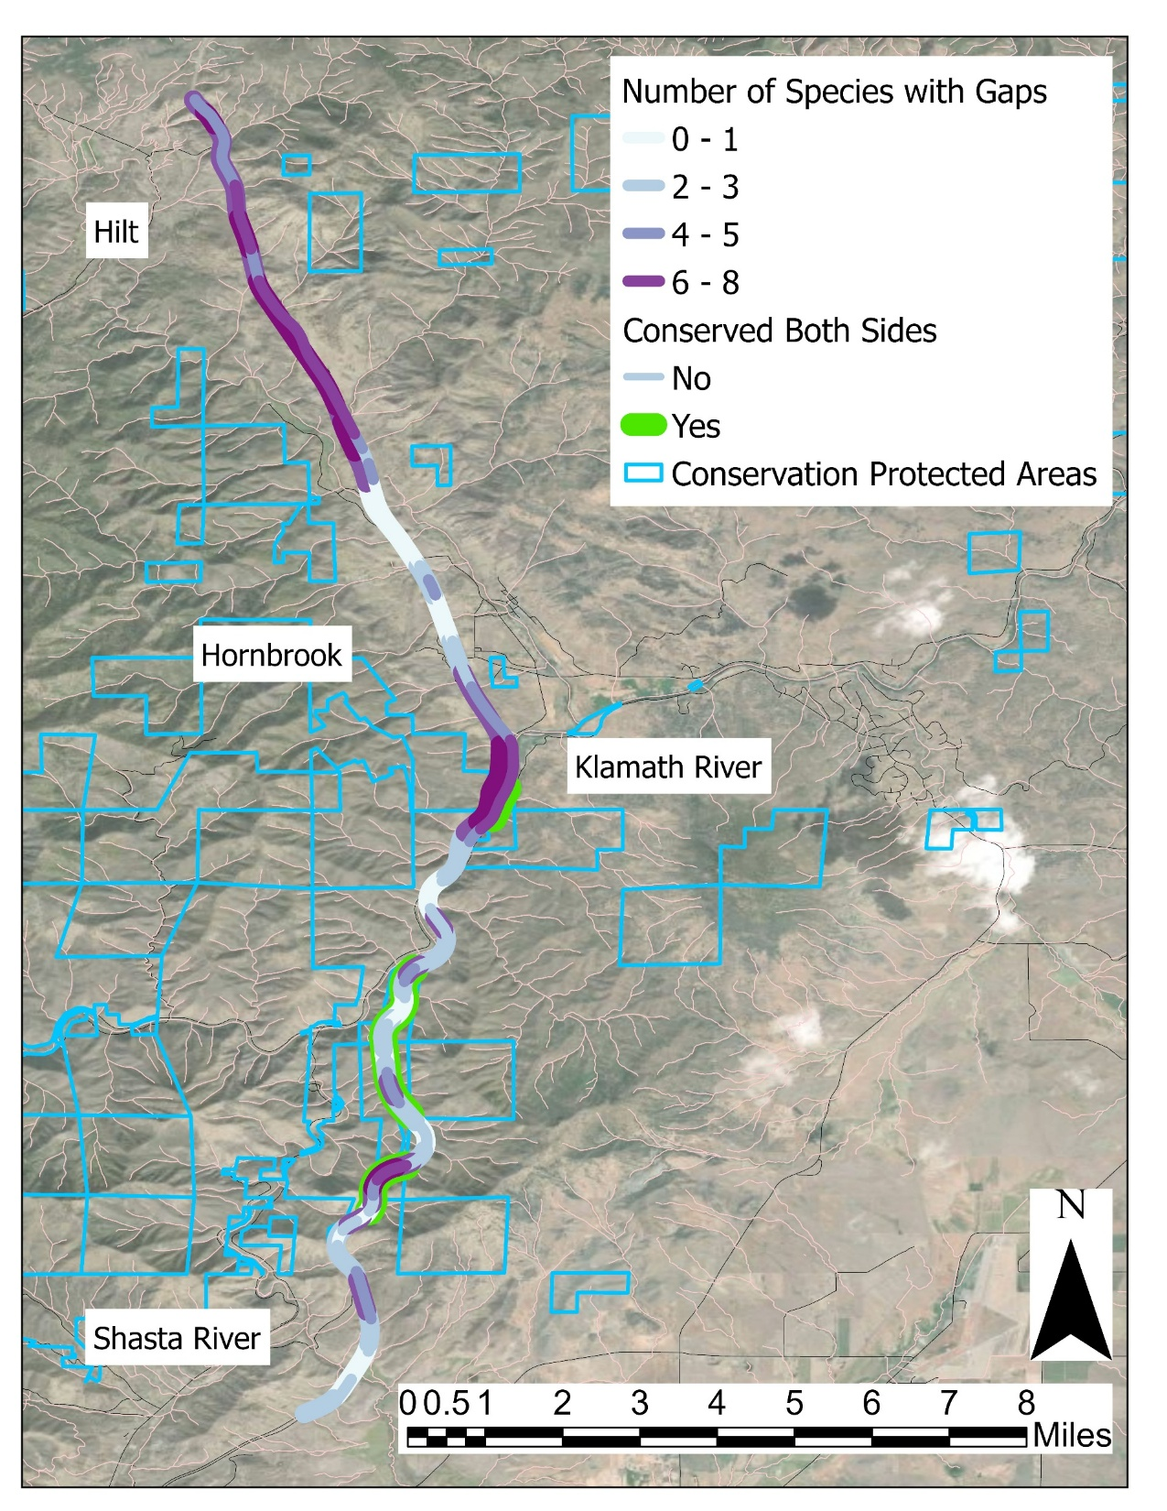
Where are Gaps?

Slide 15
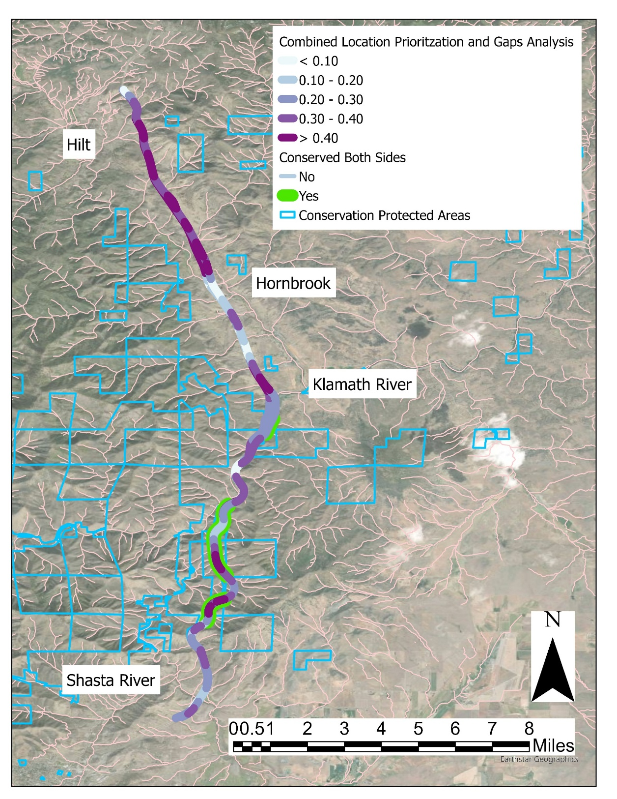
Combined Approach
G
F
E
D
C
B
A

Slide 16
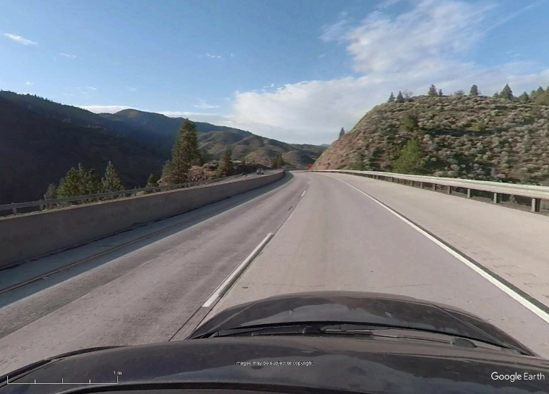
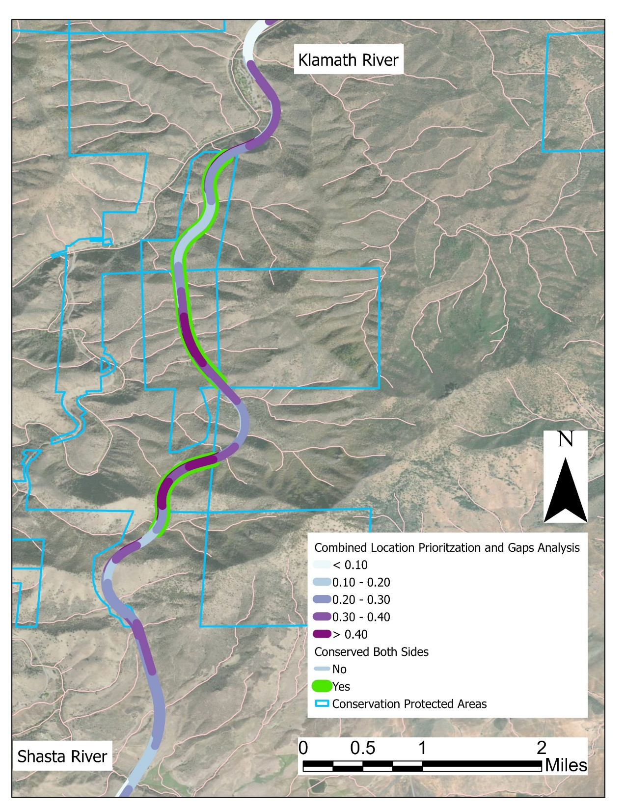
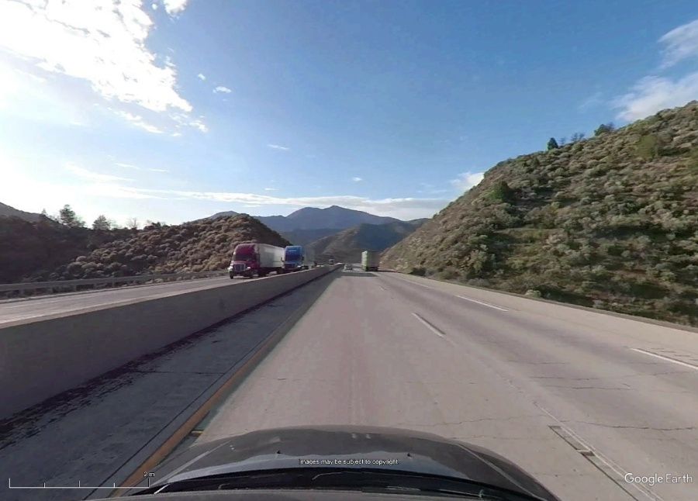
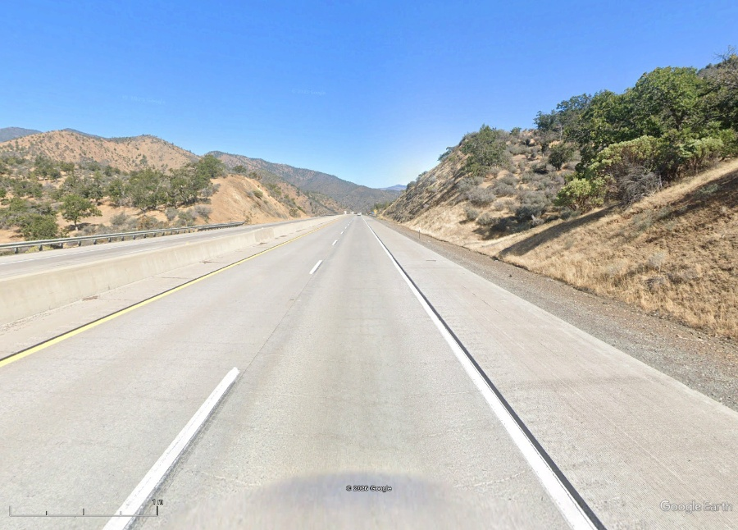
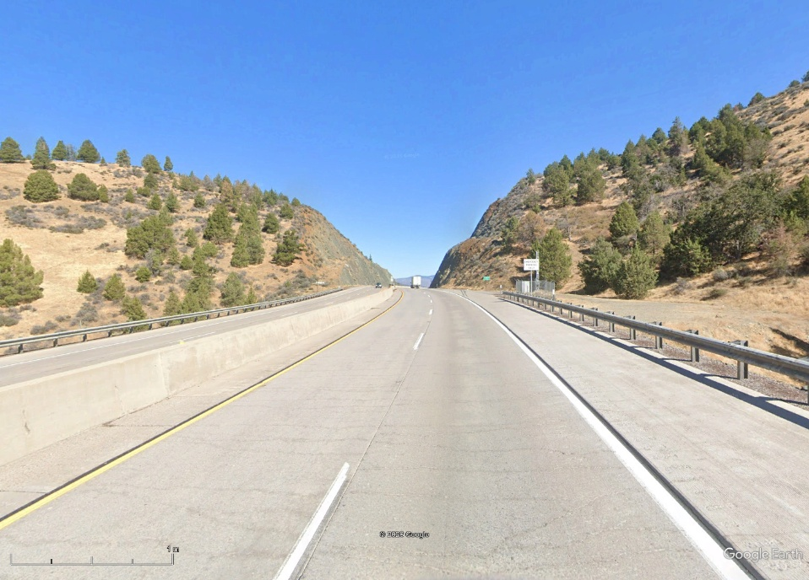
D
B
C
A
Approx locations of OC with high priority values (S Section)

Slide 17
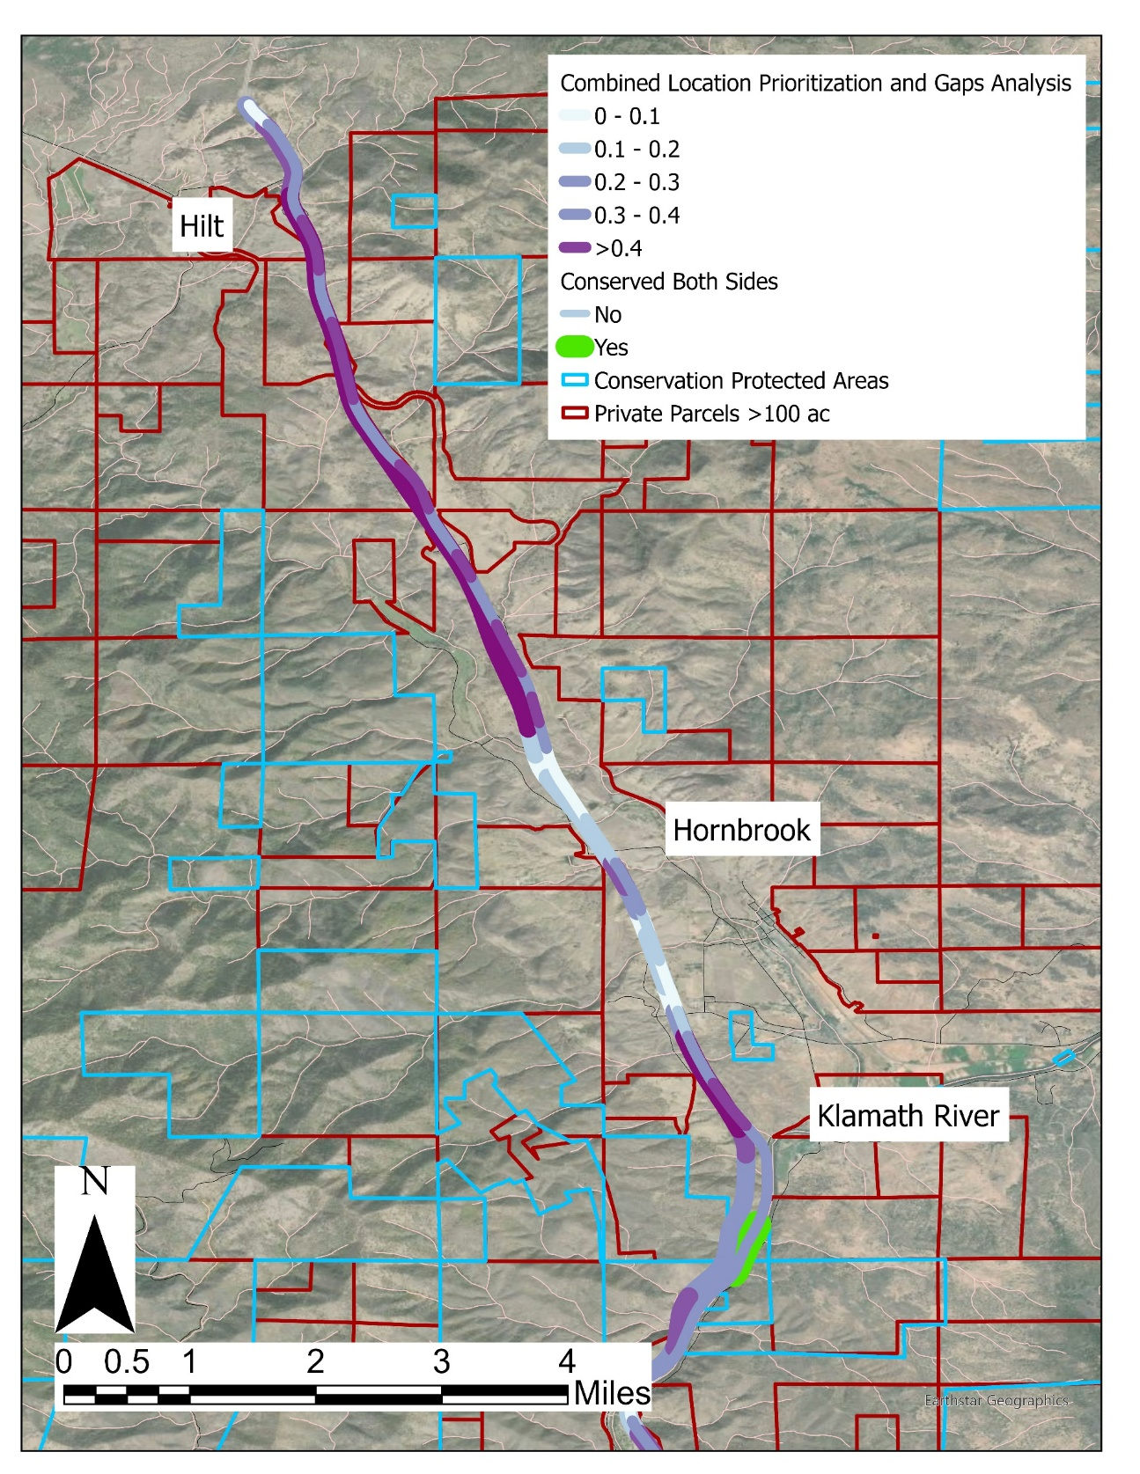
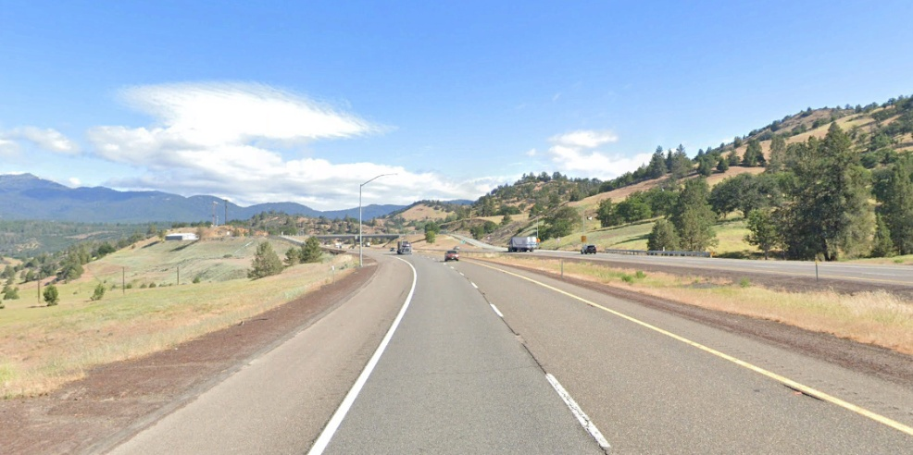
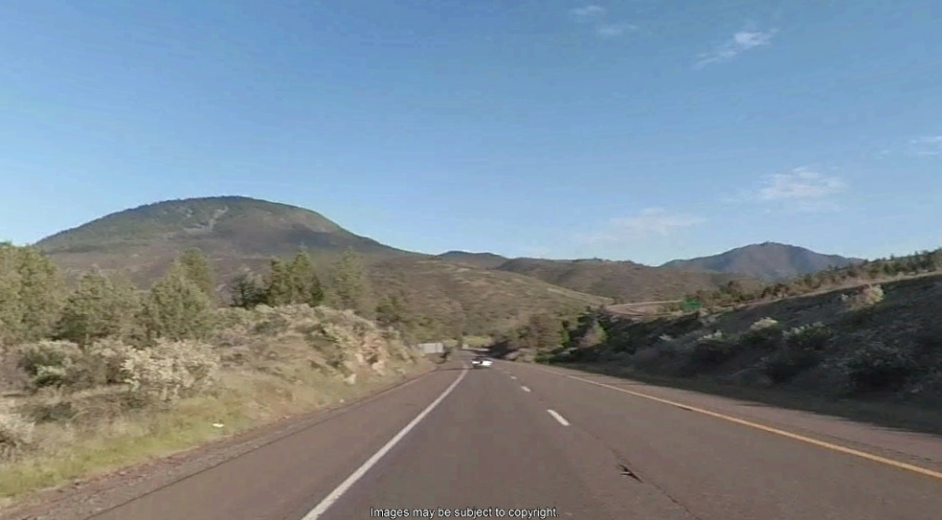
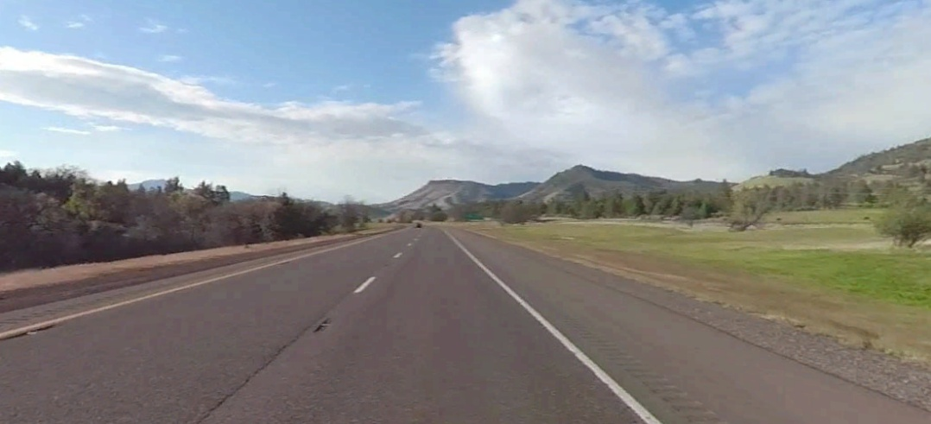
G
E
F

Slide 18
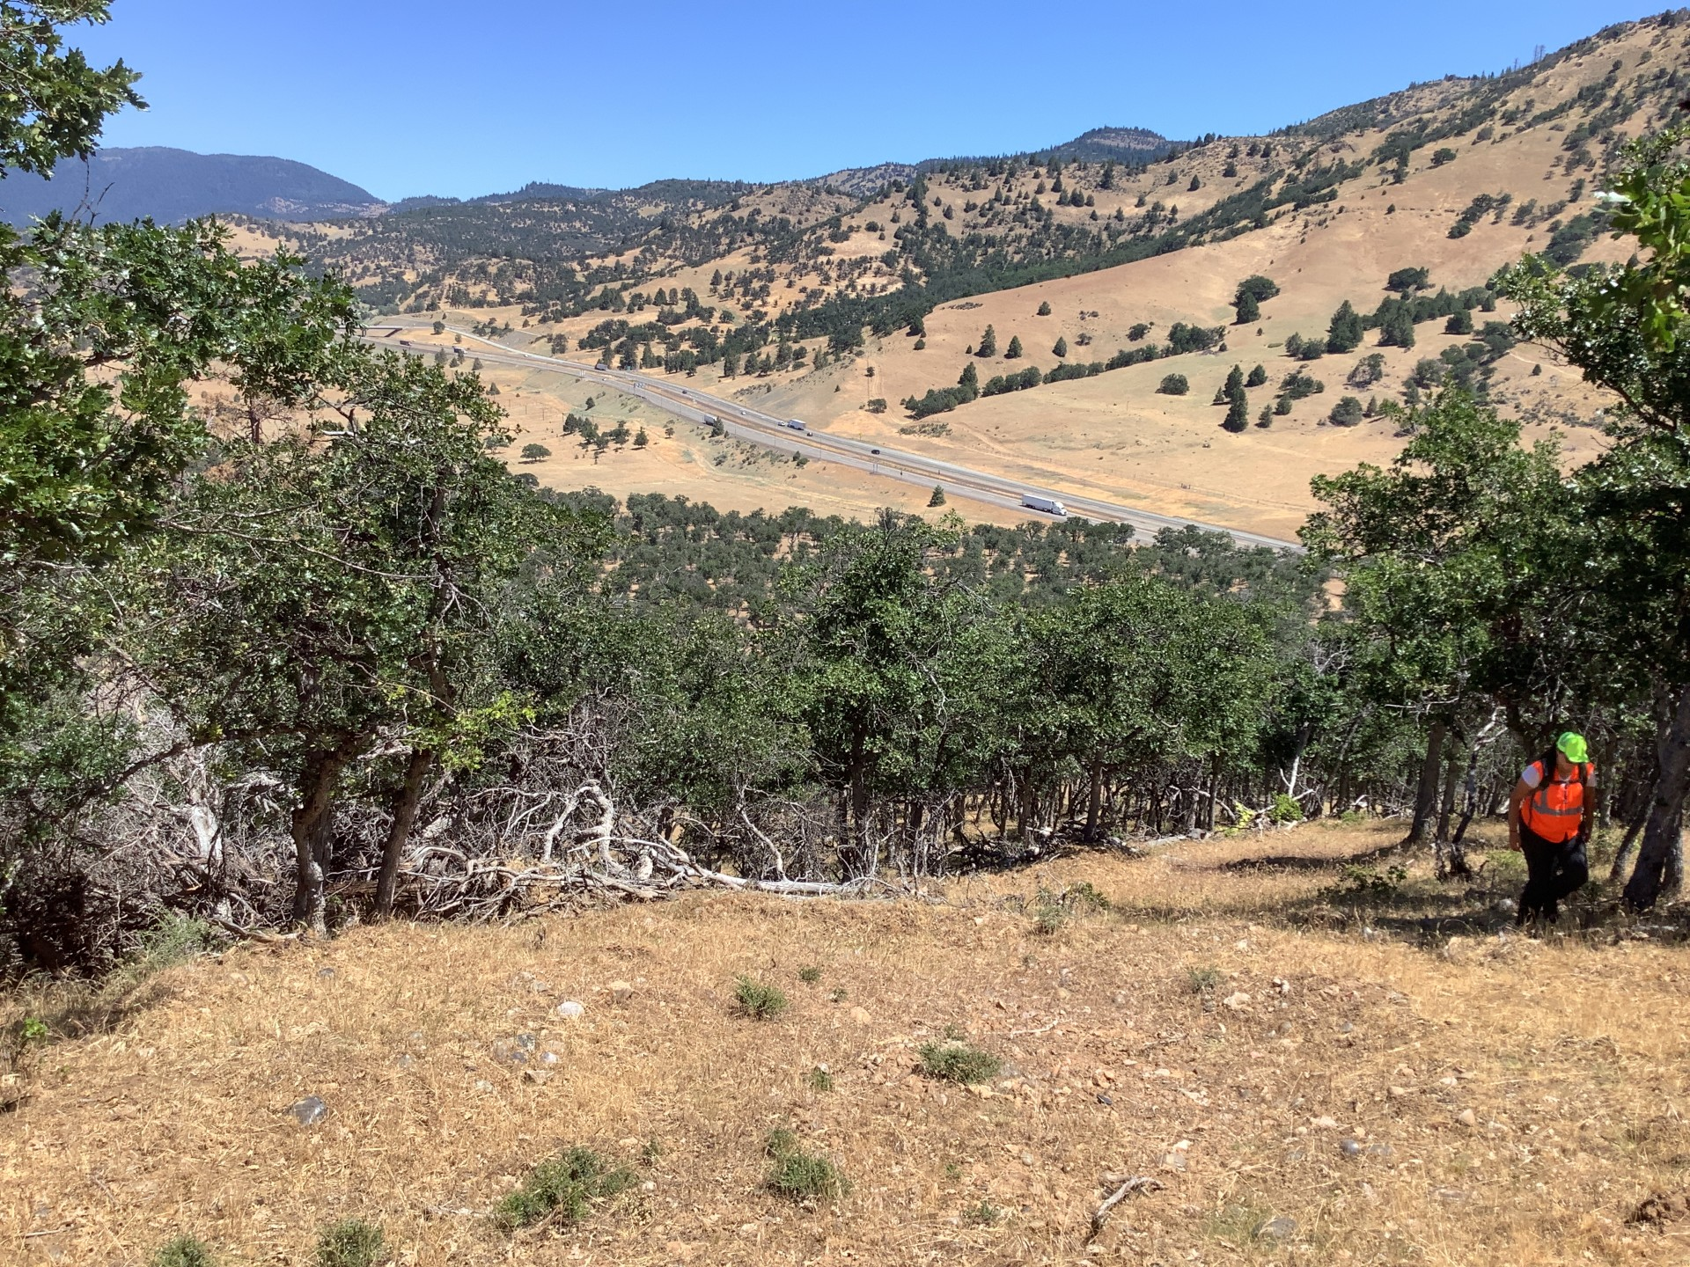
Questions?

