Slide 1
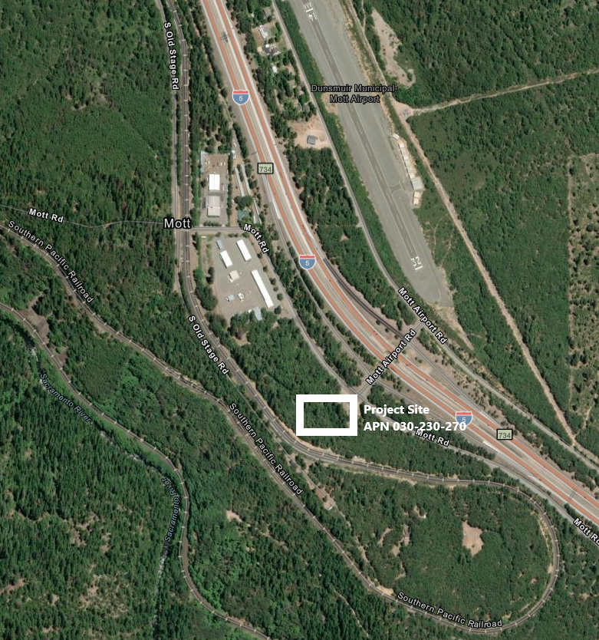
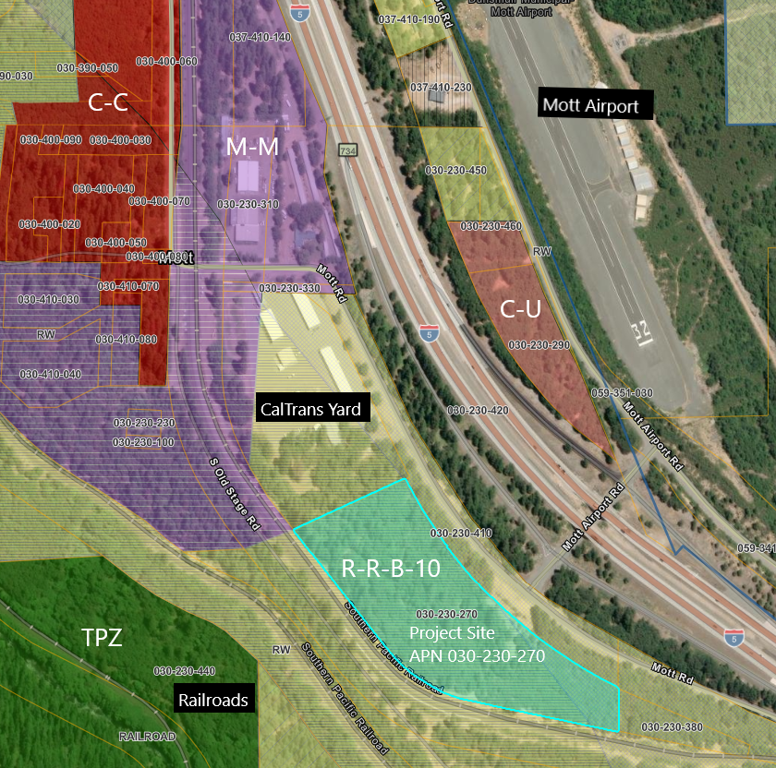
NAME: Allen Baradar (Z-26-01)
PUPROSE: Rezoning 11.40 acres from R-R to C-H.
AG-2-B-40
TPZ

