Slide 1
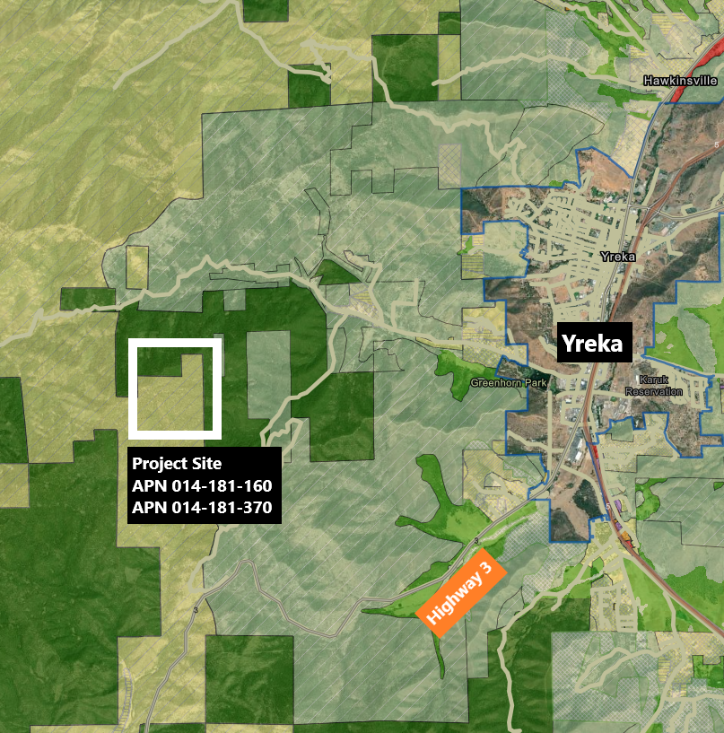
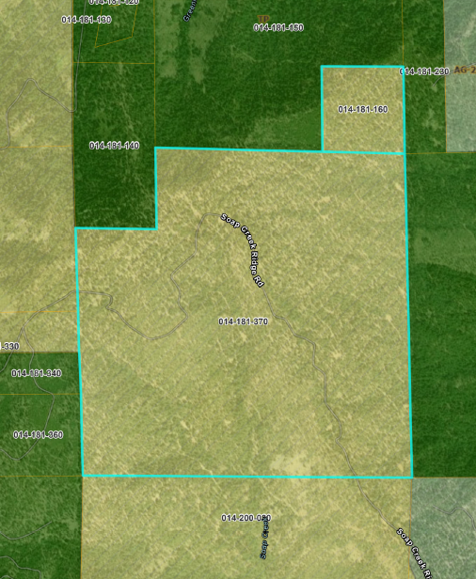
ITEM: 11F
NAME: Acer Klamath Forest (Z-24-05)
PUPROSE: Rezoning 640 acres from R-R to TPZ.
TPZ
R-R-B-40

