Slide 1
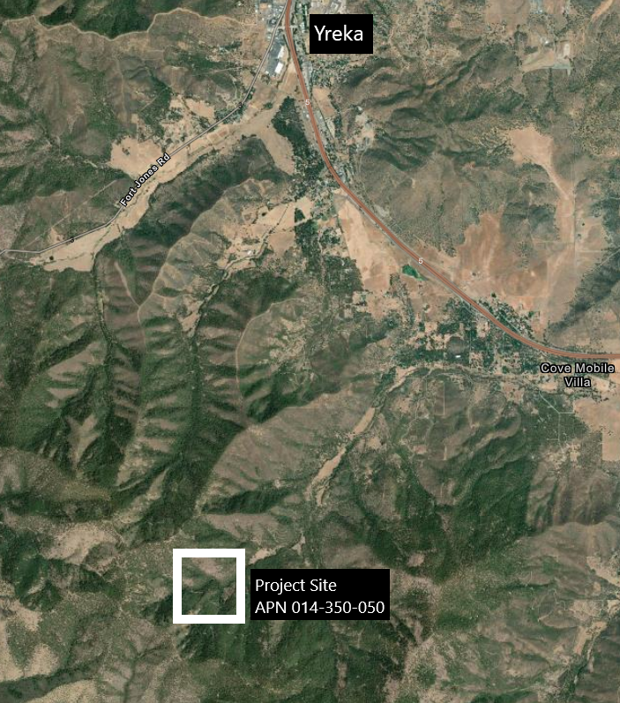
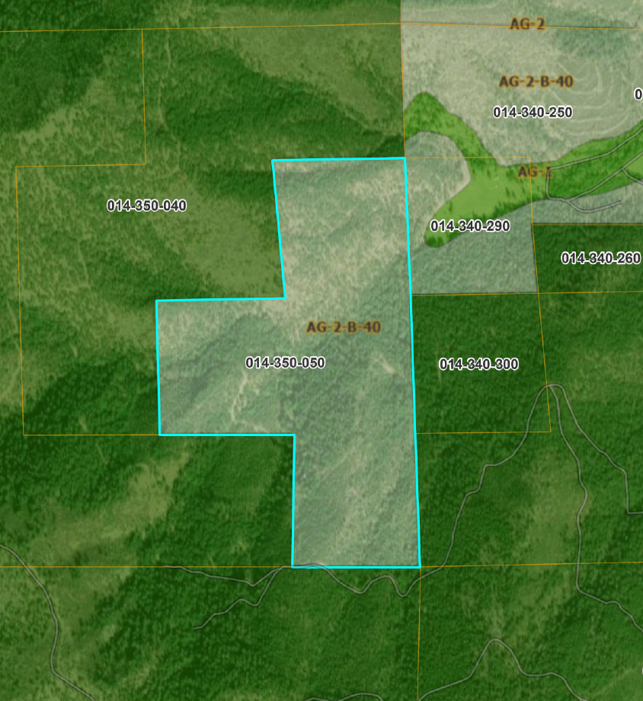
NAME: Shasta Cascades Timberlands (Z-24-04)
PUPROSE: Rezoning 160 acres from AG-2 to TPZ.

