Slide 1
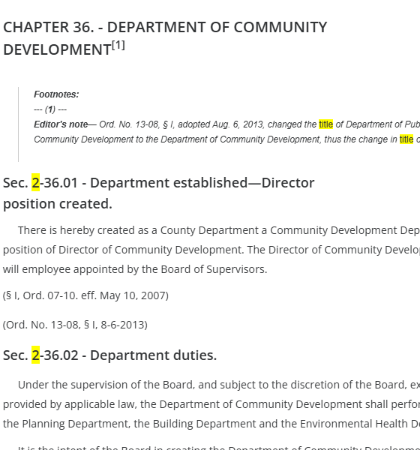
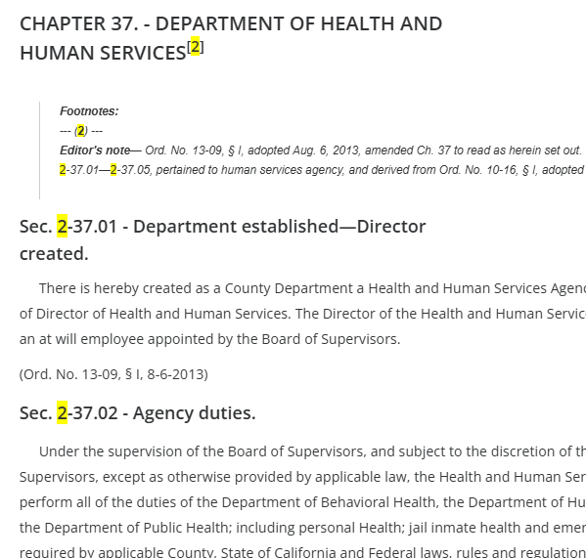
ITEM: 11D
NAME: Title 2, Chapters 36 and 37
PUPROSE: Repeal and replace Title 2, Chapters 36 and 37.

