Slide 1

BOND BHCIP ROUND 2: UNMET NEEDS
Siskiyou County Health and Human Services Agency,
Behavioral Health Division

Slide 2
Bond bhcip round 2
Proposition 1 passed in March 2024 by California voters: Approved initiative to strengthen behavioral health systems.
Key aspects of Prop 1 include:
  • Administered by DHCS
  • Behavioral Health Services Act (BHSA): Replaces the 2004 Mental Health Services Act to focus funding on individuals with the most significant behavioral health needs.
  • Bond Funding: Authorizes $6.38 billion for the Behavioral Health Infrastructure Bond Act.

Slide 3
Siskiyou county award
- Siskiyou County HHSA, Behavioral Health Division received a conditional award letter for BHCIP Round 2
- Award Amount: $23,707,541.00
- New Mental Health and Substance Use Disorder Outpatient Clinic

Slide 4
match funding
$2,370,754.10 is the required match amount
Siskiyou County HHSA, Behavioral Health Division, will provide the required match using three eligible sources.
$175,000.00 will come from the In-Kind equity value of the Bond BHCIP project property. This property is located on Moonlit Oaks.
$1,525,000.00 will come from designated MHSA funds as cash match.
$1,000,000.00 will come from Opioid Settlement funds as cash match.

Slide 5
progress to date
10/21/25 Board of Supervisors voted YES, to adopt Resolution 25- 181, authorizing the Chair to sign the letter of support, and, if awarded funds, authorize the County Administrator or designee to execute the resulting agreements and documents necessary to implement the BHCIP project.
10/28/ 25 Submitted BHCIP Application
3/11/2026 Received Conditional Award Letter
3/18/2026 Attended Conditional Awardee Kickoff Webinar
3/25/2026 Submitted Award Acceptance and Award Attestation
4/1/2026 Submitted Match Funding Documentation

Slide 6
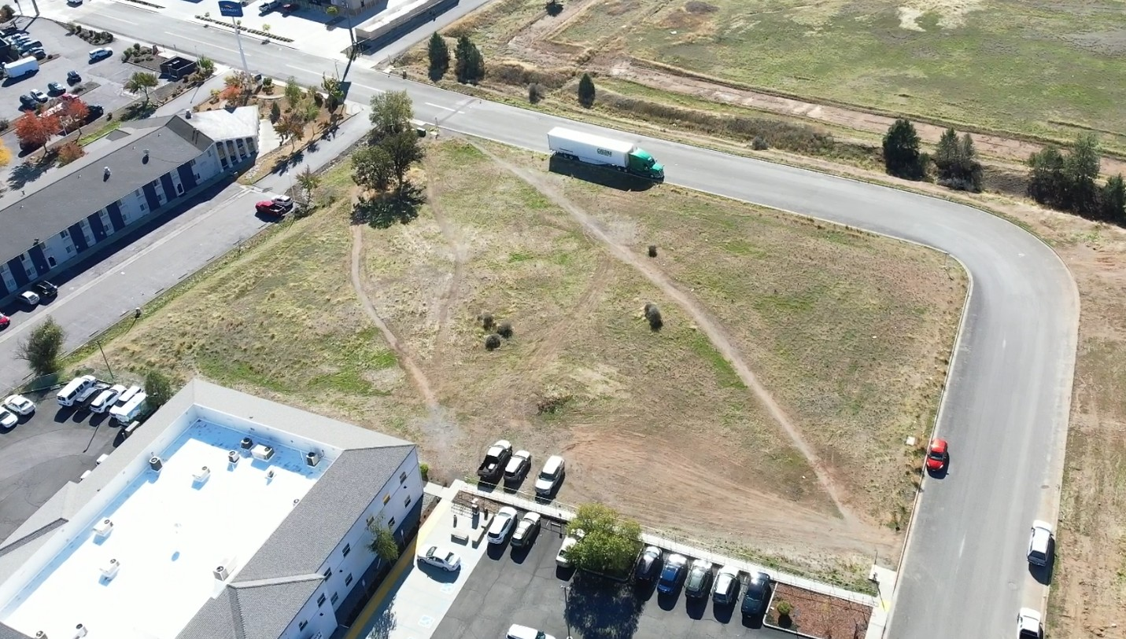
Project site

Slide 8
Estimated project timeline
Contract with Architect: 6/2026
Program Funding Agreement (PFA) Executed: 6/2026
Project Completion: 6/2031

Slide 9
Key takeaways
• 240 applications were submitted to DHCS for BHCIP Round 2
• BHCIP Round 2 was a highly competitive, with only 66 projects awarded statewide.
• Siskiyou County is the proud to be one of the selected recipients.
• This funding provides critical opportunity to enhance and expand behavioral health services.
• A new facility will help:
• Reduce stigma
• Improve access to care
• Address limitations of our current building
• Provide long-term cost savings through county ownership
• This investment represents a meaningful step forward in strengthening behavioral health services for our community.

Slide 10

Thank you

