Slide 1
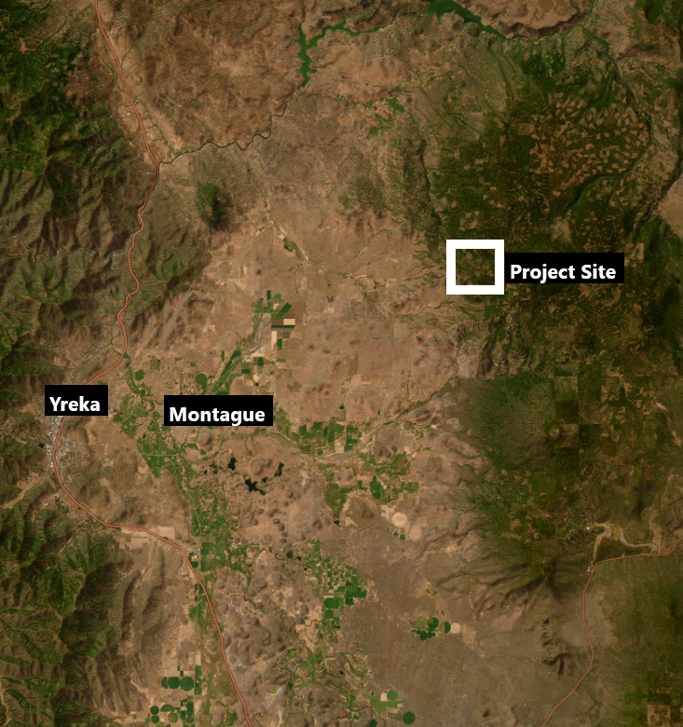
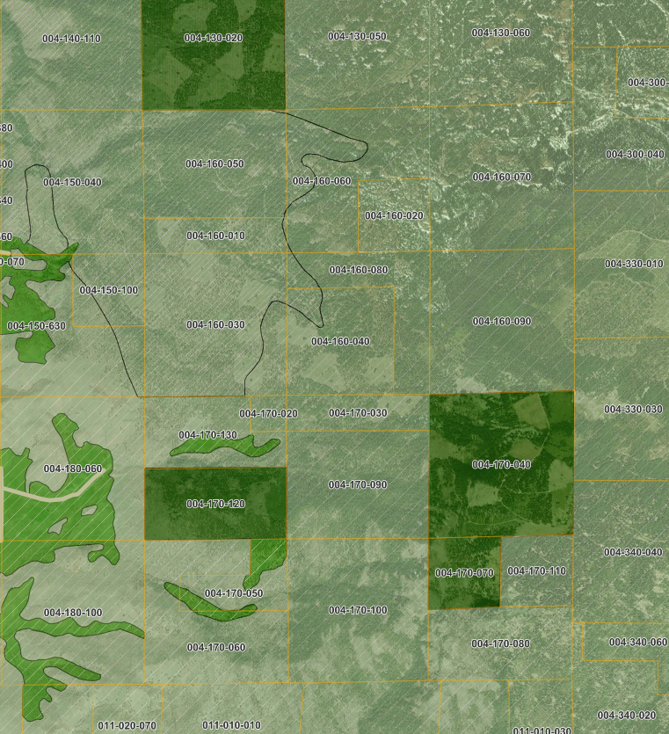
ITEM: 11G
NAME: Acer Klamath Forest (Z-24-06)
PUPROSE: Rezoning 2,600 acres from AG-2 to TPZ.
AG-2-B-40
TPZ

