Slide 1
Welfare fraud - trish Barbieri, director, social services division

Slide 2
Welfare fraud
Welfare fraud activities are required in all California County Welfare Departments (CWD). In Siskiyou County the CWD is referred to as the Social Services Division, or SSD.
Welfare fraud activities ensure integrity and efficiency in all social service programs administered by the SSD.
These activities are essential for maintaining transparency and accountability in social service programs.
The consequences of welfare fraud extend beyond financial loss, as it erodes public trust in social safety nets and diverts resourcesfrom where they are truly needed.

Slide 3
Welfare fraud SPECIAL INVESTIGATIONS unit (SIU)
Through a Memorandum of Understanding, the SSD contracts with the District Attorney for the investigation and prosecution of welfare fraud.
The SIU unit works closely with the SSD but by statute, operates independently from SSD. The SIU must be a separate organization, independent of organizations performing eligibility and benefit determination functions. Counties must ensure separate and independent operation of eligibility and investigation activities. SIU staff cannot dictate CalWORKs or CalFresh eligibility determinations but can make recommendations.
Currently, the SSD contracts for two fulltime District Attorney Investigators and one half-time evidence technician. The SSD employs office support staff to support the investigative team.

Slide 4
Program integrity efforts
Program Name | SIU Program Integrity Efforts | External Program Integrity Efforts | Who Completes Program Integrity?
TANF (CalWORKs) | Yes | Yes* | SIU & CDSS
SNAP (CalFresh) | Yes | Yes* | SIU & CDSS
General Assistance | Yes | - | SIU
Medi-Cal | No | Yes | DHCS
IHSS | Coming Soon | Yes | DHCS
* CDSS performs enhanced program integrity activities through the use of advanced fraud-prevention technology.

Slide 5
What is welfare fraud?
CLIENT WELFARE FRAUD occurs when applicants or recipients lie or misrepresent information on applications or other program forms to receive benefits they are not entitled to or misuse their benefits in illegal ways.
INTERNAL WELFARE FRAUD occurs through the fraudulent actions of SSD staff for personal gain.
Welfare fraud also includes EBT fraud.

Slide 6
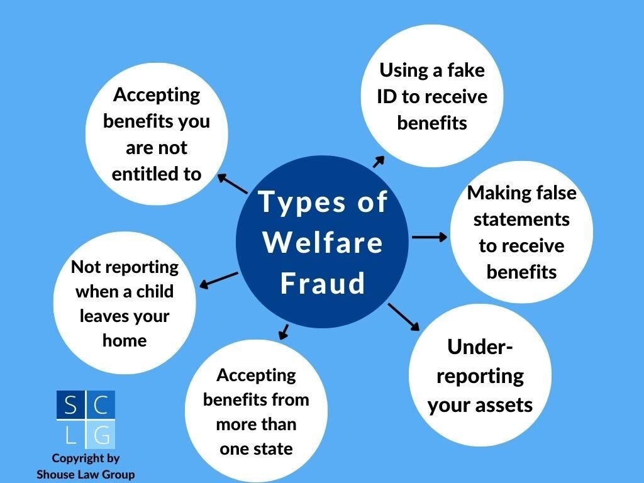

Slide 7
What is Ebt Fraud?
EBT Fraud refers to the illicit use of theft of benefits provided through the Electronic Benefits Transfer (EBT) system.
When a theft incident is reported and confirmed by a county caseworker, counties reimburse the victim. These reimbursements are largely paid for by the state.
In the month of January 2024, victims were reimbursed $20.9 million for stolen EBT benefits in California.

Slide 8
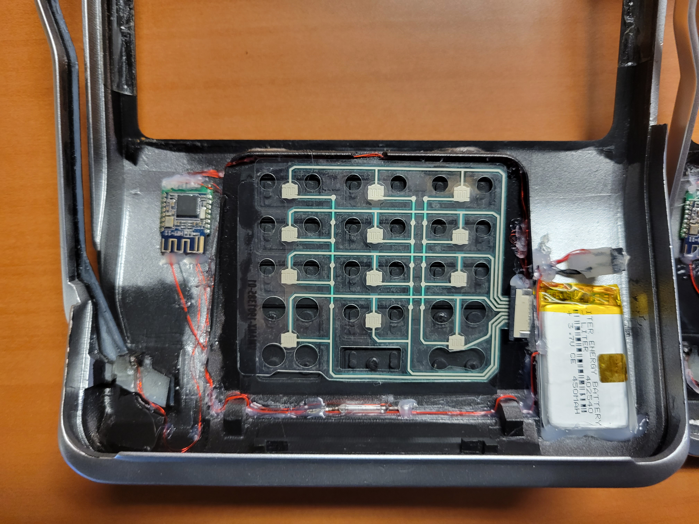
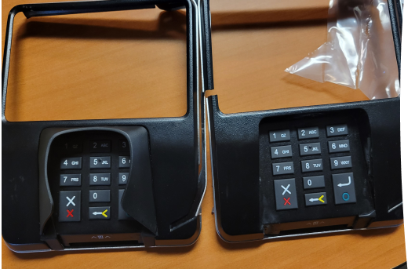
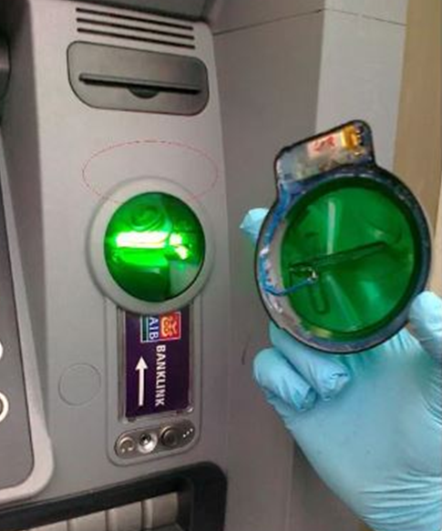
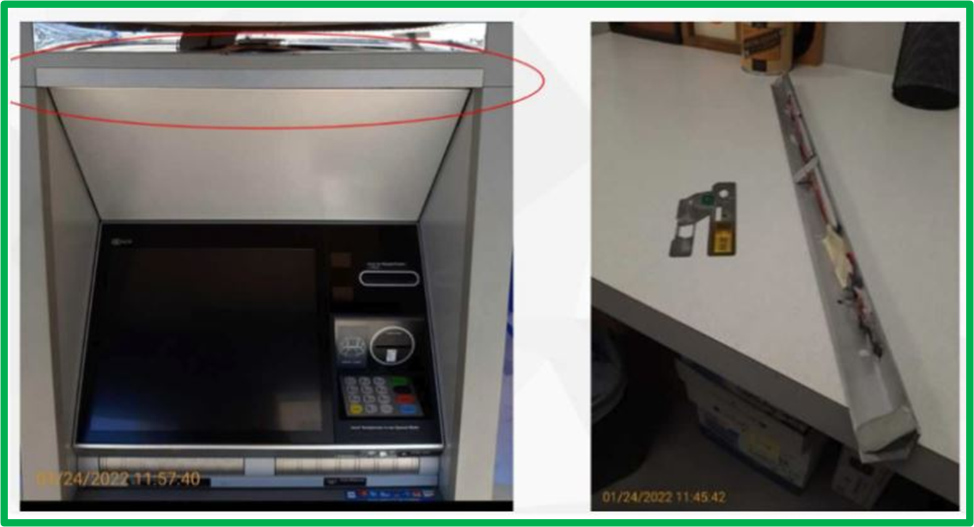
How EBT THEFT Commonly occurs
There are two typical types of EBT theft that occur: scamming and skimming.
EBT SCAMMING involves using social engineering tactics, such as when individuals impersonate a technician to trick cardholders into disclosing their card information, often via text message.
EBT SKIMMING involves stealing information through a device implanted on a card terminal.

Slide 9
What is EBT trafficking?
EBT trafficking is the deliberate exchange of benefits for cash or other non‑eligible items.
It can also be the use of false retailer credentials and doctored applications so unauthorized businesses can accept EBT benefits.
Prosecutors have charged individuals who submitted fraudulent USDA applications, misused legitimate license numbers, and installed EBT terminals at ineligible businesses like smoke shops to route benefits into illicit cash flows.

Slide 10
Program integrity efforts in California - corey Watson, deputy director ssd

Slide 11
California has Cut EBT Fraud by 83% with Advanced Fraud-Prevention Technology
The reductions are attributed to the State’s adoption of new, first-in-the-nation fraud-fighting technology, and additional safeguards implemented over the past two years.
Through these efforts, these technologies have reduced benefit replacement costs to $4 million in December 2025.

Slide 12
fraud prevention technology in california
CA Launched chip-and-tap-enabled EBT cards and Card Verification Value (CVV) functionality
CA Restricted early cash ATM withdrawals, out-of-state cash withdrawals, and promotes direct deposit for cash benefits
CA Coordinated with local law enforcement resulting in 190 arrests and the seizure of hundreds of skimming devices from point-of-sale devices and ATMs
CA Launched ebtEDGE Mobile Application and an Online Web Portal for ebtEDGE
CA Launched a data-driven, predictive model partnered with the Office of Data and Innovation (ODI) to detect fraudulent withdrawals and activities

Slide 13
fraud prevention technology in california
CA identifies compromised EBT cards and resets PINs prior to benefits being loaded on the EBT cards. CDSS then sends a list of case numbers to the County so the County can advise the clients of the need to reset their PIN.
NEW PILOT PROGRAM in February 2026
Cash withdrawal transactions at chip capable bank ATMs will only be allowed to be completed using chip/tap payment mode, not swipe/fallback. This change will make it more difficult for thieves to complete fraudulent withdrawals with their cloned magstripe cards.

Slide 14
Local Program integrity efforts da investigator jesus fernandez

Slide 15
LOCAL PROGRAM INTEGRITY EFFORTS
Program Referral System
ebtEDGE internal processes to run random audits to ensure program integrity
Administrative Disqualification Hearings
In-House Fraud Trainings for Social Services Staff and New Hires
- Tips on recognizing fraud both internal and external
Subject matter training dedicated to Internal Fraud
Fraud Hotline for anonymous reports of welfare fraud

Slide 16
LOCAL PROGRAM INTEGRITY EFFORTS
Chief’s Presentation- Local Agency Awareness
- Basic Introduction to Welfare Fraud
- Advisement to the Welfare Fraud Tip Line
Marijuana Related Enforcement
Investigators now assigned to Environmental Crimes, Auto Fraud
Consumer Protection, have a basic understanding of public
assistance benefit programs
IEVS Alerts Investigations
Deceased Persons Match, Fleeing Felons & National Prisoner
Match

Slide 17
Fraud investigations corey Watson, deputy director ssd jesus Fernandez, da investigator

Slide 18
FRAUD INVESTIGATION REFERRAL CATEGORIES
EARLY FRAUD REFERRALS – these referrals are crucial for preventing fraud before public benefits are issued when there are reasonable grounds for suspicion of fraud.
ONGOING FRAUD REFERRALS - these referrals are crucial for preventing fraud after public benefits have been issued when there are reasonable grounds for suspicion of fraud.

Slide 19
LEGAL DEFINITION OF FRAUD mpp 20-003
Fraud exists when a person, on behalf of himself or others, has knowingly, and with intent to deceive or defraud, made a false statement or representation to obtain benefits, obtain a continuance or increase of benefits, or avoid a reduction of aid benefits.
Fraud also exists when a person knowingly, and with intent to defraud, failed to disclose a fact which, if disclosed, could have resulted in the denial, reduction or discontinuance of benefits.

Slide 20
LEGAL DEFINITION OF FRAUD mpp 20-003
Fraud exists when an individual accepts benefits knowing he/she is not entitled thereto, or accepted any amount of benefits knowing it is greater than the amount to which he/she is entitled.
Fraud exists when an individual obtains, continues to obtain, or avoids a reduction or denial of benefits.

Slide 21
Prosecuting welfare fraud
CRIMINAL ROUTE:
Prosecution
Disqualification Consent Agreement (DCA)
ADMINISTRATIVE ROUTE:
Administrative Disqualification Hearing (ADH)
Nothing in the MPP precludes law enforcement officials from initiating prosecutions for fraud against welfare applicants/recipients when the necessity for such action comes to their attention from sources other than referral by the SSD.

Slide 22
Disqualification consent agreement
Individuals suspected of committing welfare fraud may sign Disqualification Consent Agreements for cases of deferred adjudication.
Deferred adjudication applies to the following:
(a) Cases in which a determination of guilt is not obtained from a court due to the accused individual having met the terms of a court order; or
(b) Cases which are not prosecuted due to the accused individual having met the terms of an agreement with the prosecutor.

Slide 23
Administrative disqualification HEARINGS
Cases in which the prosecuting authority has determined the facts do not warrant prosecution are returned to the SSD for referral to the administrative disqualification hearing process through CDSS.
Through this process if an individual is found to have committed an IPV they will be disqualified from the respective program.

Slide 24
CALWORKS AND cALfRESH intentional program violations
The prosecution and conviction of welfare fraud will result in Intentional Program Violations (IPV).

Slide 25
DISQUALIFICATION PENALTIES TRISH BARBIERI, SSD DIRECTOR

Slide 26
CALFRESH DISQUALIFICATON penalties
Welfare fraud will result in a penalty of 12 months for the first violation, twenty-four months for the second violation, and permanently for the third violation.
Trading food stamp benefits for a controlled substance will result in a penalty of 24-months for the first violation and permanently for the second violation.
Trading food stamp benefits for firearms, ammunition, or explosives will result in a permanent loss of benefits.

Slide 27
CALFRESH DISQUALIFICATON penalties
Falsifying the identity or place of residence of the individual in order to receive multiple food stamp benefits simultaneously will result in a penalty of 10-years.
Trafficking food stamp benefits of $500 or more will result in a permanently loss of benefits.

Slide 28
CALWORKS DISQUALIFICATON penalties
Welfare fraud will result in a penalty of 6 months for the first violation, 12 months for the second violation and permanently for the third violation.
There are other penalties based on the severity of the welfare fraud committed which range from two years, up to a permanent ban in receiving benefits.

Slide 29
2025 FRAUD REFERRALS TRISH BARBIERI, SSD DIRECTOR

Slide 30
Local Welfare fraud referrals & prosecutions
2025 FRAUD REFERRALS | CalFresh | CalWORKs
Total number of Early Fraud Referrals Total number of Ongoing Fraud Referrals | 46 604 | 15 184
Referrals due to Suspected Trafficking | 4 | 0
Referrals to ADH or Prosecution | 33 | 13
PROSECUTIONS – CRIMINAL AND ADMINISTRATIVE ROUTE Disqualified due to Prosecution Disqualified due to DCA Disqualified due to ADH* * SSD currently has 6 cases pending ADH | 2 0 0 | 1 1 0
2025

Slide 31

Recent prosecutions JESUS FERNANDEZ, DA INVESTIGATOR

Slide 32
case summary #1
In 2022, DA Investigators investigating a False Contracting License and Financial Elder Abuse case discovered the girlfriend of the suspect applied for benefits in suspect’s name. At the time of her fraudulent application, the suspect/boyfriend was incarcerated. The girlfriend was charged and plead to felony Welfare Fraud. After years of absconding, she was finally sentenced for the charges on Feb. 3, 2026. The amount of fraudulent aid received was $1,190.00.

Slide 33
Case summary #2
In 2023, a benefit recipient signed, under penalty of perjury, that someone stole $595 from her benefits at a local bank. A search warrant executed by SIU obtained the bank’s ATM photos, which showed the suspect who stole the benefits was the recipient herself.
The investigation showed the recipient completed a fraudulent claim to gain additional monies.
The recipient plead to a felony Perjury charge, as well as misdemeanor charges of Filing a False Report and Welfare Fraud.
At the time of discovering the fraud, the recipient was employed with the County of Siskiyou Health and Human Services Agency, Social Services Division.

Slide 34
case summary #3
In 2022, DA Investigators alerted the SSD of a possible confidentiality breach relating to a fifteen-year SSD employee who was in a management position. SIU immediately began investigating the matter.
In 2023, after obtaining several audits from welfare-based systems and conducting interviews, SIU filed a DA Complaint against the SSD employee for the felony charges of:
Forgery
Welfare fraud
Embezzlement of SNAP funds and
Perjury.

Slide 35
Case summary #3, cOnt.
The basis of the allegation was, while in performance of her work duties, she accessed the benefits case belonging to someone she was romantically involved with. She also added herself as an Authorized Representative without proper procedure and approval. Lastly, she fraudulently submitted Recertification and Semi-Annual Recertification Forms in an effort for her partner to continue receiving benefits.
In November 2025, she plead to a felony Welfare Fraud charge. After two years and successfully completing a Deferred Entry of Judgement, the charge will be dropped to a misdemeanor. Restitution of $2,822. was ordered in the case.

Slide 36
ACHIEVEMENTS TRISH BARBIERI, SSD DIRECTOR

Slide 37
achievements
Implemented ADH and DCA in collaboration with the DA
Increased awareness of external and internal welfare fraud
Successfully prosecuted cases of welfare fraud in the county
Attend National and State Welfare Fraud Training
Attend Welfare Fraud (SIU) Chief Meetings
Work collaboratively with DHCS and the US Department of Agriculture Office of Inspector General on local investigations
Use of Perceptive Data Analytics
Certification of Welfare Fraud Investigator Fernandez
Increased collaboration between DA and SSD

Slide 38
THANK YOU

