Slide 1
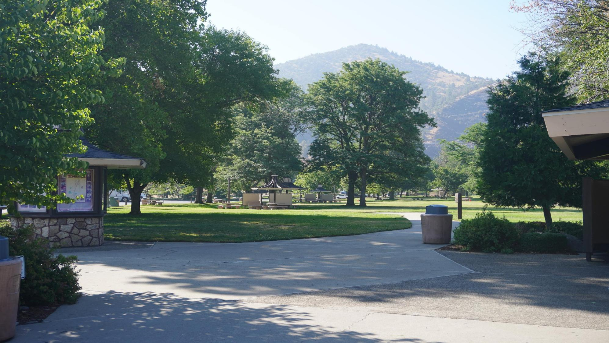
COLLIER REST STOP VISITOR CENTER

Slide 2
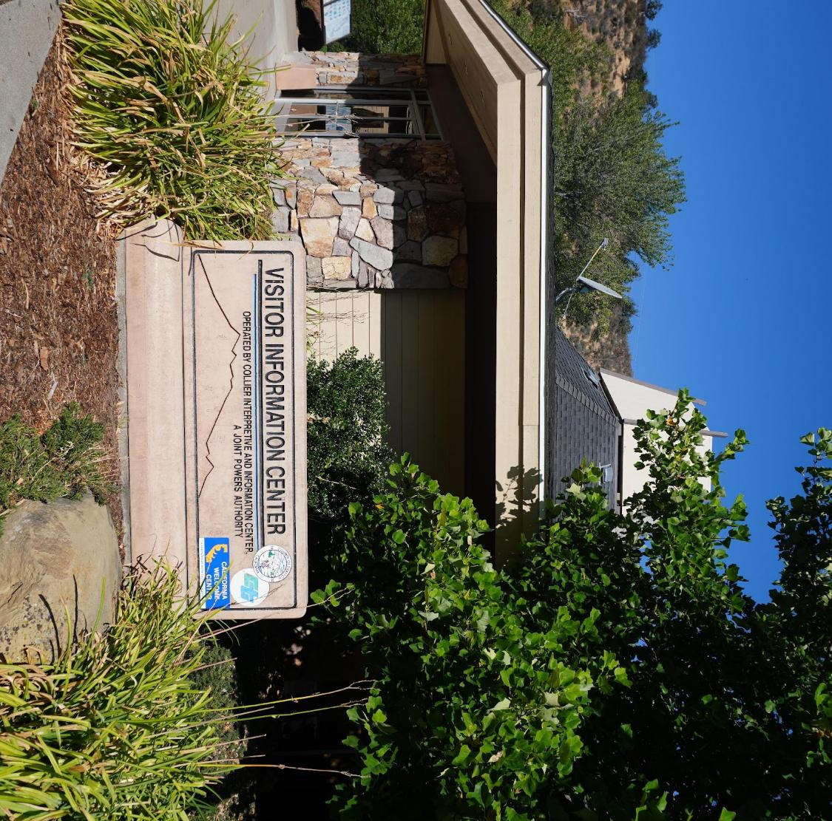
Background
Statistics
Tourism
Why Does It Matter

Slide 3
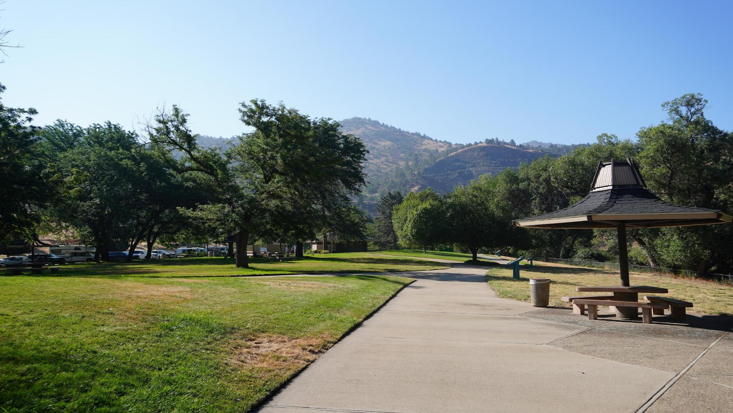
BACKGROUND

Slide 4
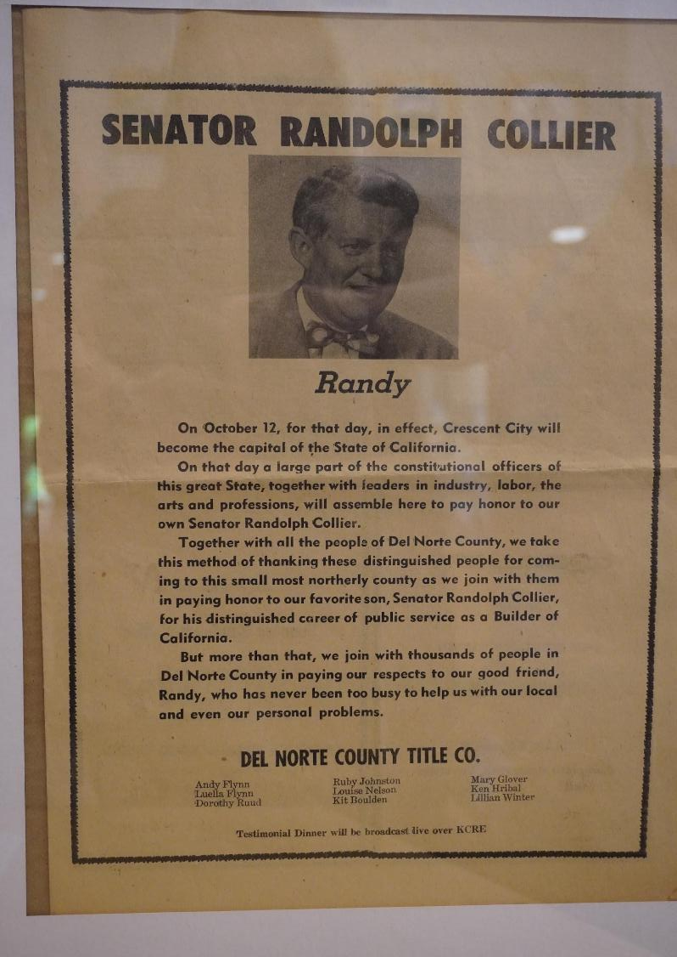
Collier Rest Area
A Vital First Impression for Siskiyou County
Named for State Senator Randolph “Randy” Collier
Leader in California transportation & infrastructure
Located on I-5 near the Oregon border
A key gateway into Siskiyou County
More than a rest stop — a regional welcome point

Slide 5
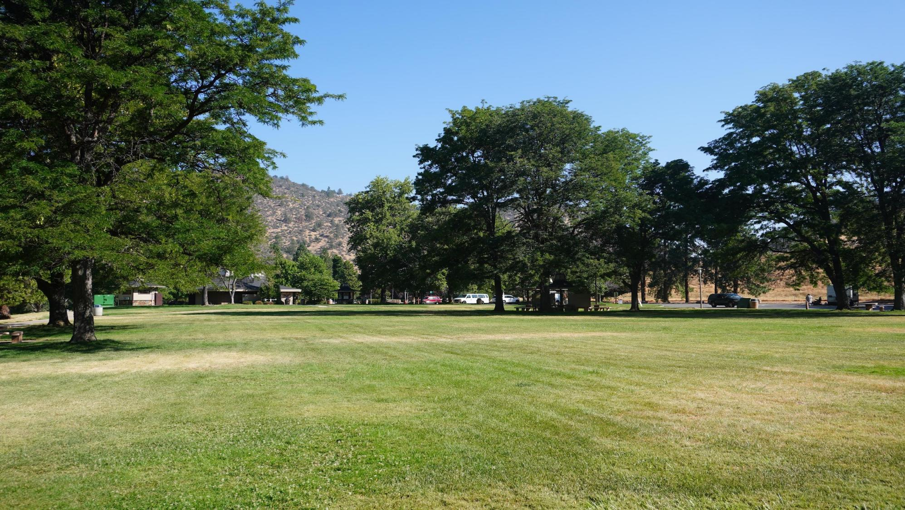
STATISTICS

Slide 6
VISITOR IMPACT NUMBERS
IMPACT FACTOR | MEASUREMENT | TARGET | ACHIEVED
Audience interaction | Percentage (%) | 85 | 88
Knowledge retention | Percentage (%) | 75 | 80
Post-presentation surveys | Average rating | 4.2 | 4.5
Referral rate | Percentage (%) | 10 | 12
Collaboration opportunities | # of opportunities | 8 | 10

Slide 7
METRIC | MEASUREMENT | TARGET | ACTUAL
Audience attendance | # of attendees | 150 | 120
Engagement duration | Minutes | 60 | 75
Q&A interaction | # of questions | 10 | 15
Positive feedback | Percentage (%) | 90 | 95
Rate of information retention | Percentage (%) | 80 | 85

Slide 8
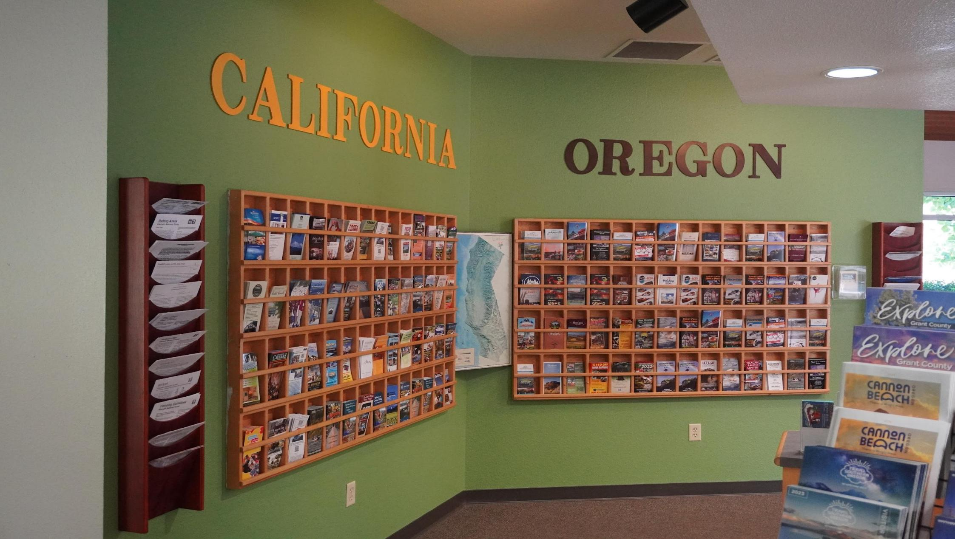
TOURISM

Slide 9
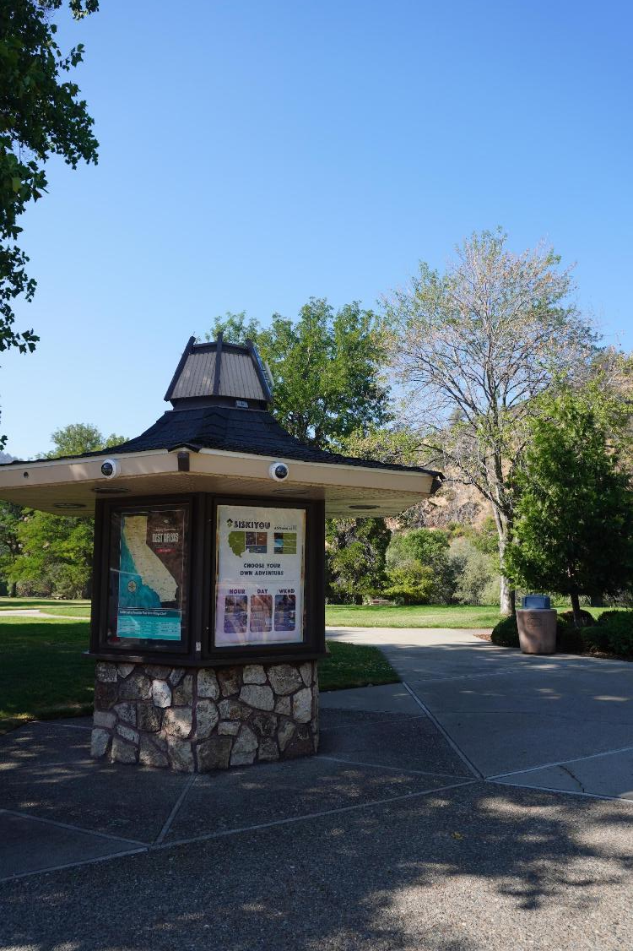
Connecting Travelers to Local Businesses & Communities
Where Travelers Decide What’s Next
Direct connection to local businesses
Promotes lodging, dining, recreation & events
Represents towns across the county
Reaches visitors before plans are made
Today:
Some partners engaged
Many missed opportunities remain

Slide 10
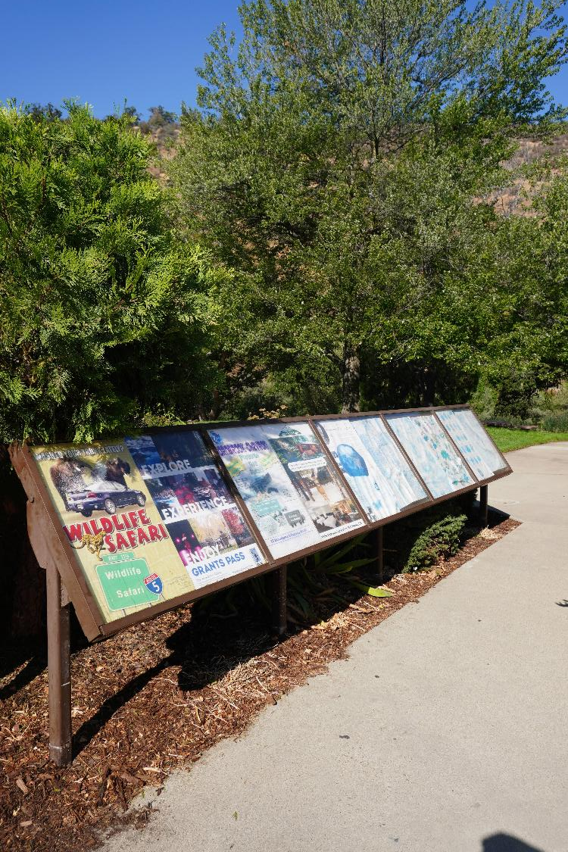
Advertising Opportunities
What we’re seeing:
Many businesses recognize the value and participate.
However, many more still haven’t taken advantage of this prime visibility.
This means missed opportunities for both travelers and our communities.
With thousands of people passing through each week, the potential impact is far greater than most realize.

Slide 11
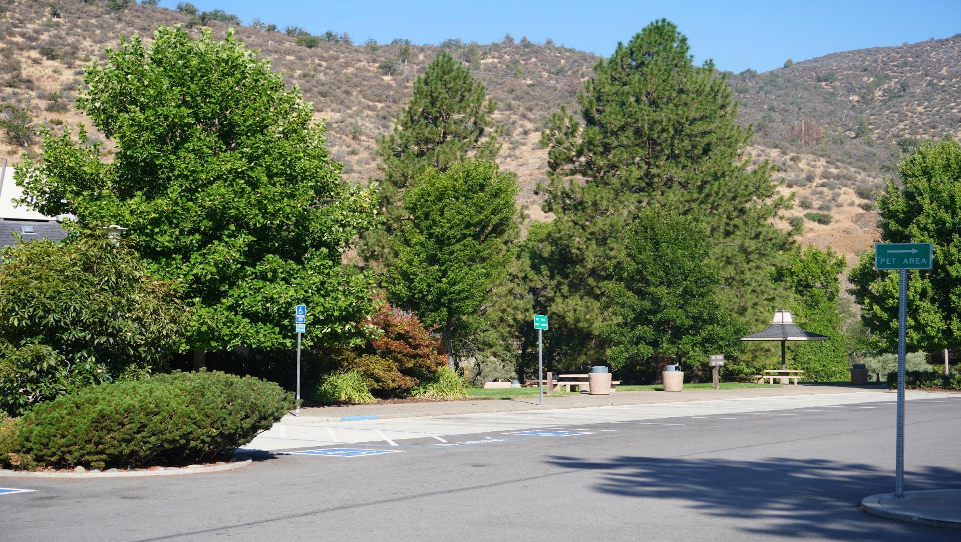
WHY DOES IT MATTER

Slide 12
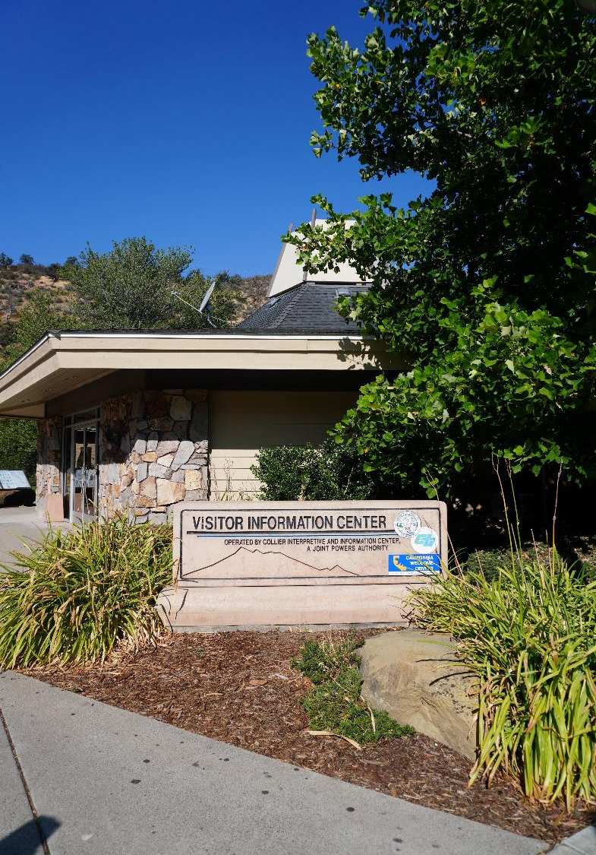
Big Impact from a Small Footprint
The Collier Visitor Center plays a quiet but significant role in supporting:
Tourism: By driving visitors into our towns, parks, trails, and attractions
Local economies: Through referrals that lead to overnight stays, meals, and retail spending
Public safety: By sharing wildfire, weather, and travel information year-round
Community awareness: By educating visitors on history, natural resources, recreation, agriculture, and more
County identity: By offering a unified “welcome” that reflects our values and landscapes
When Boards ask, “Why does this matter to my district?” the answer is simple: Because this center represents your community even if a traveler never drives directly through it.

Slide 13
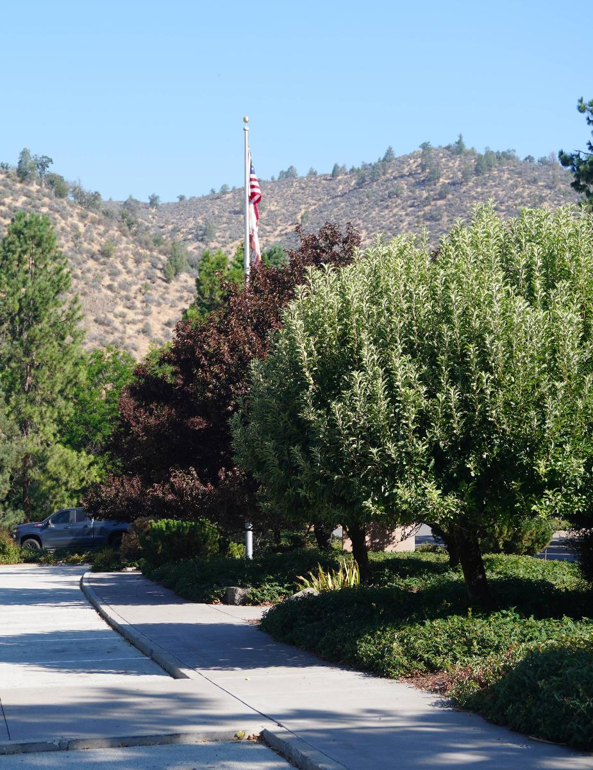
ENGAGING THE AUDIENCE
A Shared Region Opportunity
Serves travelers headed across Siskiyou County and beyond
Often the first point of contact for Lake Siskiyou, Klamath Basin, Scott Valley, Shasta Valley & more
Reaches visitors before they decide where to go or spend time
Expands visibility for local programs, destinations & services
Reflects the full diversity of Siskiyou County
Stronger impact through collaboration

Slide 14
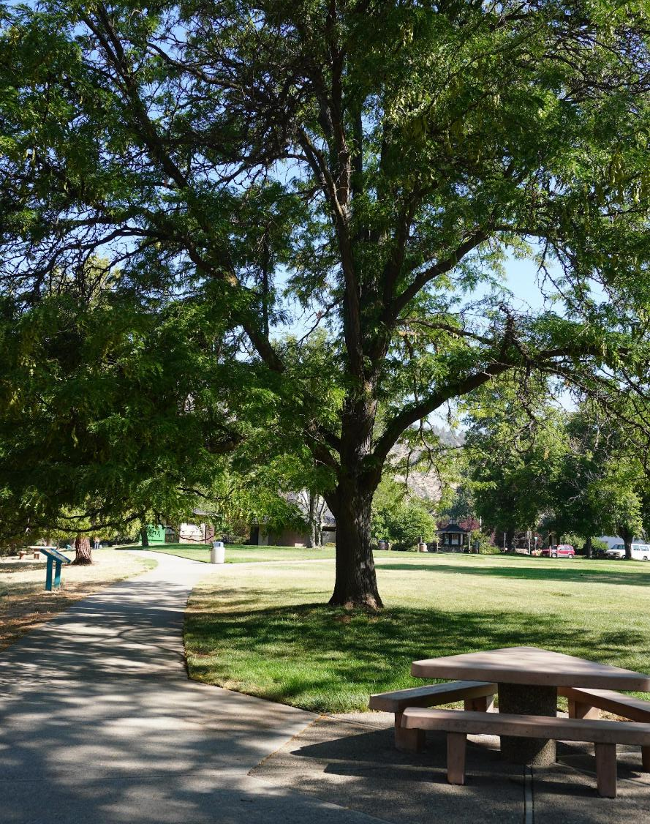
Rennie Cleland, Board President
530-260-1147​
rennie.clelandconsulting@gmail.com
https://collierctr.org/

