Slide 3
LEADERS ELEVATE COMMITMENT TO ADOPT CHILD ABUSE PREVENTION PROCLAMATIONS
9
Elevating their commitment to Child Abuse Prevention, City Councils, the Siskiyou County Board of Supervisors, and The Siskiyou County Office of Education officially adopted proclamations
*Photographed above is the Dunsmuir City Council signing the April CAPC Proclamation
Notes:
Engaging Local Leadership in Prevention Proclamations
By including city councils, the Board of Education, and the Siskiyou County Board of Supervisors in April proclamations, we:
-Elevate the importance of child abuse prevention at the highest levels of local leadership
Encourage community leaders to consider children and families in decision-making year-round
Foster visible support for protective policies, funding, and programs
Build public awareness and a shared sense of responsibility across sectors
Help integrate child well-being into broader community planning
These proclamations are more than symbolic—they are a meaningful step toward creating a culture where children's safety, health, and success are community priorities.

Slide 4
Notes:
As part of Child Abuse Prevention Month, 11 inspiring individuals were recognized as Champions for Children in Siskiyou County.
Nominated by peers who see their dedication and care firsthand
Honored at First 5 Siskiyou’s 25th Anniversary Partner Celebration
Each honoree has made a lasting impact on the lives of local children
Custom word clouds showcased the kind words shared about each individual in the nomination
This project helps build protective factors by:
Recognizing and uplifting caregivers, educators, and advocates who support children every day
Strengthening community connections and shared responsibility for child well-being
Encouraging a culture of appreciation, support, and resilience, which helps buffer the effects of Adverse Childhood Experiences (ACEs)
By celebrating these champions, we shine a light on the everyday efforts that make Siskiyou County a safer, more nurturing place for children to grow.

Slide 5
Notes:
The “I Feel Loved” Project invited children to reflect on when they feel most loved and supported, encouraging emotional expression and connection with caring adults.
This simple activity supports protective factors and helps buffer the impact of Adverse Childhood Experiences (ACEs) by:
Building emotional awareness
Strengthening child-adult relationships
Fostering a sense of safety and belonging
Project kits were shared with after-school programs countywide, with touching examples submitted by students from Hornbrook Elementary.

Slide 7
Digital Campaigns and Social Media
Facebook 1k Followers
Instagram 190 Followers
Friend us @First5Siskiyou

Slide 8
FY 24/25
Parenting Education
170
Classes and Evidence based series
785 Children participated in child development activities during parenting classes
1,107 parents attended workshops and evidence based parenting series
106 engagement with teens in a parent teen relationship curriculum
12
County Wide Professional Development Trainings
219 Professionals took part
Notes:
89 1 x Workshops
- 341 Participated in developmental activities during childcare
-631 Parents attended a 1x Workshop
9 Parenting series
-444 Children
-476 Parents
-9 Teens came together for 106 engagements in the Parent and Teens Curricula

Slide 9
Teacher of the Year Award 2025
Acknowledging teachers for their role in nurturing and educating children by focusing on protective factors.

Slide 10
Symbols of protection: Siskiyou County united against child abuse
Blue pinwheels are a national symbol for April's Child Abuse Prevention Month. They represent hope, health, and happiness for all children. The pinwheel is used to promote the idea that every child deserves a safe, nurturing, and joyful childhood, free from abuse and neglect. Their bright, spinning nature is a reminder that prevention is possible when communities support families and protect kids.
Notes:
Distribution Highlights – Child Abuse Prevention Month
Countywide Reach:
A total of 2,526 Blue Pinwheels, 245 Yard Signs, and 10 CAPC Flags were distributed across Siskiyou County. Many Stickers were shared with schools, businesses, healthcare centers, and community programs to spread awareness throughout April.
Community Enthusiasm:
Many organizations expressed excitement about receiving this year’s materials.
Some businesses display yard signs year-round as an ongoing show of support.
Others were thrilled to receive their new supply of shining blue pinwheels.

Slide 11
Notes:
Distribution Highlights – Child Abuse Prevention Month
Countywide Reach:
A total of 2,526 Blue Pinwheels, 245 Yard Signs, and 10 CAPC Flags were distributed across Siskiyou County. Many Stickers were shared with schools, businesses, healthcare centers, and community programs to spread awareness throughout April.
Community Enthusiasm:
Many organizations expressed excitement about receiving this year’s materials.
Some businesses display yard signs year-round as an ongoing show of support.
Others were thrilled to receive their new supply of shining blue pinwheels.

Slide 13
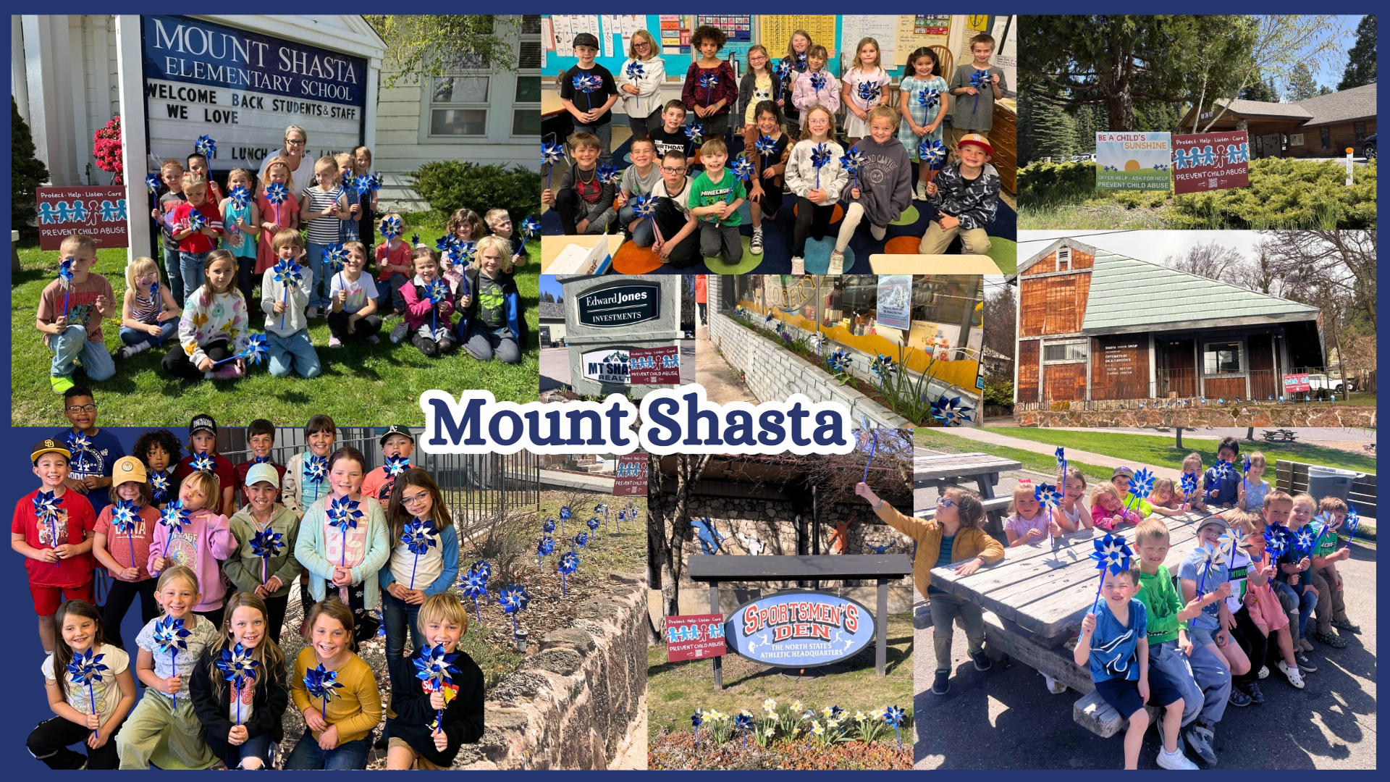

Slide 15
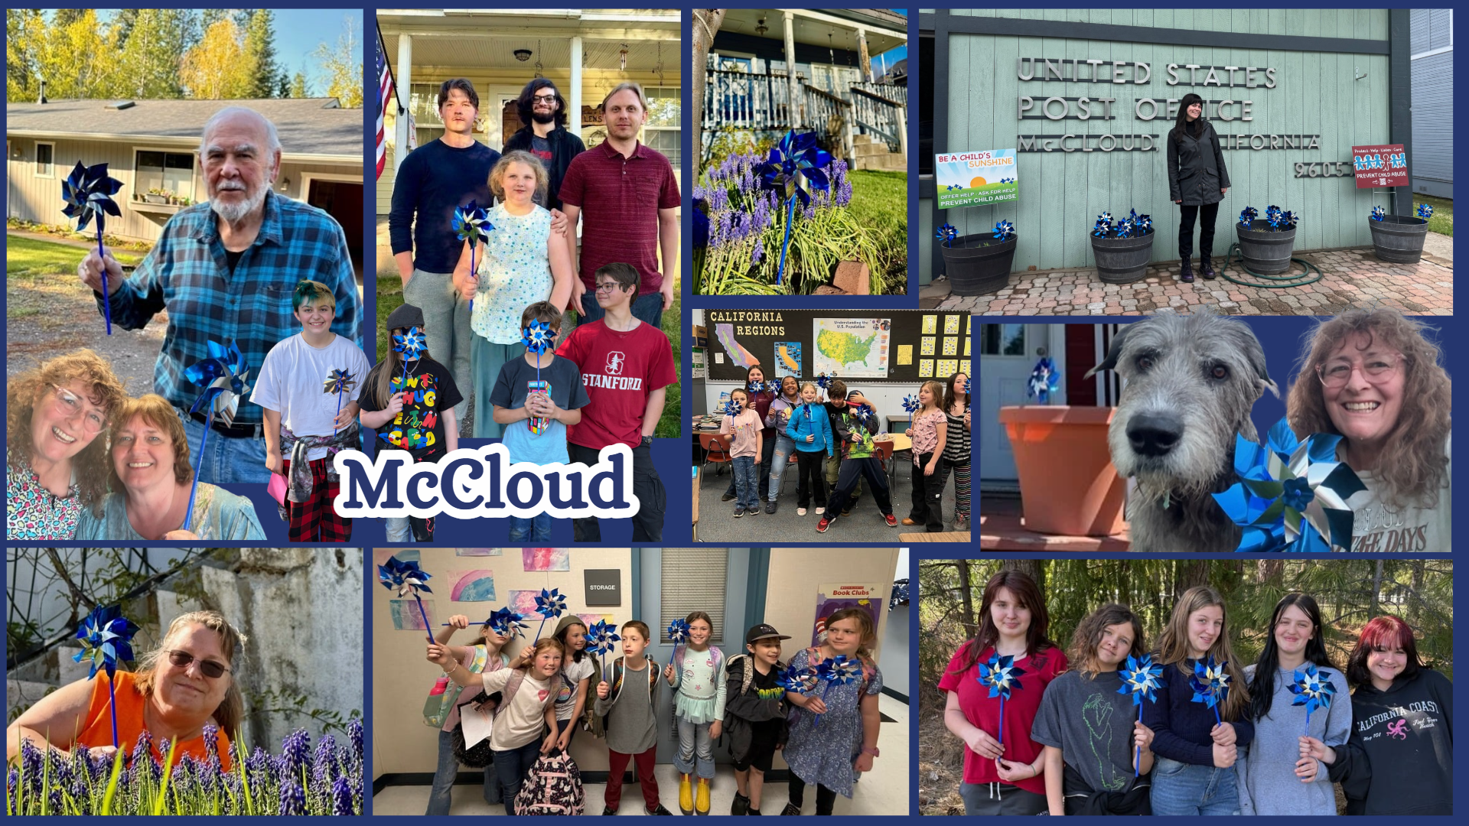

Slide 19
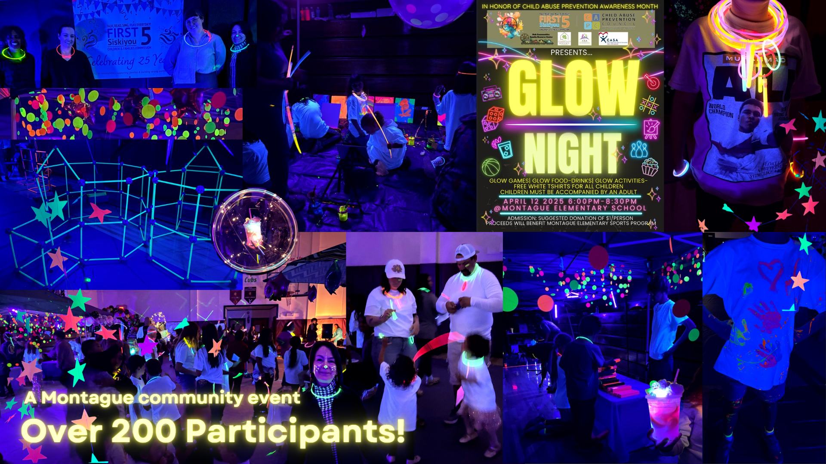

Slide 24
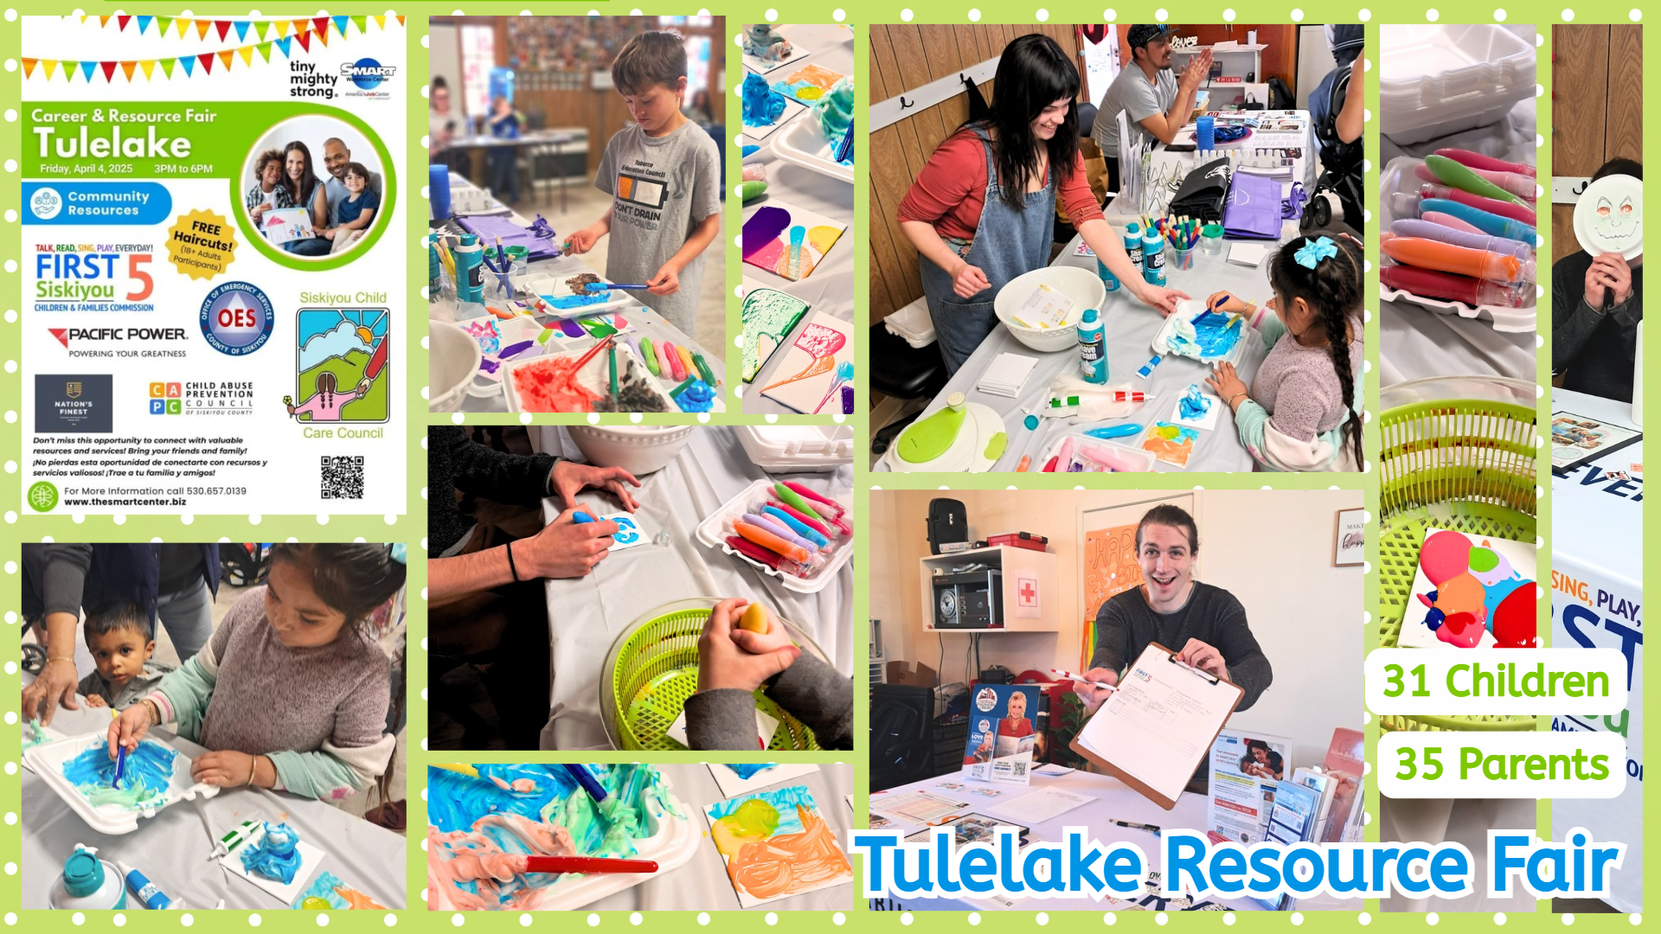

Slide 25
