Slide 1















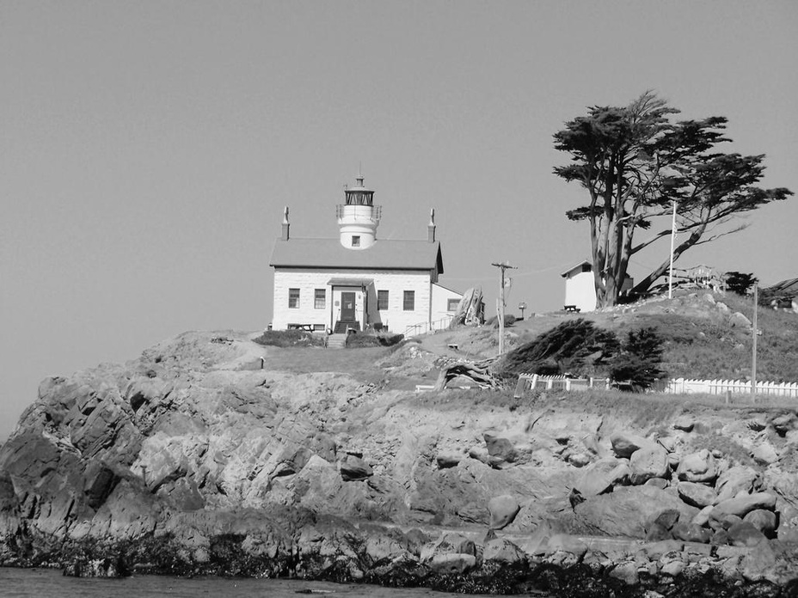







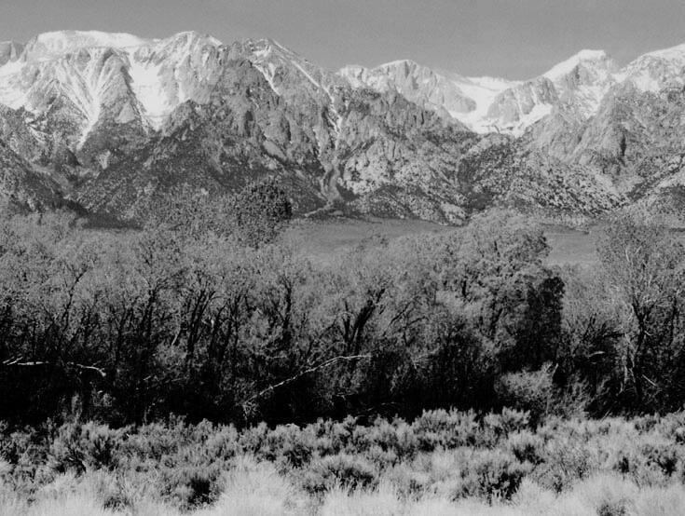


County Charters
Presentation to Siskiyou County Board of Supervisors
October 21, 2025
Presented by Eric Lawyer

Slide 2



California State Association of Counties
CSAC is a non-profit association composed of, and governed by, all 58 counties in California.
Founded in 1894.
Advocates on behalf of county government before state and federal policymakers.
Provides education opportunities to county supervisors, county administrators, and top staff.
Educates the public about county government.
www.counties.org

Slide 3

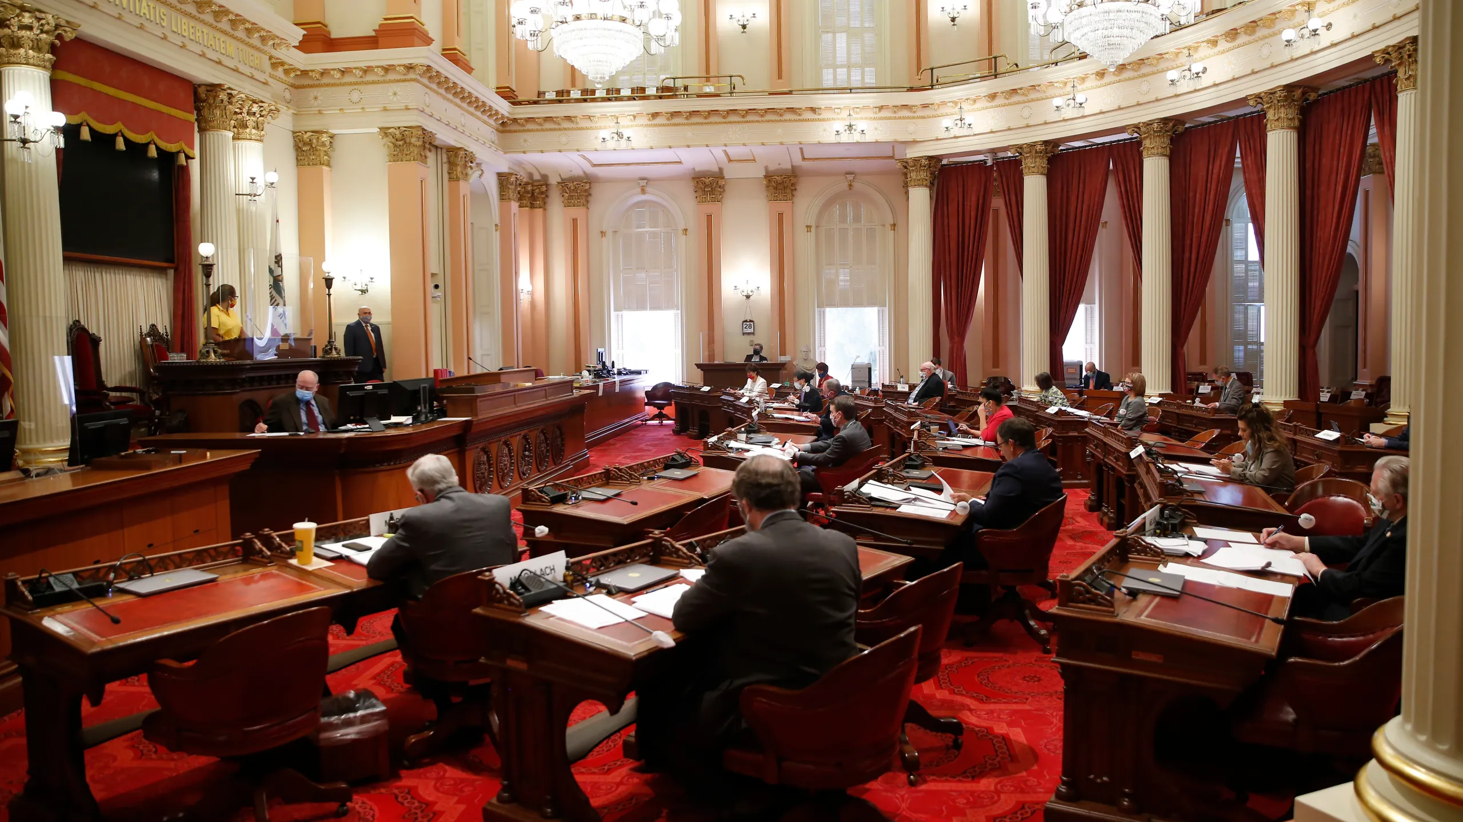



What is a county charter?
Governing provisions for county
Alternative or supplement to county ordinances
Published in state statutes
Provides some additional flexibility to counties to supersede state law on issues of county governance (e.g. filling board vacancy, expanding Board of Supervisors, alternative election methods)
Requires voter approval to adopt or amend

Slide 4






Article XI, Section 1
“The State is divided into counties which are legal subdivisions of the State…The Legislature shall provide for county powers…”
Key:
County powers largely dictated by the state.
Legal Subdivision
A charter can be proposed to voters by the Board of Supervisors or a via a charter commission.
Legislative Provision of County Powers
The constitution itself says it is the responsibility of the legislature to provide for county powers.

Slide 5
Article XI, Section 3
Counties and cities may adopt, amend, revise, or repeal charters with a majority vote of its electorate. Adopted charters supersede inconsistent laws and have the force and effect of legislative enactments.
Key:
Counties and cities charter have authority—which supersede state law.
Charter Proposal
A charter can be proposed to voters by the Board of Supervisors or via a charter commission.
Charter Commissions
Via initiative, voters can elect 15 individuals to a charter commission to draft a county charter and voters decide whether to adopt the charter at the next election.

Slide 6




County
Charter Limits
Charter provisions supersede state law, but only certain provisions can be in a county charter to begin with – within the parameters of California Constitution Article XI, Section 4.
“Only such provisions of a county charter as are authorized by the Constitution supersede State laws in conflict therewith, and then only to the extent that such provisions are not limited by the Constitution.”
Wilkinson v. Lund (1929)
“A county…possesses and can exercise only such powers as are expressly granted it by the constitution or statutes.”
Byers v. Board of Supervisors (1968)
Charter Authority in the California Constitution:
Article XI, Section 3 (cities and counties)
Article XI, Section 4 (counties)
Article XI, Section 5 (cities)
Link to Constitution text online.

Slide 7
County
Charter Powers
Charter counties can control the structure and operation of county government within the parameters of California Constitution Article XI, Section 4.
“Charter counties lack the ‘municipal affairs’ authority of charter cities,…they nevertheless share much of the authority exercisable by charter cities over the structure and operation of their local government.”
Dibb vs. County of San Diego (1994)
Charter Authority in the California Constitution:
Article XI, Section 3 (cities and counties)
Article XI, Section 4 (counties)
Article XI, Section 5 (cities)
Link to Constitution text online.

Slide 8
Article XI, Section 4
Section 4 defines what a county charter shall provide for. These can be read as provisions required to be in a charter. Even requirements on minimum standards for county charters have been interpreted by a court decision.
Key:
Some items must be in a county charter (kinda).
County Charters must include:
Officials
An elected governing body of 5 or more members.
An elected sheriff.
An elected district attorney.
An elected assessor.
Other elected or appointed officers.
Governance
The compensation, terms, and removal of officials.
The performance of functions of these officials.
The powers and duties of the governing board and all other officers, including consolidation of duties and filling vacancies.

Slide 9


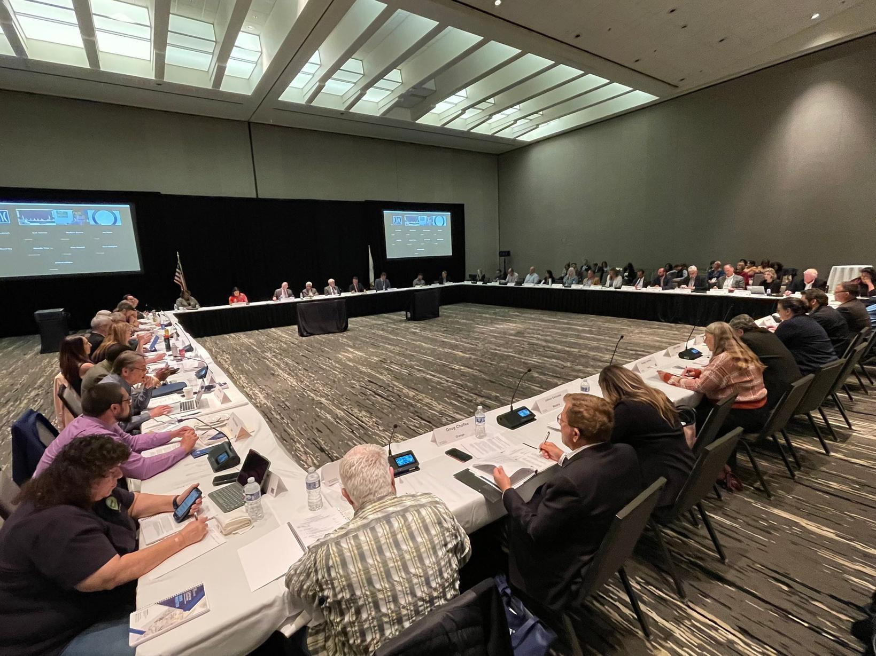


Case Law
Kerr v. County of Orange
Article XI, Section 4
Orange County adopted charter in 2002
Charter only included language regarding board vacancies – not all of what is included in Section 4
Lawsuit regarding possible violation of Section 4
Court found that exclusion of language simply means that county defers to general law

Slide 10
Article XI, Section 5
Charter cities are granted somewhat broad authority to make and enforce ordinances and regulations regarding municipal affairs.
Article XI, Section 7
A county or city may make and enforce within its limits all local, police, sanitary, and other ordinances and regulations not in conflict with general laws.
Key:
Significant difference between municipal affairs and matters of statewide concern.
Cities have municipal powers
By nature, municipal powers have been somewhat more expansive than the police powers granted to counties.
Counties (and cities) have police powers
Counties lack authority for municipal affairs, but do have police powers. These empower counties to adopt ordinances or regulations that promote the public health, safety, and general welfare of their communities.

Slide 11
Matters of Statewide Concern
“City charters adopted pursuant to this Constitution shall supersede any existing charter, and with respect to municipal affairs shall supersede all laws inconsistent therewith.”
Key:
Municipal affairs doctrine: home rule for what are not matters of statewide concern.
Implied Preemption
Some statutes are implicit matters of statewide concern. While statute, or the constitution, may be silent – courts decide.
Express Preemption
Some statutes declare a matter to be “a matter of statewide concern,” or use similar language to ensure it applies to general law and charter cities and counties.

Slide 12
Article XI, Section 1
“The State is divided into counties which are legal subdivisions of the State…The Legislature shall provide for county powers…”
Key:
As legal subdivisions, county authority is constrained – even with a charter.
Legal Subdivision
Unlike cities, counties include every square inch and every person in the state.
Legal subdivisions v. Municipalities
One can choose whether or not they live in a city – this isn’t true for counties.

Slide 13
City
Municipal Powers
Article XI, Section 5 of the California Constitution provides that city charters may “…make and enforce all ordinances and regulations in respect to municipal affairs…and with respect to municipal affairs shall supersede all laws inconsistent therewith…”
Municipal Affair
Some revenue sources (e.g. real property transfer tax)
Municipal elections
Referendum or recall procedures
Compensation of city officers and employees
City contracting (historically)
Labor (historically)
Land use and zoning (historically)
Matter of Statewide Concern
Traffic and vehicle regulation
Educational policies
Open meetings
Eminent domain
Tort claims
Local agency investments
Charter Authority in the California Constitution:
Article XI, Section 3 (cities and counties)
Article XI, Section 4 (counties)
Article XI, Section 5 (cities)
Link to Constitution text online.

Slide 14
County
Police Powers
The State is divided into counties which are legal subdivisions of the State.
California Constitution Article XI, Section 1.
“(Counties) may make and enforce within its limits all local, police, sanitary, and other ordinances and regulations not in conflict with general laws.”
California Constitution, Article XI, Section 7
A county may use its police powers to do “’whatever will promote the peace, comfort, convenience, and prosperity’ of (its) citizens…”
San Diego County Veterinary Medical Assn. v. County of San Diego (2004)
Charter Authority in the California Constitution:
Article XI, Section 3 (cities and counties)
Article XI, Section 4 (counties)
Article XI, Section 5 (cities)
Link to Constitution text online.

Slide 15
General Law
Charter
Board Vacancy: appointed by Governor
Board members: limited to five members
Elected officers: limited to statutory powers
Elections: limited to general district-based elections
Board Vacancy: Local control (appointment or election)
Board members: Can expand to more than five
Elected officers: some additional powers to make positions elected (e.g. County CEO)
Elections: ability to hold ‘at large’ and other forms of elections (may be constrained by federal Voting Rights Act)
Charter Authority in the California Constitution:
Article XI, Section 3 (cities and counties)
Article XI, Section 4 (counties)
Article XI, Section 5 (cities)
Link to Constitution text online.

Slide 16
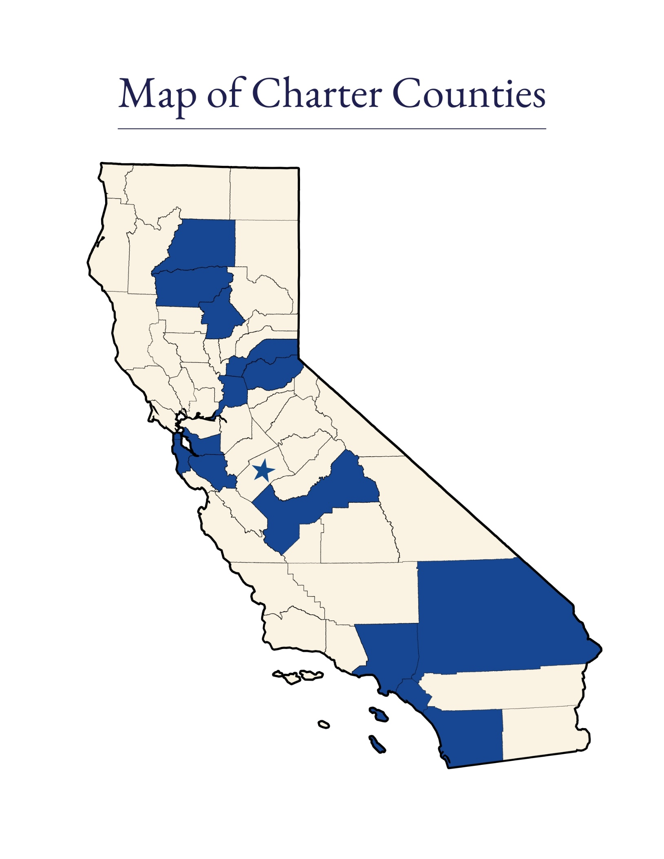
California’s Charter Counties
58 Counties in California
15 Charter Counties
43 General Law Counties

Slide 17
California’s Charter Counties
County
Ratification of Charter (Year)
Ratification of Charter (Year)
County
Los Angeles
Butte
Tehama
Alameda
San Bernardino
San Francisco*
Fresno
San Diego
1913
1917
1917
1927
1931
1931
1933
1933
San Mateo
Sacramento
Santa Clara
Placer
El Dorado
Orange
Shasta
1933
1933
1951
1980
1994
2002
2025
*Also a Charter City.

Slide 18
Government Code § 24009 and 24204
Statute also provides general law counties authority to make elective positions appointive if approved by voters via local initiative approved by a majority of voters. When changed via charter, elected officials must be allowed to complete their elected term.
Key:
Counties can change many positions with or without a charter.
Electable Positions Include:
Treasurer
County Clerk
Auditor
Sheriff*
Tax Collector
District Attorney*
Recorder
Assessor*
Public Administrator
Coroner

Slide 19

Recent Issues
Los Angeles County
Measure G (2024)
Expansion of Board of Supervisors from five to nine members
Election of County CEO
Ethics Reform
Accidental repeal of past charter amendment, Measure J

Slide 20
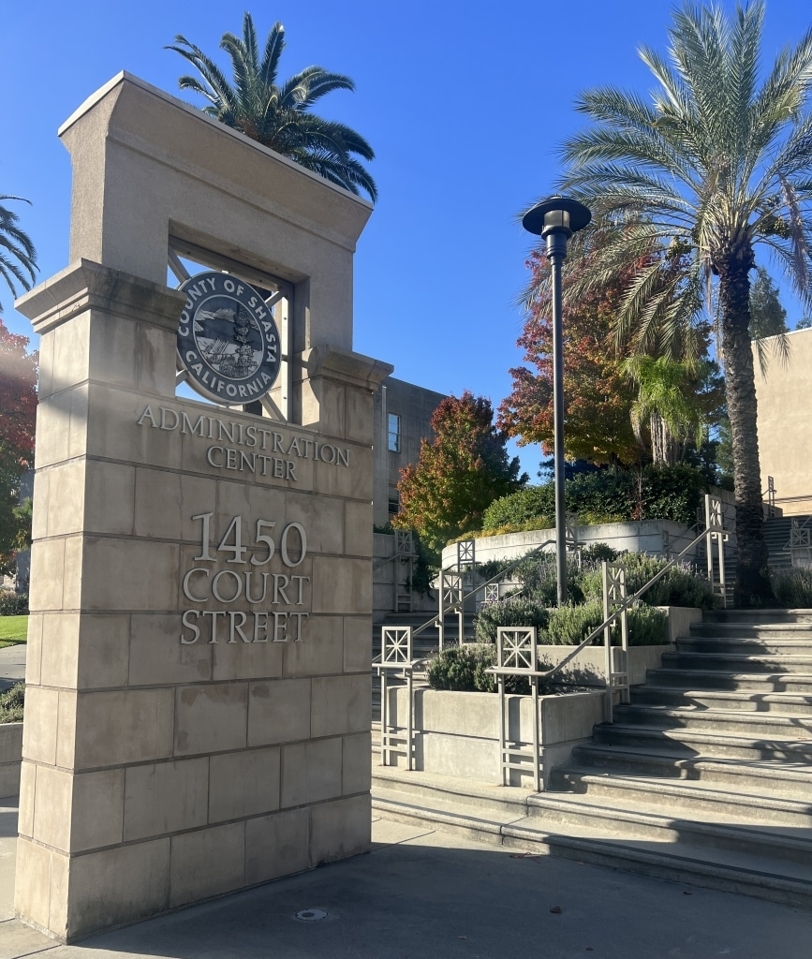
Recent Issues
Shasta County
Measure D (2024)
First approved by voters in March 2024
Deadline missed to certify and transmit the charter to the Secretary of State (SOS)
Charter officially submitted on August 29, 2025
SOS confirmed Shasta County charter status on September 11, 2025

Slide 21
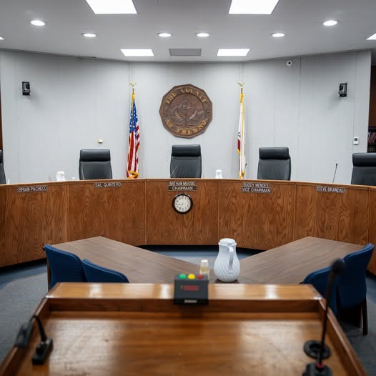
Recent Issues
Fresno County
Measure A (2024)
Moved election of Sheriff and District Attorney from presidential cycle to gubernatorial
AG and Secretary of State lawsuit alleging preemption by AB 759 (McCarty, Statutes of 2022)
Invalidated by court ruling June 2, 2025

Slide 22

Recent Issues
San Mateo County
Measure A (2025) - Passed
Allows the San Mateo County Board of Supervisors to remove the elected Sheriff from office with a four-fifths vote of the Board
Only grants the Board those powers until December 31, 2028

Slide 23
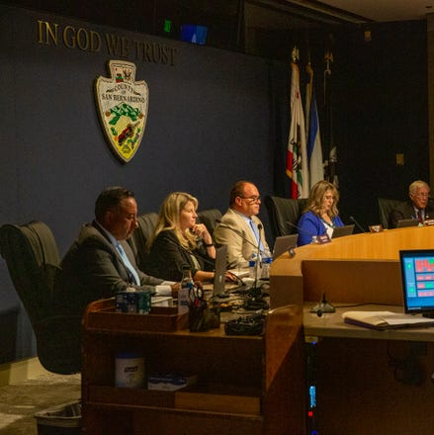
Recent Issues
San Bernardino County
Measures K (2020), D (2022), and L (2024)
Measure K: Single term limit & $60k comp; reversed two years later.
Ties compensation of certain county officers to the average of those in Orange, Riverside, San Diego, Los Angeles, and Ventura Counties
Establish a minimum funding amount in the county budget dedicated to law enforcement efforts in the unincorporated areas of the county
Requires annual reporting by Sheriff

Slide 24

Other Issues
Tehama County
Supervisor compensation
County charter limits the salary of each member of the Board of Supervisors to $1045 per month and requires voter approval to adjust the salary.

Slide 25





The Charter Process
The process for becoming a charter county is outlined in Government Code Sections 23700 to 23732.
A Board of Supervisors proposes a charter OR voters, by initiative, decide whether to draft a charter and elect a charter commission.
Voters, by majority vote, decide whether to adopt the charter at the next election.

Slide 26


The Charter Process
The process for becoming a charter county is outlined in Government Code Sections 23700 to 23732.
Board of Supervisors
Charter Commission
Proposed Charter
Voters
If Approved…
At the will of the voters, prepares a charter for the county, which must be signed by a majority of the 15 elected commissioners.
Must include the components outlined in California Constitution Article XI, Section 4.
Can prepare and propose a county charter for the voters to consider.
Decide whether to adopt the charter by simple majority vote.
The charter takes effect and is filed with the Secretary of State.
OR

Slide 27



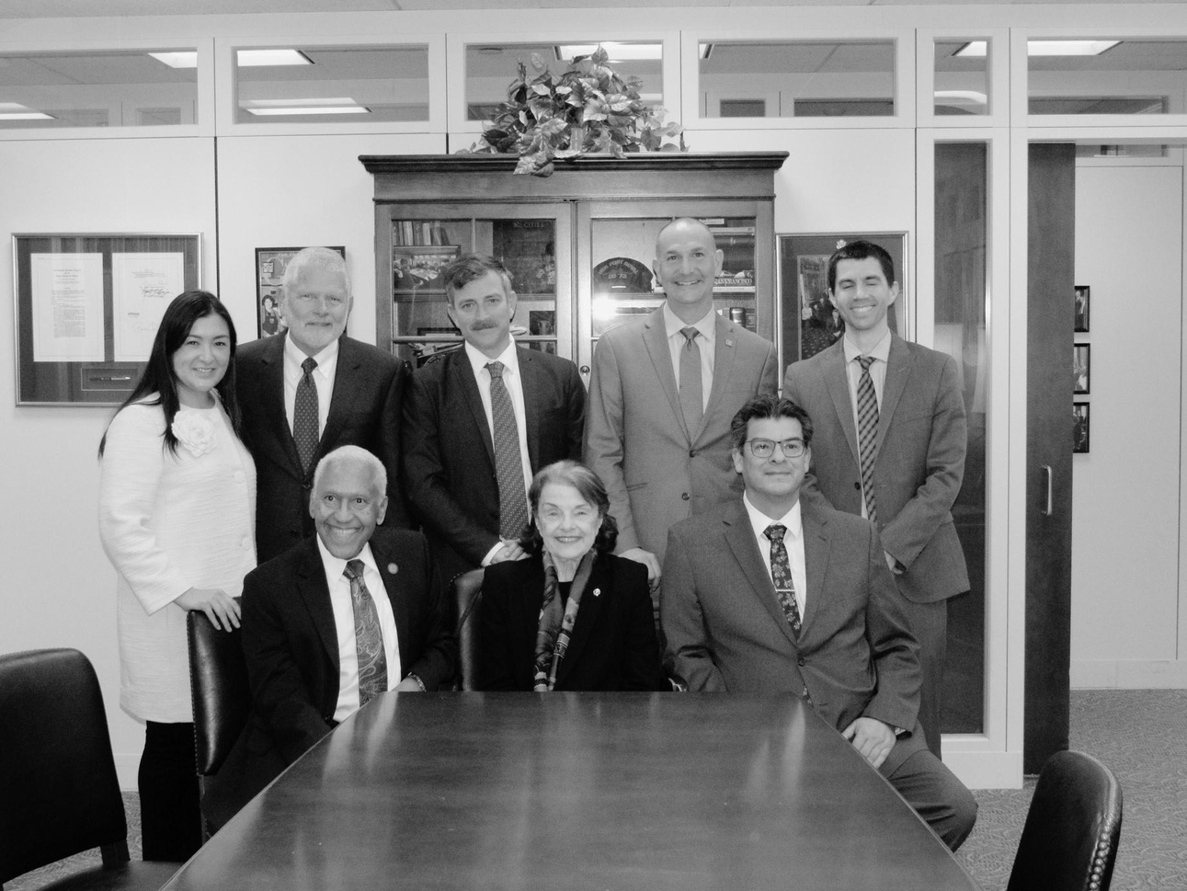




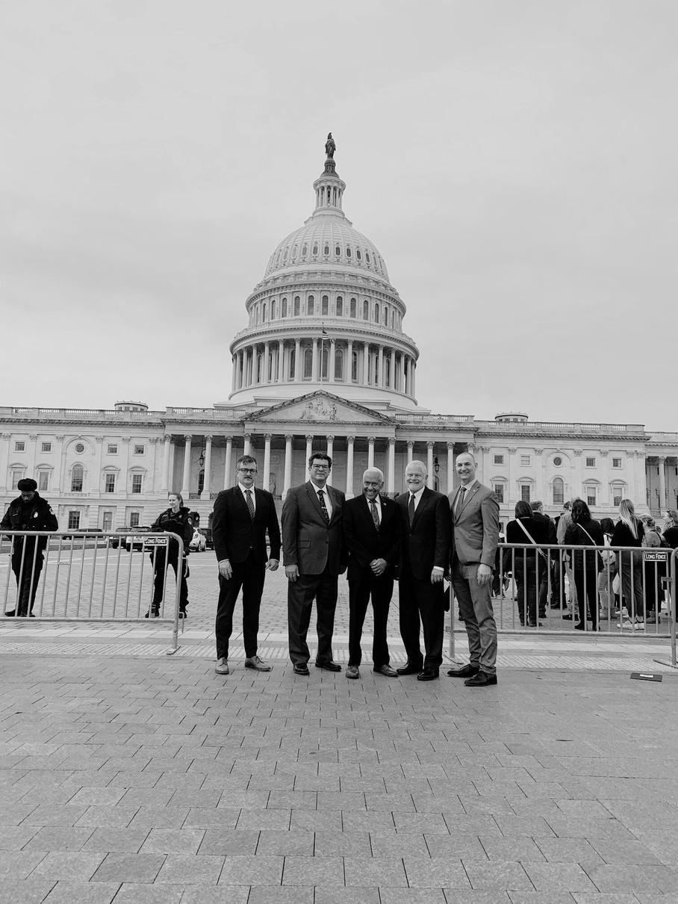





THANK YOU
Copyright 2024 by California State Association of Counties®

