Slide 1


Rural County Representatives of California
Patrick Blacklock
President & CEO
Andrew Lincoln, Napa County
2025 RCRC Rural County Photo Contest Winner

Slide 2







RCRC Organization
Divisions
Government Affairs
Economic Development
Business Development
Administration and Finance
Affiliate Entities

Slide 3

RCRC 2025-27 STRATEGIC PLAN
Vision
RCRC is the premier advocate and innovative service provider for rural counties in California
Equitable Access
Broadband
Housing
Health Services
Insurance
Impactful Policy Advancement
Rural Education and Research
Innovative Approaches
Local Control
Healthy Communities
Forest Resiliency & Wildfire
Resource Management
Infrastructure
Economic Development
Tribal Collaboration
Operational Excellence
Fiscal Health
Technology
Human Resources
Member Engagement
Communication

Slide 4


State & Federal Advocacy
Impactful Policy Advancement
State Policy Areas
Forest Health/Wildfire
Water/drought
Broadband
Housing
Energy
Health Access
California Public Utilities
Commission (CPUC)
Agriculture
Williamson Act
Wildlife
Federal Policy Areas
Forest Health/Wildfire
Water/Drought
Wildlife
Key Topics
  Recruitment & Retention of Employees Ad Hoc
  Predator Management Ad Hoc
  State Mandate Reimbursement
  Jail Medical Services Study
  Indigent Health Planning / CMSP

Slide 5



Golden State Finance Authority (GSFA)
& National Homebuyers Fund, Inc (NHF)
Equitable Access
Golden State Finance Authority
Since 1993 In
Siskiyou County
Provide affordable housing solutions
Offer financing options for energy efficiency
Secure infrastructure financing
  Grant Advanced Line of Credit Program
  Rural Broadband
  Forest Resiliency
Helped 166 individuals/ families purchase homes
Provided over $ 543K
in down payment assistance
National Homebuyers Fund, Inc
Expand Homeownership
Strengthen Communities
Notes:
Grant Advanced LOC – Short term funds to help advance funds while they are waiting for a grant – Also know as the advanced rebate program

Slide 6
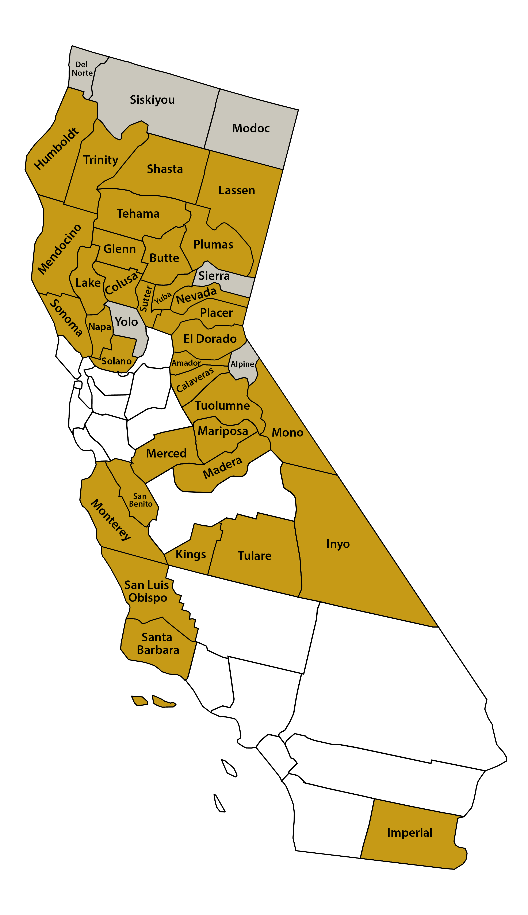
Golden State Finance Authority (GSFA)
Equitable Access
Assist-to-Own Program
8
GSFA Member County
GSFA Member County and Employee Utilized the Program
# of County Employees that have Utilized the Program
(2 or more employees)
20
Provides up to 5.5% assistance for down payment and closing costs on primary residence purchases or refinances for GSFA Member County employees.
  Enhances employee retention and recruitment
Flexible qualifying criteria:
  Accepts less-than-perfect credit (FICOs as low as 640)
  Debt-to-income ratios up to 50%
  No first-time homebuyer requirement
  Not limited to low-income borrowers
4
2
9
9
8
2
4
3
3
2
4
4
3
2
6
3
2
8
5
10
2
4
28
2
8
8
Notes:
Next Slide “Grant Advanced Line of Credit Program”

Slide 7
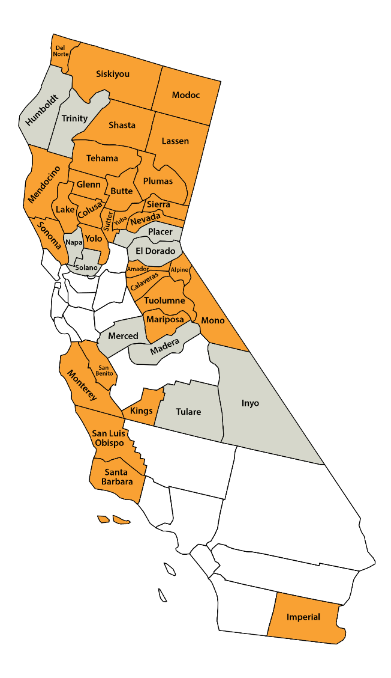
Golden State Connect Authority (GSCA)
Equitable Access
CPUC Federal Fund Account (FFA) Last Mile
GSCA FFA Last Mile Awards
  Imperial County $13,834,949
  Alpine County $ 6,985,978
  Mammoth Lakes $ 4,158,014
  Mono County $ 6,074,134
  Amador County $57,180,300
  Tehama County $74,798,880
  Glenn County $22,351,876
  Total $185,384,131
GSCA Member, FFA Submission by GSCA
GSCA Member, No FFA Submission by GSCA
City with FFA Submission by GSCA
* Funding for Round Two of the FFA Last Mile Program for Calaveras, Inyo, Monterey, and Trinity counties is still pending.

Slide 8


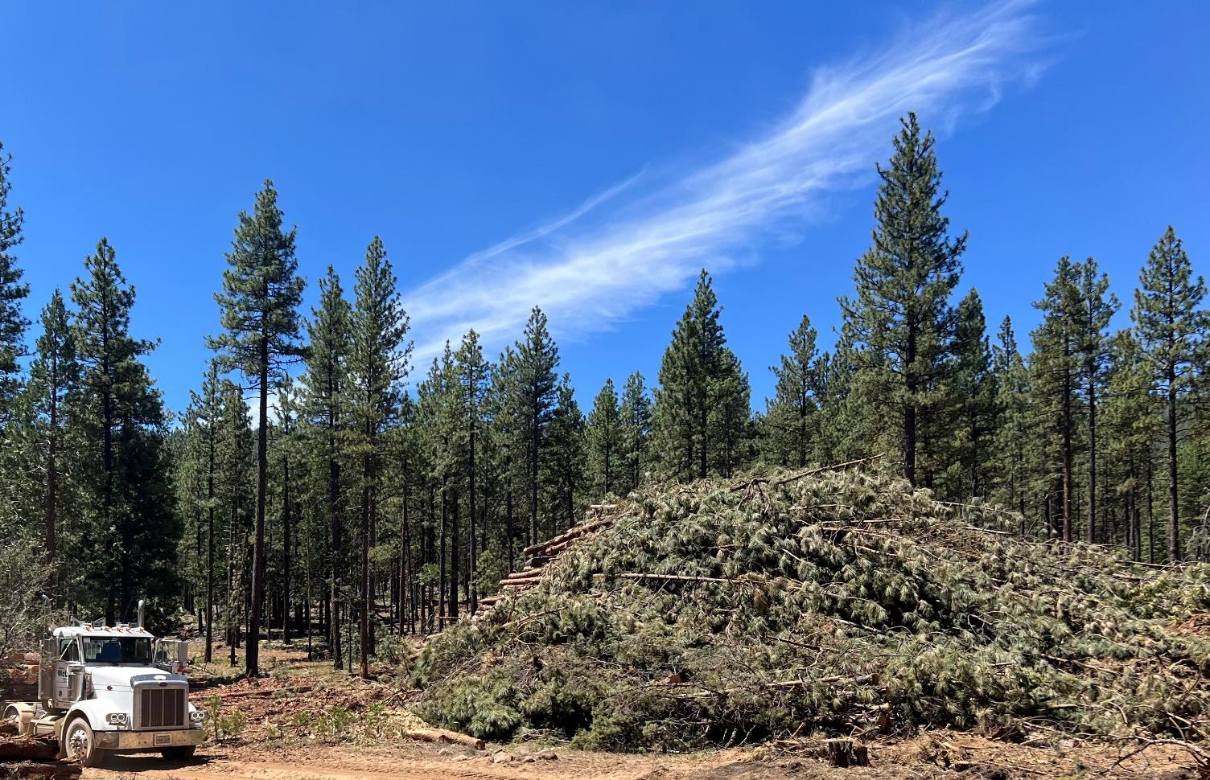





Golden State Natural Resources (GSNR)
Healthy Communities
Overgrown forests increasing risk of catastrophic wildfires
Modoc National Forest - Summer 2024
Forest treatment targets established by State and Federal government
Limited outlets for the removed biomass
GSNR established to create a sustainable and economically viable use from this woody biomass

Slide 9

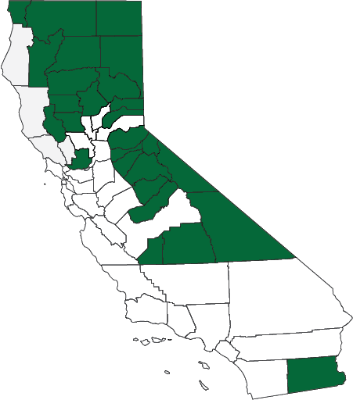
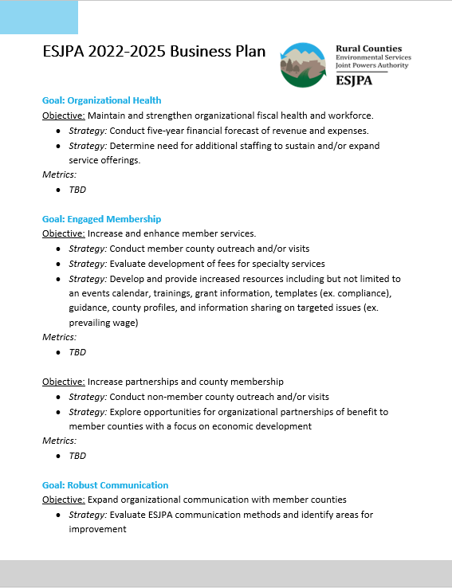
Environmental Services Joint Powers Authority (ESJPA)
Operational
Excellence
ESJPA Business Plan
ESJPA represents 26 rural California counties on solid waste regulatory and legislative policies.
ESJPA advocates on the state and federal level to provide unified political voice for rural solid waste management.
ESJPA offers policy leadership, technical expertise and direct assistance to member counties for environmental compliance.

Slide 10
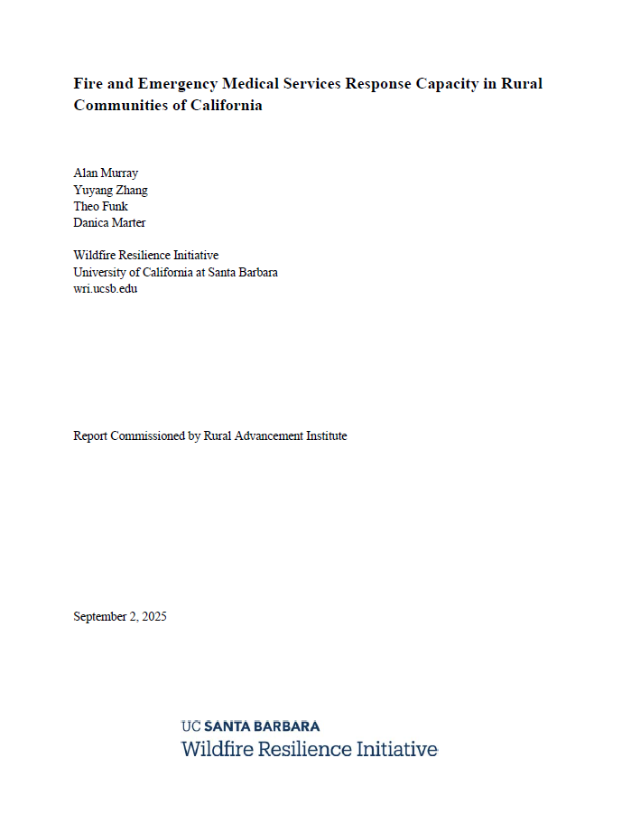

Rural Advancement Institute (RAI)
Impactful Policy Advancement
RAI facilitates academic research and educational opportunities that advance understanding of rural California amongst policymakers and the public.
Educational Tours:
  Behind the Scenes of the Recreation Economy
  Beyond the Lettuce Curtain: Innovations and Challenges
Research and Projects:
  Fire / EMS Capacity in rural counties – UCSB
  Housing Study – Sacramento State
  Healthcare workforce landscape in rural counties – UCSF

Slide 11



QUESTIONS?
Keep Up with RCRC:
Website: www.rcrcnet.org
Sign up for the Barbed Wire newsletter
Follow us on social media:
RCRC
1215 K St., Suite 1650
Sacramento, CA 95814
(916) 447-4806
@ruralcounties
@ca_ruralcounties
@RuralCounties

