Slide 1

Siskiyou County
Wildfire Impacts:
2015–2025

Slide 2
Rising Wildfire Activity Over the Past Decade

Slide 3
Total Estimated Costs: Suppression, Damage, and Recovery (2015–2025)

Slide 4
Community Impacts: Structures Lost & Fatalities

Slide 5
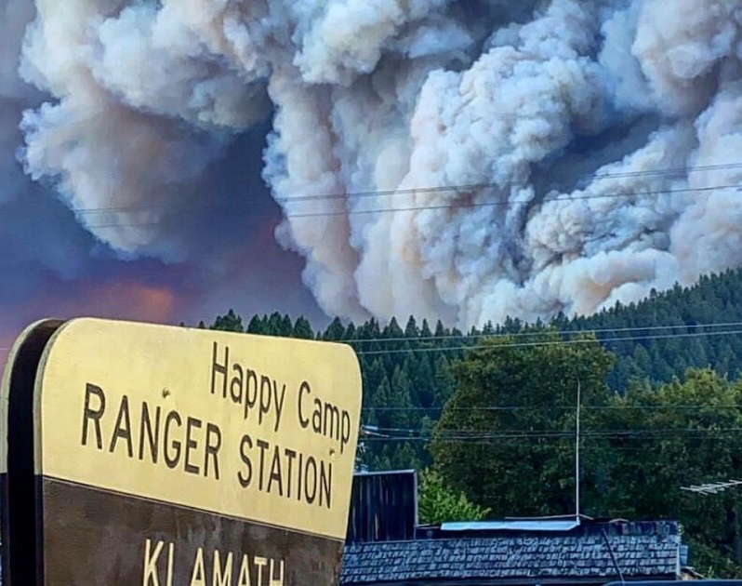
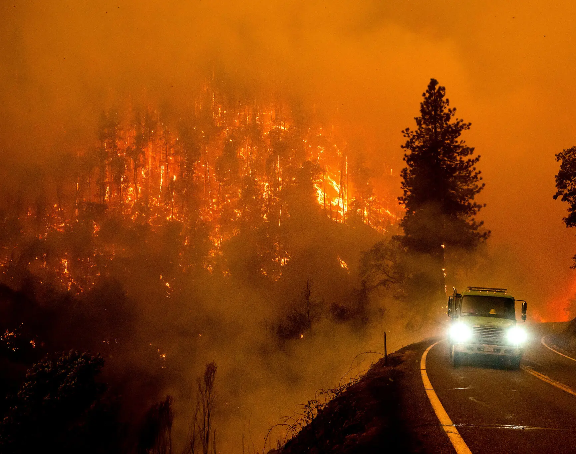
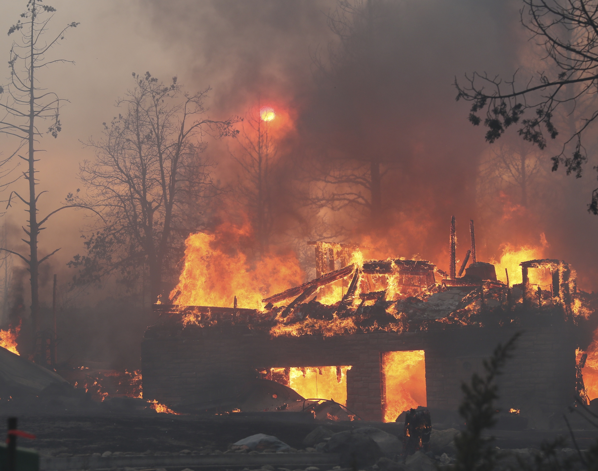
Major Fires That Shaped the OES
Slater Fire (2020)
440 Structures Lost, 2 Fatalities
Estimated Incident Cost: $98,818,650
McKinney Fire (2022)
185 Structures Lost, 4 Fatalities
Estimated Incident Cost: $361,520,000
Mill Fire (2022)
118 Structures Lost, 2 Fatalities
Estimated Incident Cost: $36,896,048
Photo Credits: Slater Fire – NPR, McKinney – AP, Mill Fire – AP

Slide 6
Human Factor
Slater Fire survivors remain primarily unhoused or in temporary housing in travel trailers.
County programs have an average wait of 8 months to 1 year to locate rentals for a person in county housing sheltering/homeless programs.
Nearest larger cities:
  Redding, CA, and Medford/Phoenix, Oregon,
    Carr Fire in 2018 and the Alameda Fire in 2020
McKinney and Mill Housing is being rebuilt
Multiple Long-Term Recovery Groups have been established

Slide 7
Key Takeaways & Next Steps
Wildfires are growing in size, frequency, and cost
Increasing burden on local resources and residents
  WUI
Need for sustained investment in mitigation, prevention, and recovery
  Mitigation dollars
Supports the case for bipartition state and federal funding partnerships
  CalFire
  US Forest Partnership and Values-at-Risk
    Klamath
    Shasta-Trinity
    Six Rivers

Slide 8
Q&A

