Slide 1
Shasta-Trinity National Forest Mount Shasta and McCloud Ranger Districts
Siskiyou County Board of Supervisors Meeting
May 20, 2025

Slide 2
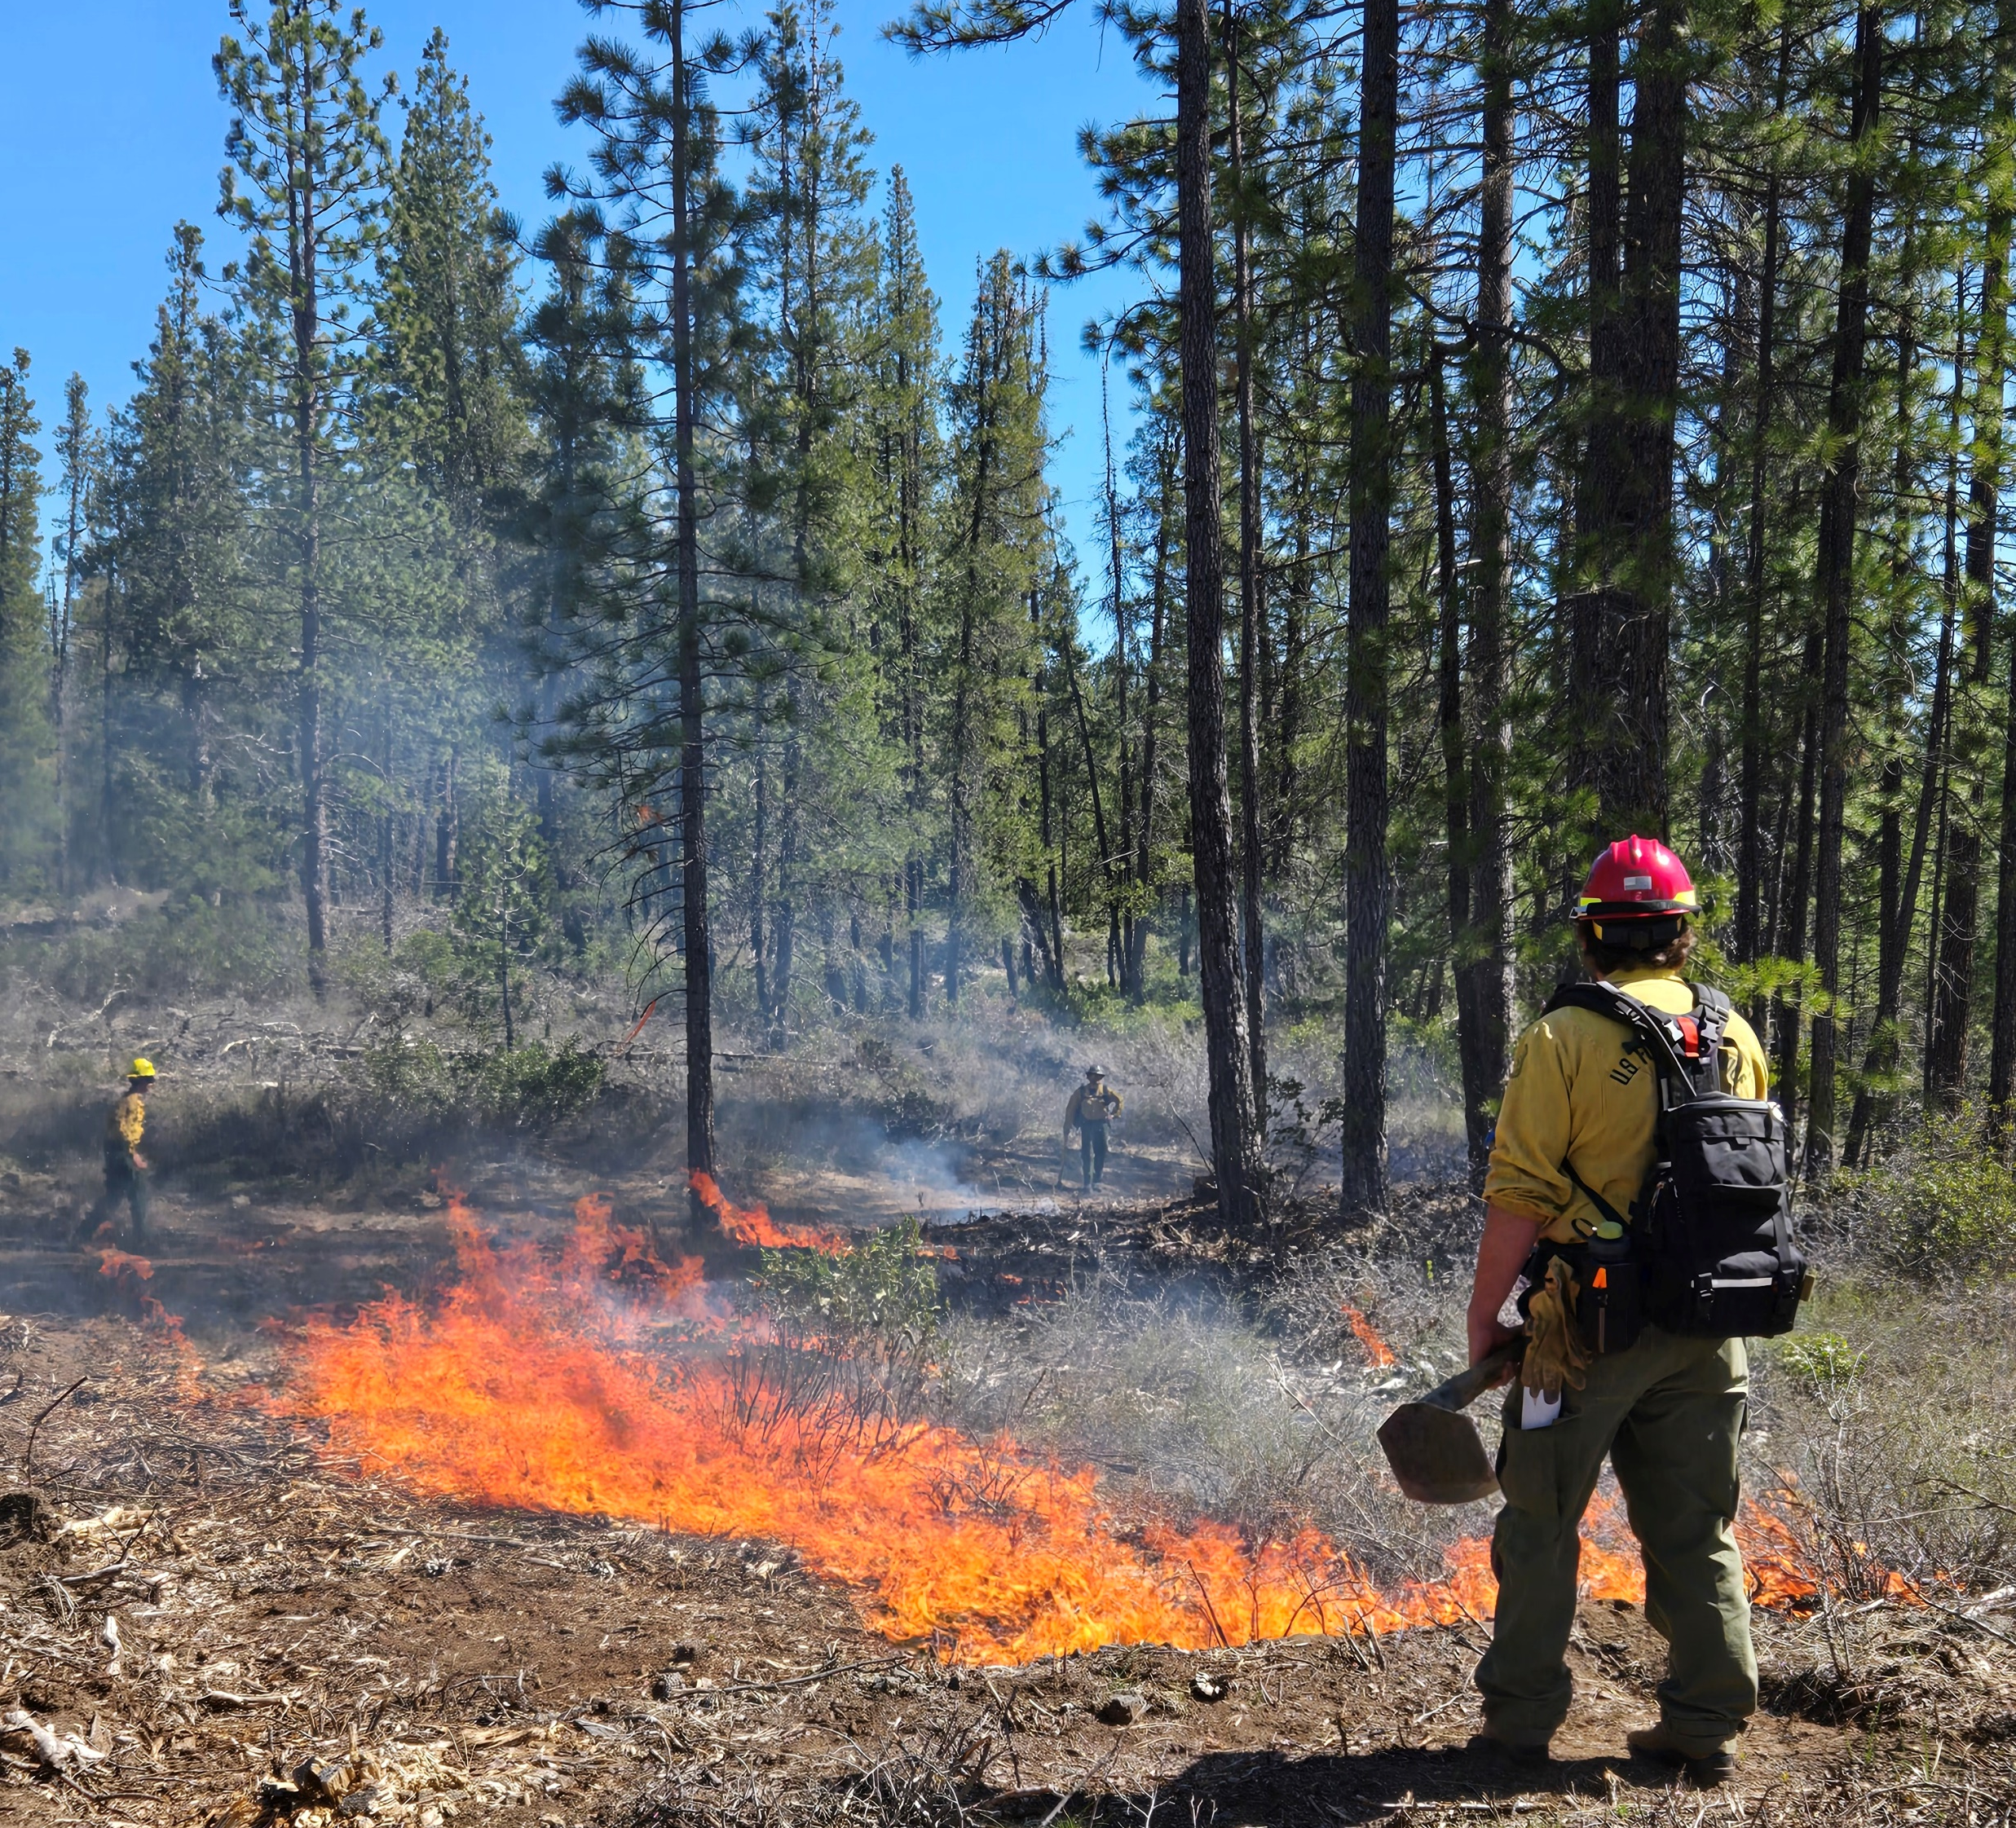
District Updates – 2025 Fire Season
2025 Fire Season
District Fire Staffing
6 Engines,1 Water Tender, 3 Patrols
No Substantial Change from 2024
17 Fires Caught in 2024 on Mount Shasta & McCloud Districts

Slide 3
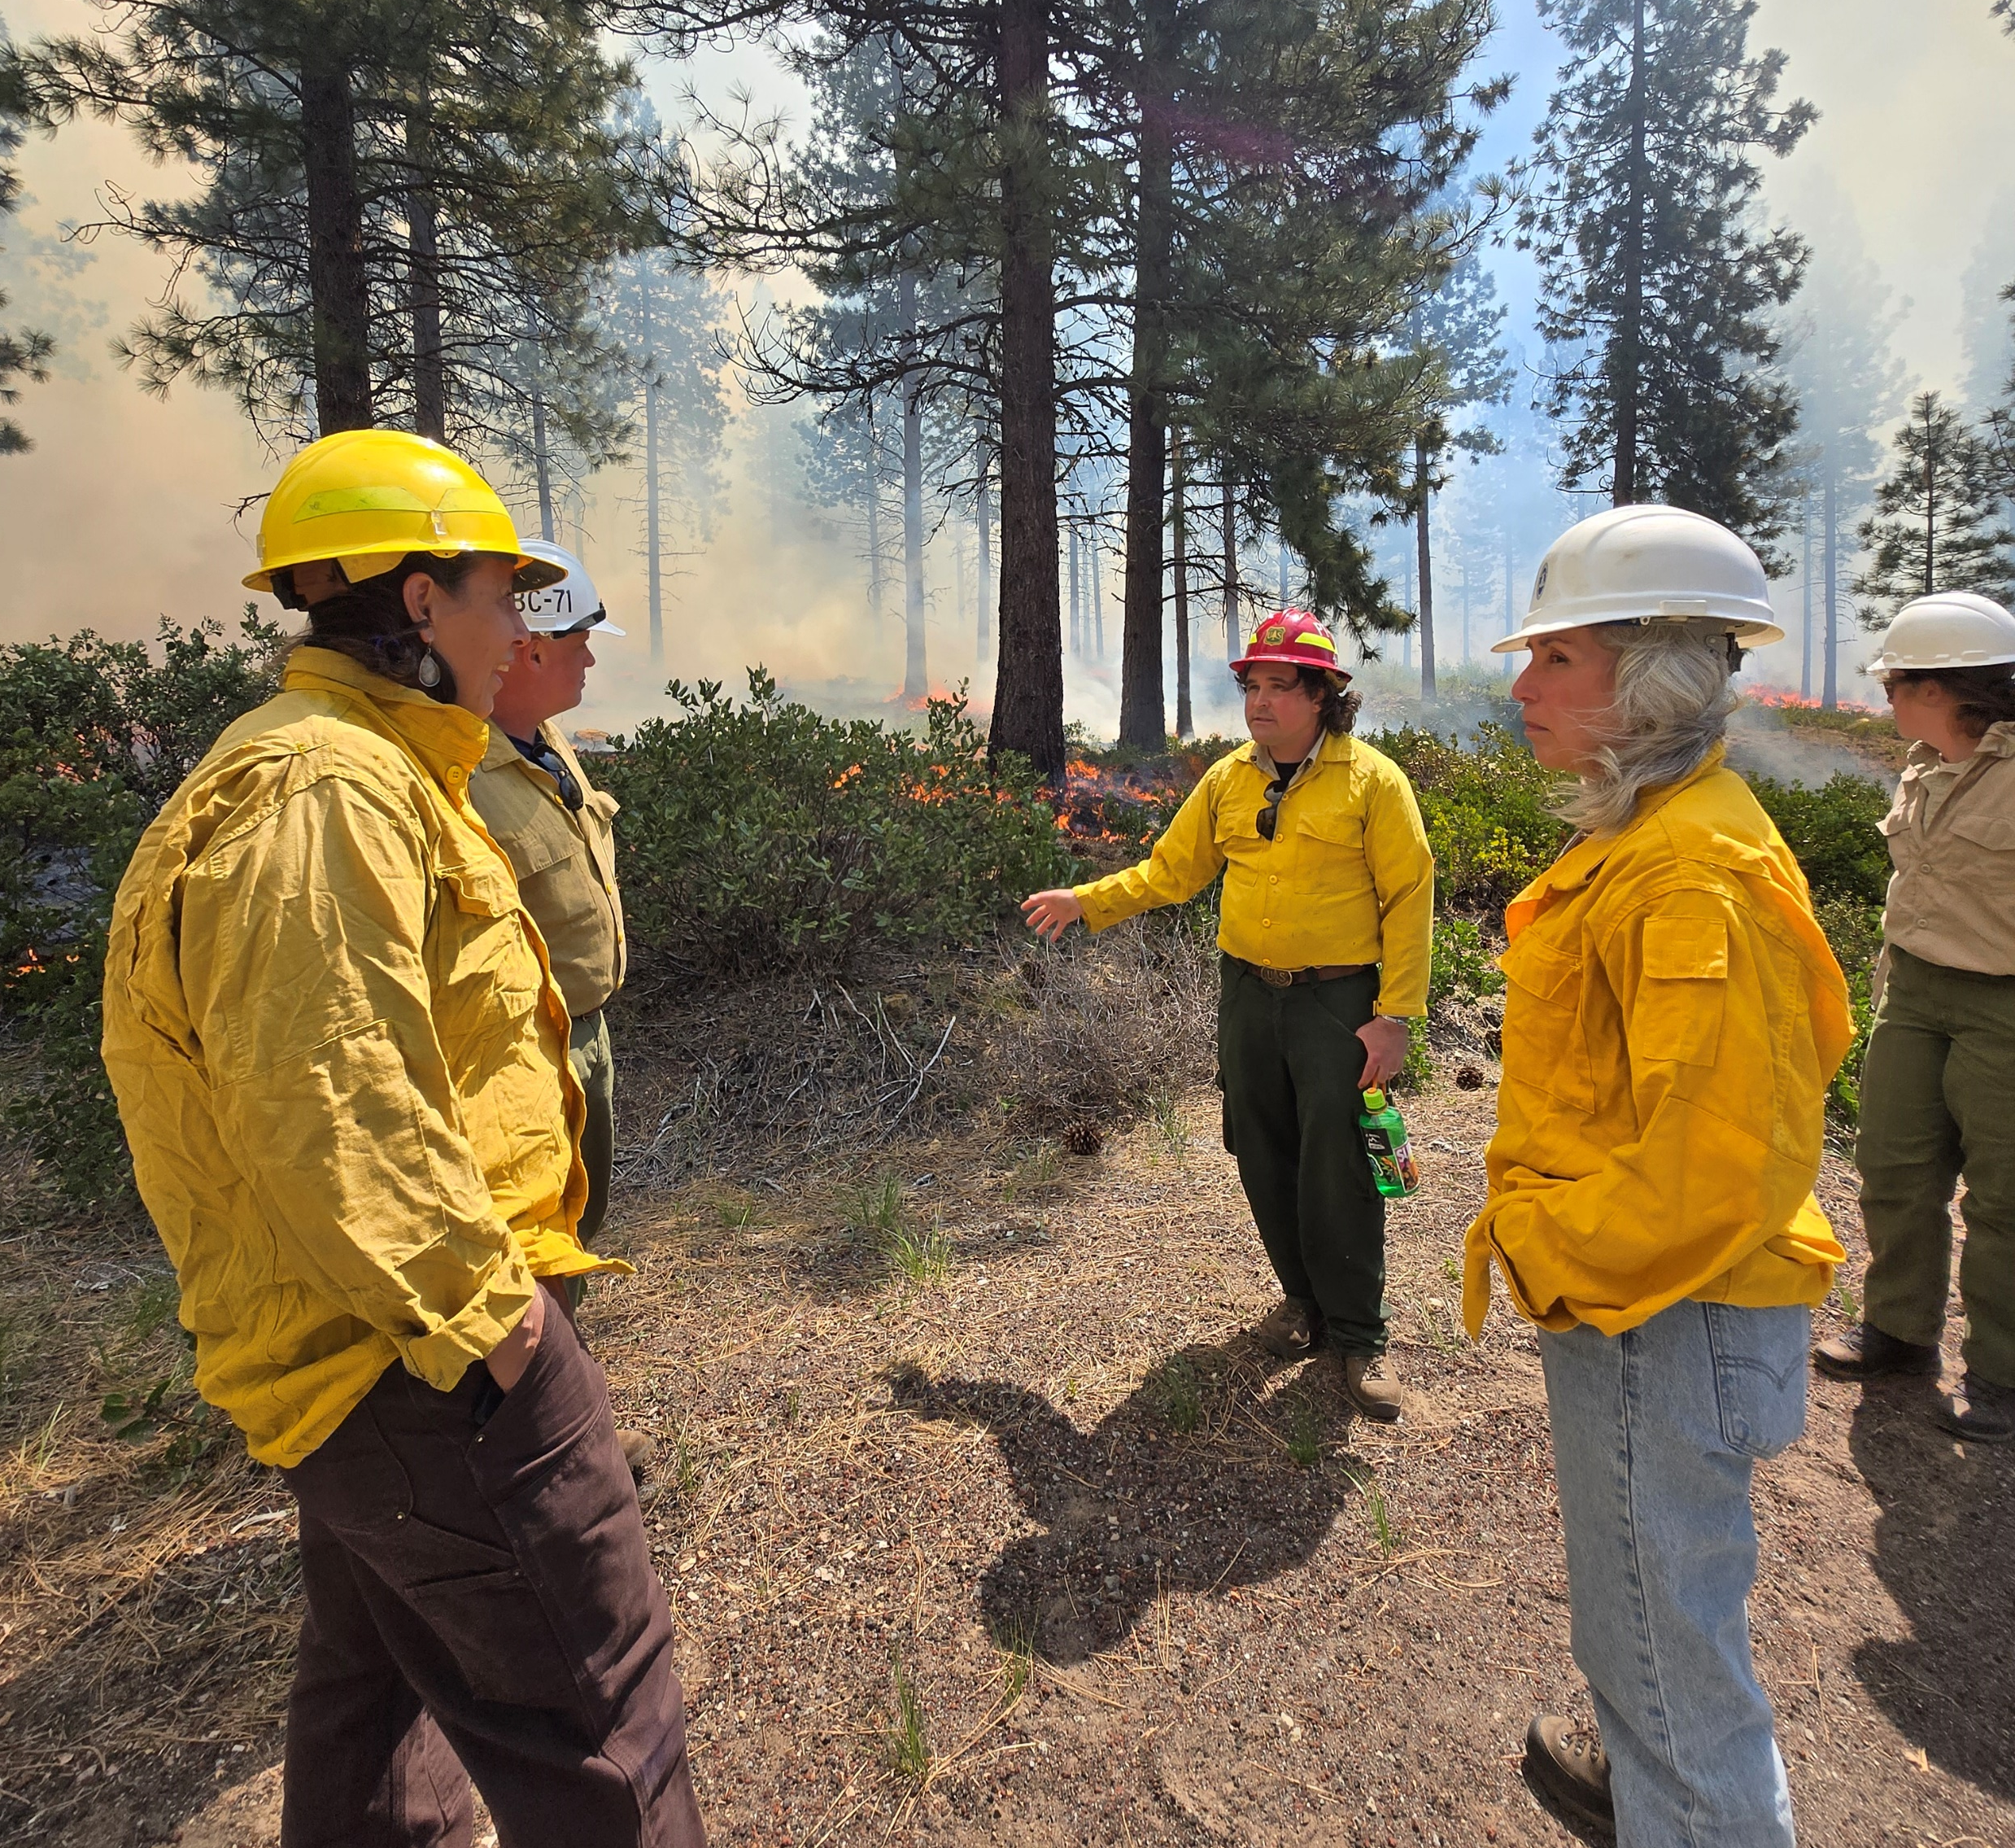
District Updates – Project Implementation
Implementation
Spring 2025 Burns
Highway 89: 236 Acres
McBride: 171 Acres
Piles: 210 Acres
Total: 617 Acres Burned
8 Active Timber Sales
1,100+ Acres Planted in Lava Fire Footprint

Slide 4
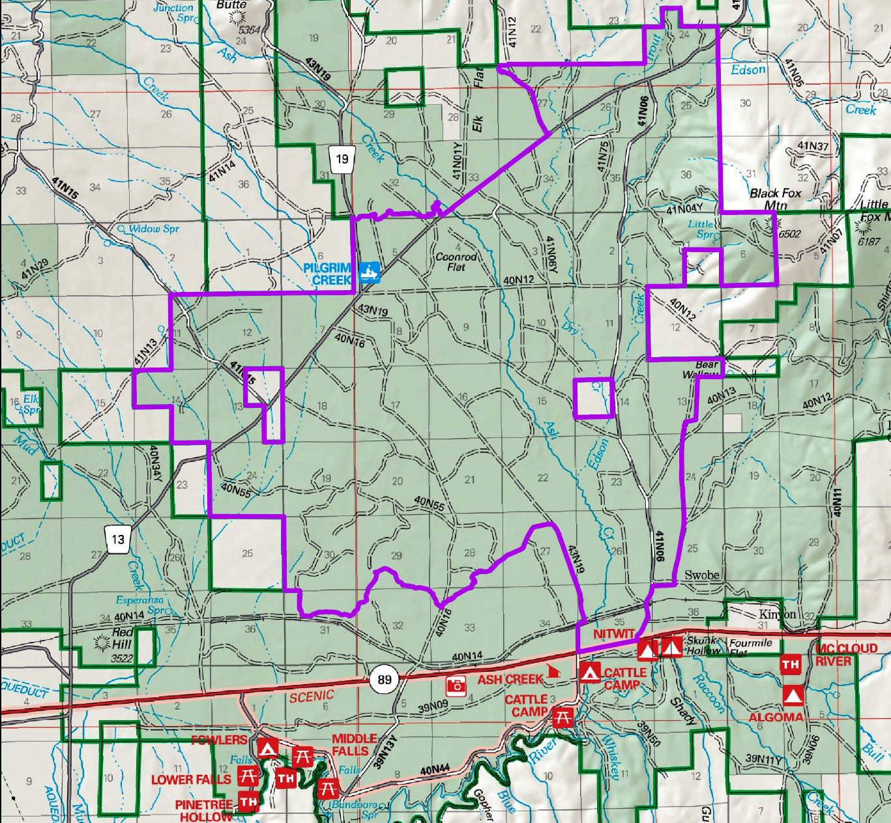
District Updates – Project Planning
Planning
Lava Roads Repair
Parks Trinity Fuelbreak
Ash Creek Proposal
Approx 24,000 Acres
McKenzie Butte Proposal
Approx 19,000 Acres
Forest wide Prescribed Fire and Small Diameter Fuels Project

Slide 5
District Updates – Road Updates
Roads
Pilgrim Creek Road
$400K in Repairs in 2025
Esperanza Road
Potential Paving in 2026
Ski Park Highway
Applied for Funding to Repave the Road
Tom Young Road
Vegetation Work

Slide 6
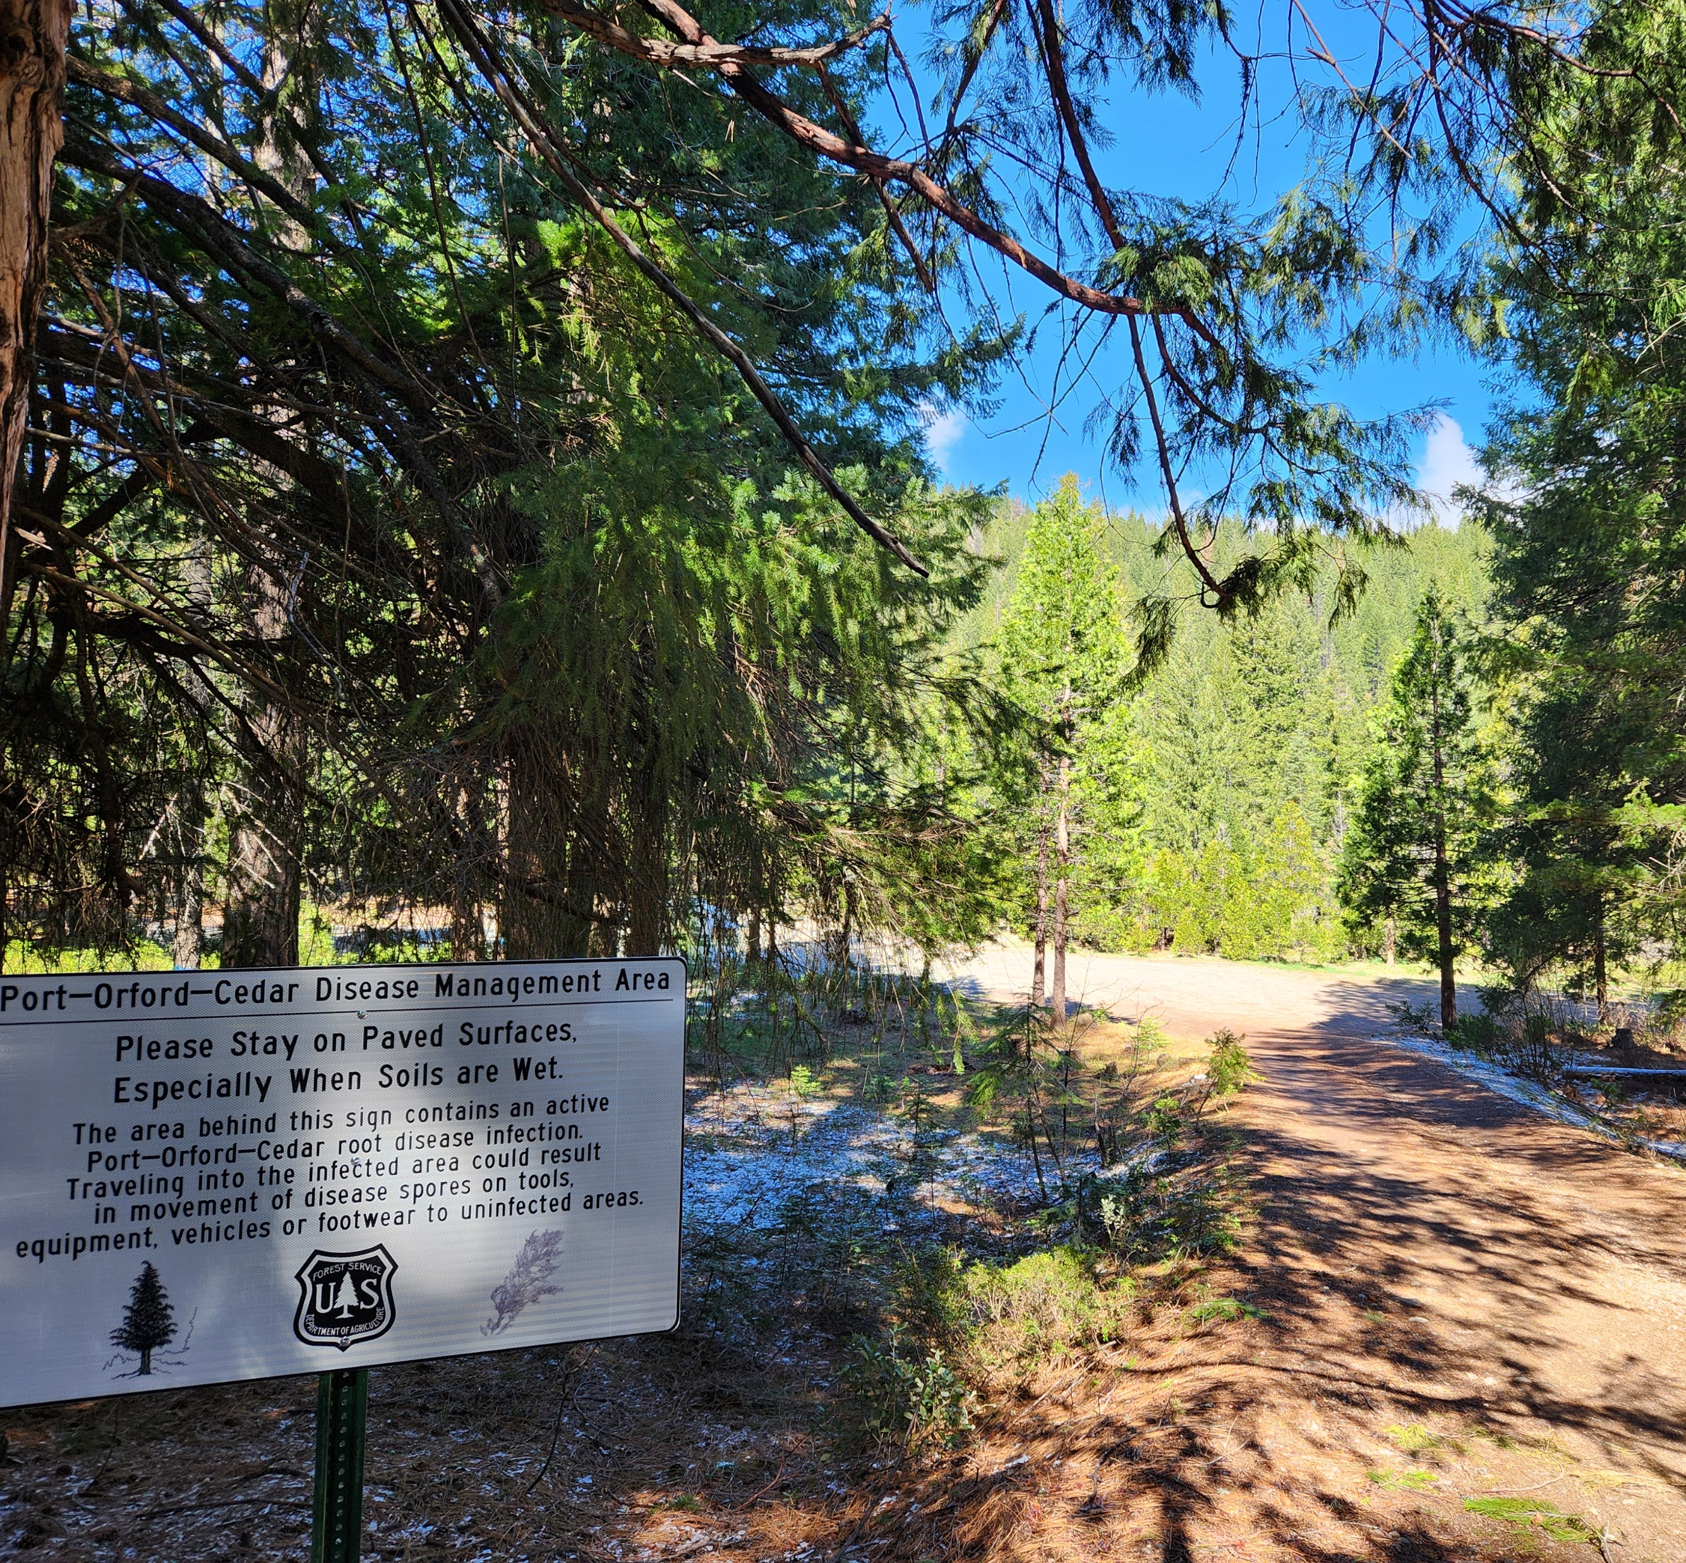
District Updates – Area Closures
Closures
Slate Creek Road (Storm Damage)
Rainbow Thin Timber Sale Area (Logging Operations)
Twin Arrows (Port Orford Cedar Root Disease)

Slide 7
Questions?
Thank You for Sharing Your Time with Us

