Slide 1
Local Responsibility Area Fire Hazard Severity Zone
Roll Out and County Responsibilities

Slide 2
Introduction and County Requirements
In accordance with State Code Section 51178, the State Fire Marshall is required to identify levels of fire hazard.
Local jurisdictions are receiving notices from the Office of the State Fire Marshall on the Local Responsibility Area (LRA) Fire Hazard Severity Zone (FHSZ) maps as identified by the State Fire Marshall.
Siskiyou County received its notice on February 10, 2025.
LRA’s include cities, counties and districts.
Siskiyou County’s obligations within our LRA include:
Information Sharing (public review and comment)
Legislative (designation by ordinance)
Notes:
Levels of fire hazard are based on consistent statewide criteria and based on the severity of fire hazard expected. An LRA is an area where the local government is responsible for wildfire protection.
An LRA is an area where the local government is responsible for wildfire protection.
Information Sharing Obligation: Government Code 51178.5 Within 30 days after receiving a transmittal from the State Fire Marshal that identifies fire hazard severity zones pursuant to Section 51178, a local agency shall make the information available for public review and comment. The information shall be presented in a format that is understandable and accessible to the general public, including, but not limited to, maps.
Legislative Obligation: Government Code section 51179 requires a local agency to designate, by ordinance, moderate, high, and very high FHSZ within 120 days of receiving the identified FHSZ's from the State Fire Marshal pursuant to Section 51178.
Note: County may choose to increase the designation of a FHSZ from the FHSZ identified by the State Fire Marshal, (for example if the FHSZ zone edges in the maps are not aligned with parcel boundaries), but County is not allowed to reduce the designation of a FHSZ.

Slide 3
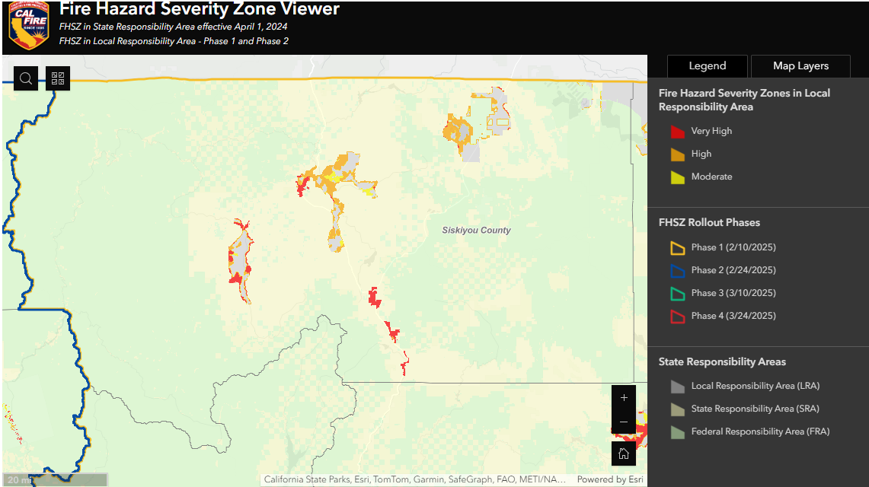
LRA FHSZ - Access Map | LRA FHSZ - Hub Site Application

Slide 4
Next Steps
County to open a 30-day comment period
Maps, backup material, and instructions on how to comment will be provided on the County’s website and shared via social media.
Community Development, Office of Emergency Services, and the Sheriff’s Departments will review the FHSZ maps and determine if any changes are necessary.
Following final review and any proposed changes to the maps, County staff will draft the required ordinance and present to the Board for approval.
Final ordinance will be provided to the State Fire Marshall by the June 9, 2025, deadline.
Notes:
Following final review and any proposed changes to the maps, County staff will draft the required ordinance and present to the Board for approval (first and second readings anticipated in May, 2025).
Final ordinance will be provided to the State Fire Marshall by the June 9, 2025, deadline.
County to open a 30-day comment period
Maps, backup material, and instructions on how to comment will be provided on the County’s website and shared via social media.
Following closing of public comment, county staff will review comments and determine how to address them.

Slide 5
Questions?

