Slide 1
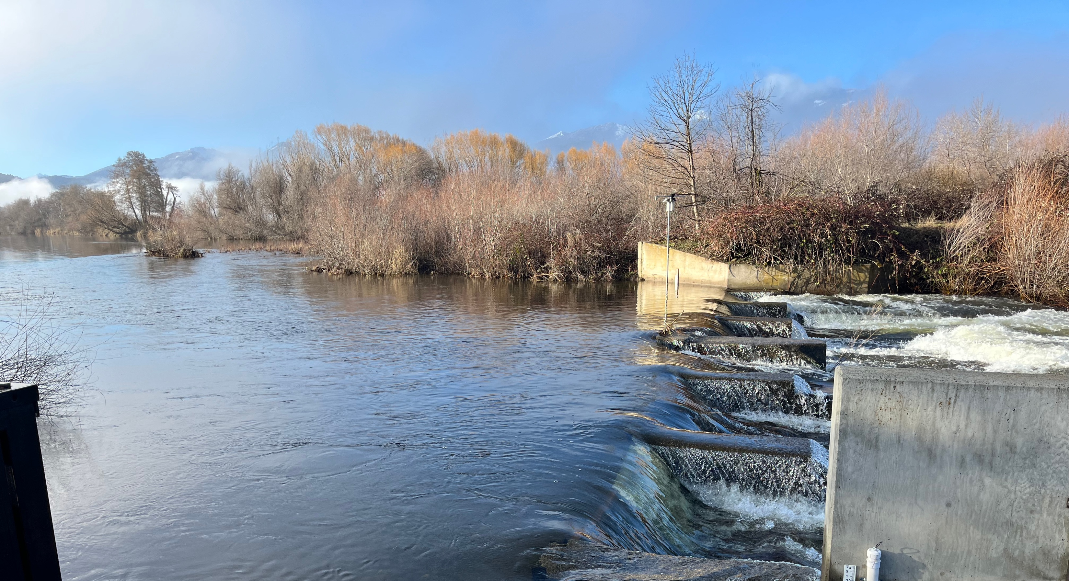


Laura Foglia PhD
Recharge in Scott Valley
January 21, 2025

Slide 2
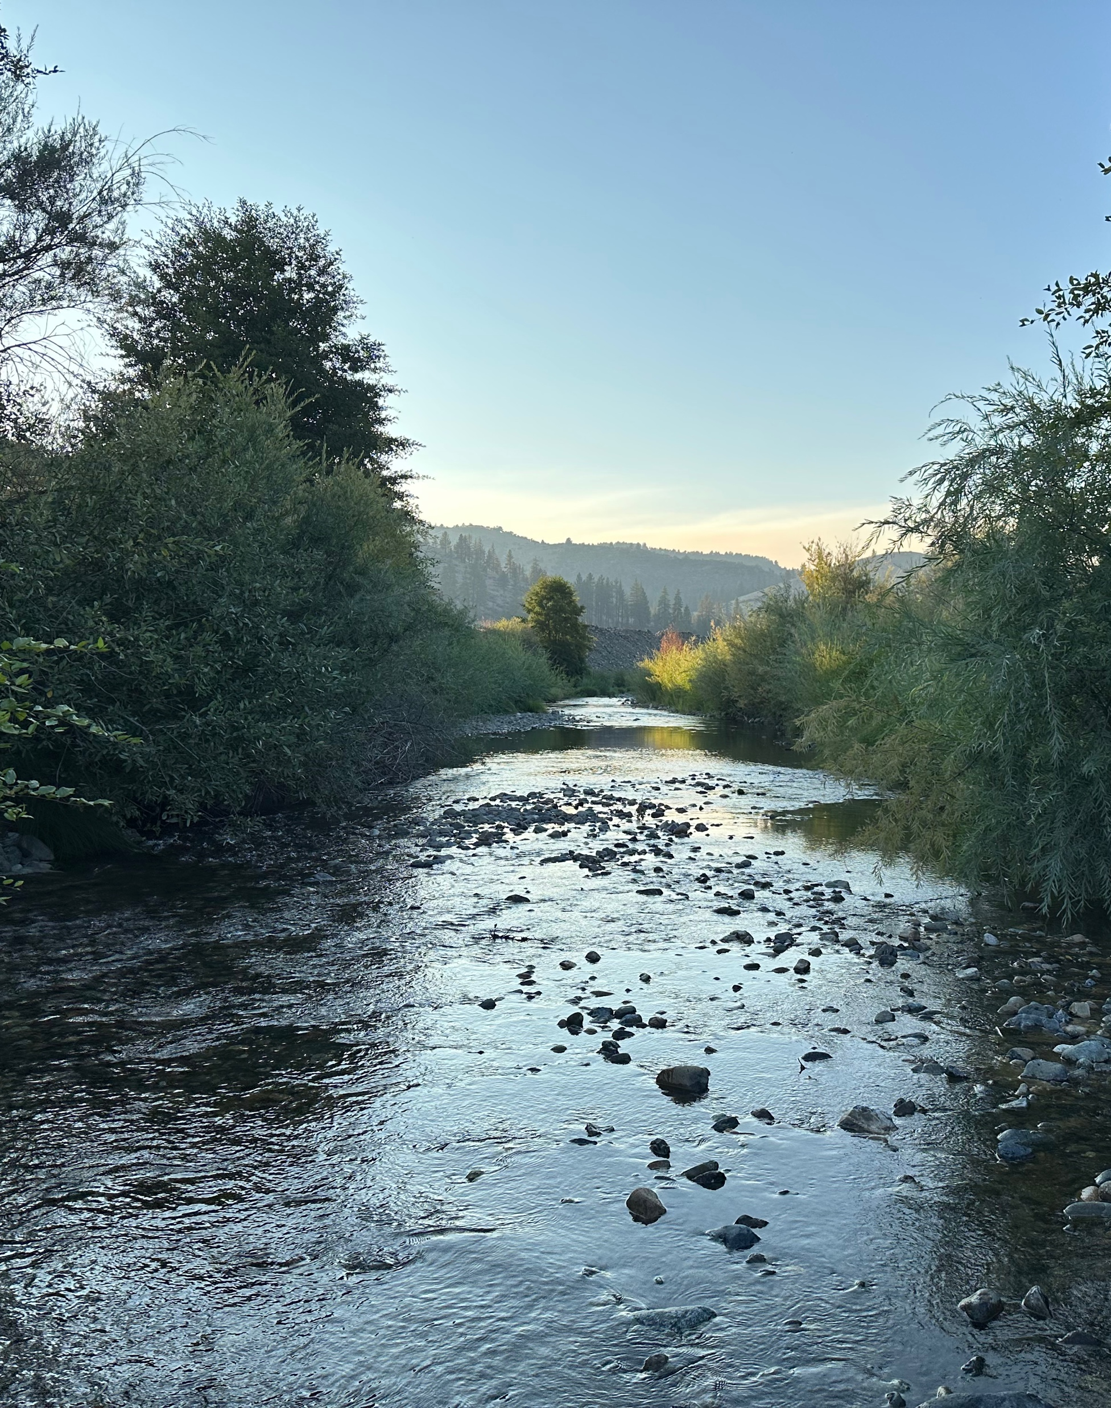




Why recharge in Scott Valley?
During periods of high flow water is diverted from Scott River and applied to fields
This increases groundwater that is then available to return to Scott River
Groundwater and surface water interconnection
Importance of instream flows in Scott Valley for fish
Existing unlined irrigation ditches
Projects include Scott Valley Irrigation District Recharge Project and Ditch Infiltration Project on the westside of Scott Valley

Slide 3
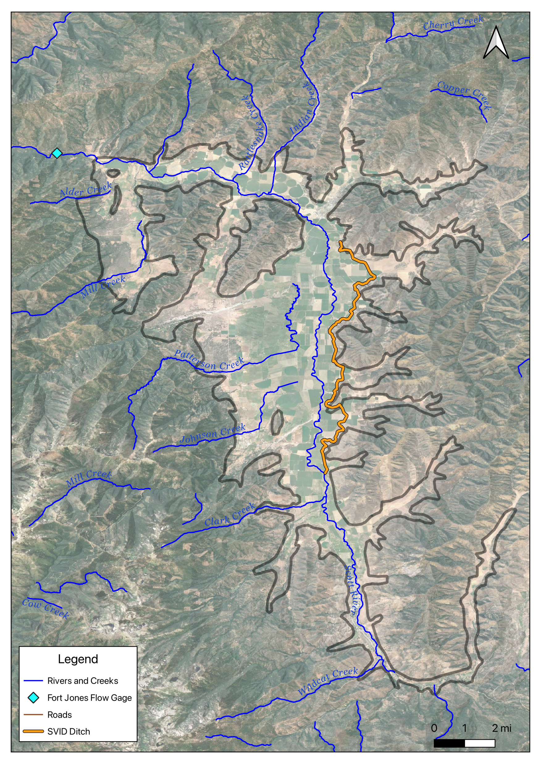
SVID Recharge Project Overview
USGS Fort Jones Flow Gage
Use Scott Valley Irrigation District (SVID) ditch to divert water from Scott River during periods of higher flow and apply to agricultural land for groundwater recharge
Diversion January through March in current permits
Long-term implementation to understand:
  Results under different conditions/ water year types
  Potential longer-term benefits of groundwater recharge
Evaluate impact to instream flows, particularly in the late summer and fall
  Physical monitoring
  Geochemical tracer monitoring
  Model simulations
Project Area
Point of Diversion

Slide 4
SVID Recharge Project- History and Results
2016 PILOT PROJECT, about 15 acres, results summarized by UCD (Dahlke H, et al., 2018, Cal Ag) → 675 af diverted to underground storage for fish and wildlife enhancement use. Diversion report submitted 10/10/2016.
2022: permit issued 03/03/2022 → about 28.6 af used to test recharge. Diversion report submitted to SWRCB 07/08/2022
2023: permit issued on 01/18/2023, water diverted for recharge from March 13 through March 31, 816 af diverted, 51.7 af applied to three fields. Diversion report submitted to SWRCB 5/31/2023.
2024: permit issued on 11/21/23, diversion for recharge started 01/15/2024 and went through 3/31/2024, 2,539 af diverted.

Slide 5
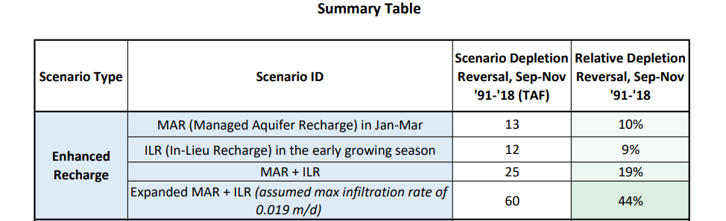
From the Groundwater Sustainability Plan…
Modelling scenarios are supporting the potential of groundwater recharge as one of the possible tools for reaching sustainability

Slide 6
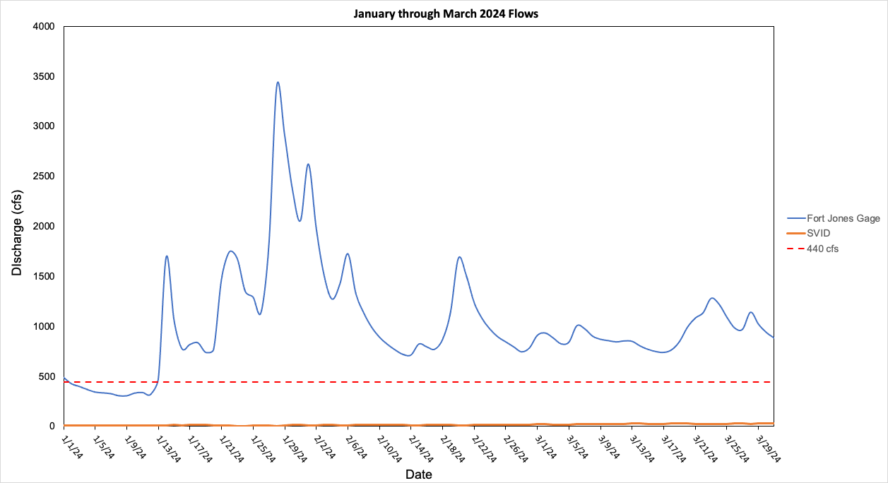
2024 Flow Conditions and Diversions
Flow diverted to SVID ditch at the point of diversion (POD), Young’s Dam is a fraction of flow measured at the Fort Jones USGS gage.

Slide 7
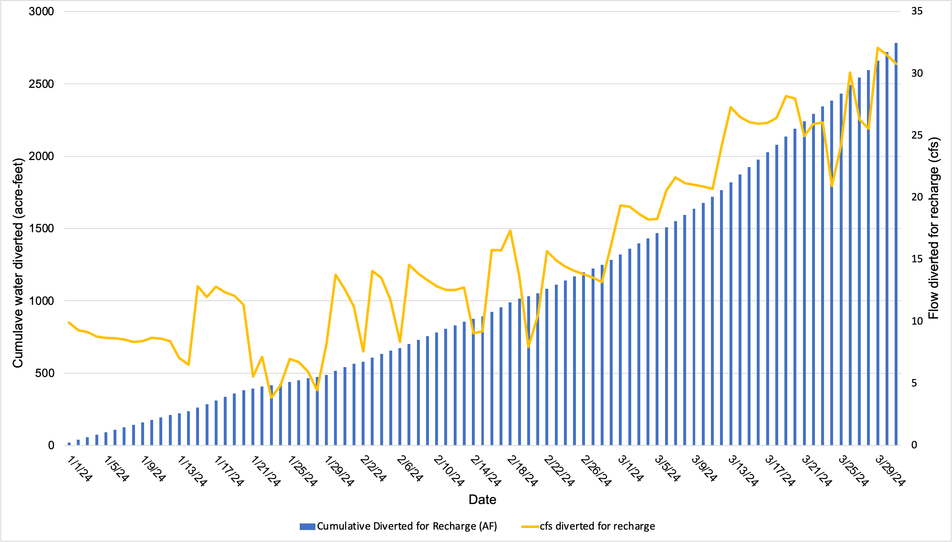
Total diverted from January 15 through March 31 = 2,539 AF

Slide 8
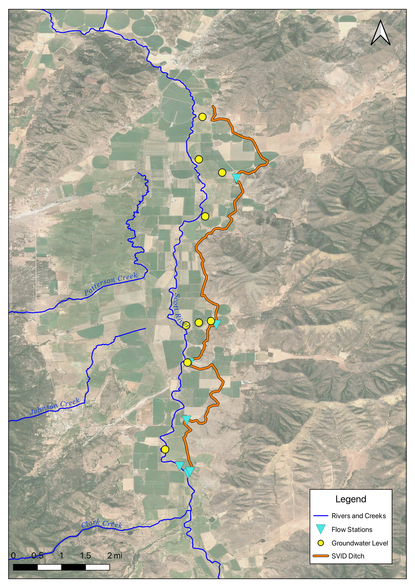
2024 Data Collection
  9 groundwater wells instrumented to measure groundwater level and temperature
  2 flow stations on Scott River (above and below point of diversion)
  5 flow stations along the ditch

Slide 9
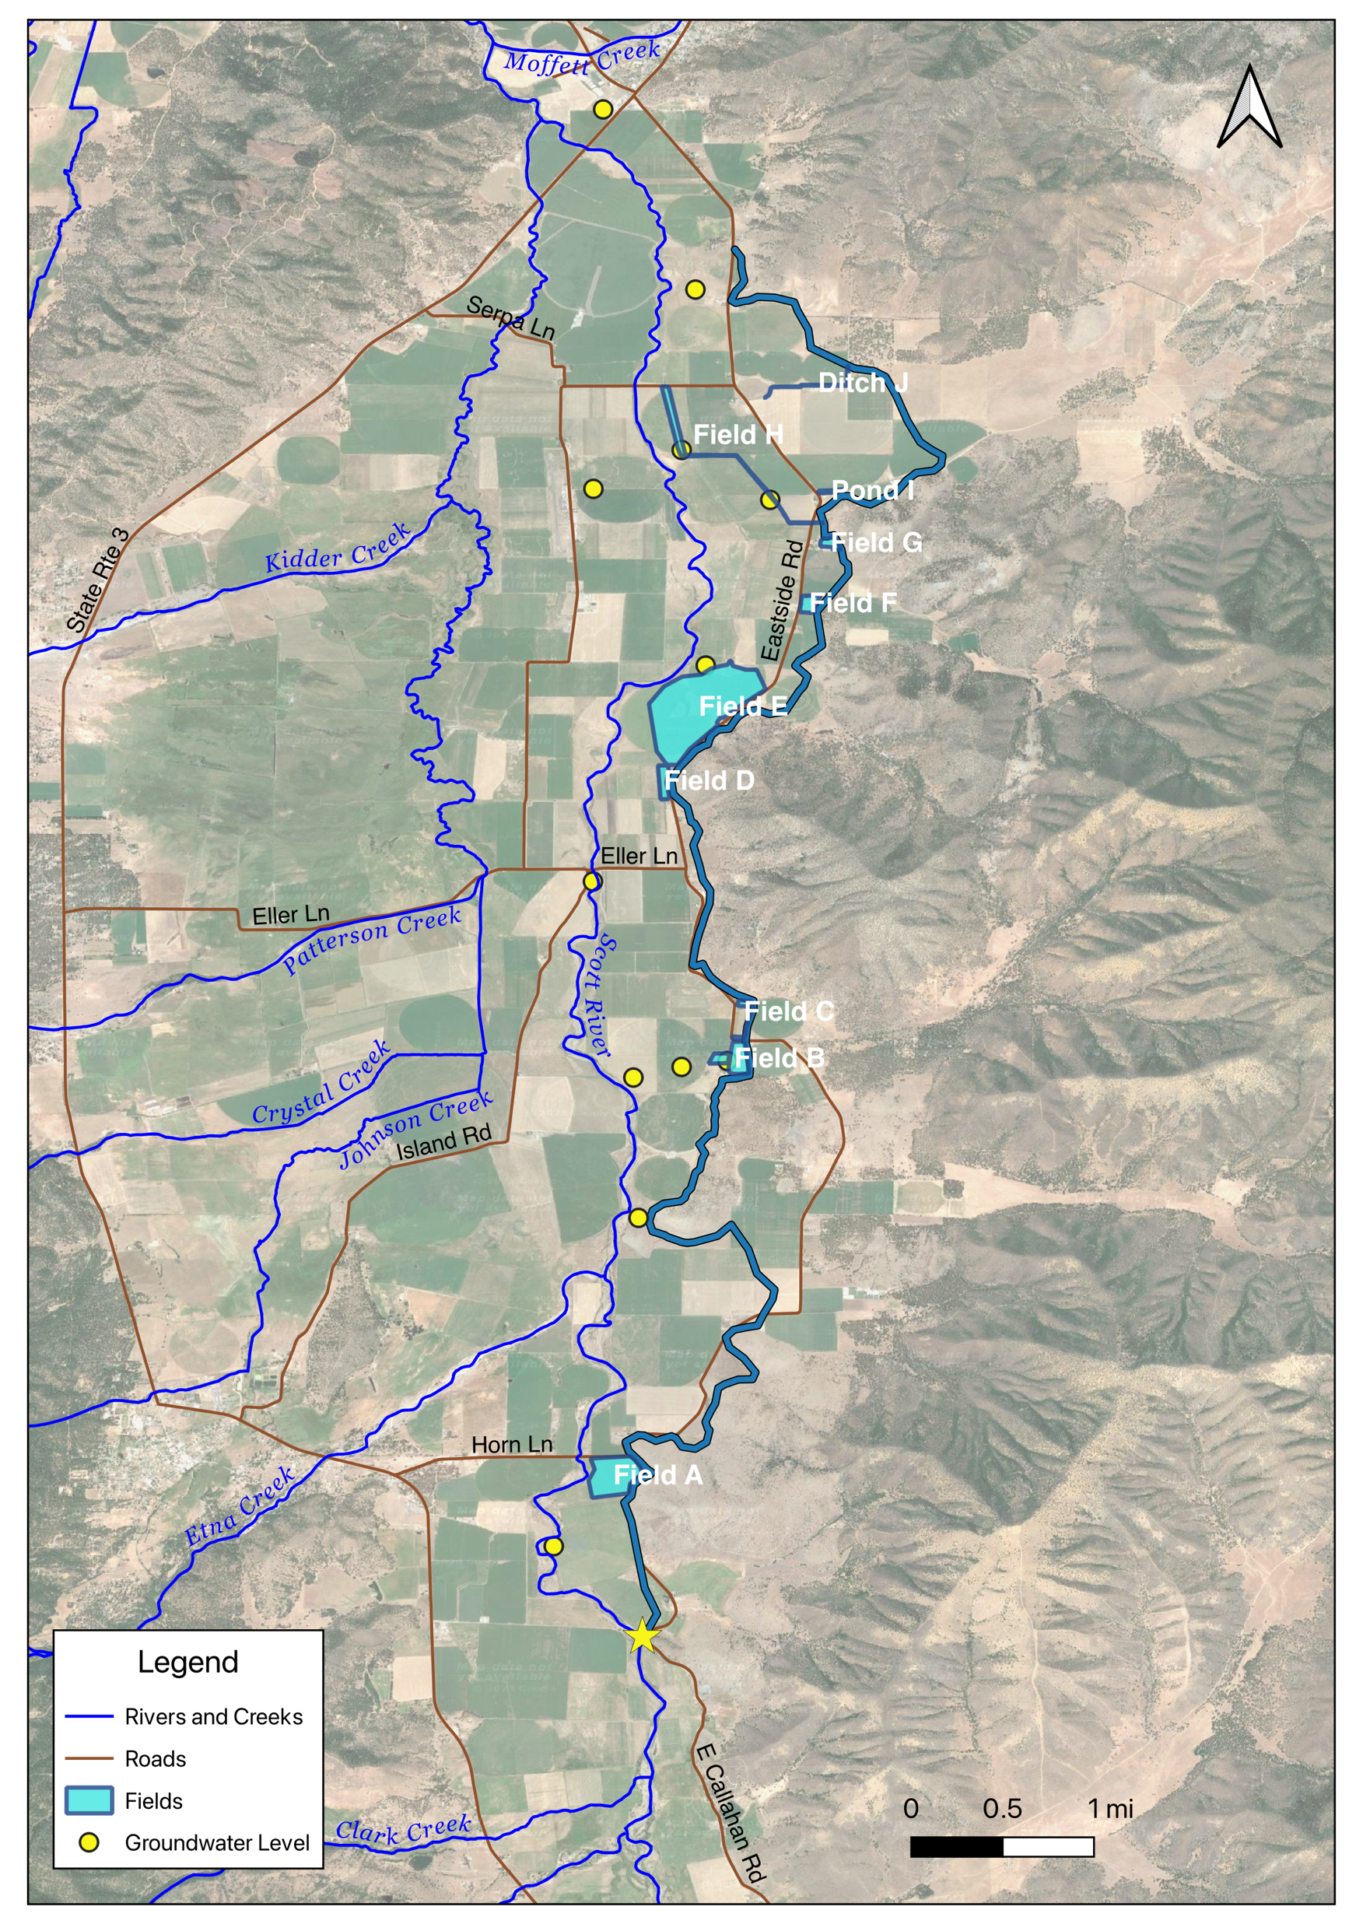
SVID Recharge 2024
Water diverted from Young’s Dam from January 15, 2024 through March 31st 2024
Total of 2,539 AF diverted from Young’s Dam
  1,774 AF applied to 10 locations~ 260 acres
  765 AF recharged through irrigation ditch
10 different locations used in SVID service area to apply water (A through J)
Field A

Slide 10
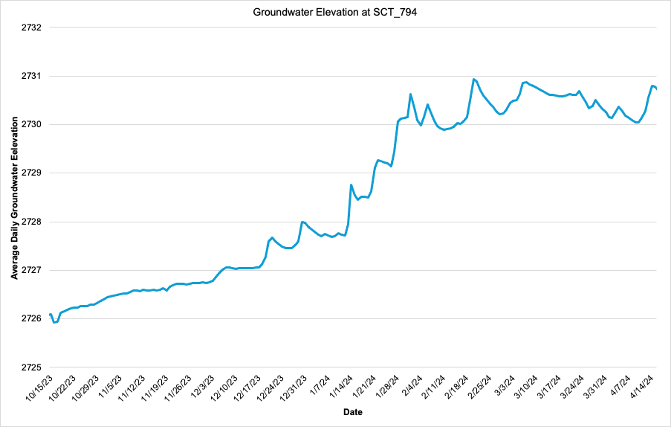
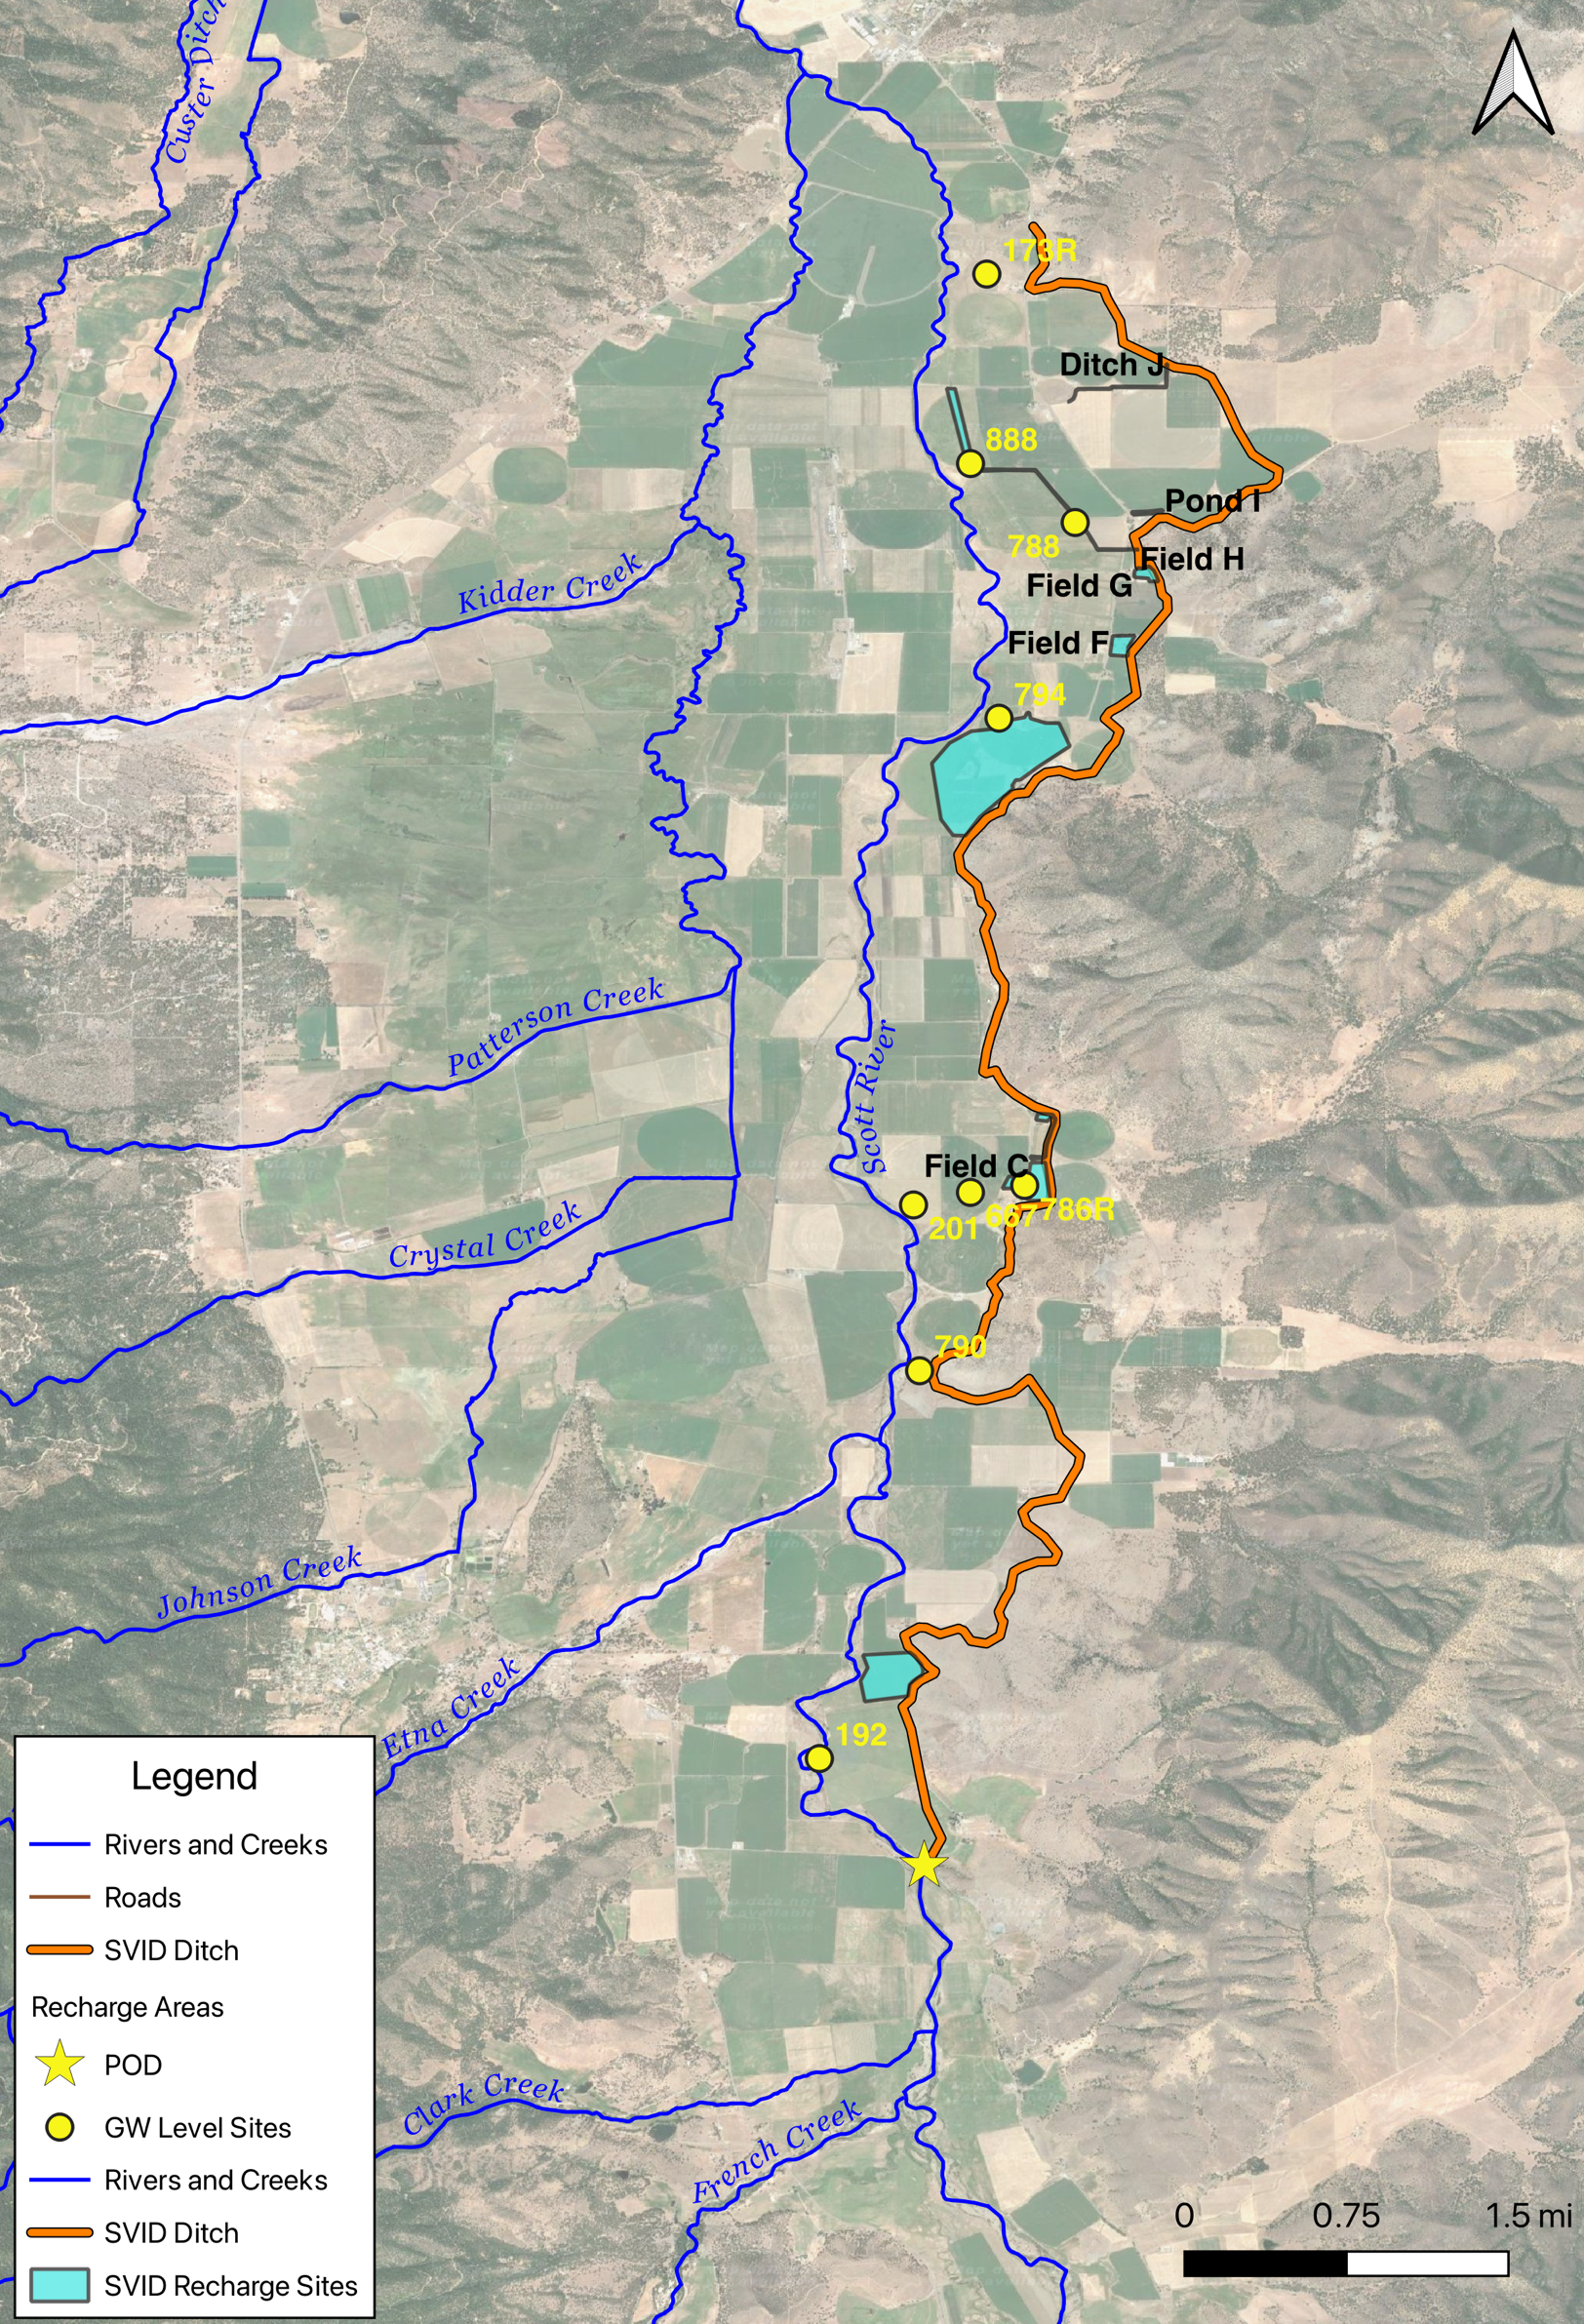
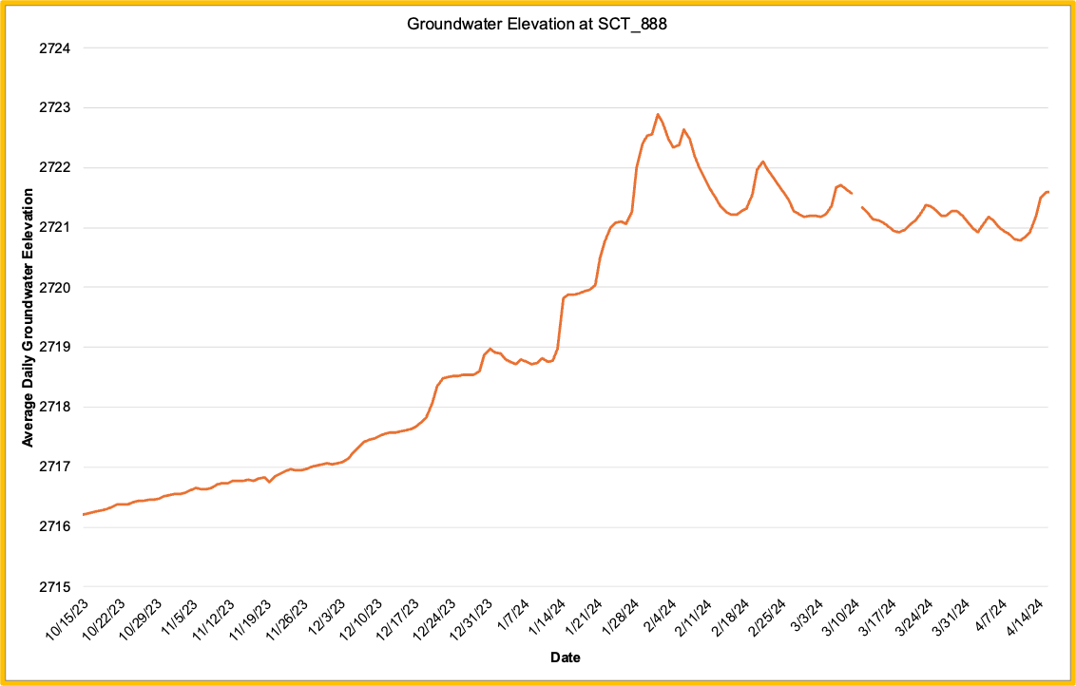
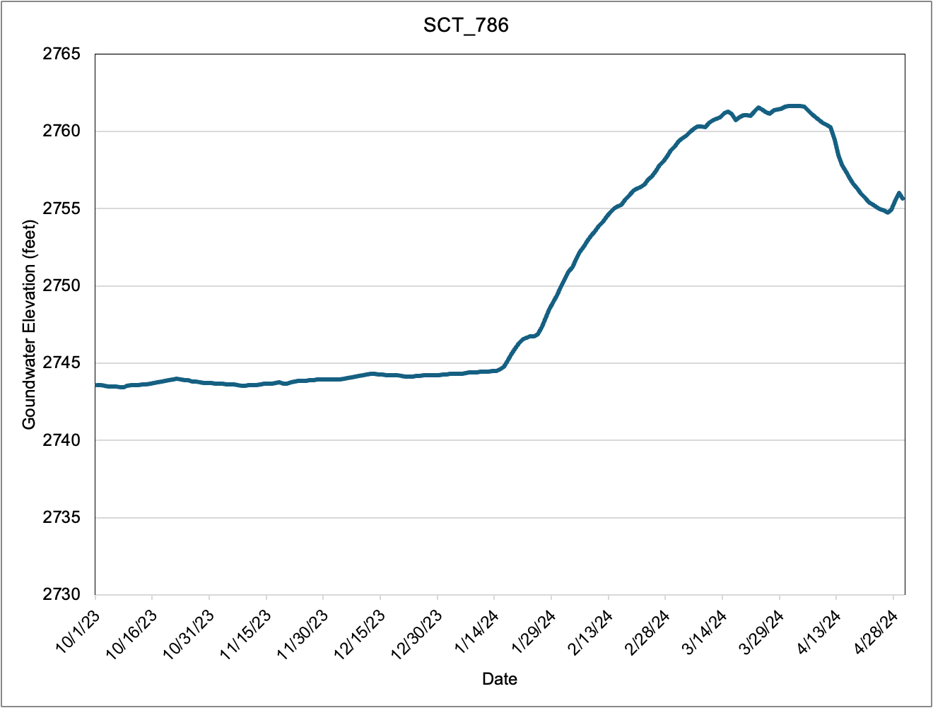
3 ft
4 ft
17 ft

Slide 11
Field B
Transect of wells from field used for recharge to the river
Longest application period for recharge
  Full recharge period from January 15 through March 31
Field B Area
Point of Diversion

Slide 12
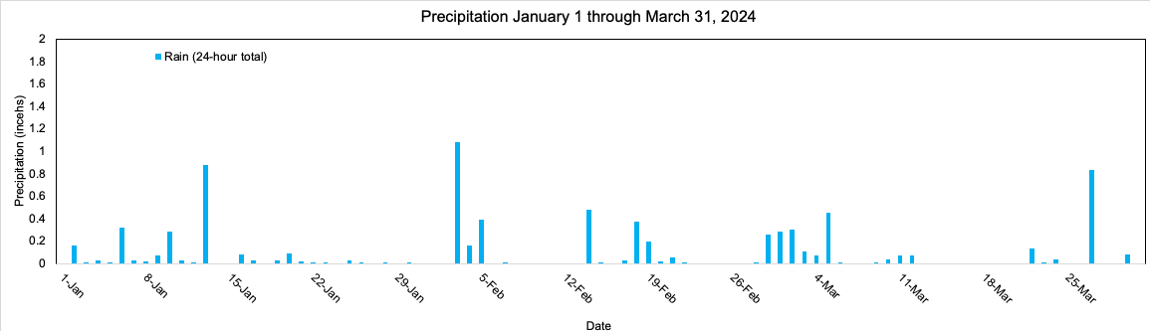
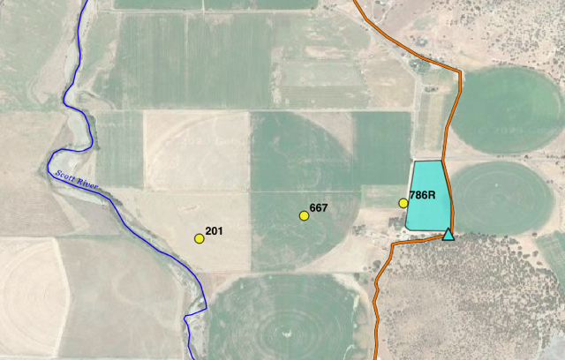
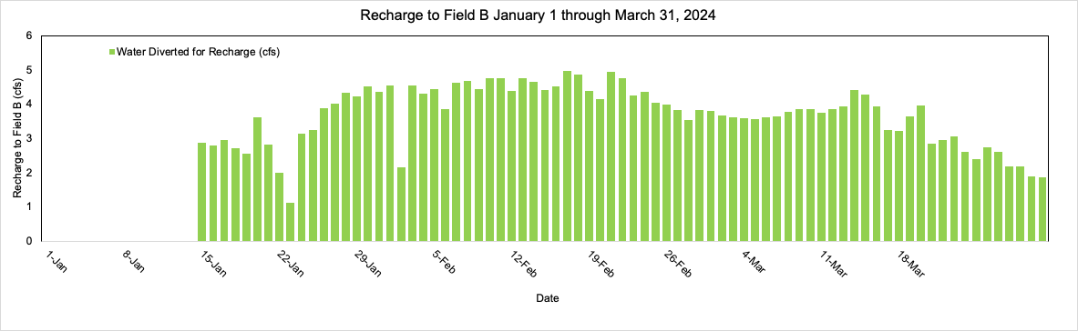
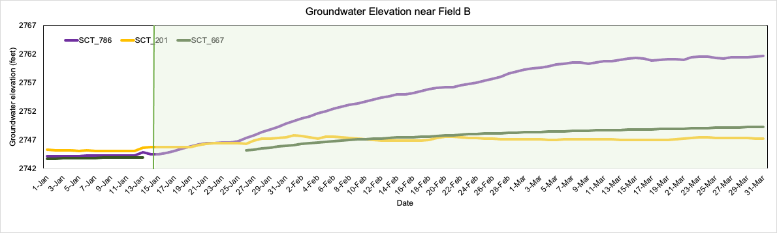
Field B
SVID Ditch
Well Transect
Notes:
Add graph with River stage → add precipitation graph

Slide 13
Contour Maps
← Contour map from December 2023, pre-recharge
Contour map from April 2024, post-recharge→

Slide 14
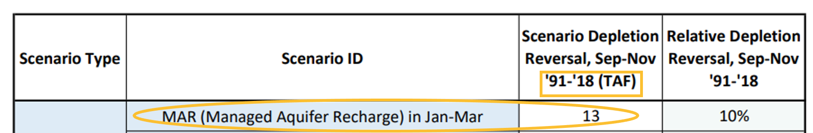
Let's put these numbers in perspective!
What does this look like year-by-year?
Modelled Benefits- Streamflow Depletion Reversal
On-Farm Recharge so far:
2024 cumulative on-farm recharge ~ 2,539 AF
Still need to consider:
1. Still need to consider the rest of the recharge period
2. Water recharged through ditch infiltration
Total Volume Recharged in 2024 through SVID Recharge Project
Scenario depletion reversal (average/year) = 481 AF
SVIHM
Depletion Reversal achieved in 2024 due to MAR

Slide 15
Water Quality
Permit Terms
  No pesticide or fertilizer application after June 1 of preceding year
  Minimize Runoff
2024
  Initiation of water quality sampling effort, samples taken in April 2024 for nitrate
For 2025
  Water quality monitoring and reporting plan
    Nitrate
    Pesticides

Slide 16
What Can Geochemical Tracers Tell Us?
Naturally occurring stable and radioactive isotopic tracers help to:
  Distinguish water sources
  Identify mixing of different water sources
  Identify gaining stream reaches
Time series are informative for dynamic systems
Can be combined with physical measurements and modeling to give clearer picture of water dynamics

Slide 17
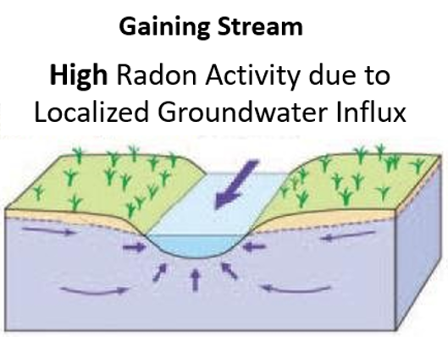
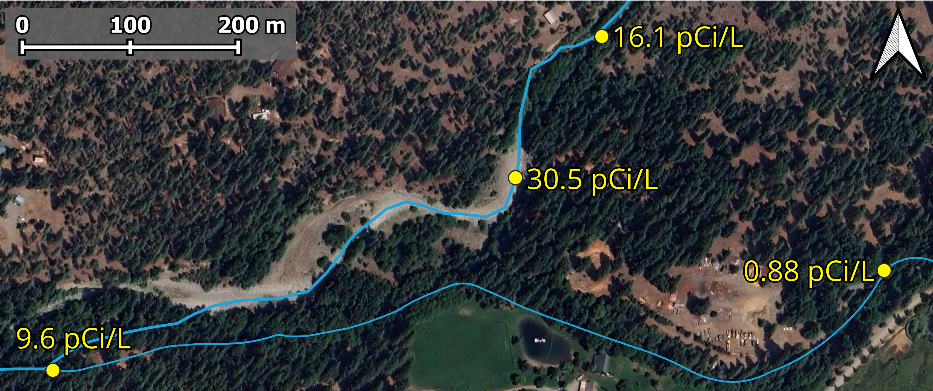
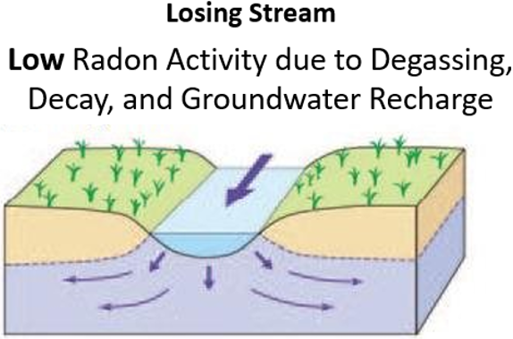
Radon
Naturally occurring radioactive noble gas (T_{1/2} = 3.8 days)
Produced in rocks, sediments, other geologic material
Accumulates in groundwater
Quickly degasses from surface water
  Allows for assessment of localized GW contribution
Local GW Background: ~200 - 250pCi/L
Flow Direction
Flow Direction
Adapted from Berthane (2015)
Notes:
Data from 9/30

Slide 18
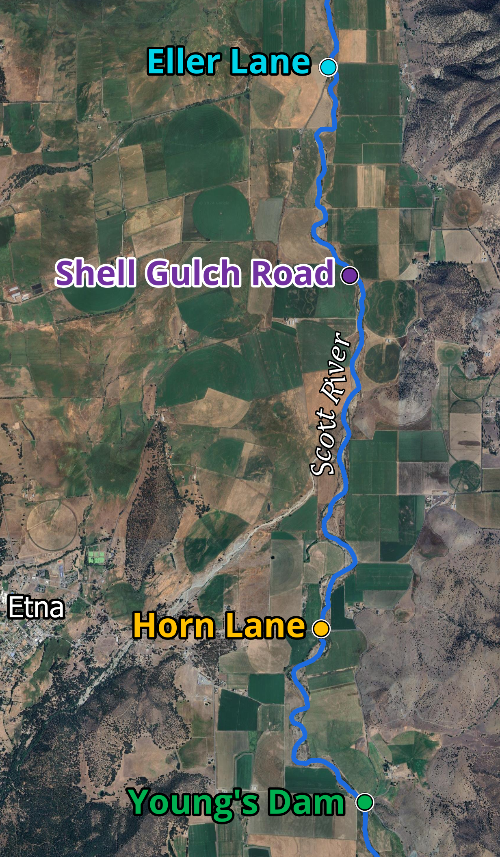
Radon Time Series – Scott River near SVID
Flow Direction
Flow Direction
Seasonal increase in apparent groundwater contribution evident at all sites
Notes:
Should add in the locations of recharge on the map?

Slide 19
Geochemical Tracer Insights
Both Scott River and Kidder Creek show:
  Seasonal increase in apparent groundwater contribution
  Seasonal shift in water source contribution
Future work
  Estimate quantity of groundwater contribution at monitoring locations
  Collect additional push point samples and finer resolution samples

Slide 20
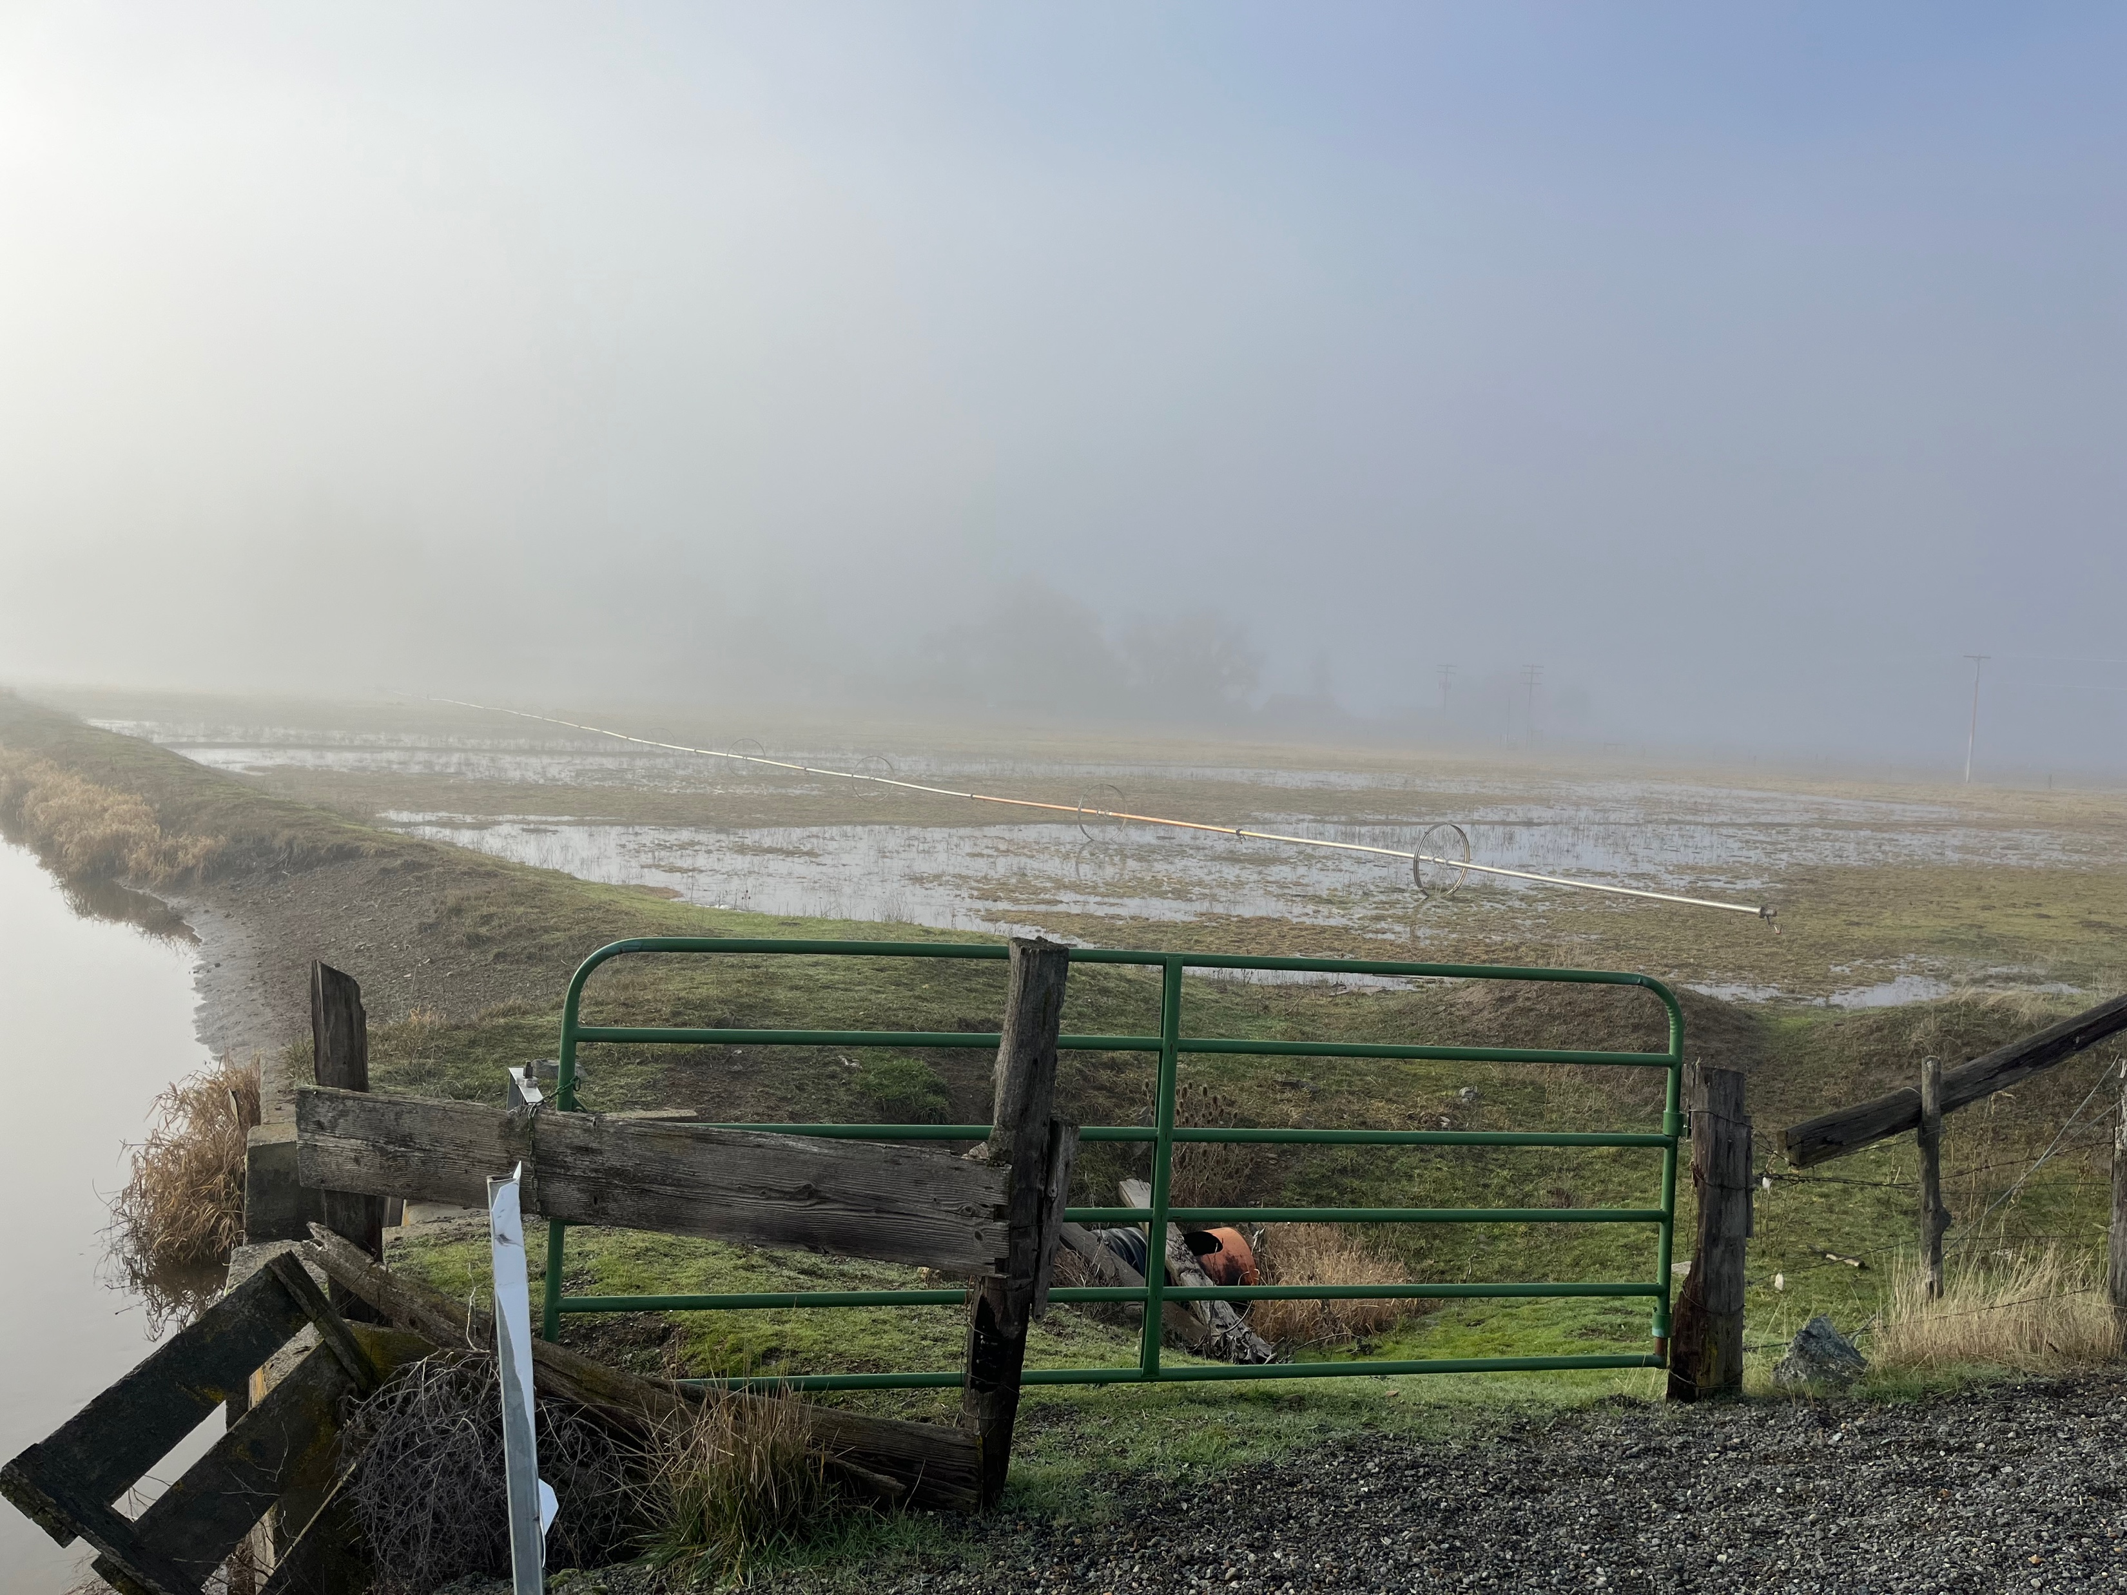
Conclusion
Project continues to evolve
  2024 had significant additions to monitoring network
Multiple years of implementation are required to study benefits in:
  Different water year types and conditions
  Potential long-term benefits
  Evaluating strategies for maximizing recharge benefit
  (e.g., key locations, application timing and frequency)

Slide 21

Thank You

Slide 22
Extra Slides

Slide 23
Agenda
Project Overview
2024 Implementation Progress and Results
  Modeled benefits
  Physical Monitoring
  Geochemical Tracer Monitoring
Conclusions

Slide 24
Intro
Who we are
Our history in Scott Valley
  University of California, Davis has been working in Scott Valley since 2008
  LWA provides technical support for the Scott, Butte, and Shasta GSAs
  Recharge project geochemical work in collaboration with University of Southern California, Department of Earth Sciences

Slide 25
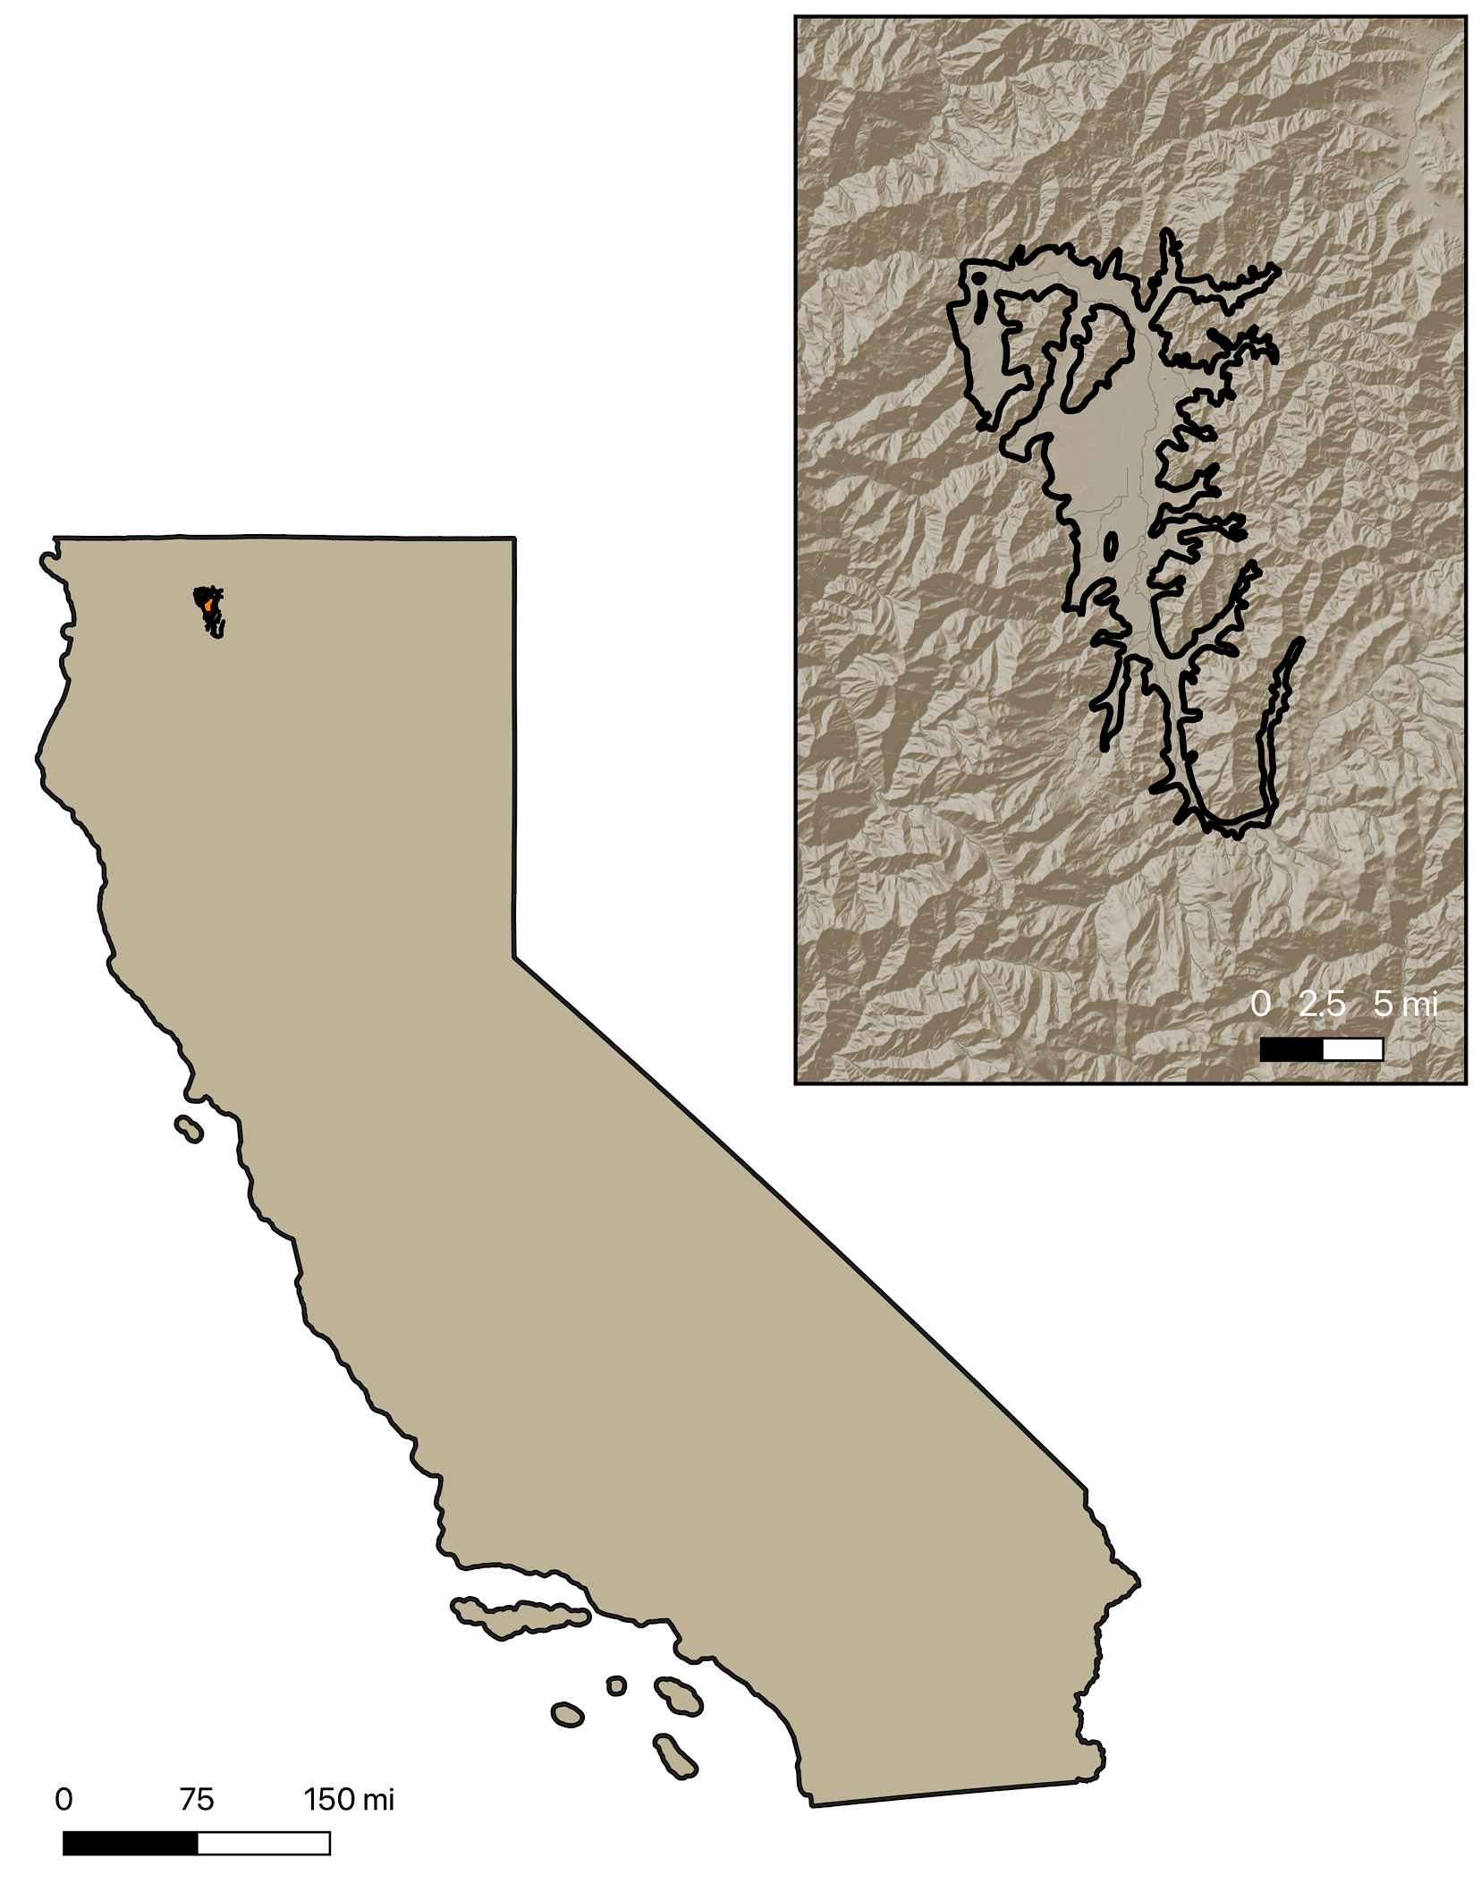
About Scott Valley
Located in Northern California
Medium-Priority Basin
  Groundwater Sustainability Plan submitted in December 2021, approved in April 2023
Scott River is a tributary to the Klamath River
Important habitat for several species of anadromous fish, including coho salmon

Slide 26
Biological Monitoring Plan
In collaboration with Scott River Water Trust
Objectives:
  Ensure that any Chinook or coho salmon redds located within the zone (100 feet above and below) of the SVID dam are not harmed during the duration of the diversion of up to 30 cfs during the Jan. 1 through March 31 recharge period.
  Ensure that there is no “take” of the threatened coho salmon, as adults, juveniles, or eggs due to operation of the diversion for this project.
  Minimize the potential harm to outmigrating salmonids during the MAR operation.

Slide 27
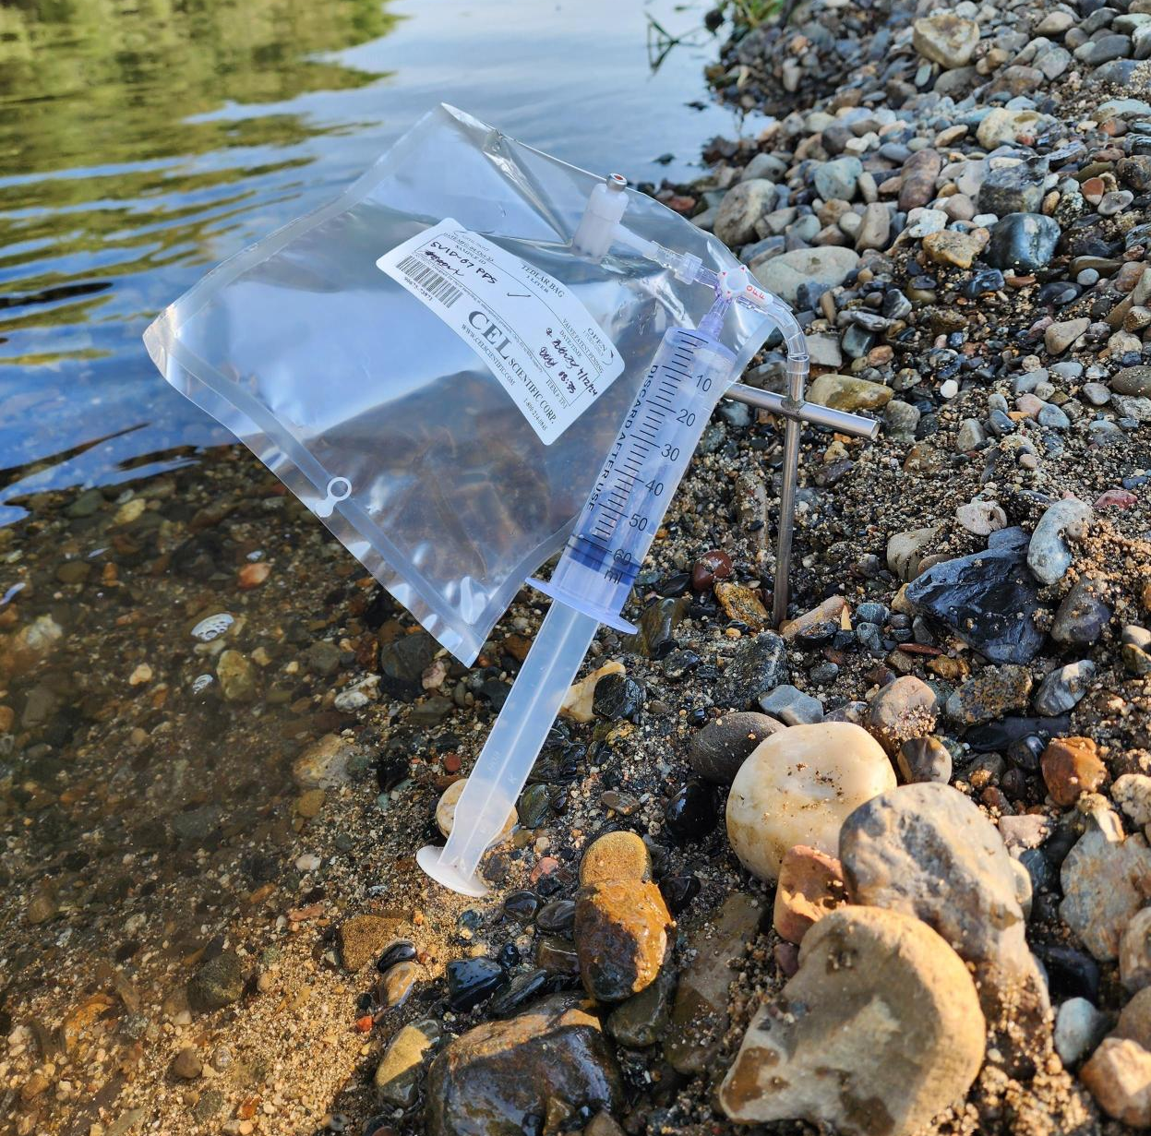
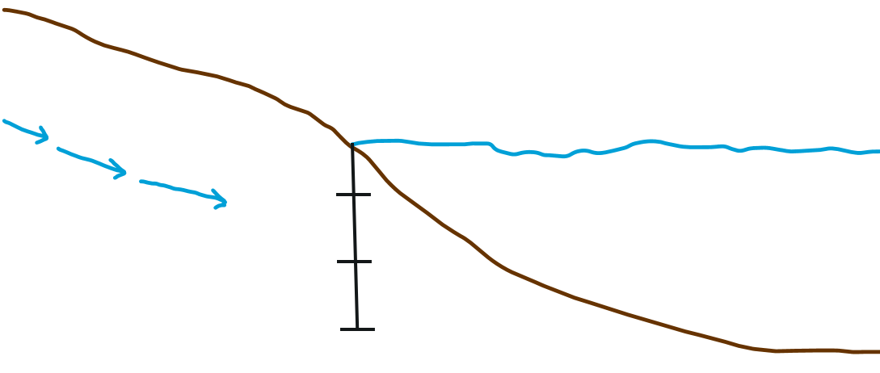
Push Point Sampling to Evaluate GW Connectivity
Push Point Sample Collection at Eller’s Lane
PushPoint sample
Surface Grab Sample
Groundwater
inflow
10 cm
30 cm
50 cm

Slide 28
Evidence for Gaining Conditions in the Scott River
PushPoint sample
Surface Grab Sample
Groundwater
inflow
10 cm
Sediment – Water interface
30 cm
50 cm
Increased Radon activity with depth
Evidence of gaining stream conditions

Slide 29
Stable Isotopes of Water
Warmer,
Lower Altitude
Evaporation Trendline
Delta notation: δ²H, δ¹⁸O
  Standardized ratio of heavy to light isotopes in parts per thousand (‰)
Isotopic composition of water impacted by phase changes in the water cycle due
  Different water sources have naturally distinct isotopic signatures – or ‘fingerprints’
Can be used to identify:
  Different water sources
  Mixing between sources
  Impacts from evaporation
δ²H (‰)
Cooler,
Higher Altitude
Global Meteoric Water Line
δ¹⁸O (‰)
Global Meteoric Water Line
Mixing Line
Water B
δ²H (‰)
Water A
δ¹⁸O (‰)
Notes:
δ²H Standardized representation of relative amount of H-2 to H-1 and δ¹⁸O is standardized amount of O-18 to O-16

Slide 30
Water Isotope Time Series – Scott River near SVID
Global Meteoric Water Line
Seasonal shift in Scott River water isotope composition
Suggests a change in water source contribution through time

Slide 31
Biological Monitoring Plan
In collaboration with Scott River Water Trust
Objectives:
  Ensure that any Chinook or coho salmon redds located within the zone (100 feet above and below) of the SVID dam are not harmed during the duration of the diversion of up to 30 cfs during the Jan. 1 through March 31 recharge period.
  Ensure that there is no “take” of the threatened coho salmon, as adults, juveniles, or eggs due to operation of the diversion for this project.
  Minimize the potential harm to outmigrating salmonids during the MAR operation.

Slide 32
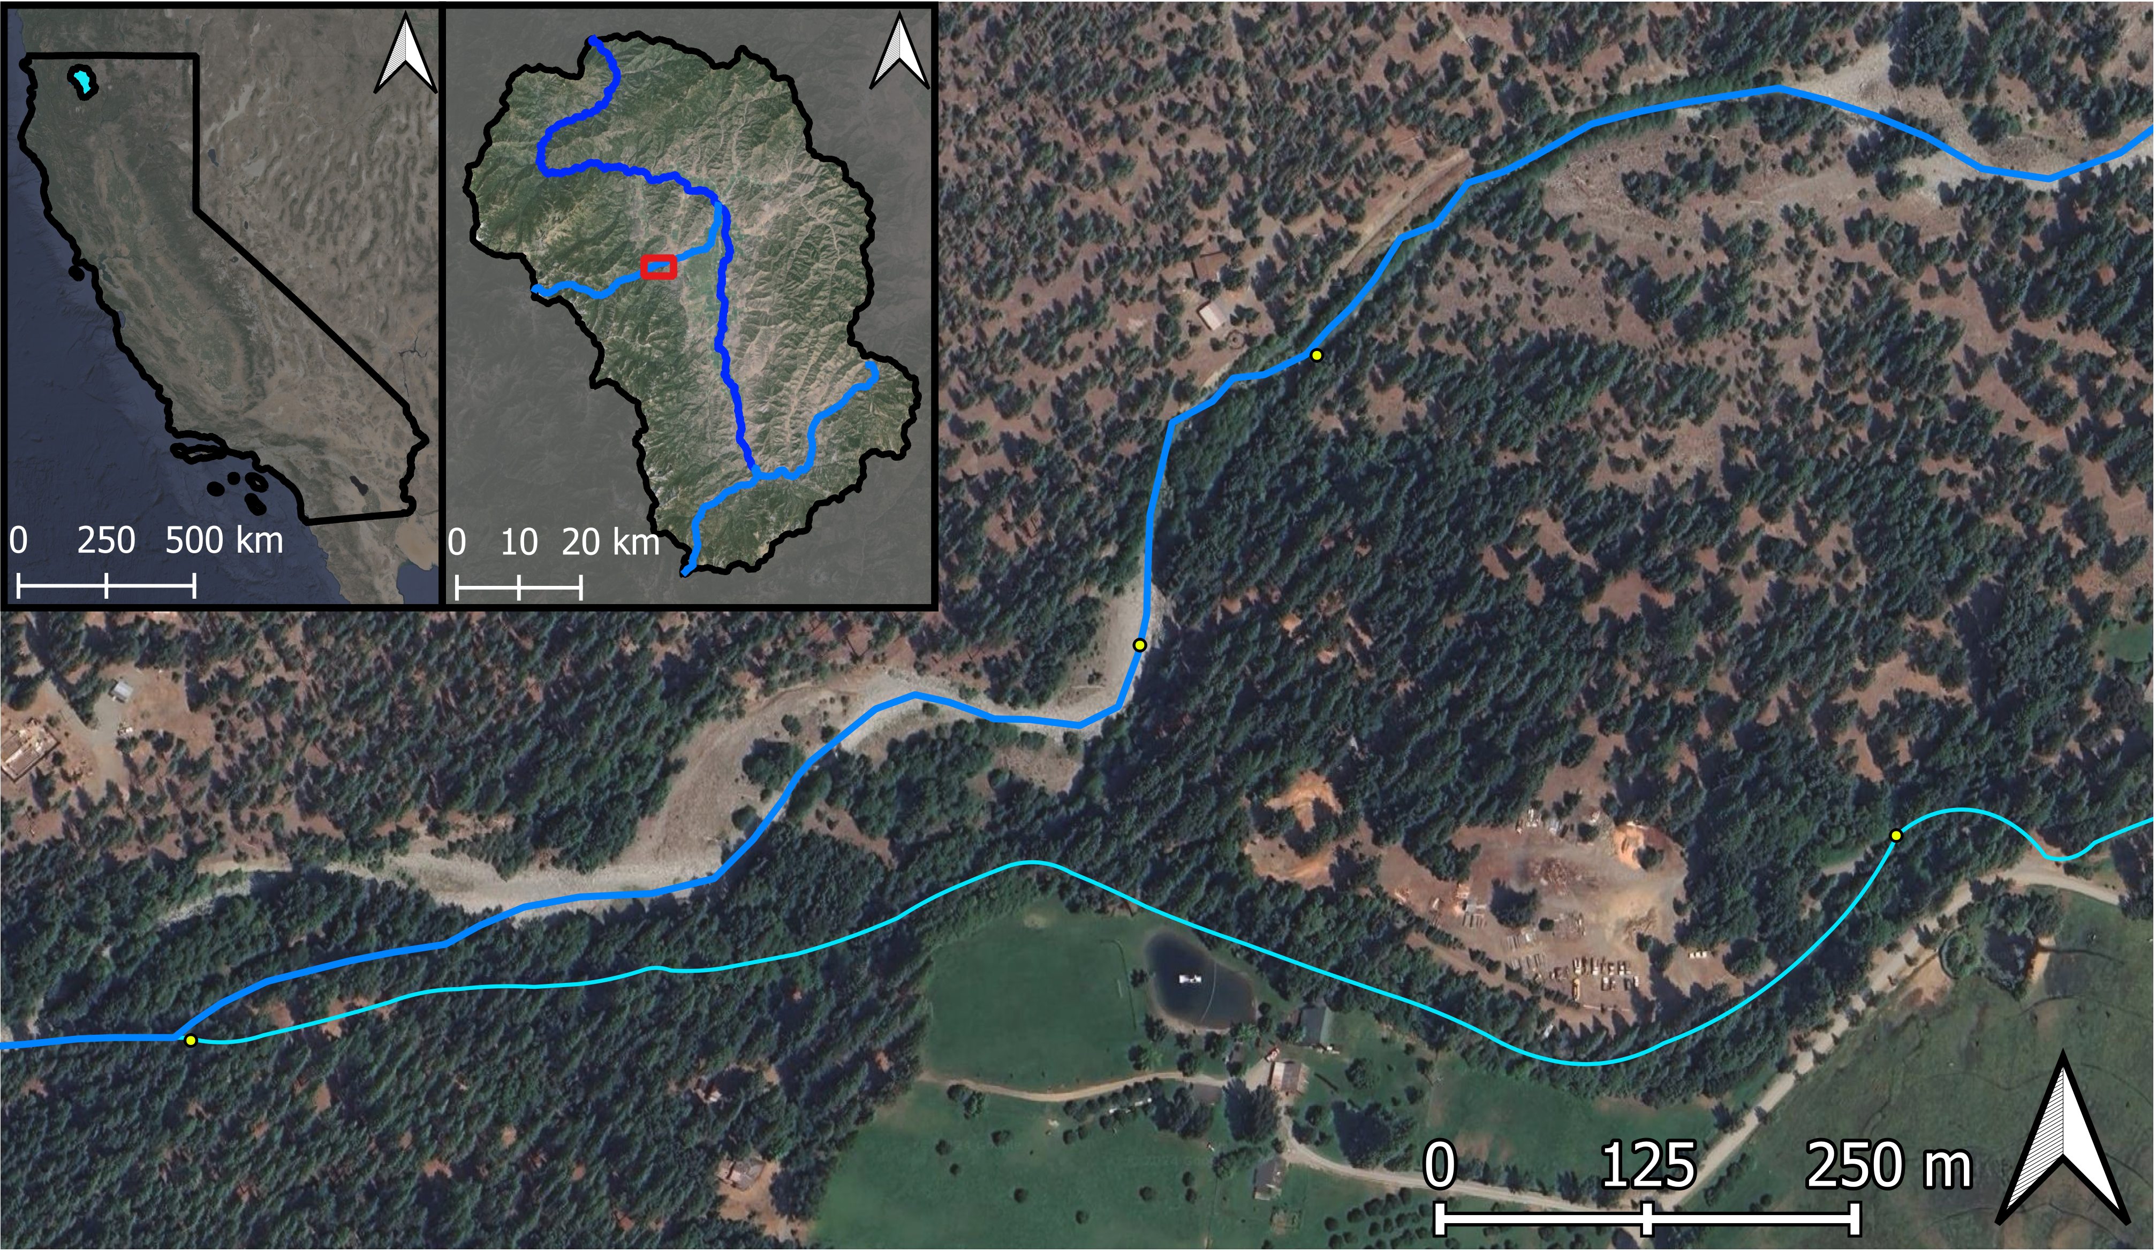
Kidder Creek Earthen Irrigation Ditch Study
Kidder Creek
Flow Direction
Salmon Pool
Kidder Creek
Downstream
Earthen Irrigation Ditch
Kidder Creek
Earthen Irrigation Ditch
Kidder Creek at Ditch Diversion

Slide 33
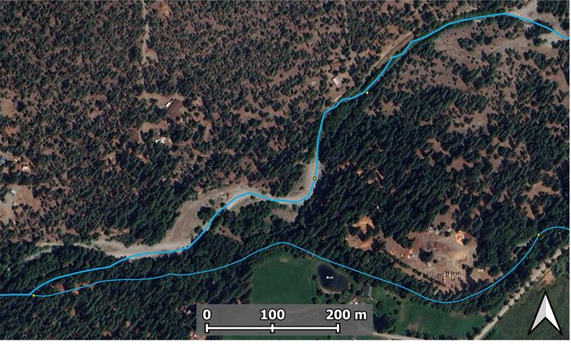
Kidder Creek Radon Time Series
Seasonal Increase in Kidder Creek Radon Activity
Consistent with Increasing GW Contribution
Irrigation ditch is a likely losing area
Higher Rn, More Local GW Input
Salmon Pool
Kidder Creek
Downstream
Earthen
Irrigation
Ditch
Kidder Creek
at Diversion
Lower Rn, Gas Exchange?, Less Local GW Input?

Slide 34
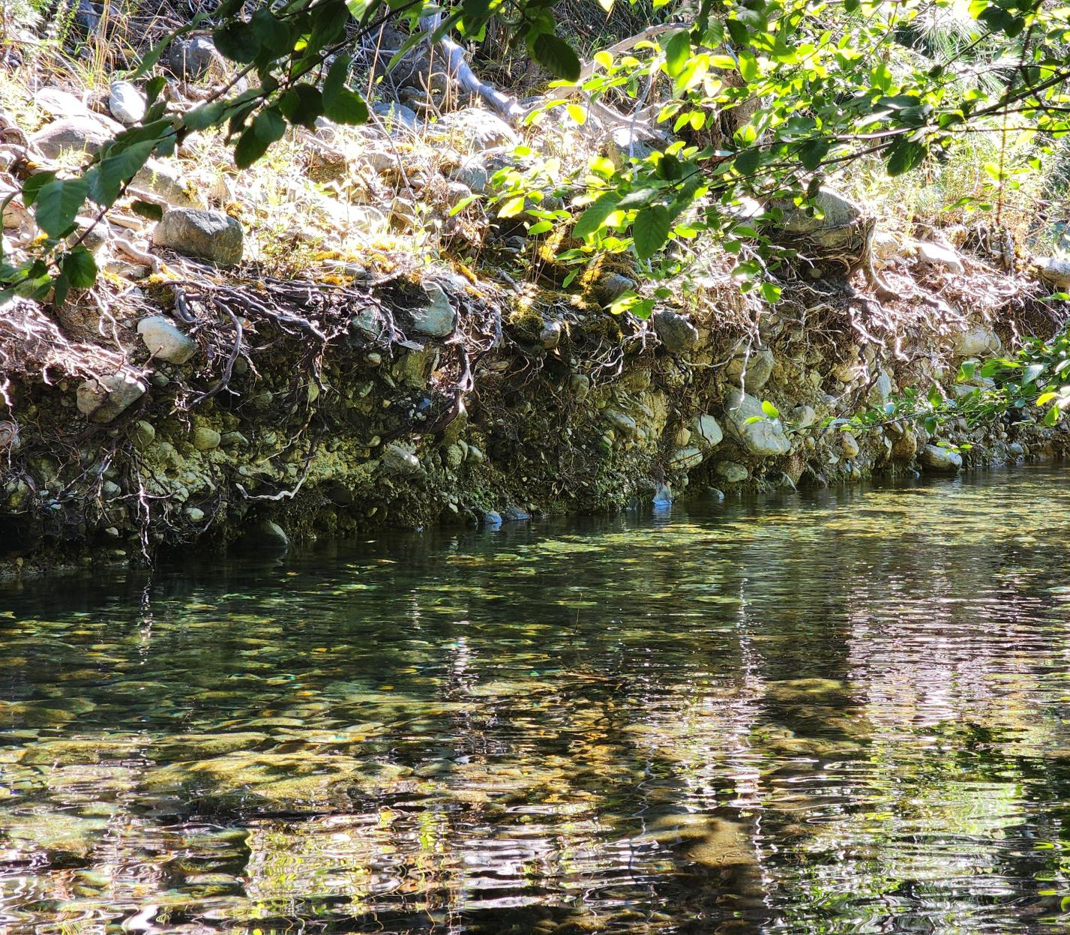
Salmon Pool GW Seepage
Undercut Bank Seepage
(-10 cm depth): 240 pCi/L
Push point sample to collect visible seepage
Seepage Radon activity similar to local GW
Salmon Pool: 10 -16 pCi/L
Salmon Pool
Kidder Creek
Downstream
Earthen
Irrigation
Ditch
Increasing late summer Radon
Kidder Creek
at Diversion

Slide 35
Water Isotope Time Series – Kidder Creek
Kidder Creek at Diversion
Kidder Creek Downstream
Earthen Irrigation Ditch
Estimated Local Meteoric Water Line
*Additional Water Isotope Results Forthcoming
June 24
June 10
Aug. 12
July 30
Seasonal shift Kidder Creek water isotope composition
Suggests a change in water source contribution through time
May 20

Slide 36
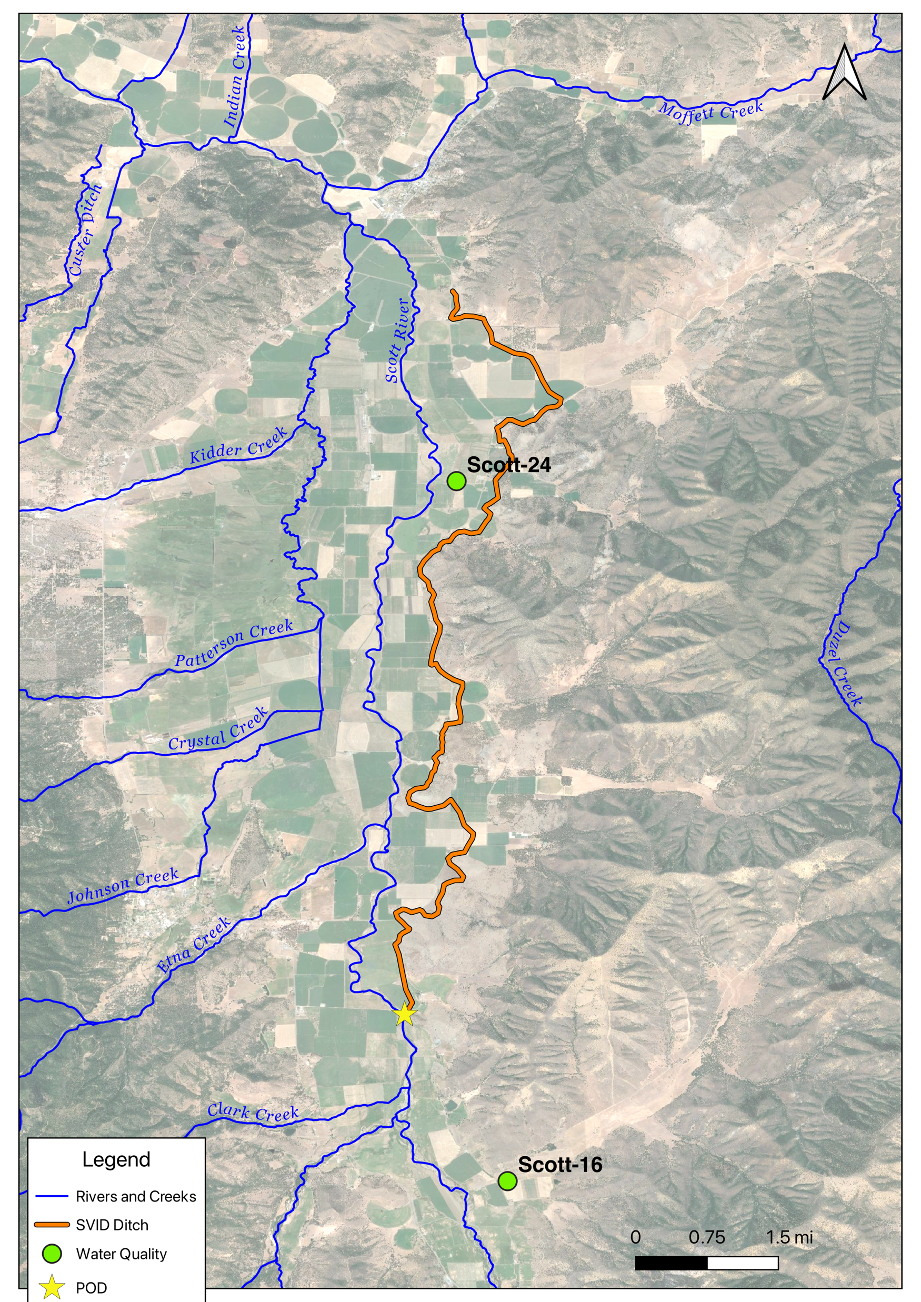
Water Quality Sampling
Nitrate as N (April 10, 2024): 9.62 mg/L
Nitrate as N (April 10, 2024): 4.27 mg/L

Slide 37
Water Quality Sampling
Nitrate as N (April 10, 2024): 9.62 mg/L
Nitrate as N (October 14, 2021 from NCRWQCB): 5.2 mg/L
Nitrate as N (April 10, 2024): 4.27 mg/L
Nitrate as N (September 15, 2021 from NCRWQCB): 1.6 mg/L
Notes:
Chris Watt, NCRWQCB. February 2023. SCOTT RIVER VALLEY AND SHASTA VALLEY GROUNDWATER CHARACTERIZATION

