Slide 1
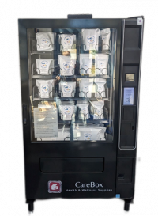
Public Health Vending Machine- CareBox
810 S. Main St., Yreka, CA 96097 * (530) 841-2134 * phinfo@co.siskiyou.ca.us

Slide 2
Siskiyou County Public Health (SCPH)
Mission
To promote and improve the health and wellness of the people of Siskiyou County through community empowerment and partnership
Vision
For all Siskiyou County residents to live healthy, connected, and equitable lives
Values
Excellence, Community, Service, Innovation, Collaboration, Equity
810 S. Main St., Yreka, CA 96097 * (530) 841-2134 * phinfo@co.siskiyou.ca.us

Slide 3
CareBox Overview
The CareBox is a health and wellness supplies vending machine. The CareBox is a safe and stigma-free option for Siskiyou County residents to access free health and harm-reduction products and education.
Open to all Siskiyou County Residents once registered. To register:
Call or visit SCPH
Visit a Health Siskiyou Outreach (HSO) or Wellness On Wheels (WOW) location, schedules available on SCPH website.
Locations
Siskiyou County Behavioral Health Lobby 2060 Campus Drive, Yreka, CA (open Monday-Friday, 8:00 am to 5:00 pm)
Siskiyou County Jail Lobby 315 S. Oregon St. Yreka, CA (open every day from 6:00 am to 11:00 pm)
SCPH CareBox Update

Slide 4
CareBox Items
Shaving Kits, Hygiene Kits, COVID-19 At-Home Tests, Pregnancy Tests, Menstruation Kits, Safe Sex Kits, Narcan® & Testing Strips (Fentanyl and Xylazine testing strips), First Aid Kits, Foot Care Kits, Large & Medium Size Socks, Nutritional Shakes, Disposable Washcloths, Oral Health Kits.
Seasonal items: Bug Spray & Sunblock, Weather Kits (hand warming packets, disposable poncho, & emergency blanket).
Items available once per month with minor exceptions for certain products.
Funding for items available through Clearinghouse and California Overdose Prevention and Harm Reduction Initiative (COPHRI).
SCPH CareBox Update

Slide 5
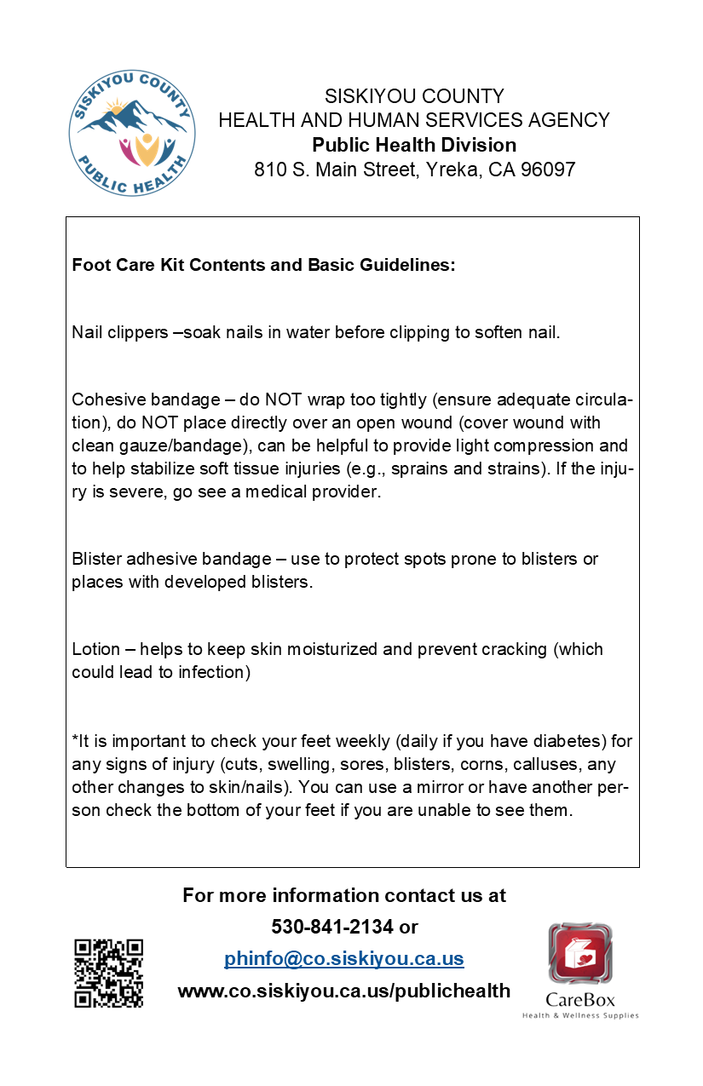
Educational Material
Packaged with items that would benefit from additional guidance and referrals to more resources.

Slide 6
By the Numbers – Participants
332 total participants registered since beginning of program in August 2023.
231 participants registered from January 1st – December 18th, 2024.
*From participants registered January 1st, 2024-December 18th 2024
SCPH CareBox Update

Slide 7
By the Numbers - Participants
Location*
District 4
80%
District 5
1%
District 1 11%
District 3
1%
District 2
2%
Other
5%
*From participants registered January 1st, 2024-December 18th 2024
SCPH CareBox Update

Slide 8
By the Numbers – Quantity Dispensed
Total Quantity of Items Dispensed* is 5,449.
*From January 1st, 2024-December 18th 2024
SCPH CareBox Update

Slide 9
Future Objectives
Additional machines in South County, East County, West County.
Acquire more comprehensive data such as occupation status and living situation status.
Potential Barriers
Funding – approximately $12,717.94 for a new, fully stocked machine.
Staffing capacity to stock machines and provide troubleshooting support.

