Slide 1
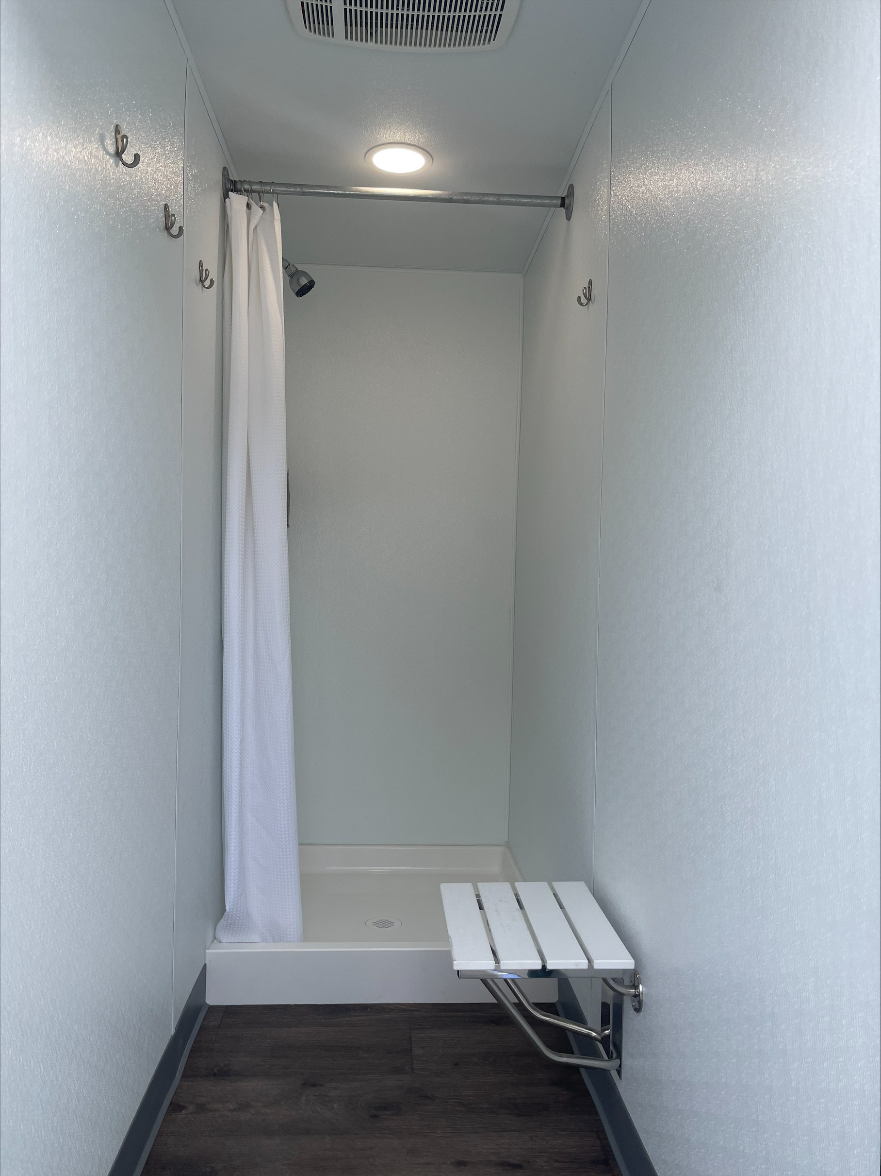
Outreach Initiatives
For Individuals Experiencing Homelessness
Maddelyn Bryan, Health and Human Services Agency

Slide 2
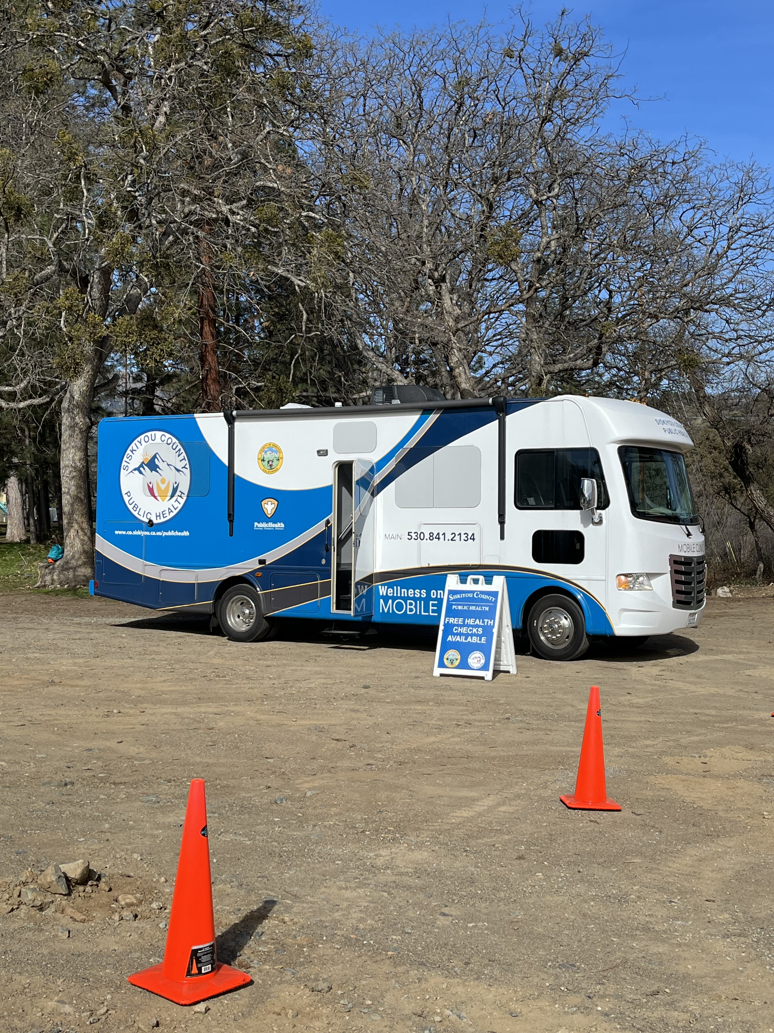
Partnerships
City of Yreka
Yreka Food Bank
Northern Valley Catholic Social Services
Nation's Finest
Public Health
Siskiyou Spay-Neuter Incentive Program (SNIP)
Mobile Crisis
Seventh Day Adventist Church
Coming soon (Our Heroes' Dreams, VyncaCare)

Slide 3
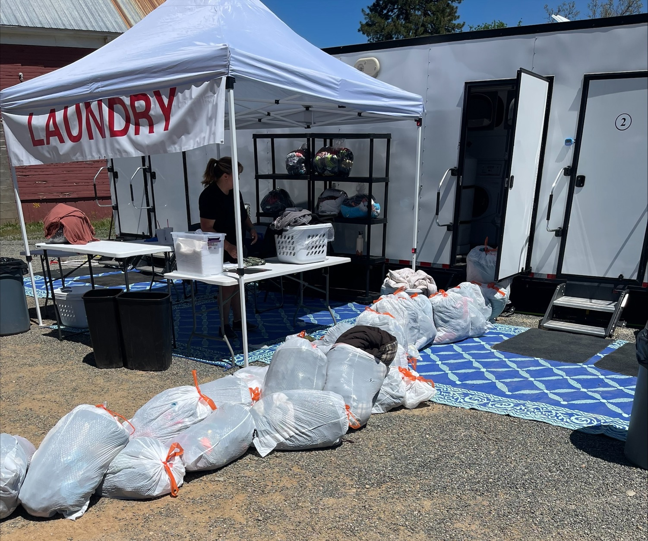
Data (through May 21)
Total individuals served: 148
Total loads of laundry:404
Total showers: 260
Average participants per event: 42

Slide 4
Impact
Success stories:
Connection to longer-term resources.
Relationship building with vulnerable populations (veterans, SMI, DV victims).
Participant testimony:
If it wasn't for this service, I wouldn't have gone to Six Stones for treatment. It's embarrassing to go somewhere not showered, not clean. I took a shower and got clean clothes and I went to Six Stones that same day. I've been going to Six Stones for treatment ever since. - Participant

Slide 5
Additional Presenters
Collier Azare – Nation's Finest
Barron Browning – Emergency Command Support
Rico Gutierrez – Homeless Outreach

