Slide 1
Memorandum of Understanding Between Siskiyou County and the Klamath River Renewal Corporation – Roads and Bridges
December 10, 2024

Slide 2
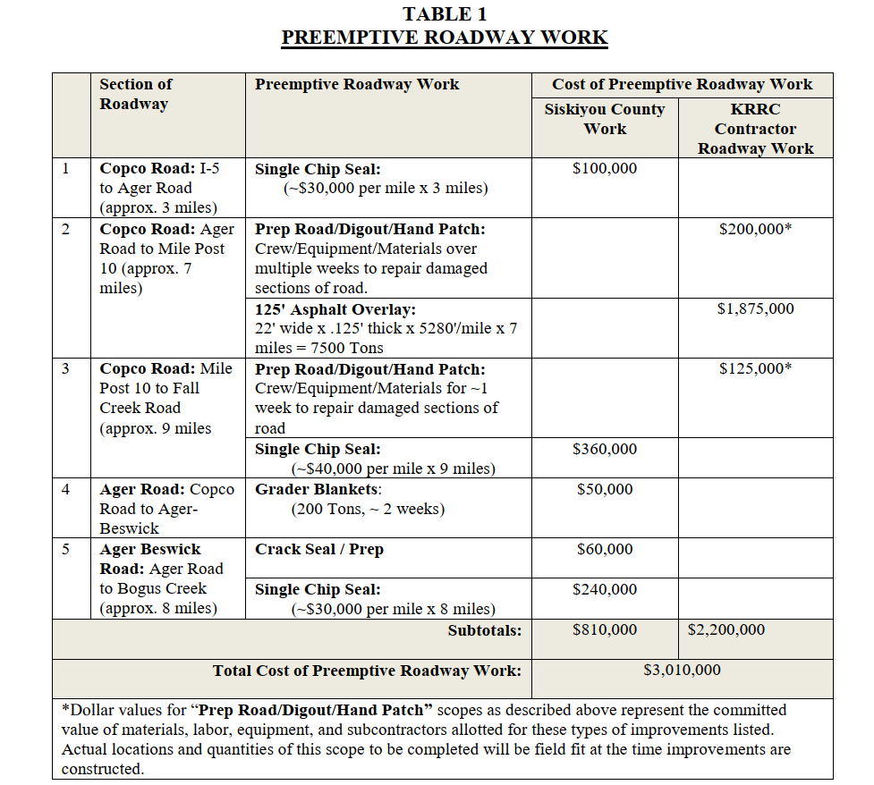
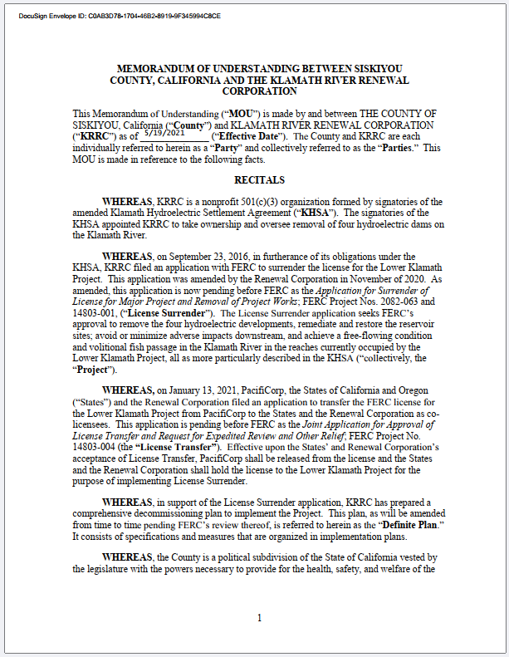
On May 19, 2021, the County and KRRC entered into an agreement regarding the roads and bridges to be utilized during the removal of the four lower Klamath River Dams.
The $810,000 (rows 3,4, and 5) was funding provided by KRRC for the County to perform the work described in Table 1.

Slide 3
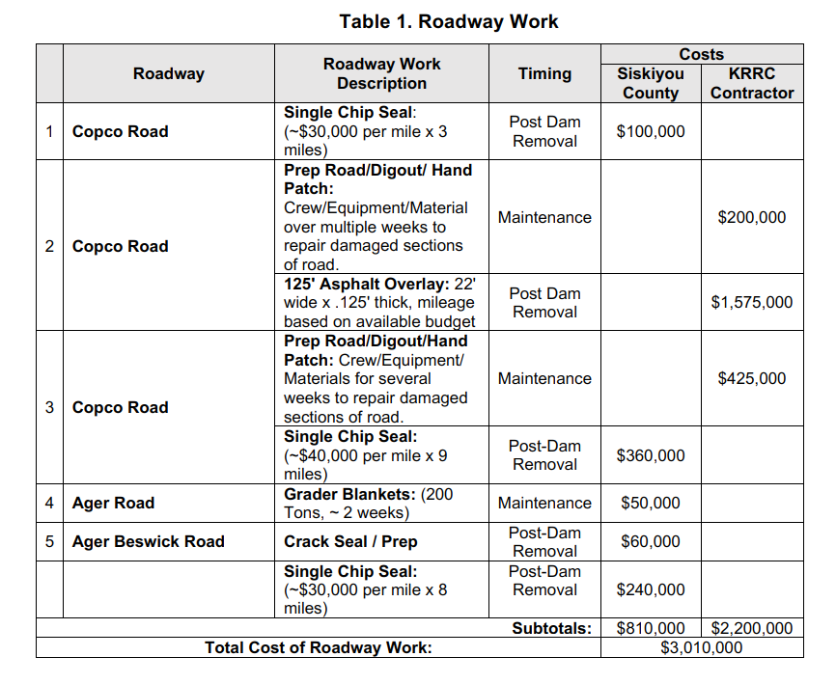
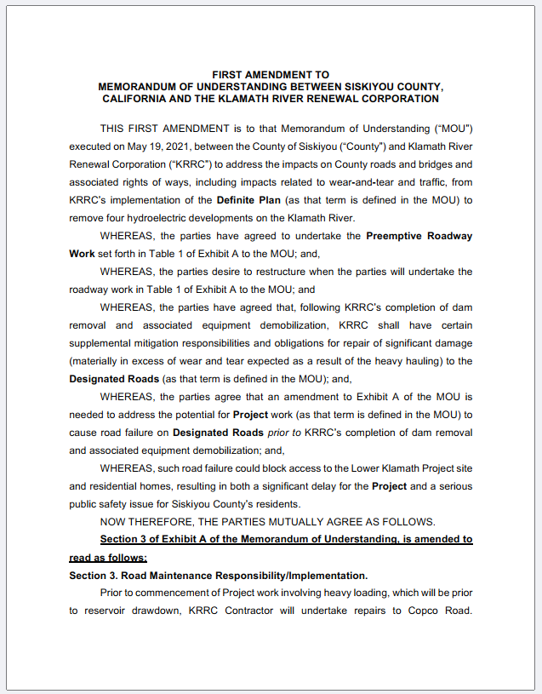
On May 20, 2023, the parties amended the MOU to move $300,000 from KRRC’s commitment to Post Dam Removal work (row 2) to Maintenance during dam removal (row 3), resulting in a total of $625,000 in Maintenance (rows 2 and 3).
Following this amendment, KRRC fulfilled its obligations for maintenance work and reimbursed the County $50,000 for work performed on Ager Road (row 4).
$2,235,000 was dedicated to post dam removal work.
* Figures outlined in red indicate funding expended under the MOU.

Slide 4
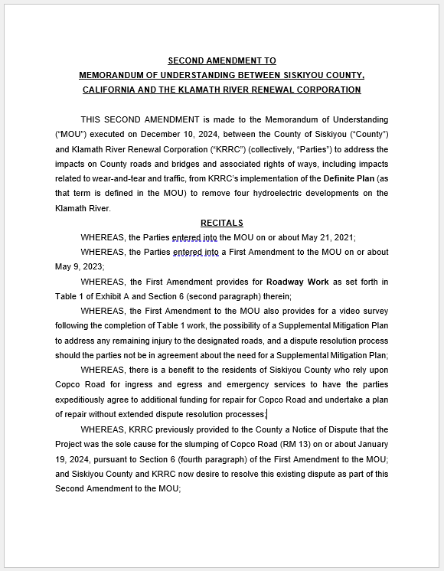
Today, county staff is requesting that the Board approve the second amendment to the MOU:
KRRC shall transfer to the County $3.5 million for the County to repair Copco Road.
KRRC shall donate to the County up to 2,000 yards of road base owned by KRRC, for the County to utilize for repairs to Copco Road.
The First Notice of Dispute Regarding Roadway Work Pursuant to Amended MOU is withdrawn.
Mile Post 13 road failure and repair dispute.
The Parties agree that these amended terms satisfy and complete all remaining duties of the Parties under the MOU, including the First Amendment to the MOU. This Second Amendment supersedes any different terms in the MOU or its First Amendment.

