Slide 1
Interstate-5 Siskiyou Wildlife Crossing Planning Project
County Board of Supervisors Meeting, 11/12/24
Fraser Shilling, Ph.D., Dudek

Slide 2
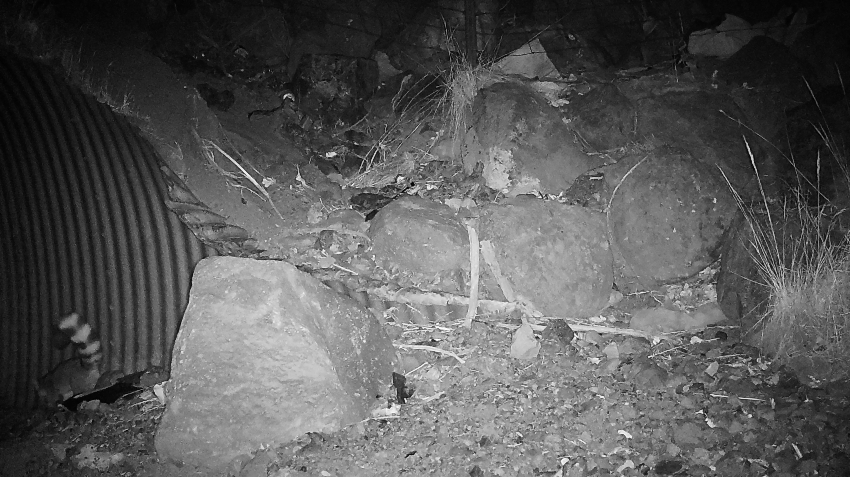
Wildlife Crossings
Existing crossings
Pipe culvert
Box culvert
Arch culvert
Bridge
Over-crossing
Associated structures

Slide 3
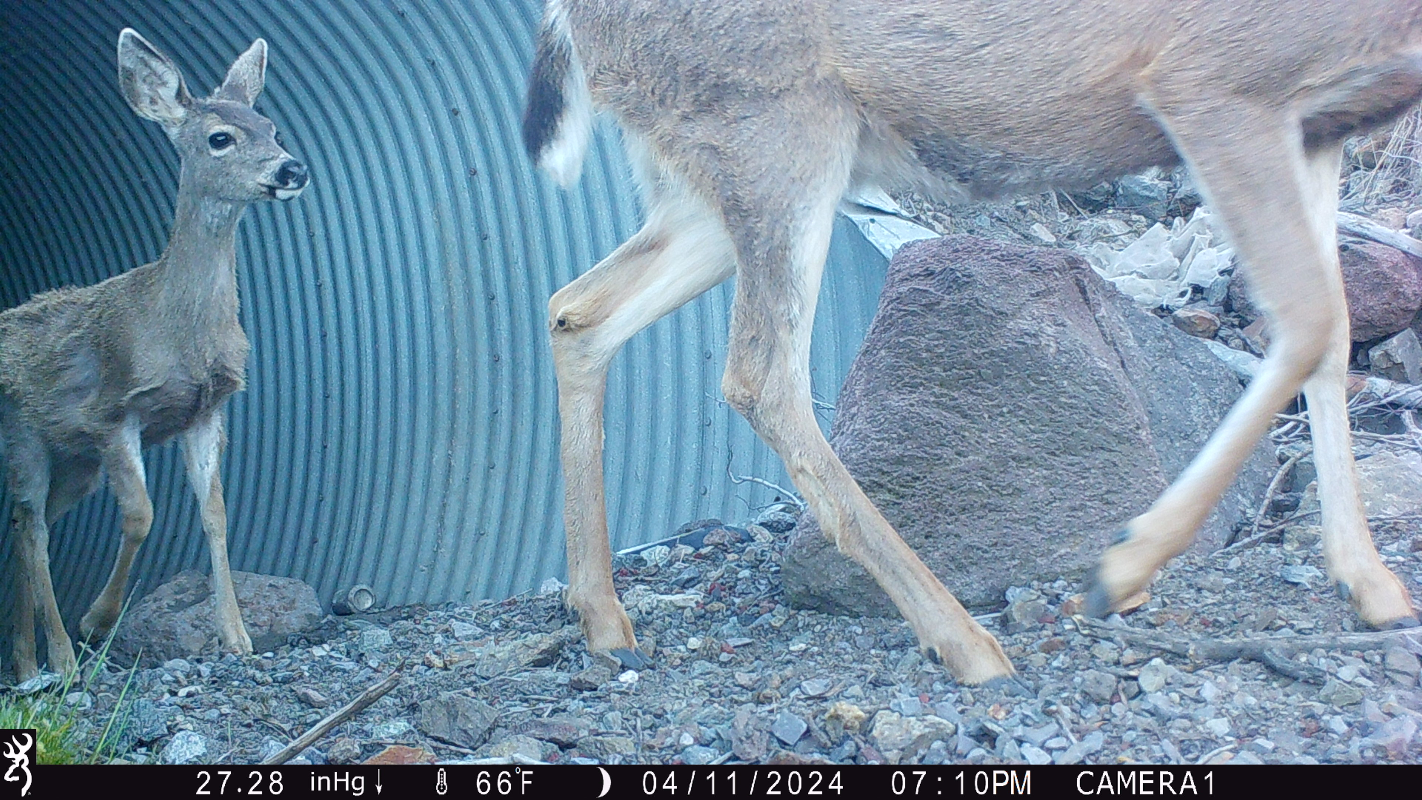
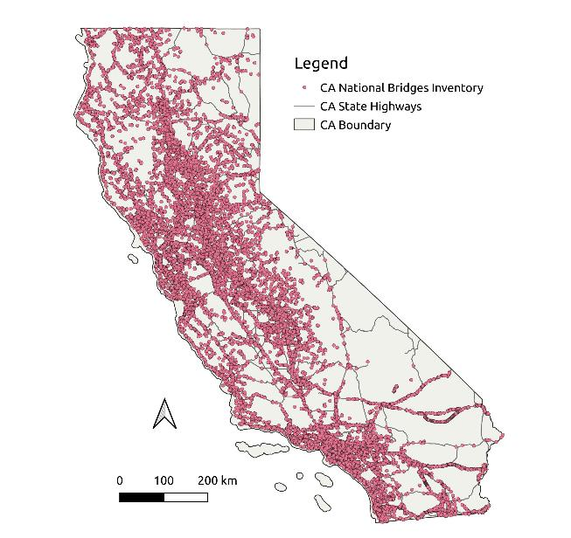
Existing structures

Slide 4
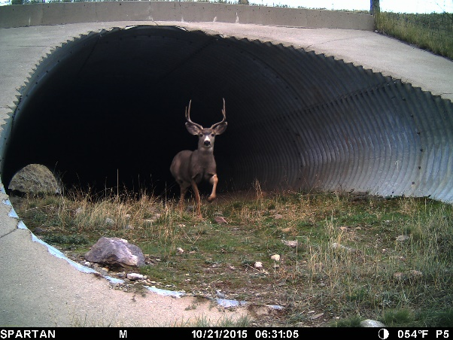
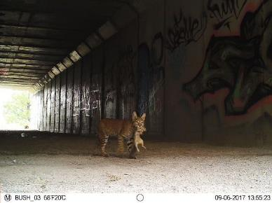
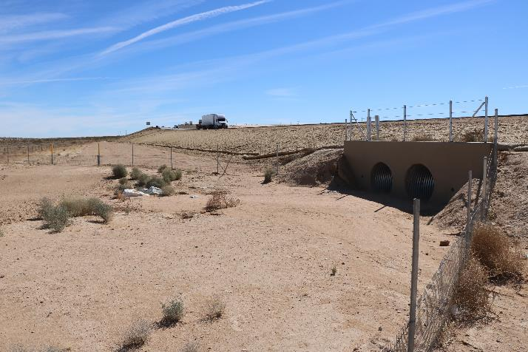
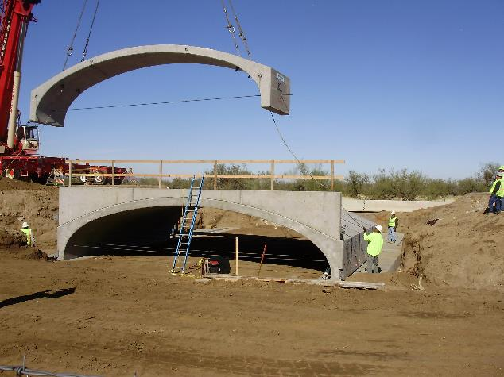
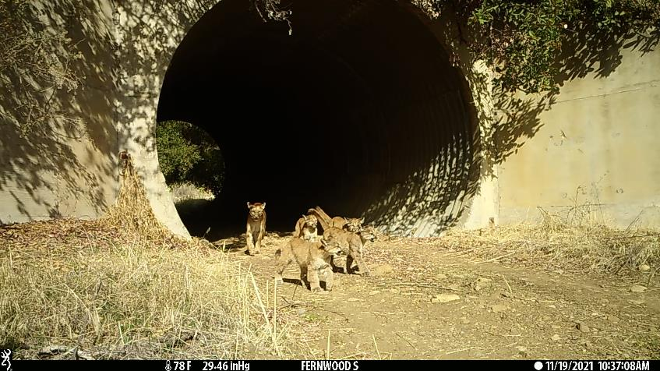
Culverts
Arch
Pipe
Box

Slide 5
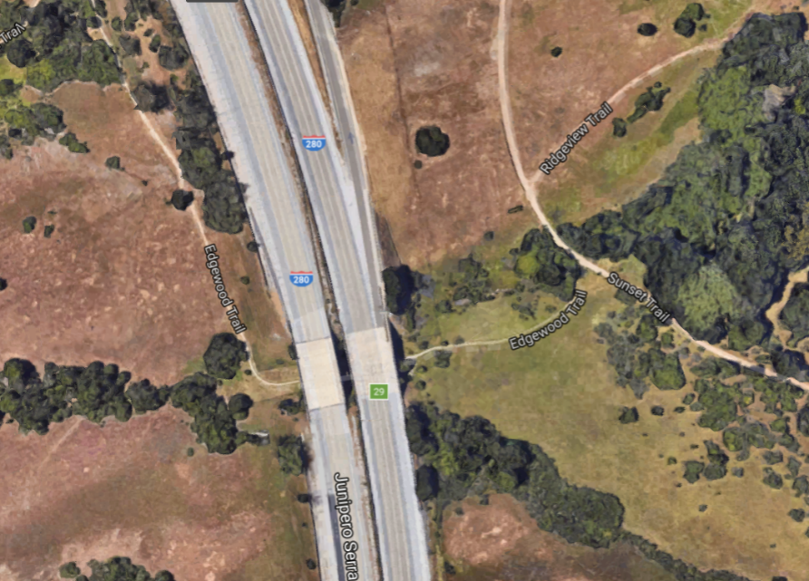
Bridges/under-crossings

Slide 6
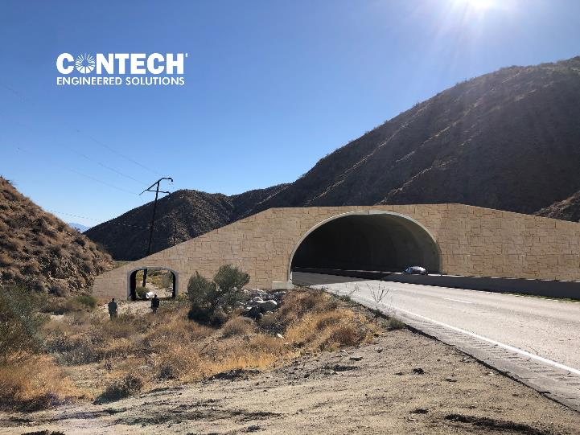
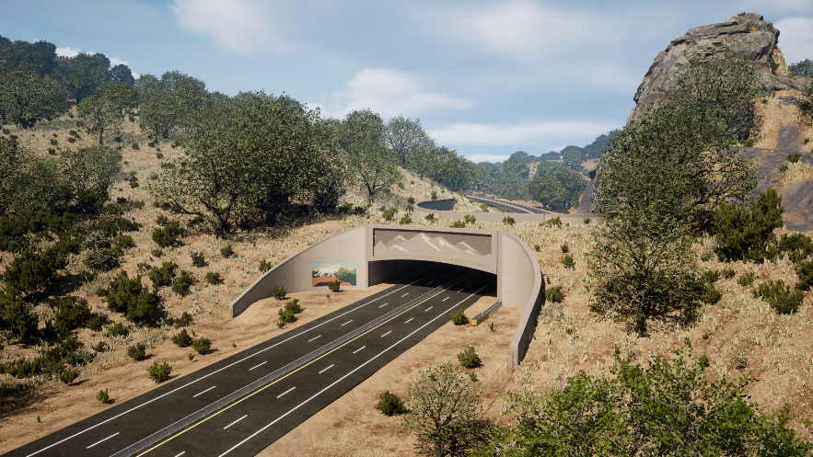
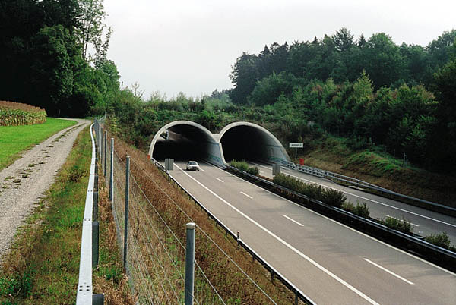
Bridges/over-crossings

Slide 7
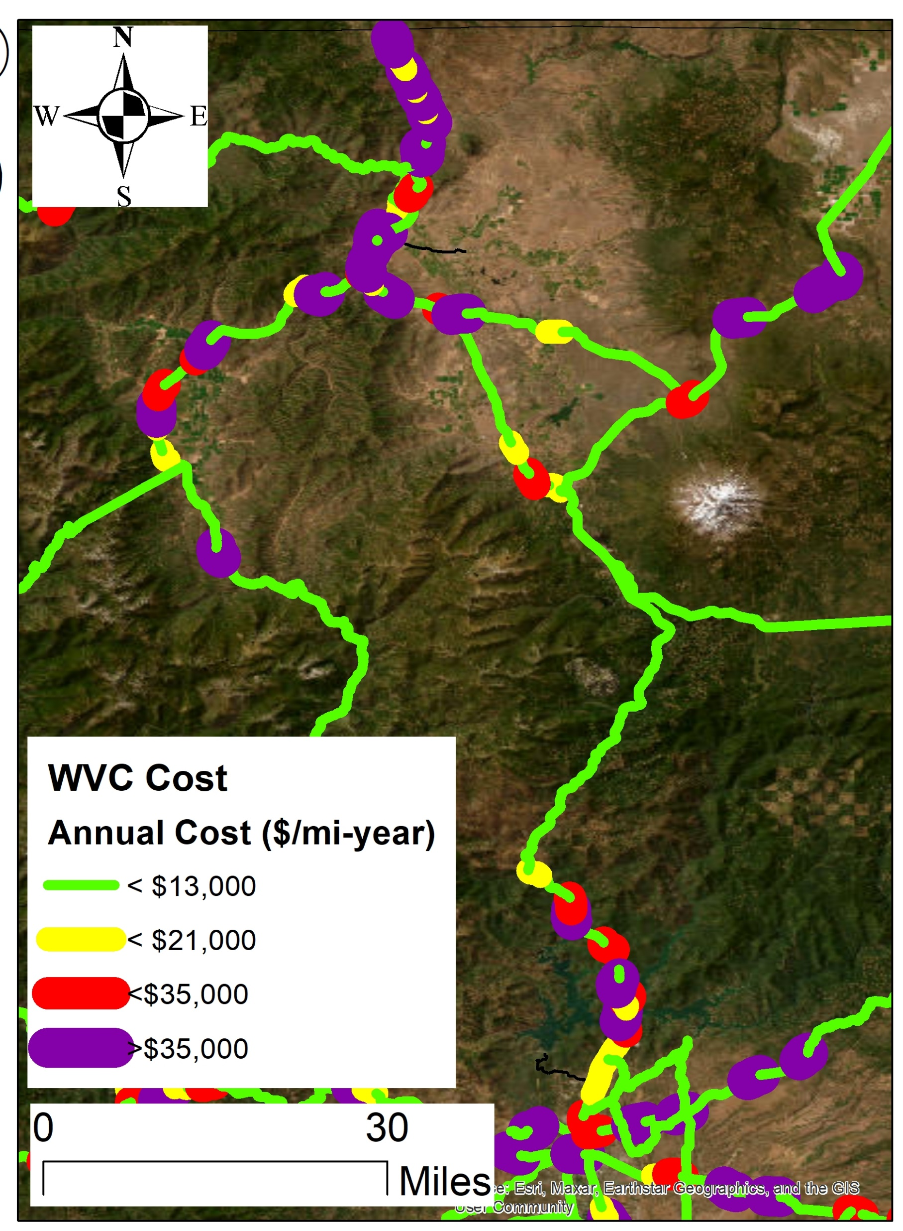
Primary Objectives
High cost of wildlife-vehicle collisions
Prioritize locations maximize wildlife connectivity AND reduce wildlife-vehicle collisions
5

Slide 8
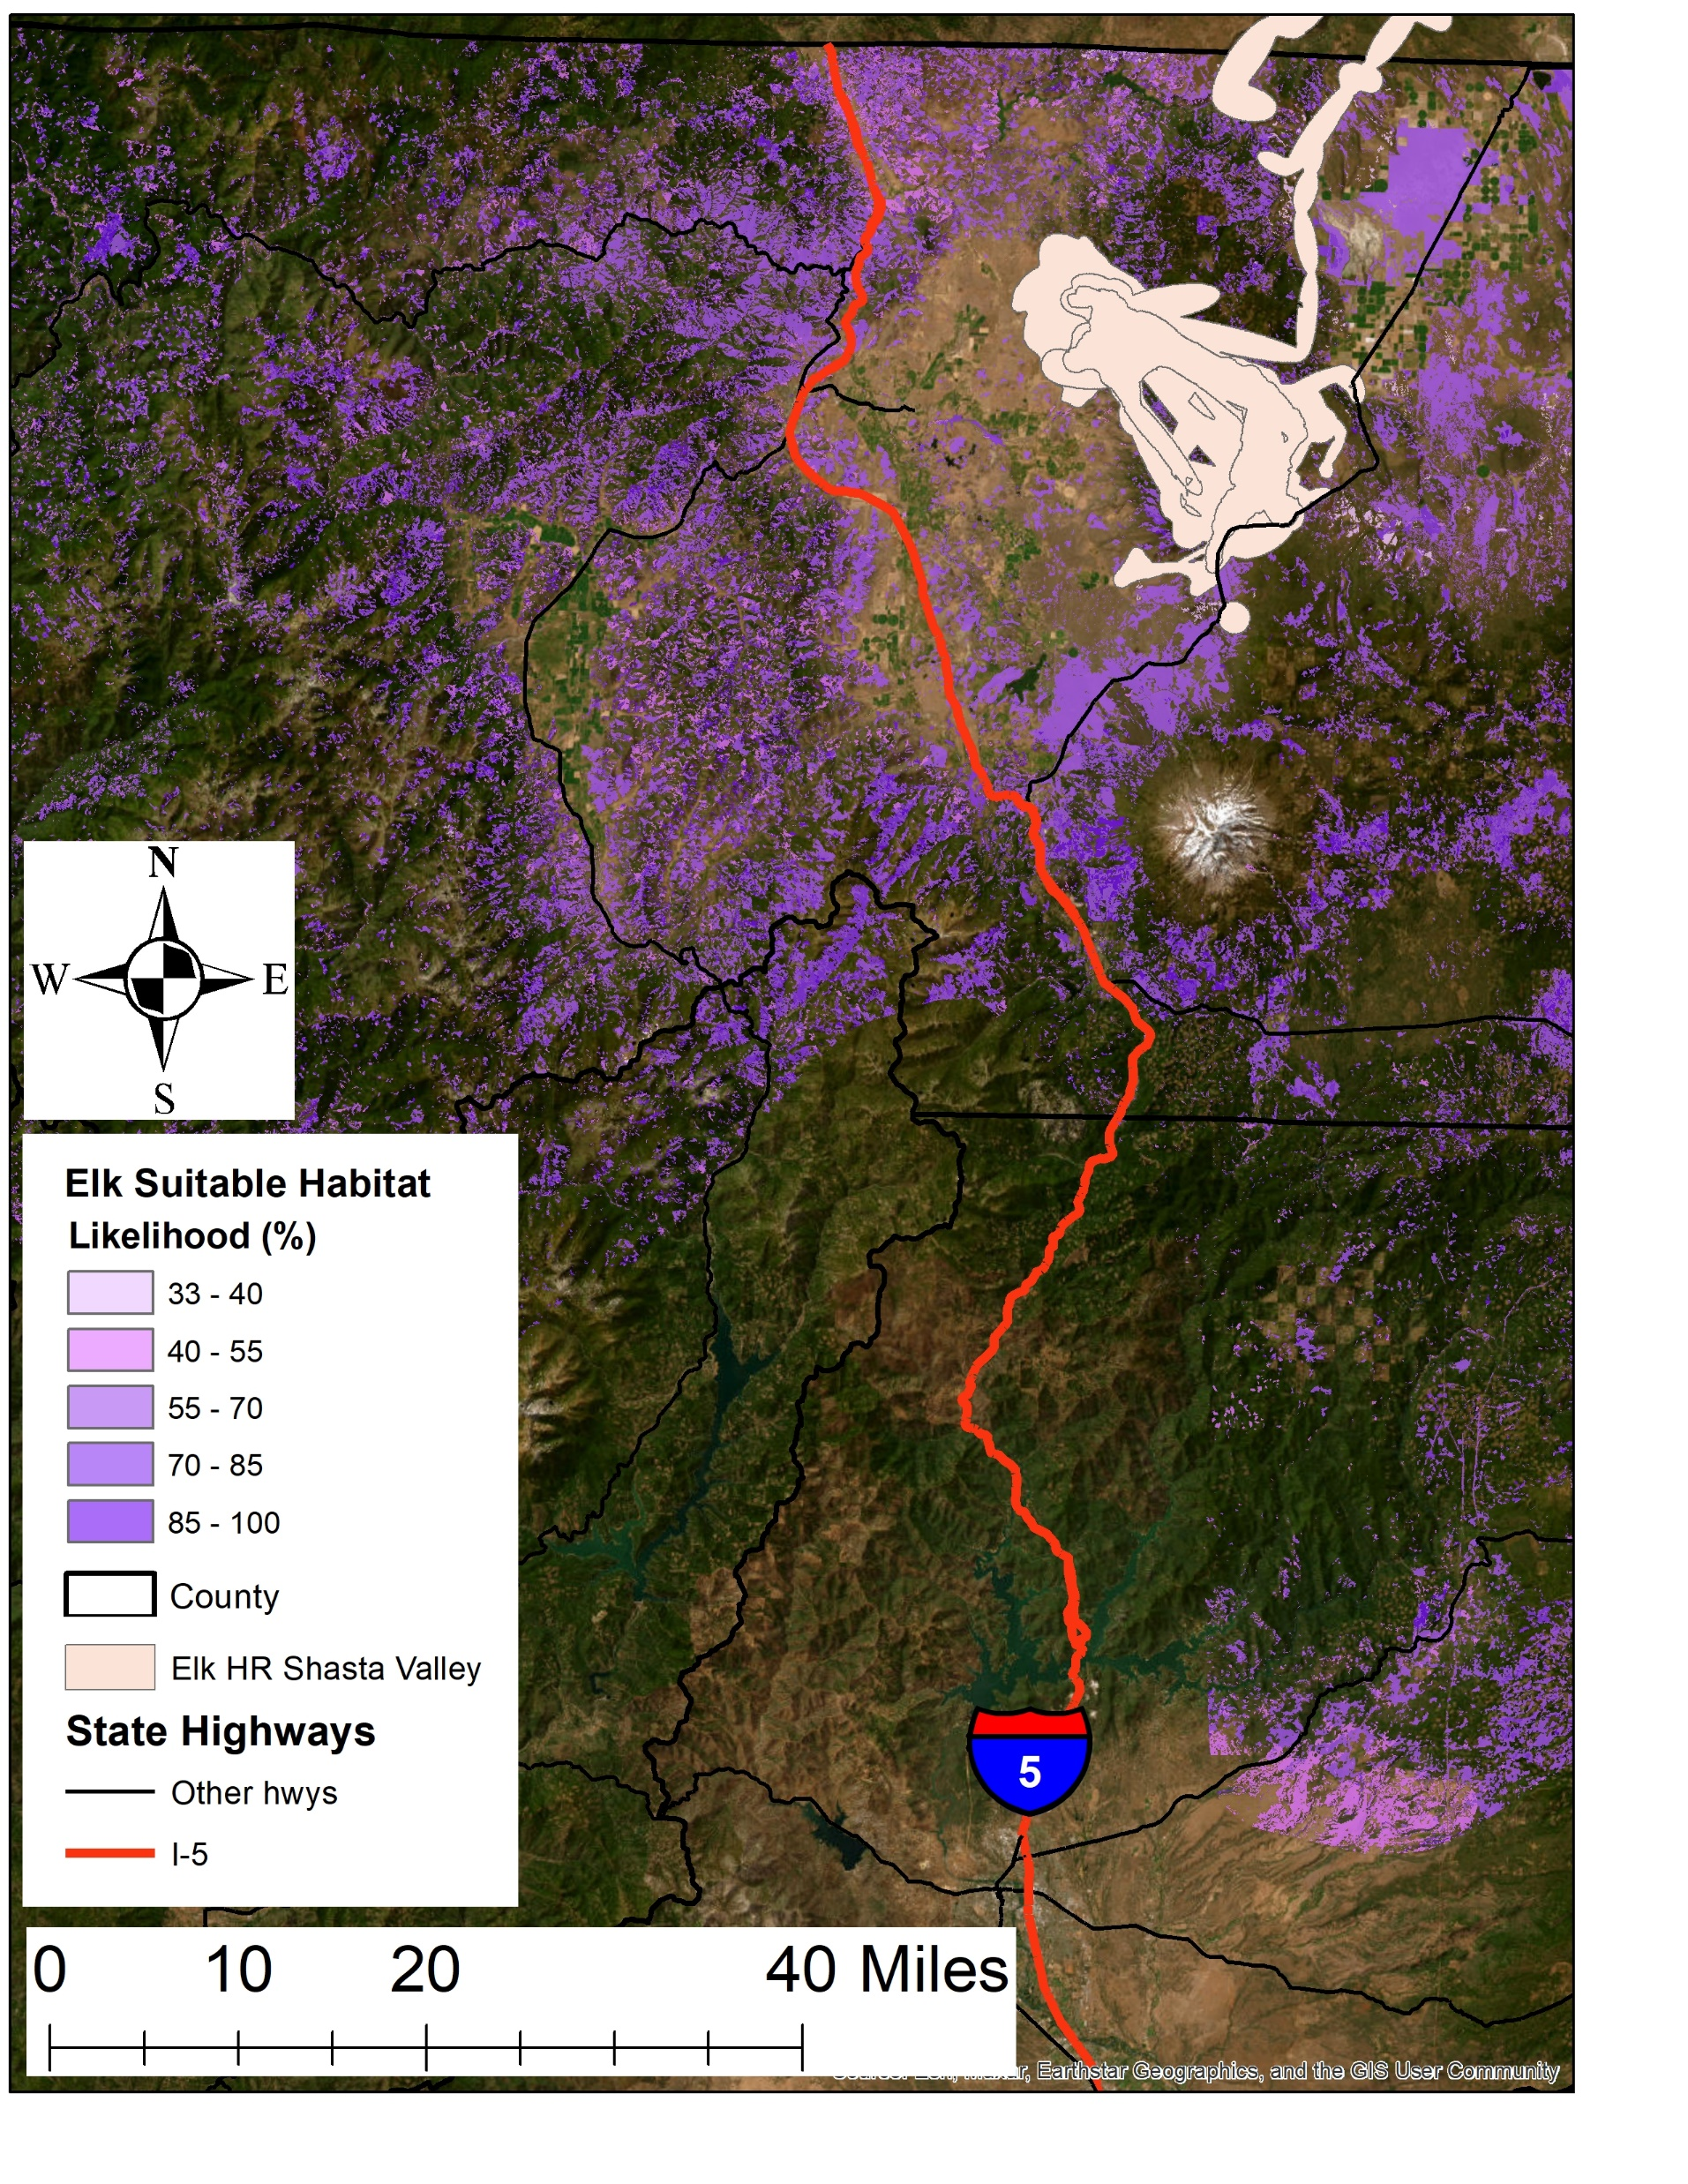
Overall Process
Start with ecology – where are the wildlife and where do they need to move
Engineering feasibility
Caltrans documentation (PID) and environmental clearance
Ends with 65% design

Slide 9
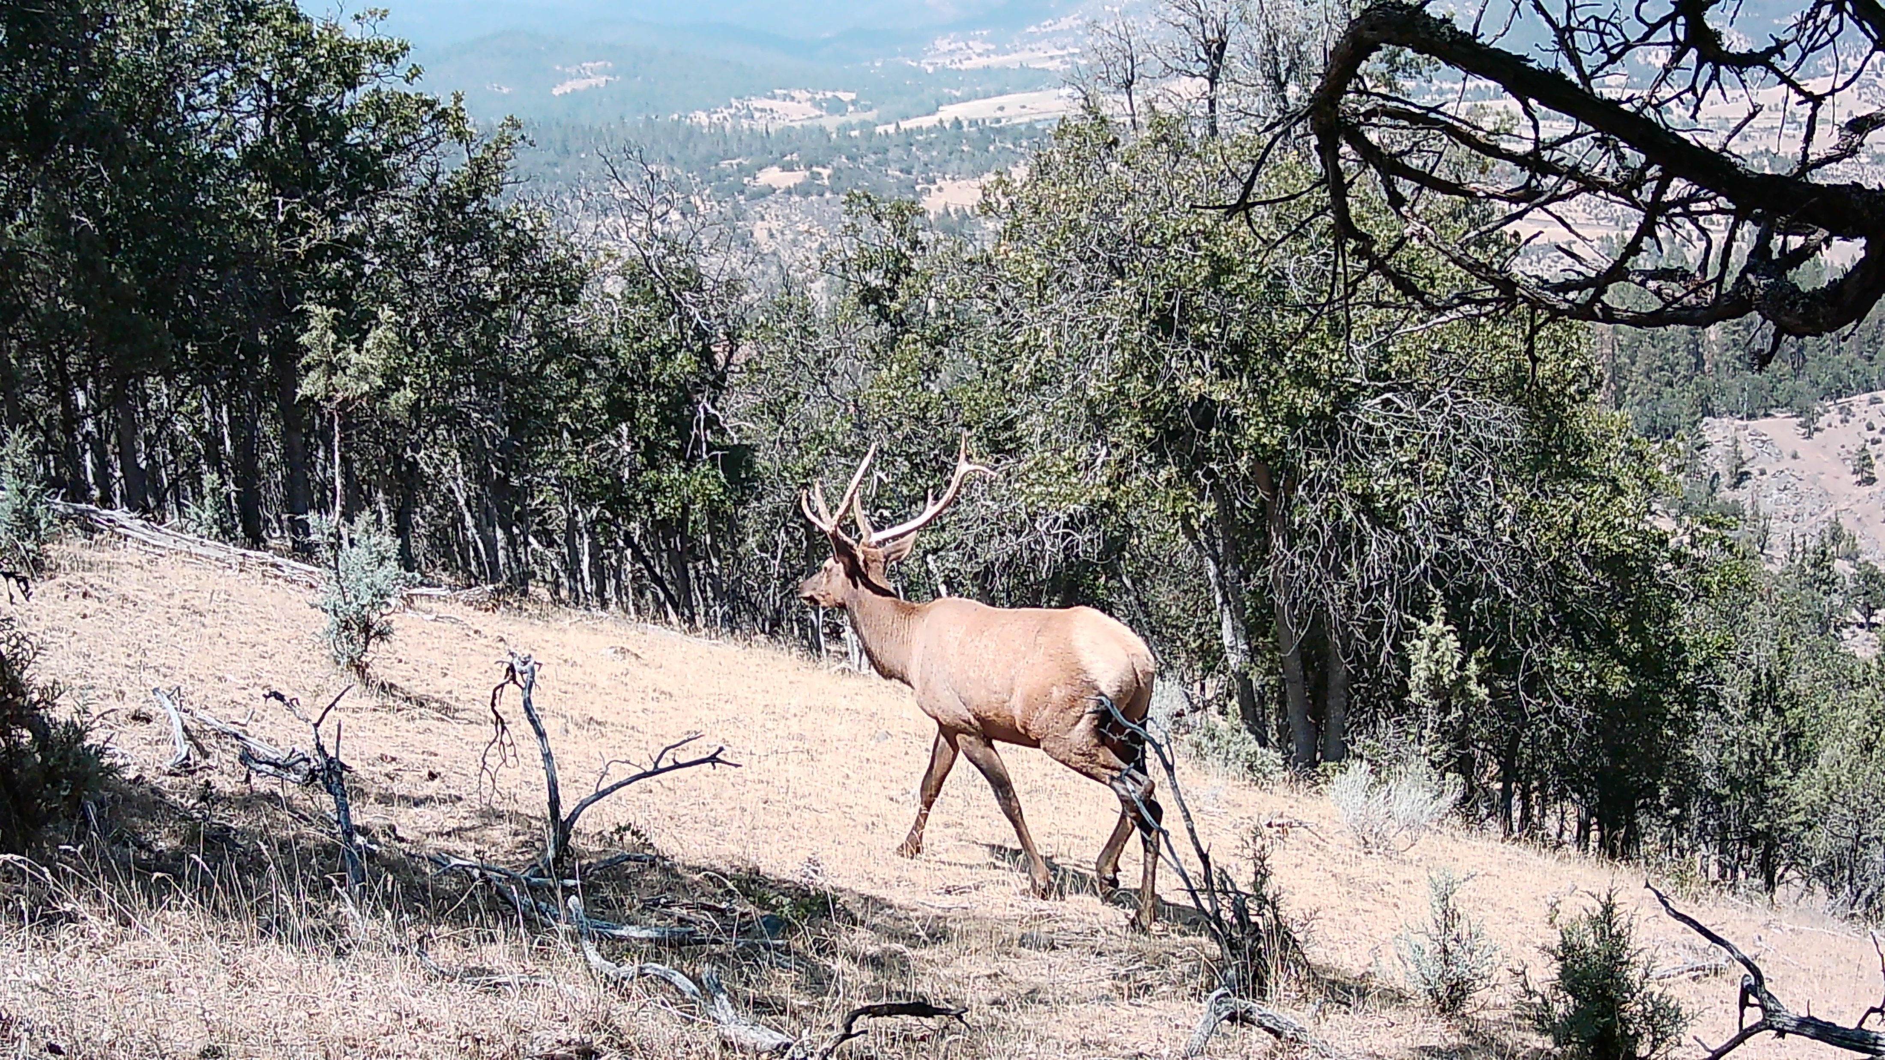
Collect Data
a) Wildlife vehicle collision/roadkill (carcass and crash)
b) Wildlife occurrences
c) Wildlife use of existing highway crossings
d) Wildlife habitat
e) Traffic disturbance
f) Slope
g) Ownership/conservation status
i) Other infrastructure (nearby roads/development)

Slide 10
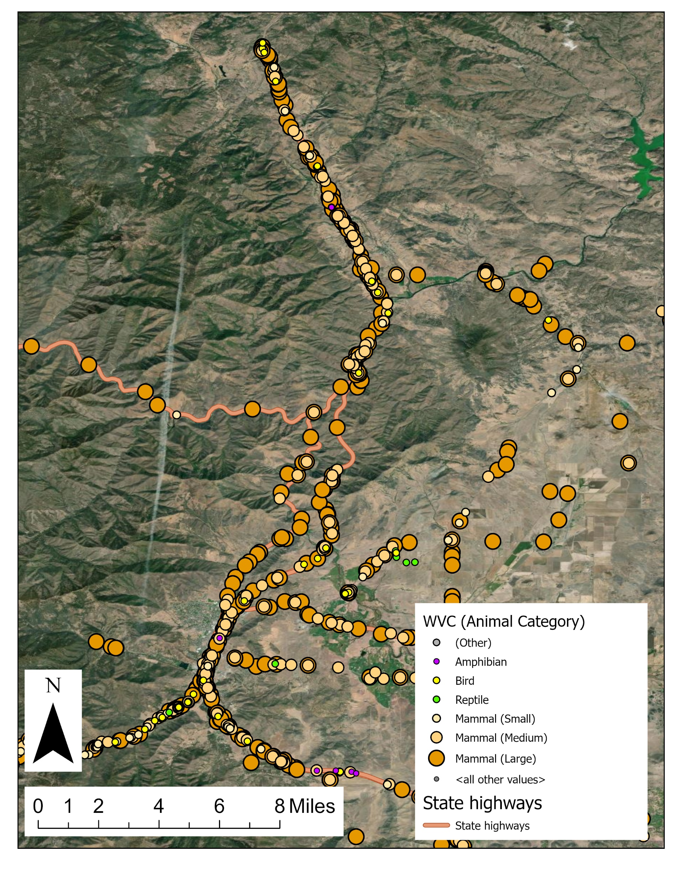
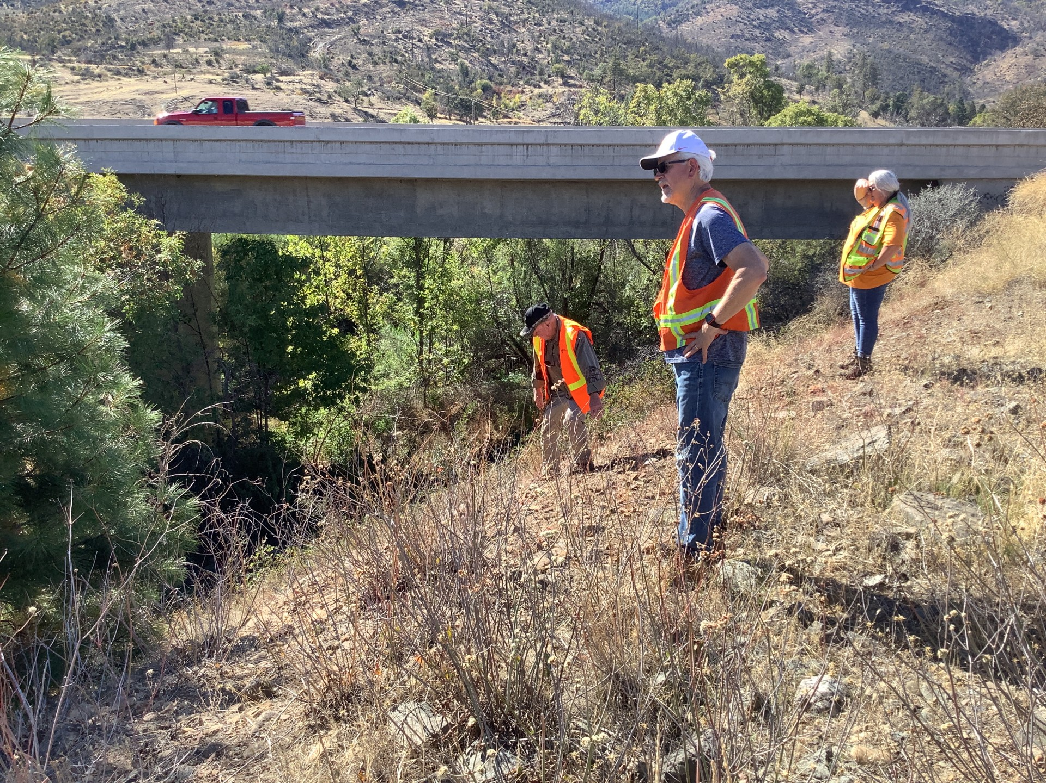
Alternatives Analysis
Starts with objective
Collect data about wildlife are doing right now
Identify and map possible locations for over-crossings
Informs next steps:
Narrow these possibilities down for a CEQA analysis
Pick two of the best and most-feasible ones for 65% design and engineering

Slide 11
Plan/build wildlife over-crossings

Slide 12
What are we doing right now?
Finishing up camera data collection
Getting data from Oregon, CDFW, Caltrans and others
Starting alternatives analysis
By next late spring (2025), identify and map possible alternative locations
Engineers do field investigations of alternatives
Develop final set of possible locations (late summer, 2025)

Slide 13
Questions?

