Slide 1
The following photos were taken along Copco Road from Mile Post (MP) 3.6 to MP 17.5 (the entire range depicted in blue, below), and document impacts to the Road as a result of Lower Klamath Dams Decommissioning activities.

Slide 2
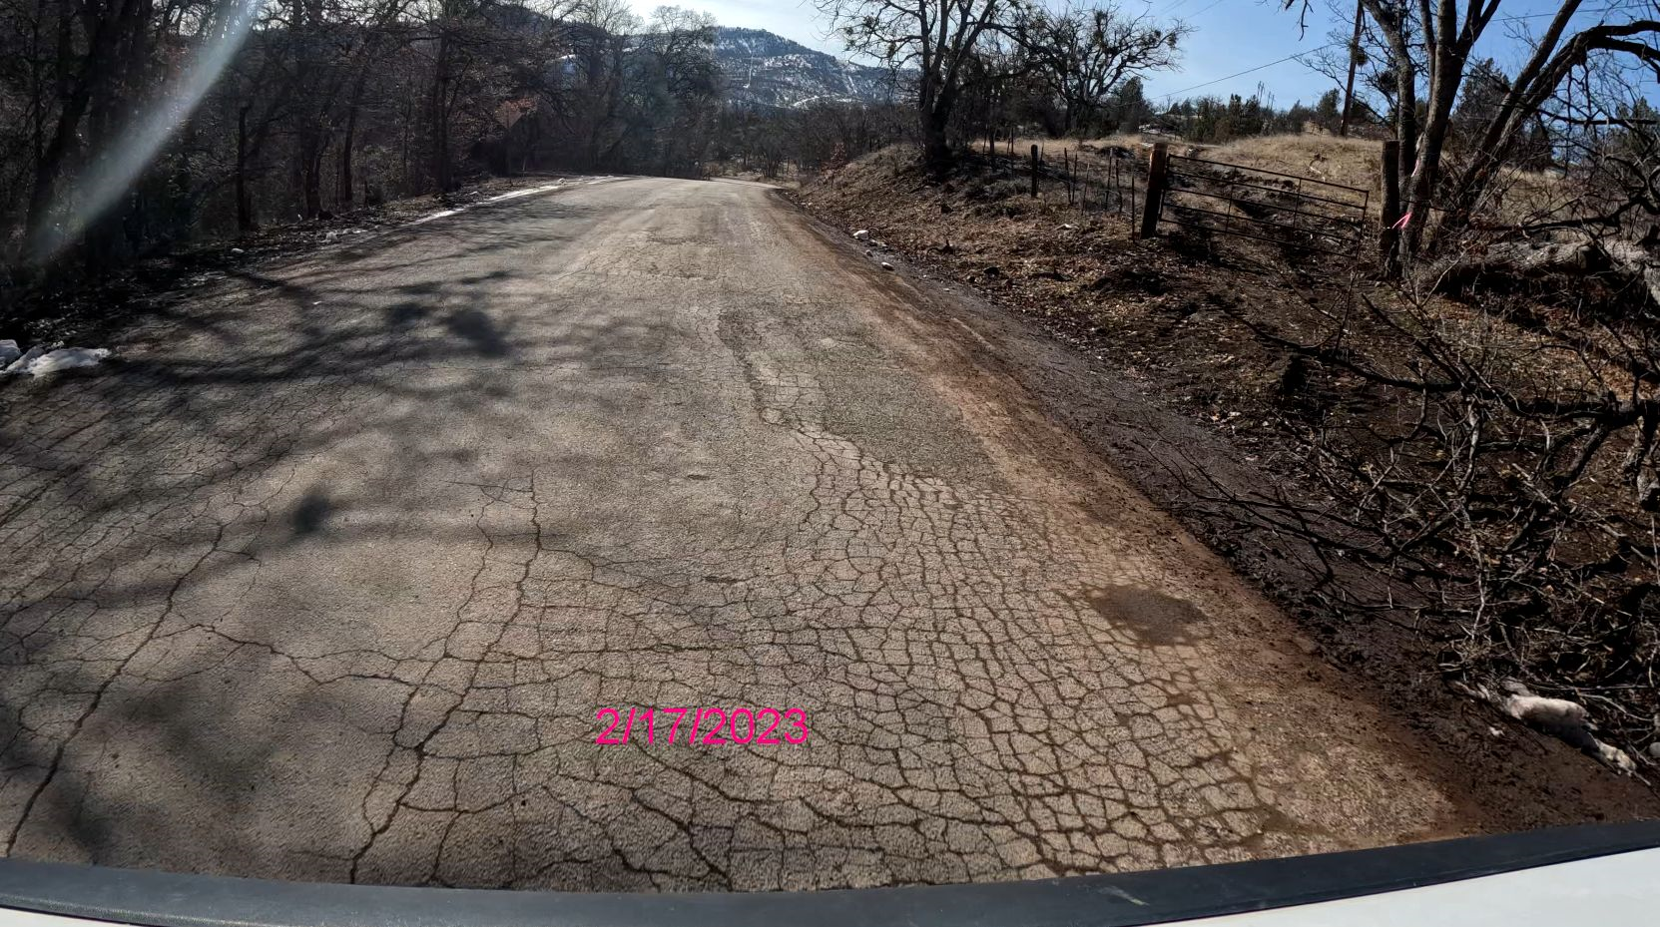
February 7, 2023
September 16, 2024

Slide 3
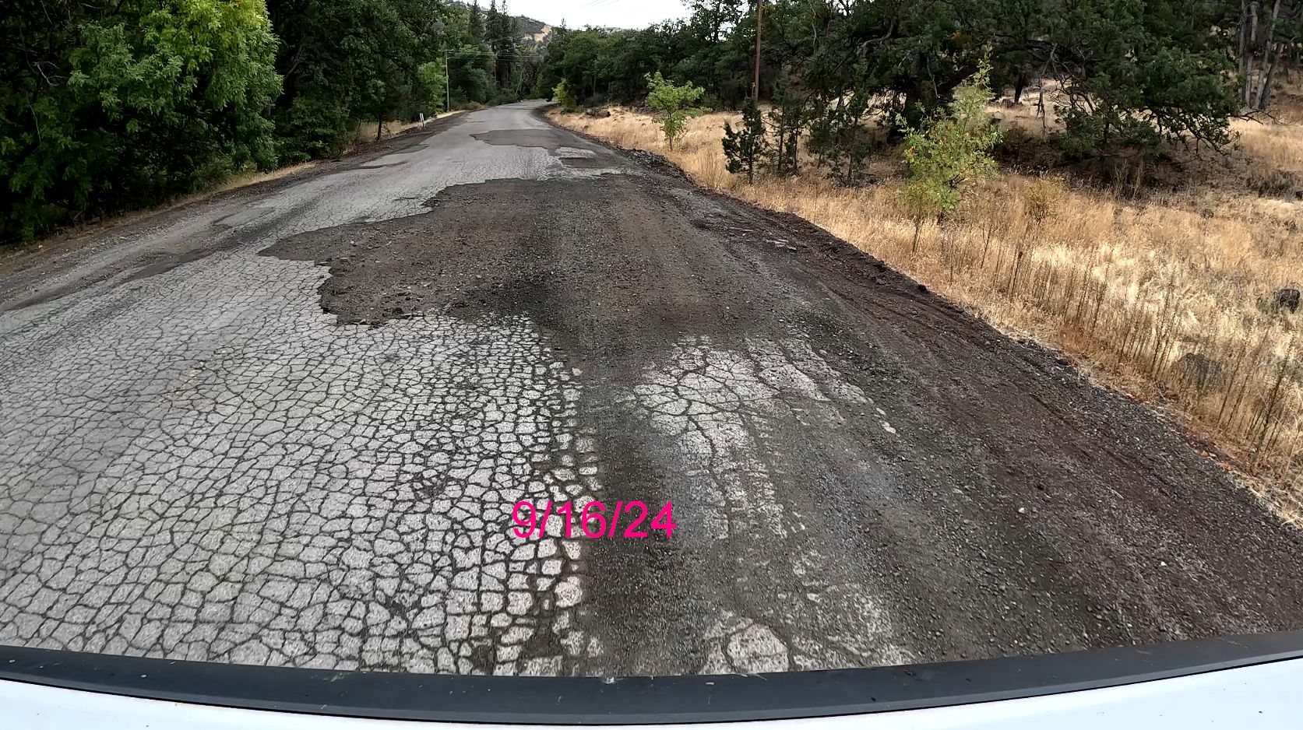
September 16, 2024
February 7, 2023

Slide 4
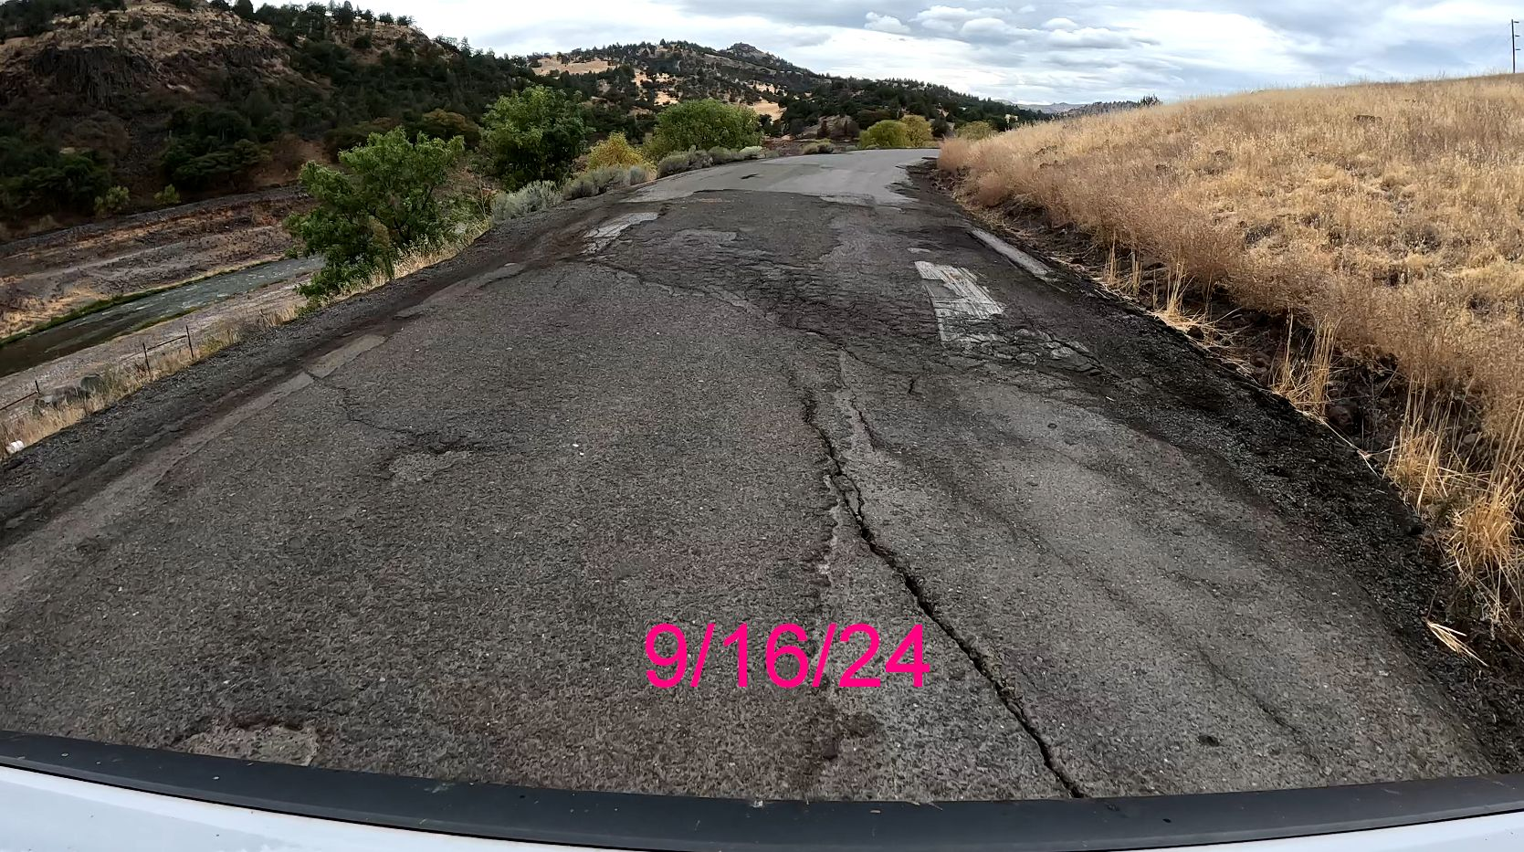
September 16, 2024
February 7, 2023

Slide 5
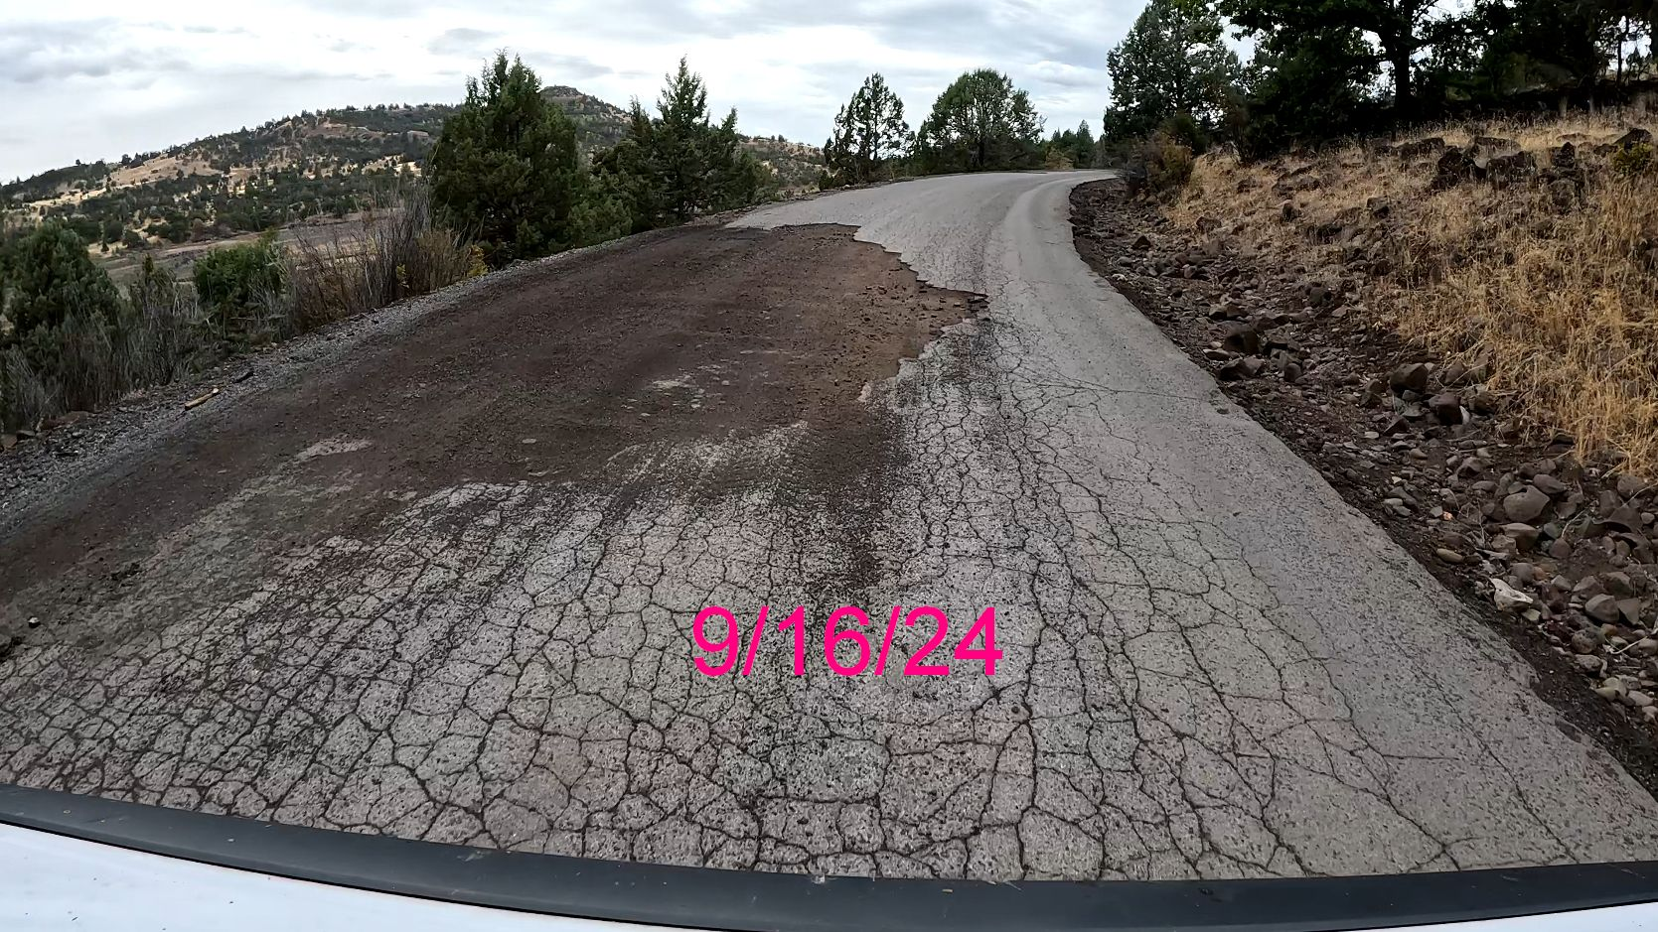
September 16, 2024
February 7, 2023

Slide 6
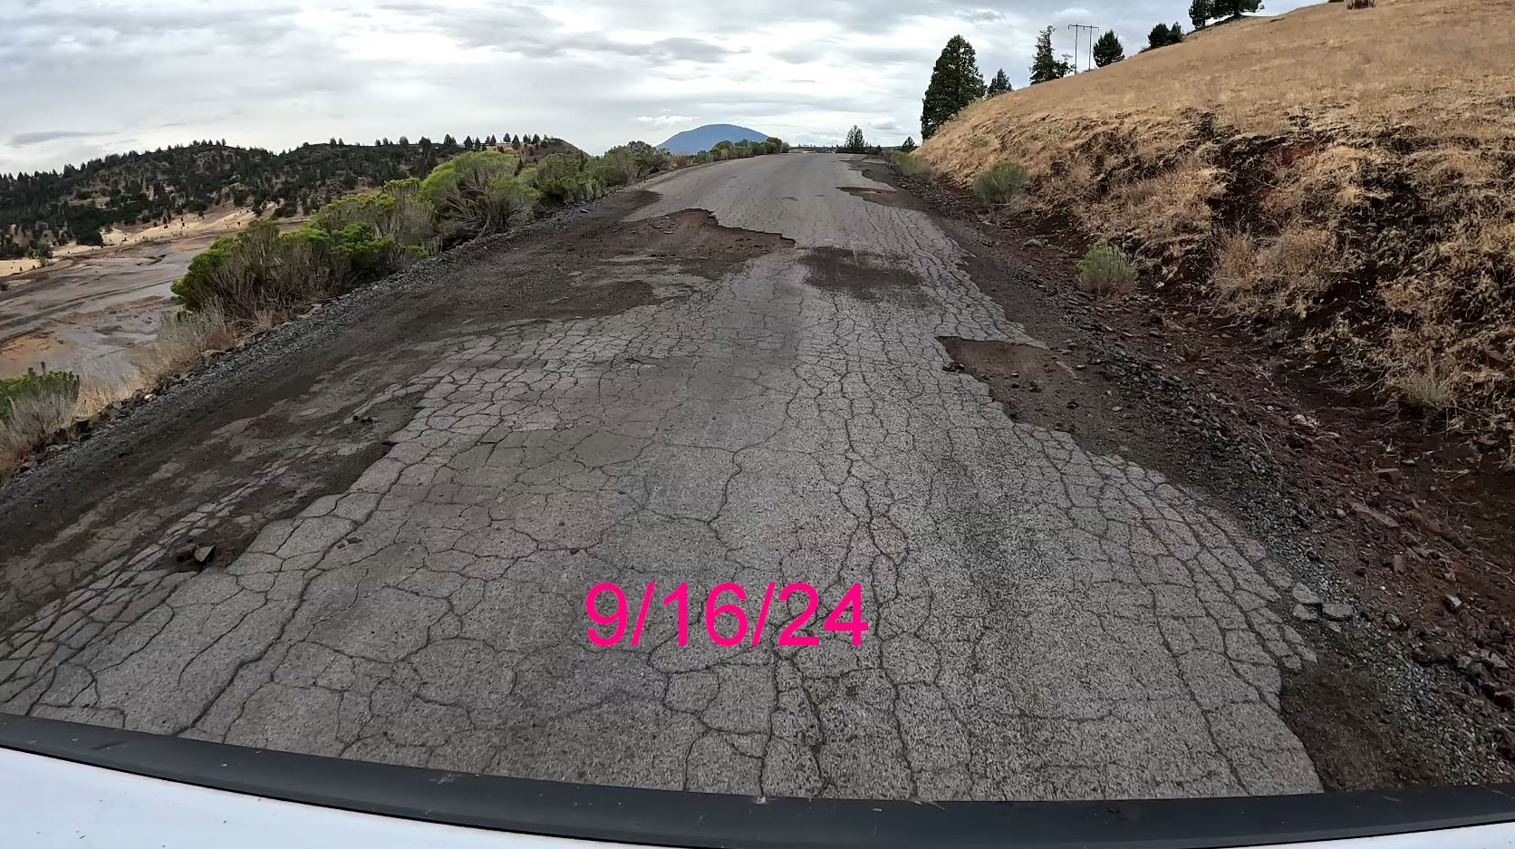
September 16, 2024
February 7, 2023

Slide 7
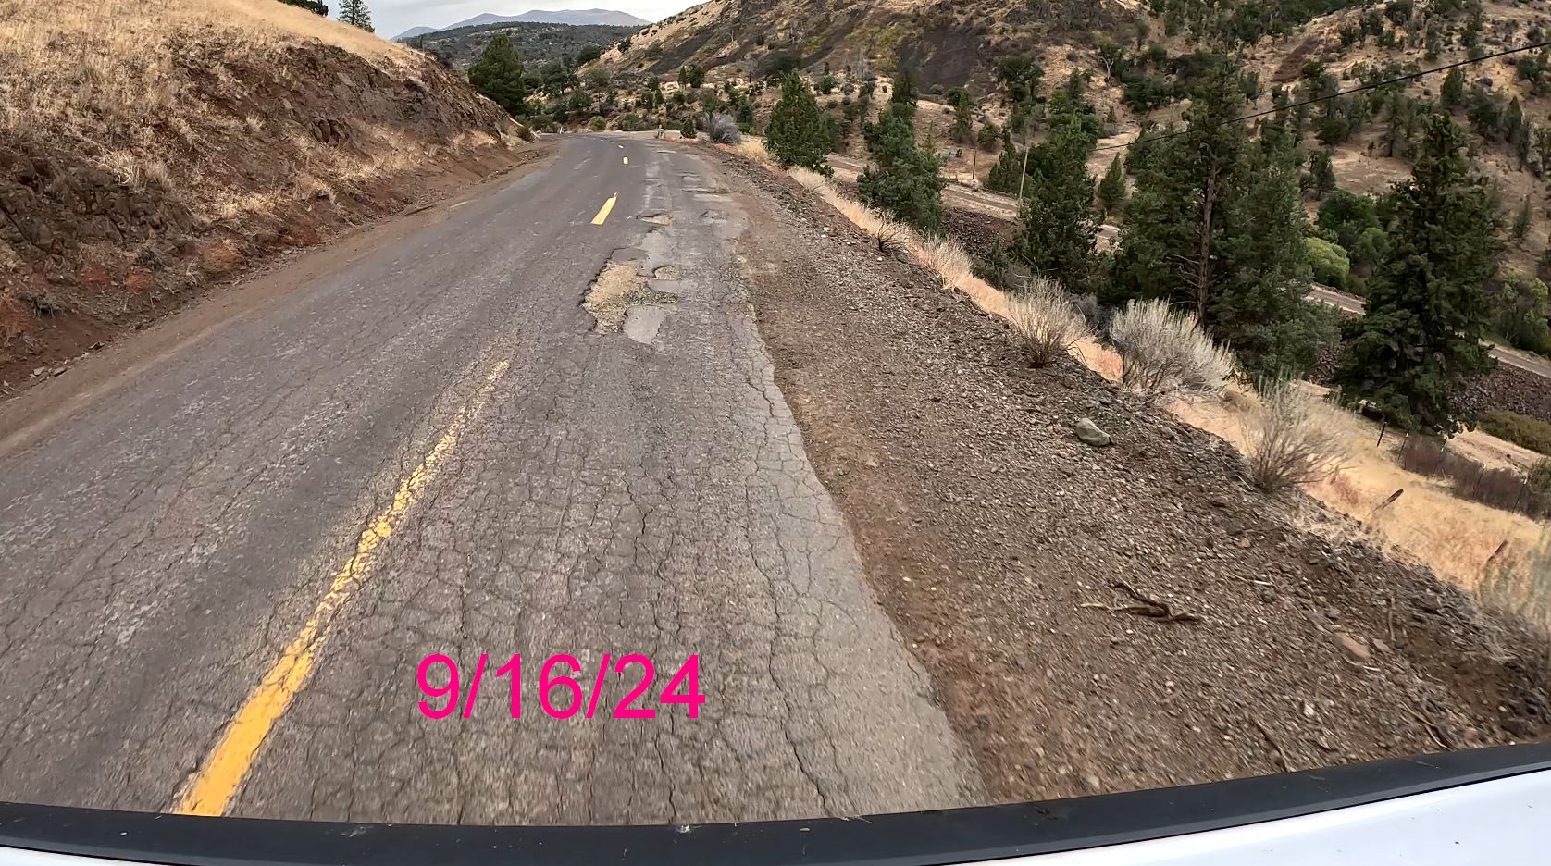
September 16, 2024
February 7, 2023

