Slide 1
Coordinator’s Grant & Community Wildfire Defense Grant
Presented by:
FSCSC & CORE

Slide 2
CAL FIRE/CFSC County Coordinator Grant:
Objective: to develop county-wide collaboration & coordination amongst wildfire mitigation groups. From 2021-2023 CFSC provided $175,000 to hire County Coordinators to:
Build a census of wildfire mitigation groups
Analyze gaps in county-wide wildfire resiliency & emergency preparedness. Develop recommendations to fill gaps.
Develop mechanisms to improve outreach & coordination efforts.
In April 2024, CFSC awarded additional $199,774.40 to FSCSC to continue County Coordinator grant through 12/31/24.

Slide 3
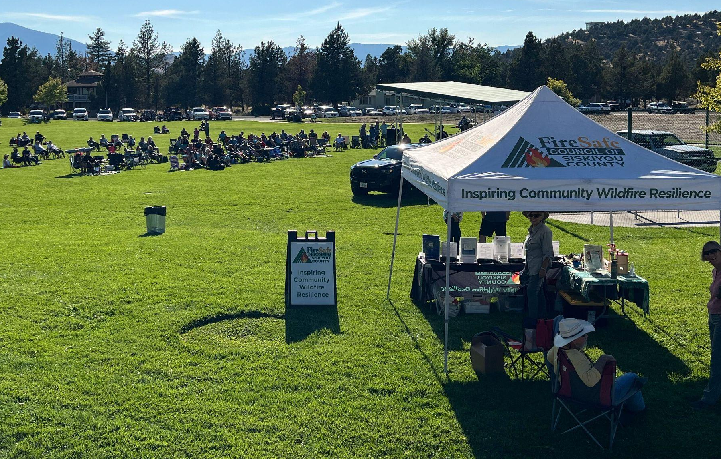
Coordinator’s Grant: Outreach & Education
In 2024:
24 Events
35 Days of Outreach
Residents Engaged: ~2200
Kids Engaged: 800
Emergency Alert Sign-Ups: 342
2022-2024 Cumulatively:
FSCSC directly engaged face to face with nearly ONE QUARTER
of the population of Siskiyou County!!
Post Mill Fire FSCSC Hazard Tree Removal Project, Celebration Concert in Lake Shastina, Funded by Rain Rock Casino

Slide 4
Coordinator’s Grant
Invited to be panelist at the McConnell Foundation Grant Writing Training, 2024

Slide 5
Coordinator’s Grant
FSCSC and Partners at the Siskiyou Community Wildfire Workshop, 2024

Slide 6
Coordinator’s Grant
FSCSC and Partners at the Siskiyou Wildfire Mitigation Group Meeting, 2024

Slide 7
Coordinator’s Grant
FSCSC at the Siskiyou Golden Fair, 2024

Slide 8
Coordinator’s Grant
Ready Raccoon & FSCSC at the Happy Camp Youth Fire Science Education Event, 2024

Slide 9
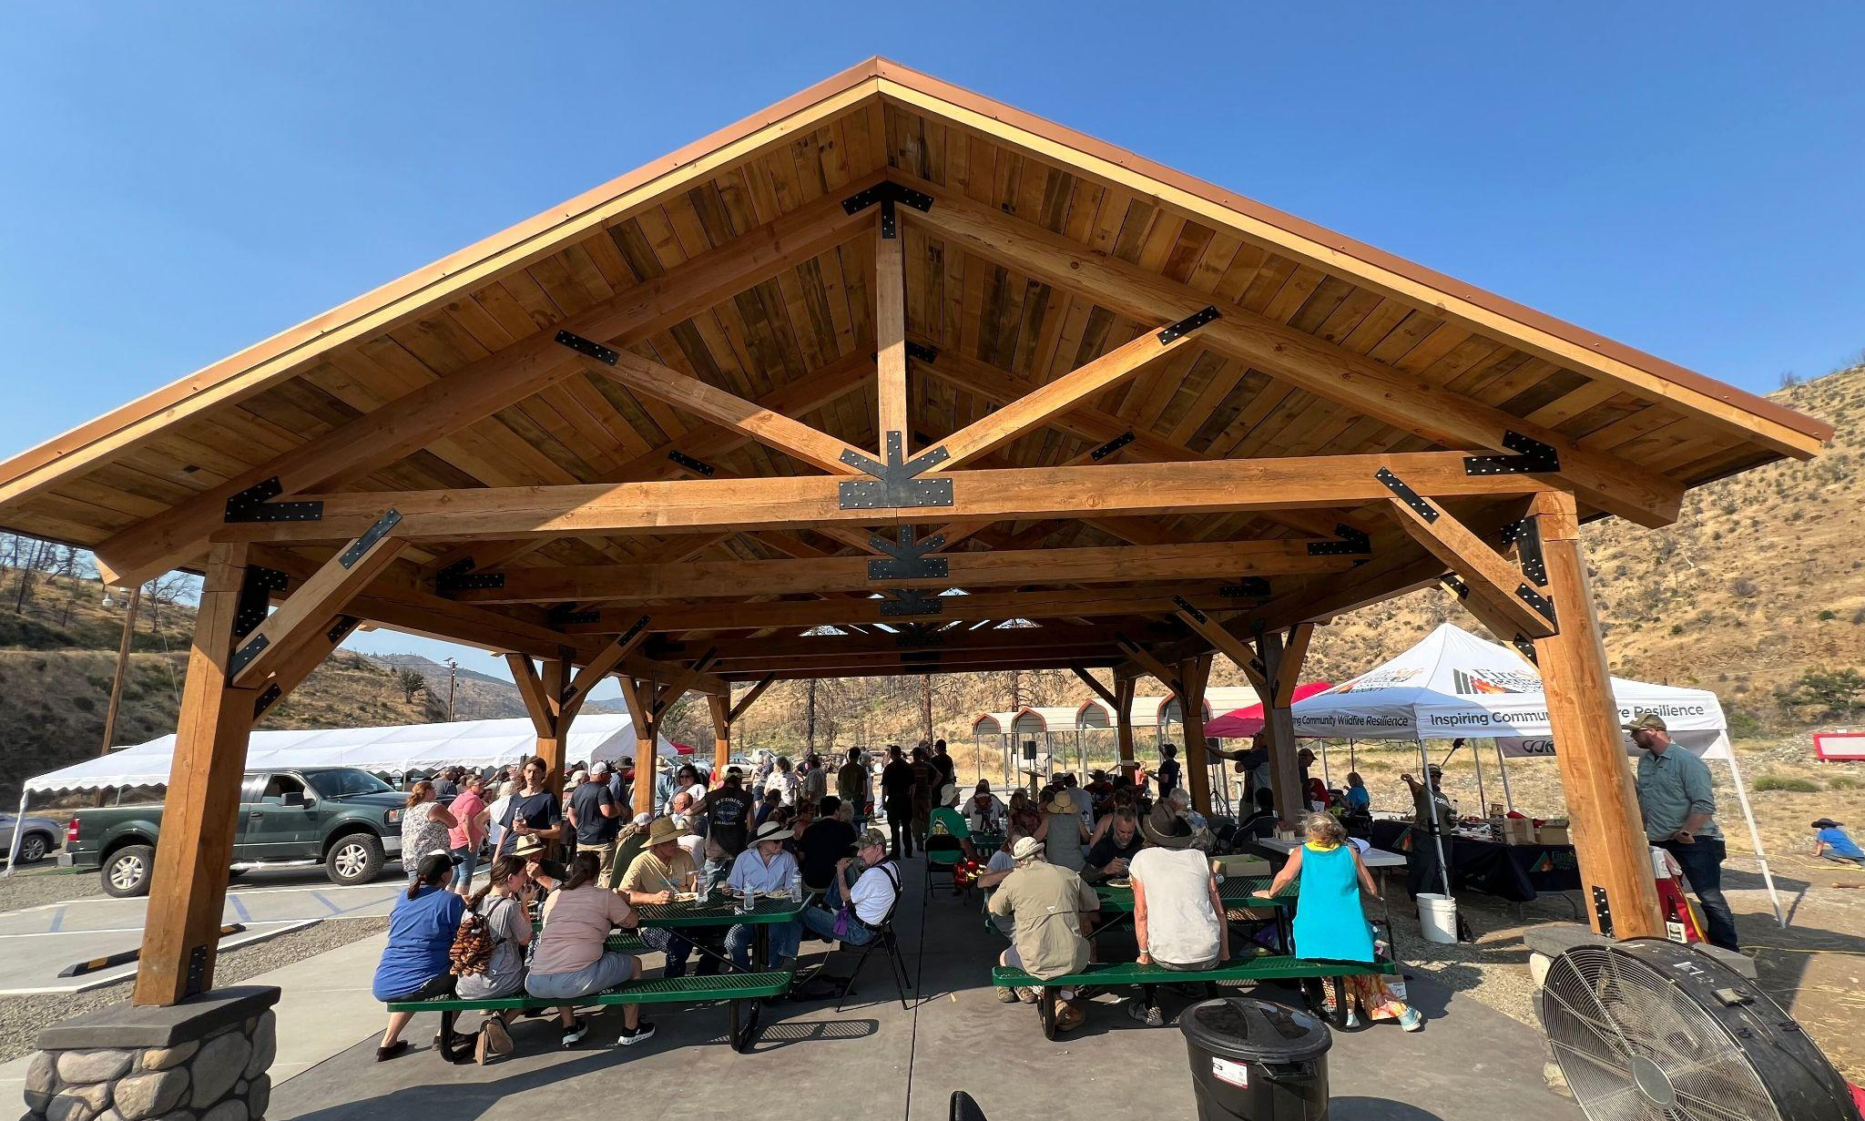
Coordinator’s Grant
FSCSC at Klamath River Community Hall Pavilion Dedication, McKinney Fire Recovery Celebration

Slide 10
Community Wildfire Defense Grant
The CWDG project aims to prepare, educate, and empower low-income and vulnerable communities of Siskiyou County against the threat of wildfires.
The CWDG project will be in effect until July 2028.

Slide 11
Our Mission
Efforts include:
Public outreach and education
Defensible space assessments
Implementation of defensible space of 500 homes
And, fuels reduction along roadsides to improve entry and egress for emergency personnel.

Slide 12
OUTREACH & EDUCATION
To gain participants in the CWDG project.
Educate and empower residents to create Firewise USA communities.
Coordinate training for community members and volunteer activities to learn the basic tasks and benefits of creating defensible space and home hardening.
Identify and train volunteers to be ambassadors to establish and sustain potential Firewise USA sites post CWDG project.

Slide 13
OUTREACH & EDUCATION April - October 2024
Events – 21
Residents Engaged – 1,780
Home Assessment Sign Ups – 266
Emergency Alerts – 342
Kids Educational Engagements – 801

Slide 14
Forks of Salmon Community Workshop 09/07/24

Slide 15
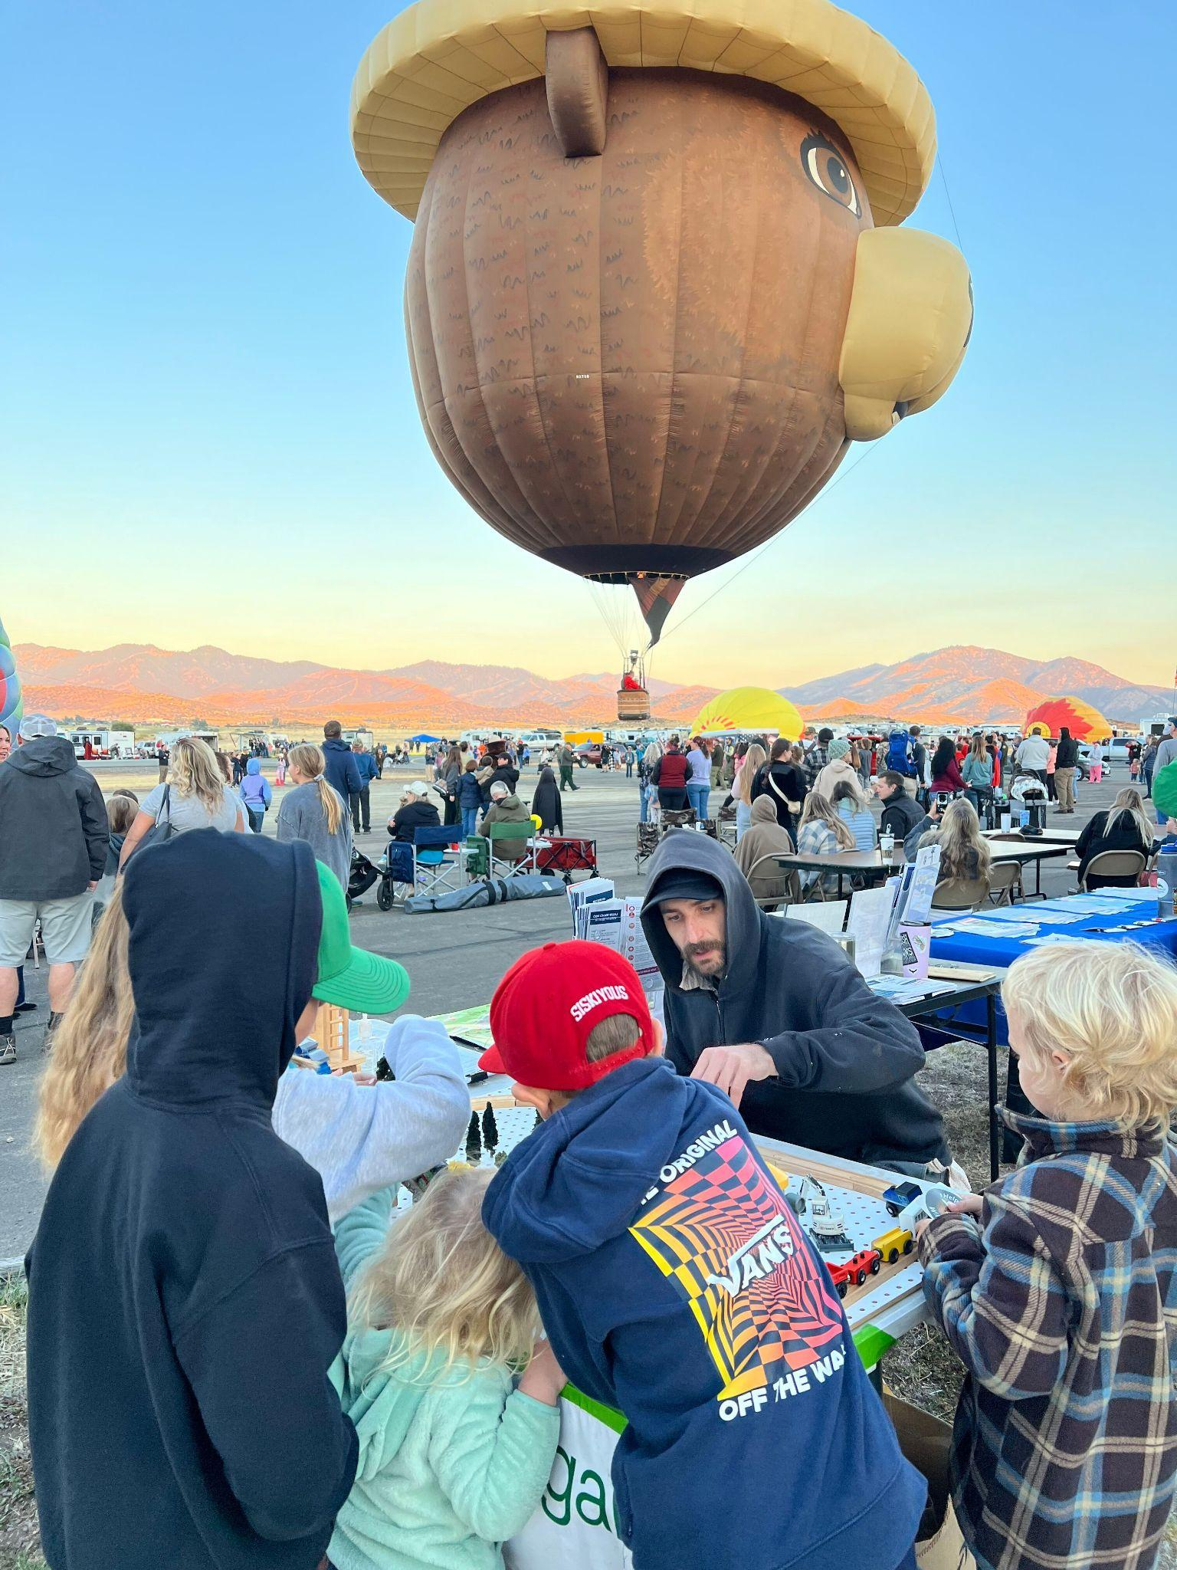
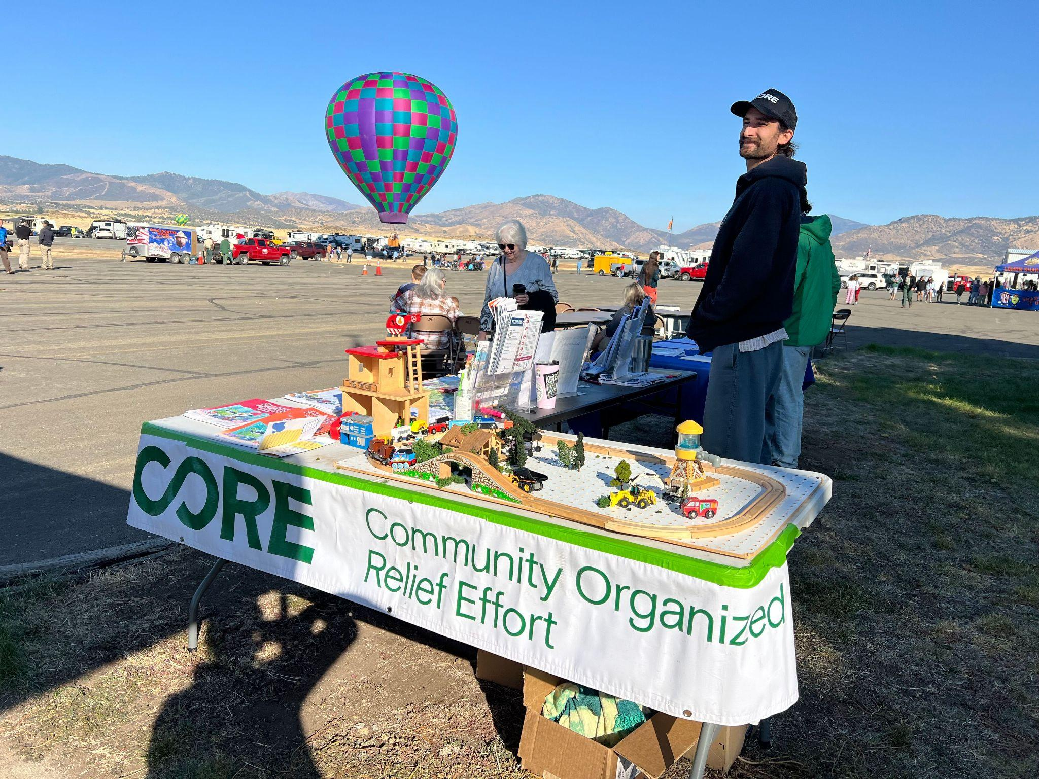
Montague Hot Air Balloon Festival 09/21/2024

Slide 16
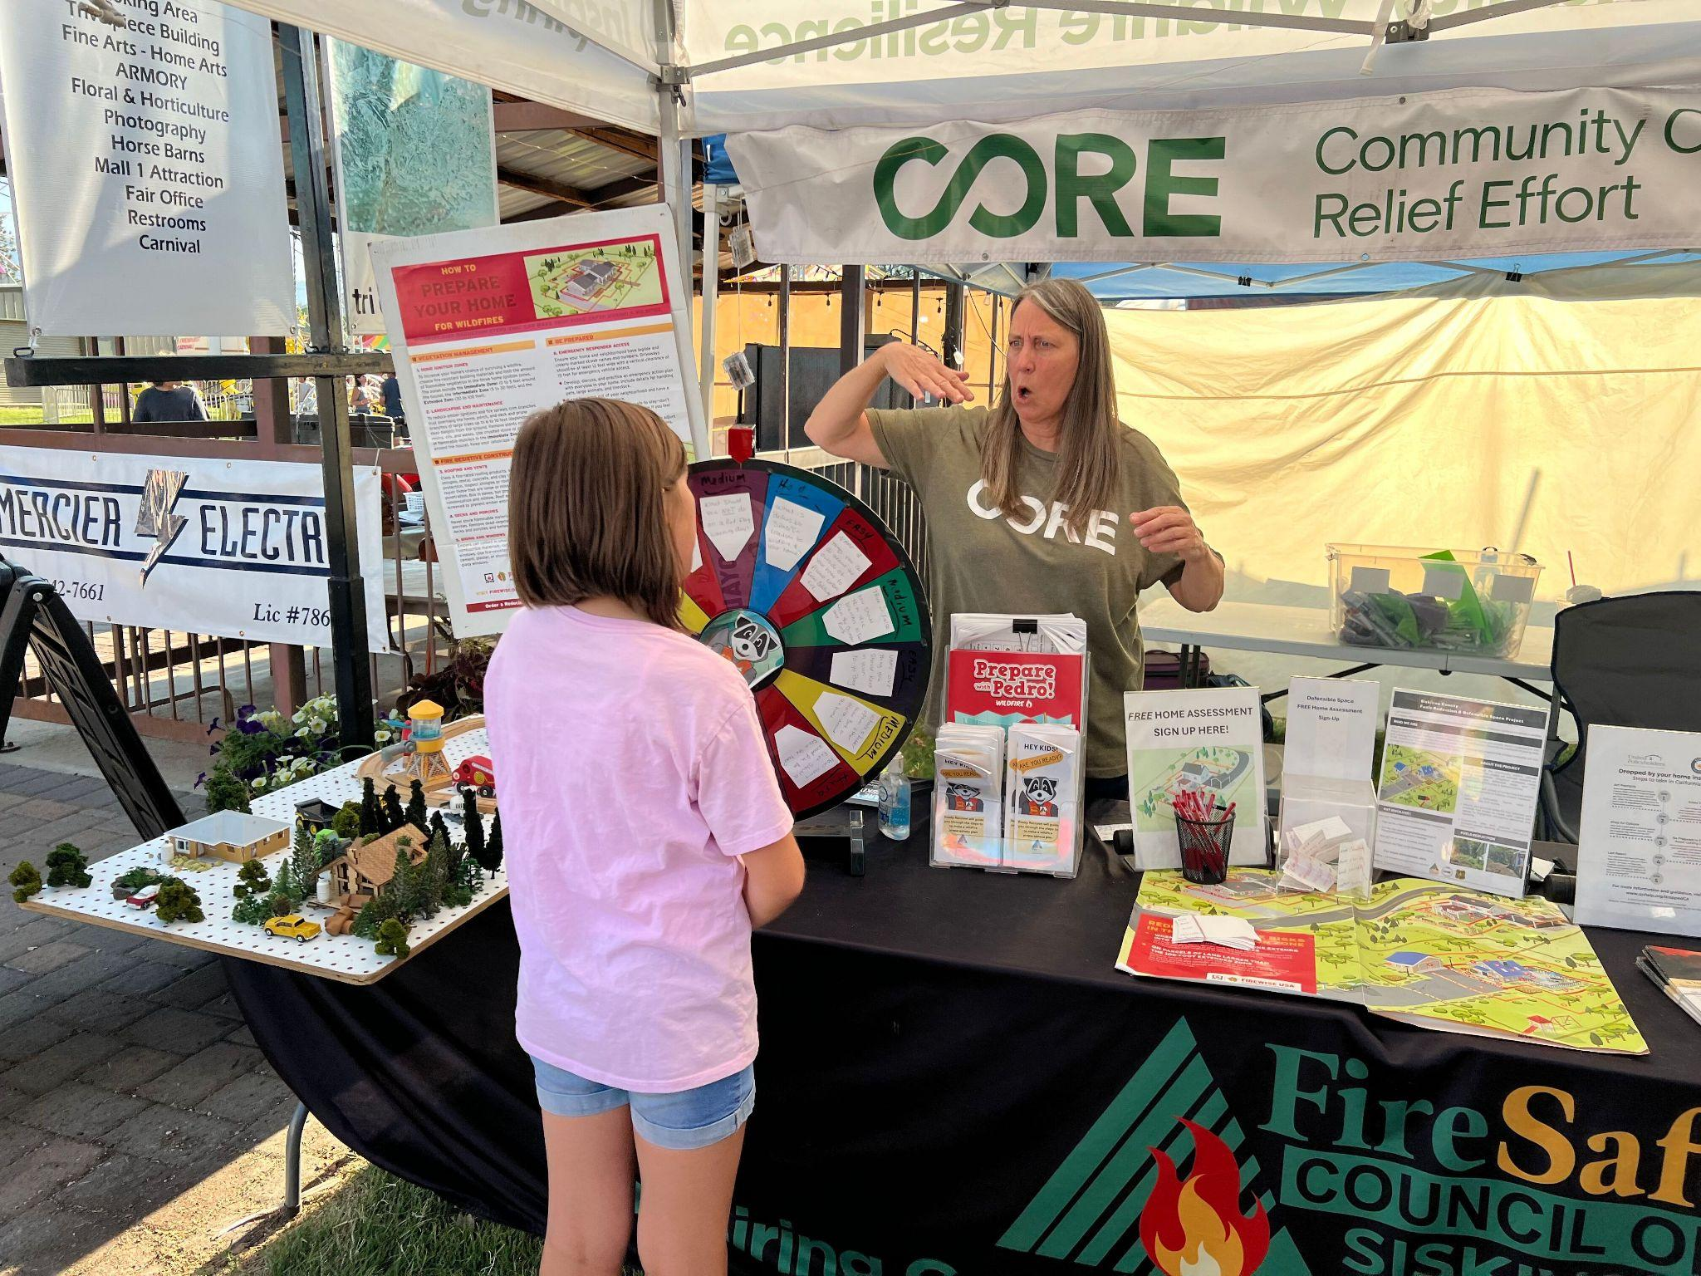
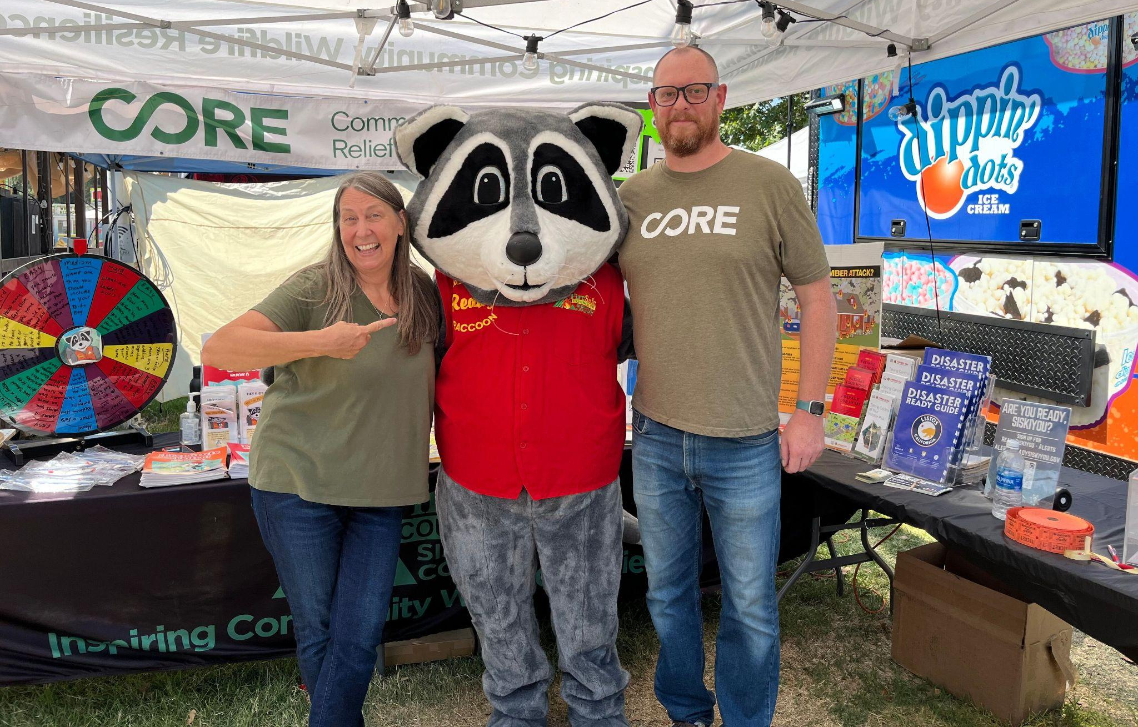
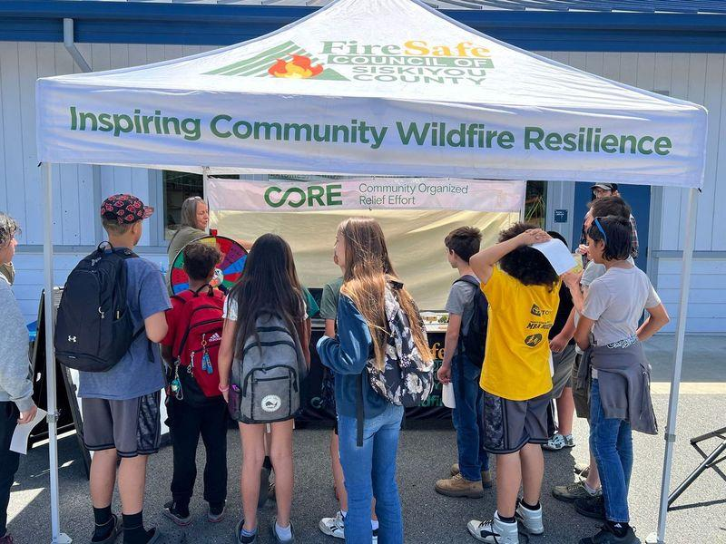
Above: CORE/FSCSC at Siskiyou Golden Fair 2024
< CORE/FSCSC at Orleans- Sommes Bar Youth Firewise Education Event 2024

Slide 17
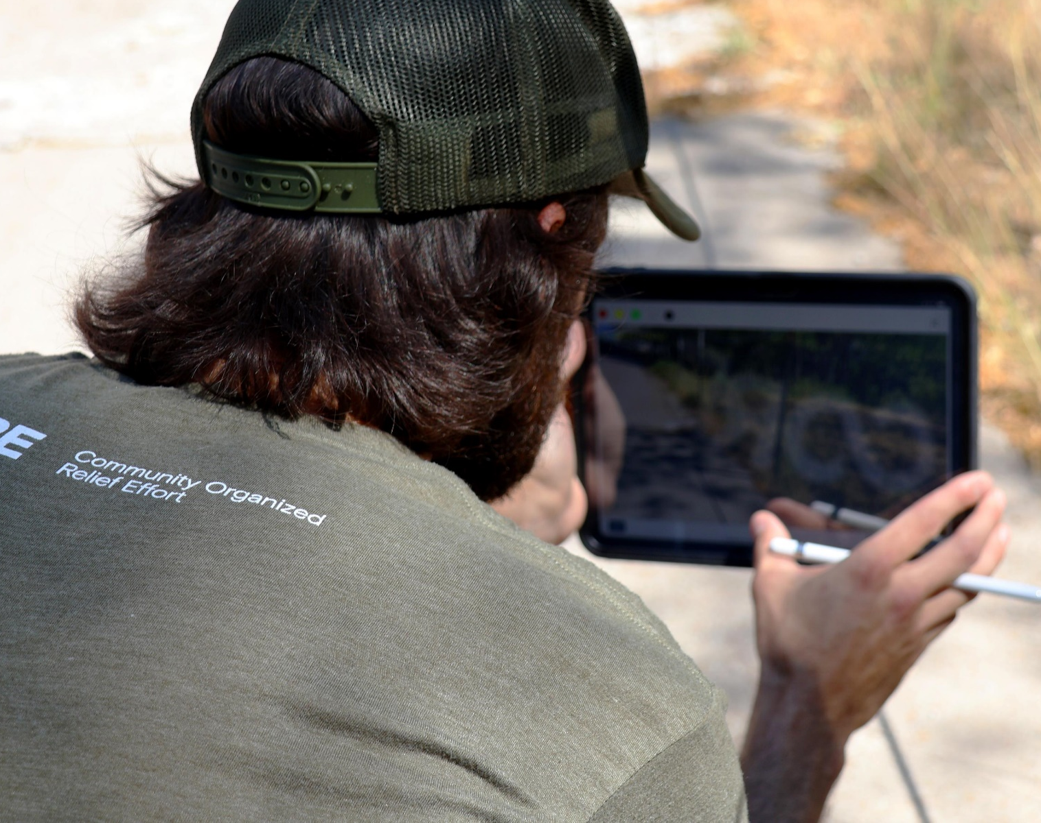
HOME ASSESSMENTS
Free wildfire home assessments and suggest recommendations using a wildland fire home assessment program, Fire Aside.
Educate homeowners on the benefits of defensible space, home hardening, wildfire preparedness, mitigation, and response resources.
Started home assessments July 8, 2024
Completed: 36

Slide 18
Defensible Space Implementation
Complete defensible space work on at least 500 homes in prioritized communities in Siskiyou County.
Obtain landowner agreements prior to beginning defensible space and debris removal work on any private property.
Utilize the wildland fire home assessment program and recommendations to complete the contractor’s scope of work (SOW).

Slide 19
Roadside Fuels Reduction
Identify and prioritize areas for fuel reduction and roadside fuel breaks to create safer ingress and egress for firefighters, emergency personnel, and residents
Coordinate, plan and work with relevant stakeholders (e.g. County officials, CAL FIRE, US Forest Service, etc.) of planned fuel reduction roadside projects.
This project will treat roads 50 ft to either side and up to approximately 300 acres total in selected areas.

Slide 20
Community Prioritization
Data was collected and analyzed for community prioritization. A ranking system was determined by the following factors:
Fire Severity
Fire History (Last 5 years)
Wildland Urban Interface
Ongoing Hazard Mitigation Work
USFS Klamath Basin Strategy Project, and,
Income

Slide 21
FSCSC & CORE Community Partners

Slide 22
Community Wildfire Defense Grant

