Slide 1
Shasta-Trinity National Forest Update
Siskiyou County Board of Supervisors Meeting
June 4, 2024

Slide 2
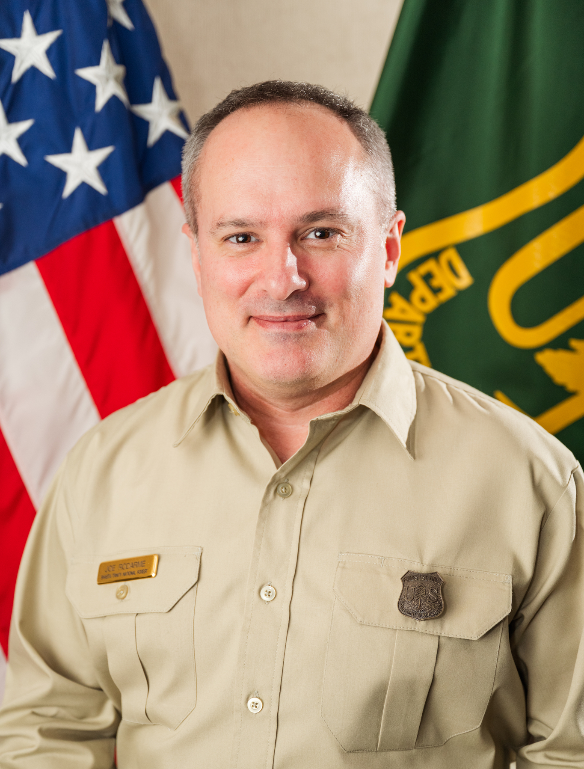
Shasta-McCloud Management Unit District Ranger
Joe Rodarme is the new permanent District Ranger on the Shasta-McCloud Management Unit
Started with the district on 24 MAR 2024
Extensive land management and leadership experience
Forest Environmental Coordinator
Bureau of Land Management Planning and Environmental Specialist
Air Force Veteran
Joe enjoys traveling, hiking, biking and family time
Proud resident of Siskiyou county and excited to be part of this great community

Slide 3
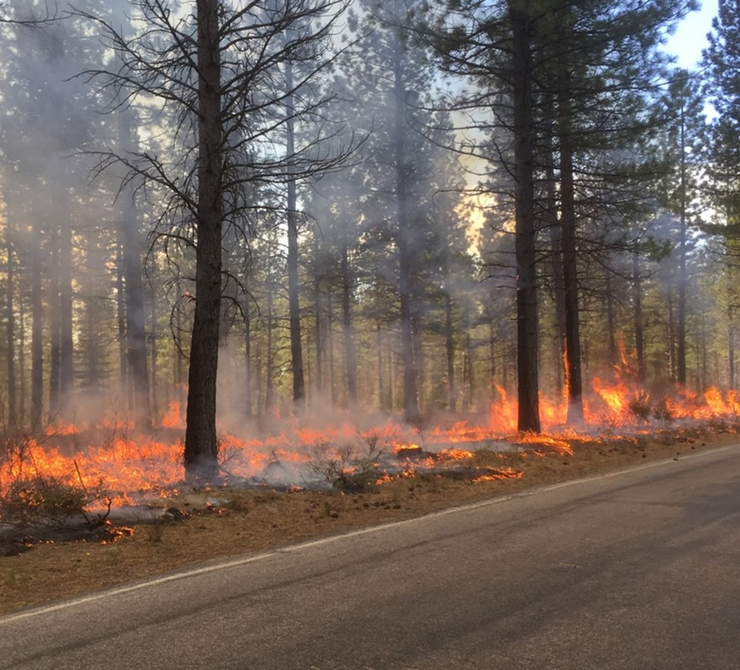
Forest Updates (1 of 3)
Wildfire Crisis Strategy Landscape
Klamath River Basin
Trinity County Landscape
Continued National Level Interest
Joint Chiefs Visit
Wildfire Risk Reduction Infrastructure Team Workshop

Slide 4
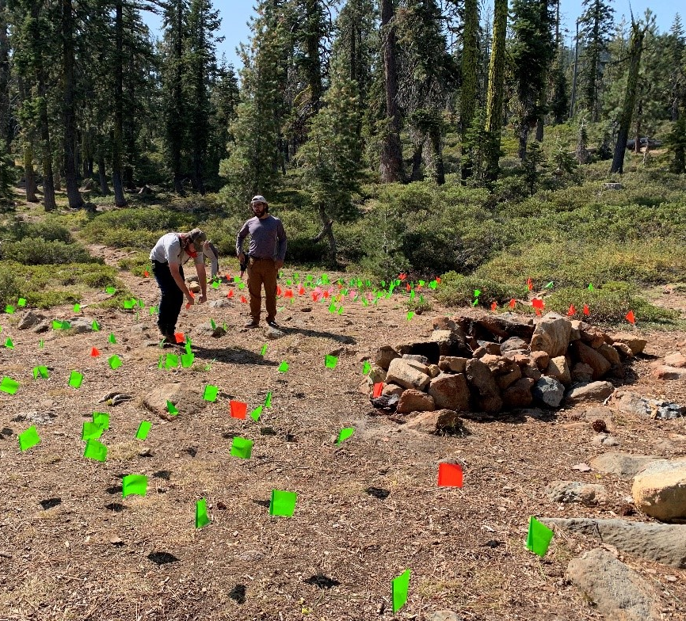
Forest Updates (2 of 3)
National Old Growth Amendment (NOGA)
Northwest Forest Plan Amendment and Update
Pacific Crest Trail Trinity Alps to Castle Crags Land Exchange

Slide 5
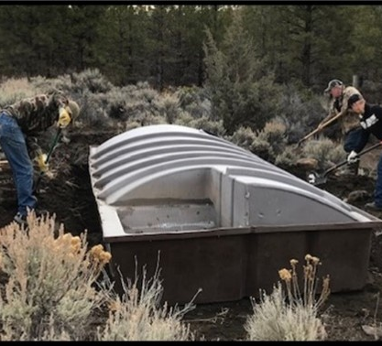
Forest Updates (3 of 3)
Air Tanker Base
Ribbon Cutting
(25 APR 2024)
Preparation for Fire
Season 2024
FY24 and 25 Budget

Slide 6
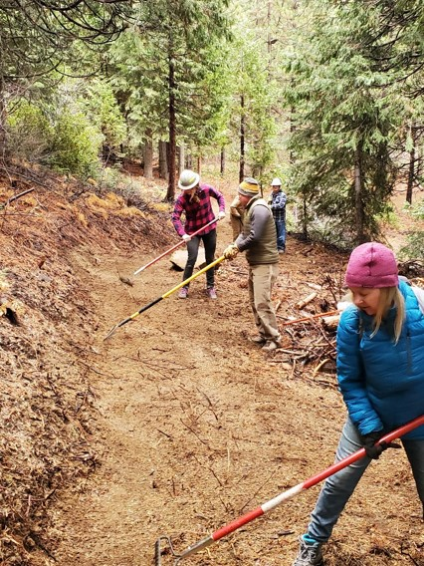
Shasta-McCloud Management Unit Update
South Fork Sacramento (SFS) Project
Designed to improve fire resilience and public safety through thinning, fuels reduction, fuel management zones and prescribed fire across 21,400 acres
Received $3.6M Sierra Nevada Conservancy grant for 1172 acres of fuels treatments along the Castle Lake road and Forest Service road 40N26 (a total of 18 miles)
Project work has started (Rainbow timber sale)
Road Updates
Youth Conservation Corps

Slide 7
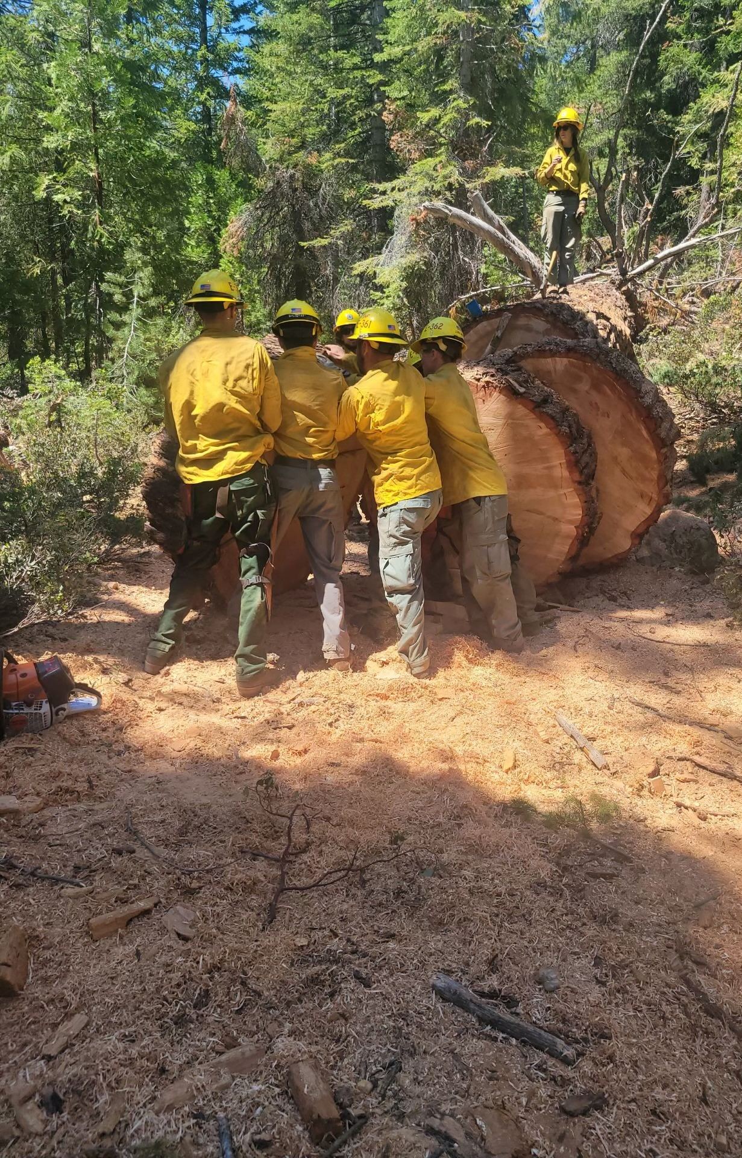
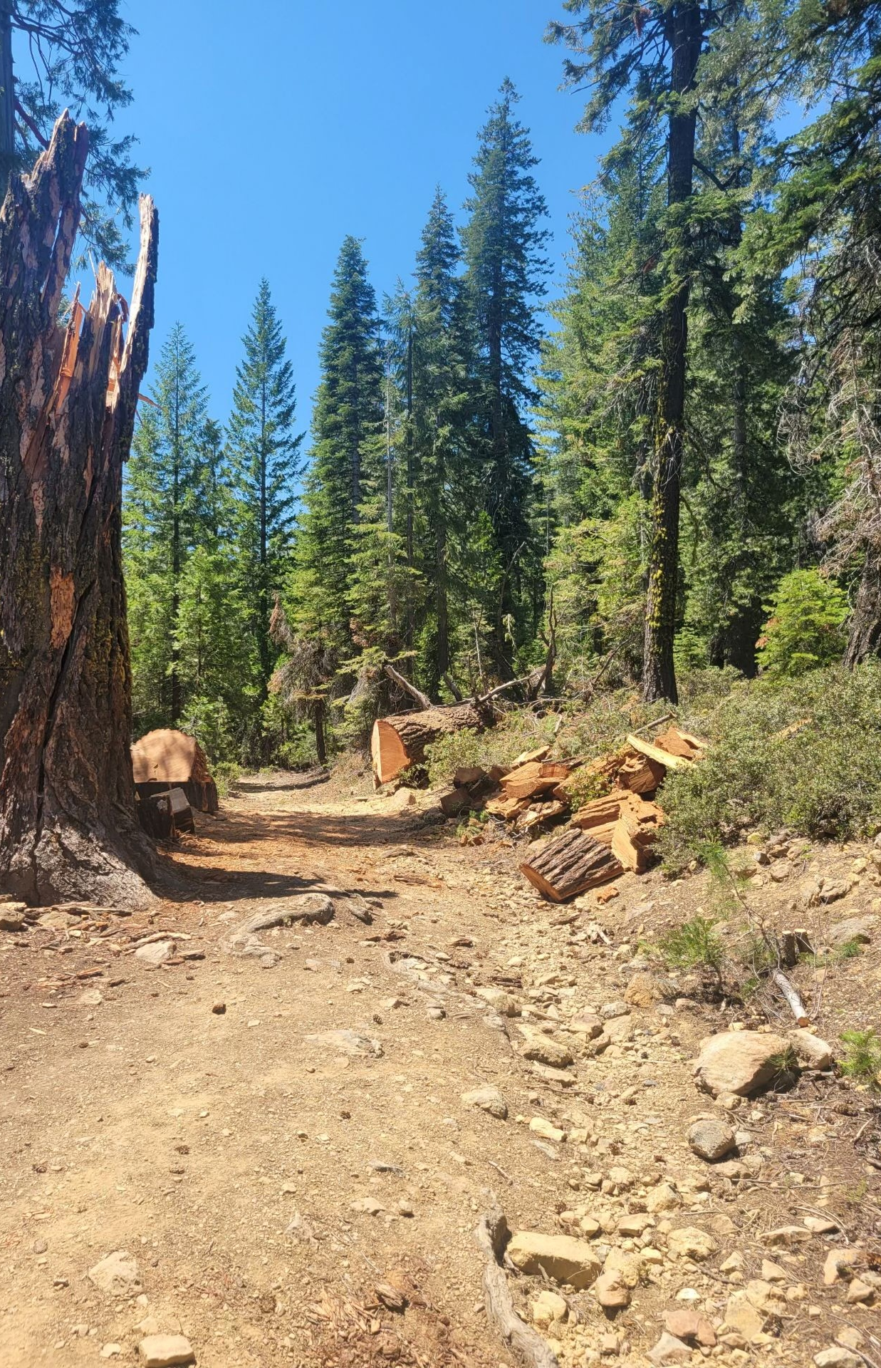
Shasta-McCloud Management Unit Update (cont.)
Fire Suppression Staffing
6 Type 3 Engines
1 Water Tender
1 Dozer
3 Fire Prevention Officers
Current Closure Orders
Slate Creek Road (storm damage)
Rainbow Timber Sale area (logging operations)

Slide 8
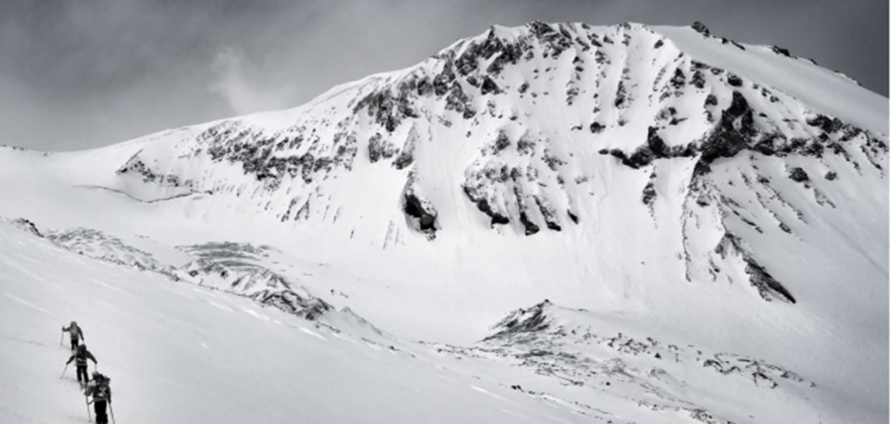
Questions?
Thank You for Sharing Your Time with Us

