Slide 1
Siskiyou County Veterans Service Office Annual Report
Thomas Jackson, Veterans’ Service Officer
July 2, 2024

Slide 2
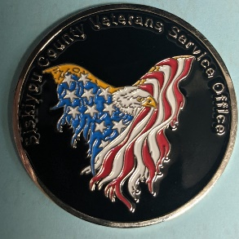
Siskiyou County Veteran Demographics
Siskiyou County Veterans Population – 3,410 (according to the USDVA National Center of Veterans Analysis and Statistics)
1,266 veterans have visited our office. (FY 2023)
3,813 Phone Calls and E-Mails handled. (FY 2023)
930 people contacted during outreach visits and outreach events. (2023)

Slide 3
Claims/Awards
Claims Submitted 2023 - 457
Claims Pending as of June 20, 2024 –
New Awards 2023 - $1,731,138.00
Average New Award 2023 - $3,788.00
All awards received from the Department of Veterans Affairs are Tax Free. Most of the money is being spent in the Local Economy.

Slide 4
Outreach Events
Mt. Shasta Outreach – 1st and 3rd Thursday
Happy Camp Outreach – 2nd Thursday
Dorris Outreach – 4th Thursday
Siskiyou County Healthy Aging Fair
Siskiyou Golden Fair
Youth Empowerment Siskiyou County
Memorial Day Services: Evergreen Cemetery, Living Memorial Sculpture Garden, Mt. Shasta Cemetery

Slide 5
Outreach Events Continued
College of the Siskiyous Veterans Orientation
Veterans Day Ceremony: Evergreen Cemetery, Living Memorial Sculpture Garden, and College of the Siskiyous
Veterans Day Dinner – Mt. Shasta Elks
Veterans Day Dinner – Yreka Elks (Guest Speaker)
North Valley Standdown (Homeless Veterans)

Slide 6
Homeless Veteran Assistance
The American Legion Cheula Post #92 Women's Auxiliary Group has made donations to my office to assist our homeless veterans.
We provide the following services to our homeless veterans:
Motel Room Accommodations (Limited Funding)
Supplies - Sleeping Bags, Blankets, Clothes, Toiletries.

Slide 7
Homeless Veteran Assistance
Gift Certificates (Food) – McDonalds (limited supply)
Motel Accommodations – Siskiyou County Veterans Leadership Council
Clothing vouchers for the Rescue Ranch Thrift Store
Nations Finest – Redding CA
Meets with the homeless veterans in Yreka to assist them to apply for Housing Benefits.
HUD VASH – Redding CA

Slide 8
State Funding
CalVet administers three CVSO related revenue programs:
County Subvention Program reimburses counties for a portion of their administrative costs for “Workload Units” performed. Funds are distributed on a pro-rata basis using allowed subvention workload units.

Slide 9
State Funding
Medi-Cal Cost Avoidance Program reimburses counties for “activities” performed that result in cost avoidance or savings to the Medi-Cal program. Funds are distributed on a pro-rata basis using allowed Medi-Cal workload units.
We receive Auditable Medi-Cal workload units by processing the MC-05 and CW-5 forms.
100 Auditable Medical workload units in FY 2023.

Slide 10
State Funding
Veterans Service Office Fund is funded through the Veterans License Plate Program. These funds are distributed on a pro-rata basis using each county’s total net expenditures for CVSO operations and training attendance.

Slide 11
State Funding Received FY 2022/2023
General Fund Local Assistance for CVSO
Siskiyou County Received - $60,317.00
Medi-Cal Cost Avoidance Allocation
Siskiyou County Received -$5,420.00
Veterans Service Office Fund
Siskiyou County Received – $2,296.53
Total Received FY 2022/2023: $68,033.53

Slide 12
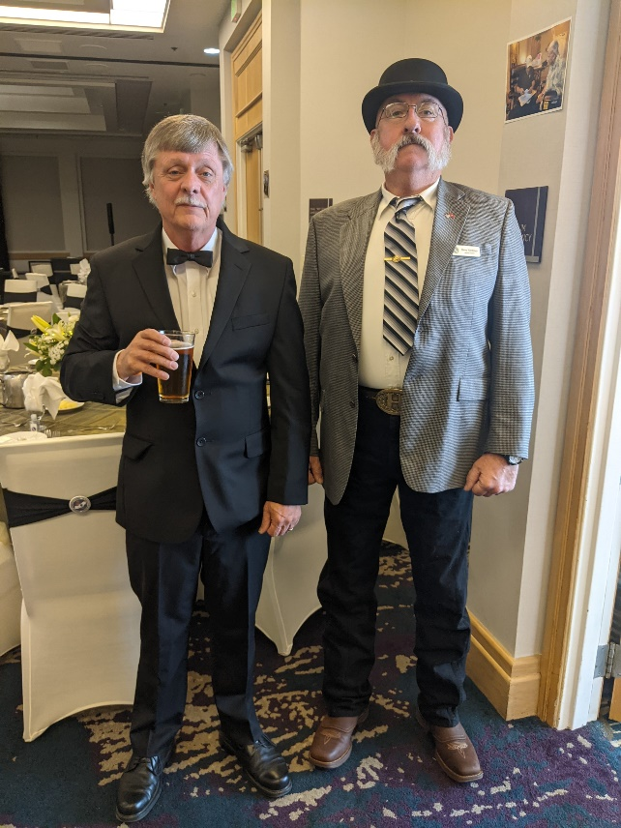
California Association of County Veterans Service Officers
The CACVSO celebrated our 75th anniversary!

Slide 13
In Conclusion…
The Siskiyou County Veterans Service Office in partnership with the California Association of County Veterans Service Officers is dedicated to assisting our fellow veterans and their dependents to obtain the benefits that the veteran earned by serving his or her country.
Our motto is “Veterans Serving Veterans”.
I’d like to extend an invitation to our County Supervisors to drop by my office for a short tour.

Slide 14
Questions?

