Slide 1
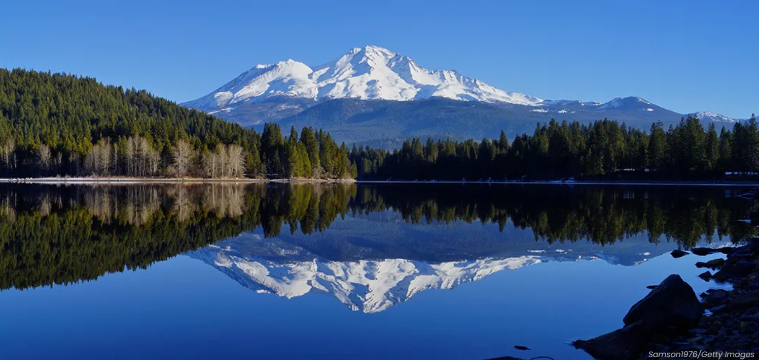
FEMA Map Discussion Topics
Flood Study Overview
Revised Products
Flood Insurance Impacts
Public Messaging
Questions &
Answers

Slide 2
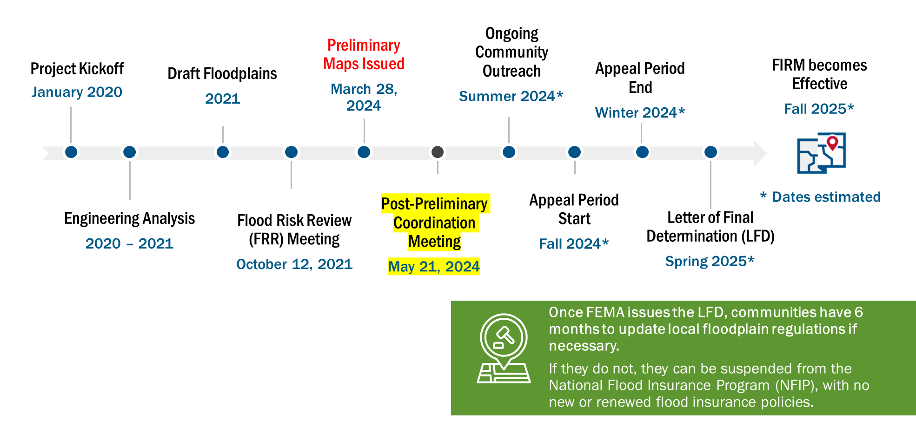
Timeline to Final Flood Insurance Rate Map (FIRM) Revision

Slide 3
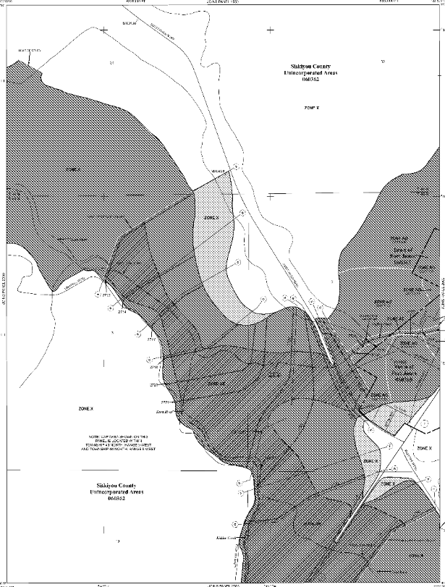
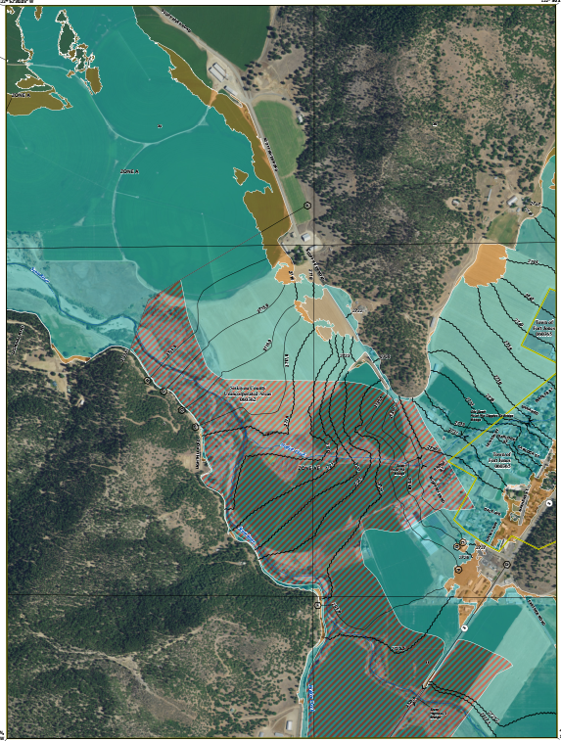
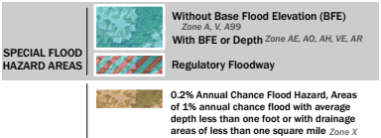
Study Results – Proposed Changes to the Map.
Effective FIRM Panel 1/19/2011
Preliminary FIRM Panel
3/28/2024

Slide 4
Determining Flood Risk
Flood Insurance Rate Map
High Risk – Zone AE or Zone A
Moderate Risk – Shaded Zone X
Low Risk – Unshaded Zone X
Key Takeaway:
Where it can rain, it can flood
Notes:
Stantec?

Slide 5
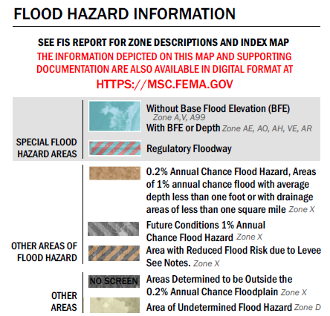
High Risk - Zone AE and Zone A

Slide 6
Moderate Risk - Shaded Zone X

Slide 7
Low Risk - Unshaded Zone X
No mandatory flood insurance purchase requirements, but…
Experience has taught us that flooding happens here and flood insurance is often a good investment.

Slide 8
Flood Insurance Basics
Mandatory flood insurance purchase in mapped 1% annual chance (100-year) floodplain (Zone AE and Zone A including floodway areas) for structure with federally insured mortgage.
No mandatory flood insurance purchase in 0.2% annual chance floodplain or unshaded Zone X areas.
Potential Flood Insurance Savings
Preferred Risk Policies (PRPs)
Grandfathering of flood insurance rates

Slide 9
Flood Insurance Options
If 12/3/2020 Maps Show (comparison to 2011 FIRM) | These Insurance Requirements, Options, and Savings Apply
Change from low or moderate risk to high risk | Flood insurance may be mandatory. Flood insurance will be federally required for most mortgage holders. Insurance costs may rise to reflect the high risk.
Change from high risk to low or moderate risk | Flood insurance is optional, but recommended. The risk of damage and loss is less but not removed. Flood insurance can still be obtained, at lower rates. 20-25% of all flood insurance claims come from low-to moderate-risk areas. Conversion offers savings. An existing policy can be converted to a lower-cost Preferred Risk Policy.
No change in risk level | No change in insurance requirements. Property owners should talk to their insurance agent to learn their specific risk and take steps to protect their property and assets.

Slide 10
Why Are Some Flood Zones Changing?
New technologies allow us to better determine flood prone areas and predict the extent of future events.
Updated flood hazard information helps inform decisions to allow your community to be built safer and stronger.
Over time, flood risk changes due to land use and natural forces.
Flood zones are changing to more accurately reflect the current flood hazards in the Scott River Valley.

Slide 11
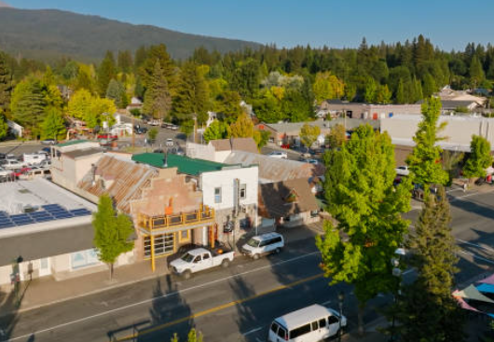
But It’s Never Flooded at my House?
FEMA maps the areas affected by the 1-percent-annual chance flood (meaning the flood with a 1% or greater chance of occurring in any given year). Bigger floods happen every year.
Nearly 25% of flood insurance claims in the US are from outside mapped high-risk areas.
If a property owner wishes to dispute their flood zone designation, new data or technical information can be submitted as part of a Letter of Map Amendment (LOMA) or Letter of Map Revision (LOMR) request.
680+ Siskiyou County Stock Photos, Pictures & Royalty-Free Images - iStock (istockphoto.com)

Slide 12
Mapping Team Contacts
Kuen Tsay
FEMA Region IX Engineer
(202) 717-1837
kuen.tsay@fema.dhs.gov
Questions?

