Slide 1
Siskiyou County University of California Cooperative Extension Office
Helping Agriculture, Natural Resources, and Youth in Siskiyou County
Rob Wilson
Siskiyou UCCE Director
Intermountain REC Director
2023

Slide 2
UC Cooperative Extension in Siskiyou County Leveraging the Power of the UC System
University of California Agriculture and Natural Resources brings the power of UC research in agriculture, natural resources, nutrition, and 4-H youth development to Siskiyou County
Our county-based advisors and campus-based specialists work as teams to bring practical science-based information to help Siskiyou residents
We are problem solvers, catalysts, collaborators, educators, and residents in the communities we serve.

Slide 3
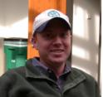
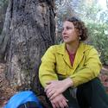
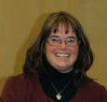
Organization Chart for Yreka Farm Advisor Office
Rob Wilson,
County Director
Grace Woodmansee
Livestock & Natural
Resources Advisor
Siskiyou County
Farm Advisor
Under new recruitment
Siskiyou County
Lenya Quinn-
Davidson
Area Fire Advisor
Humboldt, Trinity,
Mendocino, Siskiyou
Jacki Zediker
4-H Community Ed
Supervisor Region 2
(Lassen, Modoc,
Plumas/Sierra, Siskiyou)
4-H Community Education Specialist
Under new recruitment
Siskiyou County
Forest/Natural Resources Advisor
Shasta, Trinity, Siskiyou
Samantha Clawson
Cooperative Extension
Coordinator,
Siskiyou County
Economic Development Advisor
Under new recruitment
Siskiyou County

Slide 4
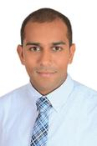
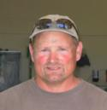
Organization Chart for Tulelake Farm Advisor Office
Rob Wilson,
County Director
Farm Advisor
Darrin Culp,
IREC Center
Superintendent
of Agriculture
Ahmed Kayad,
Siskiyou UCCE &
IREC Agricultural
Engineer Advisor
Robert Carver,
IREC Senior Farm
Machinery Mechanic
Thomas Tappan,
IREC Farm
Machinery Mechanic
Shanna Renner,
IREC Business
Office Manager
Courtney Brown,
Siskiyou UCCE
Office Assistant
Jake Walden,
IREC Ag. Technician I
Kevin Nicholson,
IREC Staff
Research Associate II

Slide 5
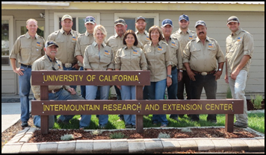
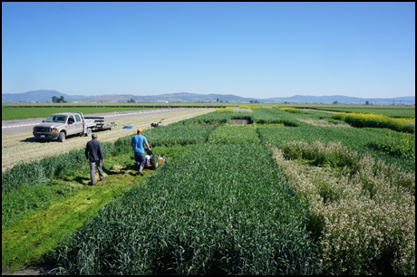
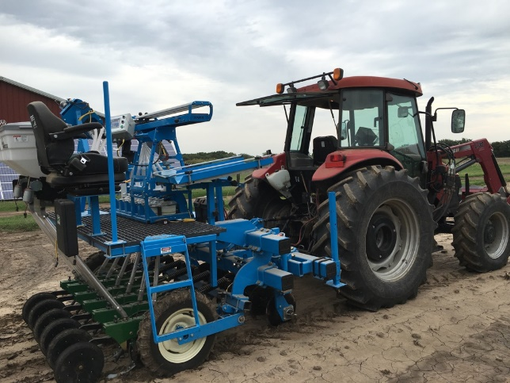
Intermountain REC
What We Do - Address critical issues in Northeast California related to food and natural resources
Focus on solving local problems and adapting technologies to the unique climate and conditions of the region
Who We Are - regional leader in field research linked to vegetables, grain, forages, and specialty crops
Facilities & Services
Tulelake Farm Advisor office
Multi-purpose lab and conference facility
140 acre research farm with specialized research equipment and staff
Partnership with Ag. industry and local growers

Slide 6
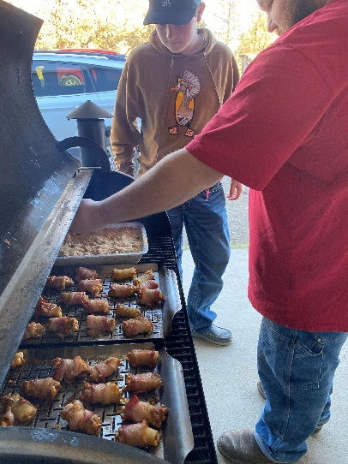
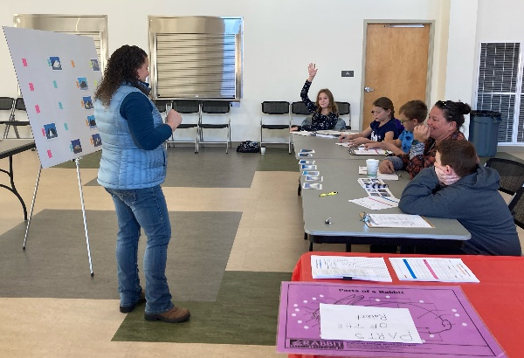
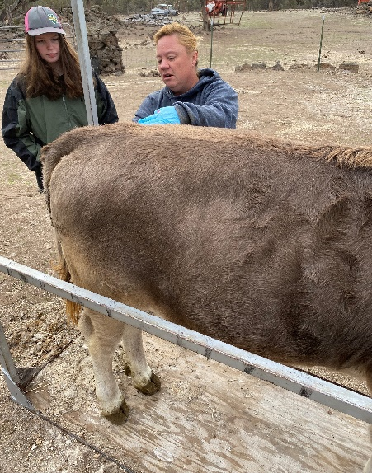
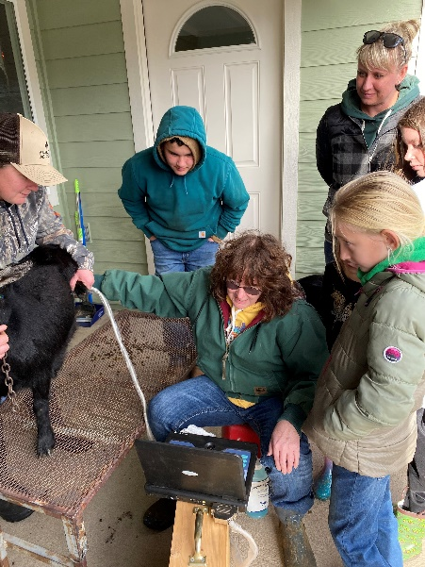
Siskiyou County 4-H Youth Development Program
Community Club Program:
9 Community Club Programs
49 Adult Volunteer Leaders
233 Youth Members
36 Different Projects Delivered

Slide 7
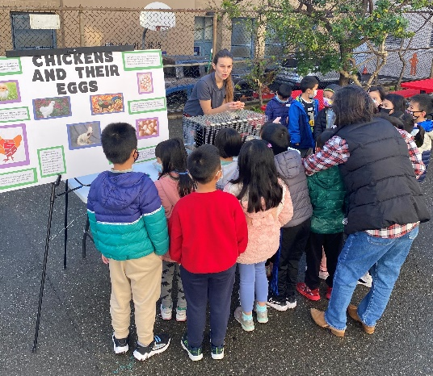
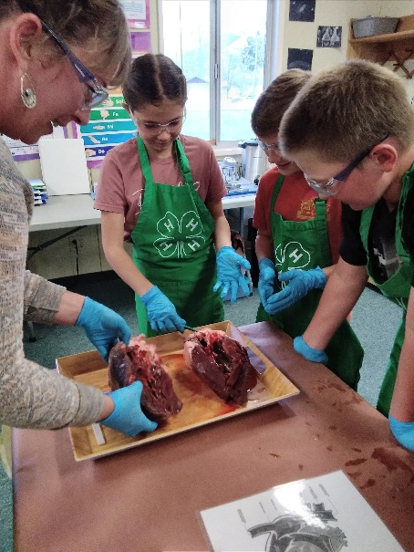
Siskiyou County 4-H Youth Development Program
Additional Program Delivery:
Afterschool Program, SAFE collaboration (166 Youth, 6 Sites)
Spring Break Day Camp, SAFE collaboration (64 youth)
School Enrichment Programs: In school science labs and Agricultural Awareness Day (359 youth)
Statewide Virtual Projects: Robotics (6 youth)

Slide 8
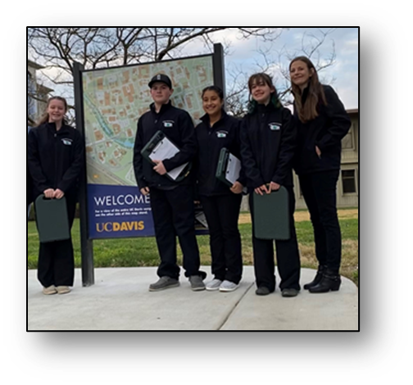
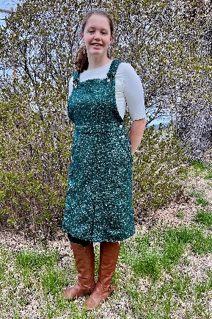
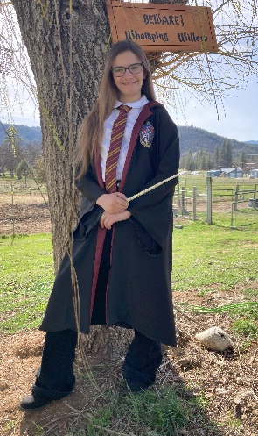
Siskiyou County 4-H Youth Development Program
4-H Member State Achievements:
Veterinary Science Contest, UC Davis- High Point 4-H Team, 1,2,5,6 Individual placings
State Fashion Revue, 5 youth competed - 3 State Winners, 2 Gold Awards
State Interview Contest, 3 youth competed,- 1 Gold Award
State Robotics Contest, 1 youth competed- 1 Gold Award
State Presentation Day, 3 youth participants- 1 Platinum(perfect Score), 2 Gold Awards

Slide 9
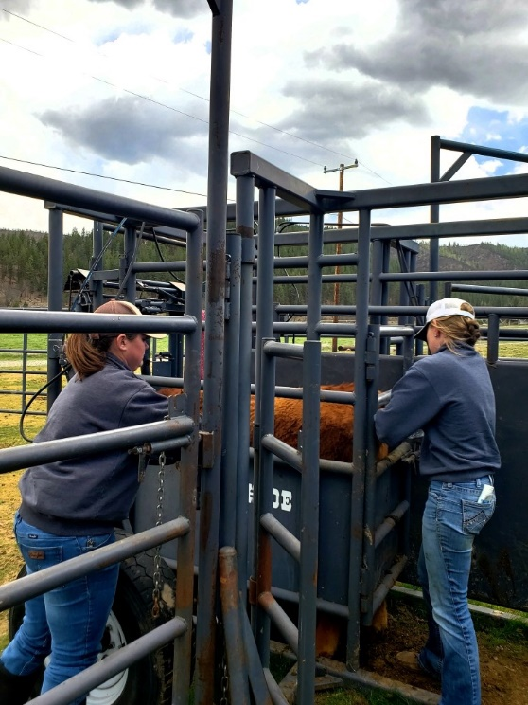
Livestock and Natural Resources Program
Advisor Grace Woodmansee
Goal: address production challenges with science-based outreach, education, and region-specific research conducted in collaboration with the ranching community.
Outreach
Education
Research

Slide 10
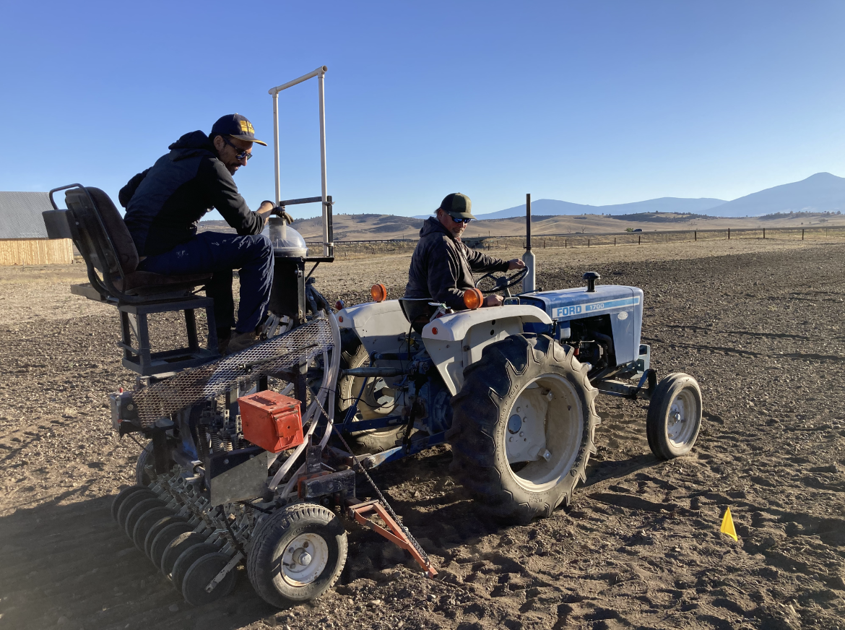
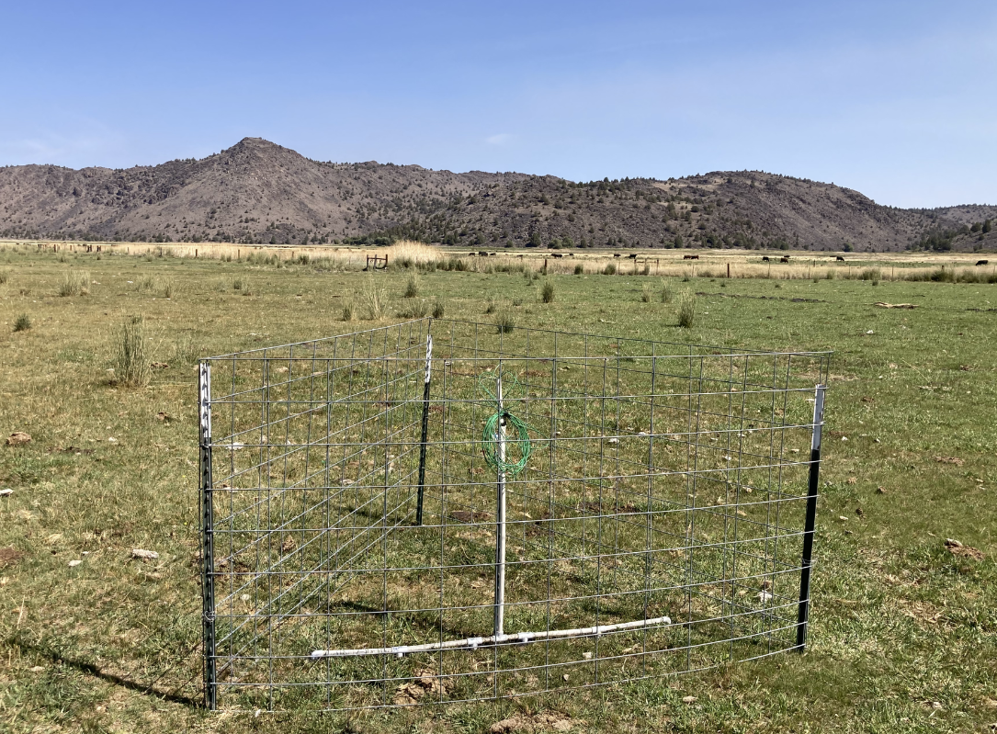
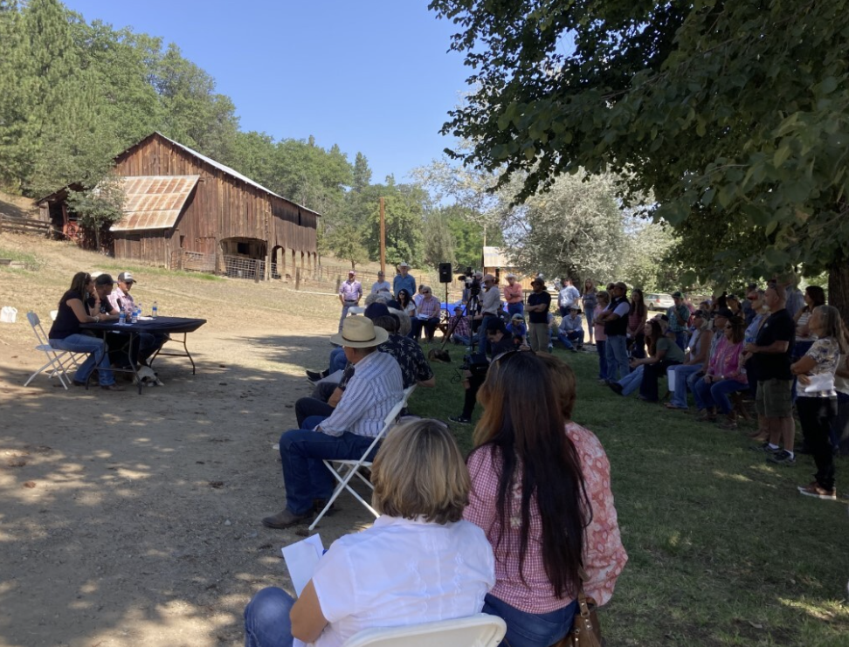
Livestock and Natural Resources Program
Key program themes:
Drought adaptation & resilience to limited water resources
Perennial grass variety trial
Tulelake, Shasta Valley, Scott Valley
Soil moisture monitoring for wildflood pastures research
Ranch management
Beef cattle herd health spring webinar series
Direct-to-consumer ranching operation research
Wildfire preparedness: Livestock Pass Program
Key outreach and extension events:
Annual Cattlemen’s Tour
2021: Stockmanship workshop, ~100 attendees
2022: DTC business planning, ~200 attendees
2023: Post-fire grazing on public lands, TBD
Annual Winter Animal Health Meeting
Research Updates

Slide 11
Wildfire preparedness: Siskiyou County Livestock Pass Program
Goal: identify commercial livestock operators (>50 head) to emergency responders so that access to care for livestock sheltering in place may be granted safely and efficiently.
Value= Established Process & Relationships
89 ranchers enrolled representing 55 operations throughout Siskiyou County
3 trainings held
4 ranchers requested to use their Pass in 2022 and all did so successfully
The Siskiyou County Livestock Pass program is the first in the state to include the USFS as a formal partner

