Slide 1
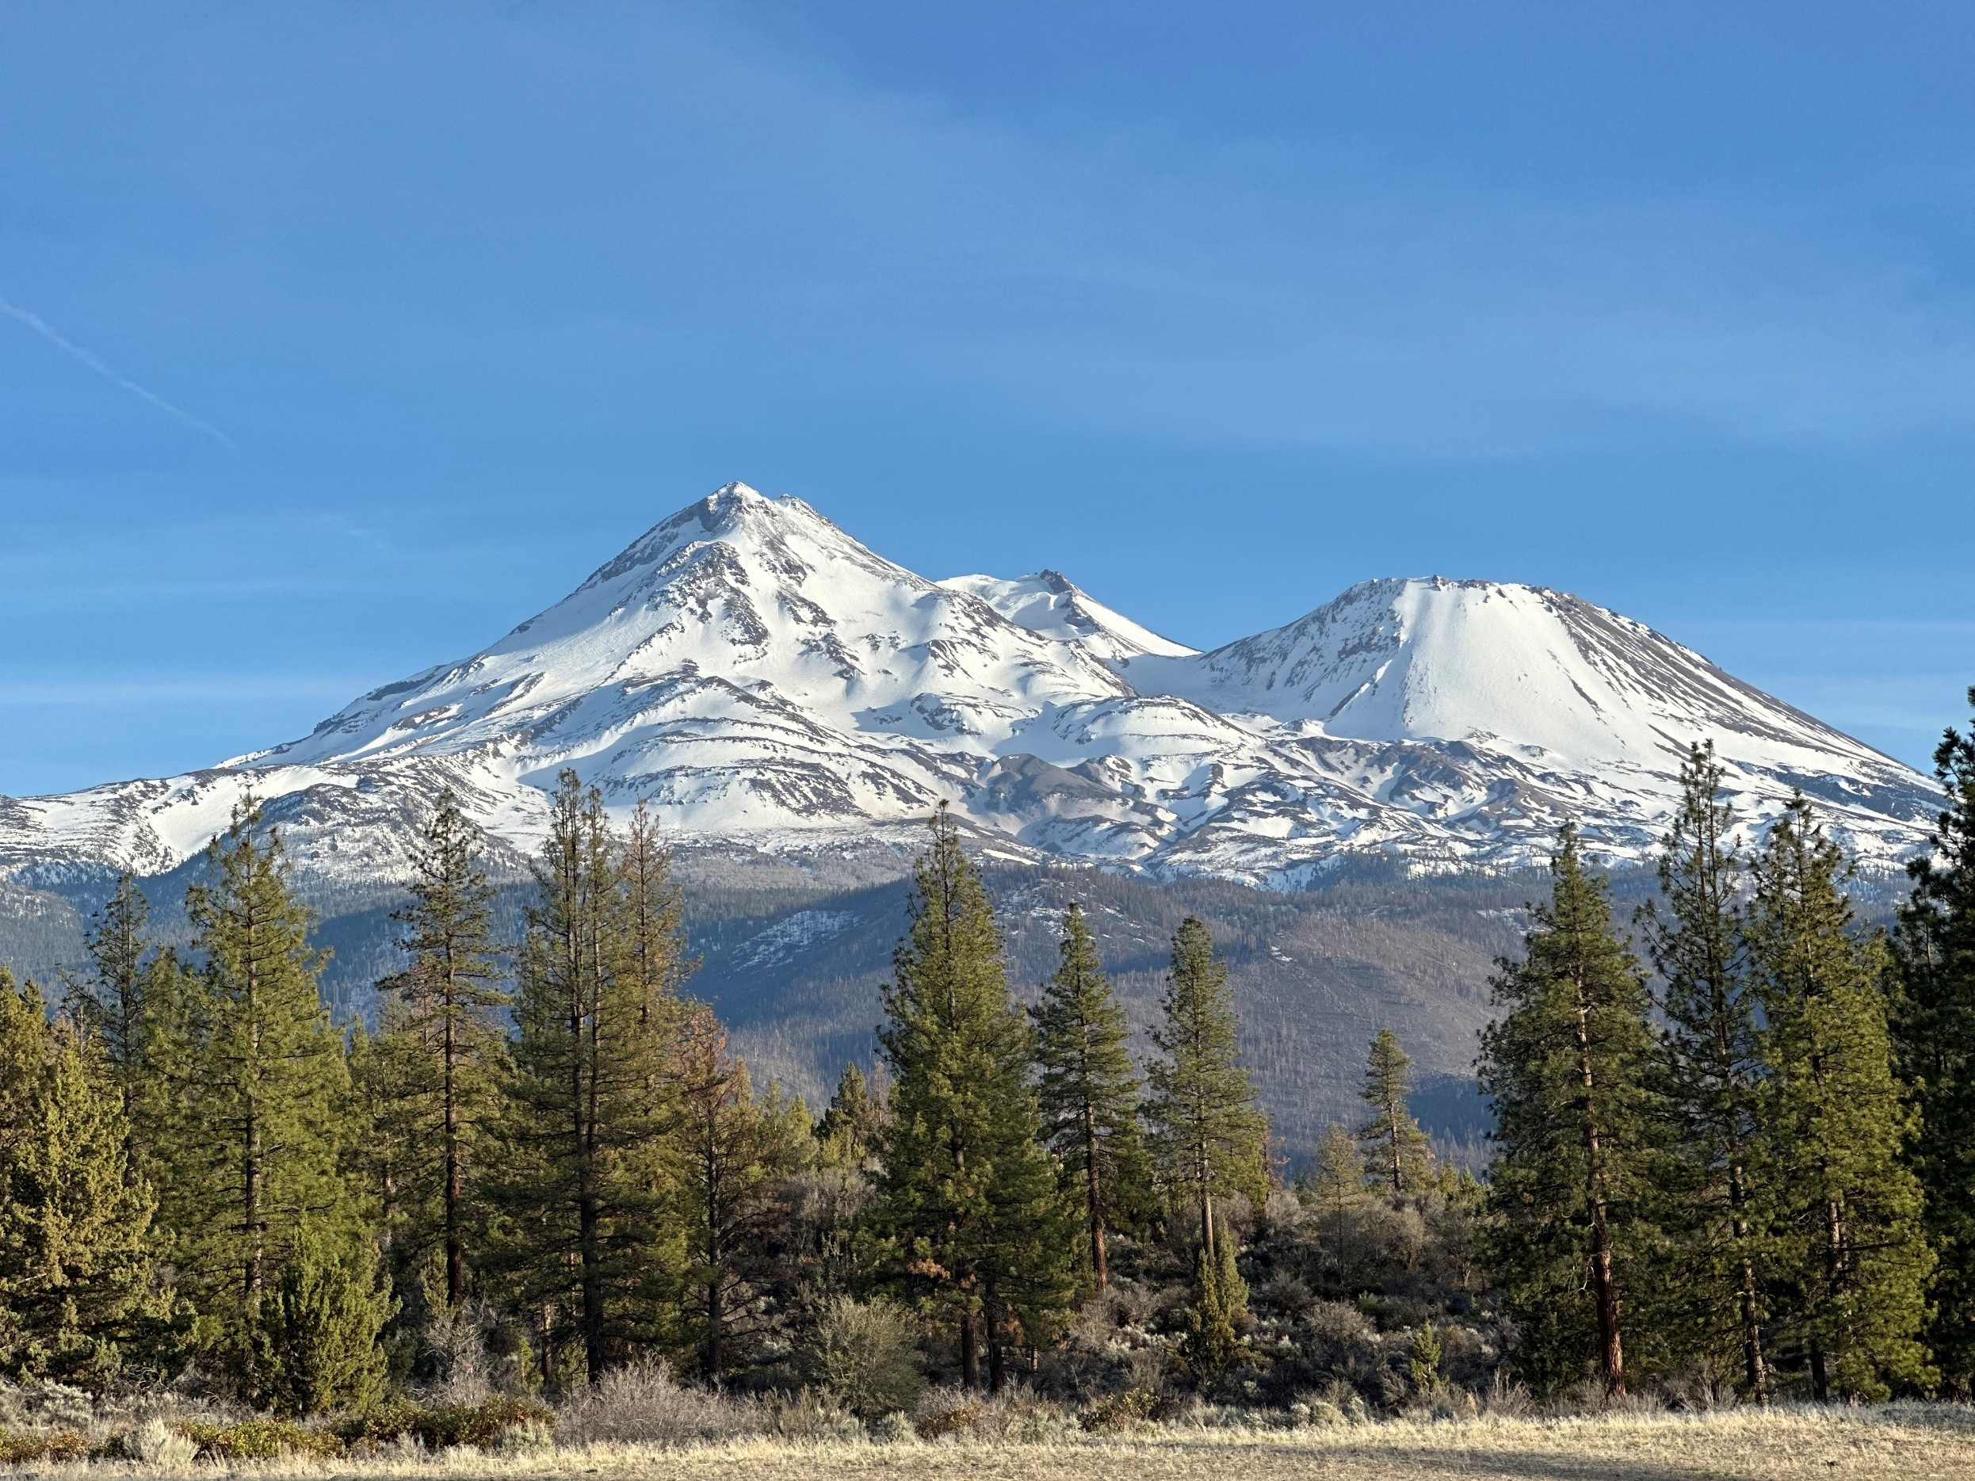
Strategic Planning for Managing Groundwater Siskiyou County Groundwater Sustainability Agency
Board of Supervisors Meeting
June 6, 2023

Slide 2
Agenda
Recap Previous Session, including Goals and Strategies
Introduce and Discuss Proposed Near- and Long-Term Tactics
Receive additional feedback on the Draft Strategy Document
Strategic Planning for Managing Groundwater
Siskiyou County GSA Board Workshop
2

Slide 3
Summarizing Work To-Date
At the February 7 District Board of Directors meeting, we:
Reviewed the results of the SWOT analysis.
Refined the Vision Statement.
Refined the Decision-Making, Funds and Resources, and Communications and Engagement Goals and Strategies.
Following that meeting, we:
Shared the SWOT analysis, Vision Statement, Goals, and Strategies with the Scott Valley, Butte Valley, and Shasta Valley Groundwater Advisory Committee meetings and solicited their input on Tactics.
Drafted tactics which we’ll present toady.
Strategic Planning for Managing Groundwater
Siskiyou County GSA Board Workshop
3

Slide 4
Strategy Document Elements
The Strategy Document is guided by a Vision Statement and organized by three Goals, with corresponding Strategies and Tactics:
Vision Statement - a description of the region’s future end state that will result from proactive, strategic activities
Goal - the desired end state of activities; foundation of planning process, supports the overall vision
Strategy - a general approach or method for achieving a goal
Tactic - a specific action that will be taken to fulfill a strategy
Strategic Planning for Managing Groundwater
Siskiyou County GSA Board Workshop
4
Notes:
EF
Vision Statement
Goal: answers the question of “what”
Strategy: answers the question of “how” in general terms
Tactic: answers the question of “how” in specific terms

Slide 5
Summarizing Work To-Date
To put you back in the mindset…
The Vision Statement reads:
The Siskiyou County GSA will collaboratively work towards effective groundwater management to achieve and maintain the sustainability of the Shasta Valley, Butte Valley, and Scott Valley Basins, consistent with SGMA and the near- and long-term goals defined in the GSPs, with fair consideration given to all beneficial groundwater users.
And the Goals and Strategies are shown on the next slides.
Strategic Planning for Managing Groundwater
Siskiyou County GSA Board Workshop
5

Slide 6
Decision-Making Goals and Strategies
Goal | Clarify GSA decision-making roles and responsibilities and the decision-making support processes that inform GSP implementation.
Strategy 1 | Better define the decision-making roles and responsibilities of GSA Board members, GSA staff, and Advisory Committee members and identify where additional staffing resources may be needed.
Strategy 2 | Establish regular communications and strengthen partnerships and projects with public agencies and basin stakeholders.
Strategic Planning for Managing Groundwater
Siskiyou County GSA Board Workshop
6

Slide 7
Funds and Resources Goals and Strategies
Goal | Develop and implement a sustainable funding and resourcing strategy for GSP implementation and GSA administration that minimizes impacts to residents and ensures adequate GSA staff resourcing to effectively implement the GSPs.
Strategy 1 | Catalog short- and long-term GSP implementation and administration costs, determine what additional funding and staff resources may be needed, and identify how those remaining costs will be covered, with a priority on minimizing impacts to residents and identifying sustainable funding sources.
Strategy 2 | Secure grant and other external funding sources to support groundwater sustainability efforts within and across the basins.
Strategic Planning for Managing Groundwater
Siskiyou County GSA Board Workshop
7

Slide 8
Communications and Engagement Goals and Strategies
Goal | Demonstrate the value of SGMA, the GSA, and GSP implementation to the public through regular engagement, education, and communication activities related to GSP implementation.
Strategy 1 | Increase transparency and the accessibility of data and information to the public (e.g., on the GSA website) so that groundwater users in the basin can clearly understand the status of the basin and monitoring efforts.
Strategy 2 | Increase education and engagement of stakeholders and other interested parties on GSP implementation activities, with a focus on communicating information related to projects and management actions and GSP funding and fees.
Strategic Planning for Managing Groundwater
Siskiyou County GSA Board Workshop
8

Slide 9
Proposed Tactics and Actions
Near-term tactics are envisioned to occur in the next year.
Long-term tactics respond to challenges that may require more time or resources to mobilize and are envisioned for implementation by the GSP updates in 2027.
We have outlined two near- and two long-term tactics for each of the three themes.
Strategic Planning for Managing Groundwater
Siskiyou County GSA Board Workshop
9

Slide 10
Near-Term Decision-Making Tactics
Tactic 1 | Develop a document that outlines the roles and responsibilities of GSA Staff, Board members, and Advisory Committee members and the process for making decisions and recommendations during GSP implementation.
Tactic 2 | Establish regular communications with agencies and organizations to outline shared goals and identify opportunities for collaboration on GSP implementation. This may include the development of coordination of agreements such as Memoranda of Understanding with Tribes.
Board Discussion Questions Do you agree or disagree with these tactics? Anything to augment or amend?
Strategic Planning for Managing Groundwater
Siskiyou County GSA Board Workshop
10
Notes:
Reminder – goal here is to clarify GSA decision-making roles and responsibilities and the decision-making support processes that inform GSP implementation.
Tactic 1 - In addition to supporting the GSA and staff, this document would also be used as a tool to onboard new Advisory Committee members.

Slide 11
Long-Term Decision-Making Tactics
Tactic 3 | Collaborate with other agencies and organizations on improvements to the groundwater monitoring network and on pursuit and implementation of multi-benefit projects.
Tactic 4 | Identify gaps in staff resources and capacity and secure additional personnel to assist the GSA with GSP implementation activities.
Board Discussion Questions Do you agree or disagree with these tactics? Anything to augment or amend? What other near- or long-term decision-making tactics should be considered?
Strategic Planning for Managing Groundwater
Siskiyou County GSA Board Workshop
11

Slide 12
Near-Term Funds and Resources Tactics
Tactic 1 | Conduct an evaluation of fee/rate options for GSP implementation.
Tactic 2 | Develop a process for tracking and sharing updates on funding pursuits for groundwater-related projects undertaken by other agencies and organizations.
Board Discussion Questions Do you agree or disagree with these tactics? Anything to augment or amend?
Strategic Planning for Managing Groundwater
Siskiyou County GSA Board Workshop
12

Slide 13
Long-Term Funds and Resources Tactics
Tactic 3 | Develop a long-term staffing plan for identifying, prioritizing, applying for, and managing grants. This may include leveraging resources across other County departments with similar grant management needs.
Tactic 4 | Develop a rate and fee schedule to fund GSP implementation and GSA administration costs.
Board Discussion Questions Do you agree or disagree with these tactics? Anything to augment or amend? What other near- or long-term funds and resources tactics should be considered?
Strategic Planning for Managing Groundwater
Siskiyou County GSA Board Workshop
13

Slide 14
Near-Term Communications and Engagement Tactics
Tactic 1 | Update the Communications and Engagement Plan for GSP implementation, including an outlined schedule of activities and milestones through 2025.
Tactic 2 | Update the GSA website to improve navigability and maintain regular (at least quarterly) updates.
Board Discussion Questions Do you agree or disagree with these tactics? Anything to augment or amend?
Strategic Planning for Managing Groundwater
Siskiyou County GSA Board Workshop
14

Slide 15
Long-Term Communications and Engagement Tactics
Tactic 3 | Improve the public accessibility of groundwater monitoring data for sustainable management criteria.
Tactic 4 | Conduct public workshops and educational events to proactively communicate anticipated GSP funding and fees and incorporate community input into the fee options and resourcing strategy.
Board Discussion Questions Do you agree or disagree with these tactics? Anything to augment or amend? What other near- or long-term communications and engagement tactics should be considered?
Strategic Planning for Managing Groundwater
Siskiyou County GSA Board Workshop
15

Slide 16
Near-Term Tactics
In the next year:
Develop a document that outlines the roles and responsibilities of GSA Staff, Board members, and Advisory Committee members
Establish regular communications (e.g., coordination agreements) with agencies and orgs to outline shared goals and identify opportunities for collaboration on GSP implementation
Conduct an evaluation of fee/rate options for GSP implementation
Develop a process for tracking and sharing updates on groundwater-related projects undertaken by other agencies
Update the C&E Plan for GSP implementation, including an outlined schedule of activities through 2025
Update the GSA website to improve navigability and maintain regular (at least quarterly) updates
Strategic Planning for Managing Groundwater
Siskiyou County GSA Board Workshop
16

Slide 17
Long-Term Tactics
In the next 5 years:
Collaborate with other agencies on improvements to the monitoring network and on multi-benefit projects
Identify gaps in staff resources secure additional personnel to assist the GSA with GSP implementation activities
Develop a long-term staffing plan for identifying, prioritizing, applying for, and managing grants
Develop a rate and fee schedule to fund GSP implementation and GSA administration costs
Improve the public accessibility of groundwater monitoring data for sustainable management criteria
Conduct public workshops and educational events to proactively communicate anticipated GSP funding and fees and incorporate community input into the fee options and resourcing strategy
Strategic Planning for Managing Groundwater
Siskiyou County GSA Board Workshop
17

Slide 18
Additional Comments
Other high-level thoughts, reflections, things we may have missed?
Strategic Planning for Managing Groundwater
Siskiyou County GSA Board Workshop
18

Slide 19
Next Steps
Make requested changes to the Strategy Document and bring it back to seek approval at a future Board meeting
Thank you for your participation!
You may contact Emily Finnegan with follow-up questions:
Emily.Finnegan@stantec.com
Strategic Planning for Managing Groundwater
Siskiyou County GSA Board Workshop
19

