Slide 2
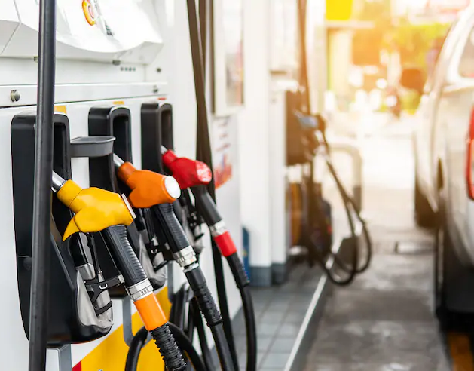
4 Issues with the Gas Tax
1. FUEL EFFICIENCY GAINS Gas-powered vehicles are becoming more fuel efficient, so owners are buying less gas and government receives less fuel tax.
2. INCREASE IN ZERO EMISSION VEHICLES Vehicles that do not use gas, such as electric vehicles, do not pay any fuel taxes.
3. INFLATION AND LOSS OF PURCHASE POWER Ongoing inflation reduces how much a static gas tax can purchase. In addition, highway construction costs typically increase faster than overall inflation.
4. UNEVEN FUEL TAX BURDEN Newer and more expensive vehicles tend to be more fuel efficient. Owners of older, less fuel-efficient vehicles pay more to use the road. The fuel tax burden is uneven and inequitable.

Slide 3
What is a Road Charge?
Road Charge is an innovative funding mechanism intended to replace the current gas tax, and more accurately ensures that all drivers are paying their fair share to use the road. Road Charge allows drivers to support local road and highway maintenance based on how many miles they drive, instead of how many gallons of gas they use.
California is studying Road Charge as:
A replacement for the gas tax
One per mile rate for all passenger vehicles
Revenue neutral, not a tax increase
Aims to stabilize funding, not change behavior
No change in how funding is spent: existing formulas and programs remain

Slide 4
What drivers pay under the Gas Tax

Slide 5
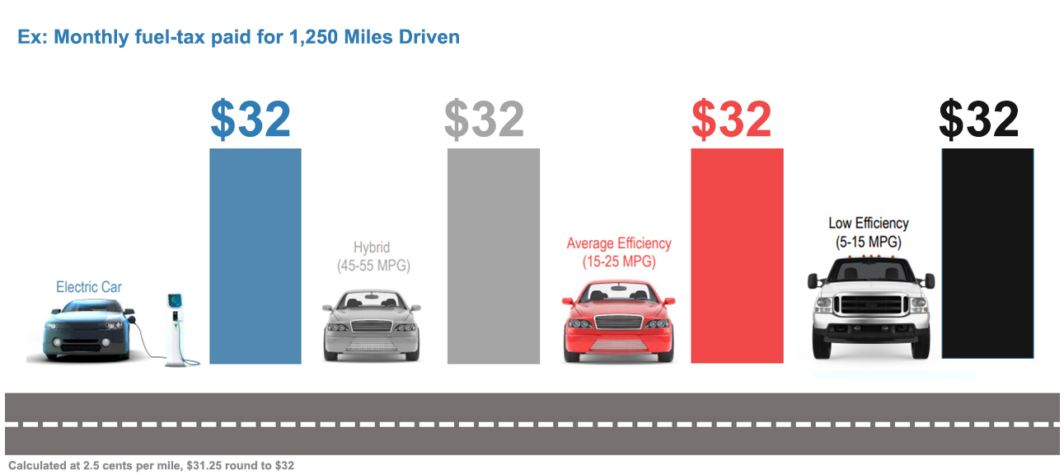
What drivers pay under Road Charge

Slide 6
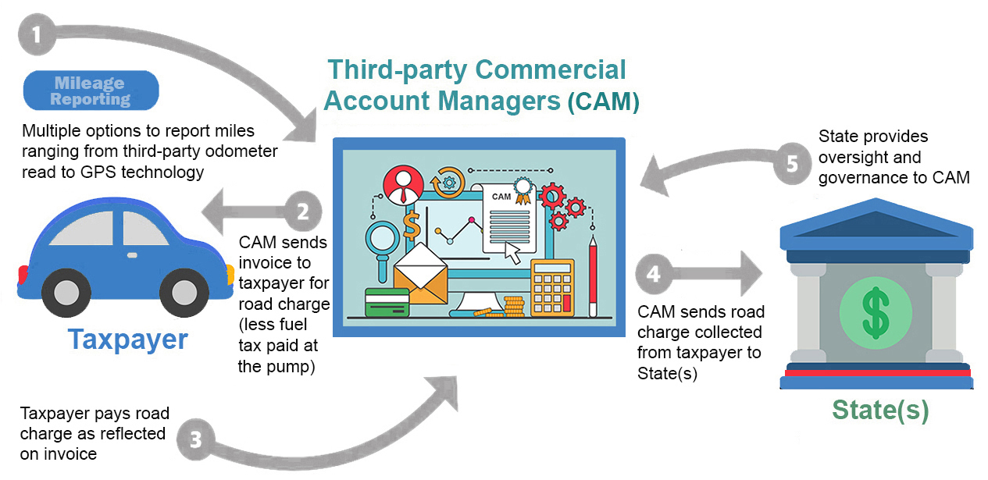
Road Charge System Structure

Slide 7
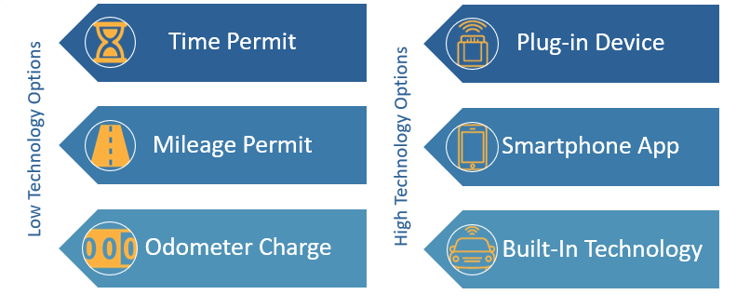
Mileage Reporting Methods

Slide 8
The National Picture

Slide 9
Public/Private Roads Project
The project is the first in the nation specifically focused on engaging rural and tribal communities to understand their concerns and priorities for a road charge system.
This project will explore the ability of current GPS technology to differentiate between public and private roads in a road charge system.
Live in March 2023.

Slide 10
Help us recruit!
Sign up to participate at www.caroadcharge/engage/contact-us/
Spread the word about participating in our upcoming pilot and earning up to $250
Community Group Meetings

Slide 11
Questions?
Lauren Prehoda Road Charge Program Manager, Caltrans lauren.prehoda@dot.ca.gov 916-654-4227
www.caroadcharge.com

