Slide 1
Williamson Act Guidelines Overview
Siskiyou County Community Development Department
Planning Division
August 2, 2022

Slide 2
Williamson Act Guidelines Overview
Voluntary program, minimum term is 10 years
Preserves agricultural and open space land
Approximately 10% of private land in Siskiyou County is under Williamson Act
Agricultural Preserve must consist of no less than 100 acres (must contain at least 40 acres of Class 1 or 2 soils)
Williamson Act Contract is a legal document that obligates the property owner, and any successors of interest, to the contract’s enforceable restrictions

Slide 3
Williamson Act Guidelines Overview
Local governments are required to establish their own rules and regulations regarding implementation of the Act within their jurisdiction. These rules include but are not limited to:
  Enrollment guidelines
  Acreage minimums
  Enforcement procedures
  Allowable uses
  Compatible uses
Guidelines for Siskiyou County have relatively remained unchanged.
The defined agricultural uses, compatible uses, and other Williamson Act criteria have not been updated since 2011.
The guidelines do not have clear definitions of uses or terminology.

Slide 4
Williamson Act Process Overview
Submit and fill out application to establish a new preserve
Parcel size, zoning criteria, and land-use criteria must be met
Must conduct uses defined in ‘Agricultural Production Uses’
‘Compatible Uses’ allowed but are taxed at normal rate
‘Change in Use’ must be processed as a contact recission and reentry
If requirements are no longer being met, landowners have 60 days to remedy contract violation
Modification and/or division of land requires an application to rescind and reenter

Slide 5
Sale of Property
Real Estate Transfer Disclosure Statement (Civil Code § 1102.6a)
New Contract Requirement

Slide 6
Monitoring and Compliance
Annual Reporting
Compliance Monitoring
  Surveys
Enforcement
  County may non-renew the contract in accordance with Government Code.
  County may seek a breach of contract in accordance with the Government Code.
  County may file an action in Superior Court of the County for the purpose of compelling compliance or restraining breach thereof.

Slide 7
Termination of Williamson Act Contracts
Non-Renewal
Cancellation

Slide 8
APA 22-02 Timeline
Code Enforcement Case
Discussion with property owners on options
BOS meeting June 14th for contract amendment, Continued for further discussion

Slide 9
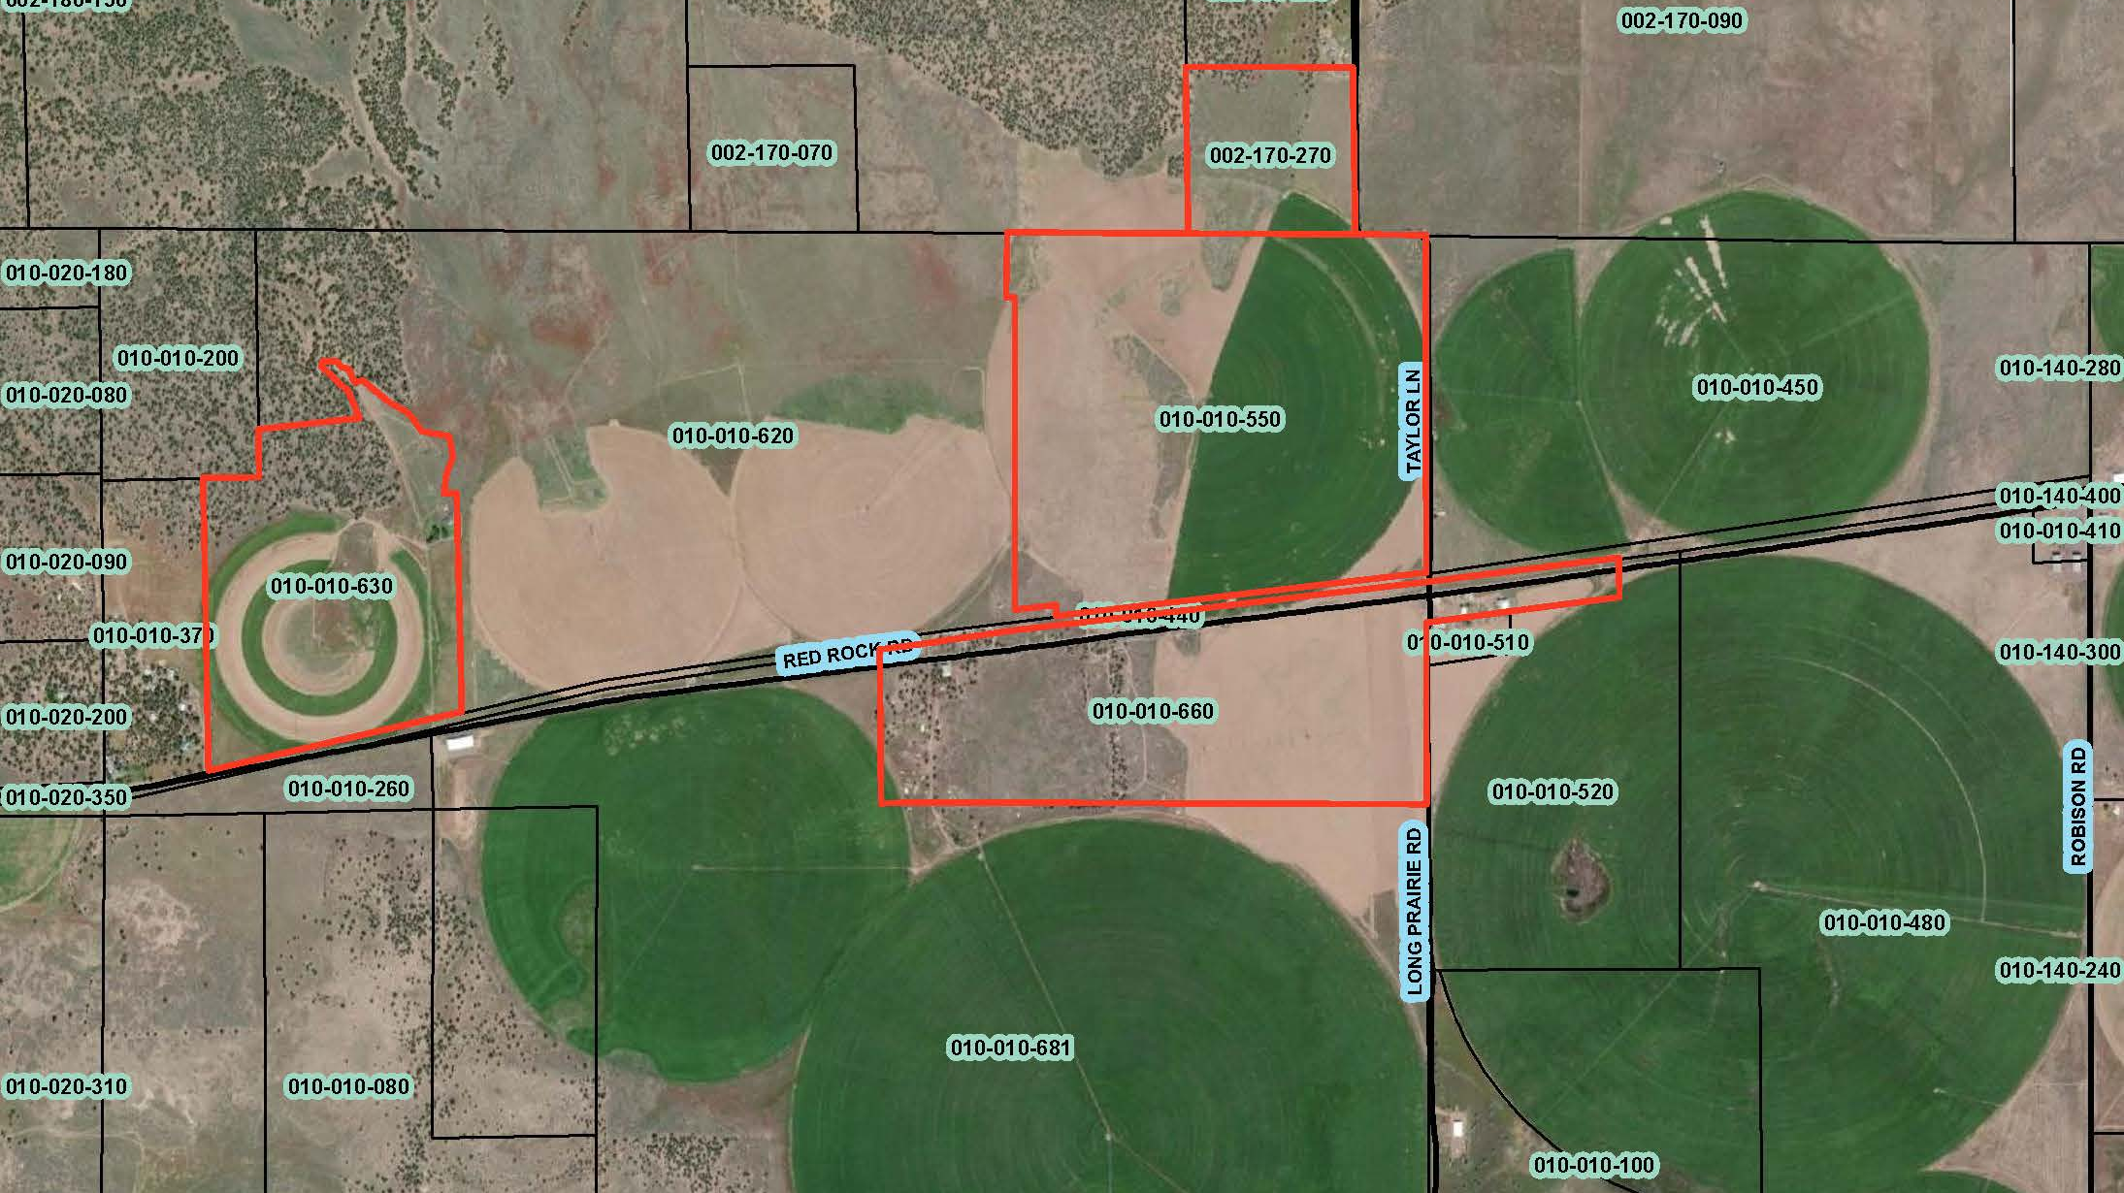
Business Location
Subject Property

Slide 10
Options for APA 22-02 Compliance
Option #1
Rezone a portion of property (approximately 5 acres) where the processing site is from AG-1 to AG-2.
Option #2
Relocate the business to an area on their property which is zoned AG-2.
Divide 40-acres containing this AG-2 area from the existing parcel.
Obtain a Use Permit to allow their business on this 40-acres.
Cancel the Williamson Act Contract on these 40-acres.
Divide 40 acres containing the business from the existing parcel.
Obtain a Use Permit to allow for a wood processing facility and bulk storage at the existing site.
Cancel the Williamson Act Contract on these 40 acres.

Slide 11
Options for APA 22-02 Compliance
Option #3
Cancel the contract for the entire parcel on which the business is located
Option #4
Cancel the contract for the entire parcel on which the business is located
Rezone the area where the business is located from AG-1 to AG-2
Obtain a Use Permit.
Relocate the business to an area on their property which is zoned AG-2.
Obtain a Use Permit.

Slide 12
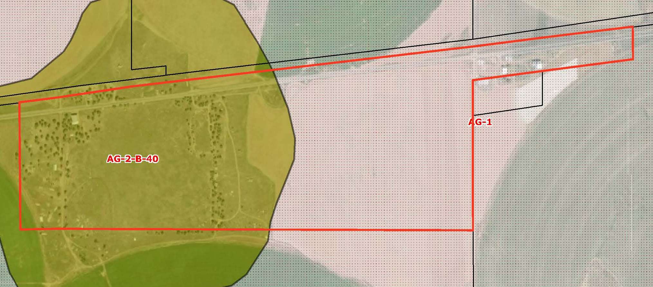
Option #2 or #4
Location within AG-2
Option #1 or #3
Area to rezone to AG-2

Slide 13
Addition of Compatible Use to County Rules
The County could consider the addition of Compatible Use #14 to the local Rules which would allow for the processing of agricultural commodities that have been produced off-site. For Example -
14. The processing and storage of Agricultural Commodities that have been grown or produced off site. Any area dedicated to this use shall be limited to 5% of the legal parcel size, not to exceed 5-acres. This use shall not create any significant traffic impacts that affect contracted parcels. All uses that apply to this rule will require a compatibility review by the Agricultural Preserve Administrator prior to the establishment of the use on contracted land.

Slide 14
Potential Pathways
Continue the public hearing to give the property owners the opportunity to return the property to compliance with County Code and the Rules for the Establishment and Administration of Agricultural Preserves and Williamson Act Contracts.
Direct staff to update the Williamson Act Guidelines to better define agricultural uses and compatible uses.

