Slide 1
Rural County Representatives of California
Patrick Blacklock
RCRC President and CEO

Slide 2
RCRC Strategic Plan
Equitable Access
Broadband
Housing
Health Services
Vision
RCRC is the premier advocate and innovative service provider for rural counties in California
Impactful Advocacy
State & Federal Advocacy
Innovative Approaches
Regulatory Engagement
Healthy Communities
Forest Resiliency & Wildfire
Water Resiliency
Infrastructure & Economic Development
Operational Excellence
Human Resources
Member Services
Communication
Corporate Administration
Fiscal Health
Technology

Slide 3
State & Federal Advocacy
Impactful Advocacy
State Policy Areas
Forest Health/Wildfire
CARE Court
Water/drought
Broadband
Housing
Energy
Social Services
California Public Utilities Commission (CPUC)
Federal Policy Areas
Forest Health/Wildfire
Water/Drought
Infrastructure
Farm Bill
Ad Hoc Committees
Drought and Water Resiliency
Wildfire and Forest Stewardship
Cannabis Regulation

Slide 4
Golden State Finance Authority (GSFA) &
National Homebuyers Fund (NHF)
Equitable Access
Since 1993 In Siskiyou County
NEW
Assist-to-Own
Program
145 individuals or families purchased a home through GSFA and 12 through NHF
Date of Activity | County of Employment | Purchase Location | Pending or Closed*
9/30/2022 | Santa Barbara | Santa Maria | Pending
9/28/2022 | Imperial | Imperial | Pending
9/23/2022 | Tulare | Visalia | Closed
9/22/2022 | Monterey | Madera | Pending
9/19/2022 | Monterey | Soledad | Closed
8/25/2022 | Solano | Auburn | Closed
8/19/2022 | Glenn | Orland | Closed
8/5/2022 | Inyo | Bishop | Closed
7/21/2022 | Colusa | Yuba City | Closed
7/14/2022 | Tulare | Porterville | Closed
6/14/2022 | Mendocino | Willits | Closed
5/31/2022 | Mendocino | Willits | Closed
5/10/2022 | Imperial | Imperial | Closed
Over $378K in down payment assistance through GSFA and $82K through NHF
*Pending: Applicant has locked in an interest rate through the program and is awaiting loan closure
Closed: Applicant has successfully completed escrow and purchased or refinanced a home utilizing the program

Slide 5
GSCA
Equitable Access
DEL NORTE
SISKIYOU
MODOC
Network Design w/GSCA
Submitted for Other Projects
Possible November Submittal
No LATA Projects Identified
84 applications submitted (Total $37.0M)
More than half of total applications are from GSCA member counties/cities/towns
35 applicants will participate w/ GSCA (Approx. $17M)
28 Member Counties
7 Cities/Towns
TRINITY
SHASTA
LASSEN
HUMBOLDT
TEHAMA
PLUMAS
MENDOCINO
GLENN
BUTTE
SIERRA
COLUSA
YUBA
NEVADA
LAKE
SUTTER
PLACER
SONOMA
NAPA
YOLO
EL DORADO
ALPINE
AMADOR
SOLANO
CALAVERAS
TUOLUMNE
MONO
MARIPOSA
MERCED
MADERA
SAN
BENITO
TULARE
INYO
MONTEREY
SAN LUIS OBISPO
SANTA BARBARA
IMPERIAL
www.goldenstateconnect.org

Slide 6
EDA PLANNING GRANT
PROVIDES FUNDING FOR: BROADBAND STRATEGIC PLANS & TWO CEDS (COLUSA & MONO/INYO/ALPINE) RCRC MEMBER COUNTIES PARTICIPATING IN EDA GRANT (SUBMITTED SEPT 2021) BROADBAND STRATEGIC PLANS IN PLACE OR IN PROGRESS
DEL NORTE
SISKIYOU
MODOC
HUMBOLDT
TRINITY
SHASTA
LASSEN
TEHAMA
PLUMAS
MENDOCINO
GLENN
BUTTE
SIERRA
COLUSA
YUBA
NEVADA
LAKE
SUTTER
PLACER
SONOMA
YOLO
EL DORADO
ALPINE
NAPA
AMADOR
CALAVERAS
MONO
TUOLUMNE
MARIPOSA
MERCED
MADERA
SAN
BENITO
TULARE
INYO
MONTEREY
SAN LUIS OBISPO
IMPERIAL

Slide 7
ZEV Initiative
Healthy Communities
DEL NORTE
SISKIYOU
MODOC
Zero Emission Vehicles (ZEV)
RCRC assisting counties with ZEV permit streamlining
Primary Reasons for Yellow or Red
No Start in Process
Ordinance not Passed
“Checklist” not Complete
All Complete, but not registered by GoBiz
SHASTA
Complete
HUMBOLDT
TRINITY
LASSEN
Close
TEHAMA
PLUMAS
Incomplete
MENDOCINO
GLENN
BUTTE
SIERRA
COLUSA
YUBA
NEVADA
LAKE
SUTTER
PLACER
SONOMA
NAPA
YOLO
EL DORADO
ALPINE
AMADOR
MONO
SOLANO
CALAVERAS
TUOLUMNE
MARIPOSA
MERCED
MADERA
SAN
BENITO
TULARE
INYO
MONTEREY
Three Phases of RCRC’s ZEV effort
Streamlining
Readiness
Implementation
SAN LUIS OBISPO
SANTA BARBARA
Note: County color labels reflect unincorporated county only, not cities/towns.
IMPERIAL

Slide 8
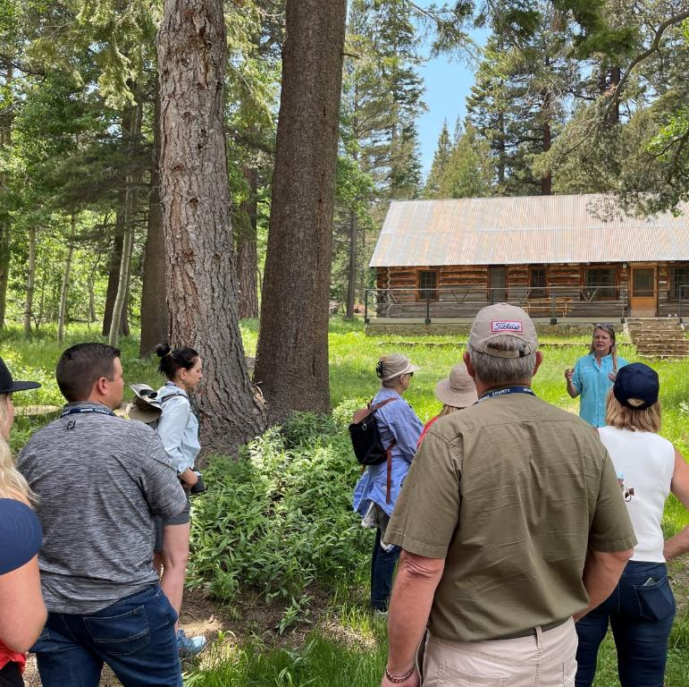
RAI
Impactful Advocacy
Rural Alliance, Inc. (RAI)
RCRC non-profit affiliate entity
RAI facilitates academic research and educational opportunities that advance understanding of rural California amongst policymakers and the public.
Currently developing:
Business Plan
Policy and Priority Areas for 2023 Research and Educational Tours

Slide 9
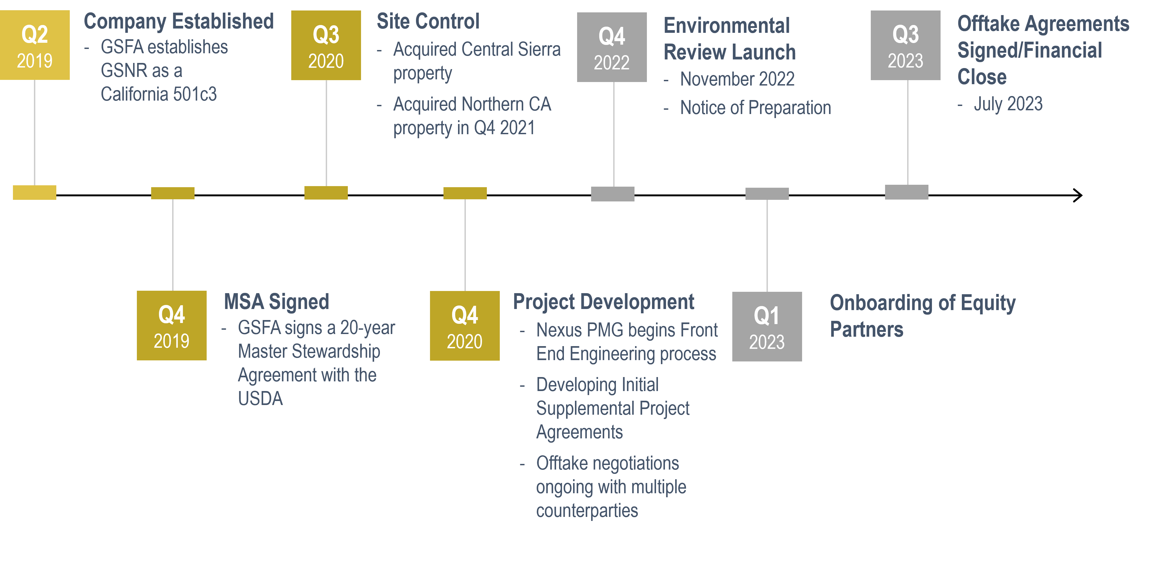
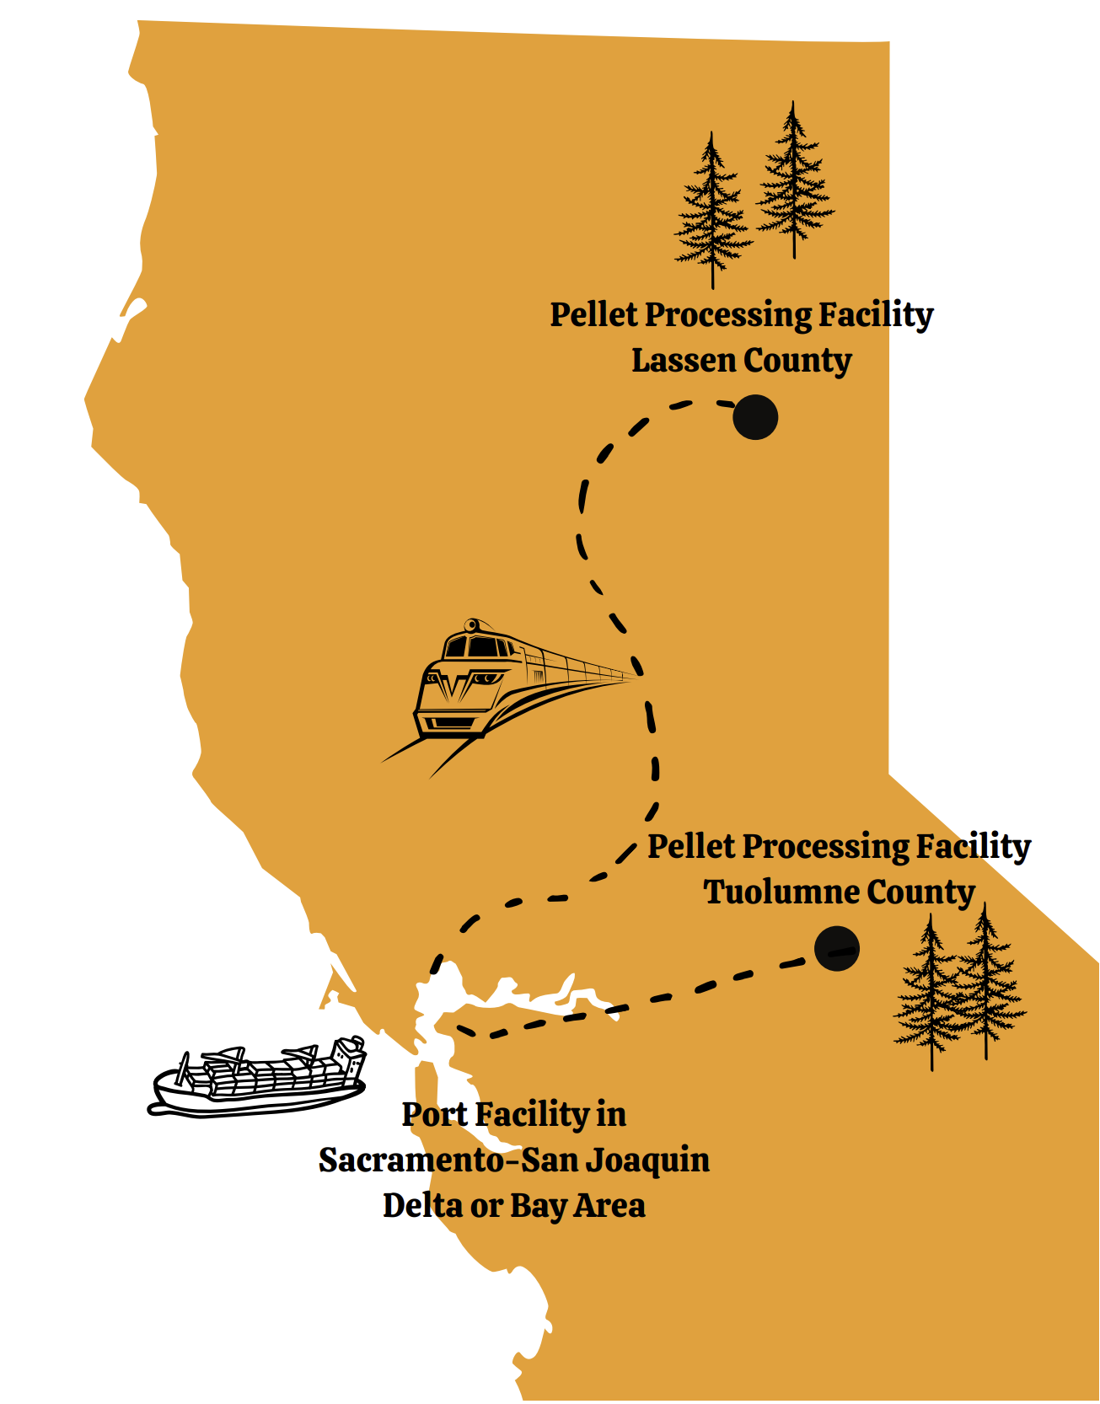
Golden state natural resources
GSNR is a 501c3 public benefit corp. focused on forest resiliency and rural economic development.
GSNR Timeline
Mission:
To enhance the quality of life, safety, and the environment in California – creating fire resilient landscapes and fire adaptive communities.

Slide 10
ESJPA
ESJPA
Operational Excellence
A local government agency comprised of 26 rural member counties,
Formed in 1993 to assist members in complying with regulatory requirements and waste diversion goals.
Provides regulatory advocacy and technical assistance, supports local public education campaigns and administers grants for recycling and hazardous waste management programs.
DEL NORTE
SISKIYOU
MODOC
TRINITY
SHASTA
LASSEN
TEHAMA
PLUMAS
GLENN
BUTTE
SIERRA
COLUSA
NEVADA
LAKE
EL DORADO
ALPINE
AMADOR
MONO
SOLANO
CALAVERAS
TUOLUMNE
MARIPOSA
MADERA
INYO
SAN LUIS OBISPO
IMPERIAL

Slide 11
QUESTIONS?
Keep Up with RCRC:
WEBSITE: www.rcrcnet.org
SIGN UP FOR THE BARBED WIRE NEWSLETTER
FOLLOW US ON SOCIAL MEDIA:
RCRC
1215 K St., Suite 1650
Sacramento, CA 95814
(916) 447-4806
@ruralcounties
@ca_ruralcounties
@RuralCounties

