Slide 1
Goodwin Zone Change (Z-21-02) and Use Permit(UP-21-06)
Siskiyou County Planning Commission Meeting
November 1, 2022

Slide 2
Project Summary
A Zone Change to rezone APN 013-120-230 from Prime Agricultural (AG-1) to Light Industrial (M-M) and rezone 013-120-330 from Prime Agricultural (AG-1) to Heavy Industrial (M-H).
A Use Permit to develop a concrete and asphalt recycling facility on the property and to expand an existing gravel parking lot.

Slide 3
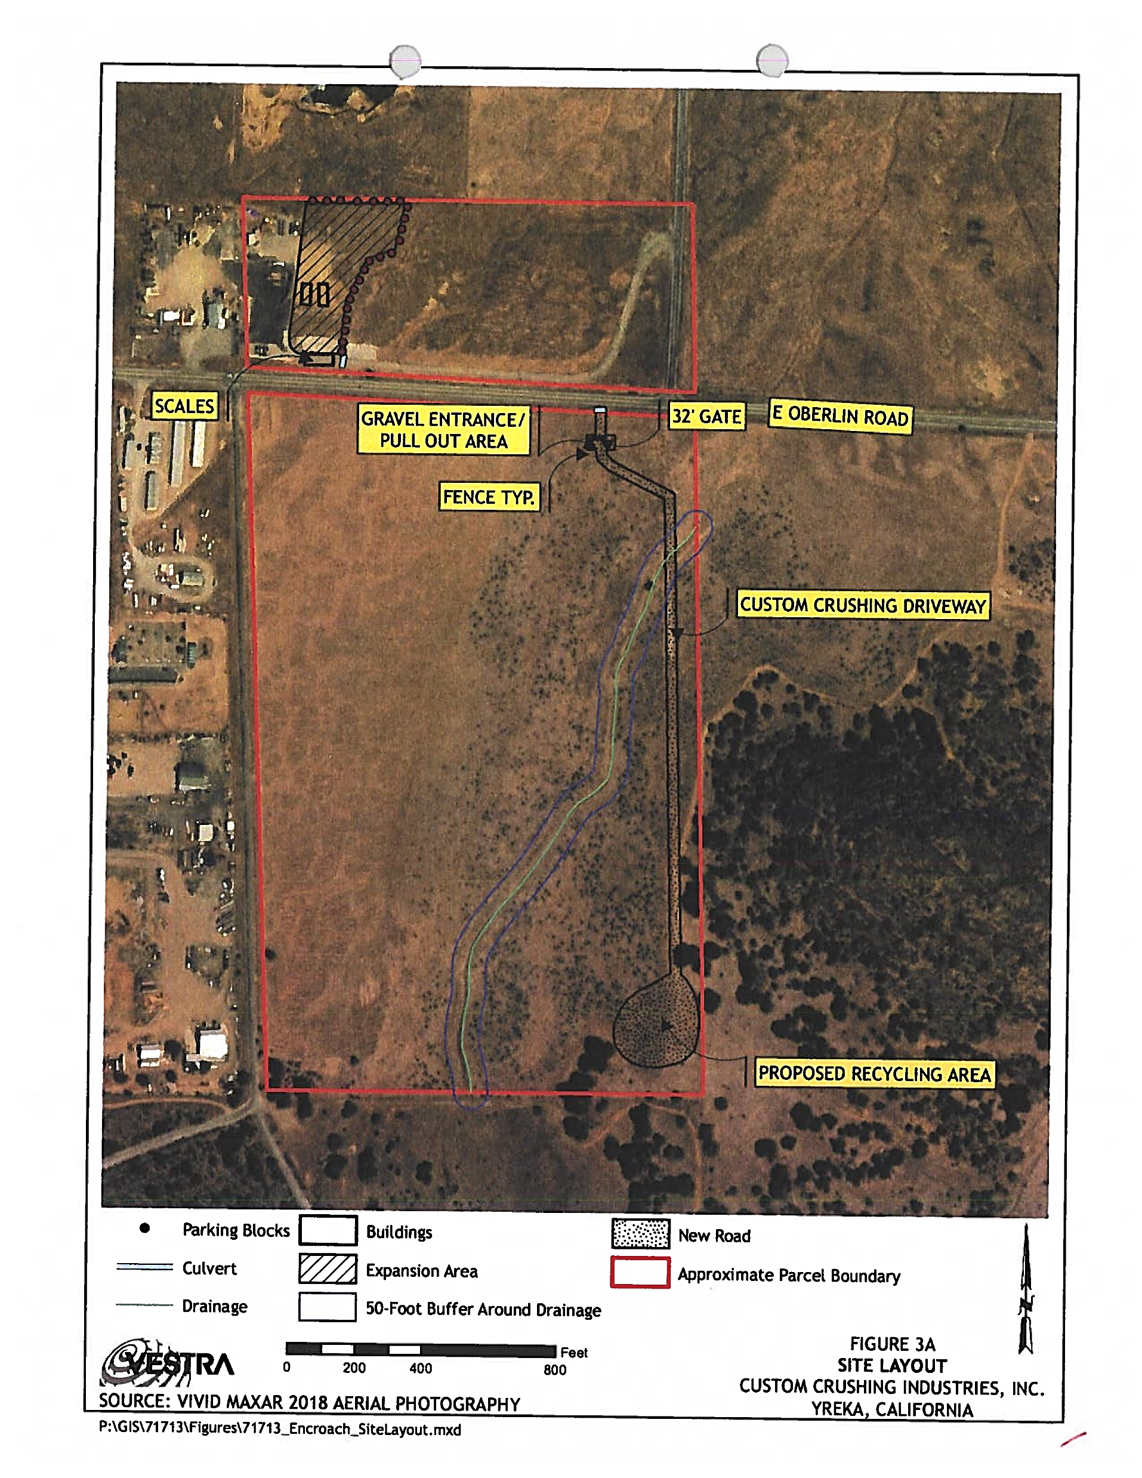
Project Location

Slide 4
General Plan and Zoning Consistency
Policy #39 outlines the process for confirming that soils are in fact not suited for the Prime Agricultural zoning district. The following items may be needed when determining soil suitability:
Submission of a soils test prepared by a California Certified Soil Scientist.
Submission of well logs that specifically demonstrate there is not enough water available for irrigation purposes.
A letter from the applicable irrigation district stating that they will not and cannot provide water.
Any other factual, documented information that the area is not and has not been capable of supplying enough water for irrigation.
If an on-site field inspection by the Planning Department reveals that the land is not prime agricultural land, the data itemized in a, b, c, and d above may not be required, i.e., obvious mapping errors.
Submission of past financial records or statements that the agricultural operation is not economically feasible are not in any way considered to be adequate proof that the land is not prime.

Slide 5
California Environmental Quality Act (CEQA)
CEQA is intended to inform government decisionmakers and the public about the potential environmental effects of proposed activities and to prevent significant, avoidable environmental damage
CEQA seeks to accomplish the five major objectives below:
Disclose Environmental Impacts
Prevent or Reduce Environmental Damage
Disclose Agency Decisions
Promote Interagency Coordination
Encourage Public Participation
The process is intended to be objective
The process uses factual, scientific, reputable data

Slide 6
Initial Study/Mitigated Negative Declaration (IS/MND) Mitigation Measures
Biological Resources
Have a substantial adverse effect, either directly or through habitat modifications, on any species identified as a candidate, sensitive, or special status species in local or regional plans, policies, or regulations, or by the California Department of Fish and Wildlife, U.S. Fish and Wildlife Service, or NOAA Fisheries?
Mitigation Measures BIO-1, BIO-2 (Nesting Birds) and BIO-2 (Rare Plant Survey)
Cultural Resources
Cause a substantial adverse change in the significance of a historical resource pursuant to in §15064.5?
Cause a substantial adverse change in the significance of an archaeological resource pursuant to §15064.5?
Disturb any human remains, including those interred outside of dedicated cemeteries?
Mitigation Measure CR-1

Slide 7
Agency Comments
California Department of Fish and Wildlife (CDFW)
Siskiyou County Public Works

Slide 8
Public Comments
Zoning Consistency
Dust/Air Pollution
Noise

Slide 9
Recommendation
Approve
Conditionally approve the proposed Use Permit based on the recommended findings and subject to the recommended conditions of approval; and
Recommend
Recommend the Board of Supervisors approve the Zone Change request based on the recommended findings and subject to the recommended conditions of approval; and
Recommend
Recommend the Board of Supervisors approve the Mitigated Negative Declaration (MND) in accordance with Sections 15074 of the CEQA Guidelines.

