Slide 1
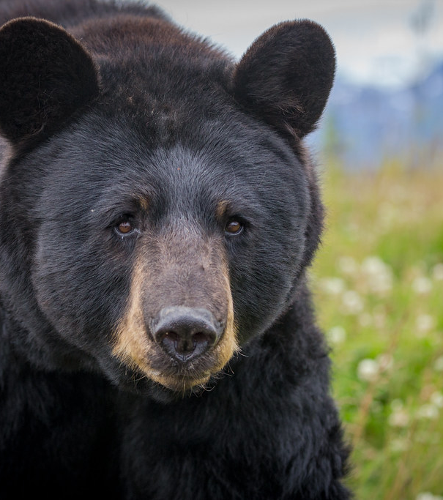
California State Black Bear Policy 2022
Presented by Axel Hunnicutt, Siskiyou Unit Biologist, CDFW
To Siskiyou County Board of Supervisors
May XX, 2022
This Photo by Unknown Author is licensed under CC BY-NC
Notes:
Intro of new policy

Slide 2
Core Focus of the Policy
Public Safety
Depredation (Property Damage)
Conflict
Animal Welfare
Notes:
Focus of the policy.
*Does not focus on population management, hunting regulations, ect., as such that will not be discussed today.

Slide 3
Department Response
Public Safety
Depredation (Property Damage)
Conflict
Notes:
Only these three “Require” a department response. LED will respond to public safety incidents and respond appropriately.
For non-public safety incidents, wildlife management staff will respond accordingly within 48 hours to assess what additional steps need to be taken.

Slide 4
Public Safety Bear Response
Protection of human life is paramount
Lethal action by law enforcement
If a PSB cannot be located immediately an ICS will be established for the duration of the incident until threat is removed
Extenuating circumstances
Notes:
PSB - A bear demonstrating aggressive action that has resulted in physical contact with a human; or a bear exhibiting an immediate threat to public health and safety, given the totality of the circumstances. Immediate threat refers to a bear that exhibits one or more aggressive behaviors directed toward a person that is not reasonably believed to be due to the presence of responders. Public safety includes situations where a bear remains a threat despite efforts to allow or encourage it through active means to leave the area
The department responds to these incidents with the utmost seriousness, protection of human life is CDFW’s foremost consideration
CDFW LED and LEOs from any law enforcement agency can take lethal action at any time if they deem a bear a public safety threat
If a public safety bear cannot be immediately located and euthanized by LEOs, then an incident command system will be established
Circumstances where evidence indicates the initial attack was unprovoked or another attack is unlikely, then the AC and RM may recommend to the Response Guidance Team that the bear is no longer a safety threat

Slide 5
Depredation Bears
This Photo by Unknown Author is licensed under CC BY-NC
Notes:
Dep. Bear - A bear that is threatening to, damaging, or destroying property for which a revocable depredation permit has been requested and can be issued in accordance with the Fish and Game Code.

Slide 6
Depredation Bear Response
Depredation permits issued for property damage
FGC section 4181 and regulations (Cal. Code Regs., tit. 14, § 401)
Application by landowner or tenant
Implementation of corrective measures
Determination of efforts used to prevent lethal measures
Decision Authority: Environmental Program Manager or Regional Manager
Notes:
Dep. Bear - A bear that is threatening to, damaging, or destroying property for which a revocable depredation permit has been requested and can be issued in accordance with the Fish and Game Code.
FGC 4181 provide for issuance of a revocable depredation permit to landowners or tenant who experience property damage by bears, as determined by CDFW.
This permit may be issued by CDFW after application from an owner or tenant of land or property, but only once satisfactory evidence of damage or destruction is presented.
Permit shall contain information of why it was necessary, what efforts were made to solve the problem without lethal measures, and the corrective actions that should be implemented to prevent further occurrence.
*CDFW will determine whether any efforts have been made to solve the problem without lethal action….if not, then CDFW will work with the applicant to propose non-lethal measures first as an alternative
Decision Authority: previously this was largely at the discretion of the unit biologist, this will not be at the discretion and decision of the EPM or RM
*Taking in the act – FGC section 4181.1(a) allows for owner or livestock or employee of that owner to immediately take a bear encountered in the act of, inflicting injury to, molesting or killing livestock if the taking is reported to CDFW no later than the next working day and the carcass is made available.

Slide 7
Conflict Bears
“No harm/No Foul” Bear
This Photo by Unknown Author is licensed under CC BY-NC
Notes:
Conflict Bear: A bear that requires action by the Department or the public due to its behavior or its situation. Included in this category are No Harm/No Foul bears, habituated bears, and animal welfare bears. Implicit in this definition is that a range of types of Conflict Bears creates a range of possible management actions
No Harm/No Foul Bear: A bear that has strayed into an area where an incident could occur, has not engaged in nuisance activity or caused property damage, and may require assistance to return to nearby suitable habitat

Slide 8
Conflict Bears
Encourage to return to suitable habitat
Relocation may be necessary
Capture or chemical immobilization
DNA samples taken
Ear tags applied
“Do Not Consume” tags
Decision Authority: Regional Manager
“No harm/No Foul” Bear
Notes:
Try to get bear to return to habitat, leave conflict area, remove attractants, hazing may be necessary
Relocation may be best situation in some circumstances, return to suitable bear habitat
Trapping/capture or CI used then we will:
Collect DNA samples of animal
Mark with unique ear tags
Mark with “DNC” tags if 2 weeks prior or during general/archery season
Decision to trap/capture or relocate made by the RM

Slide 9
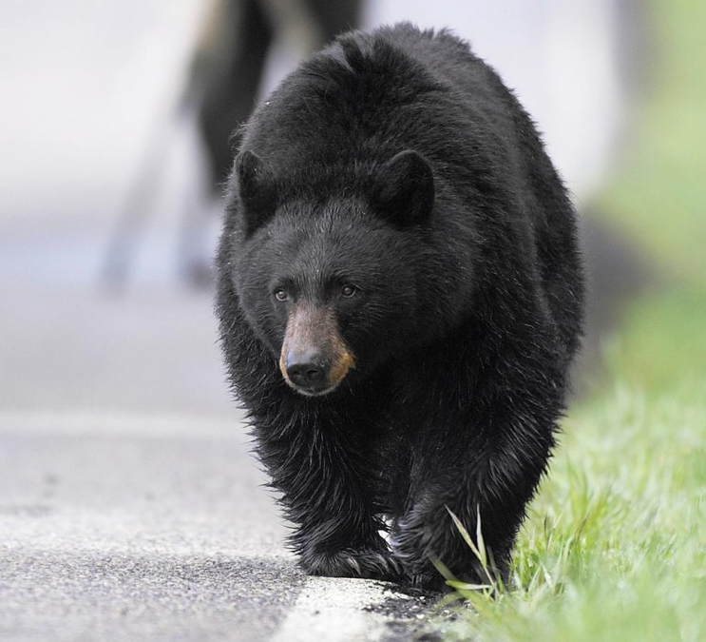
Conflict Bears
Habituated Bear
This Photo by Unknown Author is licensed under CC BY-NC
Notes:
Habituated Bear: A bear that shows little to no overt reaction to people as a result of being repeatedly exposed to anthropogenic stimuli without substantial consequence

Slide 10
Conflict Bears
Response: Case by case basis
Non-lethal corrective measures
Exhaust all feasible options before:
Relocation
Placement
Euthanasia
Habituated Bear
Notes:
Mitigating habituated bear situations should be according to specific facts and circumstances, and employ methods based on evidence and science
Best outcome – bear returns to its natural behavior & habitat
Corrective measures, attractant management, preventative measures, husbandry practices – emphasis on non-lethal measures
If circumstances dictate, relocation, placement or euthanasia of conflict bears may be employed only after all feasible corrective measures have been exhausted
Local staff will work with supervisor to implement corrective measures, provide a briefing document to supervisor
If supervisor believes these are unlikely to succeed, they will provide the EPM and WHL with info and they will provide guidance and authority for how to proceed.
Placement in a captive facility is preferred
Relocation requires approval of RM and RGT for conflict bears
Euthanasia decided by RGT
Determination of placement, relocation, or euthanasia will be decided by considering
Likelihood of successful placement or relocation
Ethics and animal welfare

Slide 11
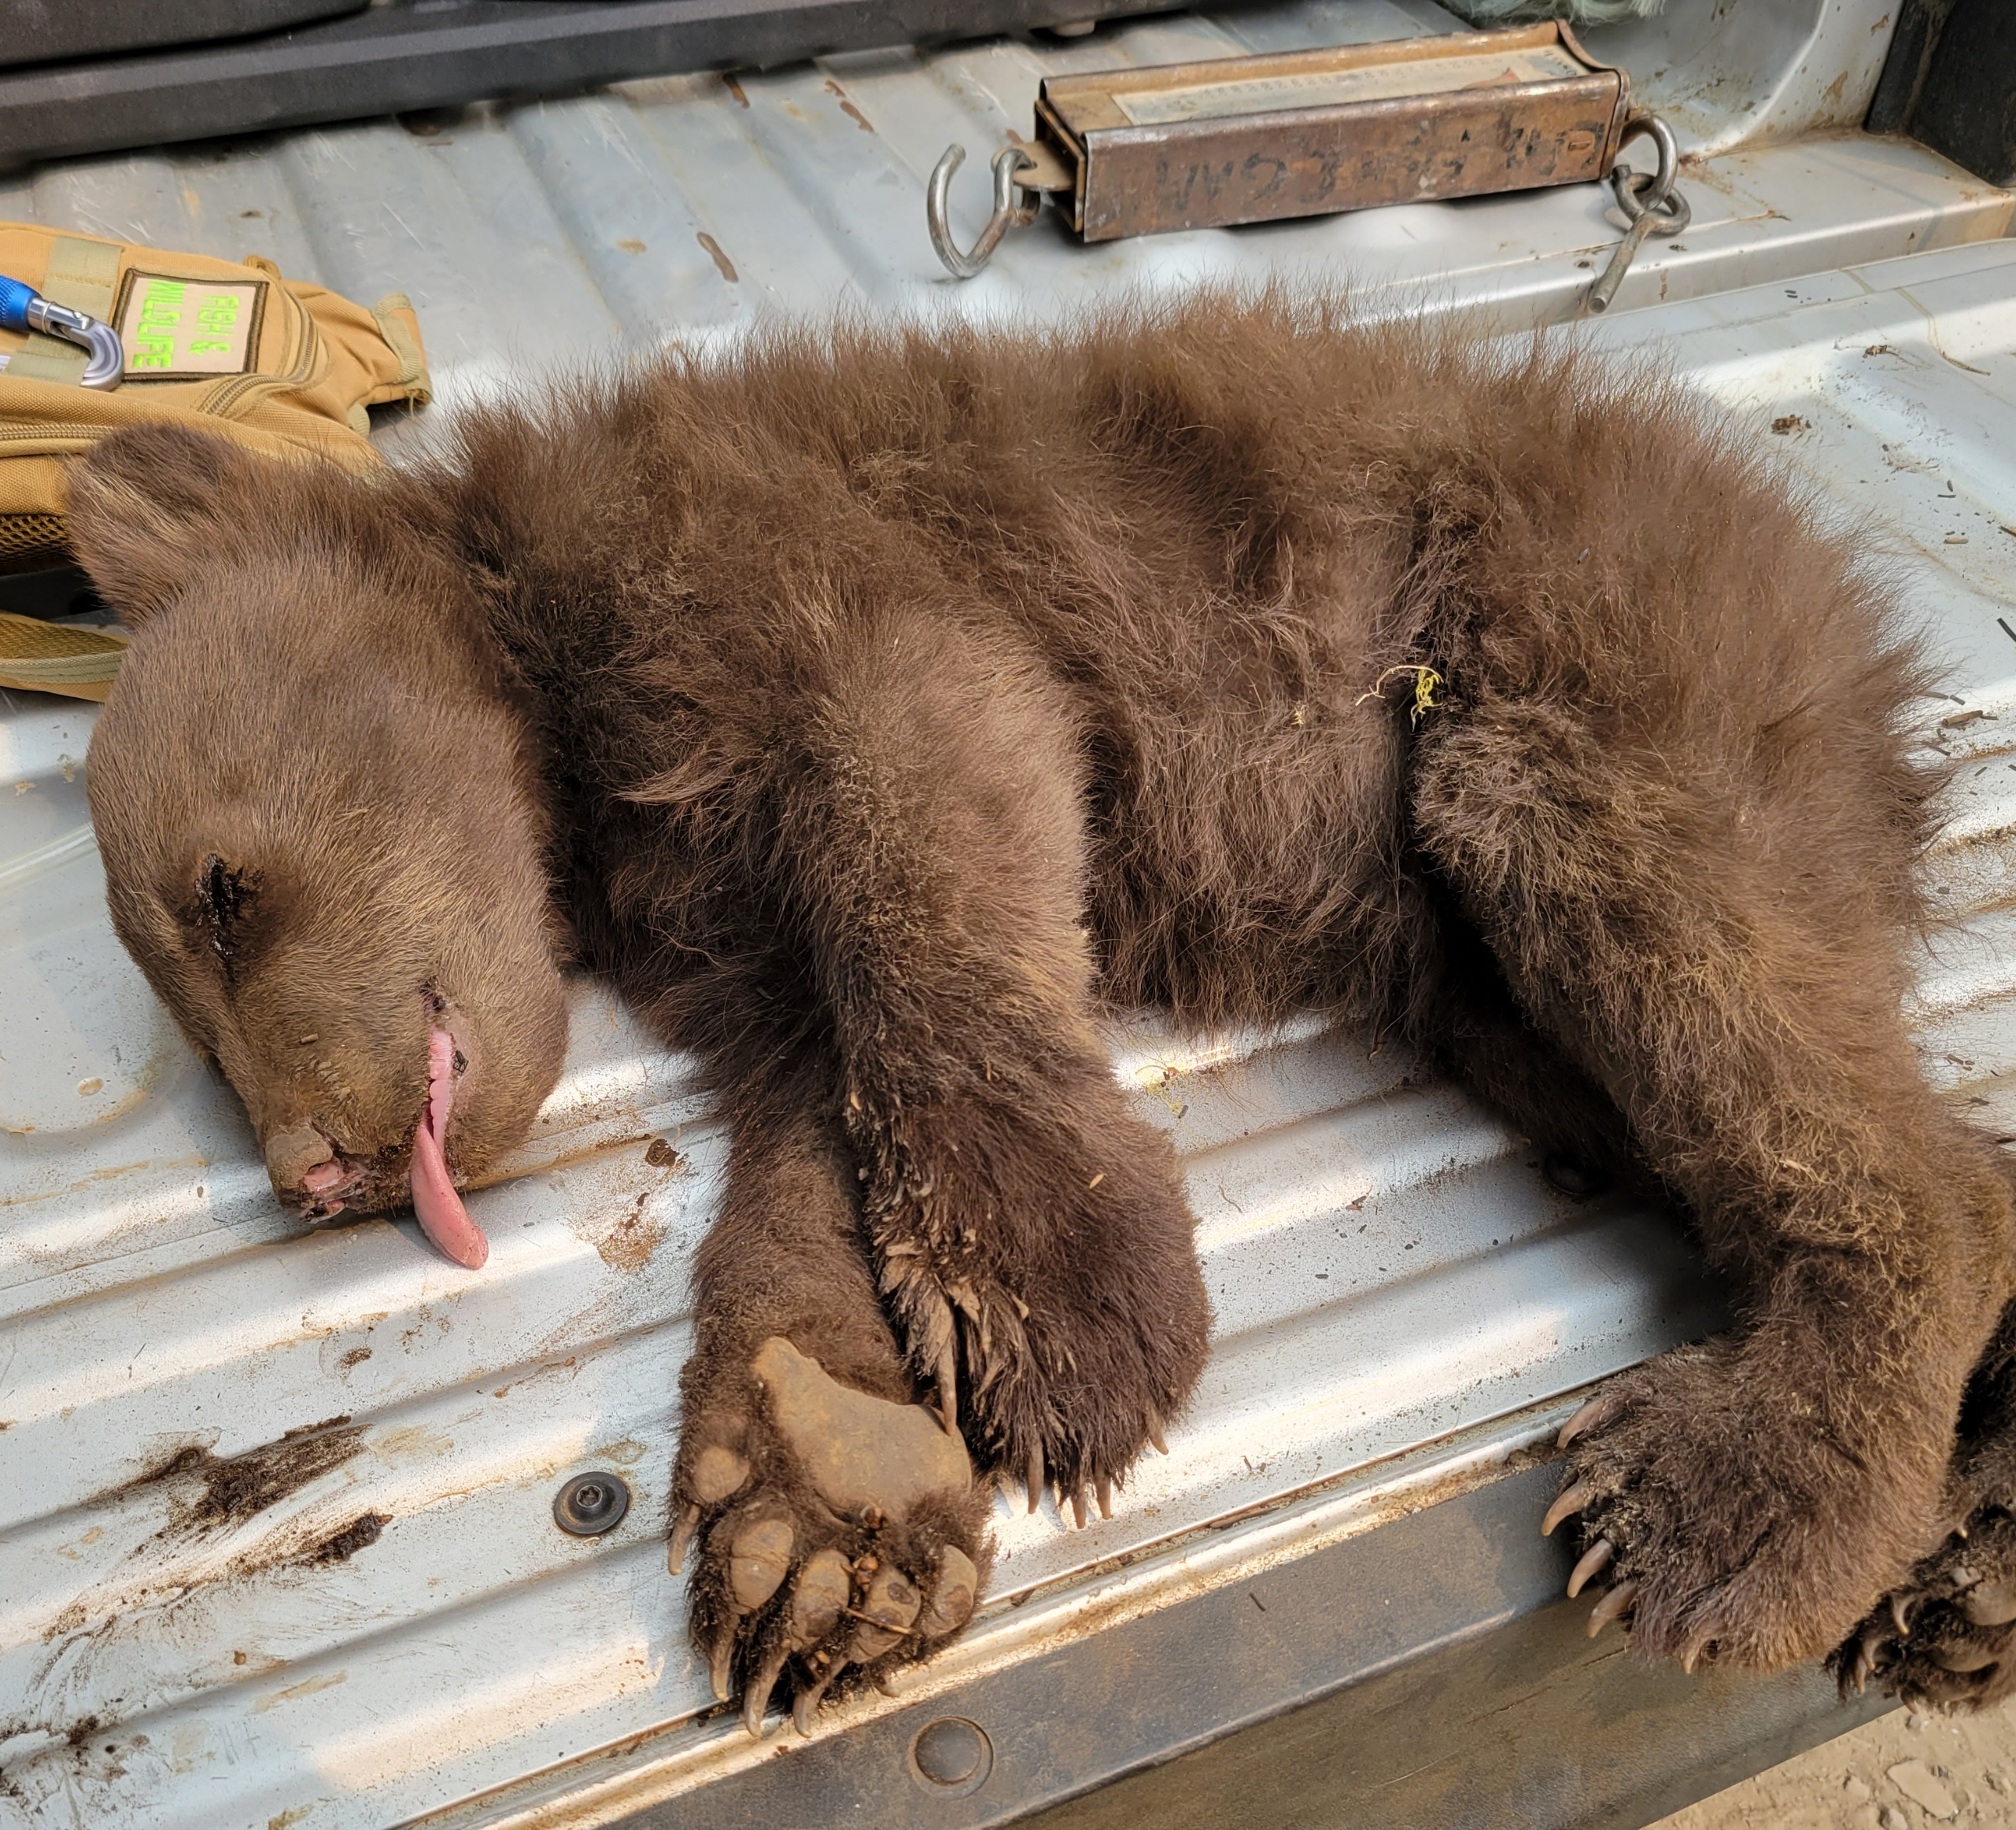
Conflict Bears
Animal Welfare Bear
Notes:
Welfare Bear: An orphaned, sick, or injured bear that may require veterinary care

Slide 12
Animal Welfare Bears
Sick/Injured Bear
Orphaned Bear
Types of injuries
Encephalitis
Consultation with Wildlife Health Lab
Decision Authority:
Response plan must be presented to RM by WHL
Euthanasia must be approved by RM or CWLB
Cubs
Yearlings
Determine candidacy for rehab
Return to the wild
Notes:
Welfare Bear: An orphaned, sick, or injured bear that may require veterinary care.
Orphaned Bear Cub: A cub of the year that is unable to survive in the wild without intervention and is not associated with a sow.
Orphaned Yearling Bear: A bear in its second calendar year of life, after January 1 but before July, that is unable to survive in the wild without intervention and is not associated with a sow.
Sick/injured
Could be related to vehicle collision, hunting accident, wildfire
Encephalitis confirmed in Siskiyou, extreme cases may require action
We work in consultation with our veterinarians at the WHL
Decision to euthanize must be made by the RM or Chief Wildlife Branch
Response plan made and presented to RM
Orphaned bears:
Previously was set weights and dates for guidance
New ones:
Orphaned cub/yearling is clearly dependent and unable to survive in the wild
There is little evidence of habituation to humans
Consensus between CDFW personnel in region and WHL EPM that the animal is suitable for rehabilitation. Final decision made by WHL EPM
Brief outline of release guidelines

Slide 13
Thank you
Axel Hunnicutt
Siskiyou Unit Biologist
530-598-6820
Michael.Hunnicutt@wildlife.ca.gov
This Photo by Unknown Author is licensed under CC BY-NC

Slide 14
Fish & Game Code 4181
(a) ”…any owner or tenant of land or property that is being damaged or destroyed or is in danger of being damaged or destroyed by elk, bear, bobcat, beaver, wild pig, wild turkeys, or gray squirrels may apply to the department for a permit to kill the animals. Subject to the limitations in subdivisions (b) and (d), the department, upon satisfactory evidence of the damage or destruction, actual or immediately threatened, shall issue a revocable permit for the taking and disposition of the animals under regulations adopted by the commission.”
(b) The permit issued for taking bear or bobcats pursuant to subdivision (a) shall contain the following facts:
(1) Why the issuance of the permit was necessary.
(2) What efforts were made to solve the problem without killing the bears or bobcats.
Notes:
Extra slide to reference FGC 4181

