Slide 1
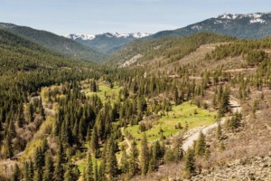
Scott Valley
Scott Valley is approximately 25 miles long and 10 miles wide at the largest point, although much of Scott Valley is less than 3 miles wide. The Scott River flows through the eastern and northern part of the valley, from south to north and across its northern flank to exit the Valley at its northwest corner toward the Klamath River. Approximately 8,000 population

Slide 2
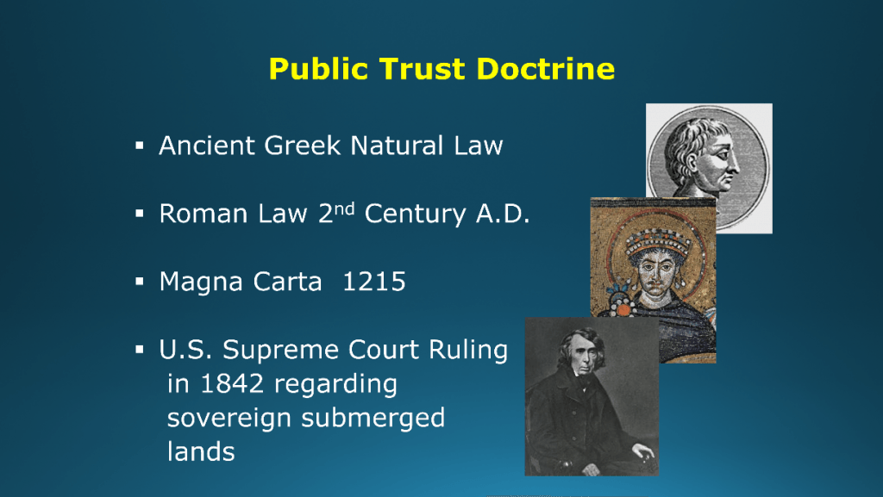
Public Trust Doctrine
The origins of the Public Trust Doctrine can be traced back to the the Roman Empire 1500 years ago.
“The air, the water, and the sea are all common to the public and is entitled to be used by anyone due to the law of nature”

Slide 3
Definition of the Public Trust Doctrine
Historically, the public trust doctrine guaranteed a public right to commercial navigation and fishing on navigable waters. Over the past few decades, however, courts in several states have expanded the doctrine beyond its historical description.
"In California, the Public Trust Doctrine historically has referred to the right of the public to use California's waterways to engage in 'commerce, navigation, and fisheries.' More recently, the doctrine has been defined by the courts as providing the public the right to use California's water resources for: navigation, fisheries, commerce, environmental preservation and recreation; as ecological units for scientific study; as open space; as environments which provide food and habitats for birds and marine life; and as environments which favorably affect the scenery and climate of the area."

Slide 4
Lawsuit: ELF v. State Water Board/Siskiyou County
On June 23, 2010, the Environmental Law Foundation and associated fishery organizations Pacific Coast Federation of Fishermen’s Association and Institute for Fisheries Resources (collectively ELF) filed a lawsuit against the State Water Board and the County of Siskiyou. ELF asserted the County’s well permitting program failed to manage groundwater resources interconnected with the Scott River in a manner consistent with the Public Trust Doctrine.
The litigation ascended and descended through California’s courts, and ultimately ELF’s arguments prevailed.

Slide 5
Lawsuit Summary
California’s Third Appellate District recognized that groundwater pumping that diminishes the volume or flow of water in a navigable surface stream may impact public trust resources.
Counties, as subdivisions of the state, have a fiduciary duty to consider the public trust before authorizing the drilling of groundwater wells whose extractions might have an adverse impact on trust resources.
The enactment of the Sustainable Groundwater Management Act of 2014 (“SGMA”) does not “occupy the field” or “replace or fulfill public trust duties.”
Obligation of SGMA: Depletions of interconnected surface water that have significant and unreasonable adverse impacts on beneficial uses of the surface water.
“The public trust doctrine applies if the extraction of groundwater adversely affects a navigable waterway.”
Obligation of Public Trust: Considers“ public trust resources and "preserves" those resources to the extent "feasible”.

Slide 6
Responsibility for administration of the trust
Under the public trust doctrine, an agency acting on behalf of the state as trustee has the power to allocate sovereign resources within its discretion, but must give due regard to the preservation of those resources.
Courts have recognized, for example, the Water Board’s ability to allocate water resources "despite foreseeable harm to public trust uses," as long as it "considers” public trust resources and "preserves" those resources to the extent "feasible”.

Slide 7
Is the Scott River a navigable water way ?
HARBORS AND NAVIGATION CODE - HNC
DIVISION 1.5. NAVIGABLE WATERS [90 - 153]
( Heading of Division 1.5 renumbered from Division 1 by Stats. 1966, 1st Ex. Sess., Ch. 61. )
CHAPTER 2. Definition and Description [100 - 107]
103. The following streams and waters are also navigable and are public ways:
Klamath River, from its mouth in Del Norte County to its confluence with the Shasta River in the county of Siskiyou; but this shall not abrogate or infringe upon mining rights or the rights of locating or operating mining claims on the Klamath River, existing on August 21, 1933, otherwise than by being made subject to the public rights of way herein declared.

Slide 8
Public Trust and Navigable water ways
The public trust doctrine applies to the Scott River regardless of whether it is considered navigable under California law. In National Audubon Society, the California Supreme Court held that the public trust doctrine applies not only to navigable waters, but also to non-navigable tributaries of navigable waters to the extent that activities in the tributaries affect the navigable waters.
Therefore, the Scott River is a tributary of a navigable waterway—the Klamath River—and is accordingly subject to the public trust doctrine under the Supreme Court’s decision in National Audubon Society. In other words, the Scott River is subject to the public trust doctrine either because it is navigable, and, if not navigable, because it is a tributary of a navigable waterway. Under National Audubon Society, the Scott River is subject to the public trust doctrine under either circumstance.
Yes, the Scott River is a navigable waterway.

Slide 9
Declared Water use for Scott Valley Scott River Adjudication Decree 1980 5 Schedules of Allotments
Allotments of water from the Scott river Stream System are set forth in five separate schedules.
Schedule A : Special Class rights which are independent and not interrelated with other rights in the stream system. 13 claimants to spring sources primarily for domestic use with minor irrigation (9 acres)
Schedule B: Independent Tributary Streams. 40 assigned schedules totaling 30,130 acres served. 619.7 CFS = 1,229 acft.
Schedule C: 60 Allotments for ground water from the Scott River interconnected zone that serve 12,975 acres.
Schedule D: 78 Claimants 15,323 acres served. 274.47 CFS 544 ac/ft.
Schedule E: Scott Valley post 1914 appropriative water rights 44 claimants, serves 8,815 irrigated acres (208,660 ac/ft), Stock use (200 ac/ft.), Mining(5 CFS), Domestic ( 4.3 ac/ft), Municipal (1.2cfs), Power (.25cfs)

Slide 10
Scott Valley groundwater wells
Reference: Scott Valley Integrated Hydrologic Model: Data Collection, Analysis, and Water Budget Final Report (Foglia, McNally, Hall, Ledesma, Hines, Harter)
Approximate groundwater well inventory data Scott Valley
Domestic Wells: 1,302
Irrigation Wells: 240
Industrial Wells: 3
Public/Municipal Wells: 4
Other (Monitoring, Test, etc.)

Slide 11
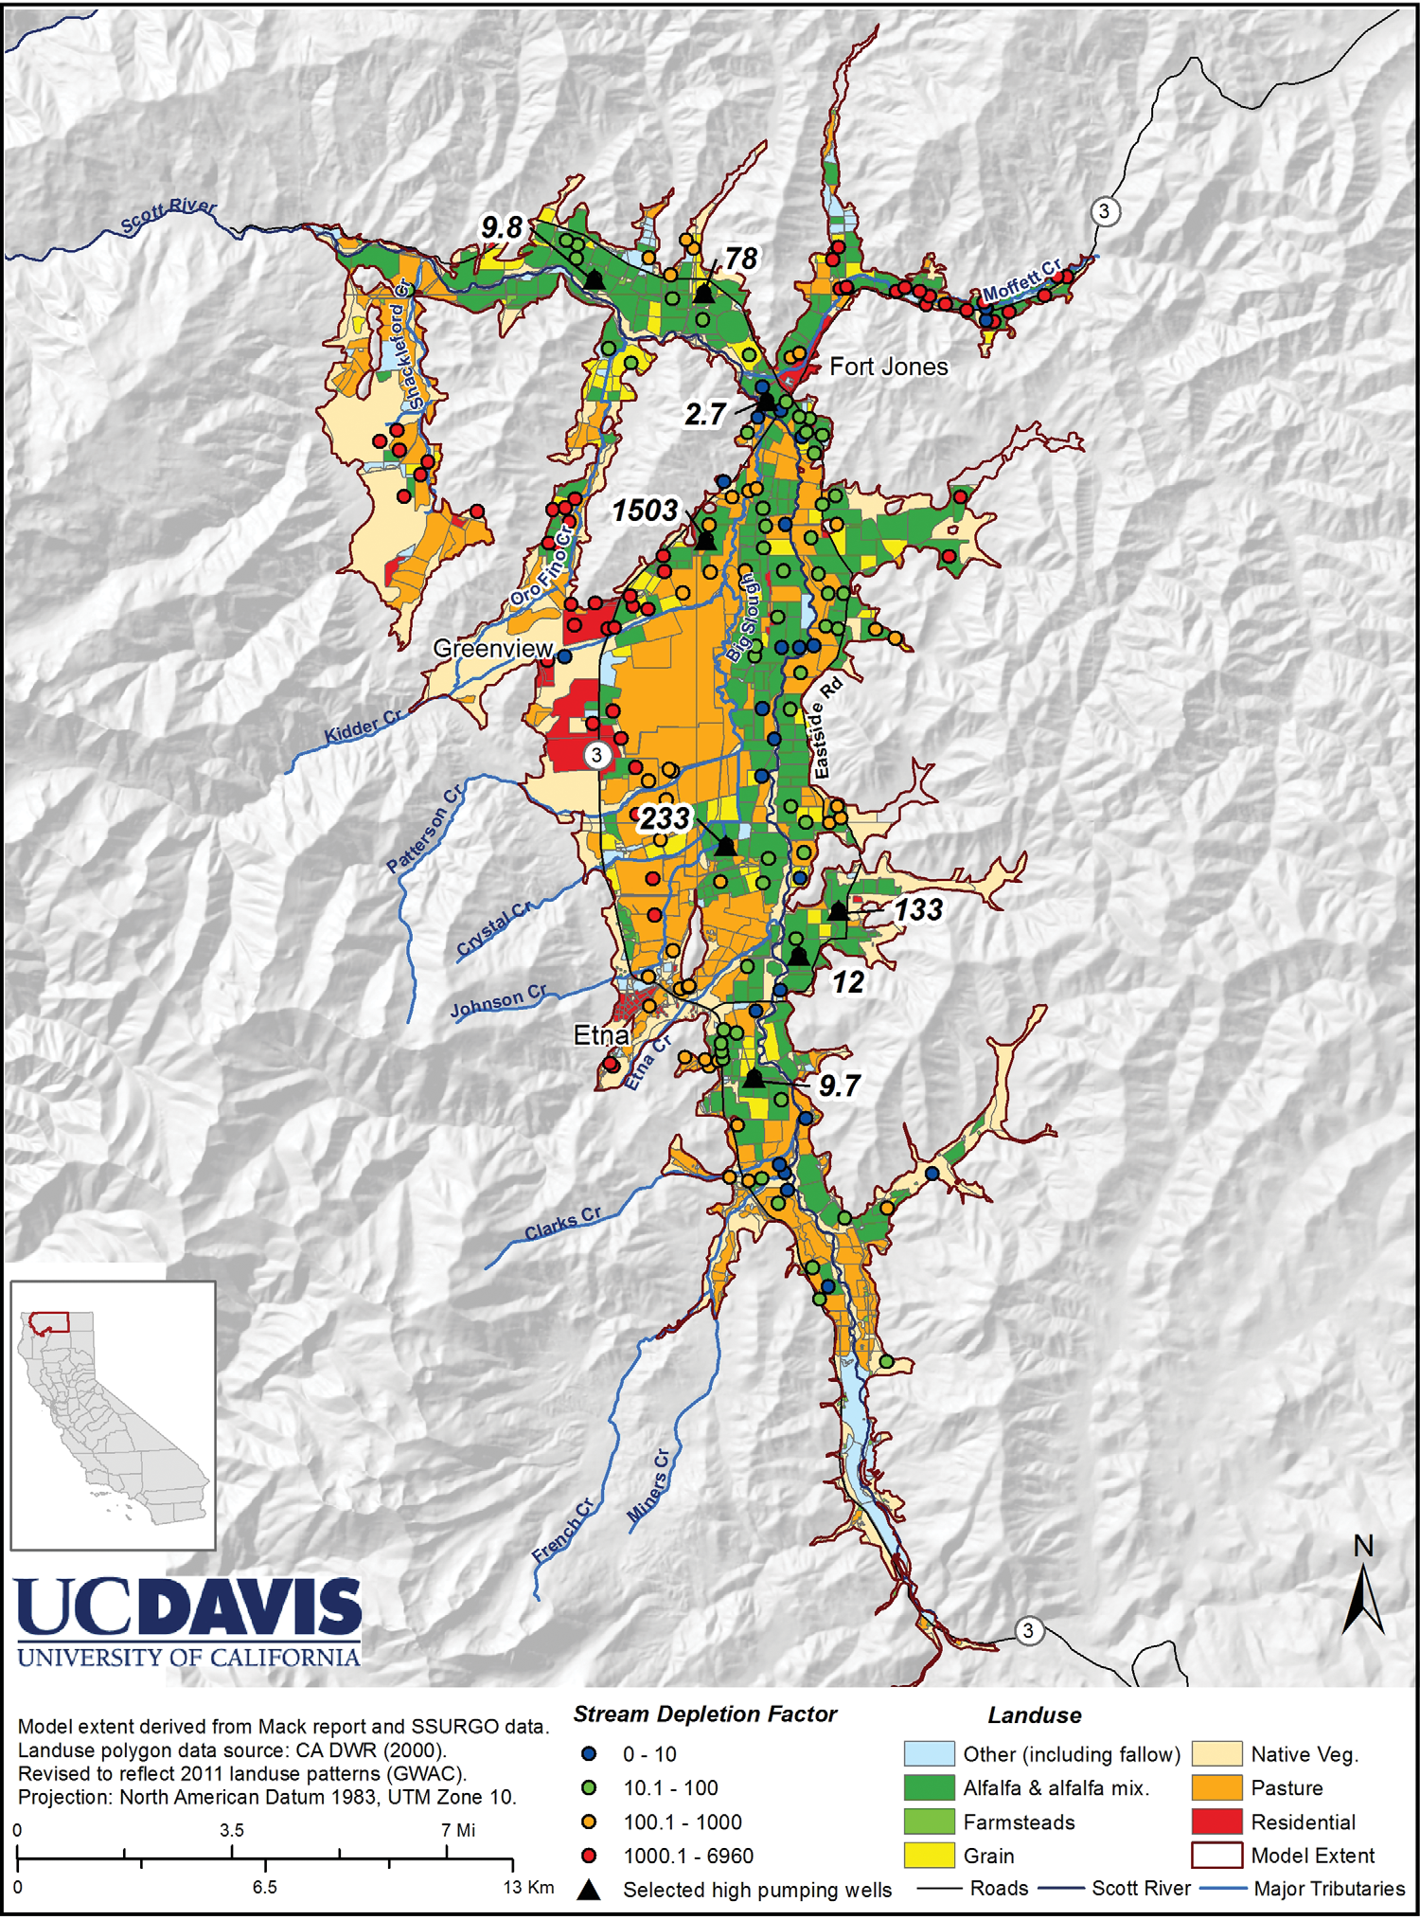
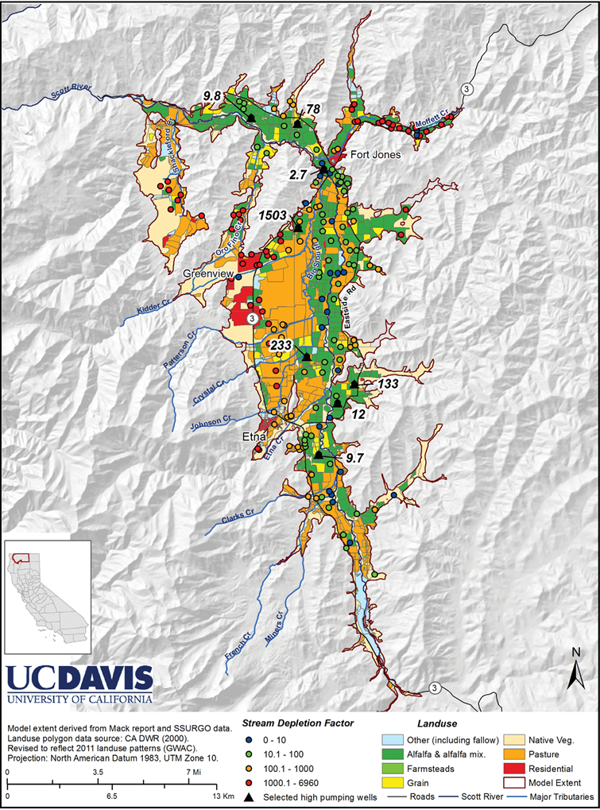
FOGLIA ET AL.: COUPLING WATER BUDGET AND STREAM-DEPLETION FUNCTIONS
Figure 1. Map of the Scott Valley with the boundaries of the groundwater model study, land use, and irrigation wells with their stream depletion factor (SDF in days) relative to the main-stem Scott River.

Slide 12
Stream Depletion Factor (SDF)
High SDF values lead to slow stream depletion and vice versa. The SDF increases (stream depletion slows down) with increasing aquifer storage coefficient and distance. But the SDF decreases (stream depletion occurs more rapidly) with higher transmissivity between the well and the stream.
For SDFs on the order of 100, significant effects on stream depletion are observable within less than 1 month and increasing impacts occur throughout the 4 month pumping season. Wells with SDF on the order of 1000 and more have a dampened effect on the stream - they effectively impact the stream as if they were located near the stream but pumping at 1/3 of the actual rate (their average annual pumping rate, since they pump 4 of 12 months, that is, one-third of the year).
The storage coefficient, here assumed constant, has been found to vary within a relatively narrow range throughout most of the valley (7–15%) [Mack, 1958]

Slide 13
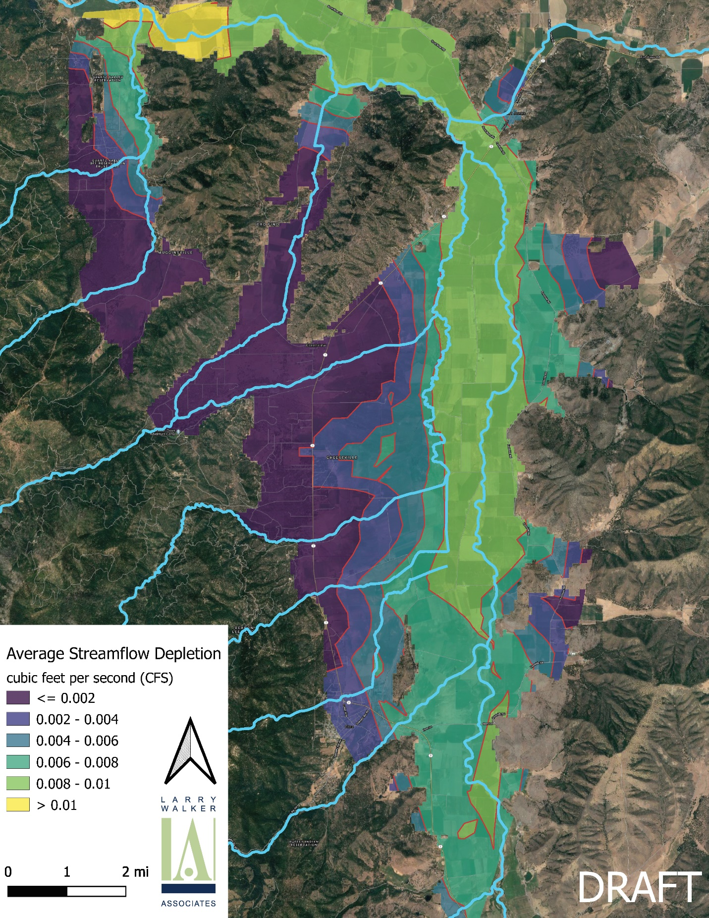
Modeling example of a 5 gpm well continuous pumping during the irrigation season.
Preliminary estimate of the spatial distribution of groundwater pumping impacts on Scott River streamflow during August 2010, expressed as the fraction of streamflow (CFS) for a 1 seasons (April 16th–September 30th) of continuous pumping at 5 GPM for 712 hypothetical pumping locations and interpolated throughout the basin.
Note: This model is very conservative as it does not take into consideration the approximately 85% of waste water recharge back to the aquifer through on-site waste waster treatment systems. Also for reference if domestic use for a house hold was 1000 gal/day, well pumping would be about 3.3 hr./day

Slide 14
Domestic well water use vs agricultural well water use
Big picture overview with the following assumptions:
House hold water use based on EPA manual of 75 gallons per day per person.
Each house hold irrigates ¼ acre of ground via lawn/garden (3 acft/ac/season)
Ground water extraction estimate for Agriculture 44,500 acre/ft./season (UCD)
Population of 8,000 – 744 (Etna surface water source) = 7,256
Water use | population | # wells | Gallons/day | Percent Recharge | Est. ac/ft. | % Groundwater Extraction
House hold | 7,256 |  | 75 (365 days) | 85 | 91.4 | 0.2%
RR- irrigation (1/4 acre garden/lawn) 4 month summer |  | 1302 | 679 (120 days) | 0 | 976.5 | 2.1%
Agricultural |  | 240 |  | 0 | 44,500 | 97.7%
Total Ag + Domestic |  |  |  |  | 45,568

Slide 15
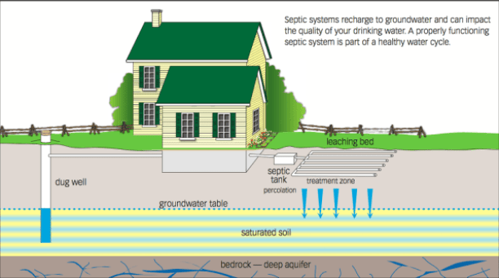
Groundwater recharge from waste water recycling
Rural settings,
80 to 90 percent of domestic water use is recharged back into the groundwater aquifer through on-site septic systems.

Slide 16
Onsite waste water treatment system –recharge-
Journal of Hydrology 388 (2010) 335-349 Consumptive use and resulting leach-ﬁeld water budget of a mountain residence
Estimates of water supply, indoor evaporation, leach-field evapotranspiration minus precipitation (ET P) and resulting drainage (D)
Van Slyke and Simpson (1974)
Units | Water supply (S) | Indoor Evaporation (8.4% of S) | Leach-field ET P (3.9% of S) | Drainage (D) (87.7% of S)
L d-1 | 1140 | 95.4 | 44.6 | 996
gal d-1 | 300 | 25.2 | 11.8 | 263
m year-1 | 11.6 | 0.97 | 0.457 | 10.2
in. year -1 | 458 | 38.4 | 18 | 401

Slide 17
Domestic water use is de minimis
Given the high degree of groundwater aquifer recharge associated with house hold water use (recycling); and
Given the overall limited volume of groundwater extracted from domestic water wells; and
Given that the majority of domestic wells are located on the margins of the valley where geologic water bearing stratigraphy has reduced hydraulic conductivity; and
Given the limits of development within the valley based on density restrictions in the Scott Valley specific plan:
Conclude 1) pumping from domestic well sites in reasonably foreseeable domestic volumes will not substantially impair or interfere with public trust uses or values within interconnected downstream navigable waters, including the Scott River; 2) feasible conditions on well casing diameter and domestic use limitation will be imposed on domestic well installations to avoid or lessen any possible impairment or interference with downstream public trust uses or values; and 3) to the extent a proposed domestic well may ultimately contribute to cumulative reductions in surface waters in downstream navigable waters, the production of groundwater for drinking, bathing, cooking, and other domestic uses on parcels in the valley is within the public interest as these parcels hold inchoate unexercised groundwater rights intended to be put to beneficial use consistent with Article X, section 2 of the California Constitution.
Recommend the Board direct staff to bring back public trust findings regarding de minimis domestic water use to be relied upon for Environmental Health Division’s issuance of domestic water well permits.

Slide 18
Consideration of the Public Trust Doctrine Agricultural wells
County of Siskiyou contracted with Larry Walker and associates to develop a groundwater modeling tool for the purpose of assisting us to make sound decisions associated with groundwater well permitting regarding impacts to the Scott River.
Demonstration of Groundwater Modeling Results of Potential Groundwater Pumping Impacts on Scott Valley Streamflow
Presented to the BOS
May 21, 2021
Stephen Maples (LWA, now Sonoma Water), Douglas Tolley (UC Davis, now DBSA), Laura Foglia (LWA), Thomas Harter (UCD)

Slide 19
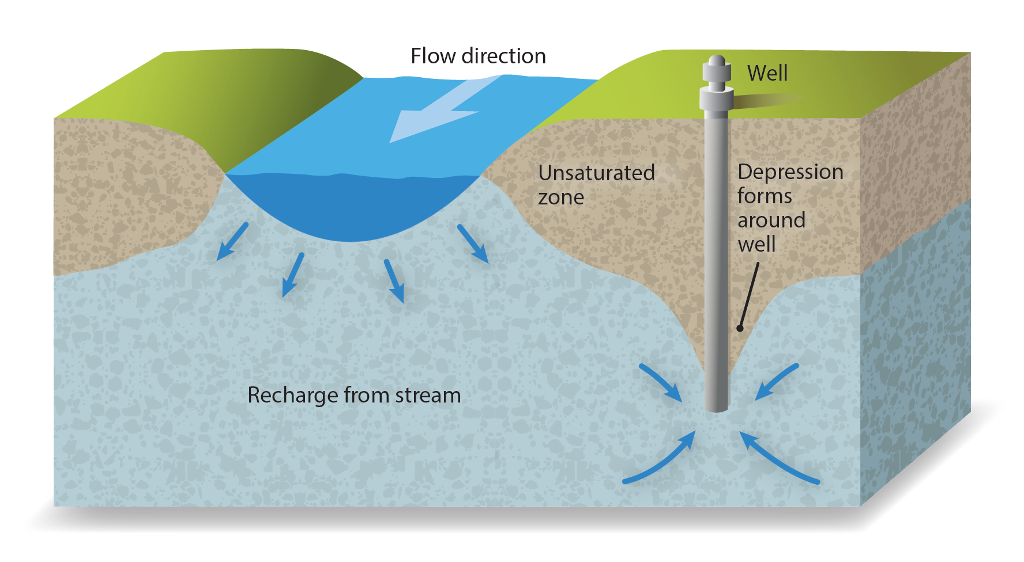
How does groundwater pumping impact streamflow?
Pumping can increase infiltration of surface water to the groundwater system, or reduce exfiltration of groundwater to surface water …
… known as “Surface Water Depletion.”
Depletion is a function of multiple factors, including proximity to the river, pumping rate, climatology, and local geology.

Slide 20
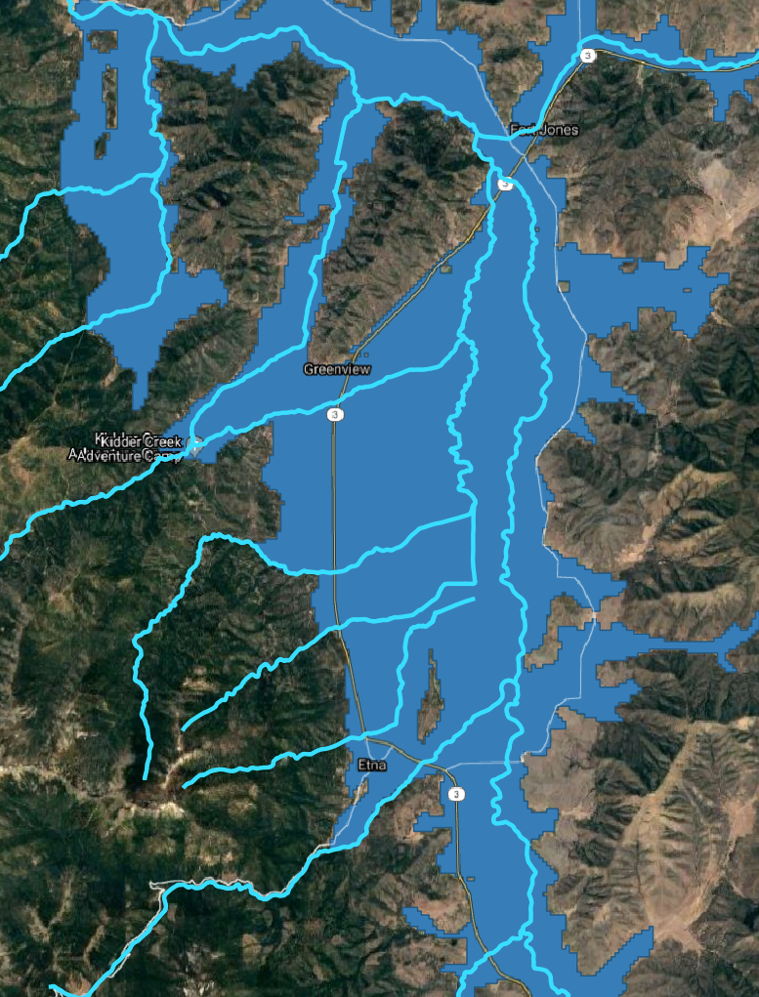
Groundwater modeling tool created to assist public trust doctrine decisions
Scott Valley Integrated Hydrologic Model (SVIHM)
County contracted with LWA to develop a modeling tool to assist with our decision making process.
Where in the Scott Valley is an agricultural well pumping 50 gallons per minute most impactful?
?
The model can provide initial reconnaissance about the locations where a hypothetical well would be more or less impactful on streamflow

Slide 21
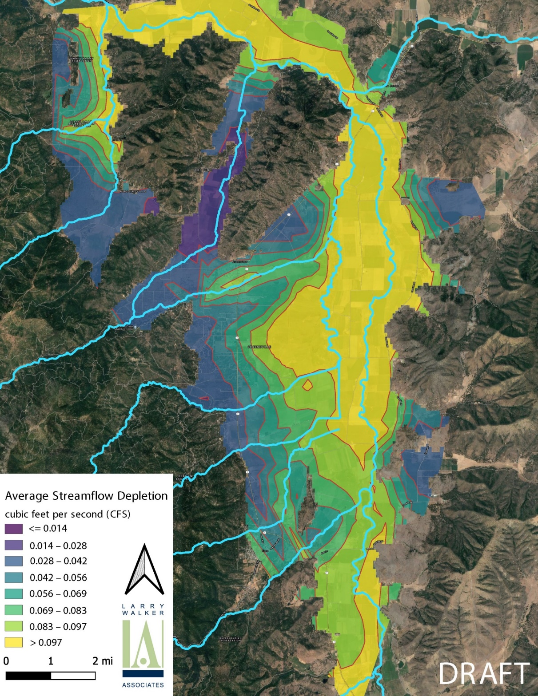
Fort Jones Stream Gage
50 gallons-per-minute pump rate
4 seasons of pumping
“dry” year (2010)
Much more widespread impact following a dry winter.
Greatest impact is still focused along the river corridor and tributaries.
0.1 CFS = <2% of low flow during a “dry” year (2009)

Slide 22

Fort Jones Stream Gage
50 gallons-per-minute pump rate
19 seasons of pumping
“dry” year (2010)
Very little difference between 4-season and 19-season scenarios.
Slight expansion of contours along the basin boundary with more years of pumping.

Slide 23
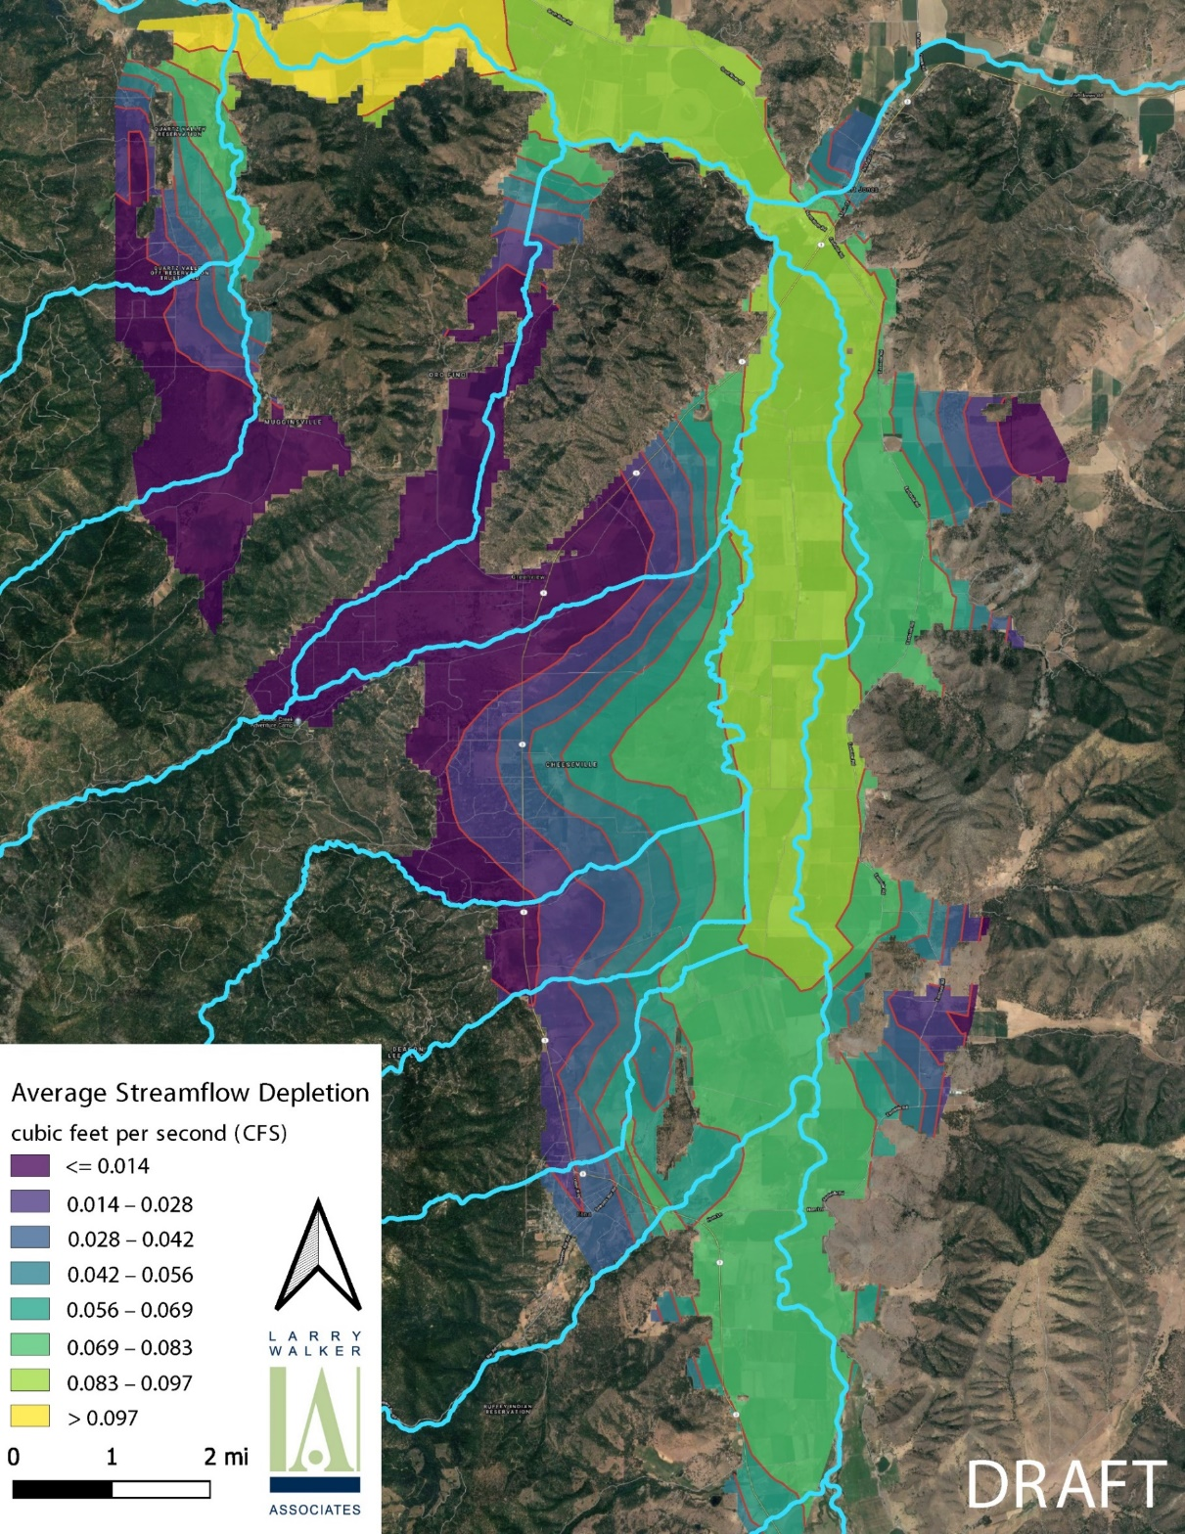
Fort Jones Stream Gage
50 gallons-per-minute pump rate
5 seasons of pumping
“normal” year (2010)
Greatest impact along the river near the Fort Jones gage
Maximum value is equal to the pumping rate:
50 GPM = 0.1 CFS
Impacts are proportional to the pumping rate … but the spatial distribution does not change.
0.1 CFS = <0.5% of low flow during a “normal” year (2010)
Decreasing impact further from the river and tributaries

Slide 24
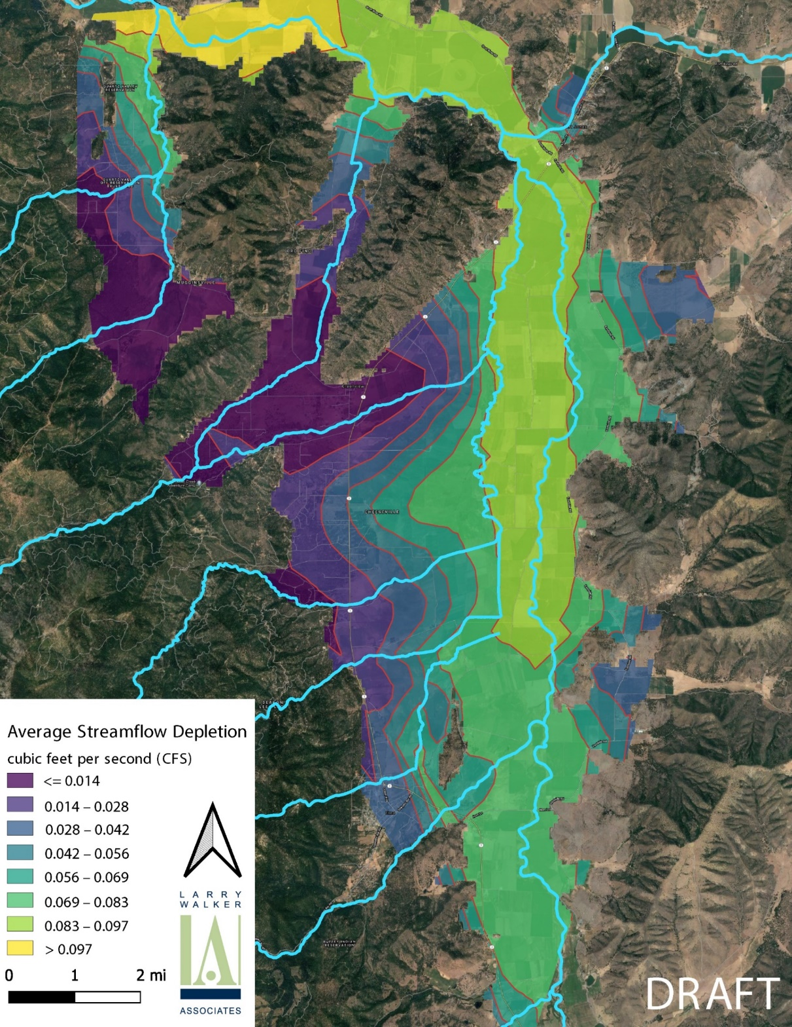
Fort Jones Stream Gage
50 gallons-per-minute pump rate
20 seasons of pumping
“normal” year (2010)
Very little difference between 5-season and 20-season scenarios.
Slight expansion of contours along the basin boundary with more years of pumping.

Slide 25
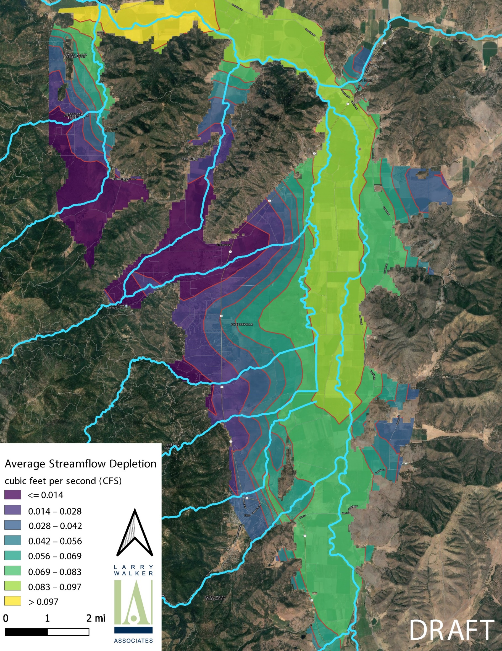
Average Streamflow Depletion summary for reference 50 gallons per minute
24 hours per day from April to September (note: not typical for standard well usage)
That said, the modeling indicates that new agricultural wells that potentially generate
Significant additional consumptive use need to be evaluated more thoroughly.
50 gallons-per-minute pump rate
20 seasons of pumping
“normal” year (2010)
1 CFS (7.48 gal/sec) = 646,272 gal/day (1.98 ac/ft.)
0.014 CFS (646,272) = 9,050 gal/day (.03 ac/ft.)
.097 CFS (646,272) = 62,688 gal/day (.195 ac/ft.)

Slide 26
Topics for general discussion
Domestic wells that are contributing to illegal cannabis cultivation need to be strongly enforced with assistance from State Water Board.
Off-parcel groundwater ordinance may need to be amended to lift the injunction and allow enforcement to insure groundwater is utilized for it’s intended land use purpose.
Municipal ground water well use also has a high degree of recharge to the aquifer, also have additional uses for fire suppression, parks etc.
How are other Counties addressing the issue?

Slide 27
Conclusions – Consideration- Recommendation regarding the issuance of future water well permits
Domestic wells are de minimis, recommend Board make public trust findings for staff to rely on in issuing ministerial domestic permits.
Municipal water wells primarily support domestic water use with a high percentage of groundwater recharge.
New agricultural well applications require an individual evaluation process to assess potential impacts to public trust resources. Staff is recommending the Board consider having agricultural well applicants be required to show no new “consumptive use effects”.
Recommend that the Public Trust analysis for agricultural well applications be administered by the County’s Natural Resources Department (NRD) as ground water is a natural resource. Chapter 8 of Title 5 of the Siskiyou County Code (SCC) administered by Environmental Health regulates standards for well construction and setback requirements. Environmental Health, informed by the NRD’s analysis, will decide if permit issuance is not in the public interest. (SCC, §5-8.14)
Establish fees for the application process, including public trust analysis.

Slide 28
Other Counties
CALIFORNIA DEPARTMENT OF WATER RESOURCES
Water Transfer (WHITE PAPER)
Technical Information for Preparing Water Transfer Proposals (Water Transfer White Paper) Information for Parties Preparing Proposals for Water Transfers Requiring Department of Water Resources or Bureau of Reclamation Approval December 2019

Slide 29
Options for consideration
Ag Well Options | Pros | Cons
Moratorium on New Agricultural Wells | Simple to implement Can set time frame for re-evaluation. | No process established or avenue to obtain a new Ag well permit while moratorium is in place.
Require Agricultural Well Applicants to Show No New “Consumptive Use Effects”. | Potential to obtain a permit to drill a new Ag Well. If seeking a replacement well, the application process is straight forward. | May require discretionary review process (CEQA) Expensive up front cost with no guarantee of approval. Will need to establish fee mechanism to pay for the review process
Establish zone requiring wells to casing perforation below 150 ft. below grade | Maintain ministerial permit process. Simple Current practice of other Counties of the State for the Public Trust | 150 foot blank casing may prohibit property owner from obtaining sufficient water source.

