Slide 1
Demonstration of Groundwater Modeling Results of Potential Groundwater Pumping Impacts on Scott Valley Streamflow
Stephen Maples (LWA, now Sonoma Water), Douglas Tolley (UC Davis, now DBSA), Laura Foglia (LWA), Thomas Harter (UCD)
May 18, 2021

Slide 2
Project Goals
Motivation → Board of Supervisors is evaluating potential impacts of new groundwater wells on surface water resources.
LWA has been requested to present results on hypothetical groundwater pumping scenarios with SVIHM.
Our presentation highlights potential impacts from a single hypothetical 6-inch diameter well with a 50-gallon-per-minute pumping capacity.

Slide 3
Project Background
Development of the Scott Valley Integrated Hydrologic Model (SVIHM) began in 2011 to simulate groundwater, surface water, agriculture interactions.
Ongoing refinement of SVIHM from 2011-2020 by UC Davis colleagues and LWA.
SVIHM provides a sophisticated platform to investigate hypothetical impacts of groundwater pumping on surface water resources.

Slide 4
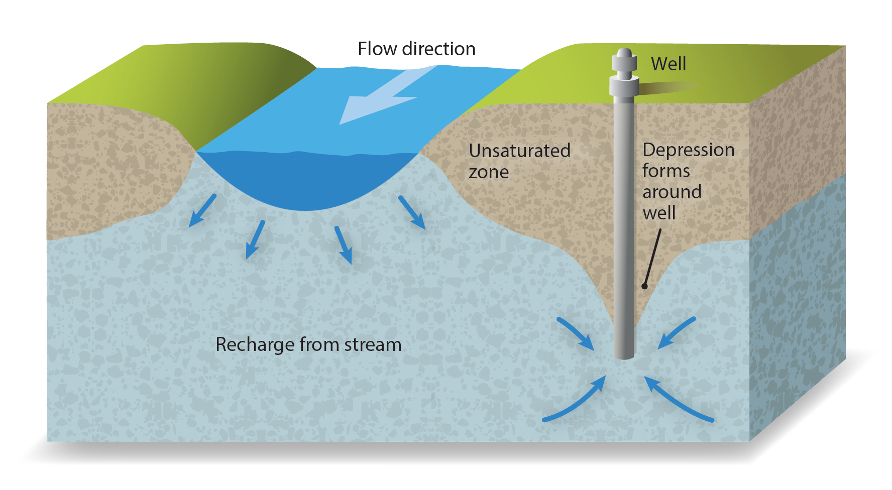
How does groundwater pumping impact streamflow?
Pumping can increase infiltration of surface water to the groundwater system, or reduce exfiltration of groundwater to surface water …
… known as “Surface Water Depletion.”
Depletion is a function of multiple factors, including proximity to the river, pumping rate, climatology, and local geology.

Slide 5
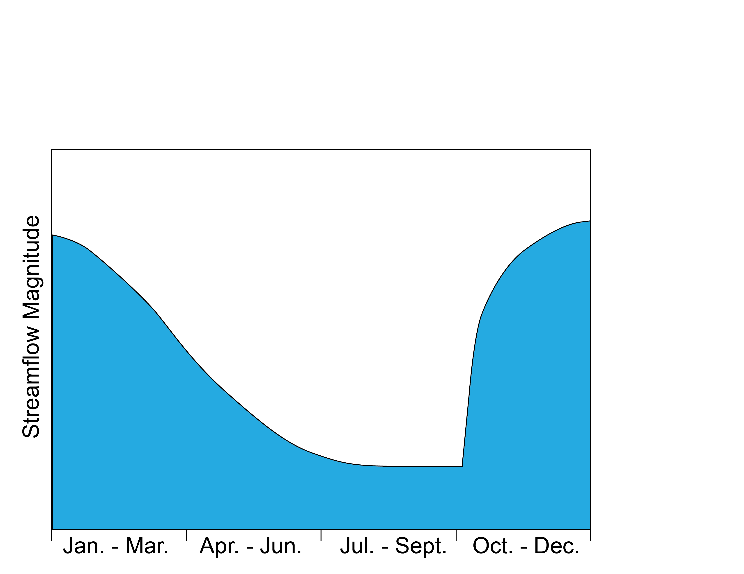



Typical streamflow Scott River hydrograph:
High flows during Winter/Spring wet season.
Low flows during Summer/Fall dry season.
Large year-to-year variability
High flows
High flows
Low flows

Slide 6
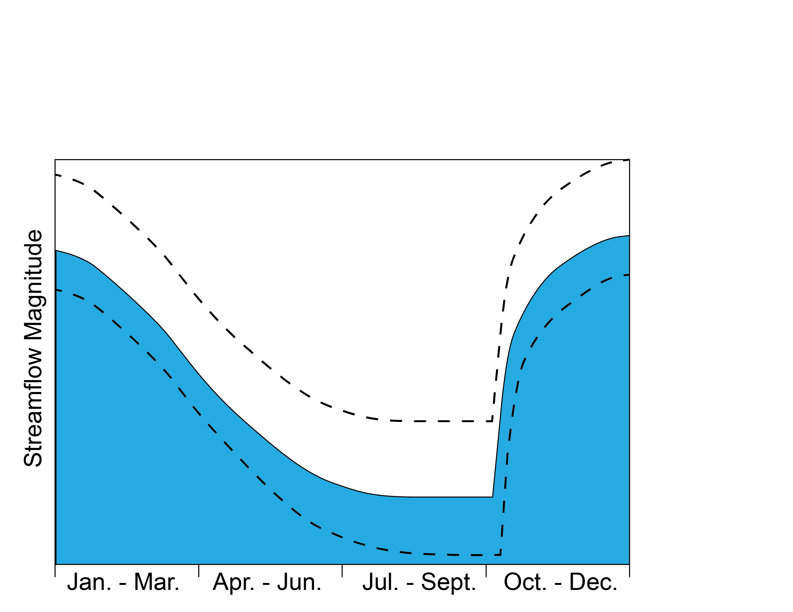
Typical streamflow Scott River hydrograph:
High flows during Winter/Spring wet season.
Low flows during Summer/Fall dry season.
Large year-to-year variability
Wet Year
Normal Year
Dry Year

Slide 7
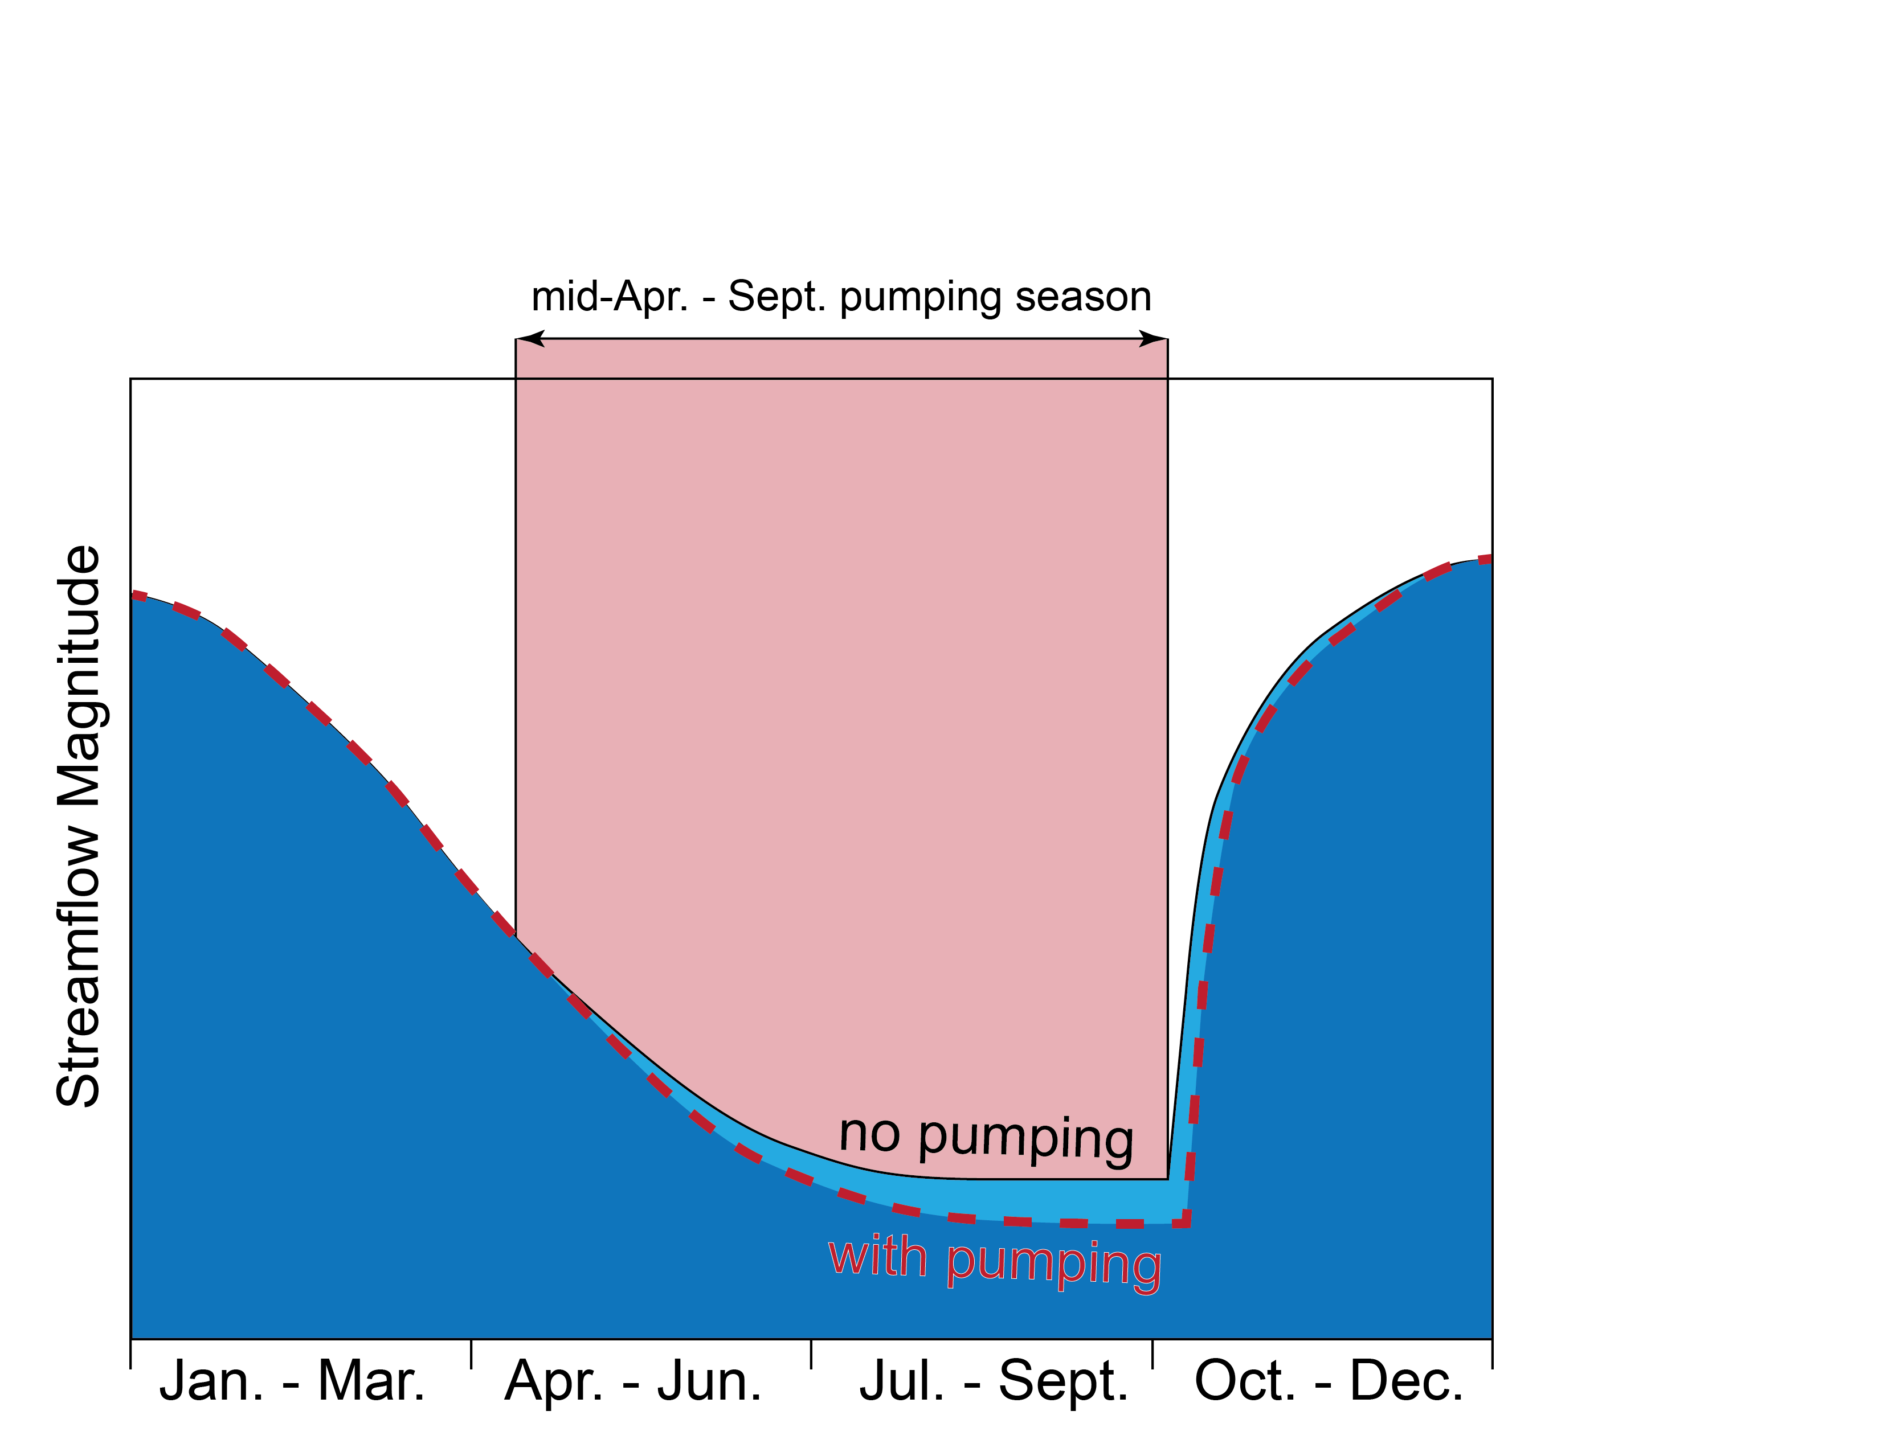
Impacts of pumping on streamflow → 1) Decreased Summer/Fall low flows
2) Delayed Fall re-wetting flows

Slide 8
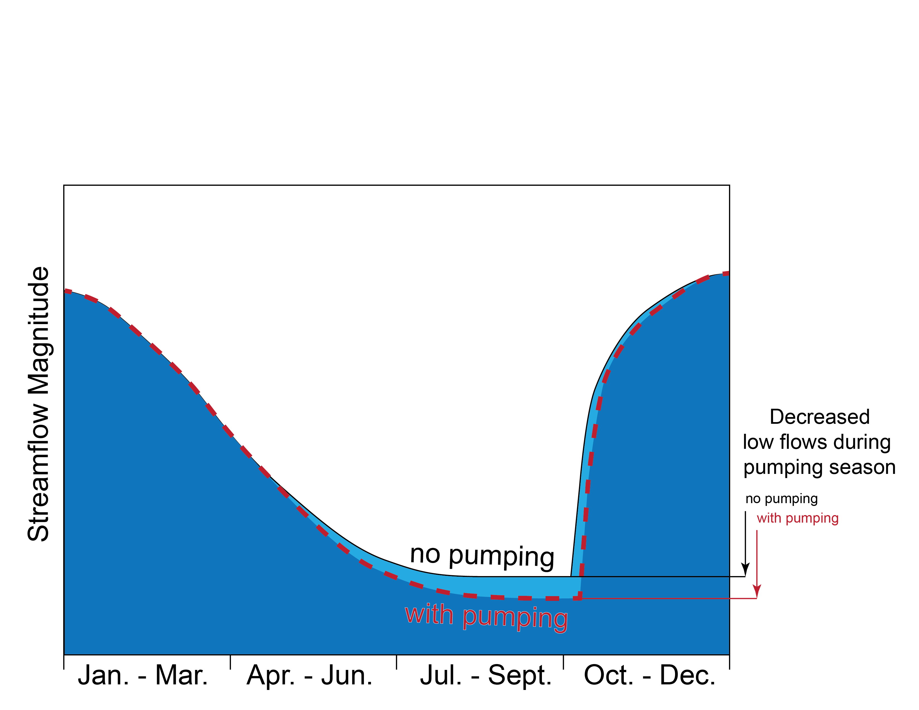

Slide 9
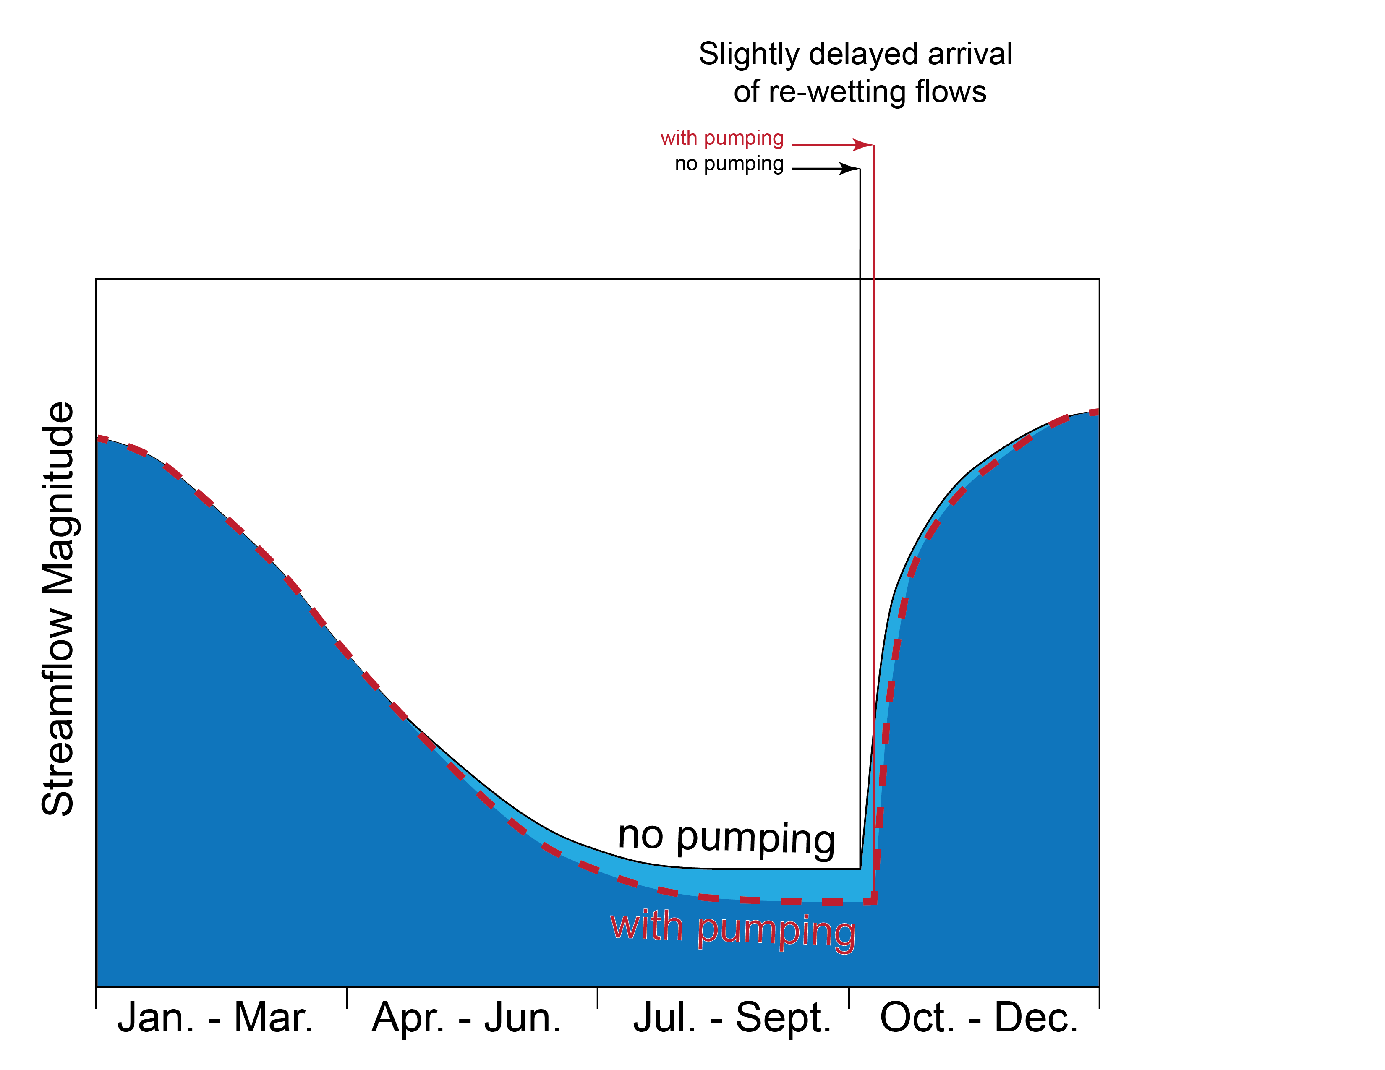

Slide 10
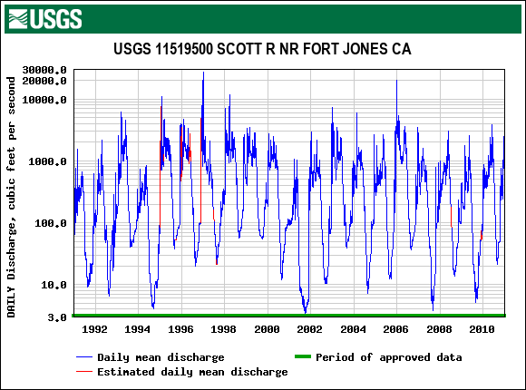
How can we use the SVIHM model to evaluate pumping impacts on streamflow?
Historical streamflow record during 20-year simulation period

Slide 11
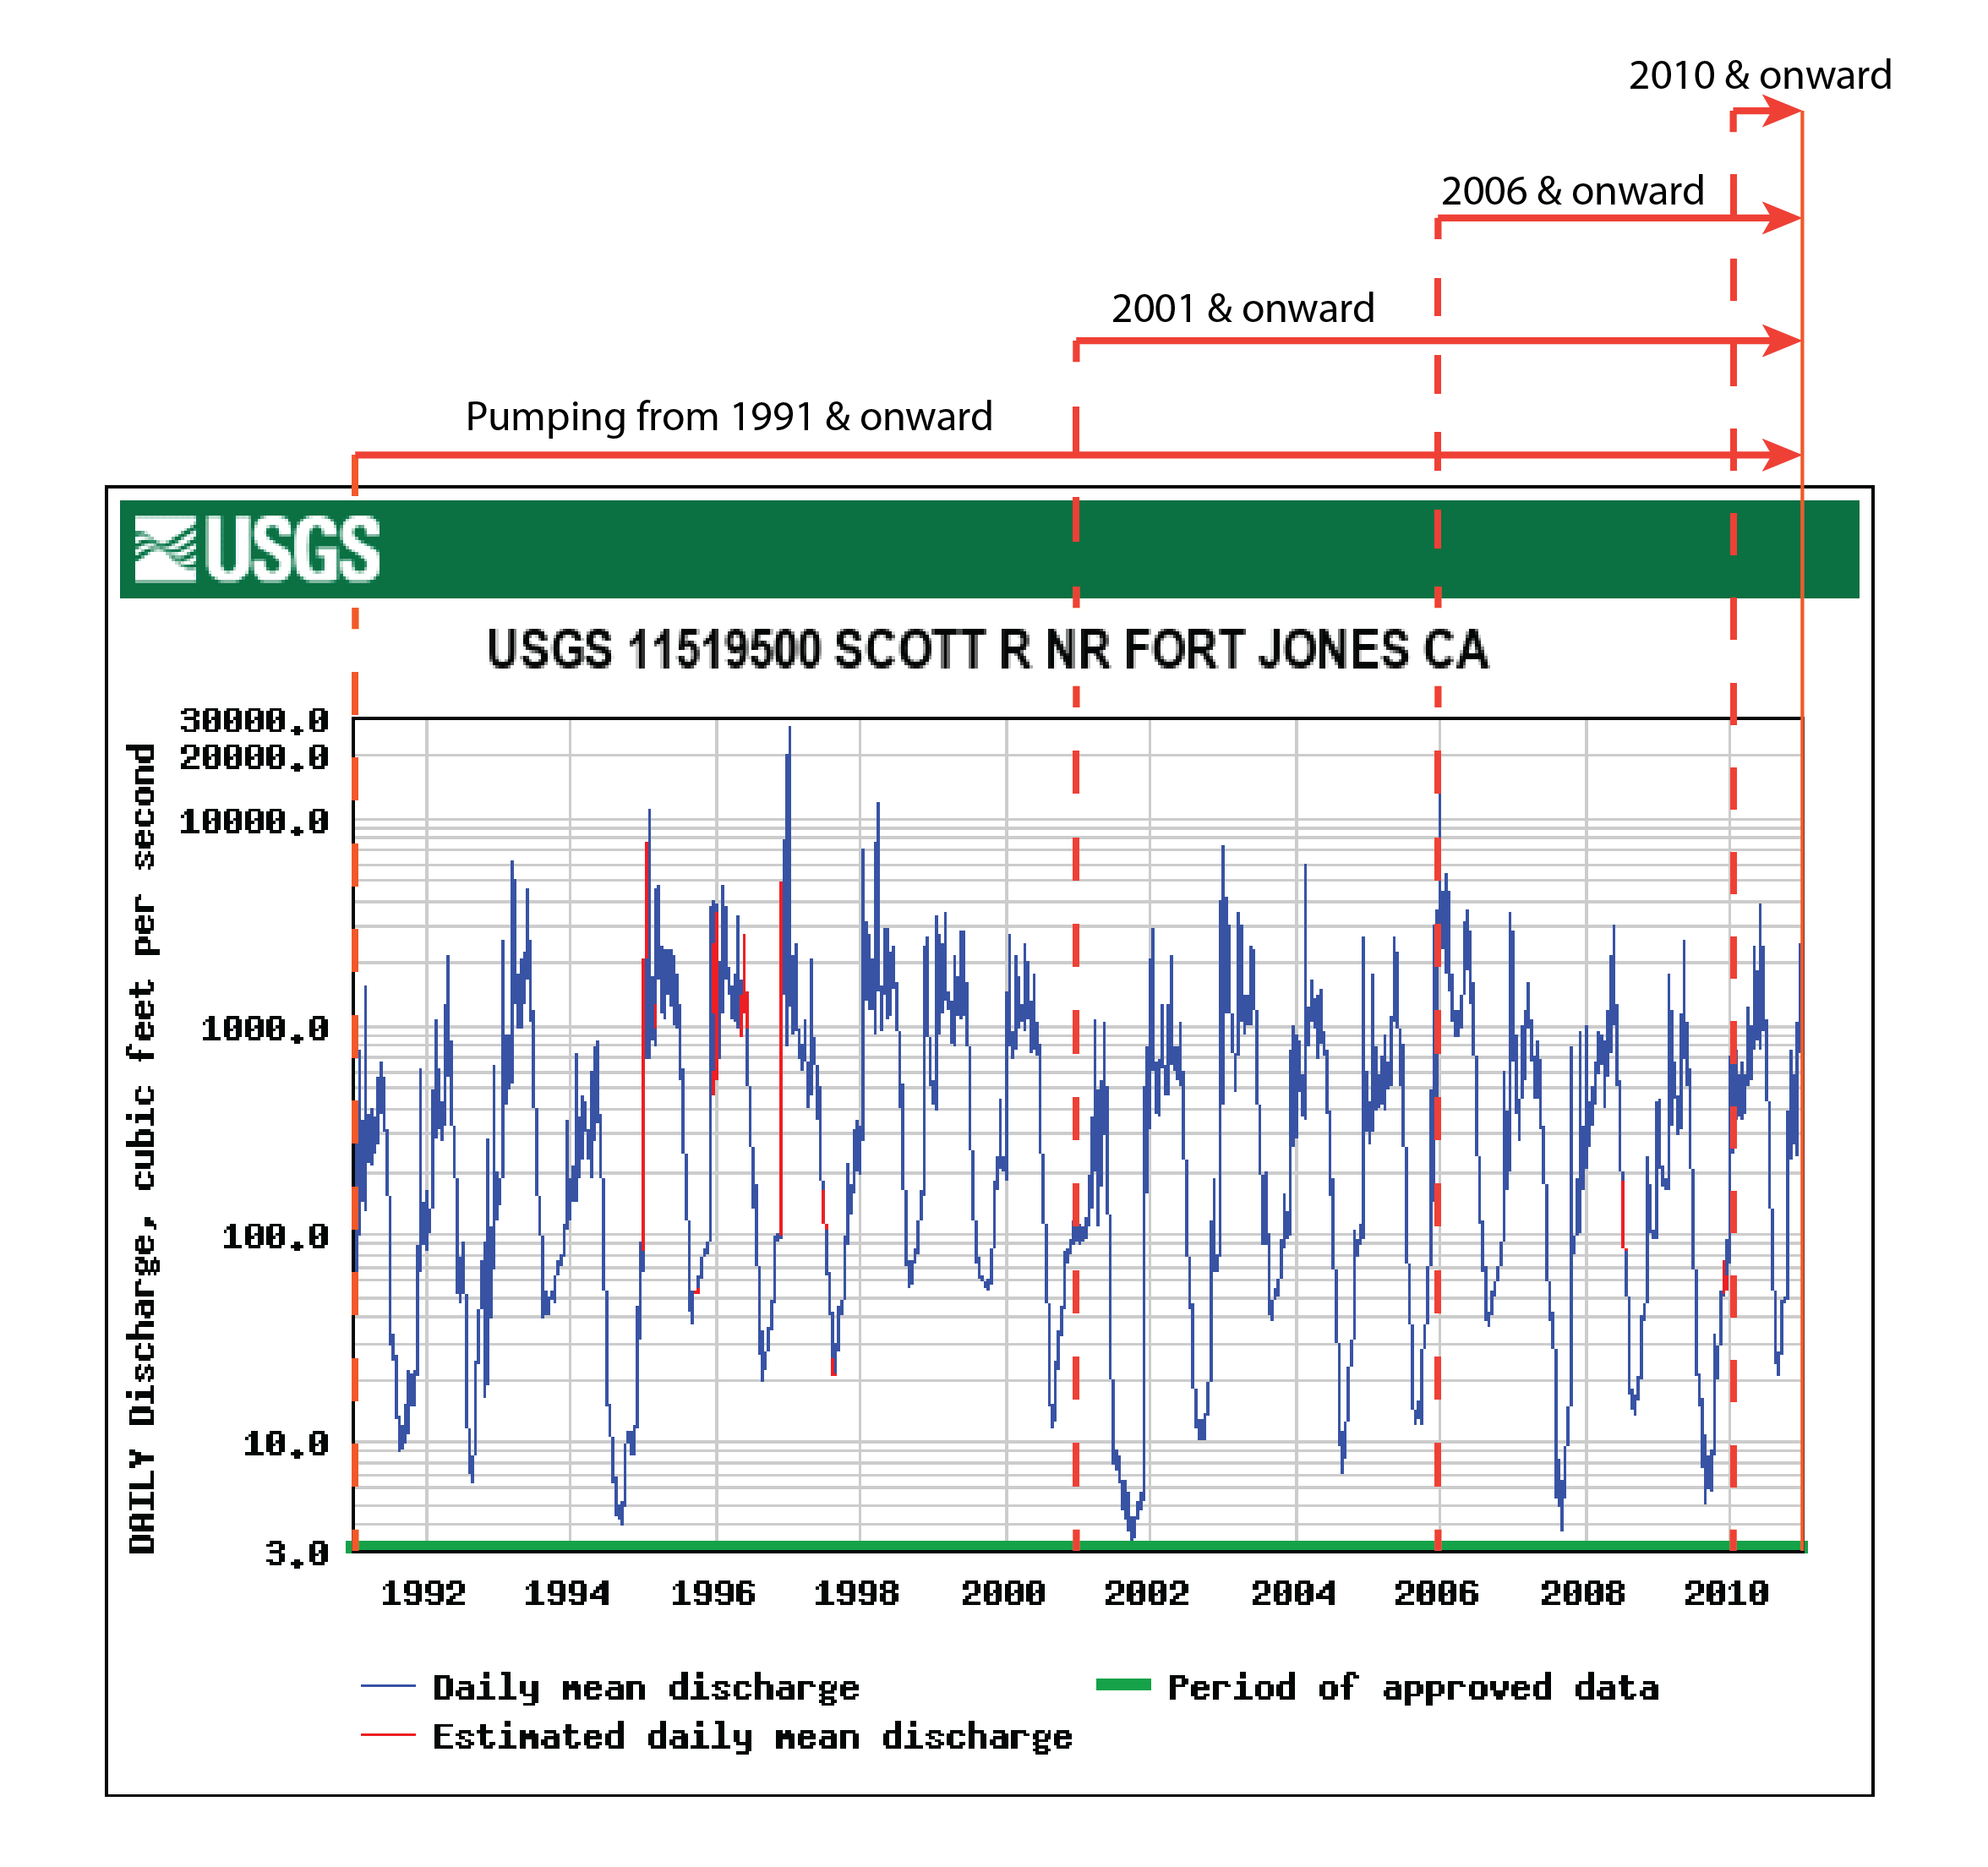
Evaluate impact of different durations of pumping

Slide 12
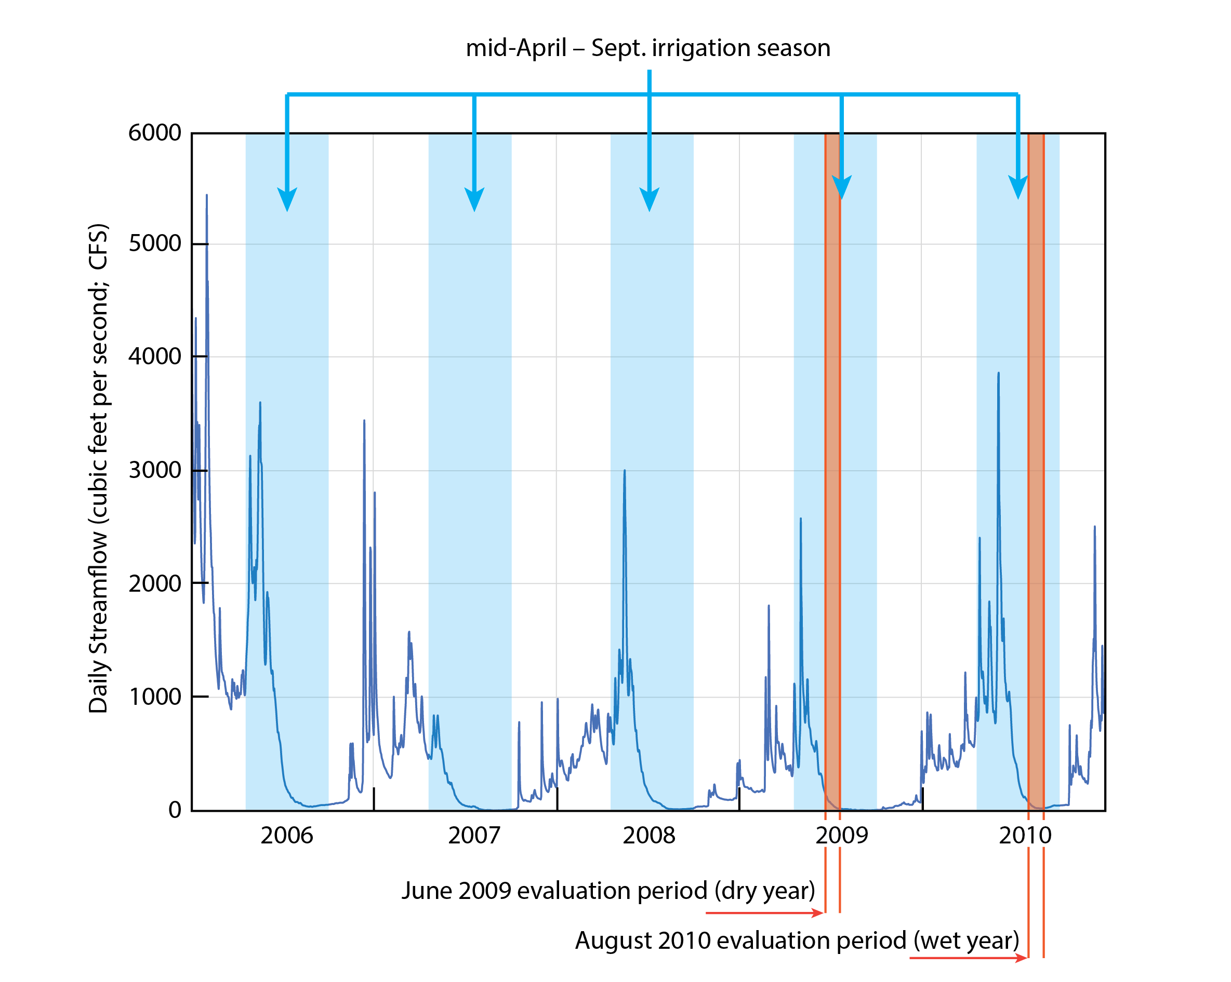
Evaluate impacts during both
“normal” and “dry” years

Slide 13
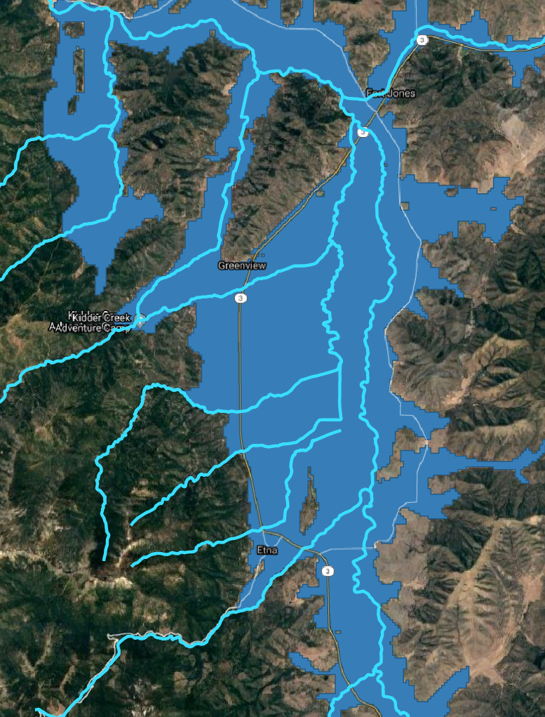
Where in the Scott Valley is a single well pumping 50 gallons per minute most impactful?
?
The model can provide initial reconnaissance about the locations where a hypothetical well would be more or less impactful on streamflow

Slide 14
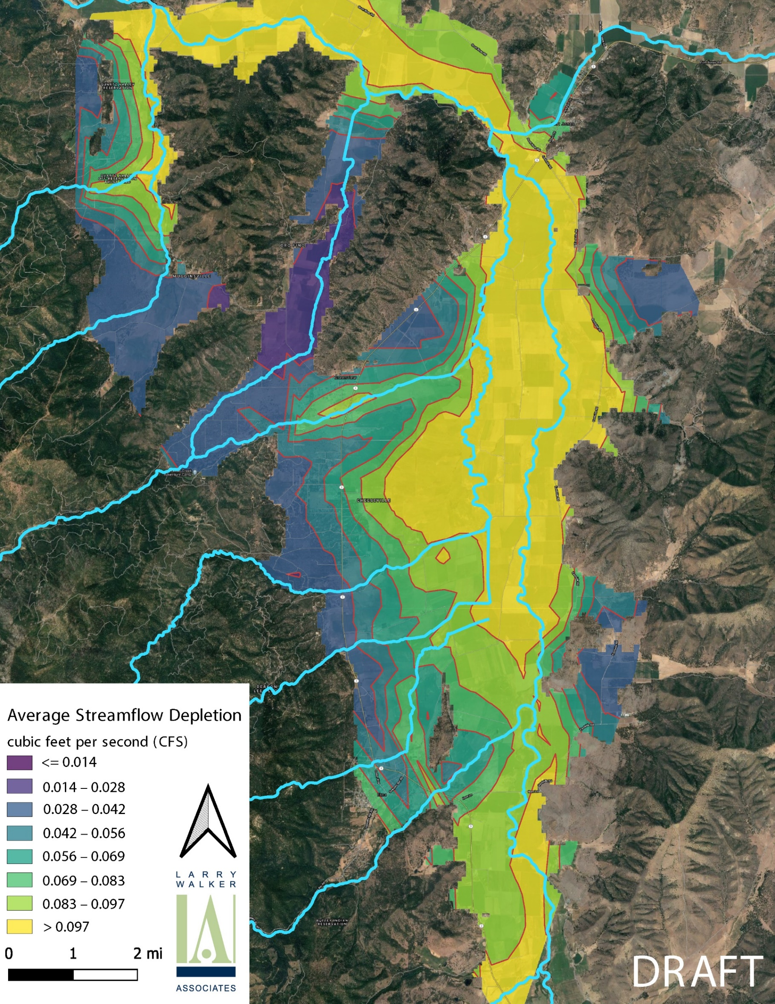
Fort Jones Stream Gage
50 gallons-per-minute pump rate
4 seasons of pumping
“dry” year (2010)
Much more widespread impact following a dry winter.
Greatest impact is still focused along the river corridor and tributaries.
0.1 CFS = <2% of low flow during a “dry” year (2009)

Slide 15

Fort Jones Stream Gage
50 gallons-per-minute pump rate
19 seasons of pumping
“dry” year (2010)
Very little difference between 4-season and 19-season scenarios.
Slight expansion of contours along the basin boundary with more years of pumping.

Slide 16
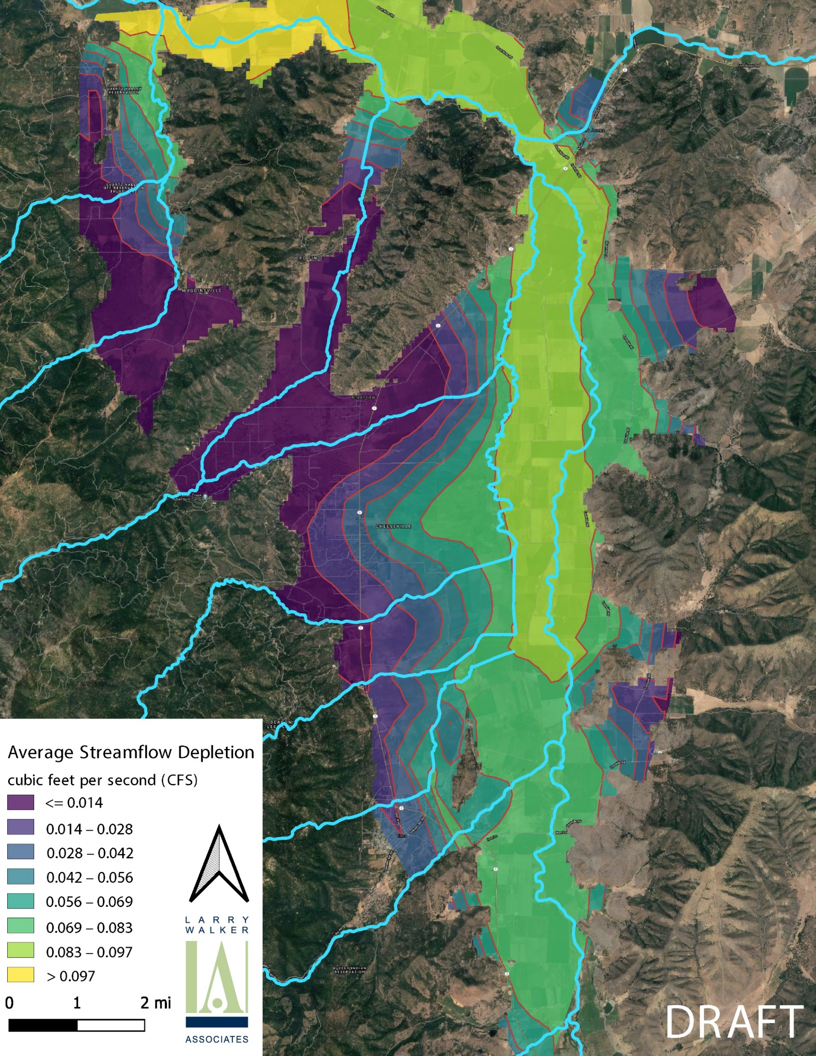
Fort Jones Stream Gage
50 gallons-per-minute pump rate
5 seasons of pumping
“normal” year (2010)
Greatest impact along the river near the Fort Jones gage
Maximum value is equal to the pumping rate:
50 GPM = 0.1 CFS
Impacts are proportional to the pumping rate … but the spatial distribution does not change.
0.1 CFS = <0.5% of low flow during a “normal” year (2010)
Decreasing impact further from the river and tributaries

Slide 17
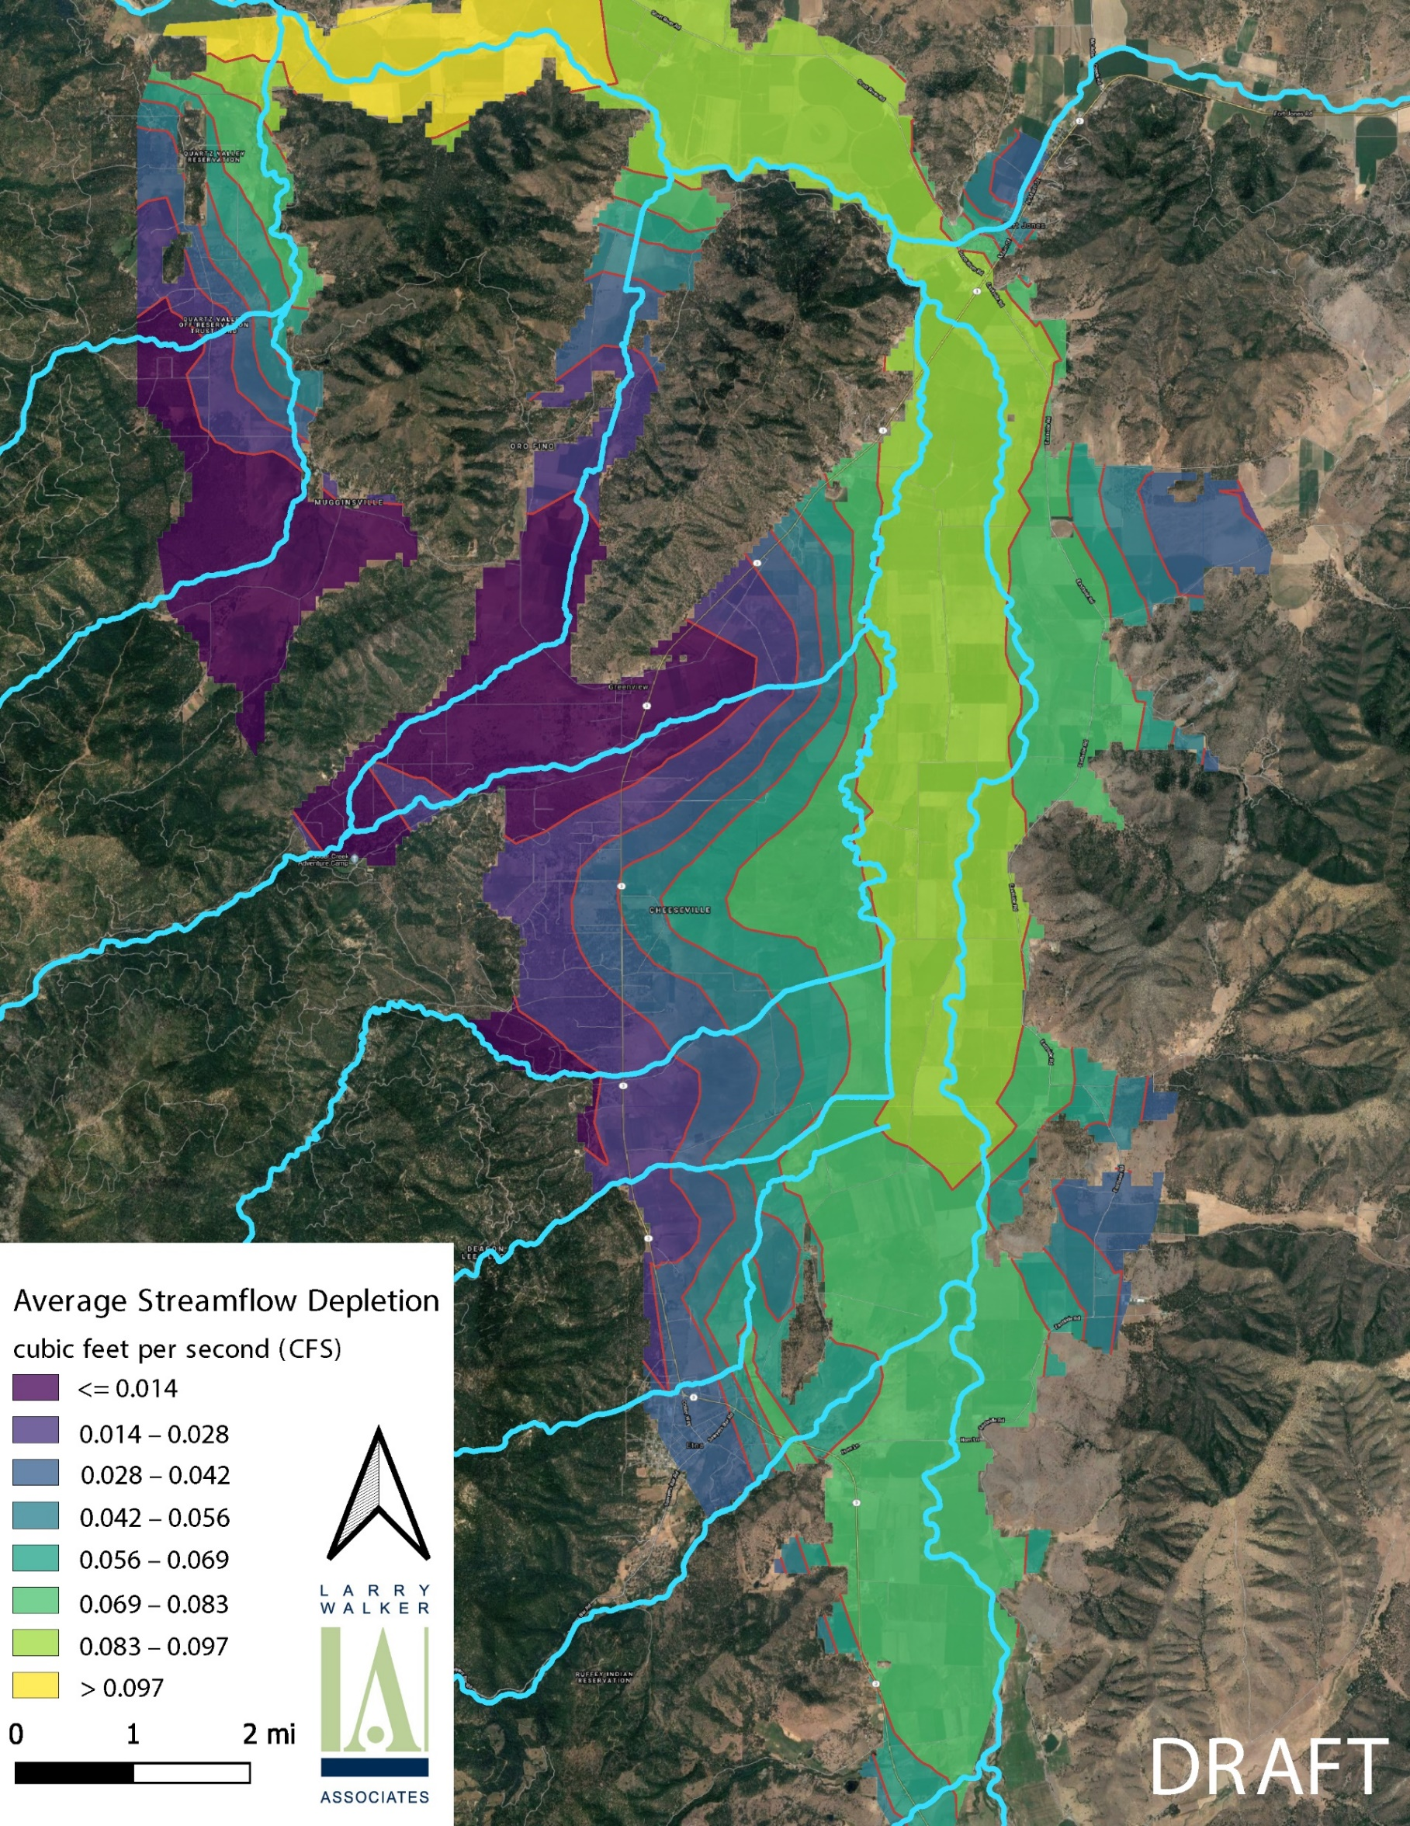
Fort Jones Stream Gage
50 gallons-per-minute pump rate
20 seasons of pumping
“normal” year (2010)
Very little difference between 5-season and 20-season scenarios.
Slight expansion of contours along the basin boundary with more years of pumping.

Slide 18
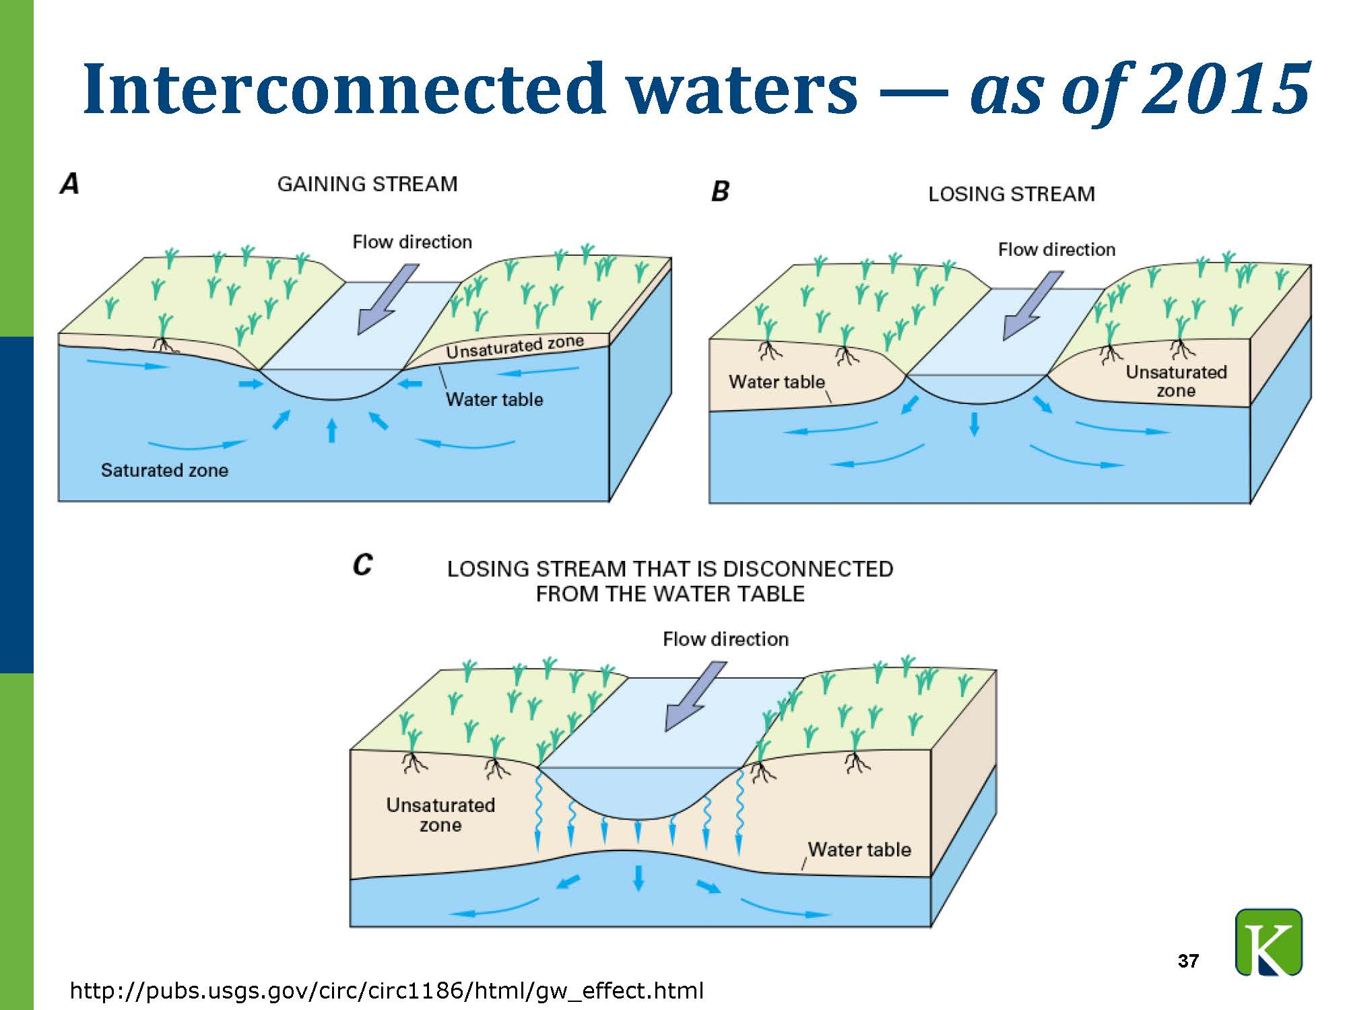
How does pumping near disconnected or dry reaches of river delay the “re-wetting” flows from the first rainfall event?
Groundwater pumping along disconnected/dry reaches “banks” the impact until re-wetting flows refill the deficit.
Additional analyses are being conducted to compare the groundwater pumping volume during dry-reach periods with typical re-wetting flow volumes to provide guidance on the duration of re-wetting delay.

Slide 19
Model Results Suggests …
Greatest impacts occur at downstream locations that are close to the river.
Impacts depend on whether previous winter was “wet” or “dry”
Number of seasons of pumping likely has only a small impact.
Impact on streamflow is proportional to pumping rate.
Effects of pumping a single well at 50 GPM may be relatively small (<2% of minimum streamflow during dry years).
Pumping along dry reaches may lead to delayed re-wetting Fall flows.

Slide 20
Take Home Messages
SVIHM shows hypothetical groundwater pumping impacts on the Scott River.
SVIHM is a reconnaissance tool that could support more in-depth case-by-case analyses.
SVIHM results alone cannot make any decisions … The model can only provide information about hypothetical pumping scenarios using historical data.
Decision-making will depend on the Board assigning specific thresholds.

