Slide 1
Siskiyou Opioid Safety Coalition
Preventing opioid overdoses, encouraging safe prescribing practices, engaging the community in collective action, and increasing access to naloxone and medication assisted treatment.

Slide 2
SOSC Membership
ANAV Tribal Health
Dignity Health
Fairchild Medical Center
Karuk Tribal Health
Siskiyou Community Resource Collaborative
County of Siskiyou:
Public Health
Behavioral Health
Probation
Sheriff
Siskiyou County Office of Education
Clinics
Pharmacy
Dentists
Community Members

Slide 3
SOSC Staff
Daniele Minock, RN, PHN, BSN –Coalition Facilitator
Michelle O’Gorman, MBA –Grant Administrator
Maggie Shepard, RN, MS –Outreach Coordinator
Jean Trevisan –Program Manager
Chrissy Montgomery, BA –Recovery Advocate

Slide 4
Overdoses are now the leading cause of death of in Americans under 50 yrs. old. SOURCE: NCHS, National Vital Statistics System, Mortality.

Slide 5
The face of the opioid epidemic is changing, and not for the good….
Between 2019 and 2020, there was almost a 30% increase in drug overdose deaths- from 72,000 to 93,000. Almost 70,000 of those deaths were from opioids. That’s 11 people dying every hour.
California saw a 40% rise in overdose deaths over the previous 12 months.
The highest number of deaths occurred in the 35-44 yr. old range.

Slide 6
Covid-19 and Overdoses
Lock downs made treatment harder to get.
Fentanyl (50-100x stronger than heroin) was involved in 60% of deaths. It is a contaminant in meth, cocaine and heroin, as well as other drugs of abuse.
People are more isolated, and more often use alone.
Suspension of evictions, extended unemployment benefits and stimulus checks gave some more disposable income.
For others, loss of jobs due to the pandemic created tremendous stress, leading to resumption of use.

Slide 9
Buprenorphine Prescriptions-age adjusted rate per 1,000 residents,

Slide 10
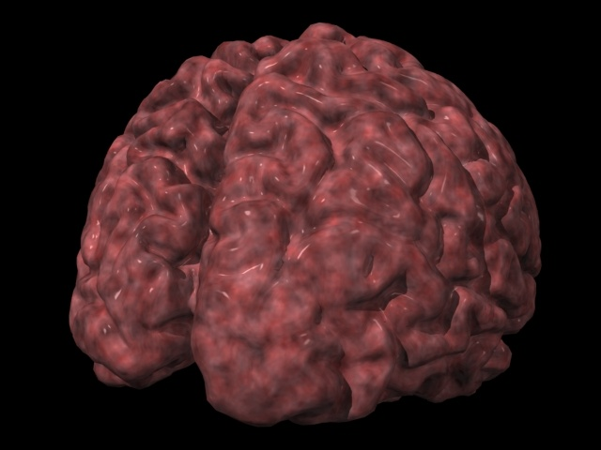
Drug Addiction is a complex illness
Notes:
Drug Addiction: A Complex Illness
Drug addiction is a complex illness. The path to drug addiction begins with the act of taking drugs. Over time, a person’s ability to choose not to take drugs is compromised. This in large part is a result of the effects of prolonged drug use on brain functioning, and thus on behavior. Addiction, therefore, is characterized by compulsive, drug craving, seeking, and use that persists even in the face of negative consequences.

Slide 11
SUD Meets the Criteria for Chronic Illness
Common features with other chronic illnesses:
Heritability
Influenced by environment and behavior
Responds to appropriate treatment
Without adequate treatment can be progressive and result in substantial morbidity & mortality
Has a biological/physiological basis, is ongoing and long term, can involve recurrences
Source: https://archives.drugabuse.gov/about/welcome/aboutdrugabuse/chronicdisease/de long-term lifestyle modification http://www.asam.org/quality-practice/definition-of-addiction

Slide 12
Relapse rates in chronic diseases
SHOUT - Support for Hospital Opioid Use Treatment

Slide 13
Key Points to Understanding Opioid Addiction
There is a strong genetic component to opioid addiction (risk is 70% genetic)
The neural restructuring that drives addiction is not under voluntary control
The addicted brain is not a rational brain
Opioid addiction is a treatable medical condition

Slide 14
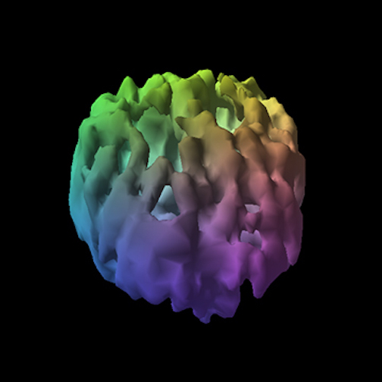
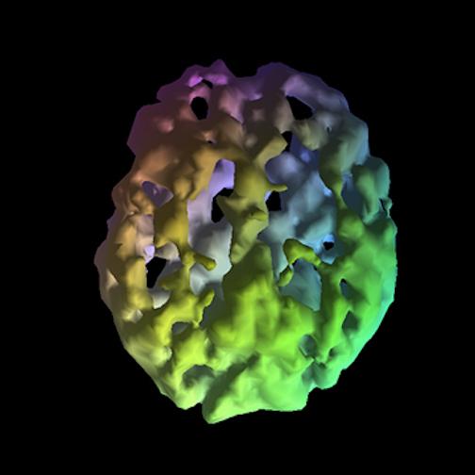
Drugs of abuse change how your brain looks and how it works.
healthy brain
25 years frequent heroin use

Slide 15
Neurotransmission

Slide 16
This is your brain…this is your brain on drugs.
Dopamine (DA) is the neurotransmitter that’s most responsible for pleasure by activating the reward pathway, and is implicated in drug cravings and euphoria.
In a typical day, the brain produces 50 ng/dl of DA, and about 100 ng/dl on a REALLY good day.
Comparatively, substances of abuse result in excessive DA production and release:
Tobacco → 450 ng/dl
Marijuana → 650 ng/dl
Heroin → 975 ng/dl
Methamphetamine → 1100 ng/dl (> 20x normal DA release!)

Slide 18
Stigma
Assigns negative attributes to characteristics, situations and behaviors of an individual that are not under the individual’s control

Slide 19
Stigma
"Stigma is a perceived negative attribute that causes someone to devalue or think less of the whole person"

Slide 20
Implicit Bias
Attitudes or stereotypes that
affect our understanding,
actions and decisions in an
unconscious manner

Slide 21
Range of treatment goals
How Do You Measure Success?
Minimization of harms from ongoing use
Sustained recovery with abstinence from all substances
Notes:
Speaker Notes:
MAT has also been shown using validated rating scales to improve quality of life in multiple domains, beginning early in treatment
This study shows an ~30% improvement across various Life domains for individuals who remain in treatment for ~6months or more
Individuals begin to see an improvement in Physical health, social relationships and subjective feelings – almost immediately. Self-ratings related to leisure activities improve after being in treatment for several months - It takes time.
Reference
Ponizovsky AM and Grinshpoon A. 2007. Quality of life among heroin users on buprenorphine versus methadone maintenance. American Journal of Drug and Alcohol Abuse 33 631-642.

Slide 22
Imagine.......
You are visiting with your sister after a recent visit to the doctor for numbness and tingling in her feet.
She says that her doctor told her that she has diabetes and that she is stupid for letting her diet get so out of control.
The doctor’s recommendation is that she see a dietician and gain some self-control. Once she does that, he will consider treating her diabetes directly with medicine.
The doctor tells her that treatment with insulin will not do her any good unless she really is ready and he will know that is true when she loses some weight.
The doctor tells her to come back when she really wants to change.
No follow-up appointment is scheduled.

Slide 23
SOSC
What we say and how we say it matters

Slide 24
Use First-Person Language
https://unityrecovery.org/person-first-pledge

Slide 25
Help Eliminate Stigma
With careful attention to language, we can:
★ Reduce the burden of stigma surrounding substance use disorders
★ Improve access to health care for people with substance use disorders
★ Save lives

Slide 26
Harm Reduction
Harm reduction is grounded in justice and human rights — it focuses on positive change and working with people barring judgement, coercion or discrimination. It does not require that they stop using drugs as a precondition of support.

Slide 27
Harm reduction uses a range of strategies in order to promote the dignity and wellbeing of people who use drugs.
Strategies include:
psychosocial support
overdose prevention
referral to treatment
safer techniques
managed use
These approaches are proven to be cost-effective, evidence-based, and positively impact both individual and community health.

Slide 28
Examples of Harm Reduction
Overdose Prevention –Naloxone
Syringe Exchange
Safe Medication Storage and Disposal
Fentanyl Testing

Slide 29
SOSC Website
For more information on any of the topics discussed in this presentation and more, please visit the coalition website at:
www.siskiyouopioidsafety.org

Slide 30
SOSC
Thank you for your time
Daniele Minock, Coalition Facilitator
daniele@siskiyouopioidsafety.org
Siskiyou Opioid Safety Coalition

