Slide 1
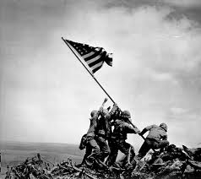
Siskiyou County Sheriff’s Office
Veterans’ Service Office Overview
Thomas Jackson, Veterans’ Service Officer
&
Sheriff Jon E. Lopey
August 7, 2020

Slide 2


Workload & Revenue
January through December 2019
Retroactive Benefits - $1,151,019.60
Monthly Benefits – $906,125.88
Lump Sum Benefits - $4,280.00
Total Benefits - $2,061,425.40
Claims Pending Decision: 160

Slide 3

The money that is awarded to our veterans and dependents is “Tax Free”.
It helps to improve their quality of life, and the majority of the money earned is spent in our local community generating revenue for our cities and our county.

Slide 4

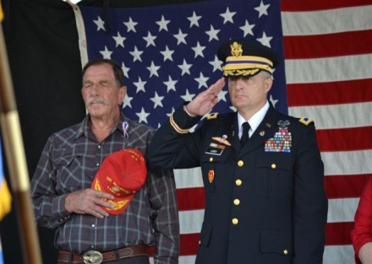
Major
Accomplishments
Office Workload 2019
  Lobby/Reception – 1,534
  Walk Ins – 210
  Scheduled Appointments – 1,006
  Total: 2,750 People Contacted
  Outreach – Mt. Shasta, Happy Camp and Dorris – 201 People Contacted
  Redding Veterans Resource Center – Homeless Veteran Outreach
  Siskiyou County Veterans Service Office now on Facebook.

Slide 5

Additional Accomplishments
Other Outreach Events Attended:
Fort Jones Christmas Parade
Marine Corps Toys for Tots
Dunsmuir Community Resource Center Holiday Food Giveaway
Yreka Elks Veterans Day Dinner – Guest Speaker.

Slide 6
Outreach Events Continued
Living Memorial Sculpture Garden Veterans Day and Memorial Day Celebrations
Evergreen Memorial Veterans Day and Memorial Day Celebrations
Mt. Shasta Elks Veterans Day Dinner
Yreka Health Fair
Siskiyou County Fair
Siskiyou County Veterans Commission Car Show
American Legion Bingo Night – Fund Raiser

Slide 7
Outreach Events Continued
Mt. Shasta Memorial Day Ceremony
Rain Rock Casino Memorial Day Car Show
SCVLC Armed Forces Day Celebration
2019 Senior Services and Fraud Prevention Fair.
SCVLC Welcome Home Vietnam Veterans Day Celebration

Slide 8
Organizations
California Association of County Veterans Service Officers
National Association of County Veterans Service Officers
Current Vice Chair of the Siskiyou County Veterans Leadership Council

Slide 9


Shortfalls
We are currently in the process of hiring a Veterans Service Representative.
We are still having issues assisting our Homeless Veteran Population. I have been working with the Redding Veterans Resource Center to deal with these issues.

Slide 10
Accreditation and Education Requirements
CAL VET (CDVA) has made it a requirement that all CVSO’S and CVSR’S pass the California of Veterans Affairs Veterans Representative Academy before we are authorized to perform the VA Claims Process.
CAL VET has also required that we attend three California County Veterans Service Officers Association Conferences per year to meet their Creditable Education Units Requirements.

Slide 11
Accreditation and Education Requirements Continued
National Association of County Veterans Service Officers Accreditation Course.
The NACVSO also requires that we have a certain number of Creditable Education Units. They have made an agreement with the CACVSO to use the CEU’s that we earn by attending the conferences. We also attend NACVSO Conferences when they are near us. I have attended the ones in Sacramento, Reno, and San Diego.

Slide 12
What’s the difference between the two Accreditation Courses?
The Cal Vet Course deals mainly with the Federal Veterans Laws, Rules, and Regulations.
The NACVSO Course deals more with the actual Claims Process and working with the clients on an individual basis.
Both of these courses give invaluable information to our CVSO’s and CVSR’s

Slide 13
Retaining Personnel
My goal is to hire a Veterans Service Representative who is dedicated to assisting our Veterans and their dependents.
The CVSR would normally replace the CVSO if the CVSO decides to retire, or can no longer perform his or her assigned duties. This allows for advancement.
Since 2011, the CVSO’s have all retired from another profession.
In order to retain a CVSR, we need to be able to offer them an incentive to remain. My office has lost a very capable CVSR to a higher paying job. My office will be looking into this matter in the near future.

Slide 14
Conclusion
The Siskiyou County Veterans Service Office continues to provide an invaluable service to our fellow Veterans and their Dependents. We assist the Veterans and Dependents to obtain the benefits that the Veteran earned by serving his or her country.
The monetary benefits are Tax Free and the majority of those benefits are spent within Siskiyou County.
The Siskiyou County Veterans Service Office also receives State Subvention Funds to help fund our office.

Slide 15

Questions?

