Slide 1
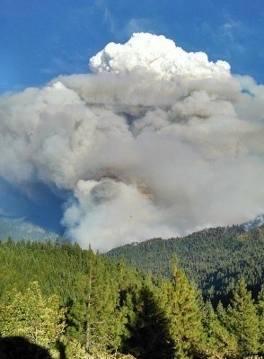
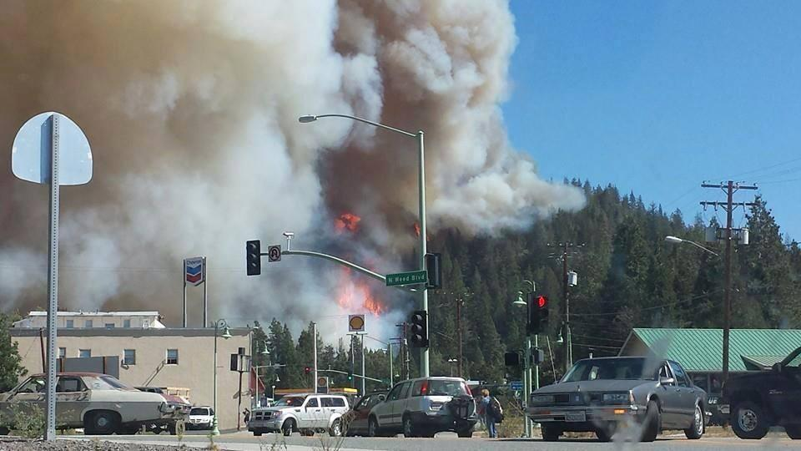
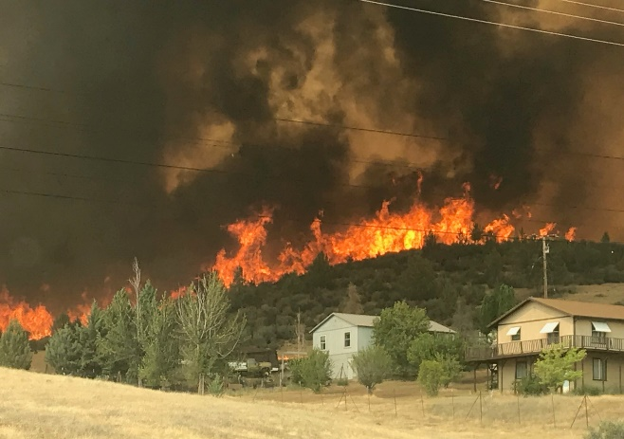
Community Wildfire Protection Plan Siskiyou County
Boles Fire | September 2014
Klamathon Fire | July 2018
Happy Complex | August 2014
County Board of Supervisors Meeting
May 21, 2019

Slide 2
CWPP Requirements
Minimum Requirements
Local collaboration: 5 public workshops, interagency meeting, 2 final review meetings (public and County Fire Chief Asso.)
Guidance for prioritizing hazard fuel treatment units
Highlighted actions to reduce structural ignitability
Plan Recommendation and Approval
Local Government
Local Fire Department (Siskiyou County Fire Chief Association)
State Forester Rep./CALFIRE
General Benefits of Updated Approved Countywide Plan
Provide updated tools for communities across Siskiyou county to adopt & utilize in their local wildfire protection plans & activities
Enable all communities potential opportunity to apply for federal and/or state funds to address wildfire hazard reduction actions

Slide 3
Brief Summary of Beneficial Aspects
(Section 1) Provides extensive updated policy information to utilize in your local CWPP and as a general reference for response to citizen questions
(Section 3) Offers helpful fire science elements that apply to the County and displayed at Planning Region level, (in Part II)
(Section 5) Explains the science process used to produce map products displaying levels of fire severity and threat
Maps and Charts (tools) help local FSCs and community citizen groups in planning and prioritizing fuel treatments
(Section 6) The Action Plan consolidates numerous useful tools:
Updated info/websites for:
Wildfire Preparedness, Emergency Alert System
Defensible space info, websites, tools
Structure Mitigation Action tables
Fuels: Mitigation Strategy, Treatment info, Prescription Tables
Important Evacuation Guidance
(Section 7) Provides potential funding source information

Slide 4
Sections with technical wildland fire information:
Section 3 – Defining the Wildfire Situation
Wildfire science elements and facts applied at the general countywide scale
Section 5 – Wildfire Assessment *
General wildfire assessment factors and process explained on countywide scale; further explained by planning region in PART II
Section 6 – Action Plan *
Key tools that apply countywide including; EAS weblinks, Defensible Space tools, fuel reduction prescription tables; evacuation guidance
* The following set of slides display a few tools from Sections 5 & 6 in PART I and PART II; our intent is to allow time for your questions and input.

Slide 5
Section 5 – Wildfire Assessment Key Terms | Science:
Components of Fire Hazard Severity:
Fuel Rank - a means of displaying model results of the potential a wildfire has upon a landscape. For the purposes of this analysis, Fuel Rank will be used as a proxy for fire hazard.
Fire Threat - a combination of two factors: 1) fire frequency, or the likelihood of a given area burning, and 2) potential fire behavior (hazard).
In this updated CWPP: important science is displayed across the entire Siskiyou county landscape and scaled to each Planning Region. They are valuable tools for individual communities to review at their local scale as they plan out their hazard fuel reduction projects.
The next 2 slides depict these map tools for Fuel Rank & Fire History on the countywide scale

Slide 6
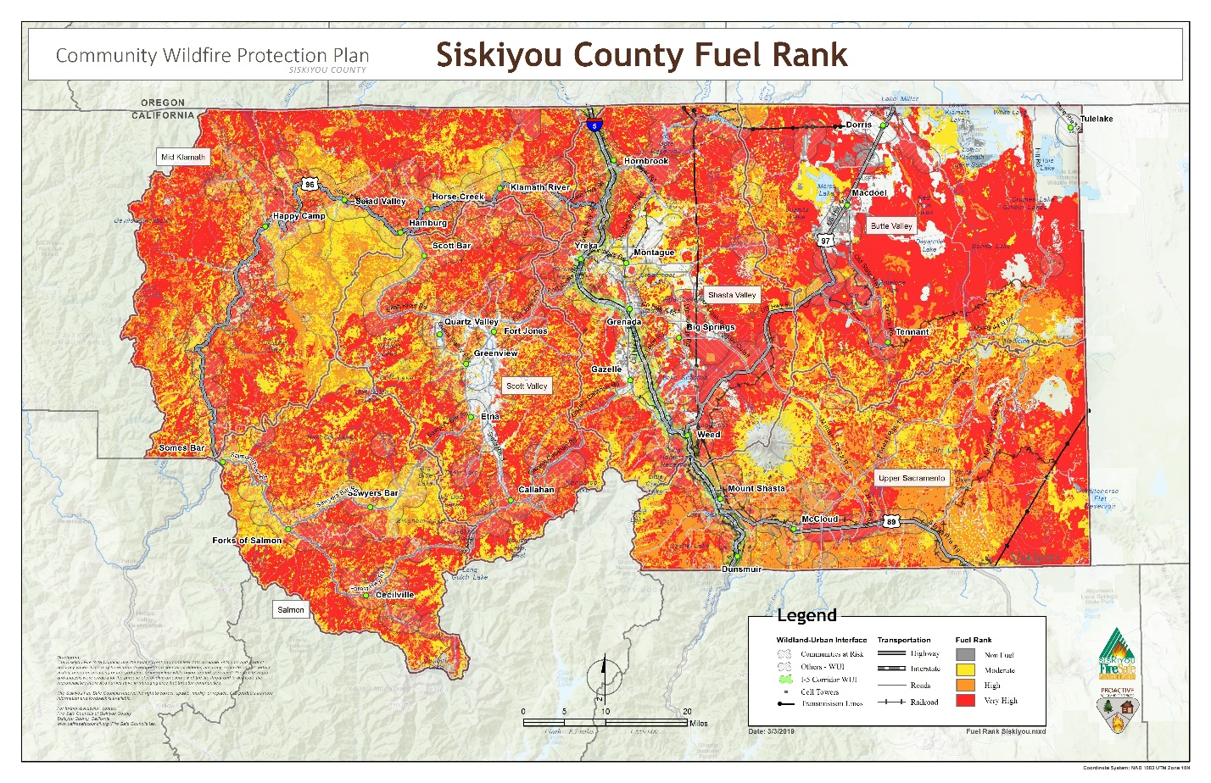
Fuel Rank shown at Countywide Scale

Slide 7
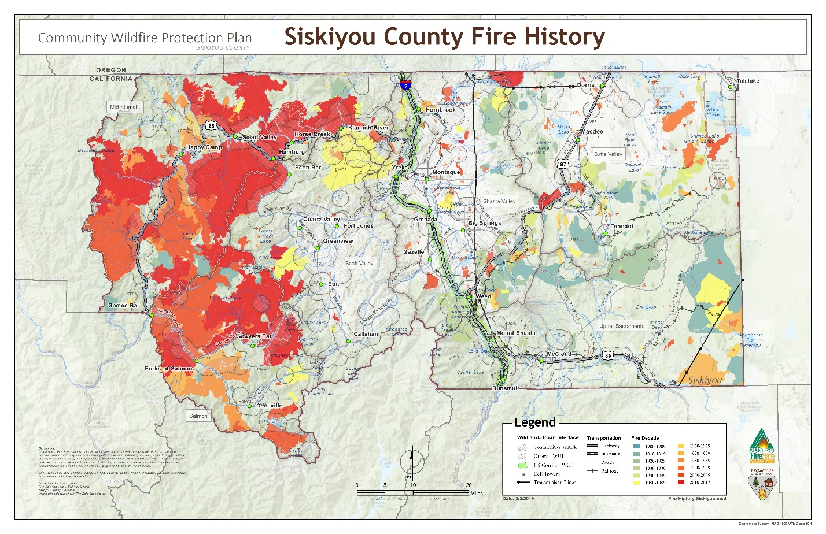
Fire History shown at Countywide Scale

Slide 8


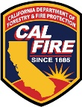
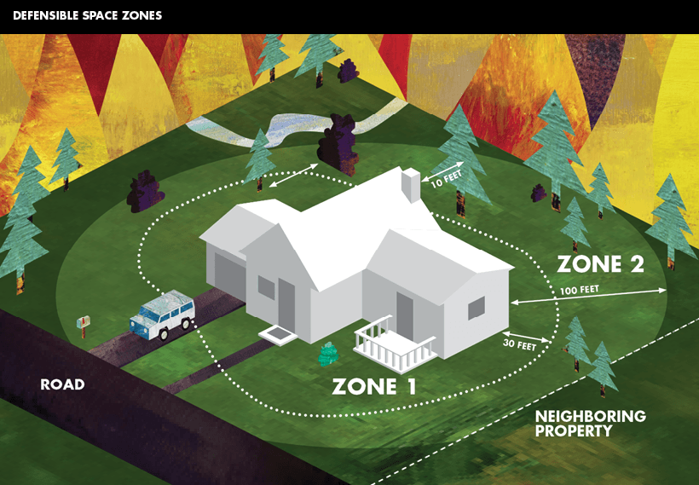
Section 6 – Action Plan Tools:
Wildfire Preparedness Tools including:
Life Safety
Area Emergency Notification Systems
Defensible Space
Fuels Mitigation Strategy
Fuel Treatment Types
Wildfire Evacuation Process Guidance
Primary Hazard Reduction Emphasis throughout the plan is Evacuation Route Clearance & Safety.

Slide 9
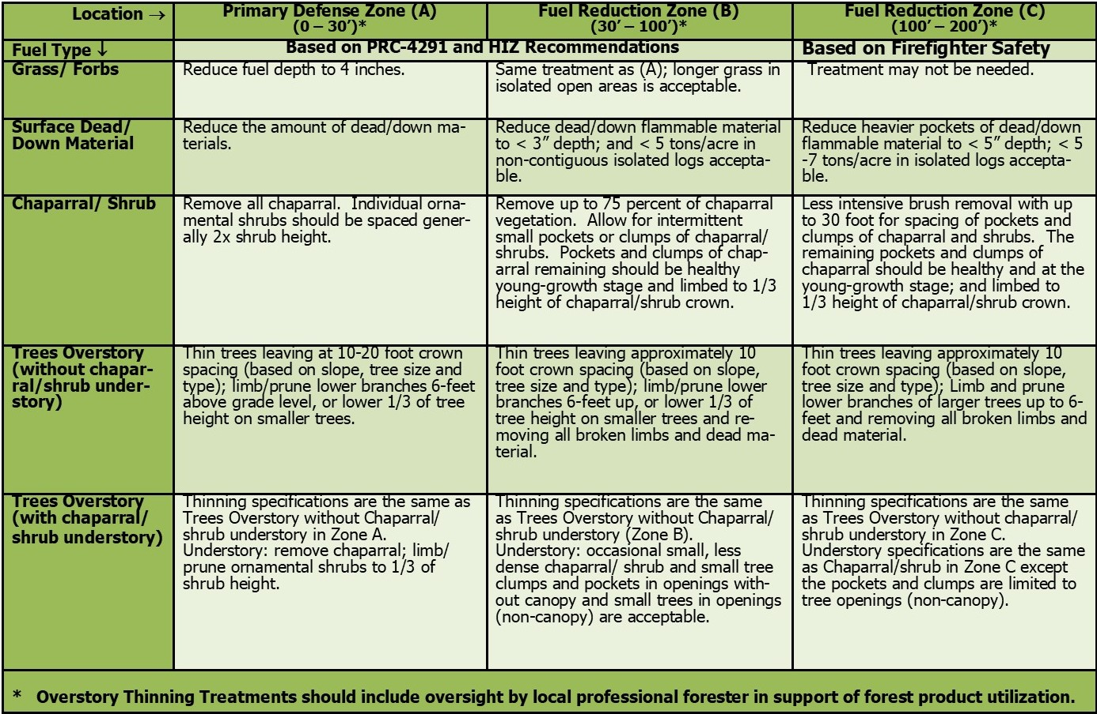
Example Action Plan Tool: Fuel Treatment Unit Prescription Guidelines (p.103)

Slide 10
PART II: Planning Regions:
BUTTE VALLEY
MID KLAMATH
SALMON
SCOTT VALLEY
SHASTA VALLEY
UPPER SACRAMENTO

Slide 11
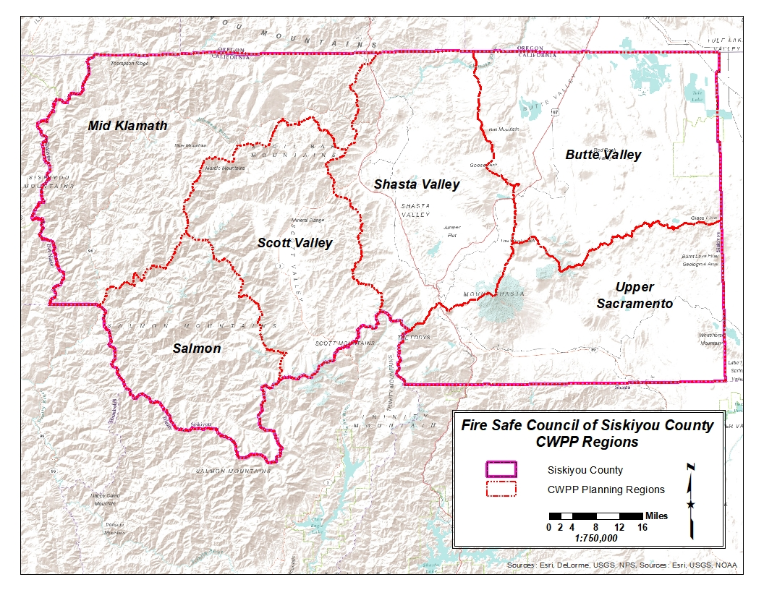
Planning Regions (PRs): 6 geographical divisions
PR Boundaries delineated in ‘08 plan
>> Next 5 Slides = Example Map Tools from various P.R.s <<

Slide 12
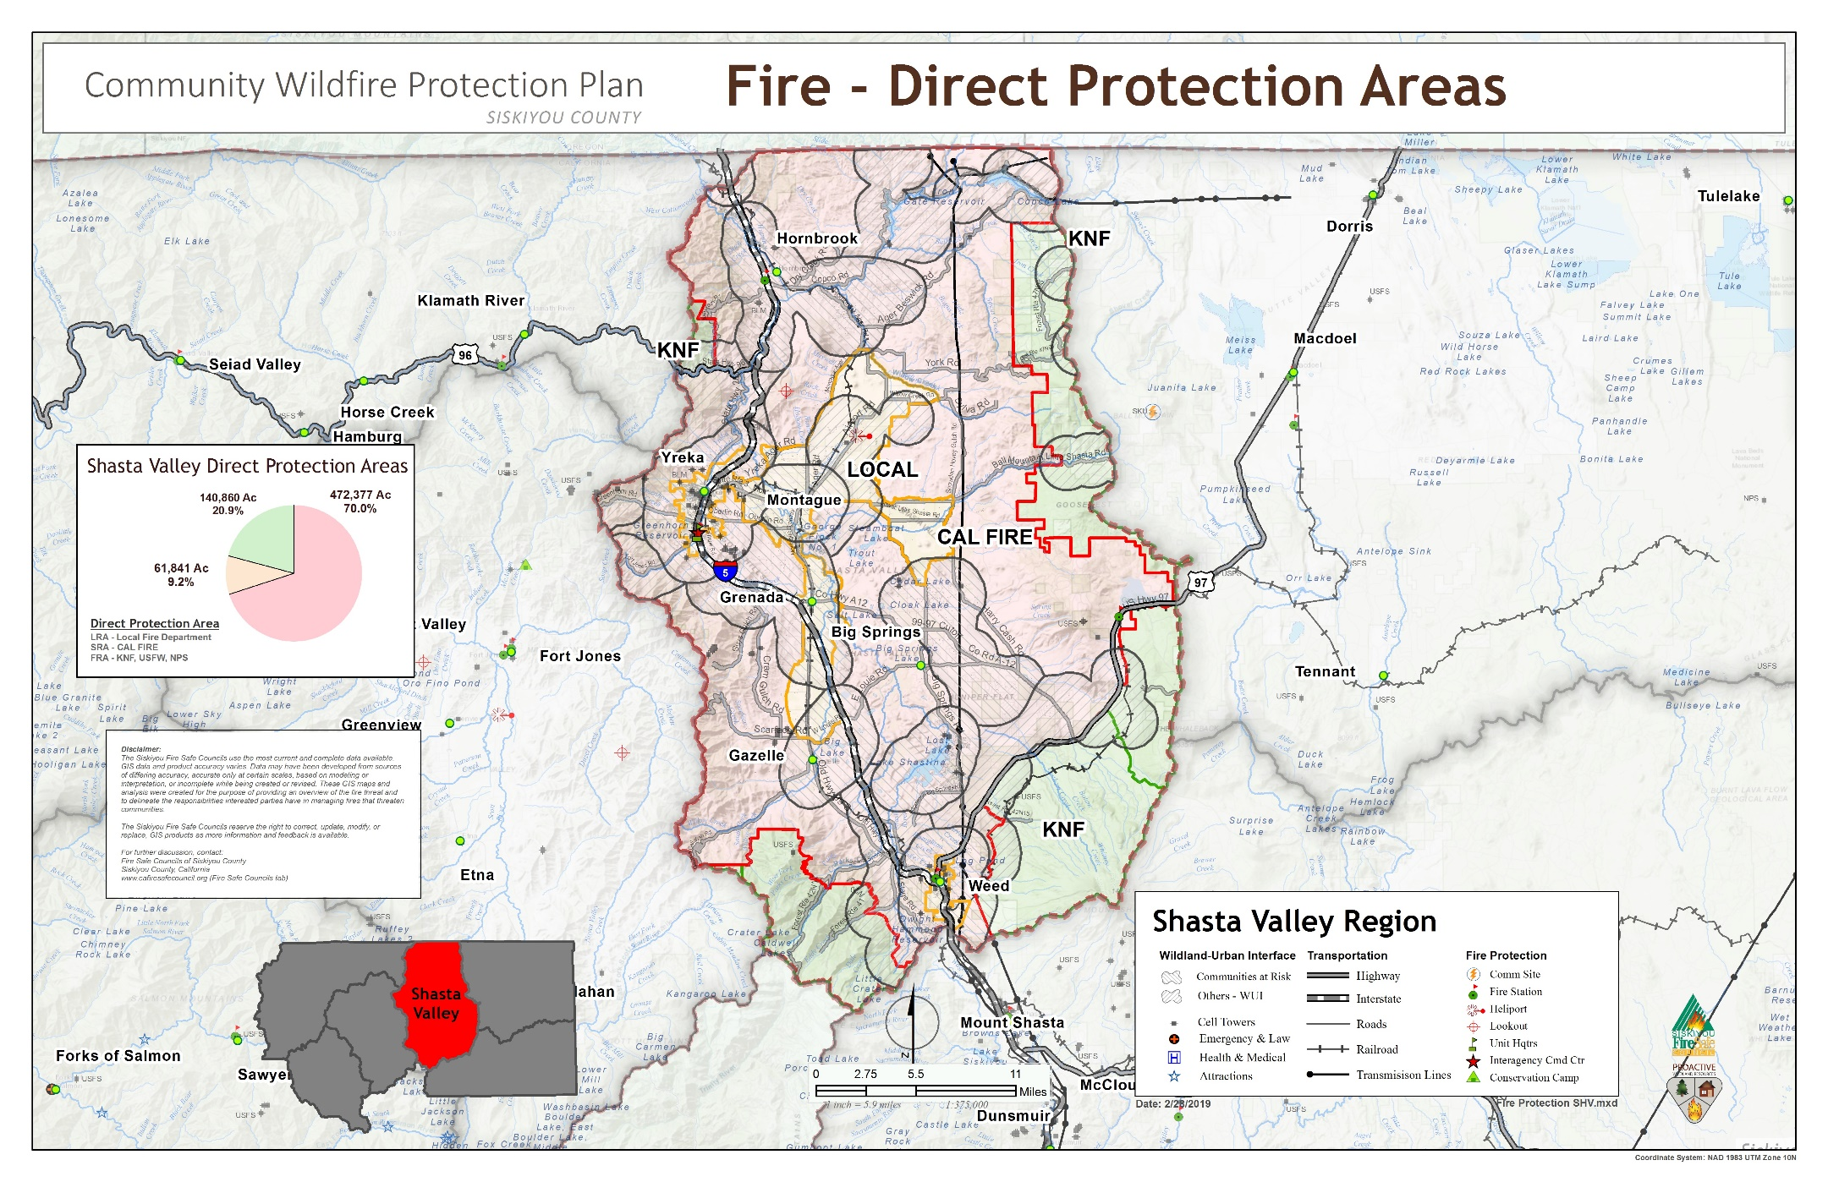
Shasta Valley – Direct Protection Areas

Slide 13
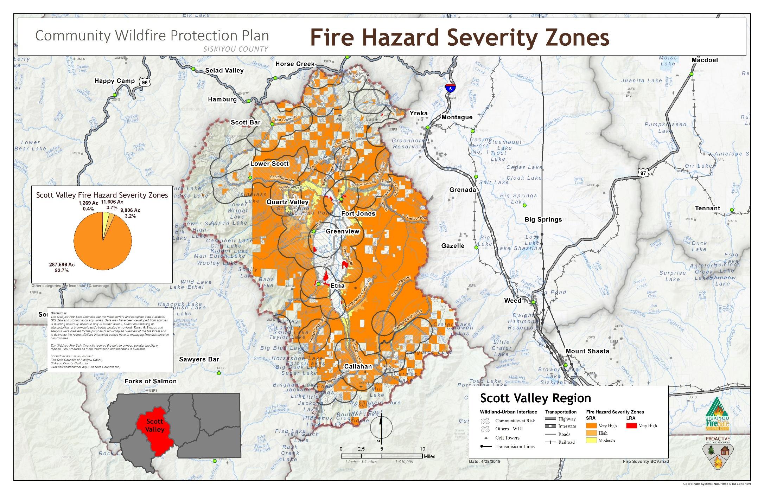
Scott Valley – Fire Hazard Severity Zones

Slide 14
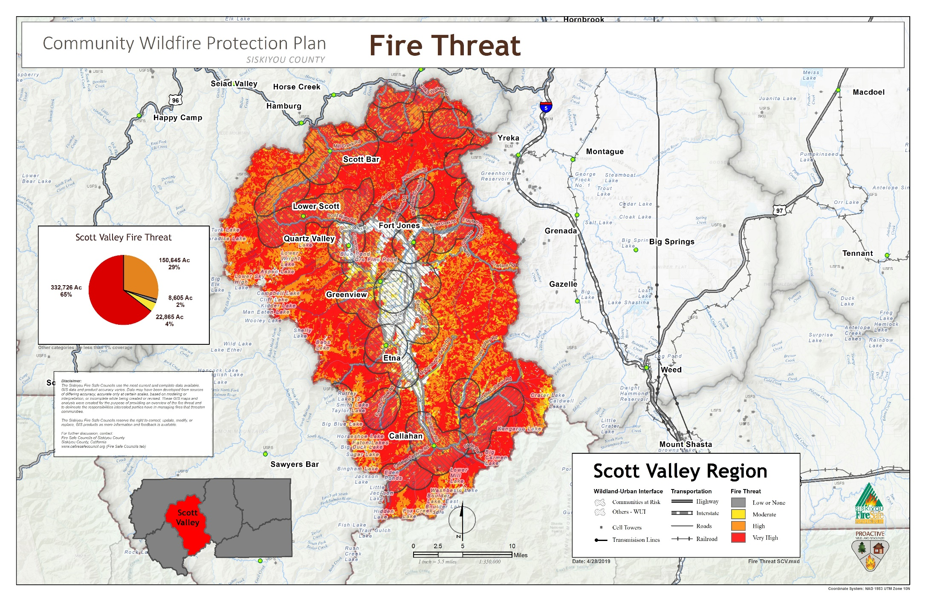
Scott Valley – Fire Hazard Severity Zones

Slide 15
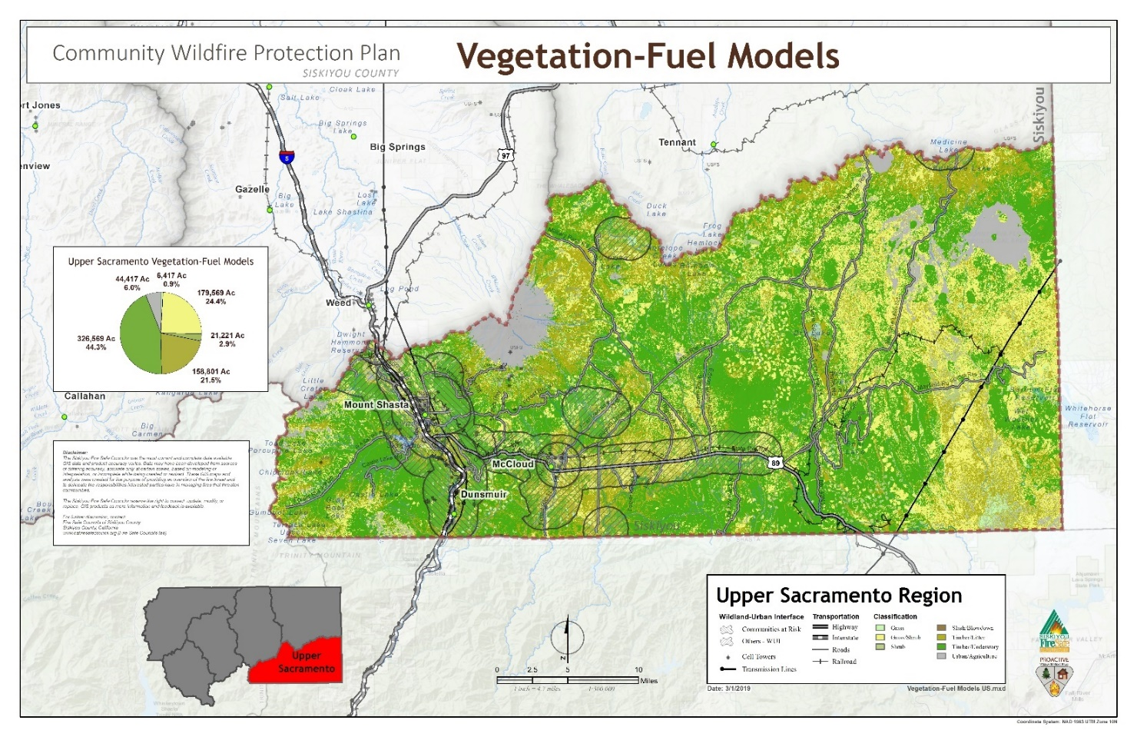
Upper Sacramento – PR 6: Vegetation-Fuel Models

Slide 16
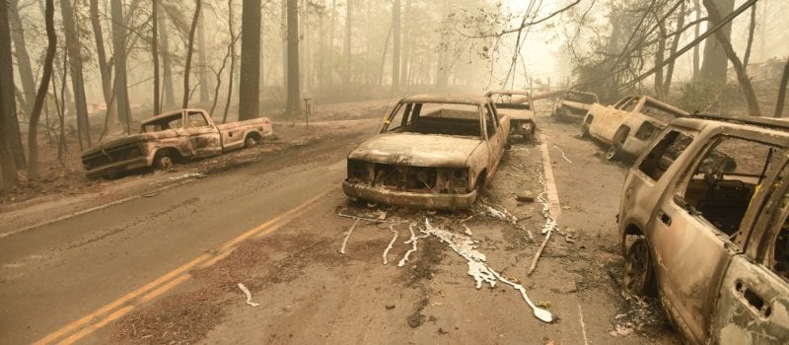
Further Beneficial Aspects of Countywide CWPP
Provides tools to help improve safety along evacuation routes
Guidance for prioritizing hazard fuel treatment
Supports opportunity to secure funding sources to help reduce wildfire threat within and surrounding all communities
Hazard fuels reduction and/or wildfire education grants
County leadership corroboration demonstrates support for implementing actions to reduce this serious wildfire situation
Assist in identifying areas of concern countywide
Updated policy and science provide tools for local FSC’s in planning and projects
(ie) Projects that have
incorporated or are set to
utilize and refine the tools
include Yreka FSC and
Dunsmuir FSC.
11.10.18 – Camp Fire: DML News, Getty Images

Slide 17
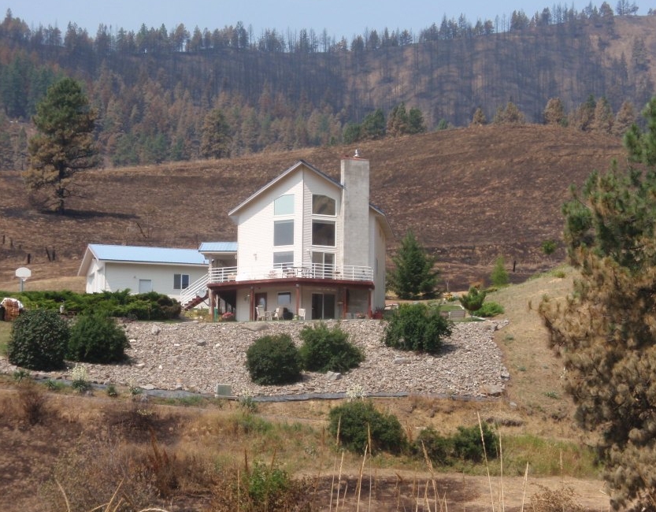
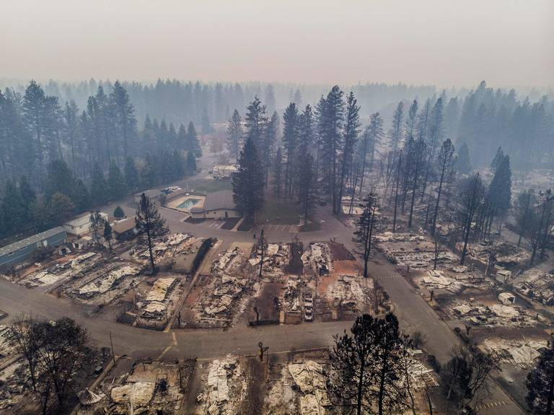
Wildfire Safety Begins at Home
‘Hardening’ homes against the impacts of a wildfire, especially embers.
Providing defensible space on your property
2017-2018 wildfire disasters are our ‘wake-up call’
Awareness & Preparedness are critical
Proactive planning and action begins at the individual citizen level.
Camp Fire | November 12, 2018 | H.Amezcua, Sac Bee

Slide 18

Community Wildfire Protection Plan Siskiyou County

