Slide 1
Board of Supervisors:
Siskiyou County
May 16, 2017
Margaret Kisliuk, Executive Director, Northern Region

Slide 3
About Us
We are a public agency that administers the Medi-Cal program in 14 counties. Our goals are to improve access, quality, and efficiency through an organized health care delivery system.
Members are assigned to a primary care provider to ensure integrated and coordinated care. The primary care provider works with the individual to address preventable and chronic conditions and to assure the most effective use of limited specialist and emergency room resources.
Our administrative costs are around 4%; almost all of our spending is on health care services and support to our communities.
PHC’s Board of 35 health care leaders and consumers includes Siskiyou County appointee Kenneth Platou.
PHC provides quality health care to over 566,700 Medi-Cal members, 17,897 in Siskiyou County.

Slide 4
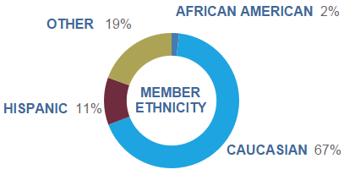
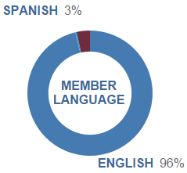
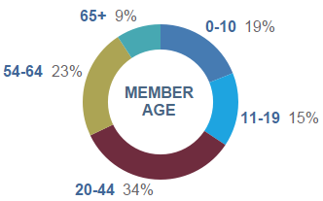
Siskiyou County Demographics

Slide 5
Status of PHC in Siskiyou County
Increased number of Partnership members/persons on Medi-Cal in Siskiyou County: approximately 1/3 of all Siskiyou County residents are members of Partnership HealthPlan.
With PHC support, community health care resources have grown with 5 providers newly recruited to the area; support for clinics seeking to improve their quality of care and processes; and funding for efforts to address community needs.
In addition to the Siskiyou County appointees to the PHC Board, Siskiyou County residents participate in our Consumer Advisory Committee, Provider Advisory Committee and Jon Andrus is on our Strategic Planning Committee.

Slide 6
Impact of the Affordable Care Act Medi-Cal Expansion
More Siskiyou County Residents got health care
Approximately 5,136 are now eligible for Medi-Cal in Siskiyou County because of the ACA, including the working poor in low wage jobs and homeless adults.
Overall, more individuals received early diagnoses of preventable chronic diseases such as diabetes. For instance, approximately 60 individuals have been diagnosed and treated for breast cancer and over 50 for cervical cancer.
Economic Impact
It is estimated that almost 300 jobs and over $45 million in business revenues in Siskiyou County are tied to the ACA expansion; mainly in the health care field.
The expansion population brings $26 million/year in federal and state health care revenues to Siskiyou County.
Better Use of Health Care Resources
Reduction in inappropriate use of emergency rooms
Early identification and treatment of preventable and chronic diseases
Linking community support to better health outcomes through targeted programs and ties between providers and the community.

Slide 7
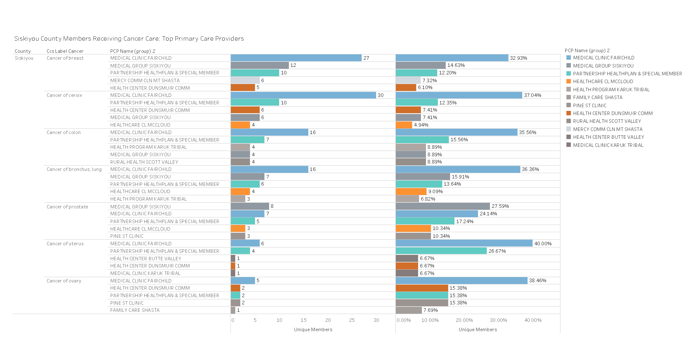
Cancer screened-expansion members in Siskiyou County

Slide 8
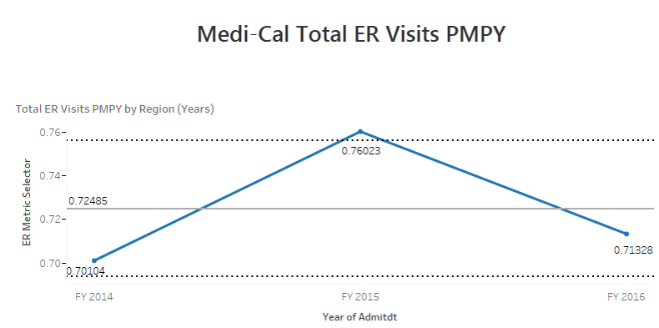
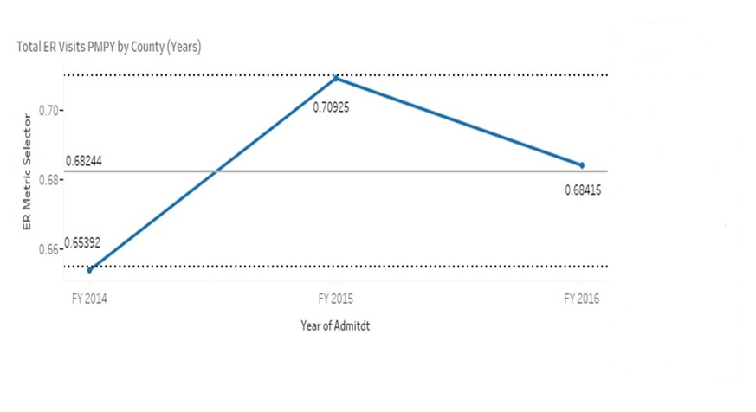
Siskiyou County ER Visits
All PHC
Counties
Siskiyou County
Start
of Expansion
Work to Expand Resources &
Outreach
Better use of Resources

Slide 9
Provider Network

Slide 10
Improving Care and Addressing Community Need
Addressing the effects of opioid abuse and other substance use treatment issues
Significant decrease in opioid use among PHC members
Working to address addiction and abuse of alcohol through establishment of Drug Medi-Cal program and other expansion of behavioral health services
Funding community-identified projects associated with social determinants of health
Participating in efforts to address the health effects of homelessness

Slide 11
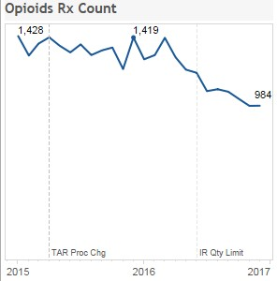
Opioids RX Count

Slide 12








Involvement in the Community
Met with 8 health care professionals, including County Health Director, Major Physician Providers, Community Clinic administrators, Hospital CEOs, etc. to discuss ideas to better serve the community.
In Siskiyou County alone, providers received over $1.5 million from our Quality Improvement Program. This program is designed to improve outcomes for our members by investing in projects for our physicians, primary care providers, and specialists.
PHC assisted in recruiting 4 new providers in Siskiyou County
Over $367,500 in Intergovernmental Transfers
8 press releases PHC released to Siskiyou County media to clarify grant goals and other community specific initiatives
Our Pain Safely Initiative saw a 67.2% decrease in unsafe doses of opioids in Siskiyou County since 2014.
$47,152 in a social determinants of health planning grants to Siskiyou Healthcare Collaborative to identify needs, resources, priorities, and strategies to effectively address key social determinants impacting health outcomes for Siskiyou County residents.
3 elected officials that PHC met with in Siskiyou County to discuss mutual goals and interests for the community specific initiatives

Slide 13

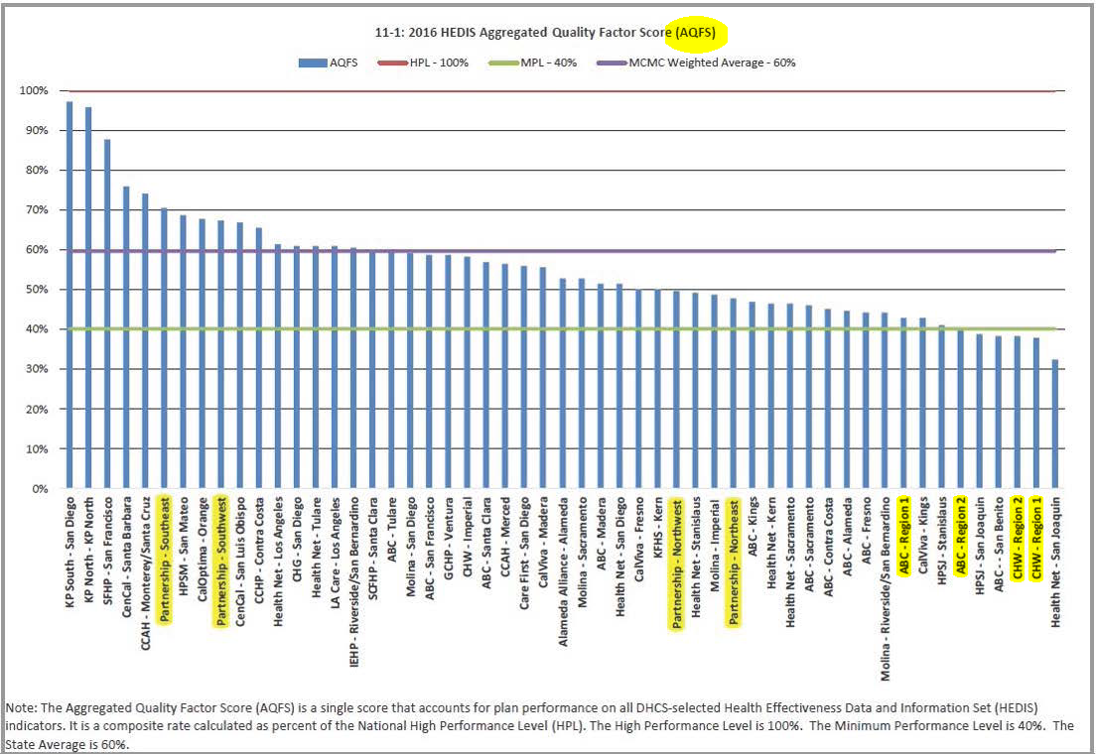
2016 HEDIS Aggregated Quality Factor Score (AQFS)
Notes:
The Department of Healthcare Services (DHS) uses a methodology annually to aggregate and rank Medi-Cal health plans based on their HEDIS performance.
PHC is pleased with the results for Measurement Year 2015/Reporting Year 2016
Across 53 reporting Medicaid regions & Healthplans in California, PHC’s Southeast Region positioned 6th out of 53 and our Southwest Region positioned 9th out of 53
The Southwest Region saw a significant jump in performance in 2016 relative to 2015; During the reporting year for 2015 the Southwest Region was ranked in the 61st percentile and improved to the 83rd percentile for reporting year 2016
This is the first year that PHC Northeast and Northwest Regions were included in the aggregated quality factor score rankings
PHC is pleased with NR performance relative to other rural expansion counties.

Slide 14
HEDIS/Quality Performance Highlights
Quality Measure | Definition | Siskiyou County 2015 | Siskiyou County 2016
Childhood Immunizations | % of 2 yr olds appropriately vaccinated | 50.00% | 50.00%
Adolescent Immunizations | % of 13 yr olds protected from meningitis and tetanus | 36.51% | 50.00%
Well Child Visits | % of 3-6 yr olds seeing pediatrician | 64.94% | 68.57%
Prenatal Care | % of births where mother seen early in pregnancy | 92.56% | 86.89%

Slide 15
HEDIS/Quality Performance Highlights
Quality Measure | Definition | Siskiyou County 2015 | Siskiyou County 2016
Postpartum Care | % of births with timely postpartum care | 58.82% | 52.46%
Blood Pressure Control | For persons with diabetes and high risk | 61.90% | 78.46%
Testing for Diabetes Care | For effective monitoring and treatment | 95.24% | 92.31%

Slide 16
HEDIS/Quality Performance Highlights
Documentation to Substantiate Compliance
OB Flow sheet, progress notes and labs; name of patients OB/GYN provider
Diagnosis of Pregnancy
Ultrasound Report

Slide 17
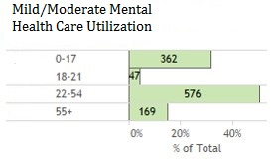
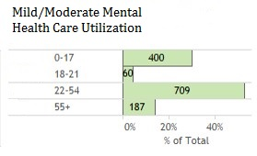
Mild/Moderate Mental Health Care Utilization
2015
Unique Members Utilizing Services increased by 126 from 2015
2016

