Slide 1

Siskiyou County Health
and
Human Services
Adult Services
APS/IHSS
To make an APS report or apply for IHSS contact Siskiyou County intake line at
(530) 841-4200
Or
(530) 842-7009 (after hours)

Slide 2
What is Adult Protective Services
APS is mandated by law to investigate reports of
abuse/neglect, make contact with the alleged victim, offer services and intervene when appropriate and necessary.
Every action taken by APS must balance the duty to protect the safety of the vulnerable adult with the adult’s right to self-determination.

Slide 3
APS Principals
Adults have the right to be safe.
Adults have the right to make decisions that do not conform with societal norms as long as these decisions do not harm others.
Adults have the right to accept or refuse services.
Adults are presumed to have decision-making capacity unless a court adjudicates otherwise.
Adults retain all their civil and constitutional rights unless some of these rights have been restricted by court action.
Notes:
Examples would be –
Adult’s have the right not to comply with medical direction or medication.
Adult’s have the right to live in a dirty home.
Adult’s have the right to make poor choices.
Adult’s have the right to hire any person as their caregiver, including family members that may be taking advantage of them.

Slide 4
Who Is Eligible for APS Service?
Elder (65 years old and older)
Dependent adult (18-64)
  Means any person residing in this state, between the ages of 18-64 years old who has physical or mental limitations that restrict his or her ability to carry out normal activities or to protect his or her rights including, but not limited to, persons who have physical or developmental disabilities or whose physical or mental abilities have diminished because of age.
Notes:
Being an elder or dependent adult does not necessarily result in a presumption of need for adult protective services – i.e. If someone has been a paraplegic all of his/her life and handling all their own affairs they do not necessarily need APS protection.
A disabled person is not always a dependent adult.

Slide 5
What is Reportable Abuse
Types of Abuse
Physical: Hitting, kicking, burning, dragging, over or under medicating.
Sexual Abuse: Unwanted sexual contact, sexual exploitation, forced viewing of pornography.
Abandonment: Desertion or willful forsaking by anyone having responsibility for care.
Isolation: Preventing the individual from receiving mail, telephone calls, visitors.
Financial: Theft, misuse of funds or property, extortion, duress, fraud.
Neglect: Failure to provide food, clothing, shelter, or health care for an individual under one’s care when the means to do so are available.
Self-neglect: Failure to provide food, clothing, shelter or health care for oneself.
Mental suffering: Verbal assaults, threats, causing fear.
Notes:
APS can not prevent these issues from happening, APS’s role in self neglect cases is to refer to services that will improve their situations. Hoarding is a mental illness that requires active participation in an intensive therapeutic almost daily intervention for a number of years to change the behavior.
It can cause extreme psychological distress if a person comes in a just throws away or cleans a hoarders home.

Slide 6
Adult Protective Services Response Criteria
Level 1 - Immediate Response:
  Requires an emergency response within 24 hours from the receipt from the referral.
Level 2 – Non-Emergency Response:
  Investigations will begin within 10 days from receipt of the referral at the APS Office.
Level 3 – Information and Referral(non-response):
  No initial investigation required. Client wants information about services specific to APS, Intake or Resources available.
  Or does not meet the requirements of law for intervention.
Notes:
Level 1 – Immediate Response Assessment
Characteristics:
Injuries evident or emergency medical care is needed. (or)
Client is in immediate danger of not having his/her basic needs to food, shelter, clothing or medical treatment met and cannot wait 10 days for services or an APS investigation (or);
Client is in immediate danger due to violence (or);
The alleged abuser will have contact with the victim within 10 days. (or)
There is a life threatening situation. (or)
A crime is taking place right now. (Intake is in the process of cross-reporting to Dispatch) (or)
Law Enforcement requests an immediate investigation
Level 2 – Non Emergency Response
10 Day Response - Characteristics:
There is no immediate danger to client.
The alleged abuser will not have contact with the client within 10 days.
The client will remain in a safe environment for the next 10 days.
NO IN PERSON RESPONSE (NIFFI)
APS worker made repeated attempts to locate and was unable
Victim moved out of state or out of County (cross report in this case)
Victim is deceased and there is no indication another elder or victim is at risk
The report is of known allegations of a past occurrence with no new allegations and no present risk to the victim
APS may confirm no present risks through contacts with other agencies (i.e. Mental Health.)
Level 3 – Information and Referral
Characteristics:
A self-reporting client does not want an APS investigation
The caller is only seeking information about county services.
There is no report of abuse.

Slide 7
Scope of APS Services
APS shall attempt to create a stable environment where the individual can safely function without requiring additional on-going intervention from APS.
APS is not intended to be a long-term/on-going case management activity, nor does APS provide placement services.
APS shall promote self-sufficiency and reduce the need for further reliance on the APS Program.
Notes:
Maximize independence
Referrals to community resources that increase safety in the home
To resolve a crisis-
By making a change with the client and/or their support system.
Difficult for APS because we are asked to act when there is little background information
Often client’s in crisis are unwilling to accept help
To ensure safety – APS attempts to work with the client for safety planning (The idea is that if they have thought about a plan, although they may not be willing to do anything today they will be more likely to protect themselves in the future.)
Examples - Restraining orders or how to get one, identifying safe contacts, Where to go for shelter, obtaining consent to alert family friends or church.
To empower the client to overcome the abuse and reduce the risk of future abuse
To preserve or protect assets –
Safeguard assets by changing bank accounts and/or freeze an account during an investigations
Advanced directives including POAs,
Money management – Rep Payee, automatic bill pay or income deposit
Educating client on scams
Educate them on how to remove their names off mailing lists or direct marketing

Slide 8
Scope of Services defined
Responding and investigating APS reports
Time limited case management
Providing resource information
Emergency services may include tangible resources such as shelter or home protection
Food, transportation, etc. (as resources allow).
Participation in Multi-Disciplinary Team (MDT) meetings
APS is not intended to interfere with lifestyle choices of individuals nor to protect those individuals from all the consequences of such choices.
An APS client who has been abused may refuse or withdraw consent at any time to preventative and remedial services offered by APS.
If the APS worker believes the elder or dependent adult is incapacitated to the extent he or she is unable to give or deny consent to APS a petition for a temporary conservatorship may be initiated.
Notes:
Purchase groceries or medication occasionally
Some temporary transportation for medical needs
At times will transport to the bank and assist client with obtaining account information.
On certain occasions, APS ER has hotel vouchers available but are not given out without an immediate need being serviced and if there is a long term plan in place.
For emergency placement, APS refers to a placement agency.

Slide 9
Steps An APS Worker Takes When A Case Is Opened
Receive the report
Determine response level
Investigate the allegations – May involve:
  Interview with collateral contacts
  Calls to physicians
  Calls or interviews with family
  Referrals to resources
  Investigation activities with financial institutions.
  Working closely with law enforcement when criminal activity is suspected
Complete a comprehensive Case Assessment (within 21 days)
Complete a Service Plan within 30 days (if case is still open)
Complete a Closure Summary when case is closed.
Notes:
Resources commonly used by APS:
MOW, Friendly Visitors, Telephone reassurance, transportation, legal aid, home equipment to increase safety (Lifeline), support groups, mental health treatment, treatment for drug & alcohol, money management options (Rep Payee or automatic bill pay, credit report checks)

Slide 10
Legal Issues in APS
APS is a Voluntary Program
APS must act within the consent of an adult who has mental capacity.
  If a crime has been committed it is cross reported to Law Enforcement whether the victim wants it reported it or not.
  Victim’s mental capacity – If a victim has the ability to make his own decisions he has full legal rights to refuse service
  This means they can live in a dirty home, hoard, give their money to anyone they choose as long there is no “undue influence” and they have capacity.

Slide 11
Legal Issues in APS cont.
APS has no legal right to remove a person from their home against their will.
  APS relies on law enforcement’s ability to place a person on 5150 mental health hold when they are gravely disabled or causing harm to themselves or others, due to a mental disorder.
  APS can call 911 for ambulance service if the person has an altered level of consciousness or is medically or mentally decompensating.

Slide 12
What APS Cannot Do
Make someone change their lifestyle.
Force someone to get treatment.
Force relatives to assist.
Find placements for everyone.
Unlimited after hours response (emergency only)
Provide long-term case management.
Put a conservatorship in place.

Slide 13
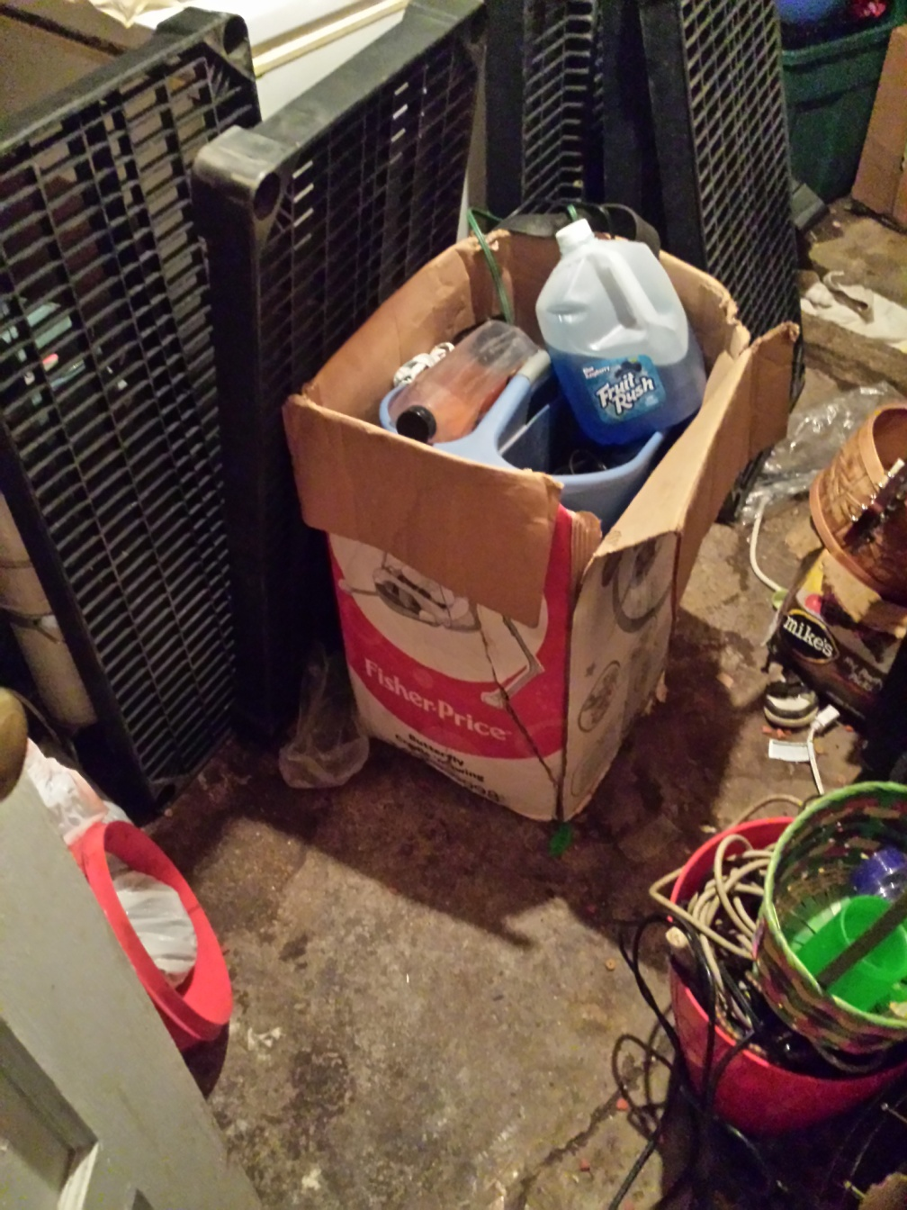
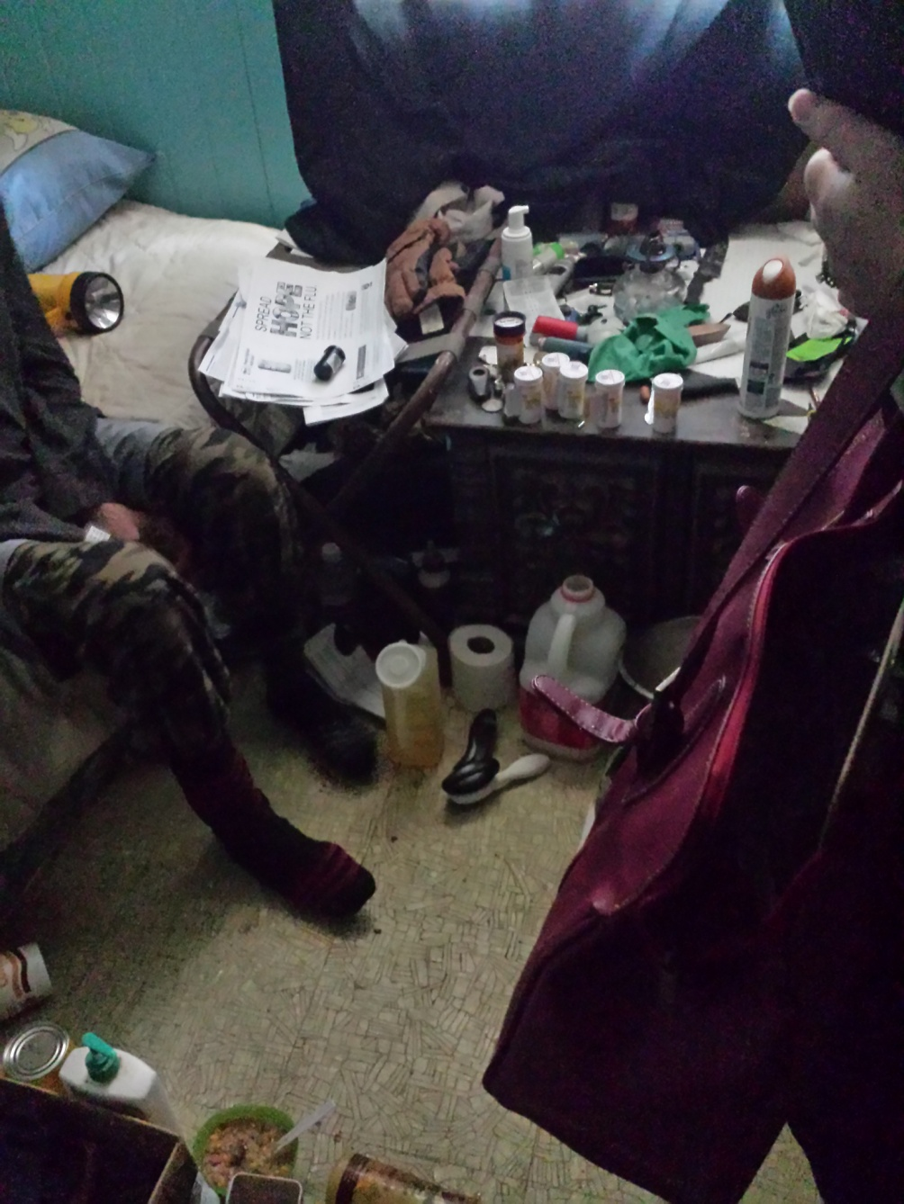

Slide 14
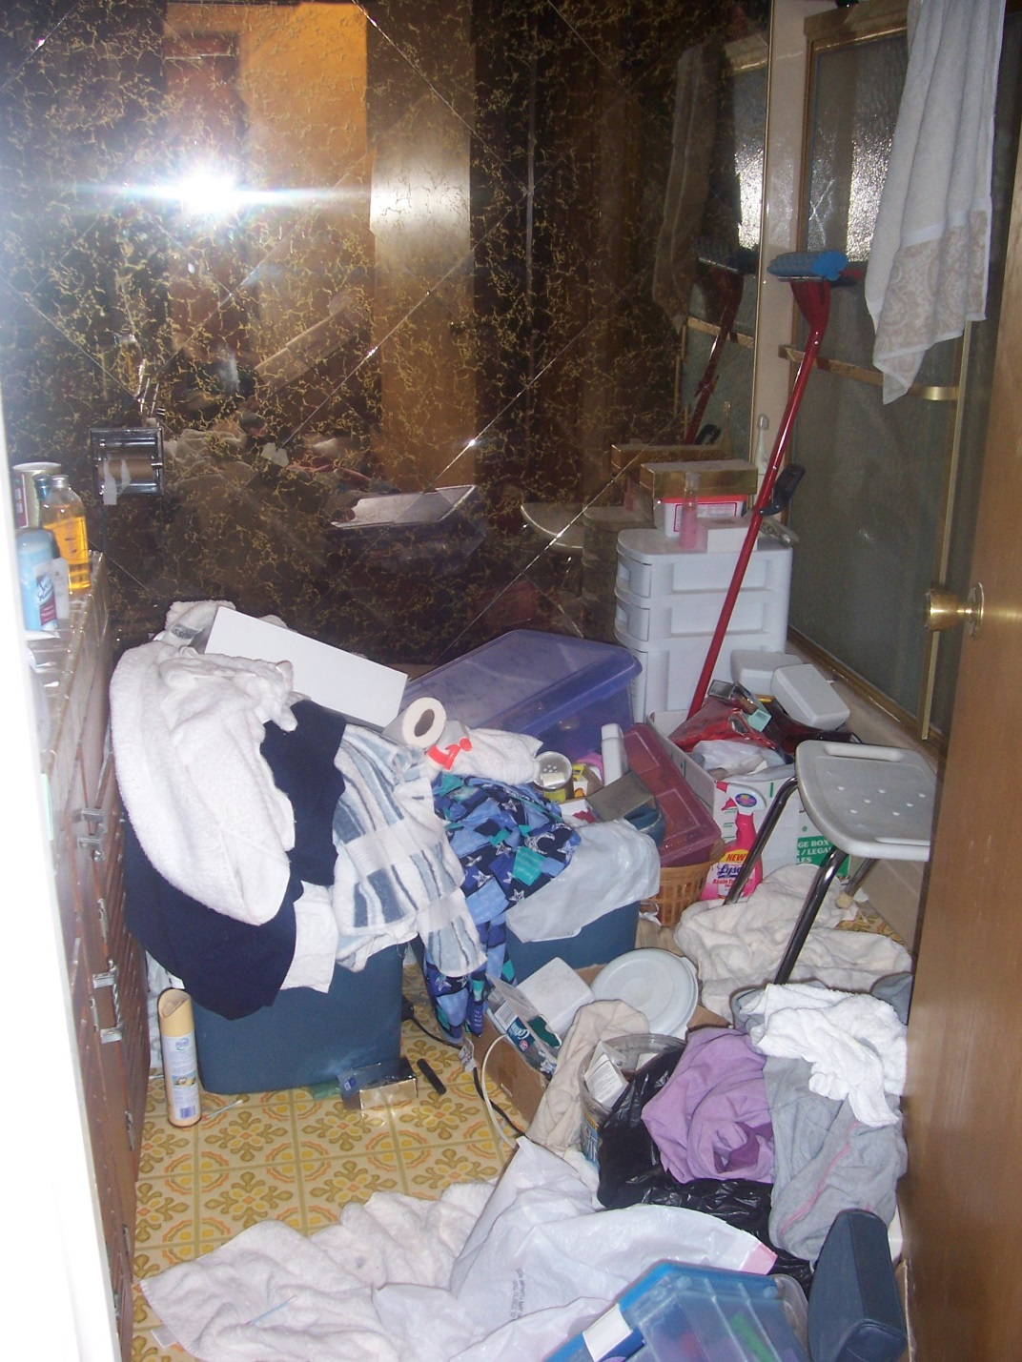
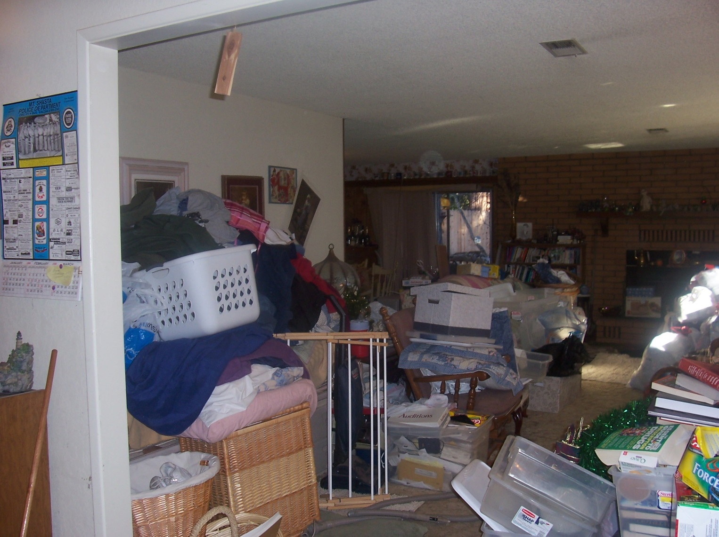

Slide 15
APS Monthly Stats – Cases Investigated
2015-16 | July | Aug. | Sept. | Oct. | Nov. | Dec. | Jan. | Feb. | March | April | May | June
APS | 23 | 33 | 24 | 12 | 18 | 23 | 16 | 38 | 27 | 27 | 25 | 24
Dep. Ad.. | 4 | 10 | 10 | 15 | 5 | 7 | 10 | 10 | 5 | 8 | 4 | 5
Ongoing | 44 | 35 | 48 | 54 | 54 | 54 | 17 | 6 | 18 | 18 | 26 | 31
Total | 71 | 78 | 82 | 81 | 77 | 84 | 43 | 54 | 50 | 53 | 55 | 60
2016-17 | July | Aug. | Sept. | Oct. | Nov. | Dec. | Jan. | Feb. | March
APS | 24 | 37 | 32 | 33 | 30 | 19 | 21 | 26 | 35
Dep. Ad. | 4 | 13 | 8 | 10 | 4 | 6 | 4 | 11 | 9
Ongoing | 19 | 25 | 29 | 30 | 25 | 32 | 26 | 33 | 20
Total | 47 | 75 | 69 | 73 | 59 | 57 | 51 | 70 | 64

Slide 16
Partner Agencies
Following is a list of some agencies we collaborate with in
order to provide services to our APS clients:
Siskiyou Home Health Services
Meals on Wheels
Golden Umbrella
Behavioral Health Services
In-Home Supportive Services
Great Northern Corporation
Local Law Enforcement Agencies
Public Health
Veteran’s Services
Social Security
Domestic Violence
Far Northern Regional Center
Victim Witness Services
Notes:
This is only a partial list. We also work with banks, legal services, hospitals, physicians and other medical/mental health providers.

Slide 17
Multidisciplinary Teams
MDT Definition
Each county shall designate an adult protective services agency to establish and maintain multidisciplinary teams (MDT) including, but not limited to APS staff, law enforcement, home health agencies, hospitals, the public guardian, private community service agencies, public health agencies, and mental health agencies for the purpose of providing interagency treatment strategies (W&I code 15763 (f) ). A multi-disciplinary team is defined as any team of two or more persons who are trained in the prevention, identification, and treatment of abuse of elderly or dependent persons and who are qualified to provide a broad range of services related to abuse of elderly or dependent persons (W&I code 15610.55 (a) ). In addition to developing interagency treatment strategies, the purpose of the MDT is to ensure coordination with existing community resources, to ensure maximum access on behalf of elders and dependent adults, and to avoid duplication of efforts (W&I code 15763[3]).

Slide 18
MDT Goal
The goal of the MDT is to discuss difficult cases so agencies can better coordinate service delivery and use the expertise of the various agencies to develop solutions. Staffing is structured to encourage input from various disciplines/professional roles in order for optimal solutions/interventions to be developed. These are specific situations and/or individuals that adult service providers are accustomed to encountering or are likely to encounter in their various professional roles.

Slide 19
MDT Core Team
For the MDT to be successful in meeting the goal of interagency cooperation and contribution,
it is important that the team membership reflect the various agencies or disciplines that deal with dependent adult and elder abuse and neglect.

Slide 20
MDT Core Team Cont.
General Membership includes but is not limited to:
Adult Protective Services/In-Home Supportive Services
County Public Guardian
Public Health
Behavioral Health
District Attorney’s Office
Law Enforcement
Local Area Hospitals
Home Health Care Agencies
Adult Day Health Care Providers
Legal Services
Gerontologists
Area Agency on Aging
Additional Team Membership includes but is not limited to:
Victim Witness
Long Term Care Facilities
Long Term Care Ombudsman
Far Northern Regional Center
Private conservators
California State Department of Health Care Licensing
Social Security
Veteran’s Services
Hospice Agencies
Domestic Violence
An individual MDT may include only a small subset of the core team.

Slide 21
Expectations of Team Members
Team members will strictly adhere to maximum protection of privacy and confidentiality rights of the client (W&I code 15754 (b) ).
Team members are expected to take MDT information to their agencies and share information and request input while ensuring the confidentiality of the presented case.
If a team member has information for the MDT and can’t attend the meeting or send a representative, he/she is expected to contact another team member and ask that person to share any information he/she may have to contribute.
Team members are to respect ideas, history, and background of others.
Meetings will start and end on time.
Case presentation outlines will be printed with the guidelines and made available at meetings.
The Adult Protective Services Supervisor or his/her designee will facilitate the MDT.

Slide 22
Case Presentation Guidelines
Types of Cases
  Cases presented must include elders or dependent adults who have experienced abuse or neglect including self-neglect. Agencies may elect to present complex cases that will benefit from multidisciplinary problem-solving.
Case Outline
  The case presenter must provide a completed case presentation outline (Attachment 3) to the MDT members at the start of the meeting.
APS Contact of Involved Parties
  The APS supervisor or designee contacts parties or agencies involved in the case at the earliest opportunity to notify them that the case will be presented and invite them to participate.
Confidentiality
  In order to ensure confidentiality, cases are referred to the MDT chair on the MDT Referral (Attachment 2), which is sent to those members requested to attend an MDT. Presenters are identified on the referral. Clients are identified only by initials throughout the discussion. At no time is the APS reporting party revealed. The MDT chair is authorized to share the client’s identity with appropriate parties for the purpose of developing a treatment plan (WIC section 15633, subdivision (b)(2)(A), 15754, and 10850.1)

Slide 23
Case Presentation Guidelines Cont.
Creative Problem-Solving
Cases are presented orally in an objective and professional manner following the case presentation outline. The team provides resources and suggestions to the presenter and is encouraged to explore creative solutions and ideas.
Action Plan
Following each case presentation an action plan is developed with clear assignment of responsibility. The action plan is written and copies given to members assigned responsibilities. The plan is maintained by the APS supervisor in a locked MDT file. The chair and/or co-chair ensure that the plans are understood and affirmed by those responsible. Group members of the MDT need to ensure follow through by their agency staff.
Follow Up
The presenting professional provides case updates at the next, or one month following the MDT via email to the participating members of that MDT. If necessary, the presenter may request a follow-up MDT.

Slide 24
The Office of the Public Guardian
The Office of the Public Guardian is a general fund program that is administered by the Health and Human Services Agency-Social Services Division
  The Public Guardian serves as conservator of a person and/or estate of individuals needing protective intervention.
TYPES OF CONSERVATORSHIP:
  Lanterman-Petris-Short (LPS)
LPS is ordered by the Court when a person is found unable to provide for their own basic personal needs of food, clothing, or shelter as a result of a severe mental disorder/illness and are unable to accept those necessities of life from a third party. These persons are considered “gravely disabled.”
          Murphy conservatorship
  Probate Conservatorship
A Probate conservatorship ordered by the Superior Court for those persons suffering from impairment and/or severe dementia, and are found unable to properly provide for
their own personal needs for physical health, food, clothing or shelter. It is also used to make medical decisions on behalf of those mentally incompetent to do so for
themselves.

Slide 25
Public Guardian Referral Process
The Siskiyou County Public Guardian accepts referrals from:
      Adult Protective Services;
      Behavioral Health Services; or
      Directly from the Superior Court.
When a referral is received, the Office of the Public Guardian:
      Initiates a formal investigation.
      Petitions the Superior Court for conservatorship if the referral meets legal criteria.
      Acts as conservator for those found by the Superior Court to be unable to properly care for themselves or their finances.
A conservatorship by the Public Guardian should be the last resort for
persons needing protection or care, as the mere act of conservatorship
takes away a person’s civil rights and liberties.

Slide 26
In-Home Supportive Services (IHSS) What is it???
A publicly funded statewide program administered by each county under the direction of the California Department of Social Services.
Provides people with limited income who are blind, disabled, or over the age of 65 with in-home care services to help them remain safely at home.
Disabled children are also potentially eligible for IHSS.
Considered an alternative to out-of-home care, such as nursing homes or board and care facilities.

Slide 27
Eligibility Criteria:
California resident
Have a Medi-Cal eligibility determination
Live in a home, apartment, or an abode of their choice (not a hospital, long-term care facility, licensed community care facility, or assisted living facility)
Have submitted a completed Health Care Certification form
Are unable to live safely at home without services

Slide 28
How the Program Works
Medi-Cal determination is confirmed
A county social worker interviews the client in the home to determine eligibility and need for IHSS
A “needs assessment” is done to determine ability to safely perform certain tasks for themselves
  This assessment includes information given by the client, and, if appropriate, by family, friends, physician or other licensed health care professionals.
  A number called a functional index rank is assigned for each function.
  Three of the functions (memory, orientation, and judgment) are used to determine the need for protective supervision.
  The general guidelines for ranking of functions are in the state guidelines.
  The social worker determines how much time is authorized using the Hourly Task Guidelines provided by the State.
Notes:
The State limits the maximum hours (including protective supervision) to 195 hours per month for non-severely impaired recipients and 283 hours per month for severely impaired.

Slide 29
How the Program Works cont.
A completed Health Care Certification must by received by the county prior to authorization of services.
The client is notified if IHSS has been approved or denied.
  If denied, the client is notified of the reason for the denial
  Denial of IHSS can be appealed through the Fair Hearings process.
  If approved, the client is notified of the type of services and number of hours (per month) that have been authorized.
If approved for IHSS, the recipient must then hire someone (their independent provider – IP) to perform the authorized services.
  The recipient is considered the provider’s employer and, it is therefore, the recipient’s responsibility to hire, train, supervise, and terminate (if necessary) their provider.

Slide 30
How the Program Works cont.
If the recipient does not have a provider already selected (often a friend or family member), the provider can contact the Public Authority Registry service to obtain a list of available providers.
It is the recipient’s responsibility to sign the provider(s) timecard each month and the provider’s responsibility to submit the timecard to the state for payment.
Wages for IHSS providers vary from county to county. IHSS providers in Siskiyou County are paid at minimum wage.

Slide 31
IHSS Cases in Siskiyou County
2015-16 | July | Aug. | Sept. | Oct. | Nov. | Dec. | Jan. | Feb. | March | April | May | June
New | 32 | 23 | 35 | 31 | 32 | 22 | 26 | 31 | 33 | 49 | 26 | 28
Open | 526 | 559 | 570 | 573 | 570 | 570 | 561 | 564 | 570 | 573 | 573 | 581
2016-17 | July | Aug. | Sept. | Oct. | Nov. | Dec. | Jan. | Feb. | March
New | 26 | 31 | 27 | 31 | 22 | 24 | 35 | 19 | 36
Open | 592 | 602 | 593 | 594 | 600 | 607 | 609 | 602 | 596

Slide 32



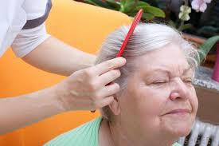






Slide 33

Thank You
Siskiyou County Health and Human Services Agency
Adult Services
(530) 841-4200
(530) 842-7009 (after hours emergency)

